Slide 1
Attention and Transformers
Oualid Missaoui

Slide 2
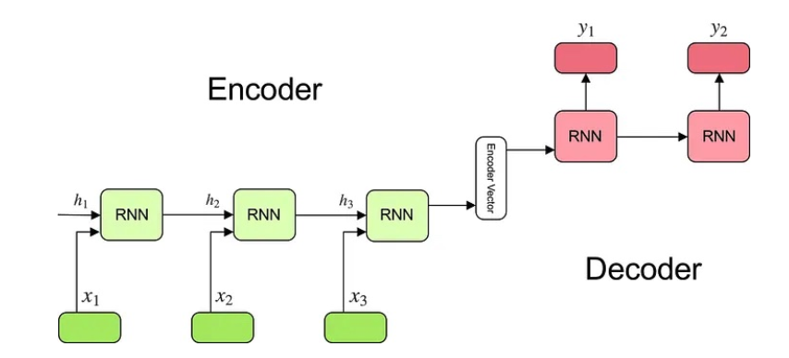
Seq2Seq Architecture
Encoding an input sentence into a fixed-size vector for the decoder (source)

Slide 3
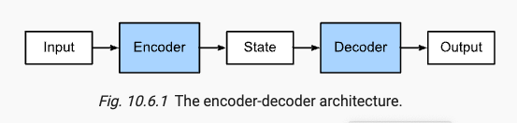
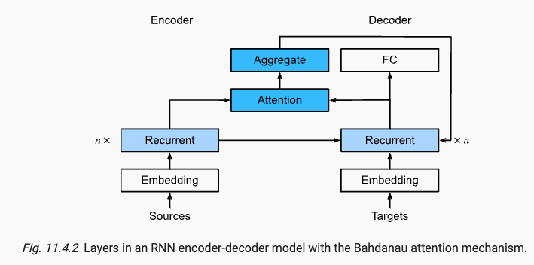
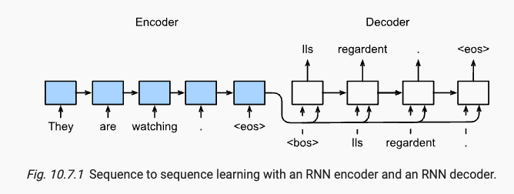
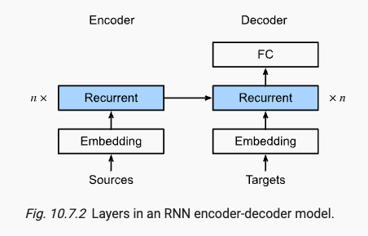


Seq2Seq: fixed vs dynamic context (c)
The key idea is that instead of keeping the state
, i.e.,, the context variable c summarizing the source
Sentence as fixed, we dynamically update it, as a function
of both:
1- the original text (encoder hidden states )
2- the text that was already generated (decoder hidden states )

Slide 4
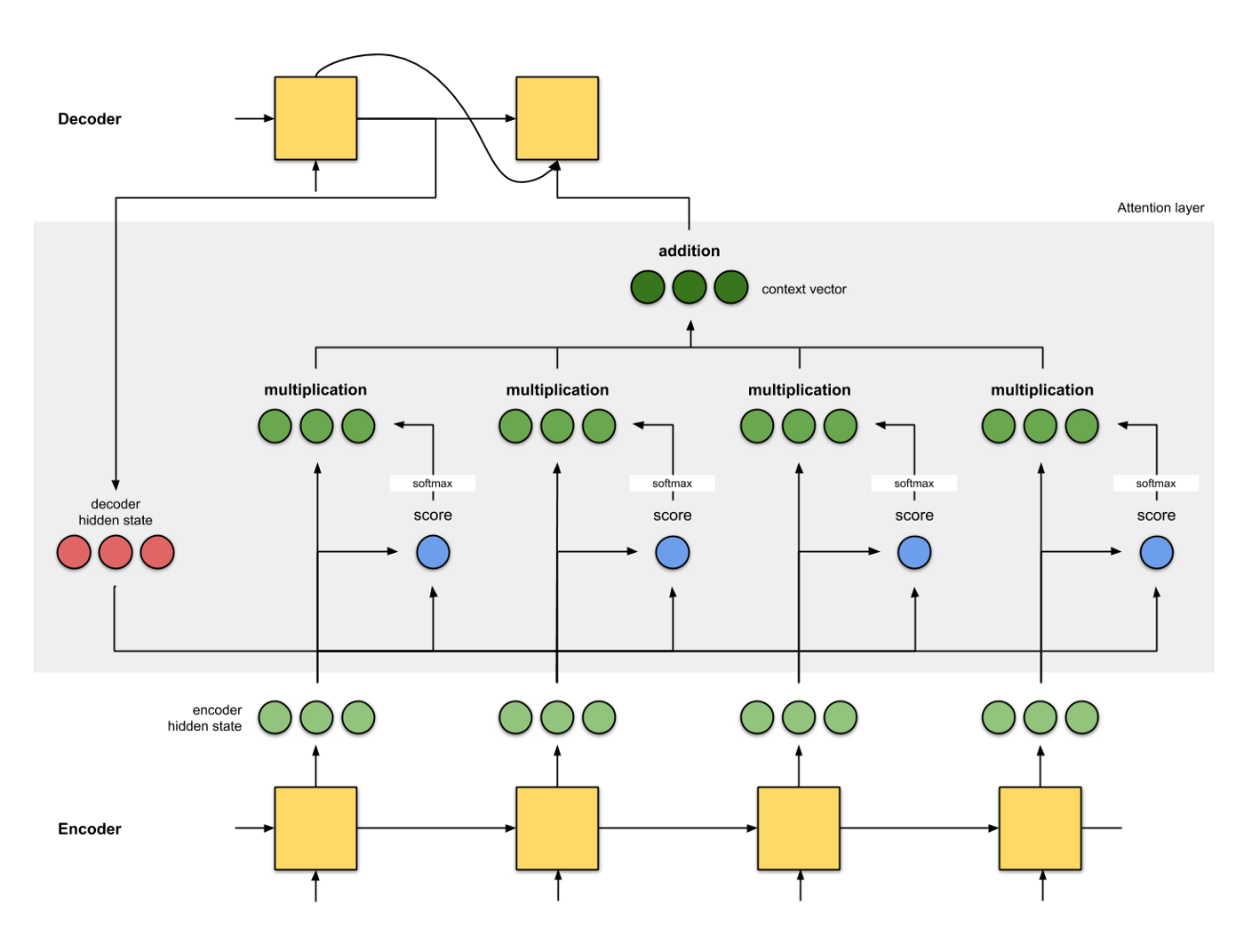
Attention Layer Illustration
Source

Slide 5
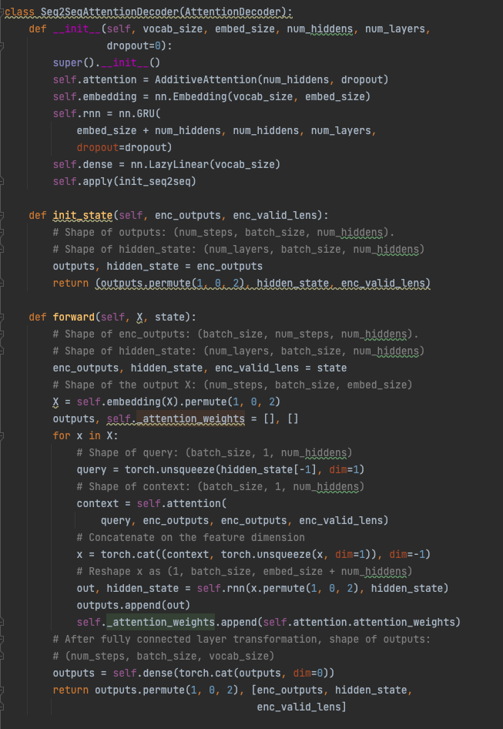
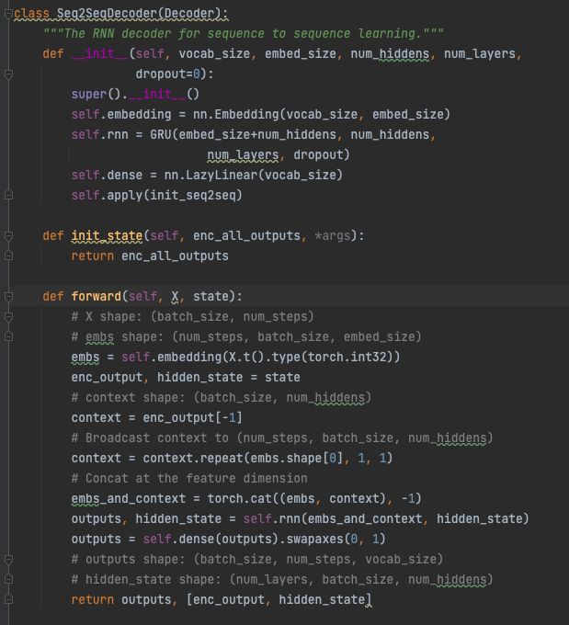
Fixed vs Dynamic context in code

Slide 6
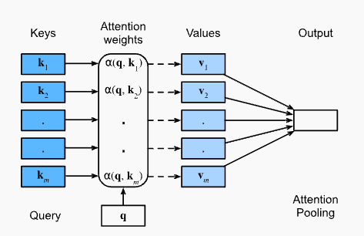
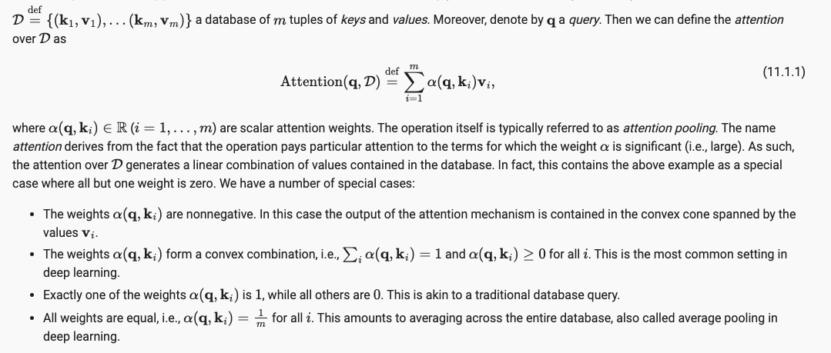
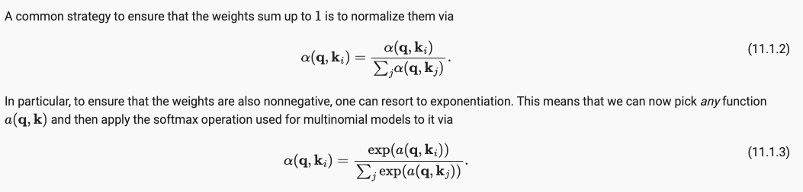
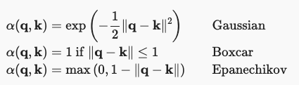
Formalizing Attention

Slide 7
Query, key, value
The query/key/value formulation of attention is from the paper “Attention is All you Need”
Attention operation can be thought of as a retrieval process
Each token, has
Query: decoder state vector
Key: encoder hidden identifiers/states
Value : encoder hidden states

Slide 8
Back to Seq2Seq
The key idea is that instead of keeping the state
, i.e.,, the context variable c summarizing the source
Sentence as fixed, we dynamically update it, as a function
of both:
1- the original text (encoder hidden states )
2- the text that was already generated (decoder hidden states )
query
key
value

Slide 9
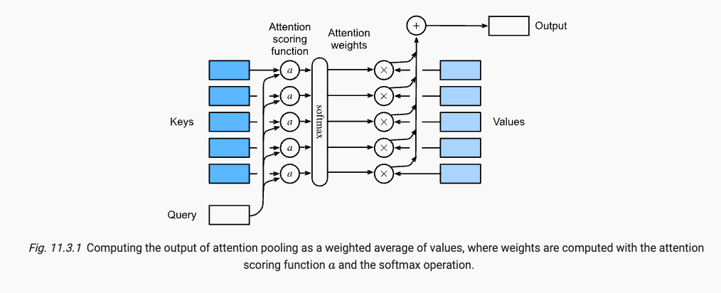
Attention Scoring Functions
(scaled) Dot Product Attention
Additive Attention
Learnable parameters

Slide 10
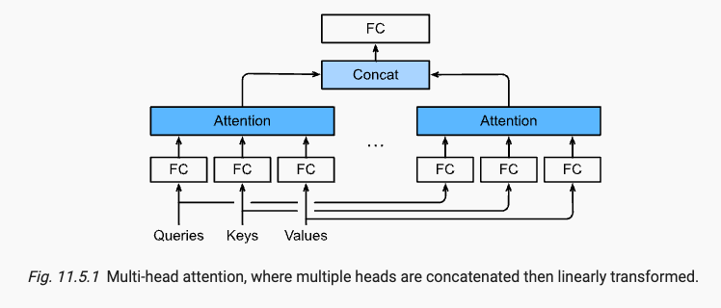
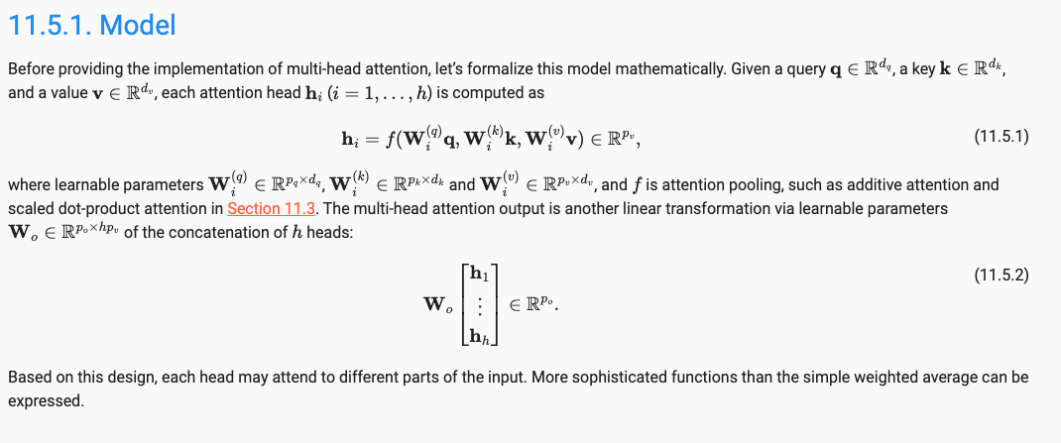
Multi-Head Attention
Capture different behaviors
Dependencies of various ranges

Slide 11
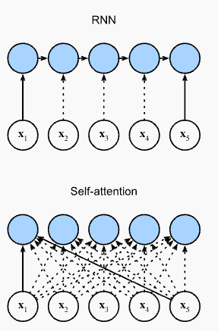
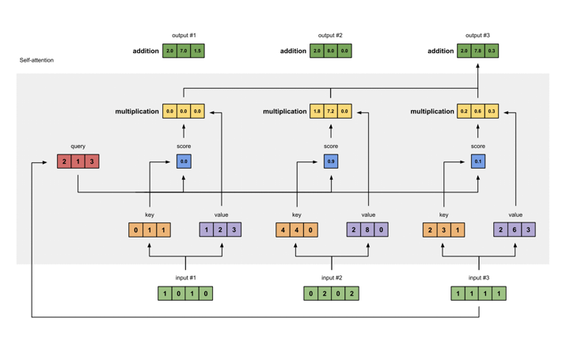
Self-Attention/Intra-Attention
Unlike the case where decoder steps attend to encoder steps, self attention consists of the fact that each token can attend (via its query vector) to each other token (matching based on their key vectors).
Query/key/value(s) are transformations of the corresponding state vectors

Slide 12
Positional Encoding
Preserves the information about the order of tokens
Represent the order as an additional input associated with each token
These inputs are called positional encodings
Fixed a priori
Sine/cosine functions
Learned

Slide 13
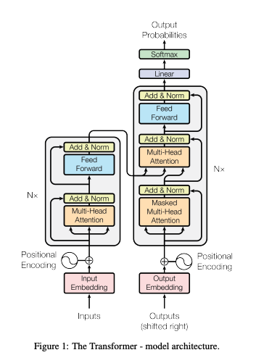
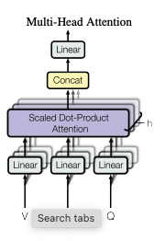
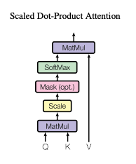
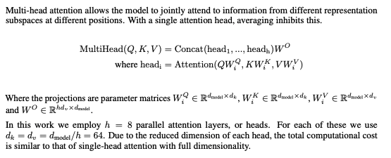

The transformer Architecture

Slide 14
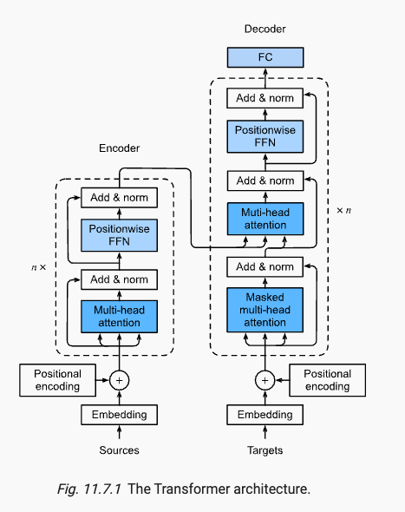
The transformer architecture
Embedding to encode text
Positional encoding to preserve the sequence order
Multi-head self-attention for
Parallel computation
Multi-view learning
Add & Normalize
Residual connection followed by layer normalization (not batchnorm)
Position-wise feed-forward network
Pool/aggregate the “learned” information for each position
Masking: each position in the decoder as allowed to only attend to all positions in the decoder up to the position

Slide 15
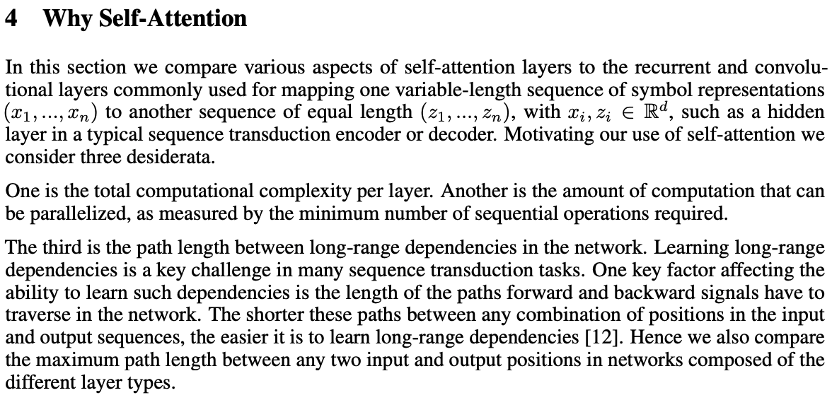
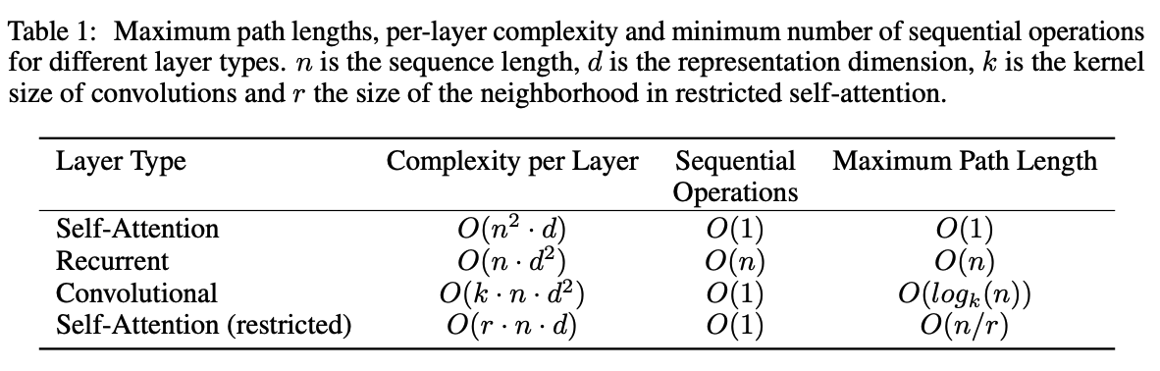

Slide 16
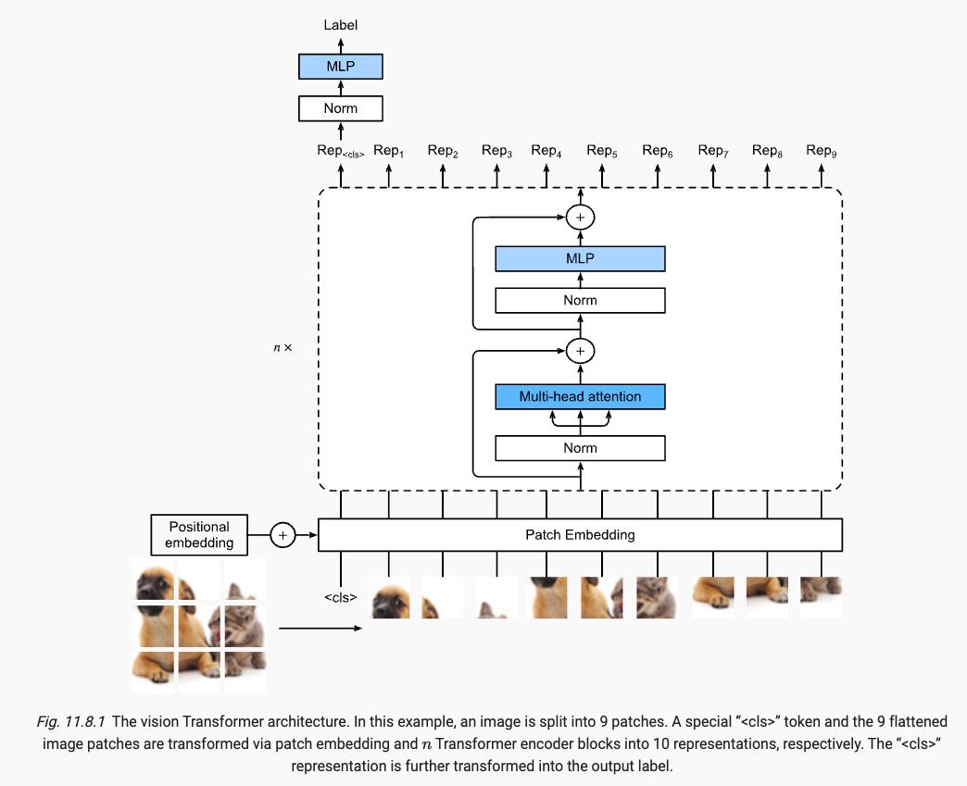
Vision Transformers

Slide 17
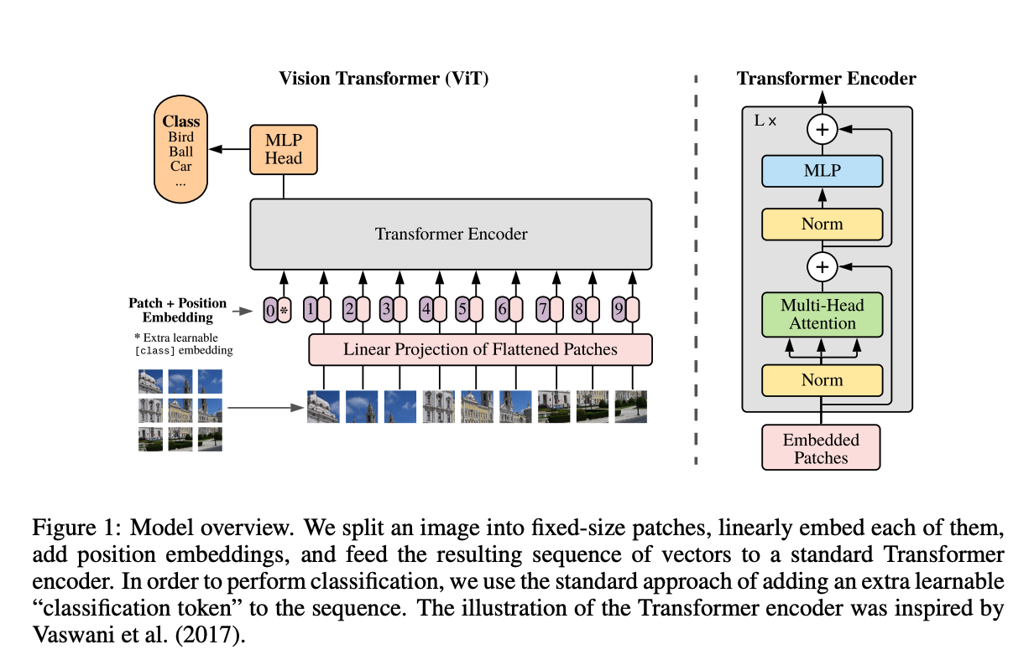

Slide 18
LLM classification
Encoder only
Bert
Encoder-Decoder
BARD , T-5
Decoder only
GPT-2/3/4

Slide 19
Prompt Engineering
Zero-shot
One-shot
Few-shot
PS: prompt engineering does not alter the model’s parameters

Slide 20
Fine-tuning
Updating the model’s parameters on task-specific training data

Slide 21
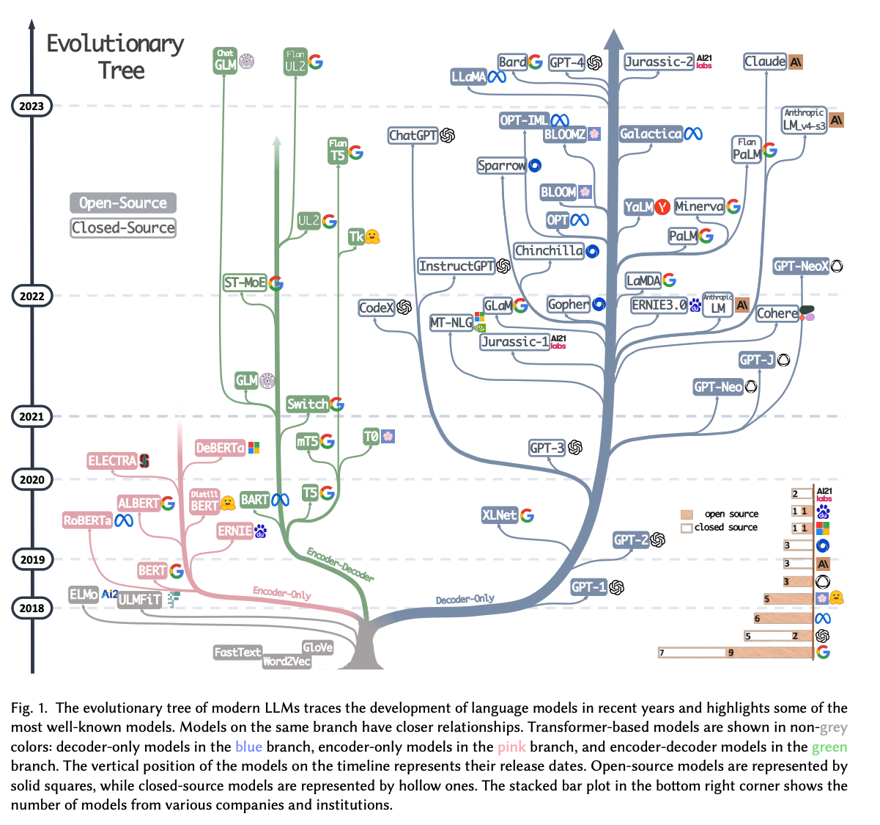
source

Slide 22
References
Blog posts
The Bahdanau Attention Mechanism
Visualizing A Neural Machine Translation Model (Mechanics of Seq2seq Models with Attention)
The Illustrated Transformer
Illustrated attention
The annotated transformer
Papers
Learning Phrase Representations using RNN Encoder-Decoder for Statistical Machine Translation, 2014
Sequence to Sequence Learning with Neural Networks, 2014
Neural Machine Translation by jointly learning to align and translate, 2014
Attention is All you need, 2017
Books
Uday Kamath et al, Transformers for Machine Learning: a deep dive
Charu C. Aggarwal, Neural Networks and Deep Learning: A textbook, 2nd edition (to be published August 1st 2023)
Illustrative code
Refactored d2l

