Slide 1
Gaussian Processes

Slide 2
Agenda
A Primer on Frequentist vs Bayesian
Bayesian Regression
Gaussian processes
Function View
Equivalent linear representation
Hyperparameters learning

Slide 3
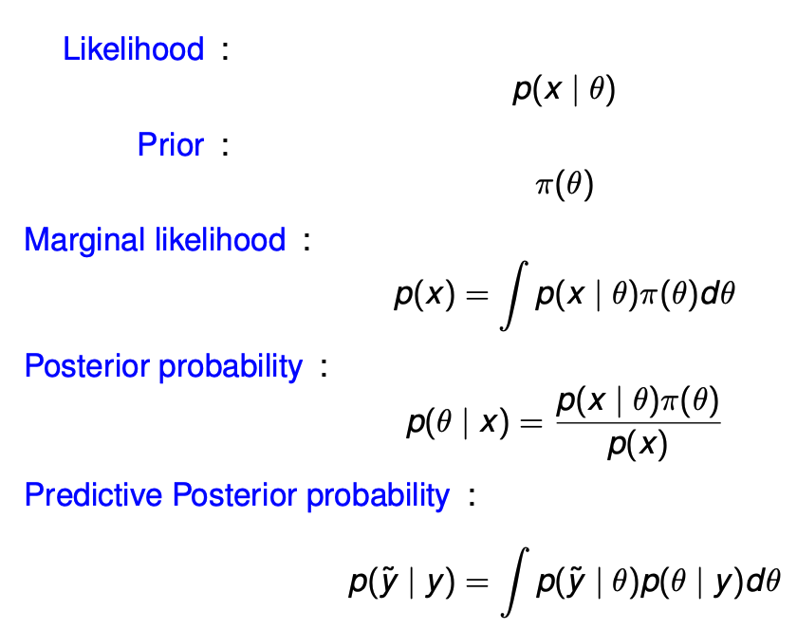
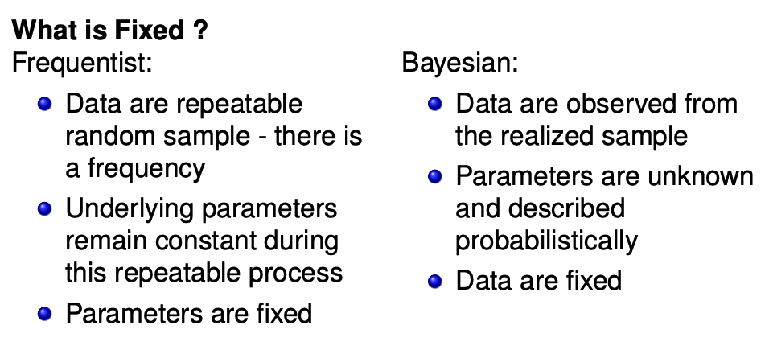
Bayesian Statistics

Slide 4
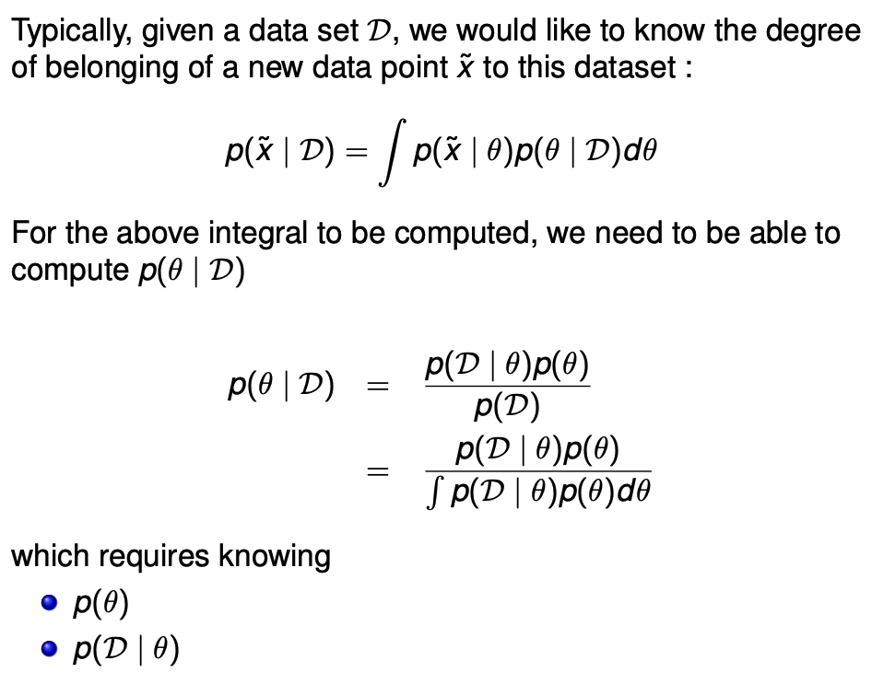
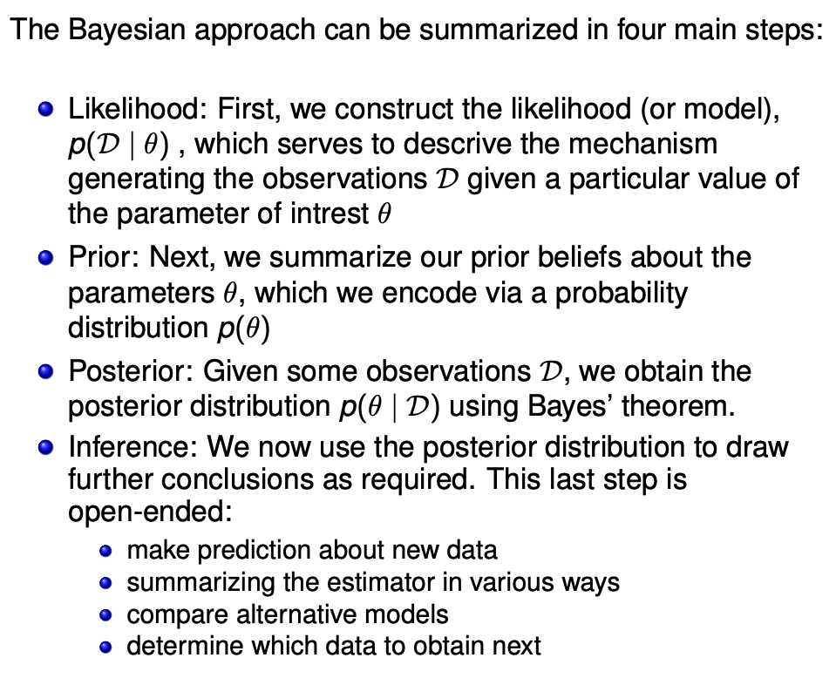
The Bayesian method

Slide 5
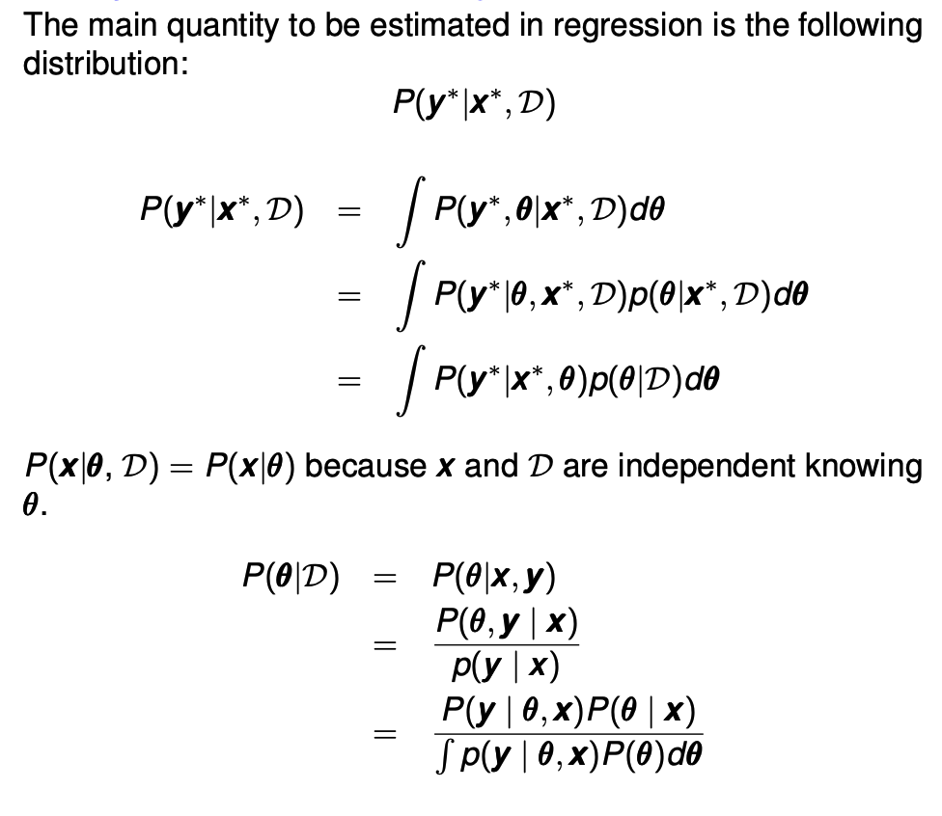
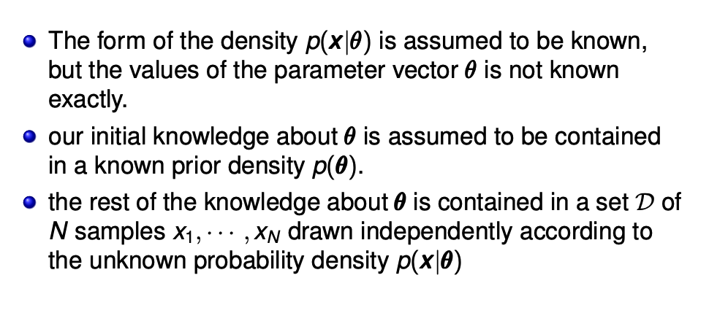
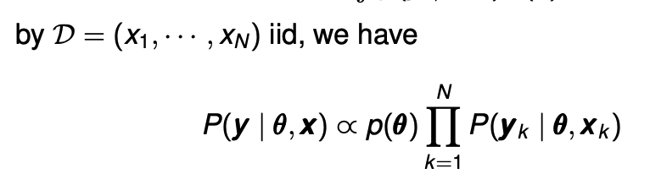
Full Bayesian Framework to regression

Slide 6
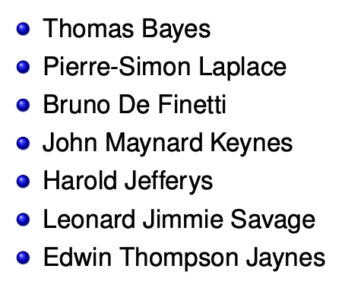
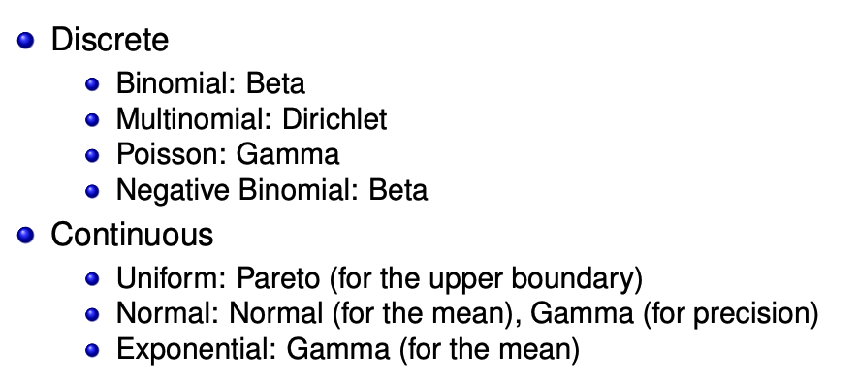
Priors
Subjective:
Priors should capture our beliefs about reasonable hypothesis before observing the data as well as possible
Objective
Non-informative
Empirical priors (empirical Bayes): learn some of the parameters of the prior from the data
Practical:
Conjugate priors:
A prior is conjugate for a likelihood function if the posterior is the same parametrized family as the prior

Slide 7
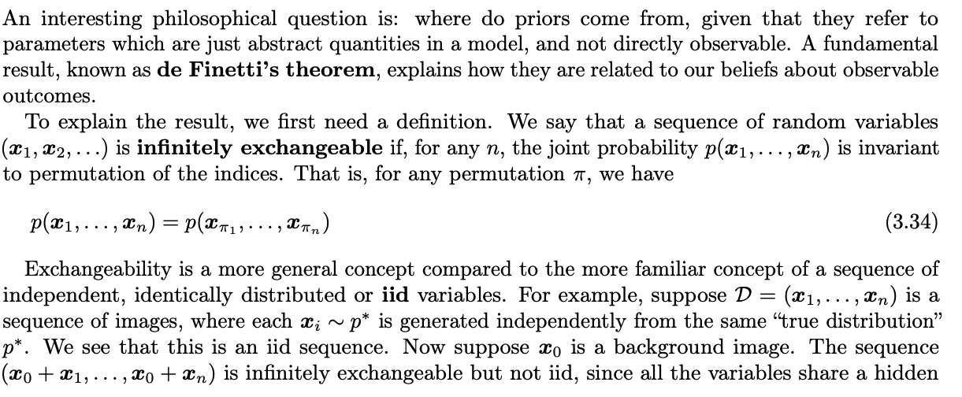
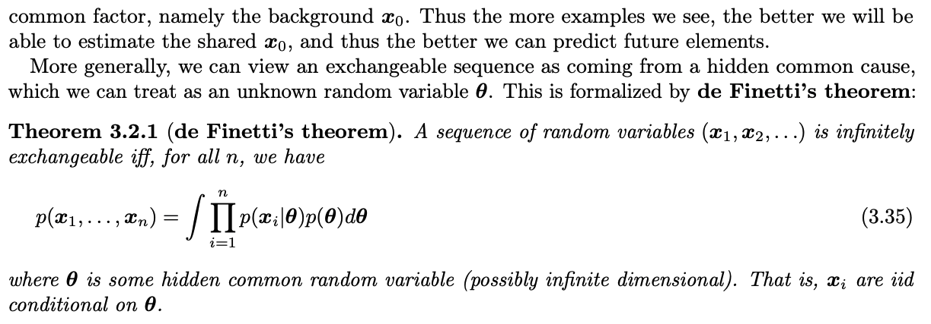
Motivation of the Bayesian approach: de Finetti’s theorem

Slide 8
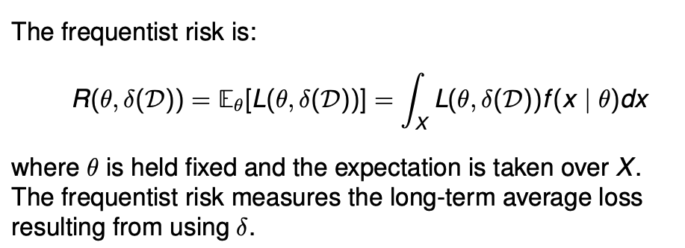
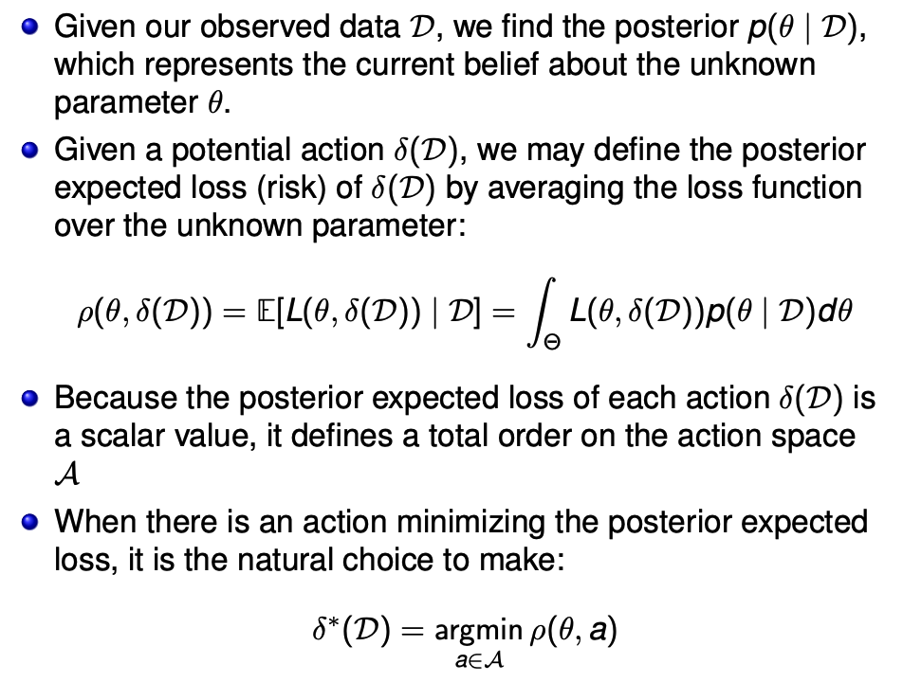
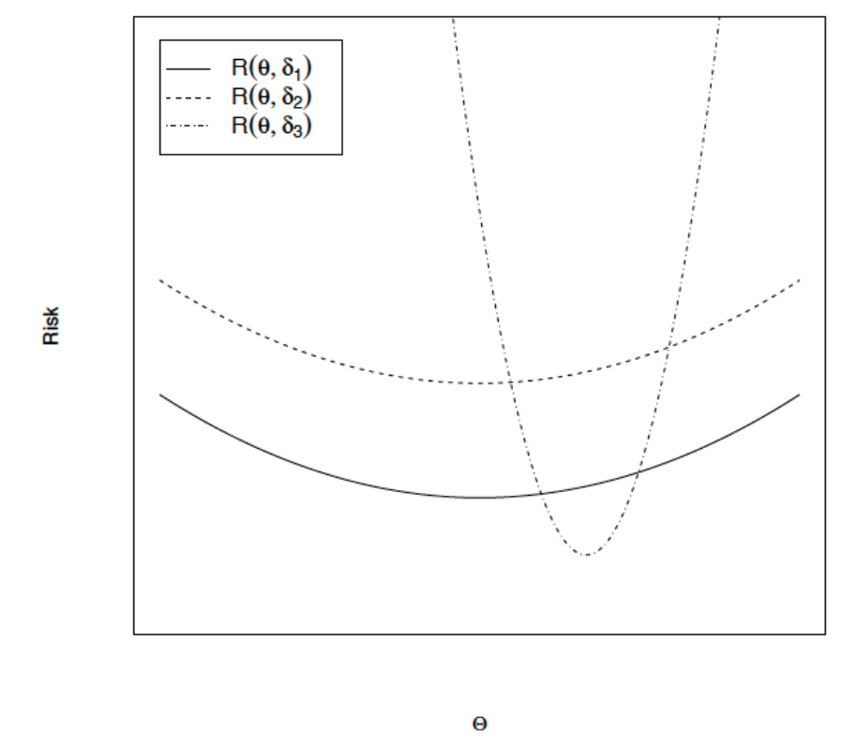
Motivation of the Bayesian approach: Decision theory

Slide 9
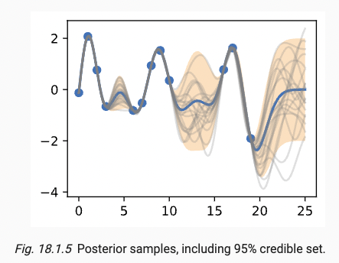
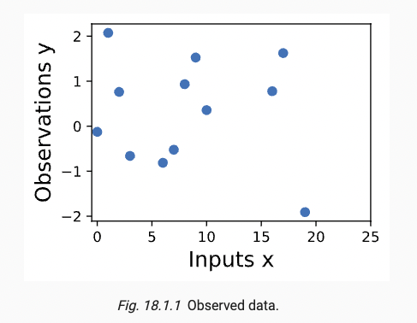
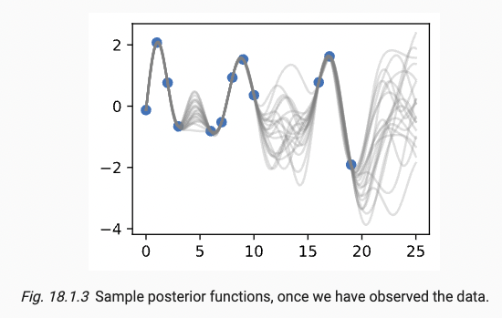
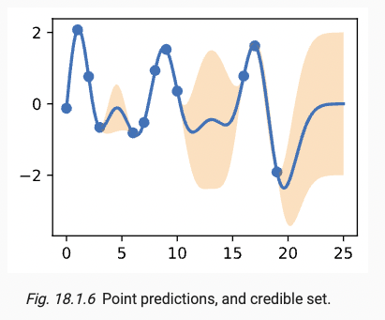
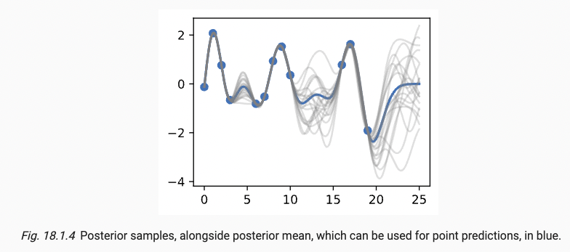
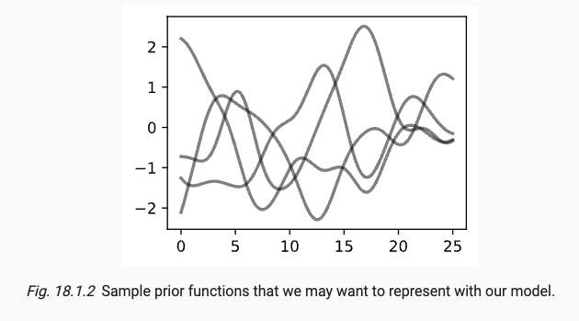
Gaussian Processes
Epistemic uncertainty: reducible error, equivalent to estimation error

Slide 10
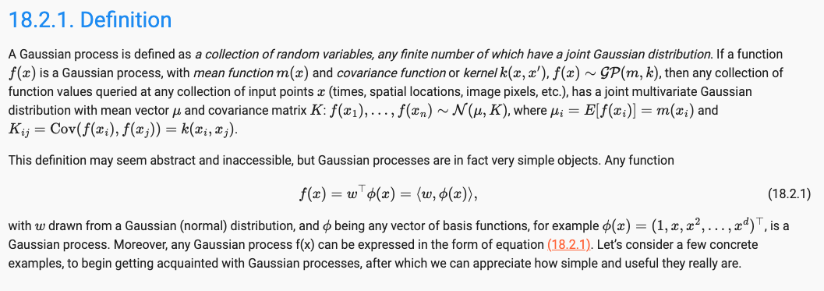
GP - Definition
A GP defines a prior over functions which can be converted into a posterior over functions once we have seen some data.
Although it might seem difficult to represent a distribution over a function, it turns out that we only need to be able to define a distribution over the functions’ values at a finite, but arbitrary, set of points, say x_1, …, x_N
The idea if two points are deemed by the kernel to be similar, then we expect the output of the function at those points to be similar

Slide 11
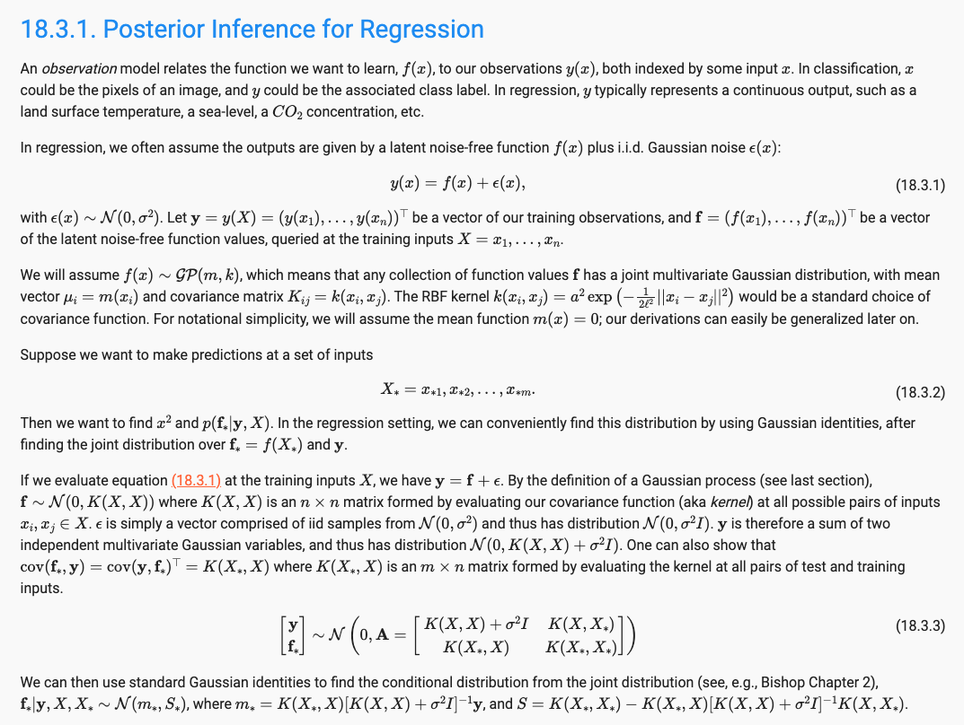
GP Inference

Slide 12
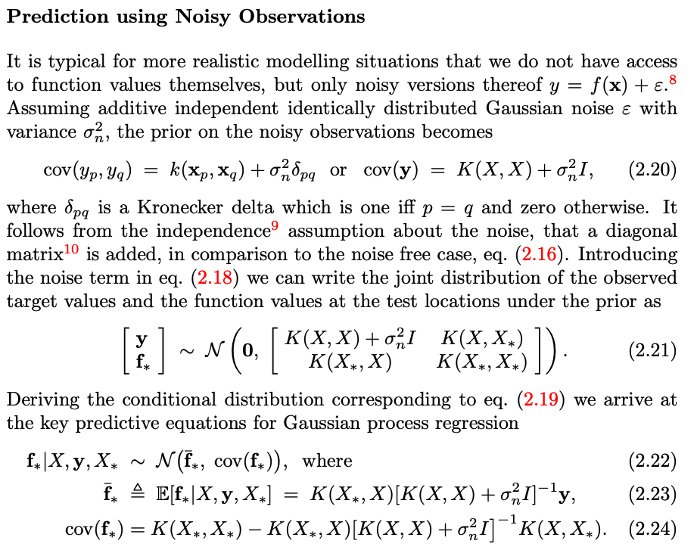
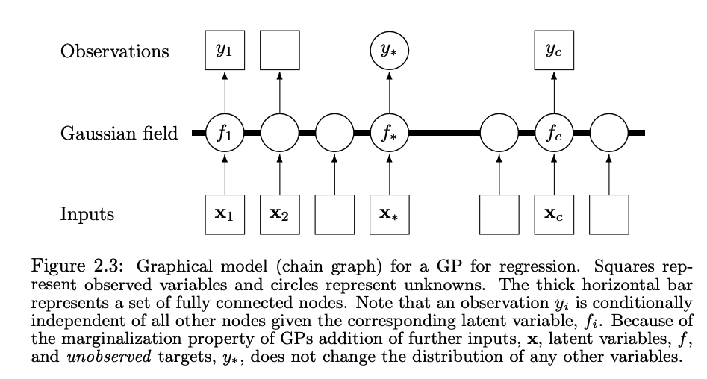
GP Inference

Slide 13
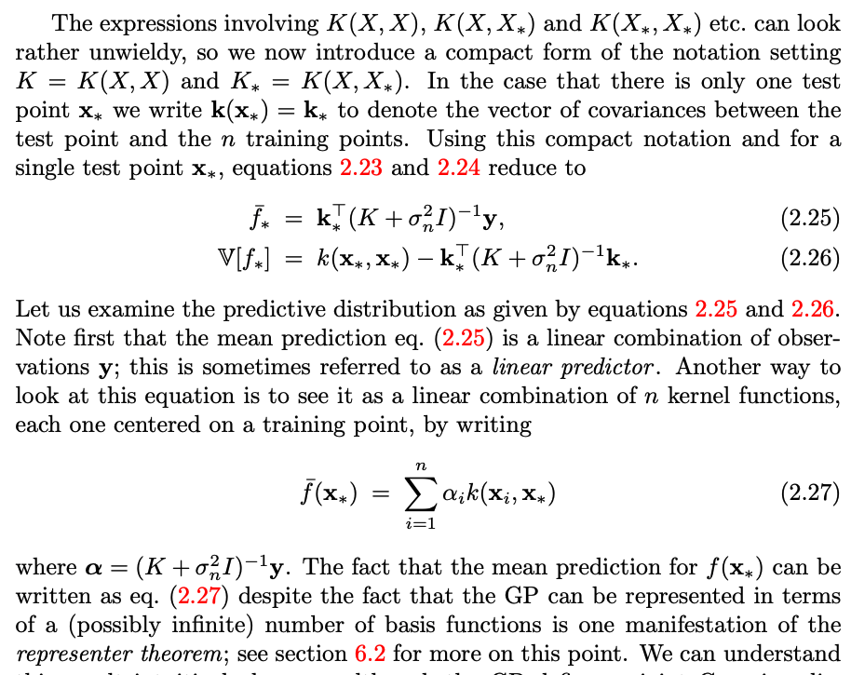
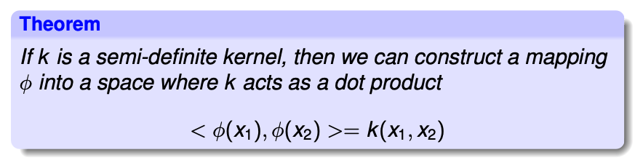
”Linear” Representation

Slide 14
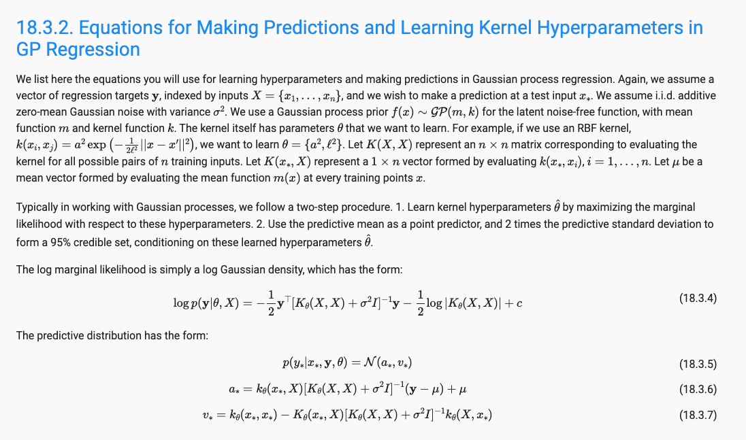
Learning Kernel

Slide 15
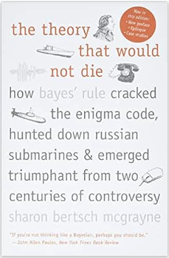
References
Bayesian Statistics
Books
Andrew Gelman et al,2021, Bayesian data analysis
E. T. Jaynes,2003, Probability Theory, The logic of science
Courses
Berkeley, Michael Jordan, 2010, Bayesian Modeling and Inference
Layman books
Sharon Bertsch McGrayne, 2012, The Theory that would not die: How Bayes’ Rule Cracked the Enigma code, Hunted Down Russian Submarines, and Emerged Triumphant from Two centuries of Controversy.
Gaussian Processes
Rasmussen & Williams, 2006, Gaussian Processes for Machine learning , MIT Press
Kevin Murphy’s books.

