Slide 1
Denoising and Detoning
Machine learning for asset managers

Slide 2
Agenda
Background
Random Matrix Theory:
Marcenko-Pastur PDF and theorem
Matrix Denoising
Matrix Detoning
Illustration on portfolio optimization
Alternative Approaches
References
Appendix

Slide 3
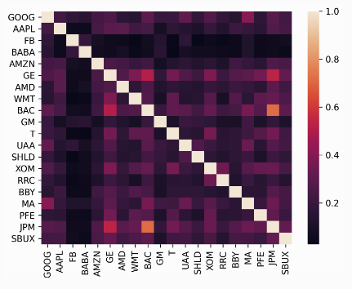

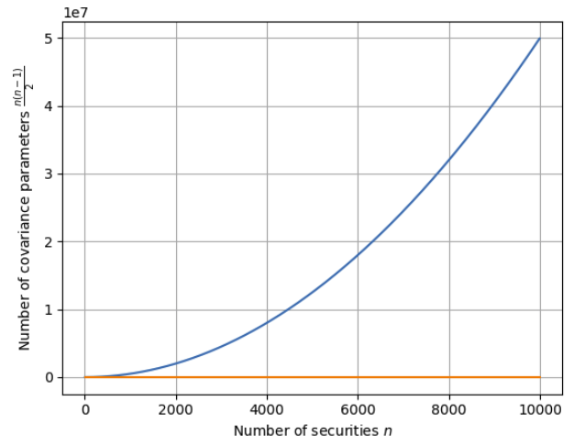
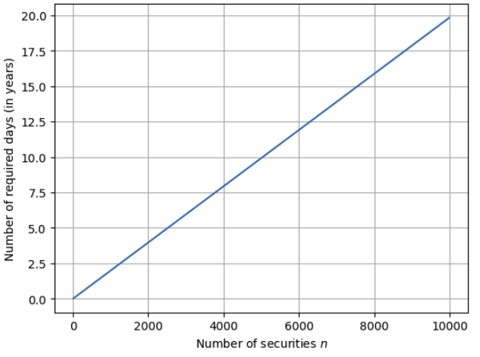
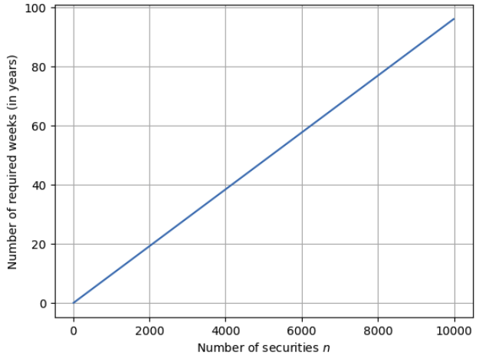
Background
Covariances are ubiquitous in finance
Run regressions
Estimate risks
Optimize portfolios
Monte Carlo scenario analysis
Clustering
Dimension reduction etc
Years of data if we want daily covariance
Years of data if we want weekly covariance
Hard to estimate true covariances due to finite/thin data

Slide 4



Sample covariances
Eigen-value decomposition
Most real world financial problems don’t have enough data to estimate high dimensional covariances
This situation leas to ill-conditioned matrices:
Small changes in the input data can lead to large changes in the output
Ill-conditioning can be quantified by the condition number:
Solution: apply shrinkage which make the covariance matrix close to diagonal, therefore reducing its condition number
Problem: shrinkage accomplishes that without discriminating between noise and signal, as a result, it can further eliminate an already weak signal

Slide 5
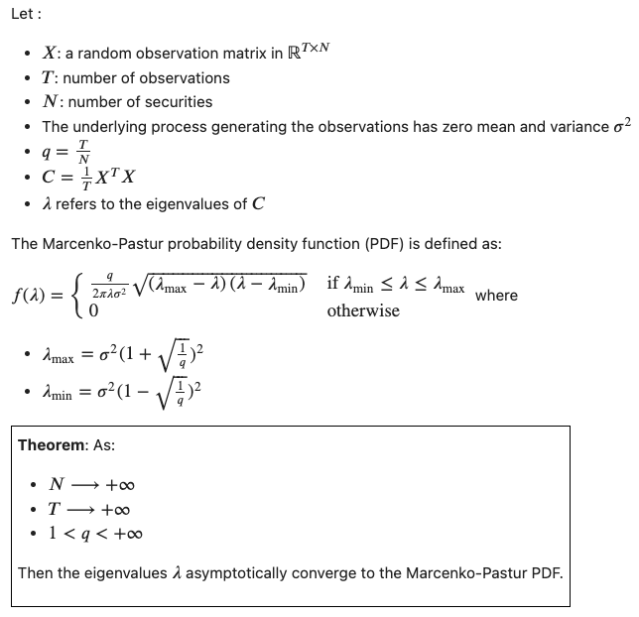
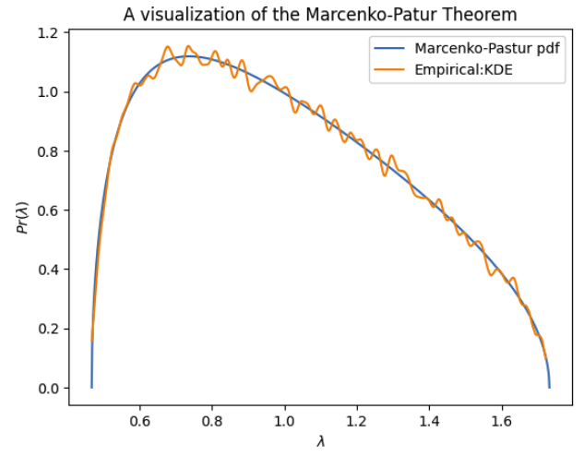
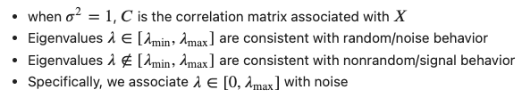
The Marcenko-Pastur probability density function

Slide 6
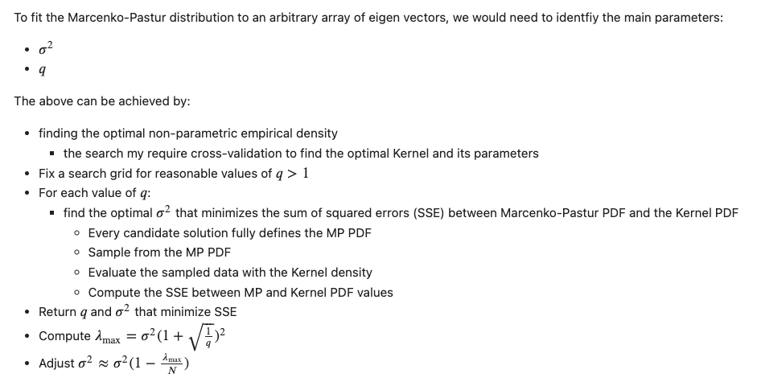
How is Marcenko-Pastur is being fit ?

Slide 7
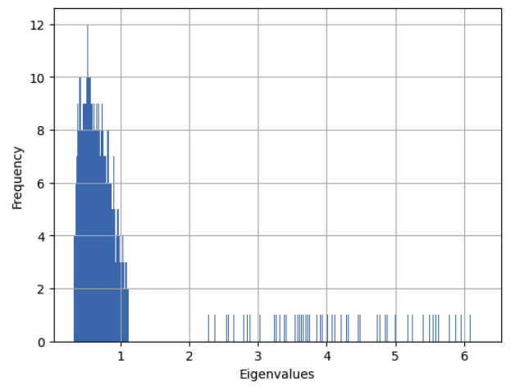
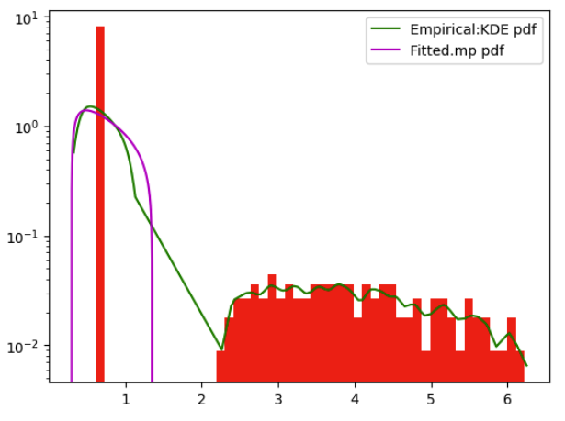
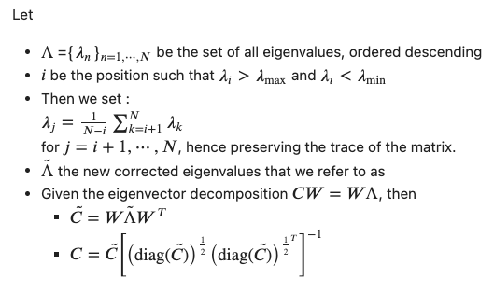
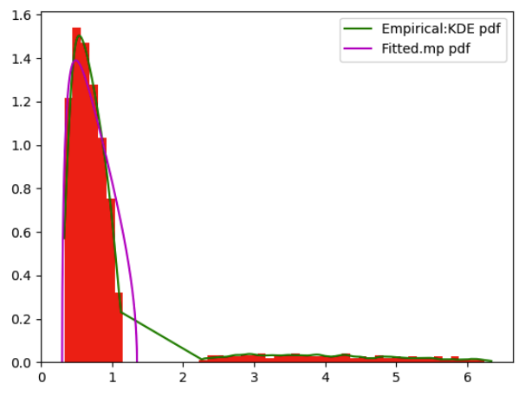
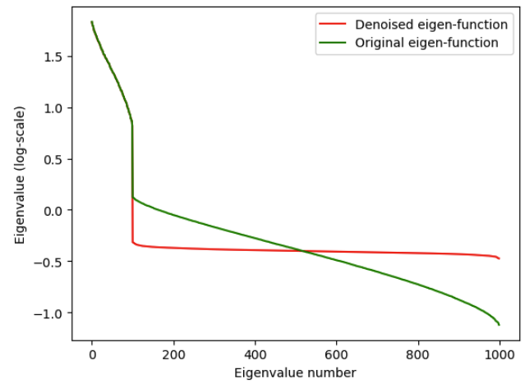
Constant Residual Eigenvalue Method- Laloux’ approach
Noise eigen-values
Signal eigen-values

Slide 8
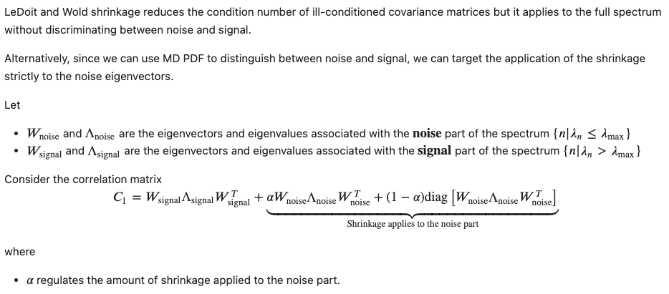
Targeted Shrinkage

Slide 9
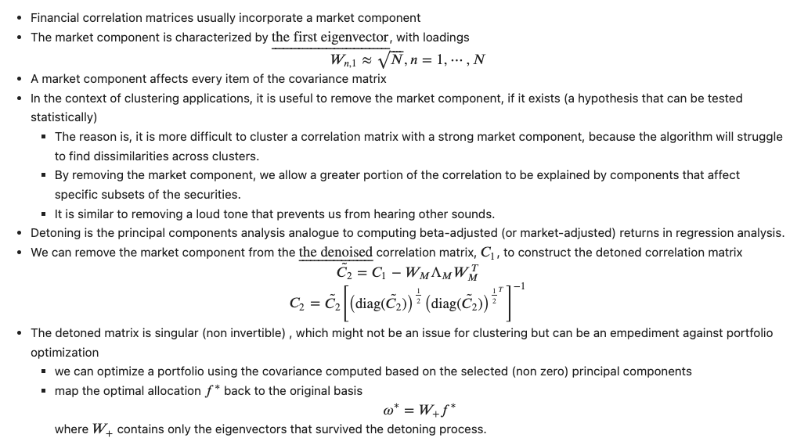
Detoning

Slide 10
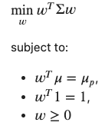
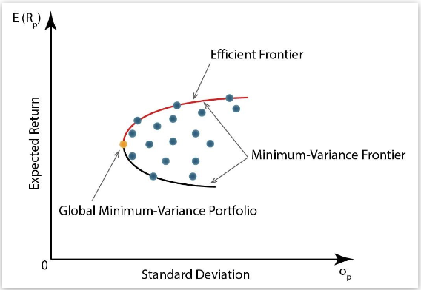



Application to portfolio optimization (1)
Given
The covariance matrix
The expected returns vector
We can identify:
The minimum-variance portfolio
The maximum-Sharpe portfolio
Source
Question: can RMT denoising of the covariance achieve better MVP and MSP ?

Slide 11
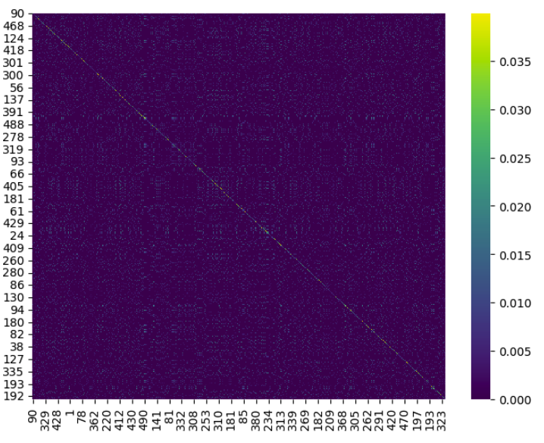
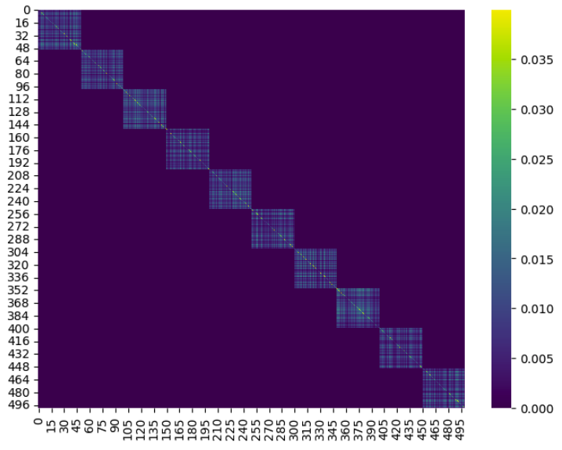
Application to portfolio optimization (2)
Hypothesis: RMT denoising helps identifying more optimal portfolios
Validation:
we need to design an experiment that allow us to compare portfolios constructed using denoised covariance matrices against true/target optimal portfolios.
To construct a true/target portfolio, we need to construct a true/target covariance matrix:
10 blocks of 50 each
Off diagonal elements within each block have a correlation of 0.5
This covariance is a stylized representation of a true (nonempirical) detoned correlation matrix of the S&P 500 where each block is associated with an economic sector
Variances are drawn from a uniform distribution between 5% and 20%
Vector of means is drawn from a normal distribution with mean and standard deviation equal to the standard deviation from the covariance matrix
Use true/target covariance to compute true/target optimal portfolios
Sample observations from the true/target matrix
Compute corresponding sample covariances
Estimate optimal portfolios w/o denoising
Evaluate if denoising helps

Slide 12
Experiment illustration
Monte Carlo
Sampled data
Sample Covariance
Sampled data
Sample Covariance
True Covariance
sample
Estimate
Sampled data
Sample Covariance
Mean Variance Optimization
Cleanse Matrices
RMT Denoising (w/o shrinkage)
Evaluation
Optimal Minimum variance portfolio
RMSE
Aggregate
Estimated Minimum variance portfolios

Slide 13
Empirical Results
RMSE for combinations of denoising and shrinkage (minimum variance portfolio)
 | Not denoised | Denoised
Not shrunk | 4.95e-3 | 1.99e-3
Shrunk | 3.45e-3 | 1.7e-3
RMSE for combinations of denoising and shrinkage (maximum Sharpe portfolio)
 | Not denoised | Denoised
Not shrunk | 9.48e-1 | 5.27e-2
Shrunk | 2.77e-1 | 5.17e-2

Slide 14
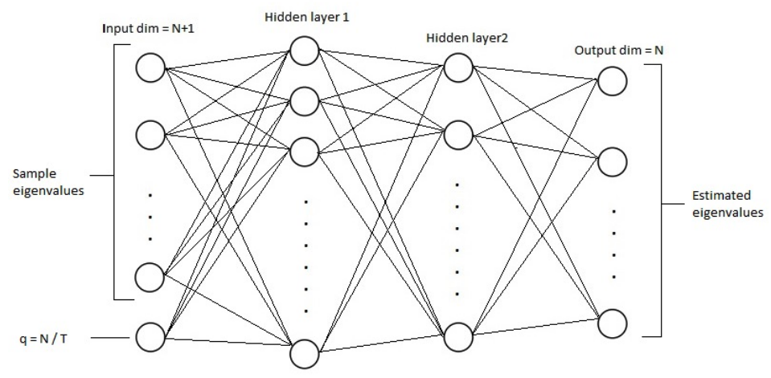
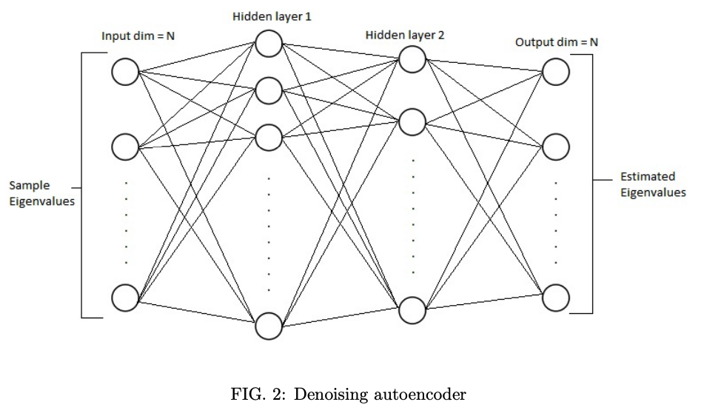
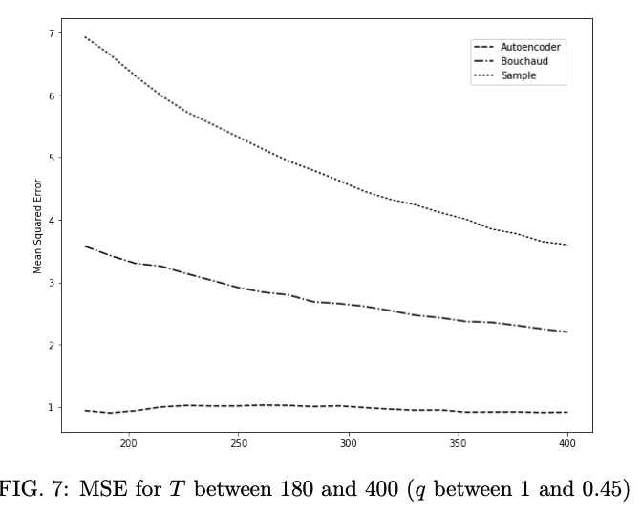
Alternative approaches
Soufiane Hayou (2017), Cleaning the correlation matrix with a denoising auto-encoder

Slide 15
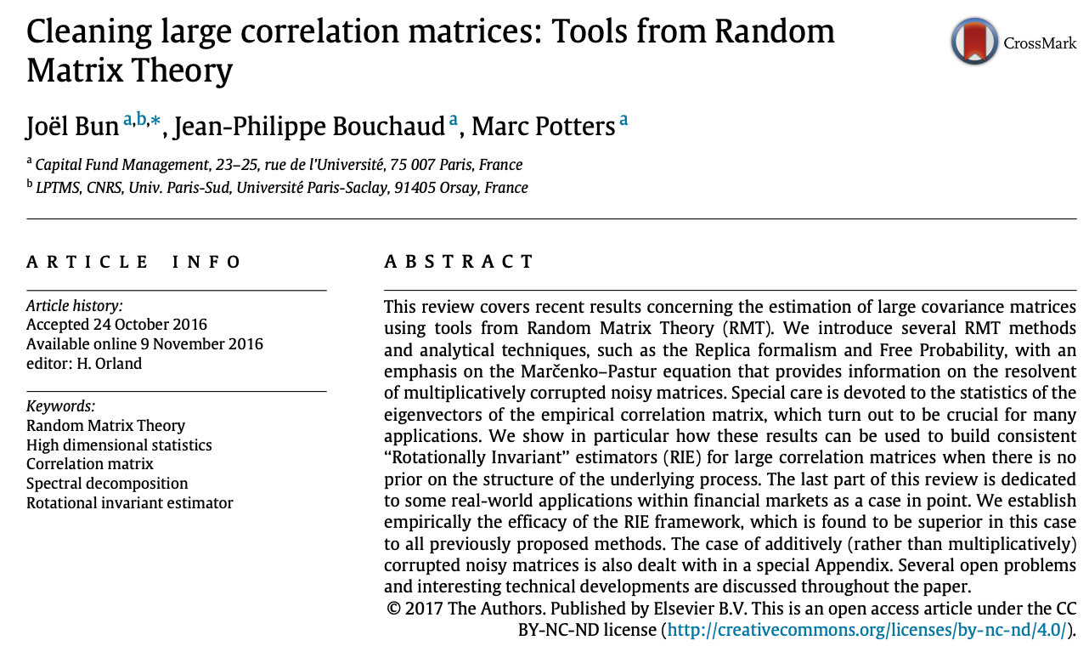
Rotationally Invariant Estimators (RIE)
Source: Joel Bun, Jean-Philippe Bouchaud, Marc Potters, (2016) Cleaning large correlation matrices: Tools from Random Matrix Theory

Slide 16
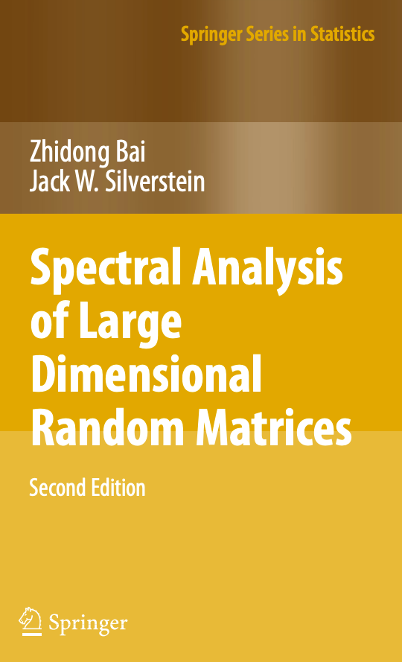
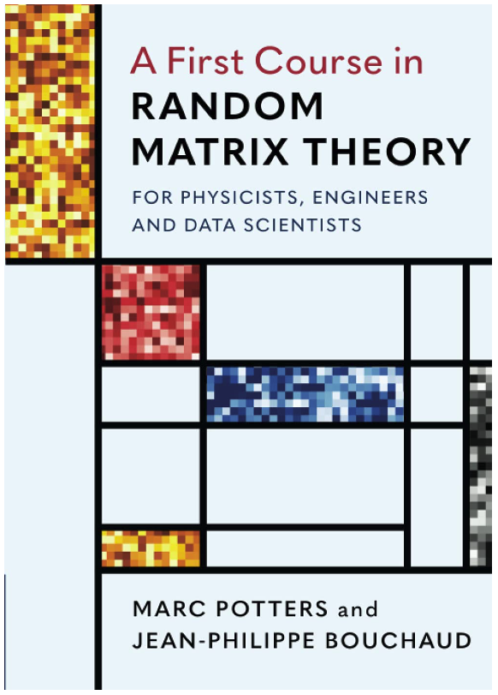
References
Ledoit, O., and M. Wolf (2004): “A Well-Conditioned Estimator for Large- Dimensional Covariance Matrices.” Journal of Multivariate Analysis, Vol. 88, No. 2, pp. 365–411.
Laloux, L., P. Cizeau, J. P. Bouchaud, and M. Potters (2000): “Random Matrix Theory and Financial Correlations.” International Journal of Theoretical and Applied Finance, Vol. 3, No. 3, pp. 391–97.
Lewandowski, D., D. Kurowicka, and H. Joe (2009): “Generating Random Correlation Matrices Based on Vines and Extended Onion Method.” Journal of Multivariate Analysis, Vol. 100, pp. 1989–2001.
Tangential: RMT is relevant in understanding DL generalizability
Charles Martin et al (2021), Implicit Self-Regularization in Deep Neural Networks: Evidence from Random Matrix Theory and Implications for Learning.
Source
source

Slide 17
Appendix

Slide 18
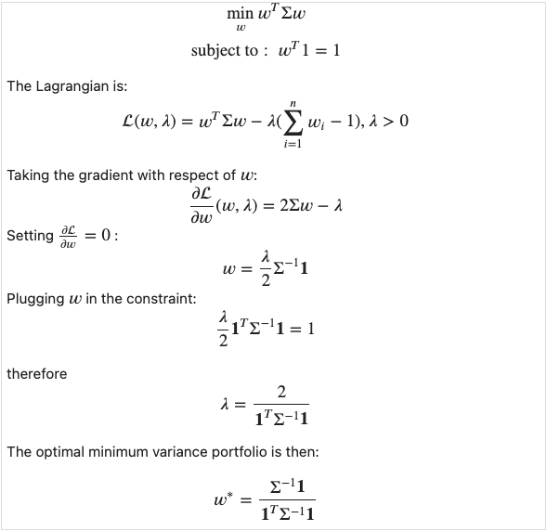
Deriving minimum variance portfolios

Slide 19
Deriving maximum Sharpe portfolio
Gregory Gundersen does an amazing job deriving the maximum Sharpe portfolio in this blog post.

