Slide 1
Optimization for Deep Learning

Slide 2
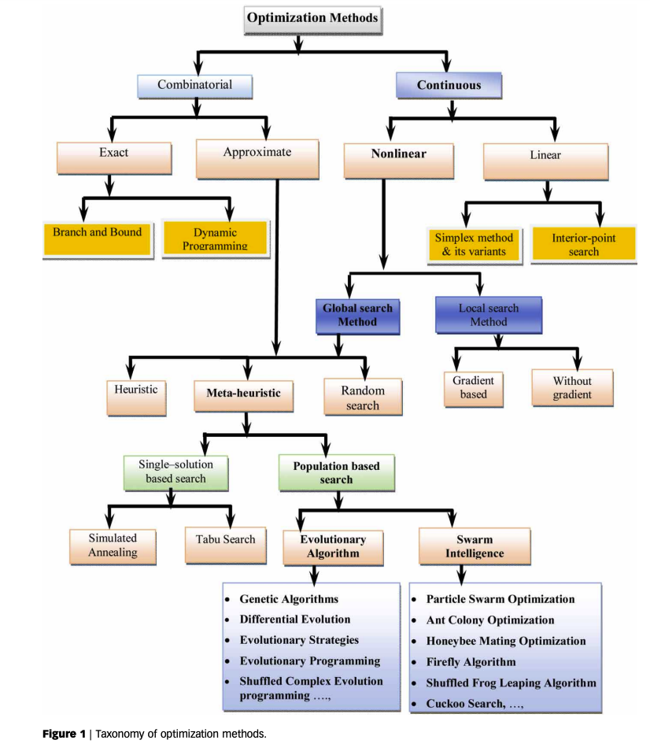
Taxonomy of optimization methods
M. Janda et al, Evolutionary algorithms, swarm intelligence methods, and their applications in water resources engineering: a state-of-the-art review, 2020

Slide 3

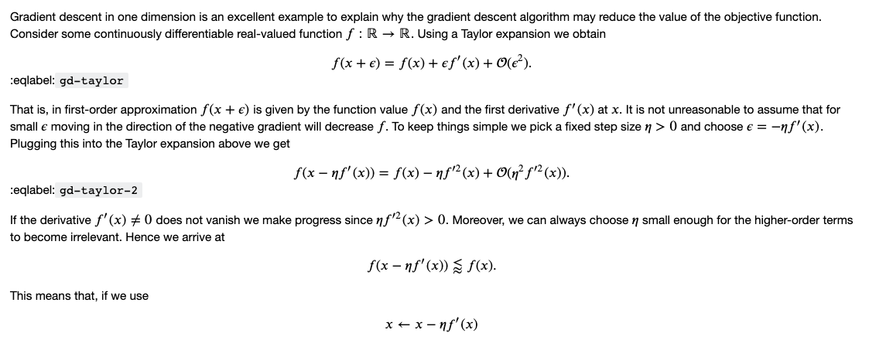
Gradient Descent - Intuition
Why does it make sense ?

Slide 4
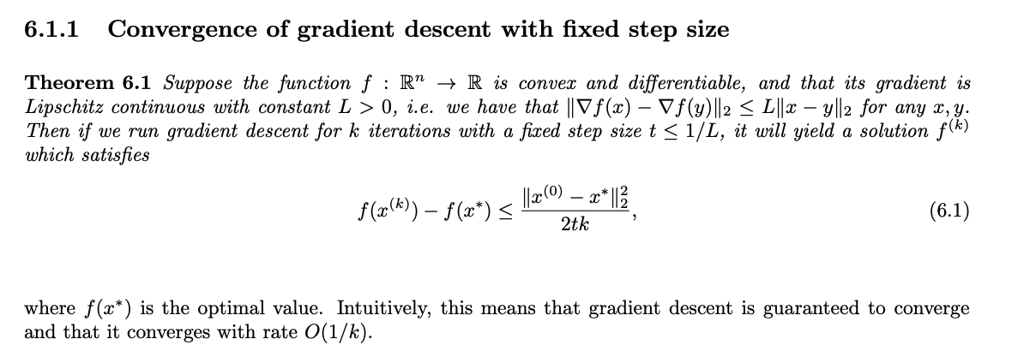
Gradient descent – Convergence
Proof

Slide 5
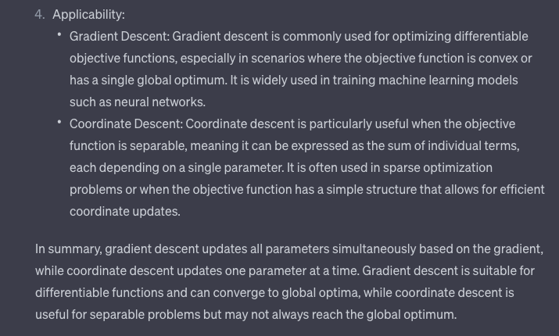
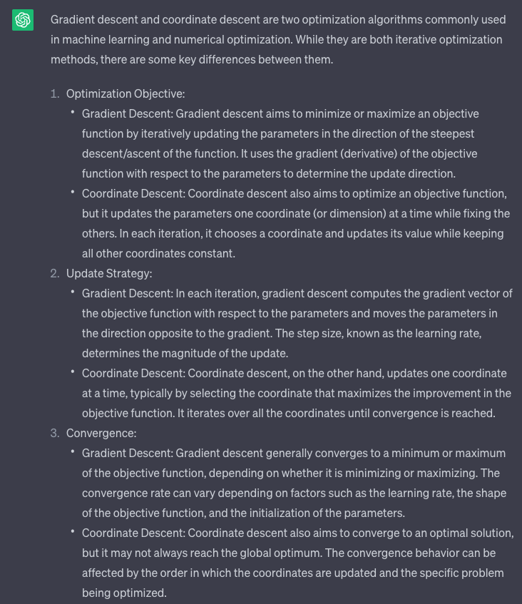
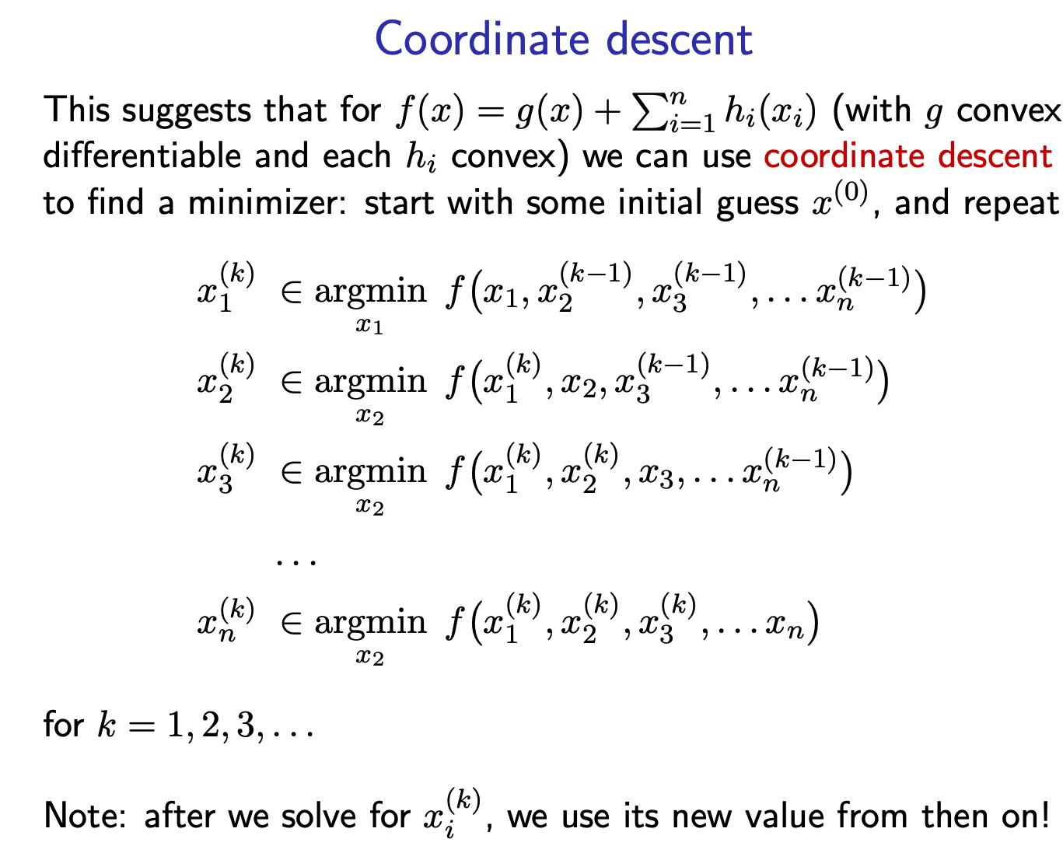
Gradient descent vs coordinate descent
source

Slide 6
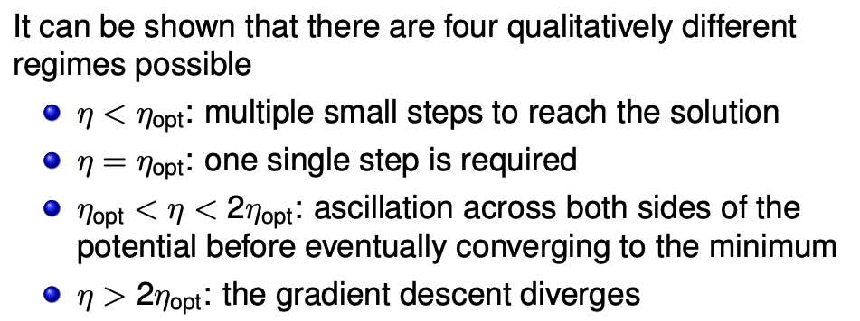
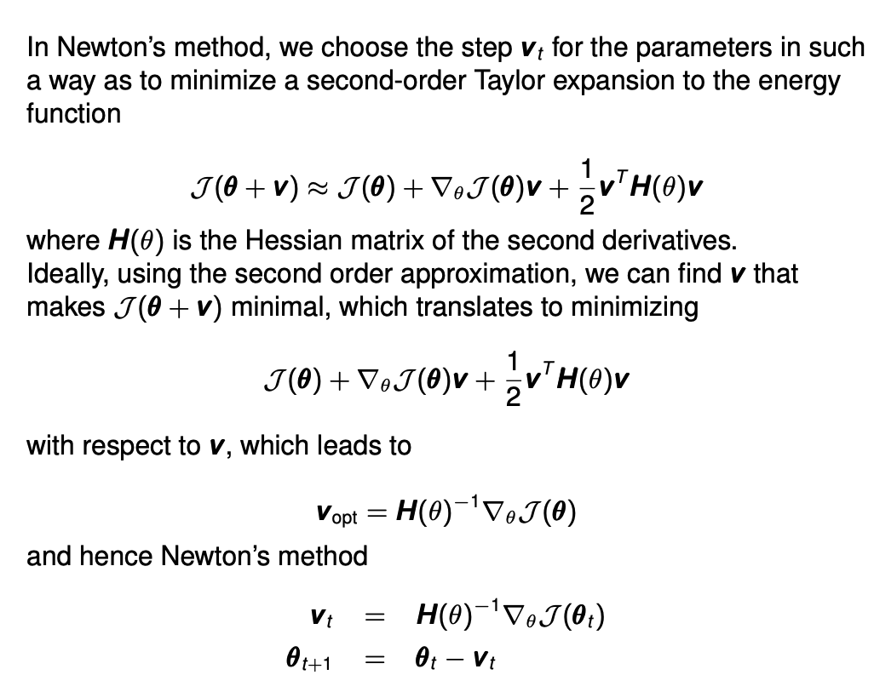
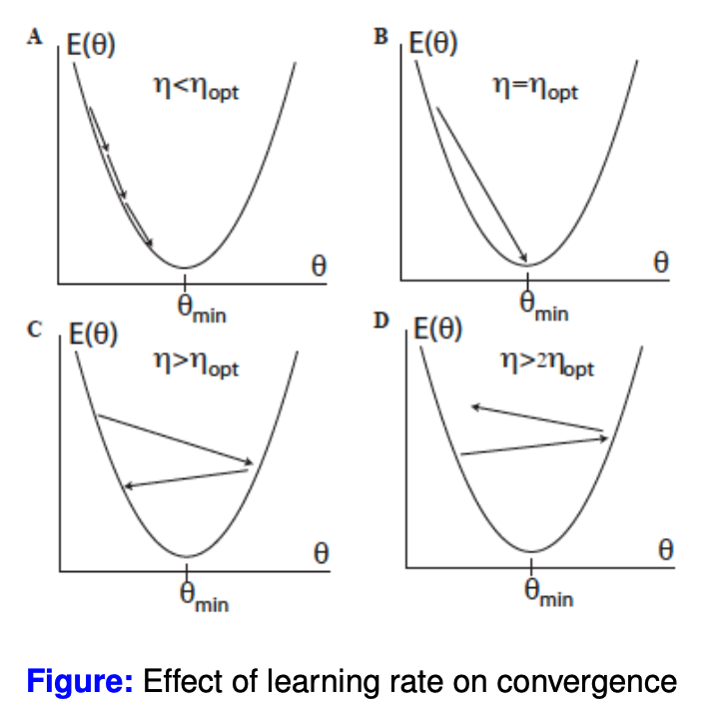
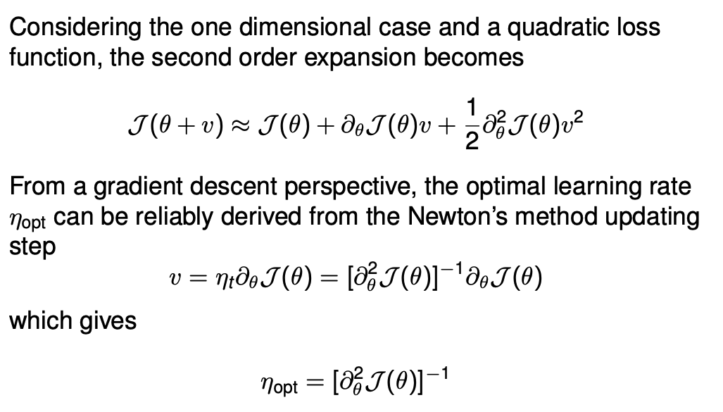
Learning rate/Newton
Source: LeCun Yann, Leon Bottou, Genevieve B Orr, and Klaus Robert Muller (1998b), Efficient backprop, in Neural networks: Tricks of the trade (Springer) pp. 9-50.

Slide 7
Limitations of the baseline Gradient Descent
The GD finds local minima of the cost function
Gradients are computationally expensive to calculate for large datasets
The GD is very sensitive to choices of the learning rates
The GD treats all directions in parameter space uniformly
The GD is sensitive to initial conditions
The GD can take exponential time to escape saddle points, even with random initialization

Slide 8
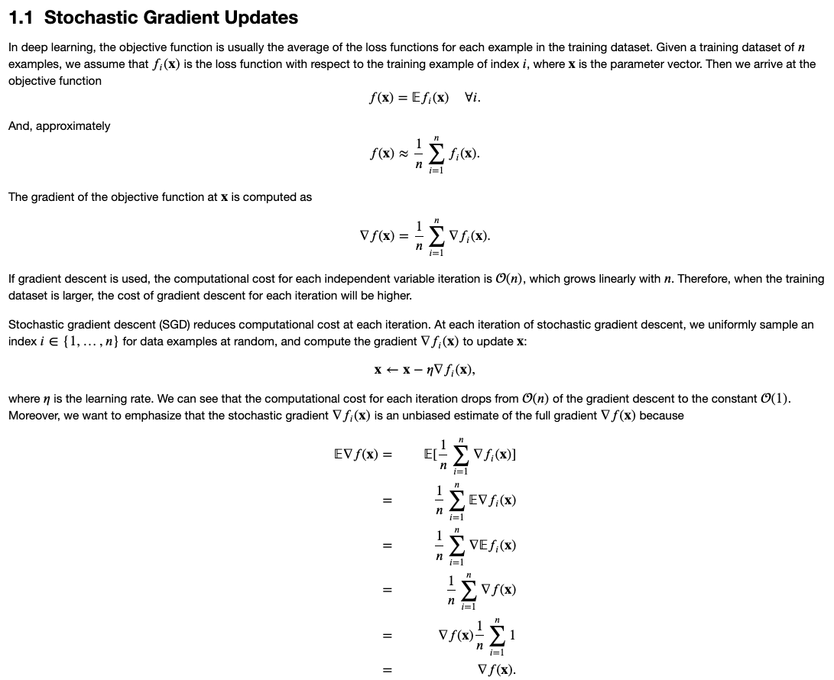
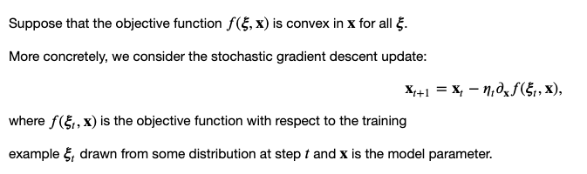
SGD

Slide 9
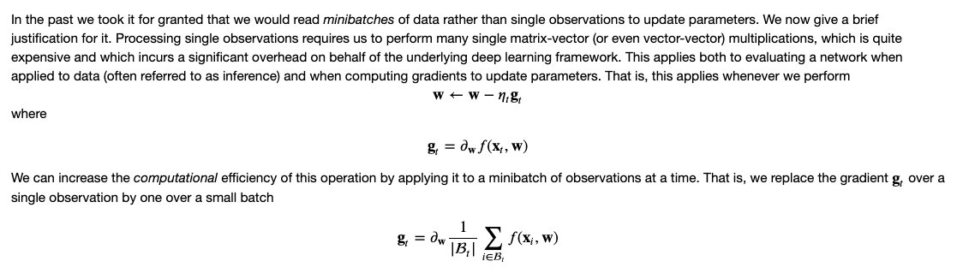
SGD with minibatches
Still an unbiased estimator of the gradient
But lower variance compared to using one single sample
Computationally more efficient than using all data compared to the variance reduction amount

Slide 10
First/Second order
Only gradient must be
computed/estimated
Hessian must be
computed/estimated
First order
Gradient Descent
SGD
MiniBatch SGD
MiniBatch SGD+Momentum
NAG
Adagrad
RMSProp
AdaDelta
Adam
Nadam
Second order
Newton
Quasi-Newton
Broyden-Fletcher-Goldfarb-Shanno (BFGS)
Gauss-Newton
Levenberg-Marquardt Algorithm
Use second order gradient (gradient squared)

Slide 11
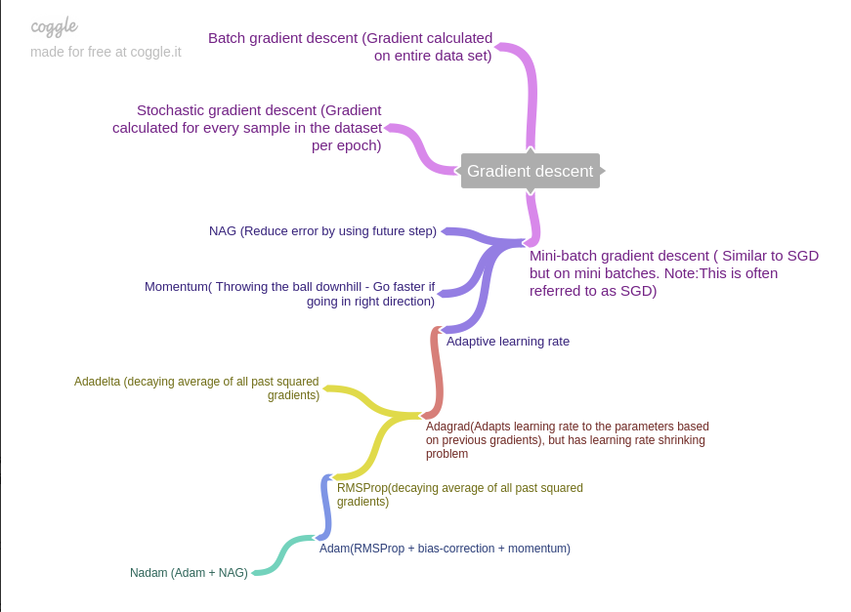
Taxonomy of major deep learning optimizers
source

Slide 12
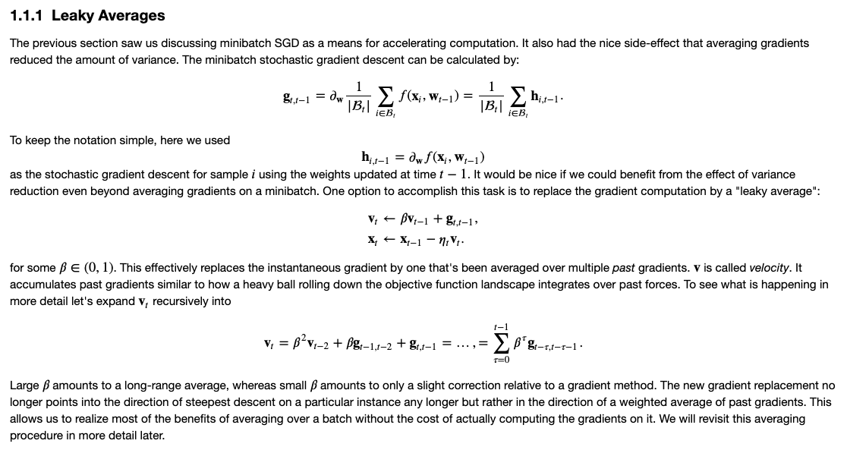
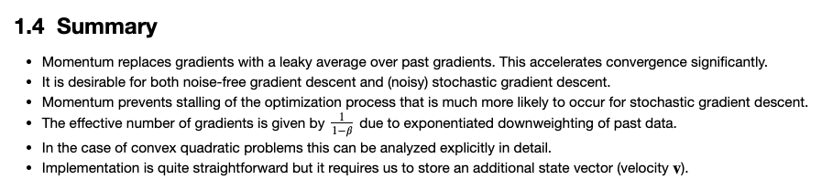
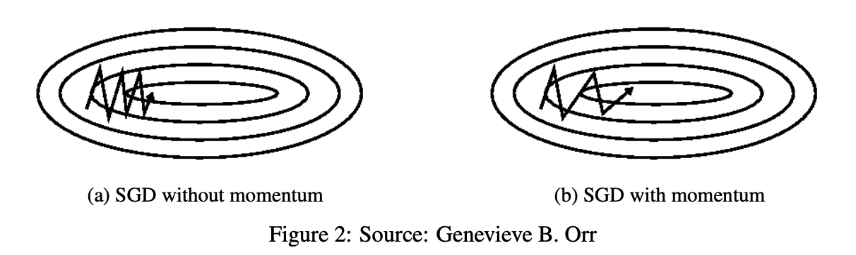
Momentum
Gain speed in directions with persistent but small gradients
Suppresses oscillations in high curvature directions
Useful in situations where the landscape is shallow and flat in some directions but narrow and steep in others

Slide 13
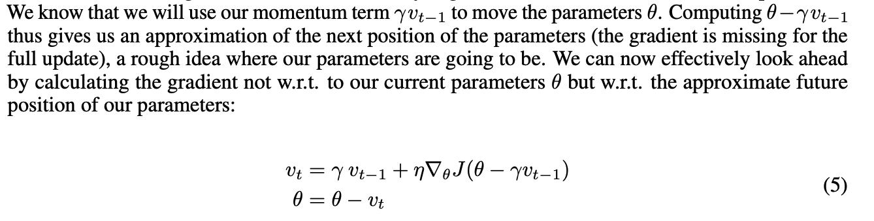
Nesterov Accelerated Gradient (NAG)y
Momentum has no concept of when to slow down
NAG is a way to make the momentum term more aware of what is coming in the landscape

Slide 14
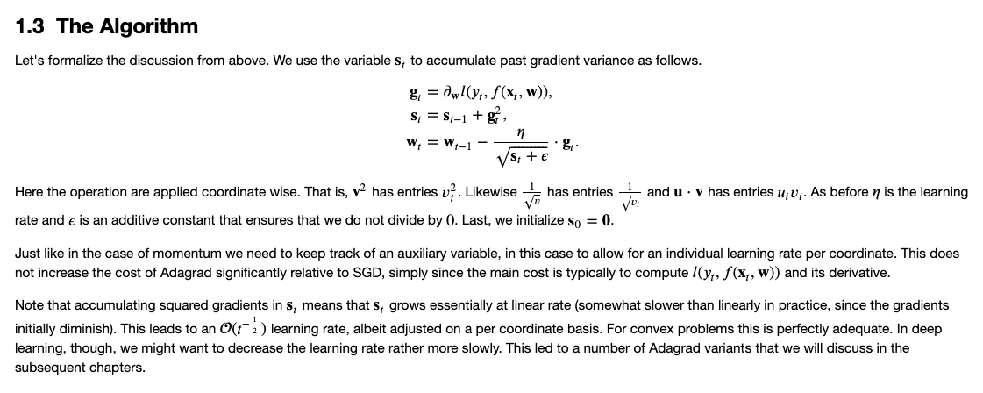
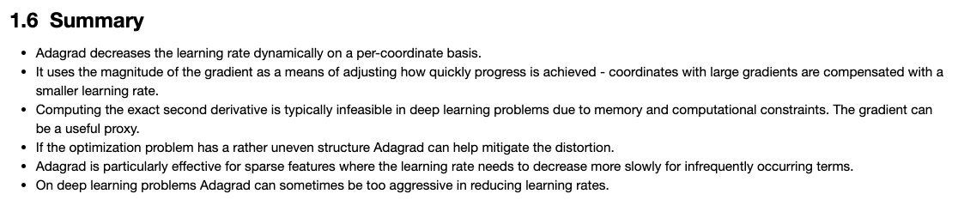
AdaGrad
Adapts the learning rate to the parameters
Larger updates for infrequent parameters
Smaller updates for frequent parameters
Well suited for dealing with sparse data
Was found to improve the robustness of SGD
Used to train GloVe word embedding

Slide 15
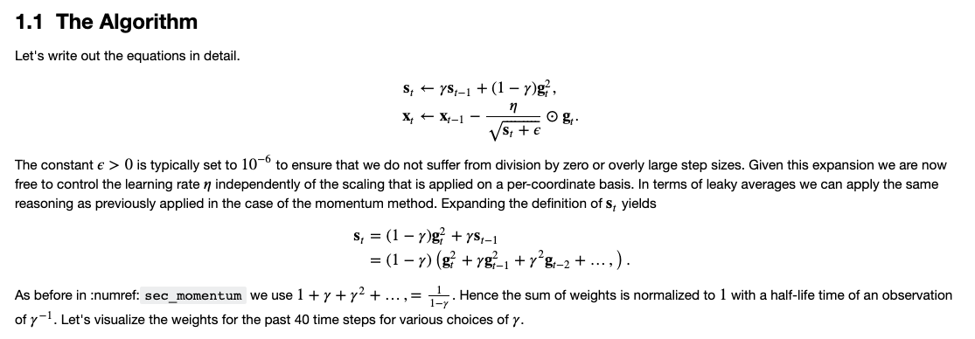
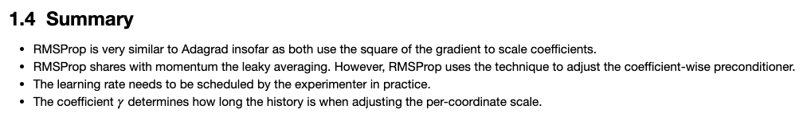
RMSProp
Proposed by G Hinton
Attempts to resolve Adagrad’s diminishing learning rate
Very similar to AdaDelta

Slide 16
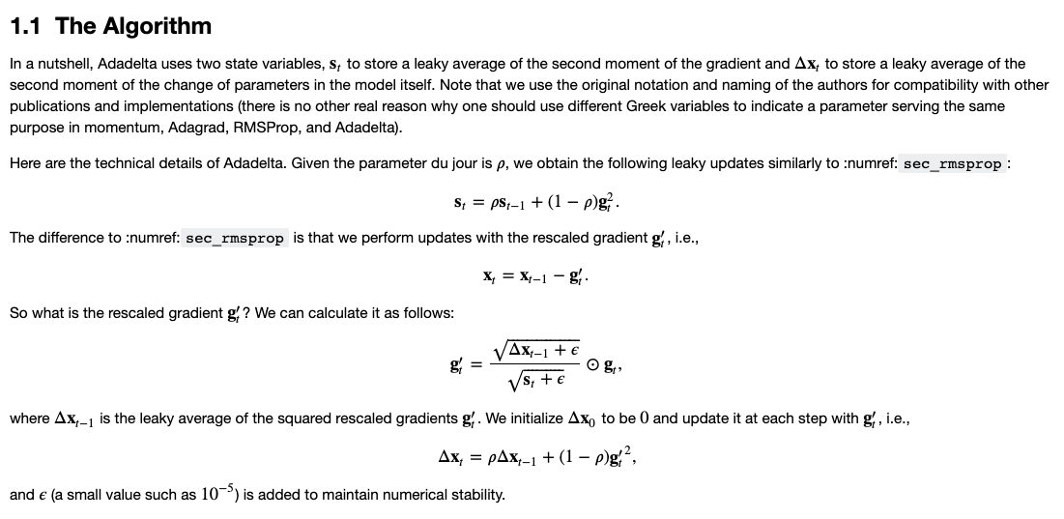
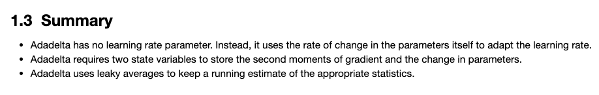
AdaDelta
Extension of Adagrad that seeks to reduce its aggressive, monotonically decreasing learning rate
Restricts the window of accumulated past gradients

Slide 17
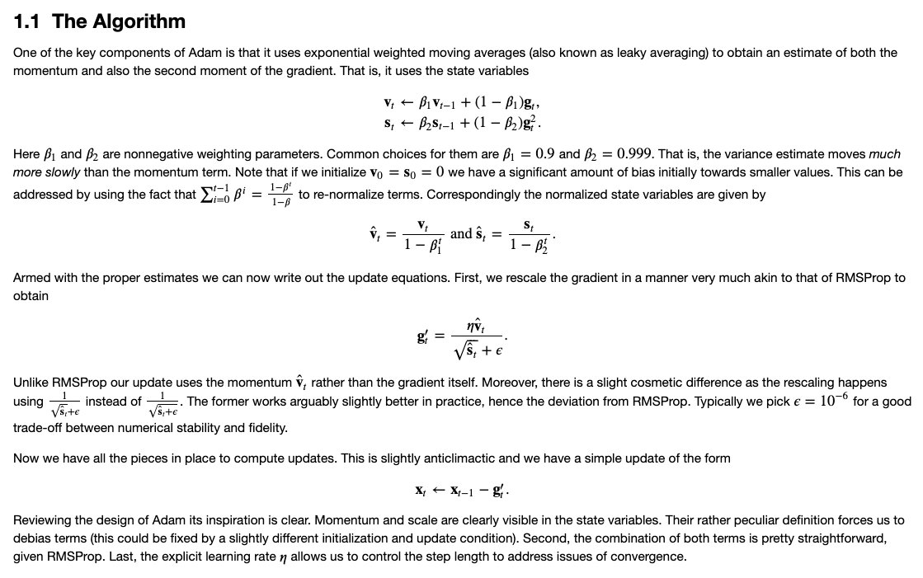
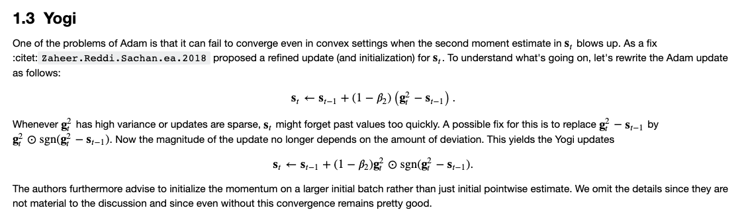
Adam/Yogi
Adam can be viewed as a combination of
RMSprop: exponentially decaying average of past squared gradients
Momentum: exponentially decaying average of past gradients

Slide 18

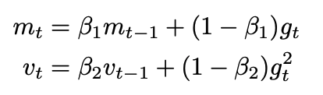
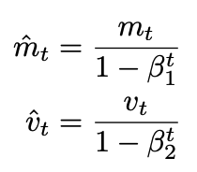
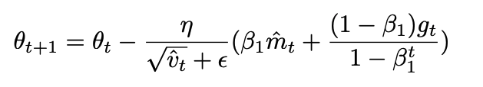
Nadam
Adam can be viewed as a combination of
RMSprop: exponentially decaying average of past squared gradients
Momentum: exponentially decaying average of past gradients
NAG is superior to vanilla momentum
Nadam:
Adam
NAG

Slide 19
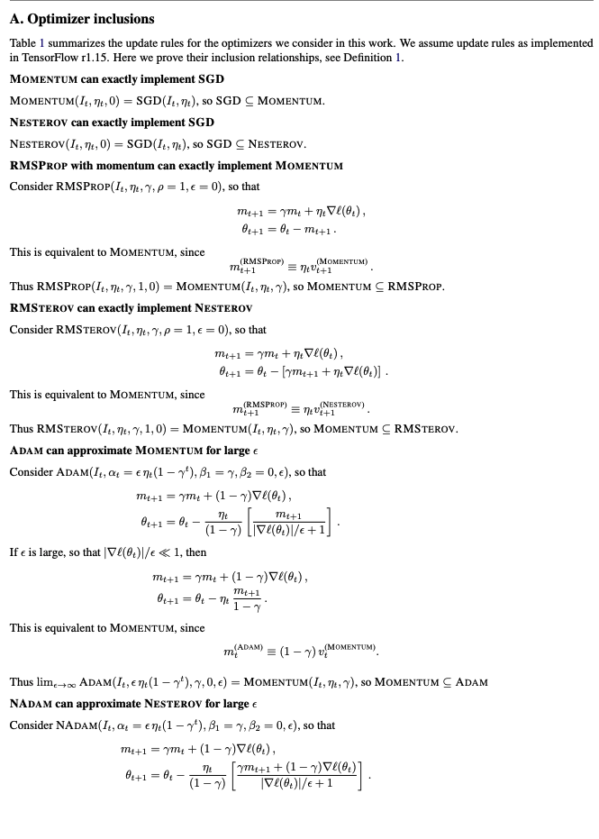
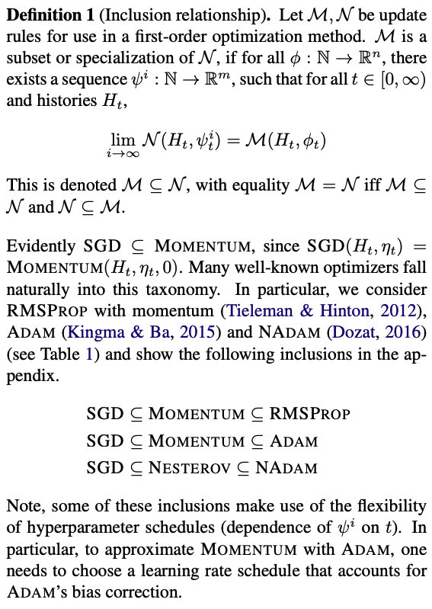
Which optimizer to use ? Inclusion principle ?
Dami Choi et al, On Empirical Comparisons of Optimizers for Deep Learning, 2020

Slide 20
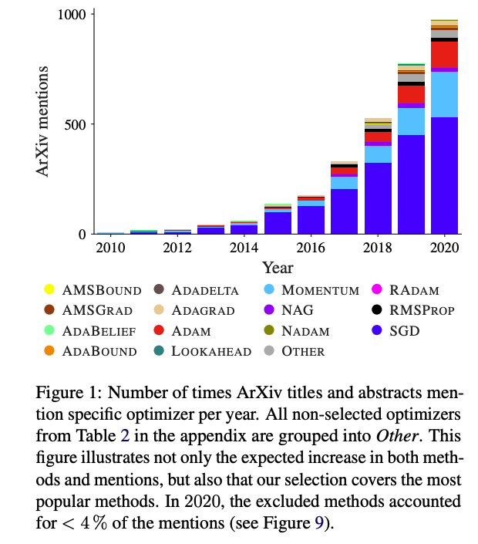
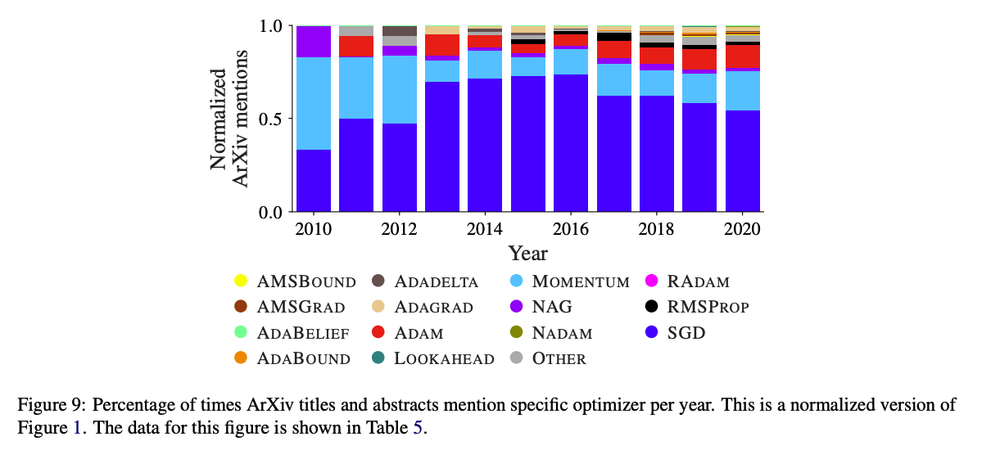
Which optimizer to use ? Follow the crowd !
Robin M. Schmidt et al, Descending through a crowded valley – benchmarking deep learning Optimizers, ICML 2021

Slide 21
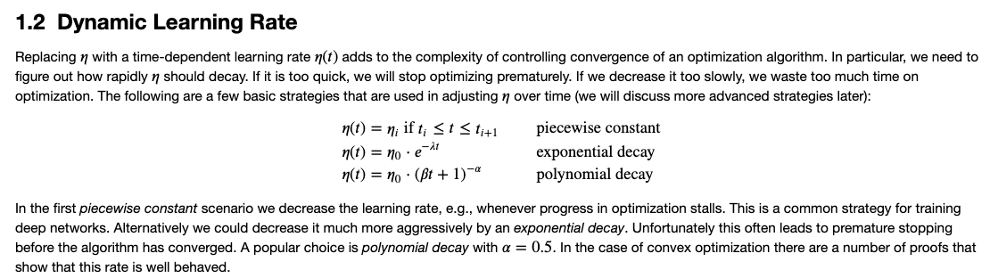
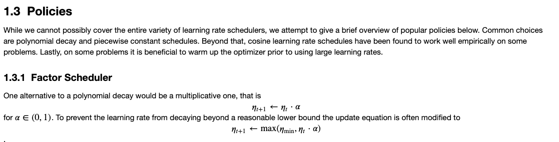
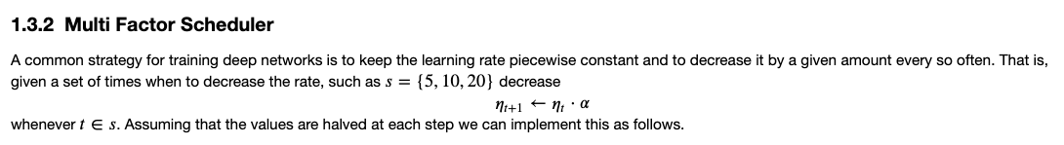
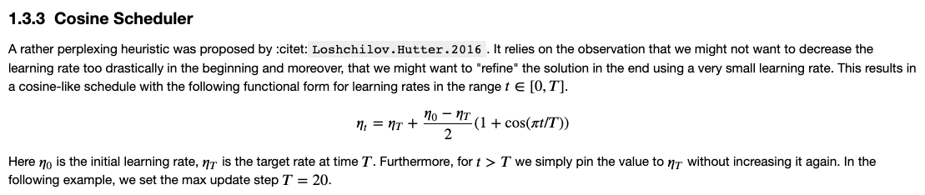
Learning rate scheduling

Slide 22
Optimizers comparatives
Optimizer | Variance | Speed | Learning rate | Persistent small gradient | High curvature | Fla/Steep region | Scale
GD | Low | Slow | Fixed | Agnostic | Agnostic | Agnostic | Agnostic
SGD (*) | High | Fast | Fixed | Agnostic | Agnostic | Agnostic | Agnostic
SGD | ~Low | ~Fast | Fixed | Agnostic | Agnostic | Agnostic | Agnostic
Momentum | ~Low | ~Fast | Fixed | Yes | Yes | Yes | Agnostic
NAG | ~Low | ~Fast | Fixed | Yes | Yes | Yes | Agnostic
AdaGrad | ~Low | ~Fast | Adaptive | Yes | Yes | Yes | Agnostic
AdaDelta | ~Low | ~Fast | Adaptive | Yes | Yes | Yes | Agnostic
RMSProp | ~Low | ~Fast | Adaptive | Yes | Yes | Yes | Agnostic
Adam | ~Low | ~Fast | Adaptive | Yes | Yes | Yes | Yes
Nadam | ~Low | ~Fast | Adaptive | Yes | Yes | Yes | Yes
(*) with one single data point

Slide 23
References
Papers
Sebastien Ruder, An overview of gradient descent optimization , 2017
Robin M. Schmidt et al, Descending through a crowded valley – benchmarking deep learning Optimizers, ICML 2021
Dami Choi et al, On Empirical Comparisons of Optimizers for Deep Learning, 2020
Ruoyu Sun, Optimization for deep learning: theory and algorithms, 2019
Books
Boyd and Vandenberghe, Convex Optimization, 2004
Charu C. Aggarwal, Linear Algebra and Optimization for Machine Learning, 2020
Courses
G. Hinton course, 2014
Ryan Tibshirani course, 2015

