Slide 1
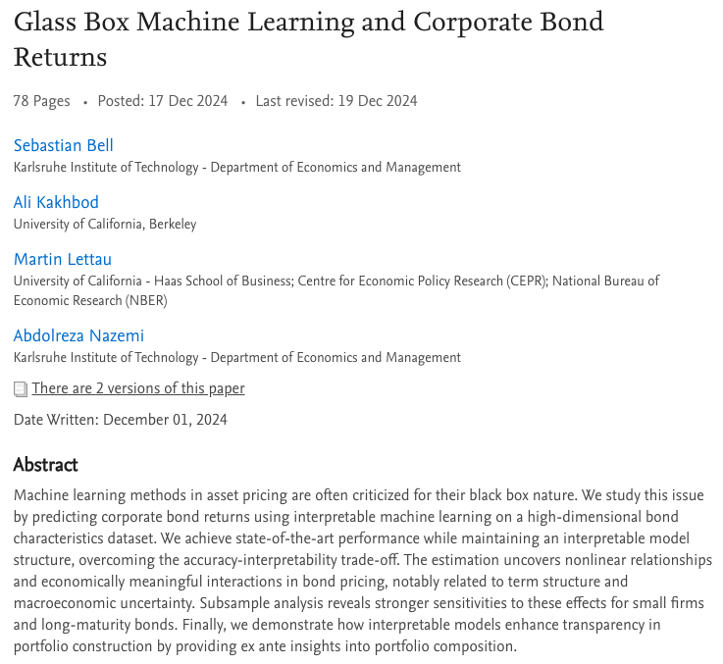
FI Technical Book-club
Prepared and Presented by Oualid Missaoui
ssrn link

Slide 2
Agenda
Introduction
Summary of the Research
Key Findings and Contributions
Methodology
Formulation
Explainable Boosting Machines
Evaluation
Importances
Data
Empirical Results

Slide 3
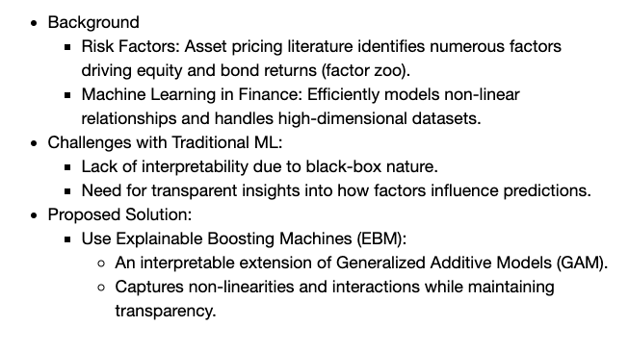
Introduction – Summary of the research

Slide 4
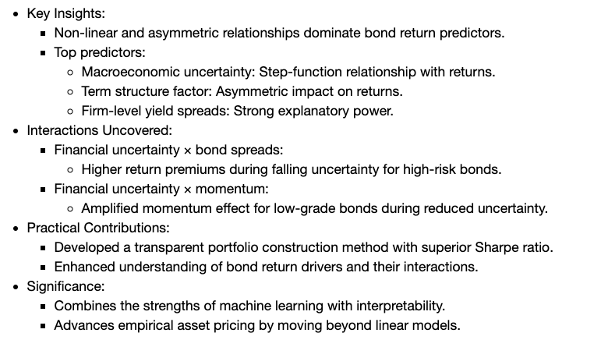
Introduction – Key Findings & Contributions

Slide 5
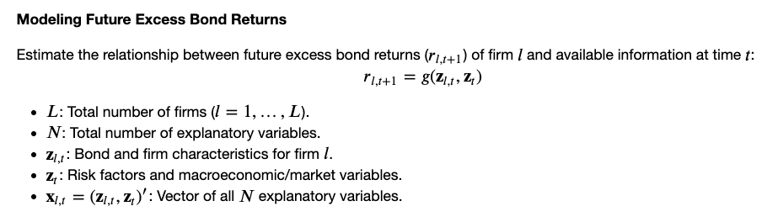
Methodology

Slide 6
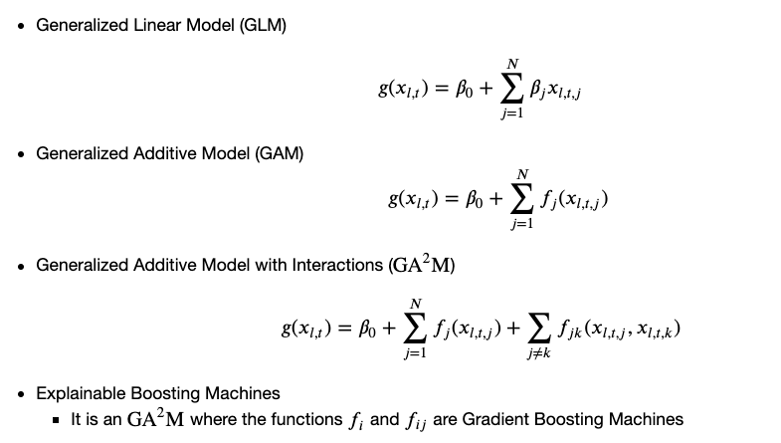
Explainable Boosting Machines

Slide 7
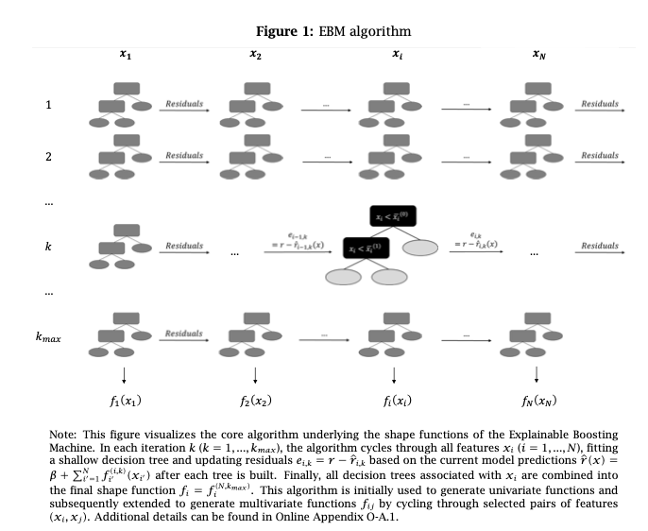

Slide 8
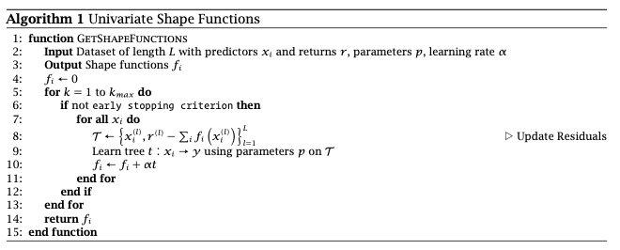
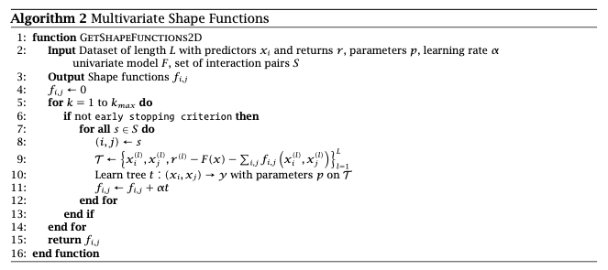

Slide 9
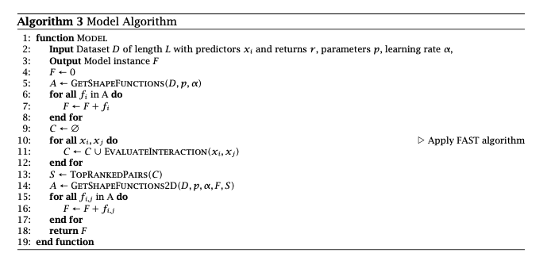
Interaction Detection
Lou, Yin, Rich Caruana, Johannes Gehrke, and Giles Hooker (2013) “Accurate intelligible models with pairwise interactions,” in Proceedings of the 19th ACM SIGKDD
international conference on Knowledge discovery and data mining, 623–631.

Slide 10
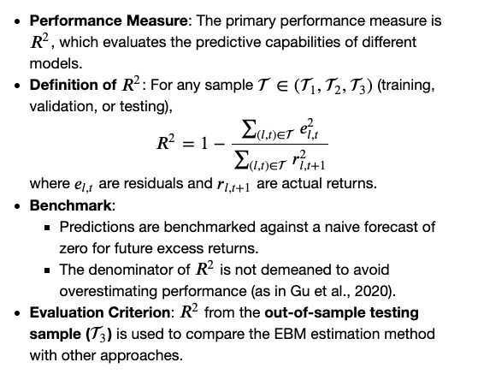
Evaluation

Slide 11
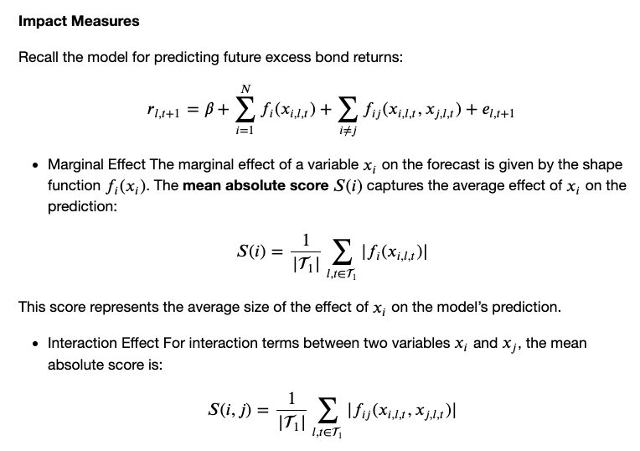
Effects of variables

Slide 12
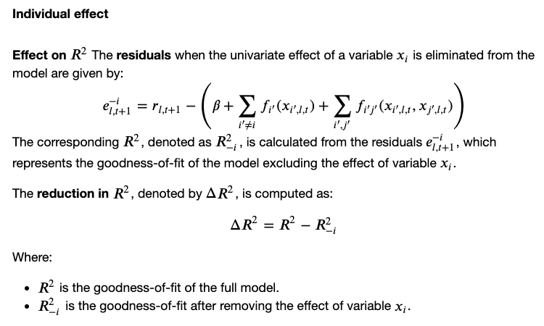
Effects of variables

Slide 13
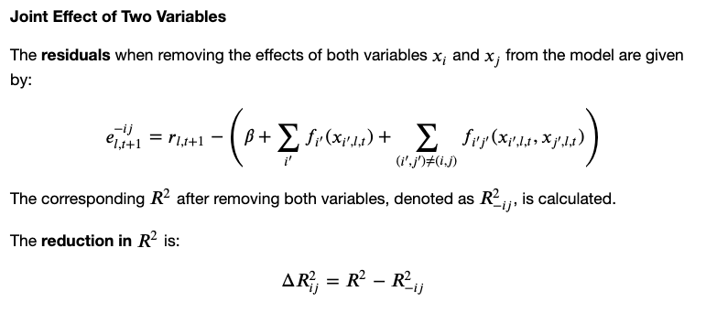
Effects of variables

Slide 14
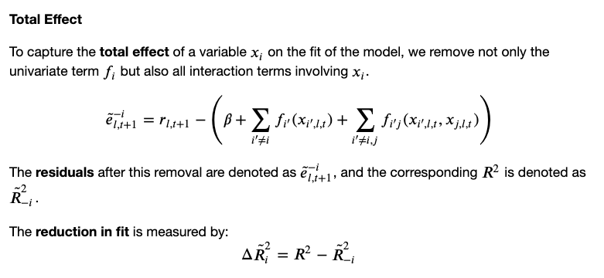
Effects of variables

Slide 15
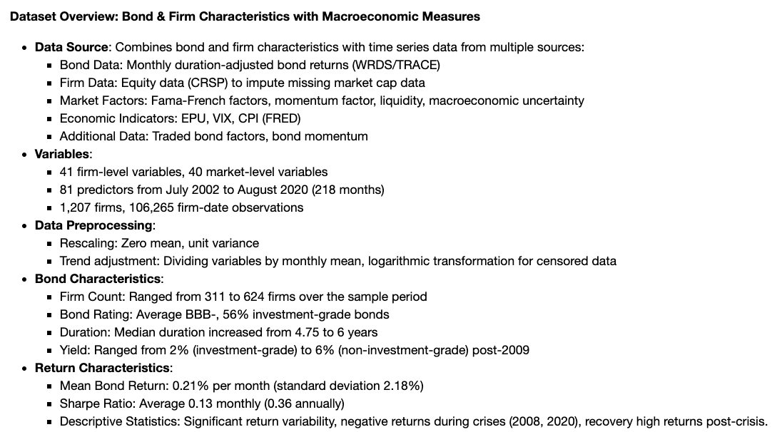
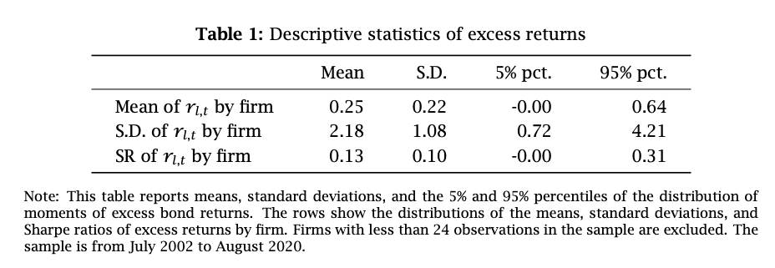
Data

Slide 16
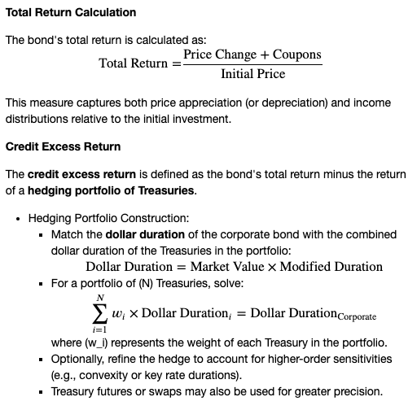
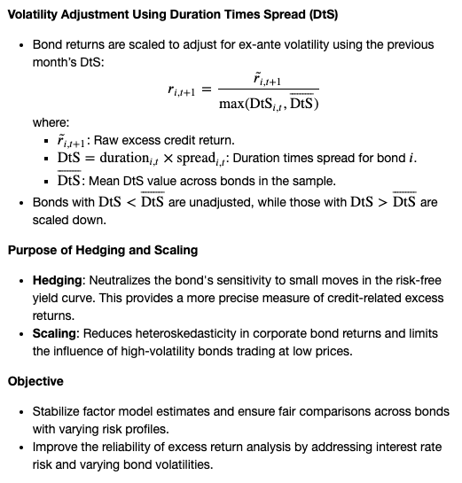
Methodology of excess return calculation
Kelly, Bryan, Diogo Palhares, and Seth Pruitt (2023) “Modeling corporate bond returns,” The Journal of Finance.

Slide 17
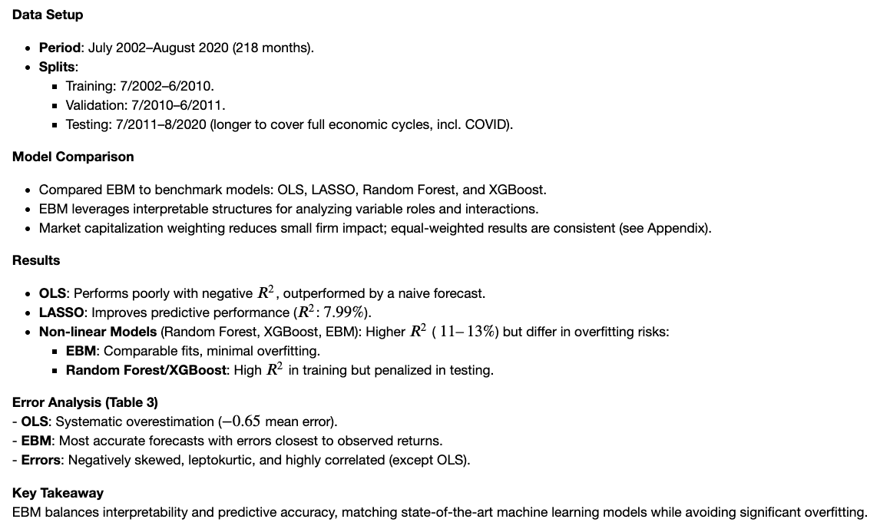
Empirical Results

Slide 18
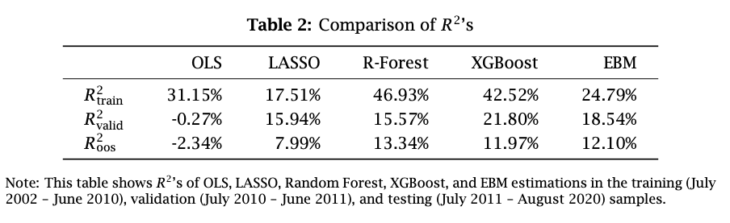
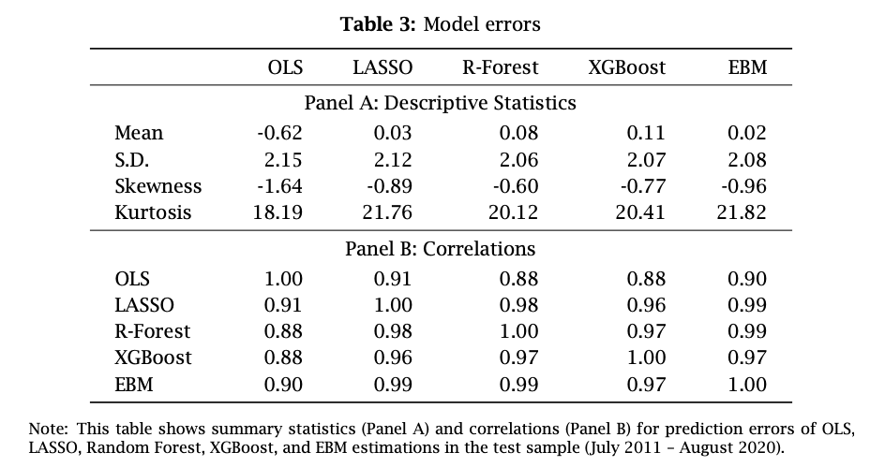

Slide 19
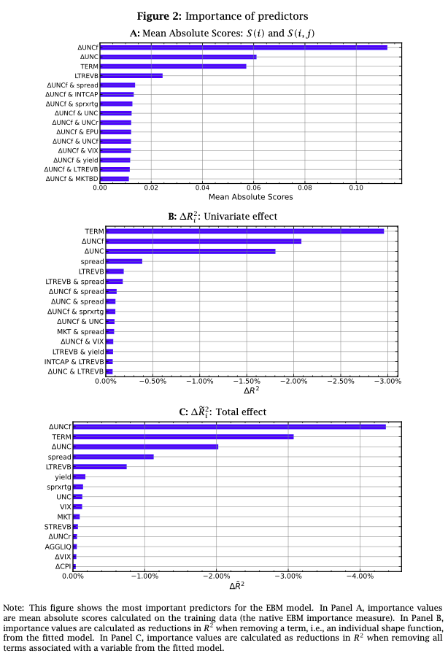
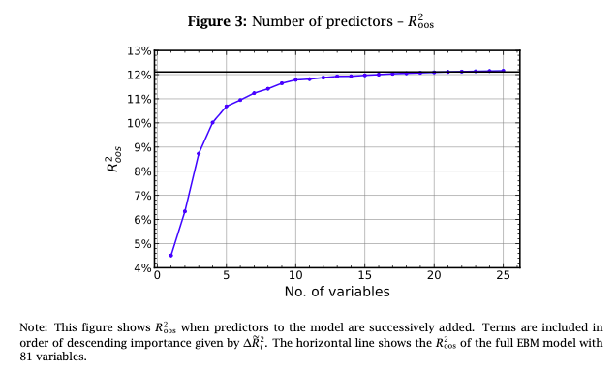
Predictor Importance

Slide 20
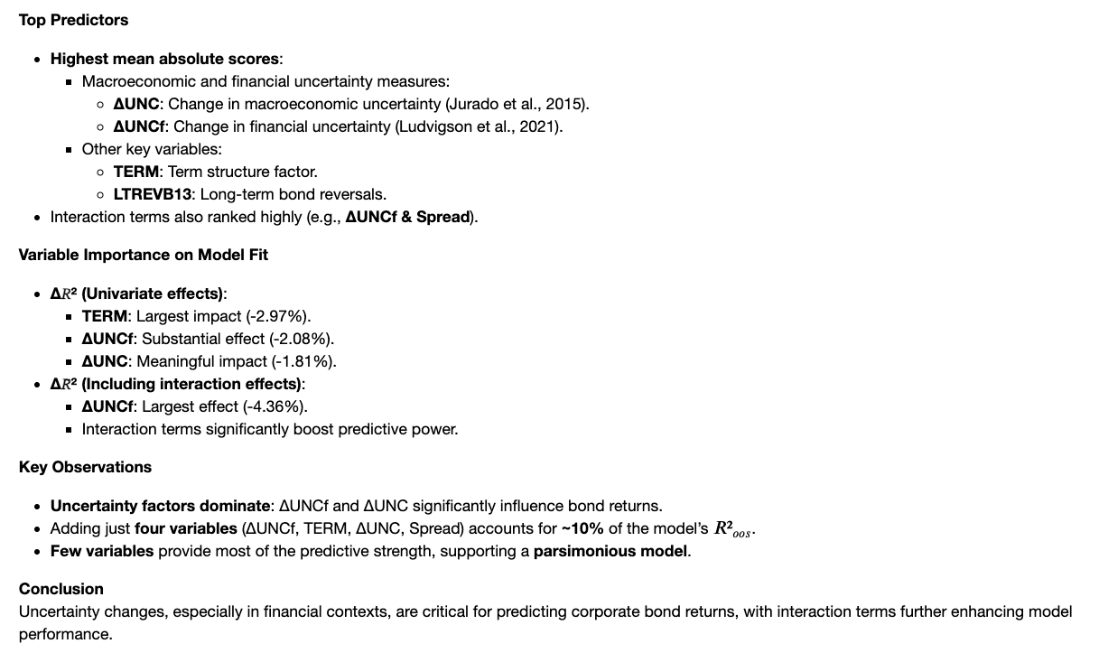
Bali, Turan G., Avanidhar Subrahmanyam, and Quan Wen (2021a) “Long-term reversals in the corporate bond market,” Journal of Financial Economics, 139 (2), 656–677.
Jurado, Kyle, Sydney C. Ludvigson, and Serena Ng (2015) “Measuring uncertainty,” American Economic Review, 105 (3), 1177–1216.

Slide 21
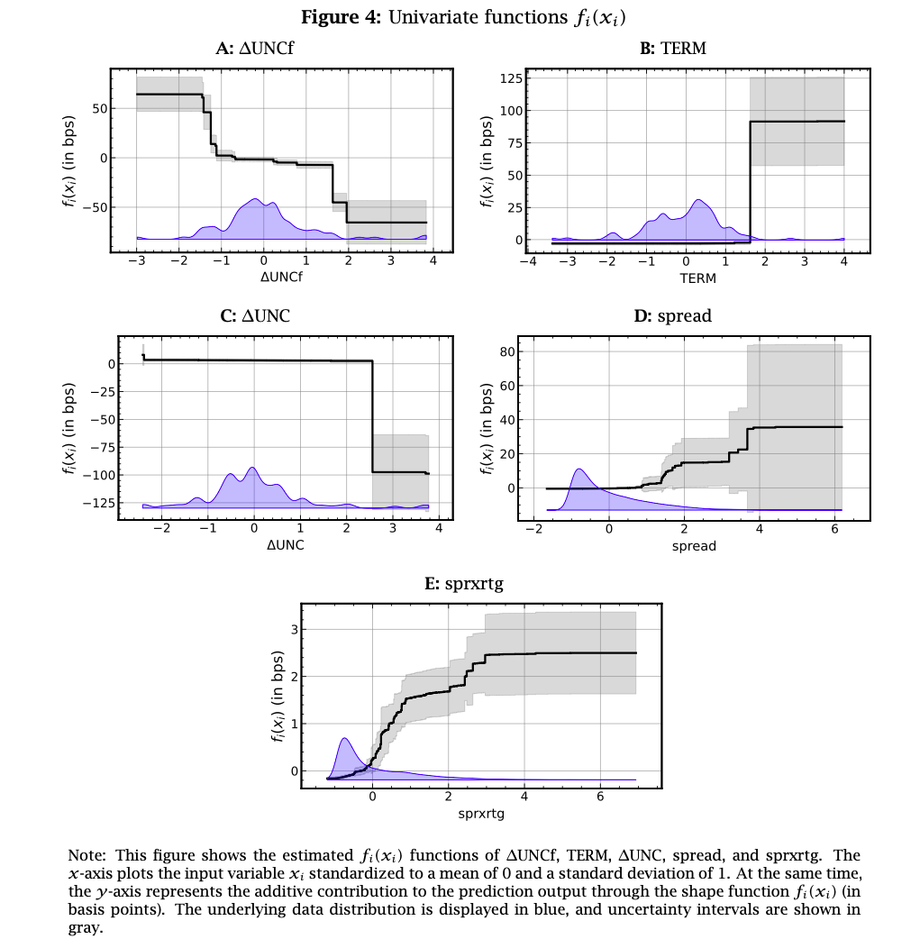
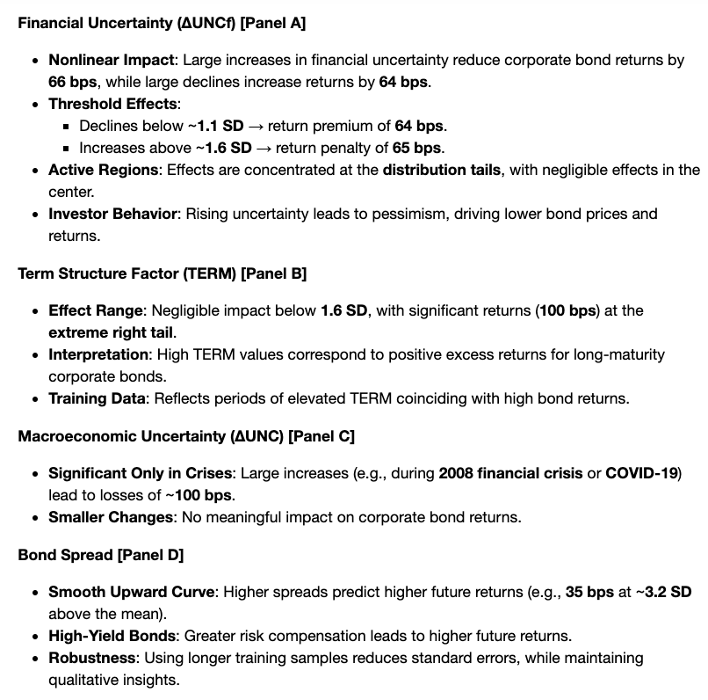
Univariate Effects

Slide 22
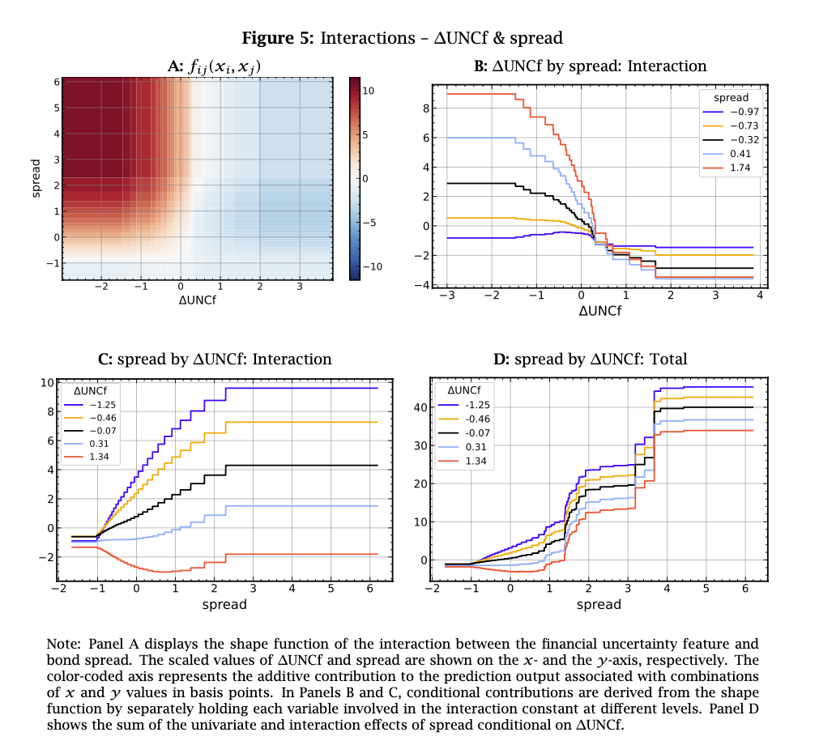
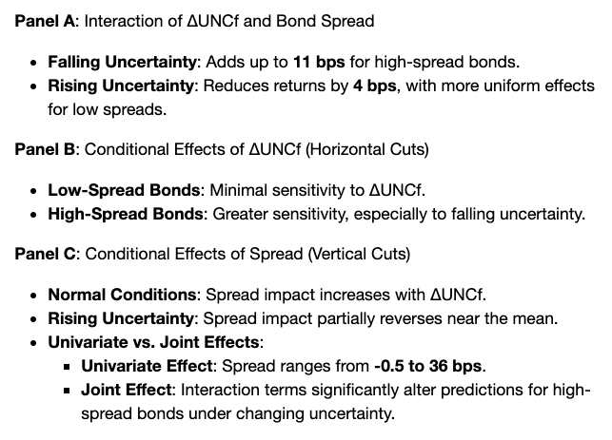
Interaction Effects

Slide 23
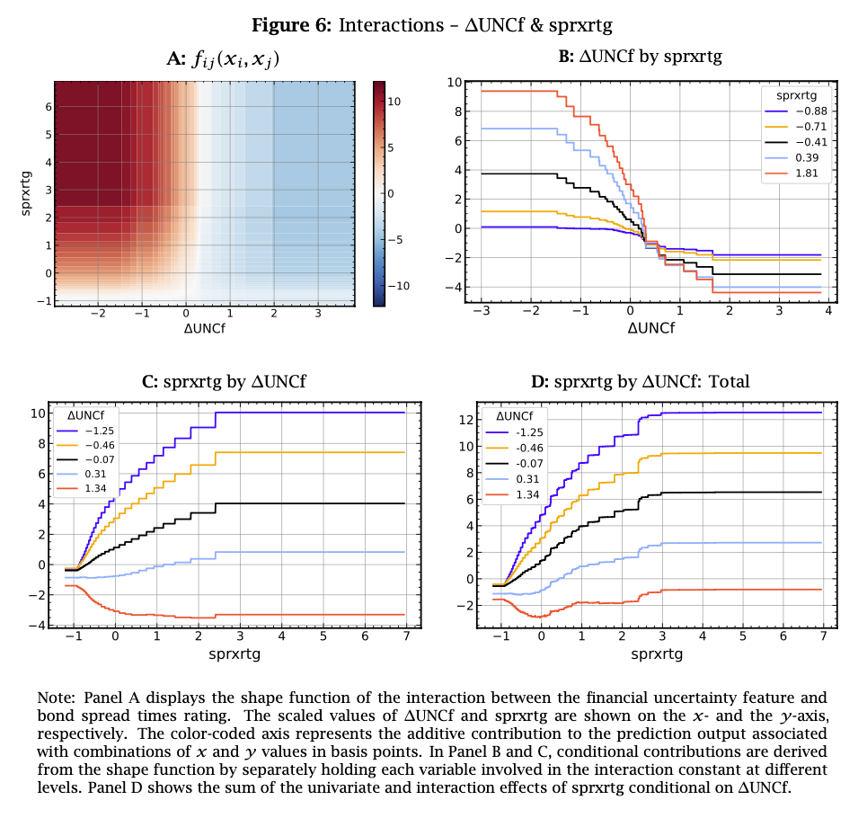
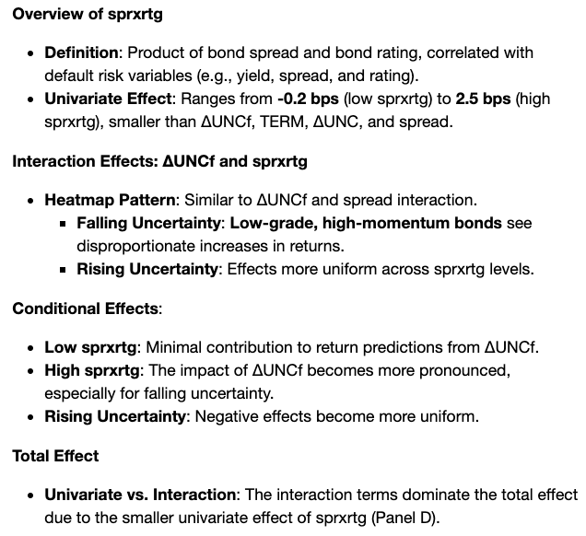
Interaction Effects

Slide 24
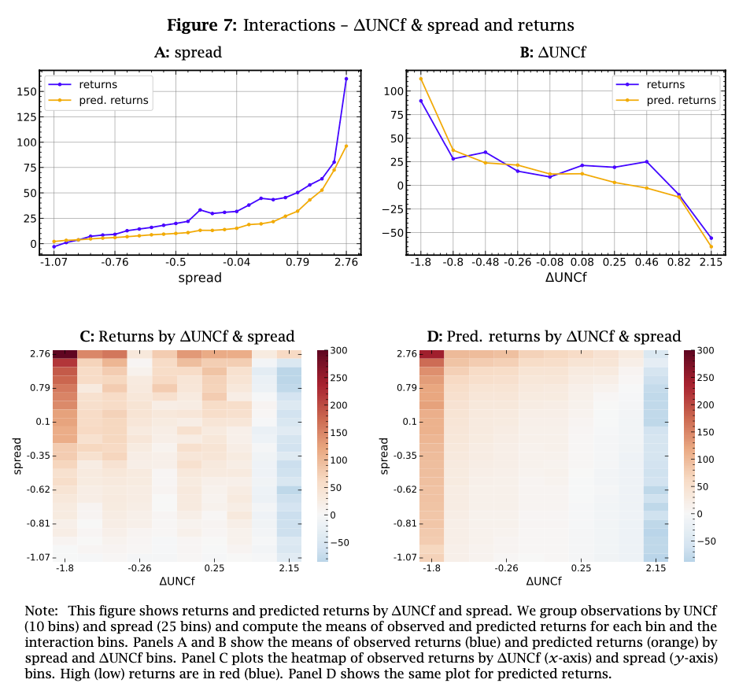
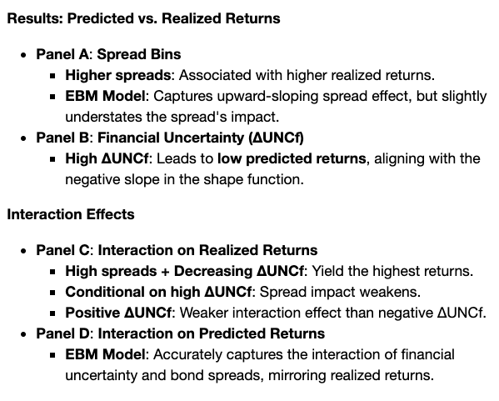
Interaction Effects in Returns

Slide 25
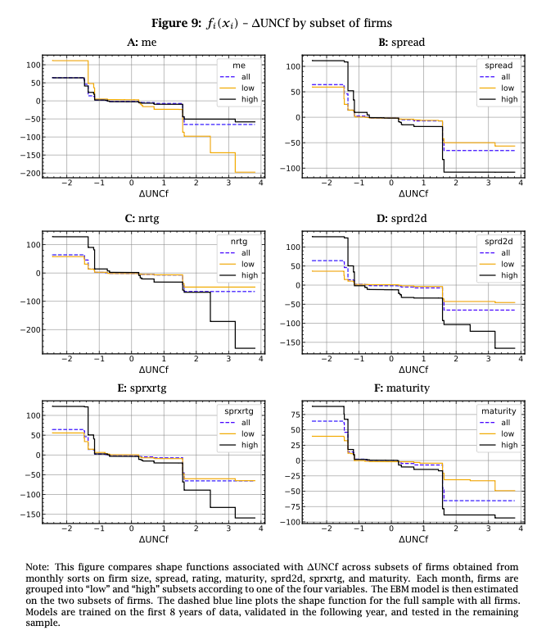
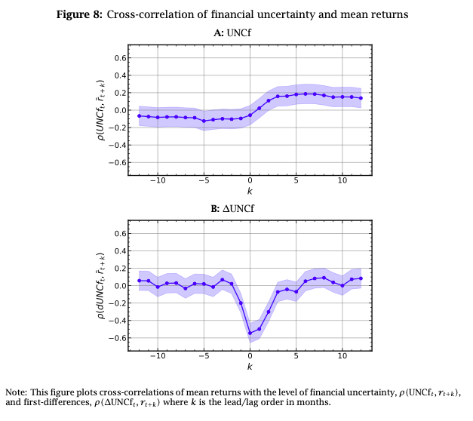
More on financial uncertainty

Slide 26
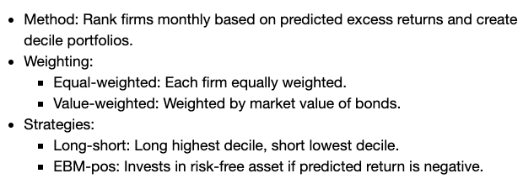
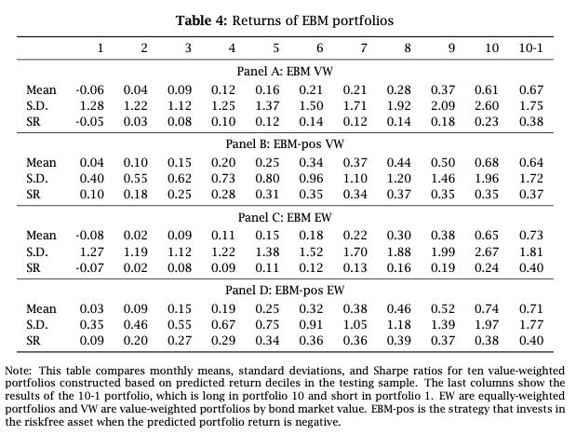
Portfolios based on the EBM model

Slide 27
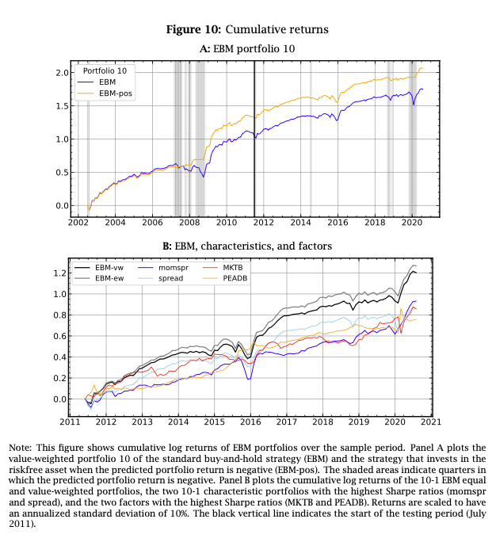

Slide 28
References
EBM Implementation
Interpret.ML: https://interpret.ml/docs/ebm.html
Nori, Harsha, Samuel Jenkins, Paul Koch, and Rich Caruana (2019) “InterpretML: A unified framework for machine learning interpretability,” arXiv:1909.09223.
Lou, Yin, Rich Caruana, Johannes Gehrke, and Giles Hooker (2013) “Accurate intelligible models with pairwise interactions,” in Proceedings of the 19th ACM SIGKDD international conference on Knowledge discovery and data mining, 623–631.
Features/Response
Bali, Turan G., Avanidhar Subrahmanyam, and Quan Wen (2021a) “Long-term reversals in the corporate bond market,” Journal of Financial Economics, 139 (2), 656–677.
Jurado, Kyle, Sydney C. Ludvigson, and Serena Ng (2015) “Measuring uncertainty,” American Economic Review, 105 (3), 1177–1216.
Kelly, Bryan, Diogo Palhares, and Seth Pruitt (2023) “Modeling corporate bond returns,” The Journal of Finance.

