Slide 1
NLP Application
Oualid

Slide 2
Agenda
Sentiment Analysis
RNN
CNN
Natural Language Inference
SNLI
NLI with attention
BERT Fine tuning
NLI with Bert Fine tuning

Slide 3
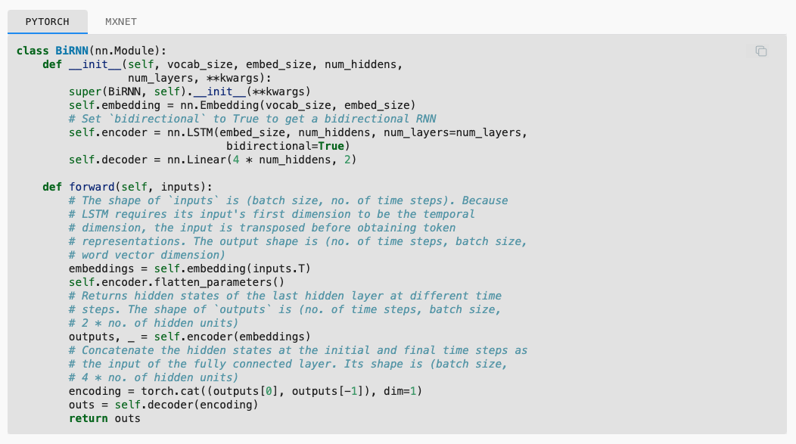
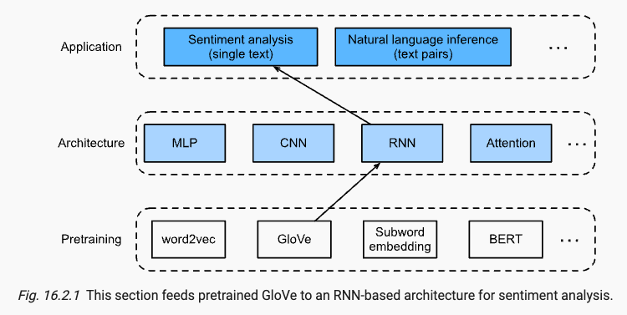
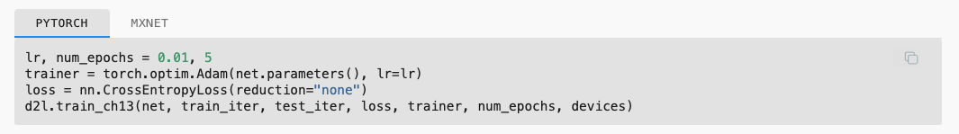
Sentiment Analysis - RNN

Slide 4
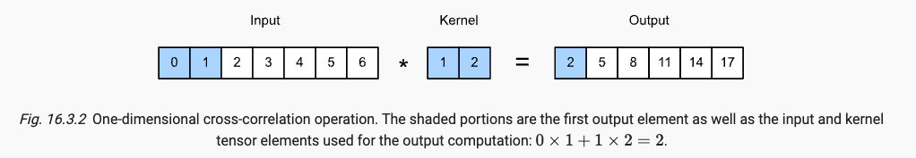
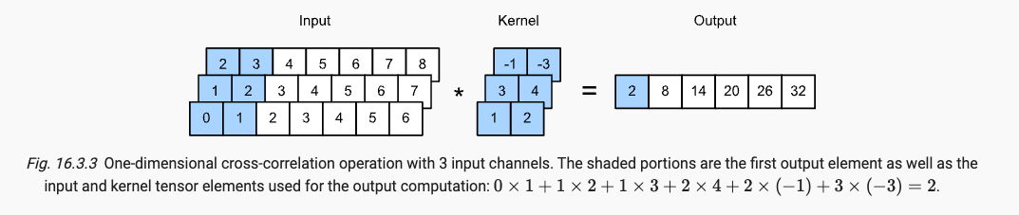
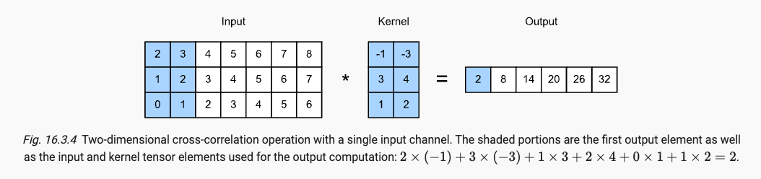
Sentiment Analysis - CNN

Slide 5
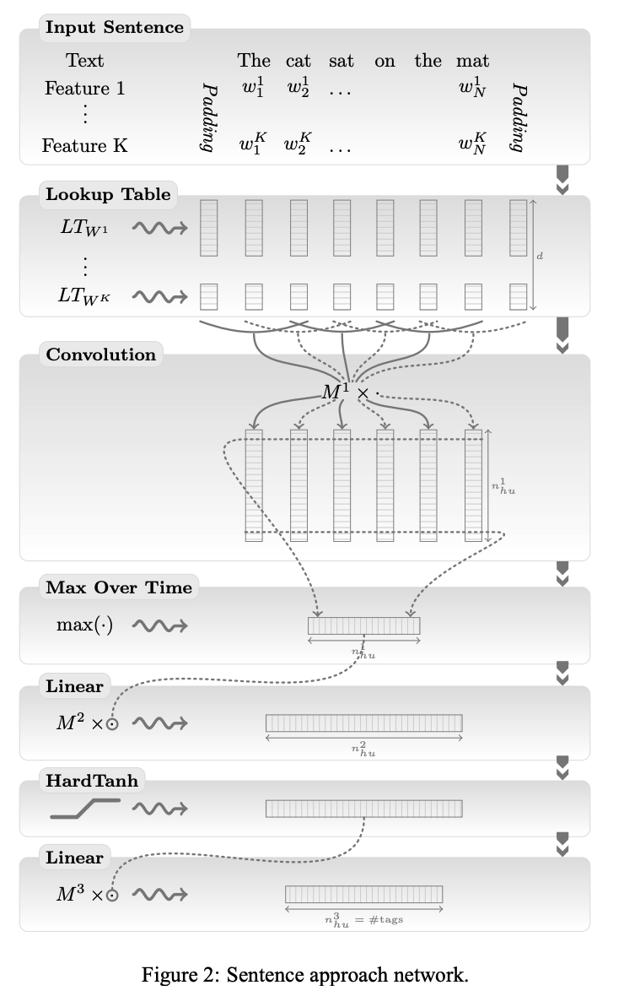
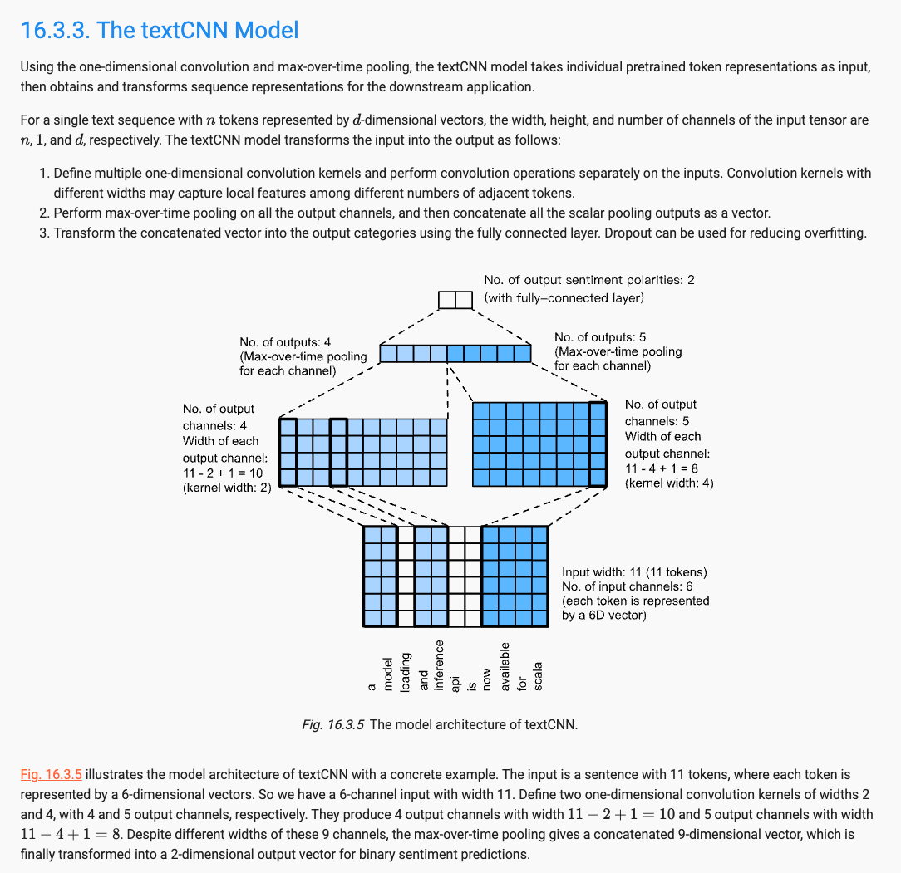
Sentiment Analysis - CNN
Collobert et al, 2011, Natural Language Processing (Almost)
from Scratch, JMLR

Slide 6
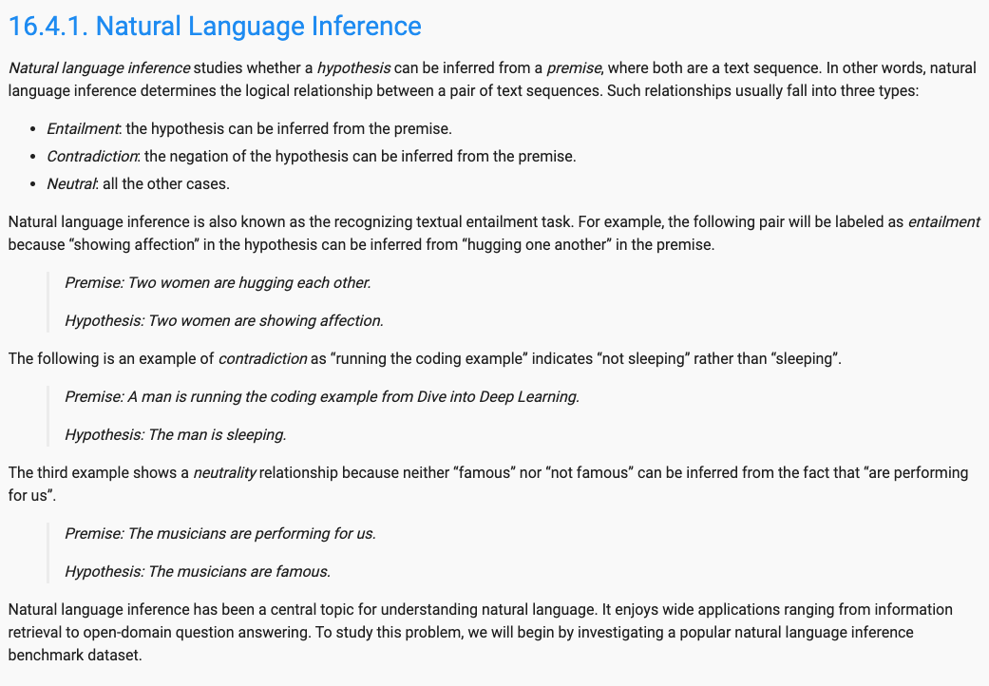
Natural Language Inference

Slide 7
Natural Language Inference - SNLI
Stanford Natural Language Inference (SNLI) benchmark
Size: 570k
Premise type: sentence
Labels:
Entailment
Neutral
Contradiction
Description:
Based on the image captions from the Flickr30k corpus, where the image captions are used as premises. The hypothesis was created manually by the Mechanical Turk workers in line with the following instructions:
Entailment: write one alternate caption that is definitely an accurate description of the photo
Neutral: write one alternate caption that might be an accurate description of the photo
Contradiction: write one alternate caption that is a wrong description of the photo

Slide 8
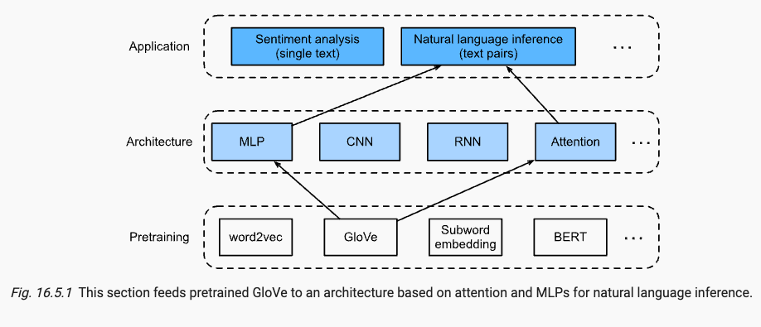
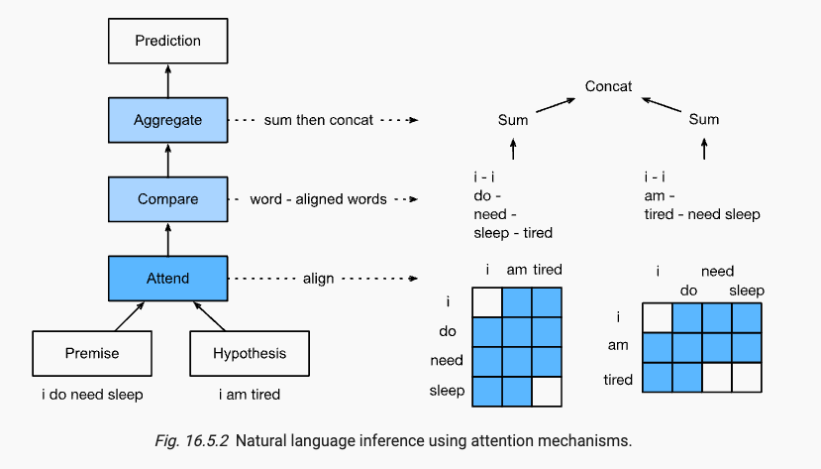
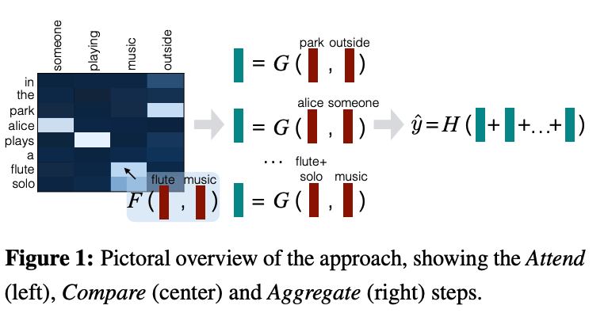
Natural Language Inference

Slide 9
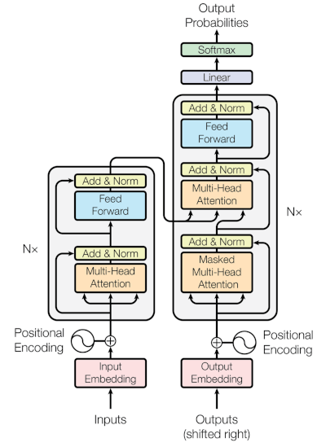
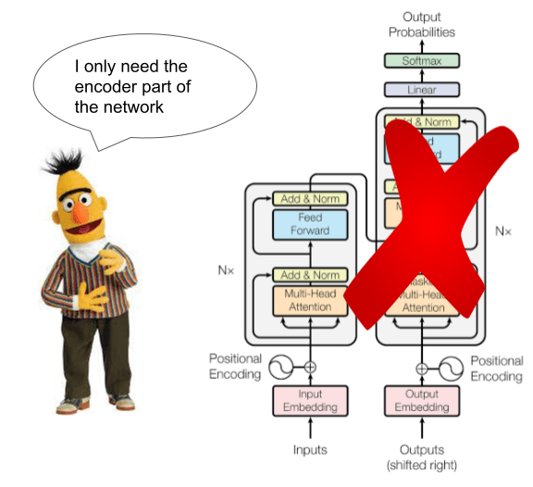
Bert Architecture
source

Slide 10
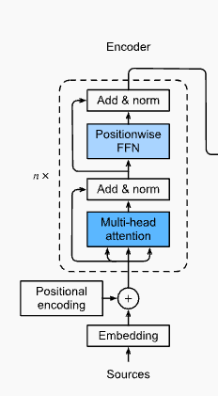
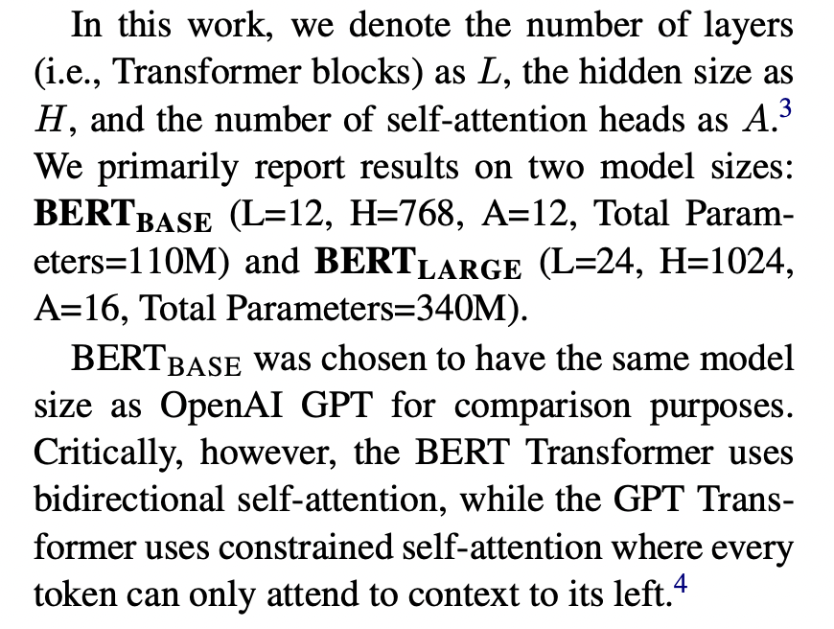
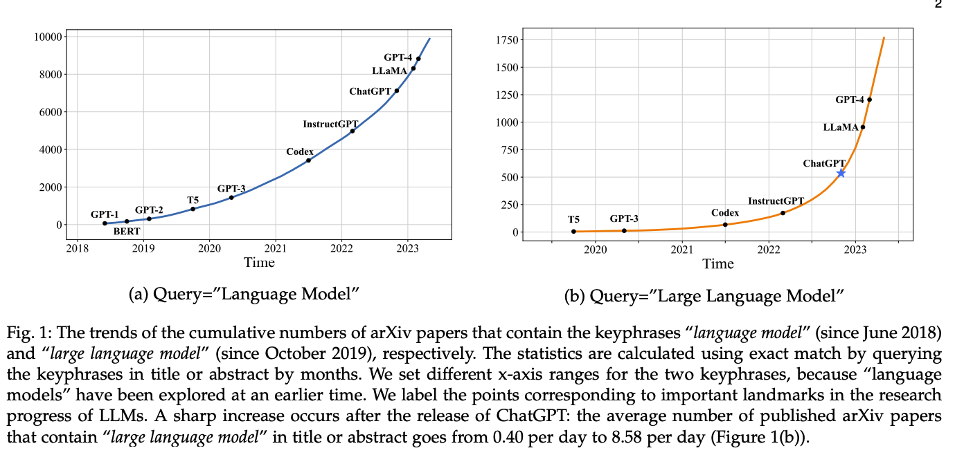
Bert architecture
(4) We note that in the literature the bidirectional Transformer is often referred to as a “Transformer encoder”
while the left-context-only version is referred to as a “Transformer decoder” since it can be used for text generation.
Zhao et al, 2023, A Survey of Large Language Models
Jacob Devlin et al, 2019, BERT: Pre-training of Deep Bidirectional Transformers for Language Understanding

Slide 11
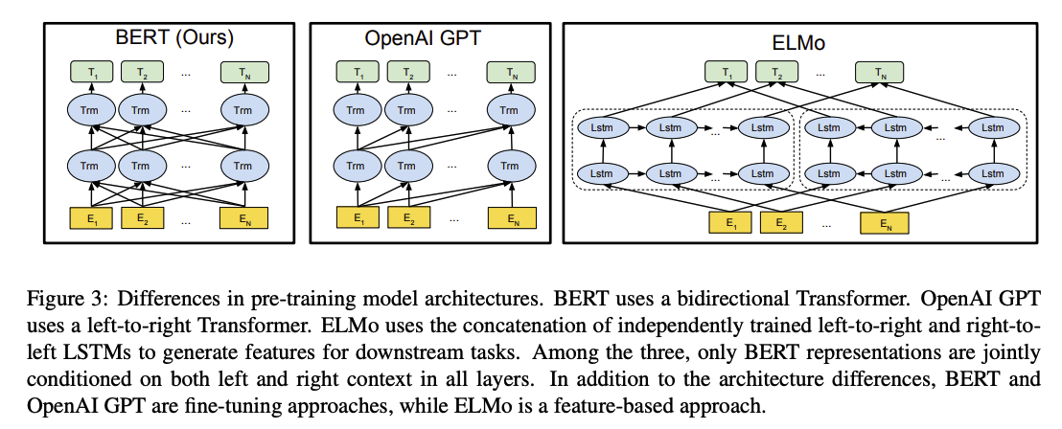
Bert Architecture

Slide 12
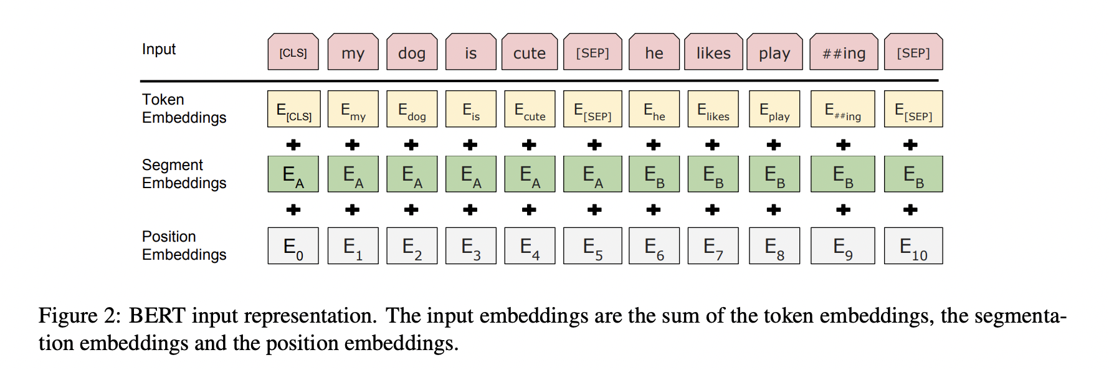
Bert embedding layer

Slide 13
Bert Pre-training
Masked Language Model (MLM)
Mask some percentage of the input tokens
Next Sentence Prediction (NSP)
Question Answering (QA)
Natural Language Inference (NLI)

Slide 14
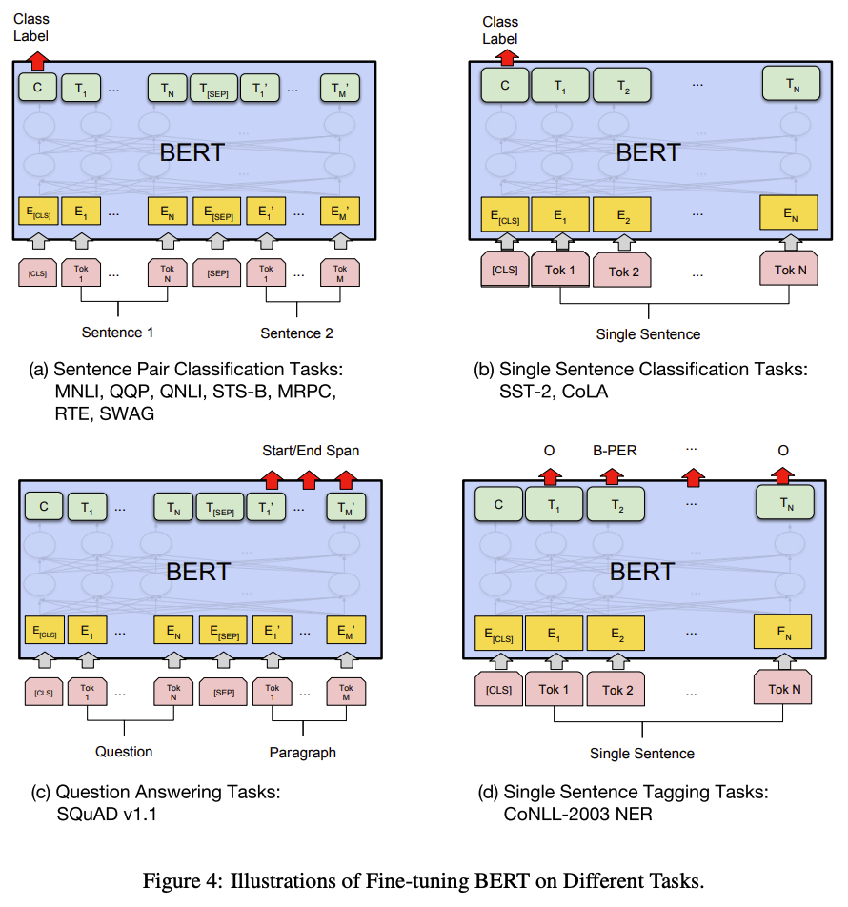
Fine Tuning Bert

Slide 15
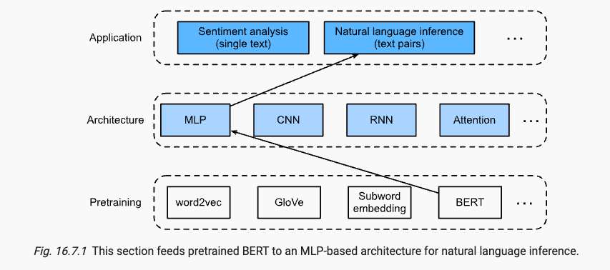
Fine tuning BERT for NLI

Slide 16
References
Blog posts
Natural Language Inference: An Overview
10 things you need to know about BERT and the Transformer Architecture That Are Reshaping the AI landscape.
Papers
NLI:
Bowman et al, 2015, A large annotated corpus for learning natural language inference
Ankur Parikh et al, 2016, A decomposable Attention Model for Natural Language Inference
Bert:
Jacob Devlin et al, 2019, BERT: Pre-training of Deep Bidirectional Transformers for Language Understanding

