Slide 1
Backtesting with cross-validation

Slide 2
Agenda
Probability of Back-test Overfitting (PBO)
Combinatorially Symmetric Cross-validation (CSCV)
Leakage-proof cross-validation
Purging
Embargoing
Purged K-Fold cross-validation
Combinatorial Purged Cross-validation (CPCV)
Proposal for the optimal market making strategy (quoting logic) using CPCV

Slide 3
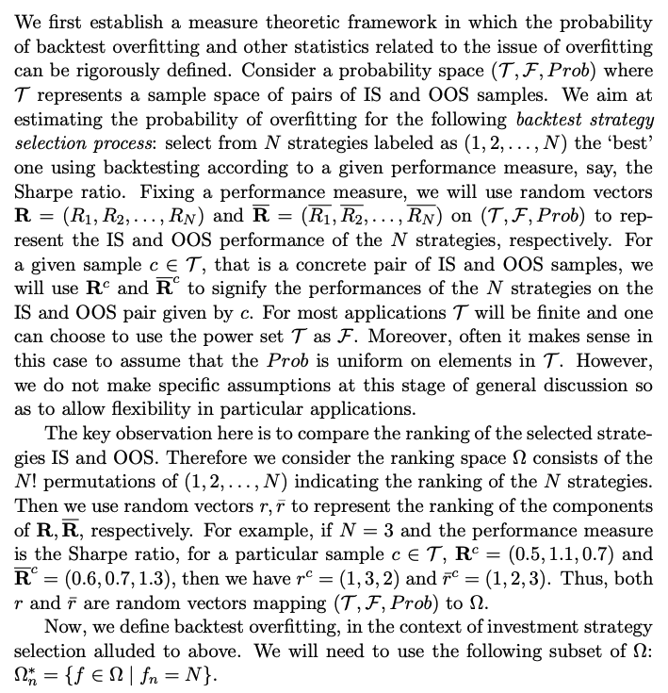
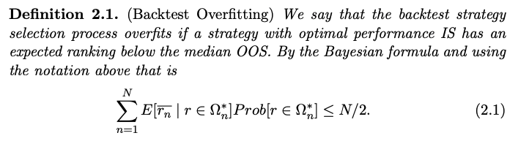
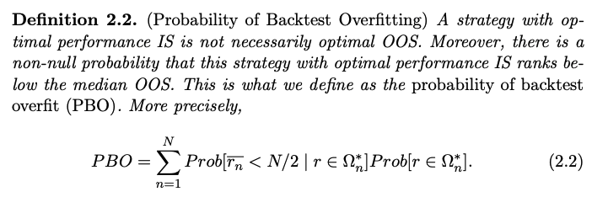
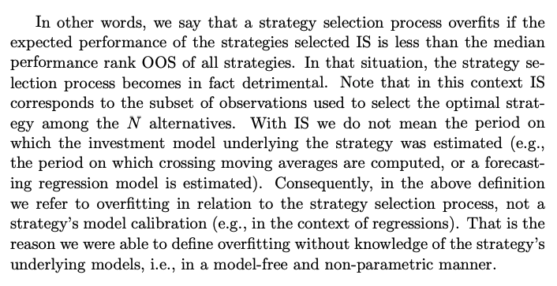
Probability of Back-test Overfitting (PBO)
Source: Bailey et al, (2015) The Probability of backtest overfitting

Slide 4
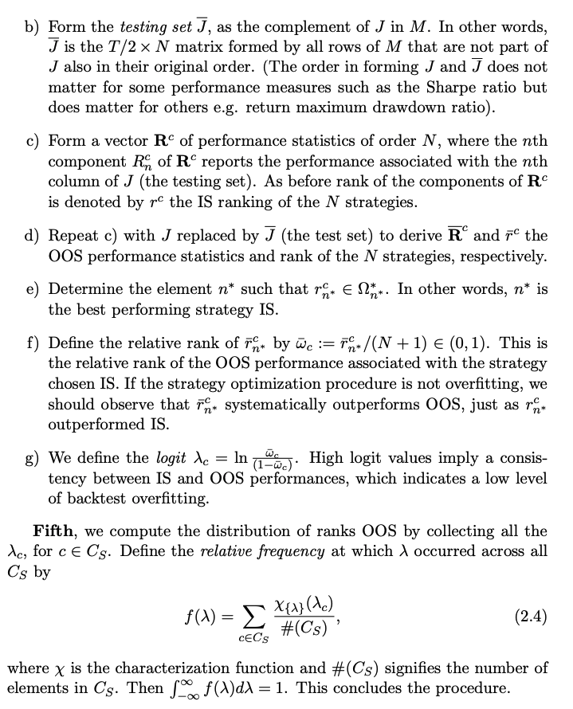
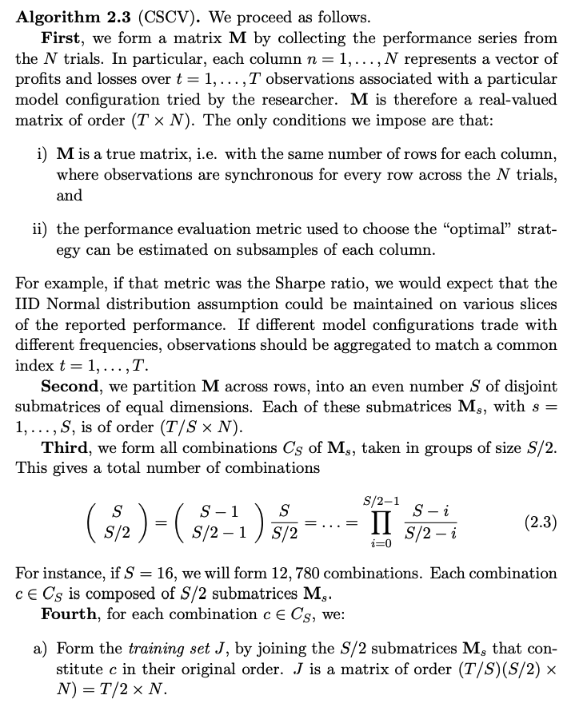
Combinatorially Symmetric Cross-validation (CSCV)

Slide 5
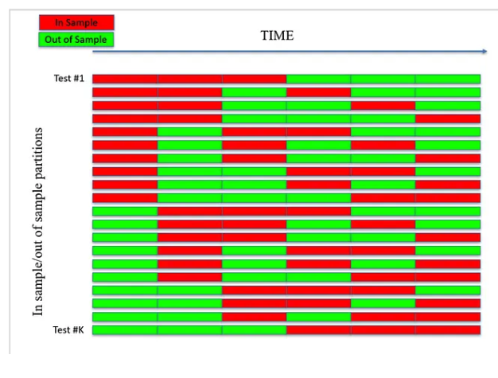
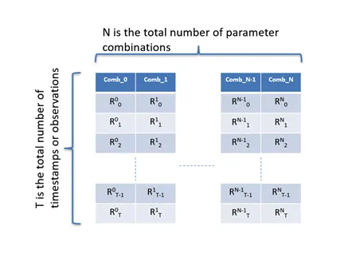
CSCV – illustration
source

Slide 6
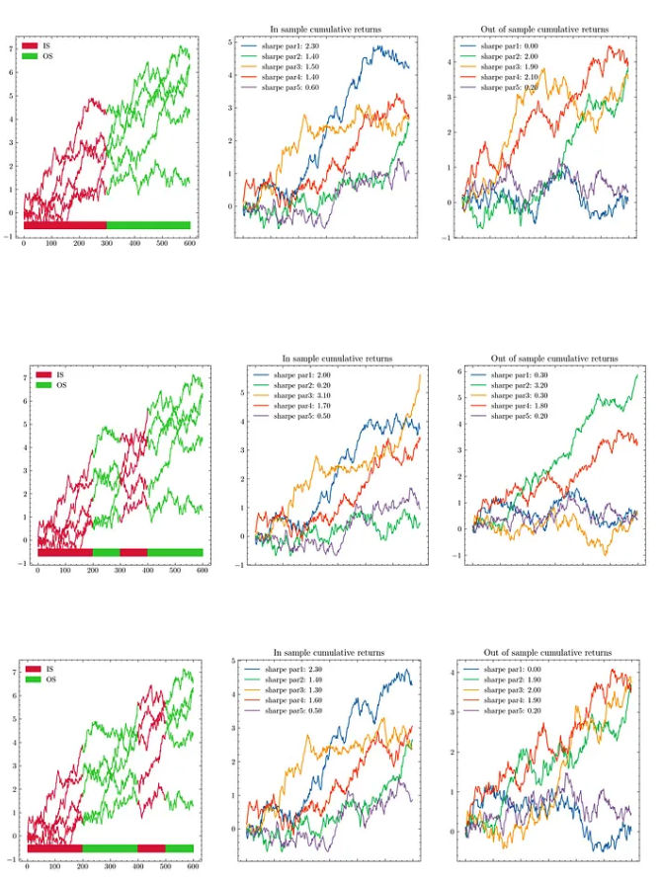
CSCV – illustration
source

Slide 7
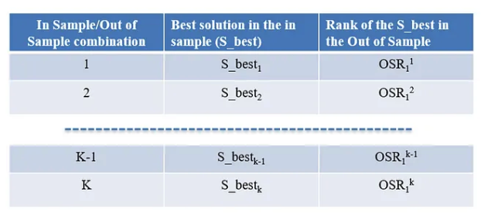
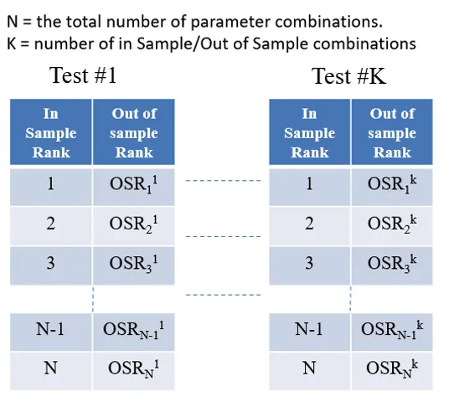
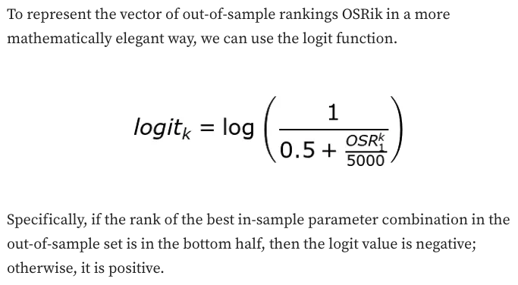
CSCV – illustration
source

Slide 8
Leakage-proof cross-validation
Purging: purge from the training set all observations whose labels overlapped in time with those labels included in the testing set
Embargoing: eliminate from the training set observations that immediately follow an observation in the testing set , because financial features often incorporate series that exhibit serial correlation

Slide 9
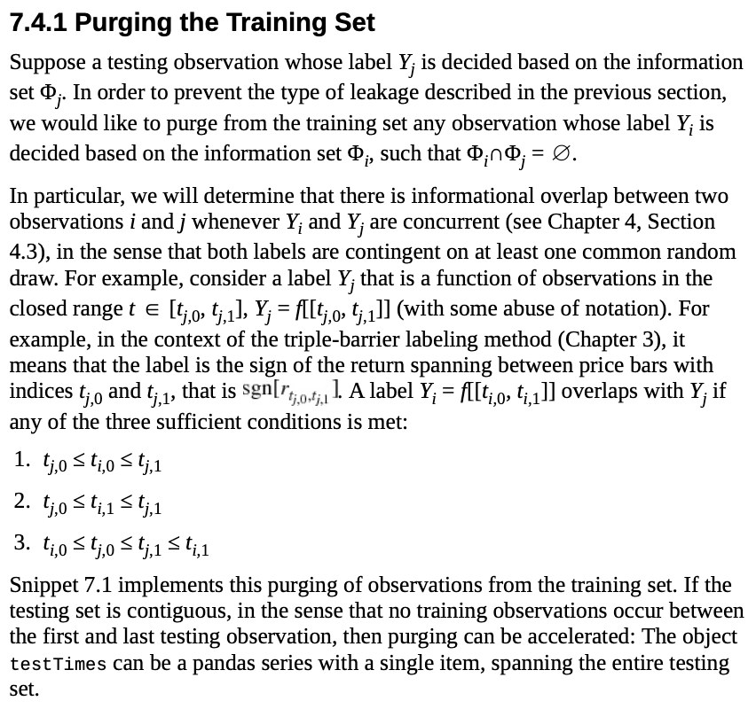
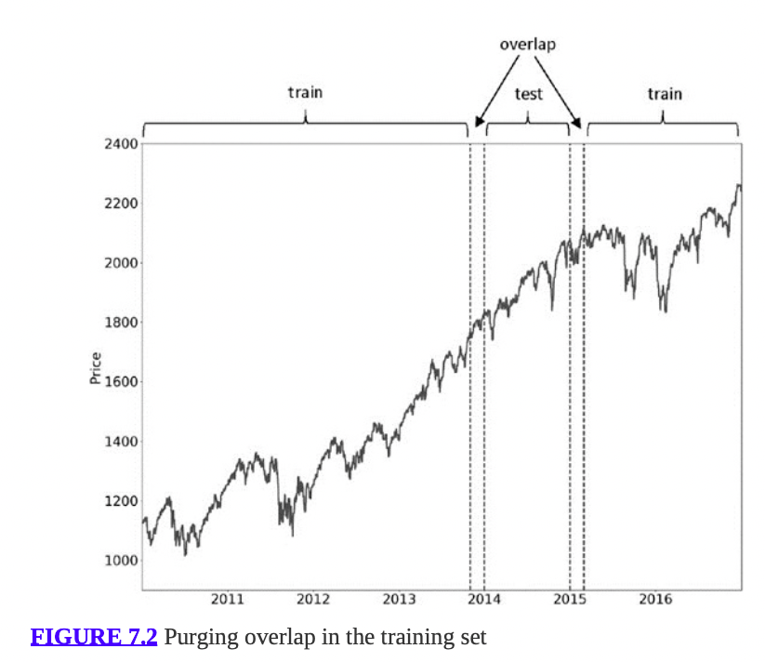
Purging

Slide 10
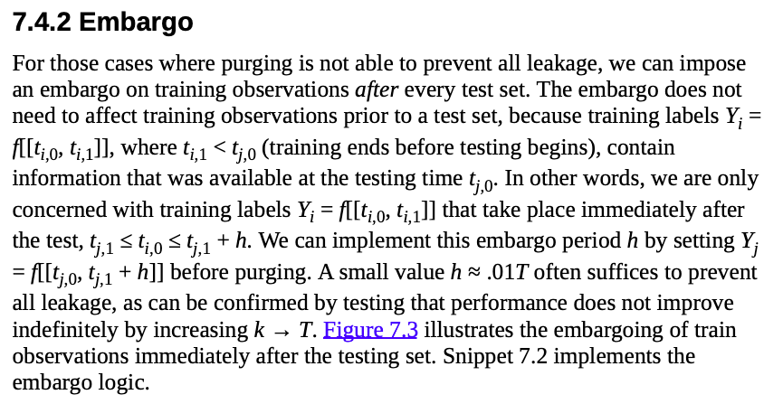
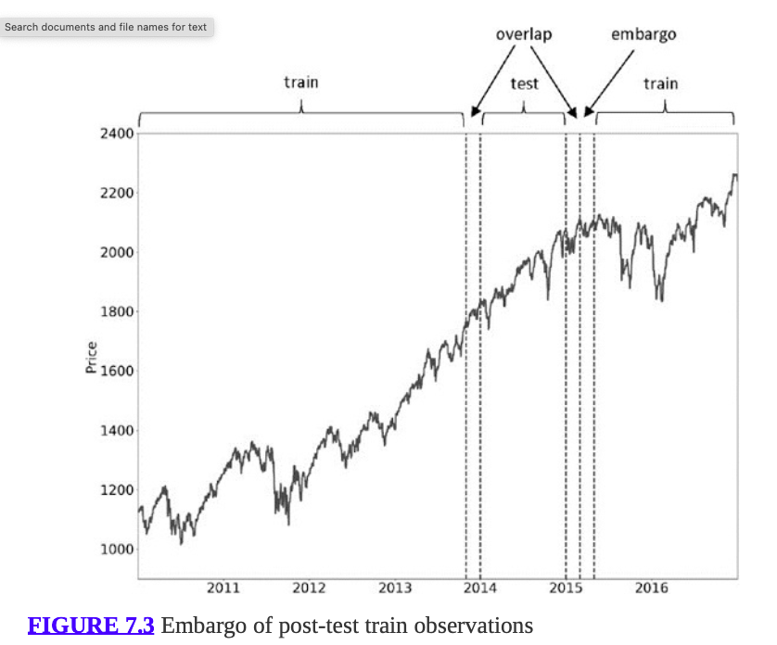
Embargoing

Slide 11
Combinatorial Purged Cross-validation
This is CSCV + Purging + Embargoing

Slide 12
Proposal for the optimal market making strategy (quoting logic) identification using CPCV
Suppose we have one full year of RFQs
Use the first six months (*) to identify the features and hyperparameters of
XC model
Edge model
Generate a space of market making strategies
All possible combinations of the key parameters (levels of aggressiveness , penalization of smart clients , any other constraints etc)
Use CPCV to generate (10,5) = 252 paths on the second half (*) of the year
For each path, train XC and Edge, and evaluate the different market marking strategies
Estimate the PBO
If PBO < 50%, examine the top 10 MM strategies and pick the one that makes the most intuitive sense , otherwise go back to better researching XC and Edge models
(*) alternatively, we can randomly pick 25 weeks for each of the tasks: model fitting and strategy selection

