Slide 1
PPI and CPI

Slide 2
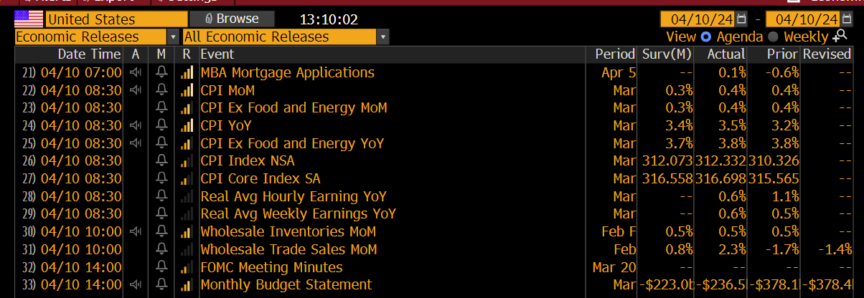
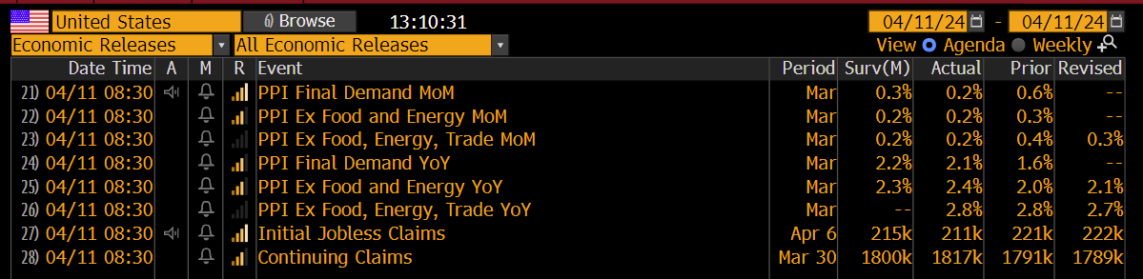

Slide 3
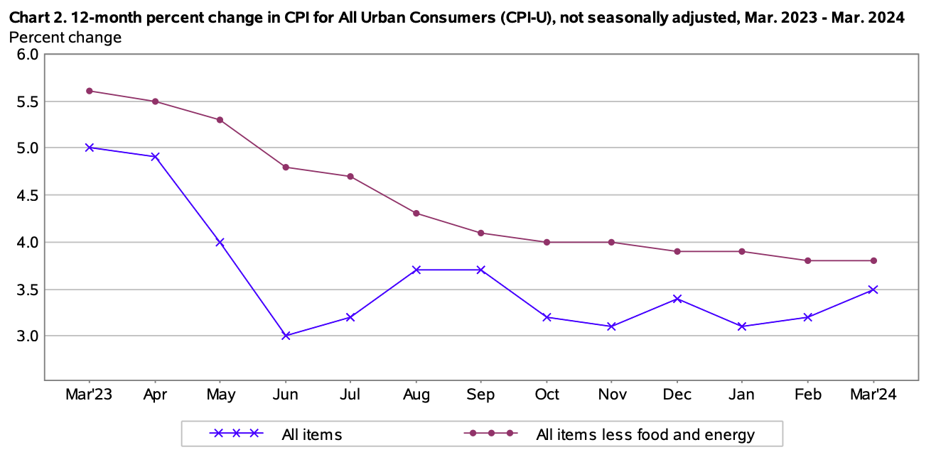
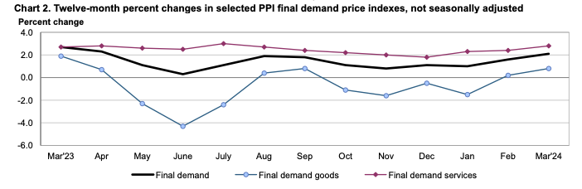
Takeaways
CPI higher than expected , indexes which increased:
Shelter
Motor vehicle insurance
Medical care
Apparel
Personal care
PPI slightly lower than expected
Robert Kaplan:
Goods are dis-inflating (somehow)
Services are sticky
CPI & PPI are conflicting
Very restrictive monetary policy offset by under-estimated impact of very stimulative fiscal policy
https://www.youtube.com/watch?v=dL9KPeVI7Bo
Can we identify the underlying inflationary pressures behind CPI ?
I found this video very intriguing so I will try to reproduce some of the claims:
https://www.youtube.com/watch?v=h9clL36dnPU

Slide 4
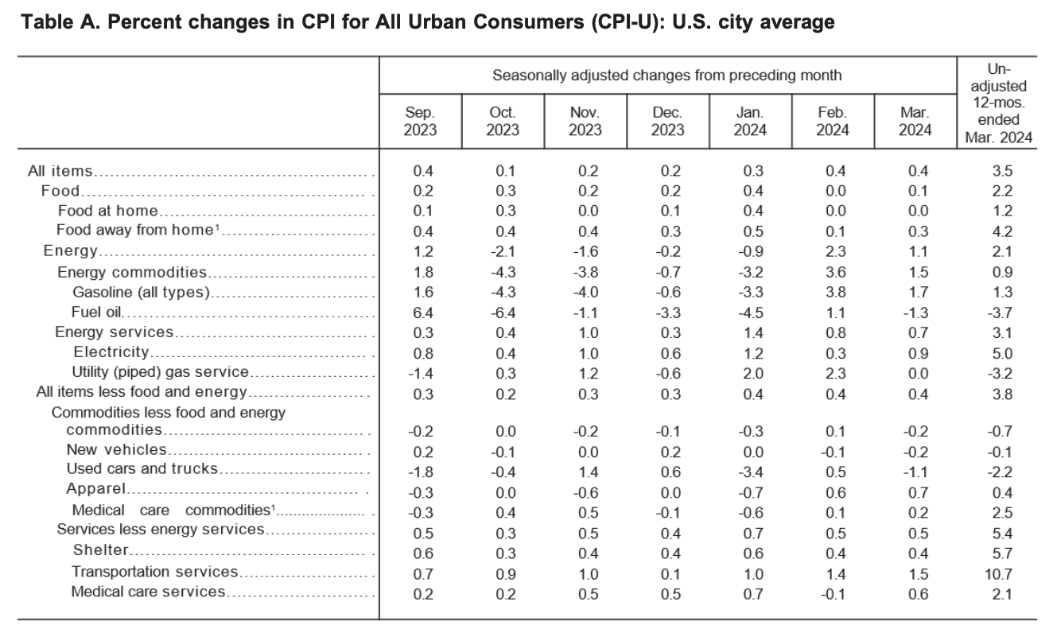
Root causes of higher than expected CPI

Slide 5
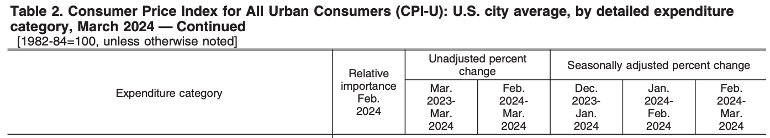
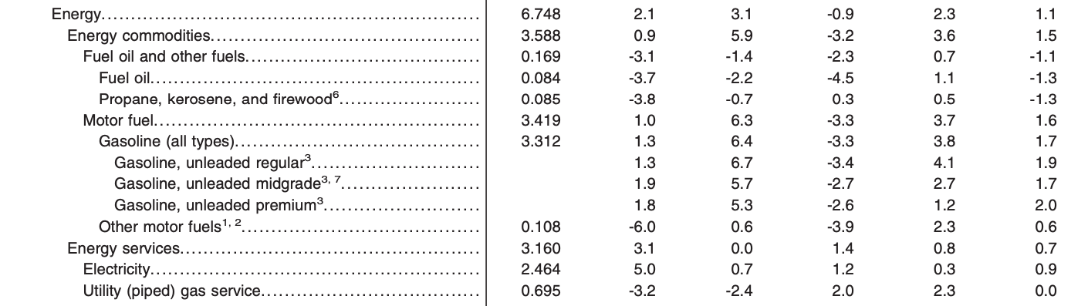
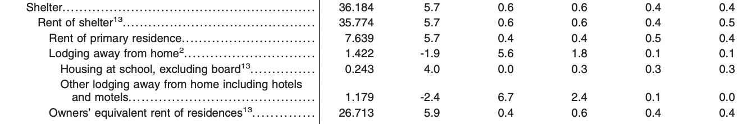
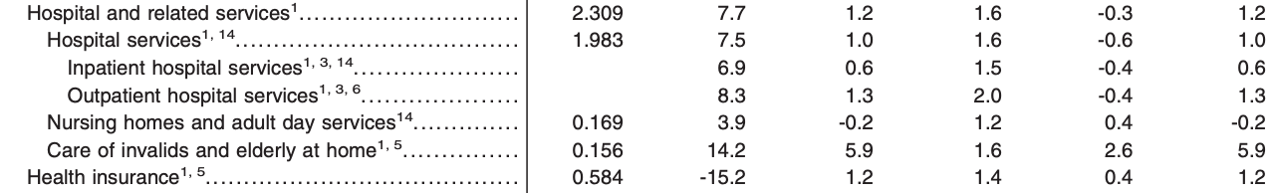

Slide 6
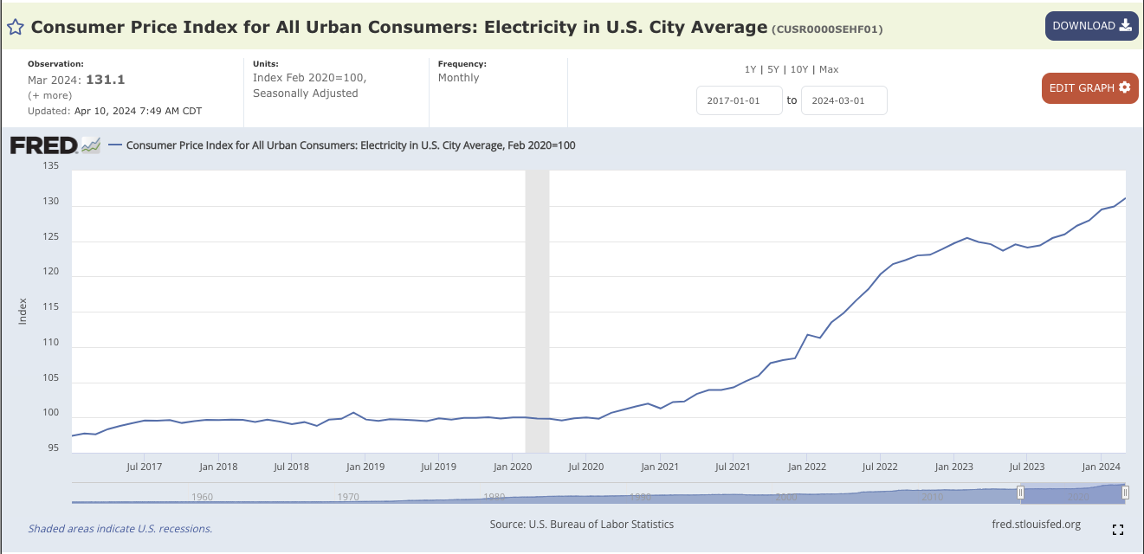
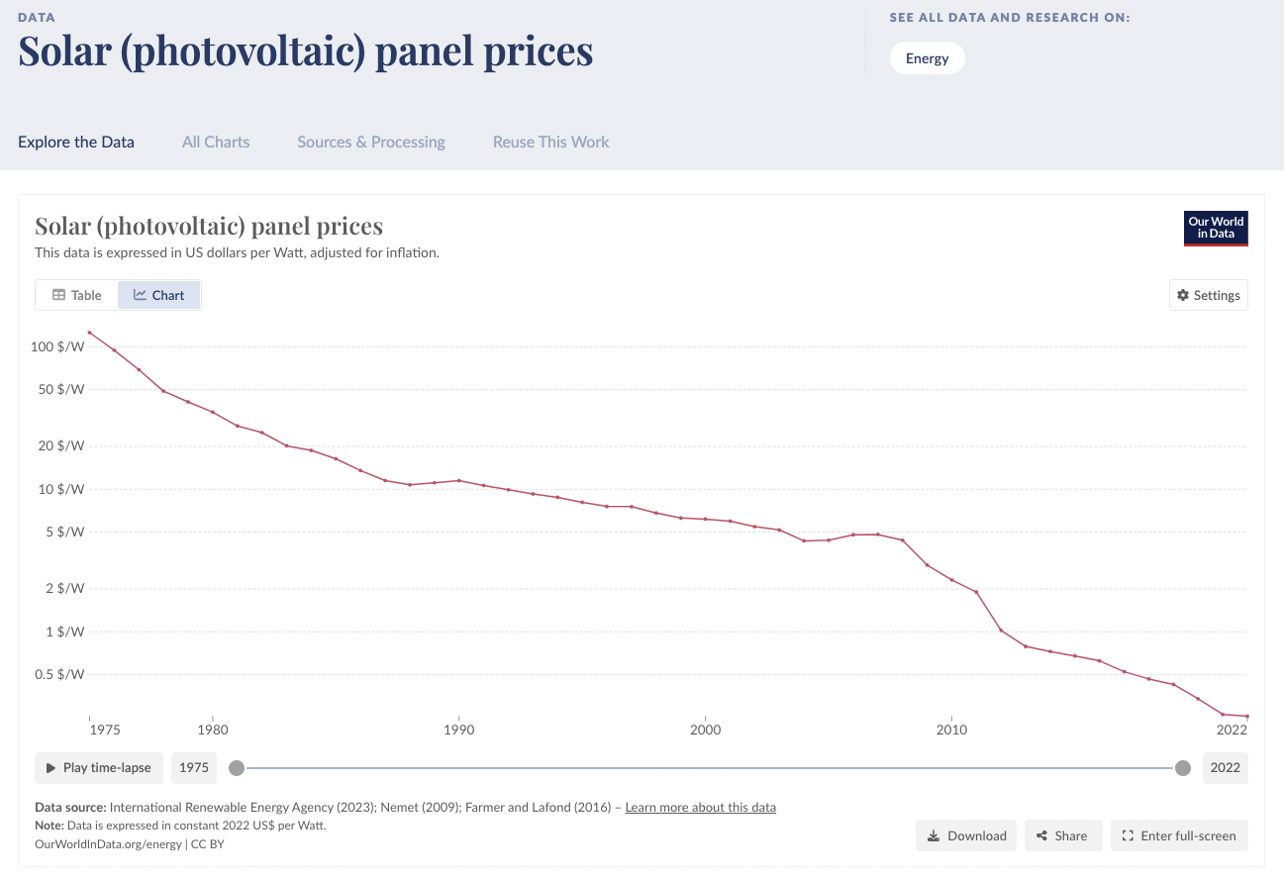
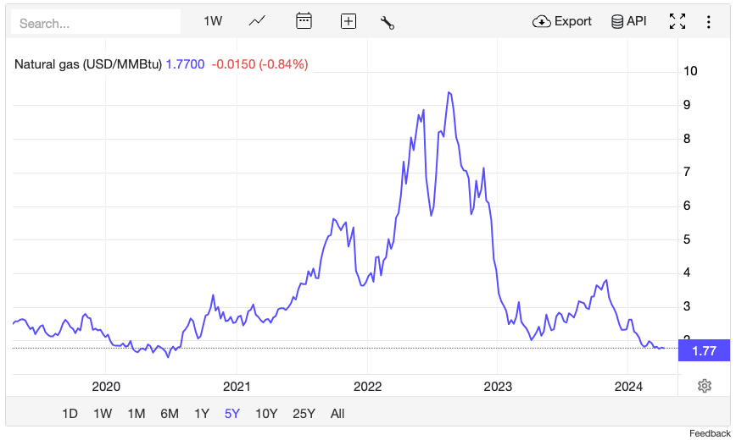
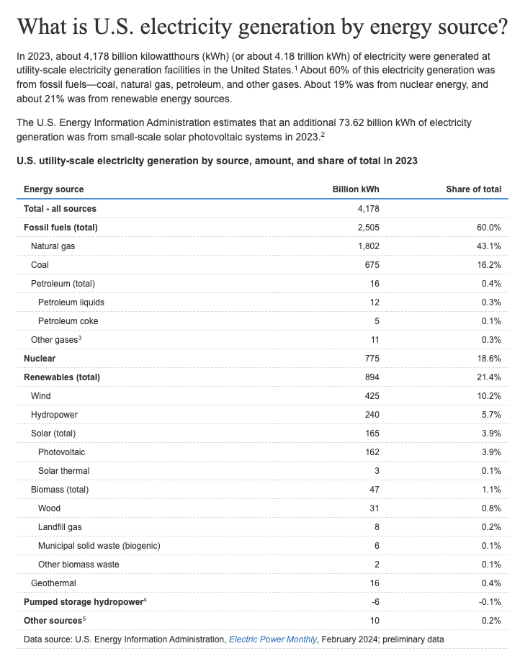
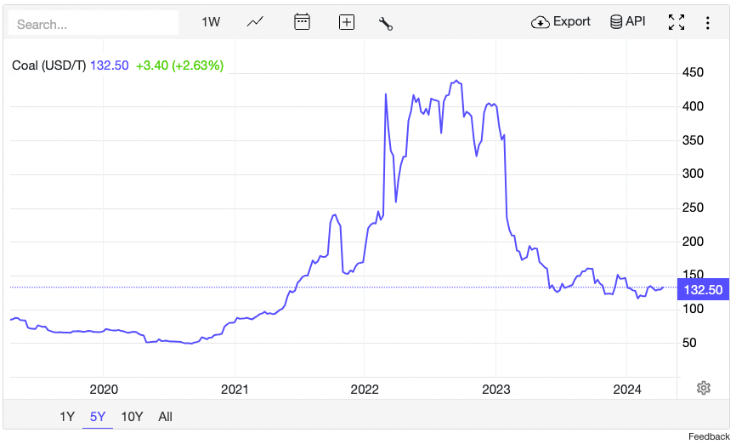
Why Electricity index is high ?
source
source
source
So it appears that electricity price high not because of higher cost of production but because of stickiness of price levels.
Once electricity prices got raised, it takes them longer time to go down.
Or maybe they need a fiscal intervention !
source

Slide 7
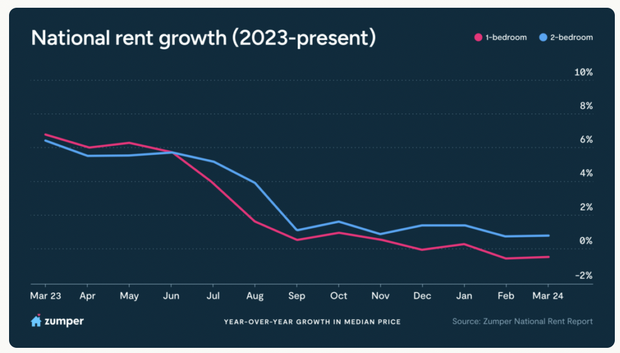
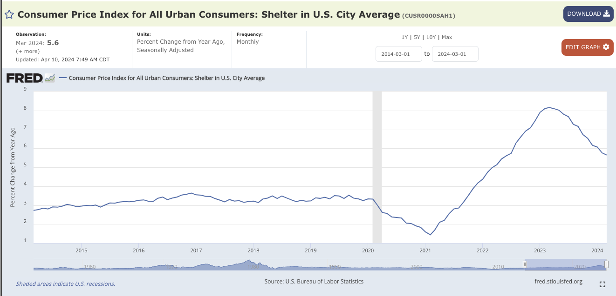
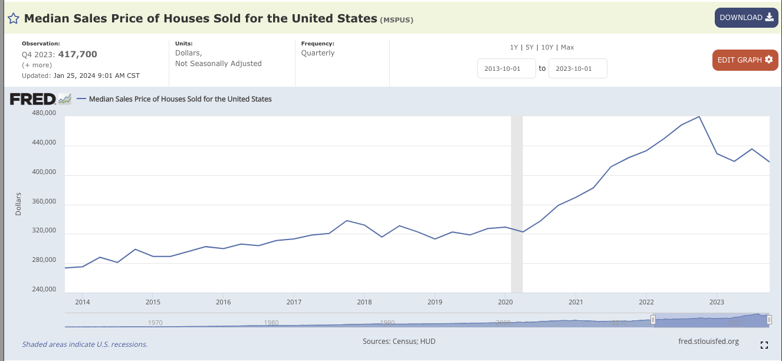
Shelter
Source
source
The are probably kept high because the distribution of houses being sold is skewed toward more expensive properties.
A potential explanation is that people living in cheaper houses cannot afford selling and buying another house because of high interest rates.
source

Slide 8
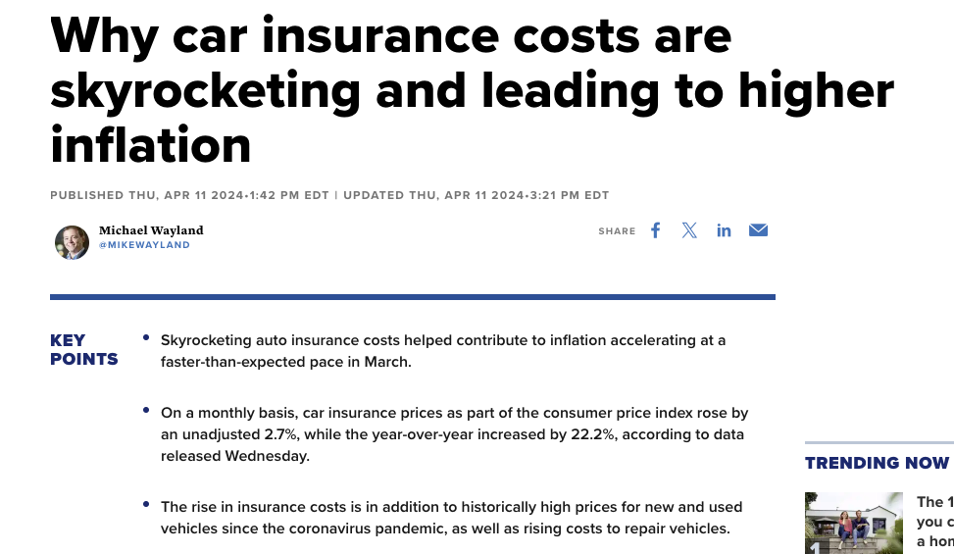
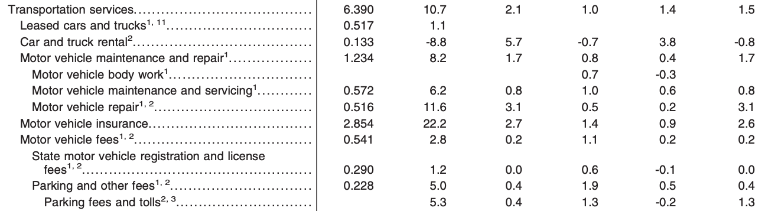
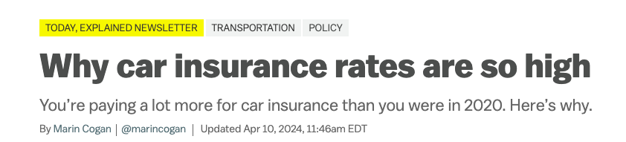
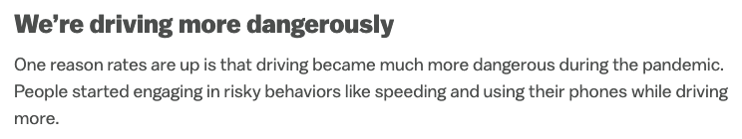
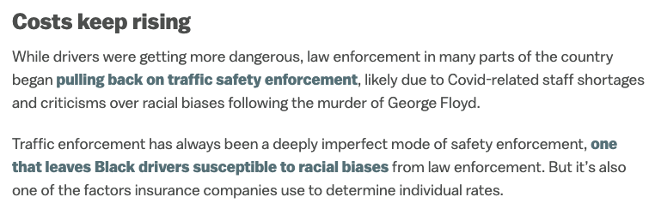
source
source

Slide 9
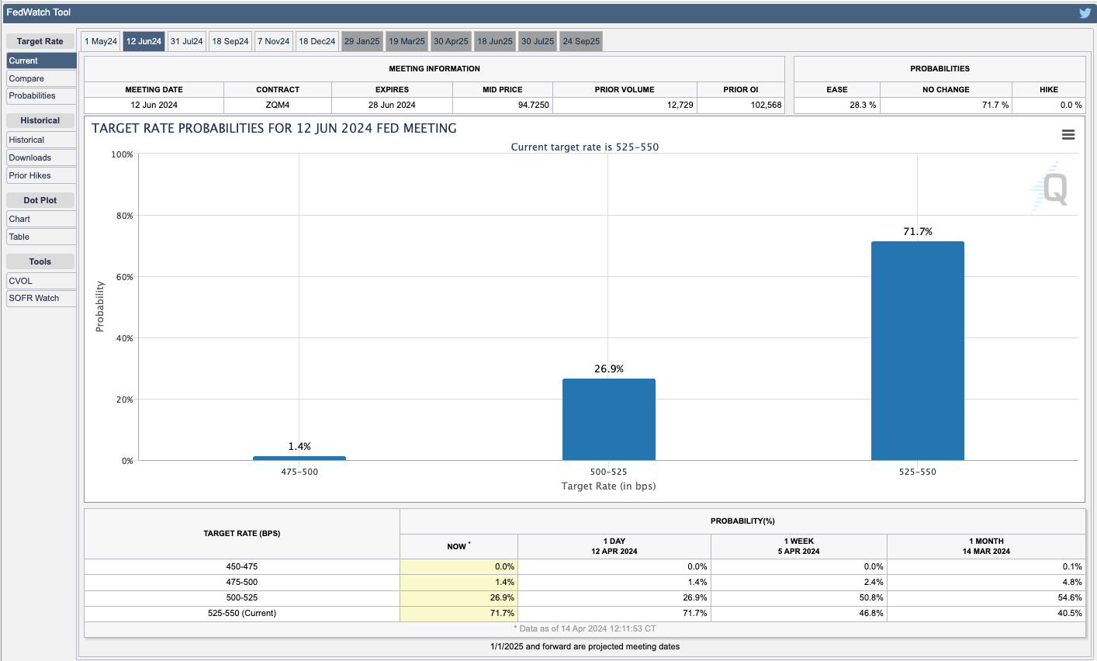
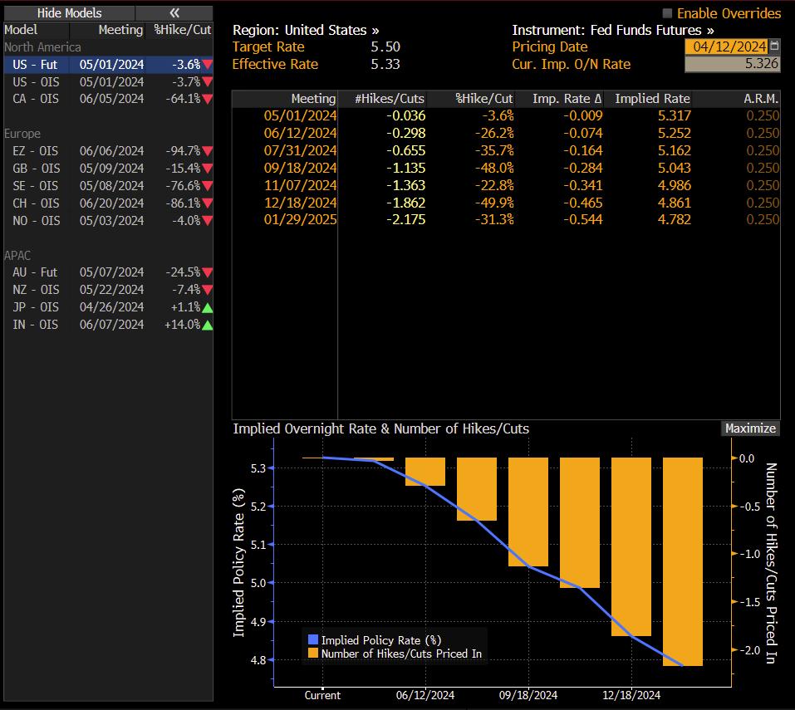
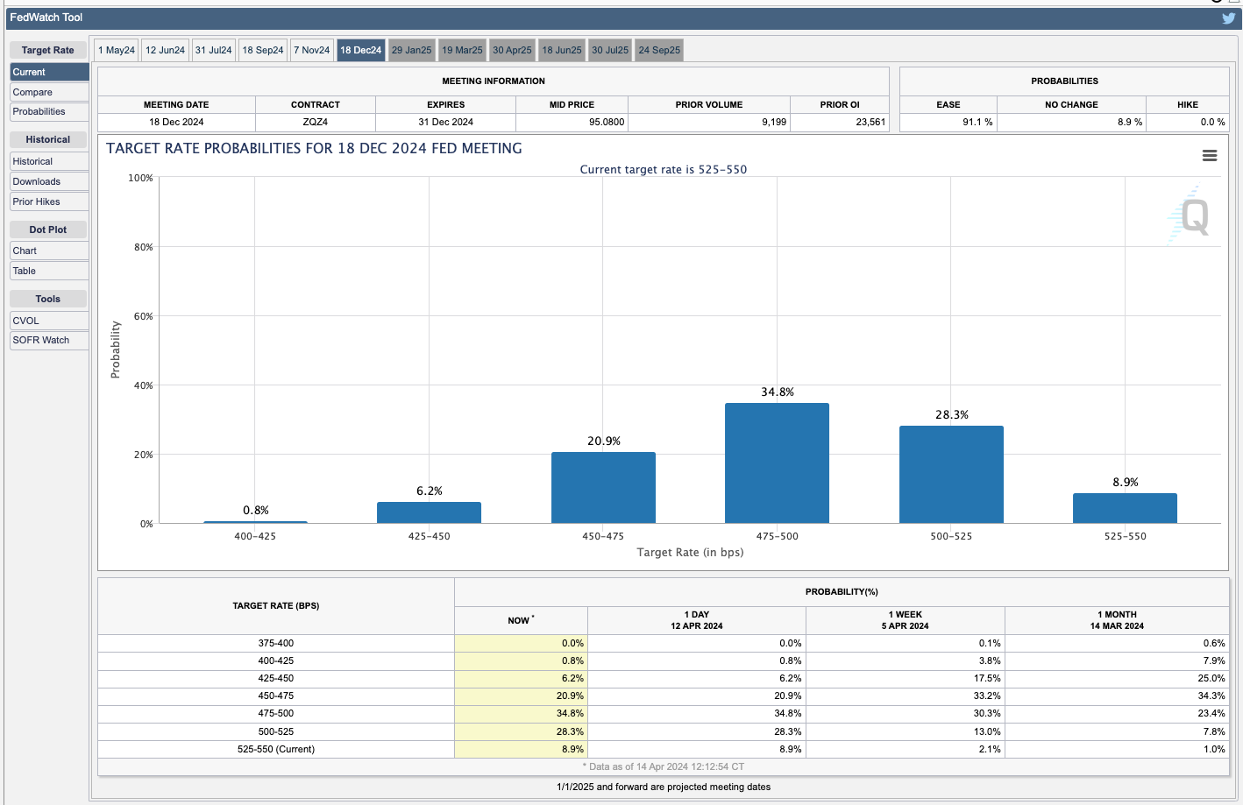
Policy implications

Slide 10
What the celebrities thought ?
Lawrence Summers
On current facts, a June cut is dangerous and egregious
It will be another policy mistake similar to summer 2021 (transitory inflation story)
A serious possibility that the next rate move will be a rate hike
https://www.youtube.com/watch?v=LXDNZuYUn-o
Mohamed El-Erian
No June cut
Still go with two cuts in 2024
Otherwise , growth will be sacrificed
A rate hike will be a huge mistake
Shift from 2% to 3% inflation target on the short/medium term, and then target 2% long term
https://www.youtube.com/watch?v=oboOSd0NTBk

Slide 11
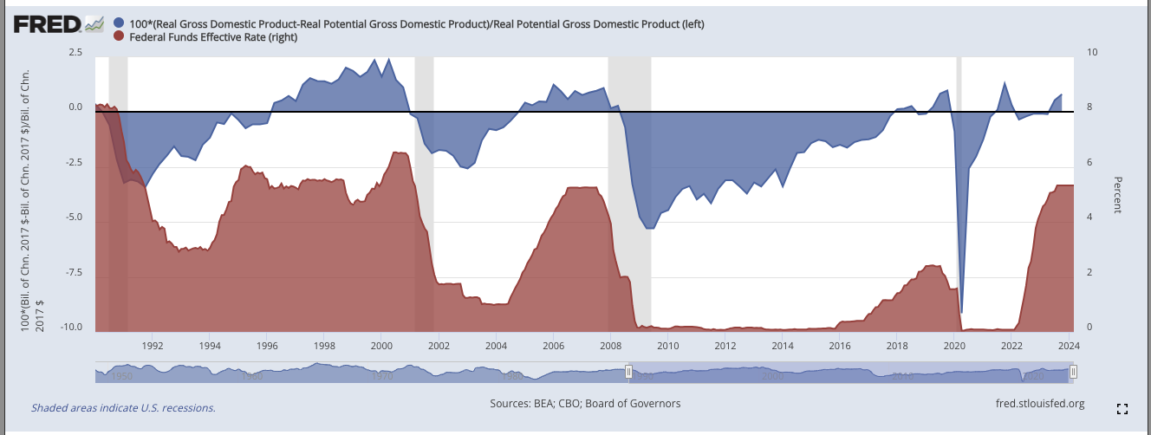
Where are we in the cycle ?
Recovery
Boom
Slow down
Stagnation
Source: https://fred.stlouisfed.org/graph/?g=f1cZ

