Slide 1
Hyperparameter Optimization (HPO)

Slide 2
Agenda
What is Hyperparameter Optimization
HPO formulation
Search technique
Bayesian optimization
HPO API
Asynchronous random search
Multi-fidelity HPO
Synchronous successive halving
Asynchronous successive halving

Slide 3
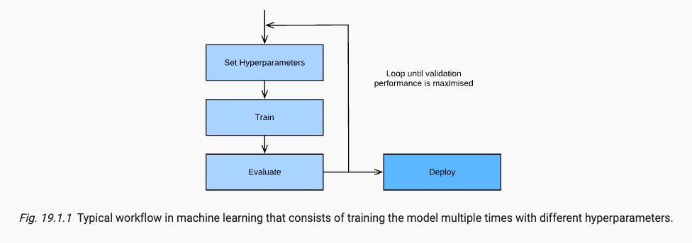
What is hyperparameter optimization
Hyperparameters:
Need to be configured by the user
Not part of the loss function optimization
Function:
Ensure SGD converges to a local optimum: learning rate, batch size
Avoid overfitting: regularization parameters such as weight decay, dropout
Capacity/inductive bias: number of layers and number of units or filters per layer
Hyperparameters optimization (HPO)
Tackles this problem in principled and automated fashion
Framing as a global optimization problem
Objective: error on hold-out validation dataset
Can be combined with or constrained by secondary objective such as training time, inference time, or model complexity
HPO extended to Neural Architecture search (NAS), subfields of AutoML

Slide 4
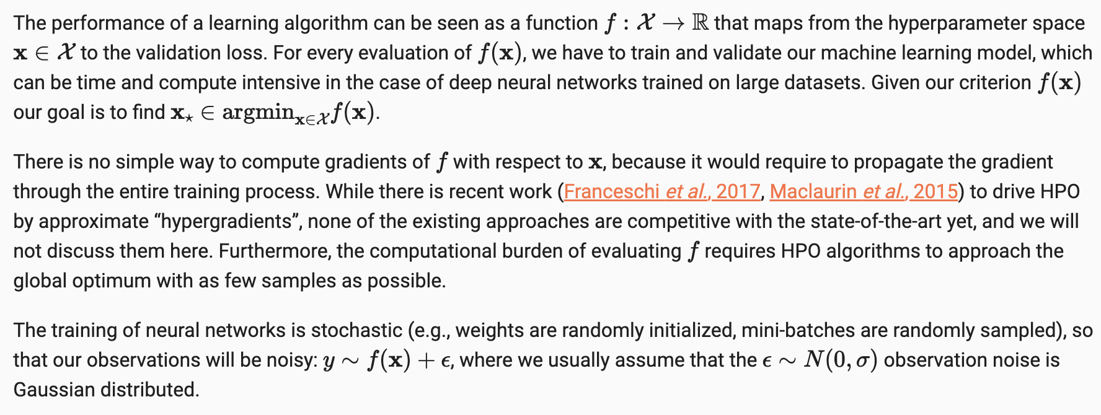
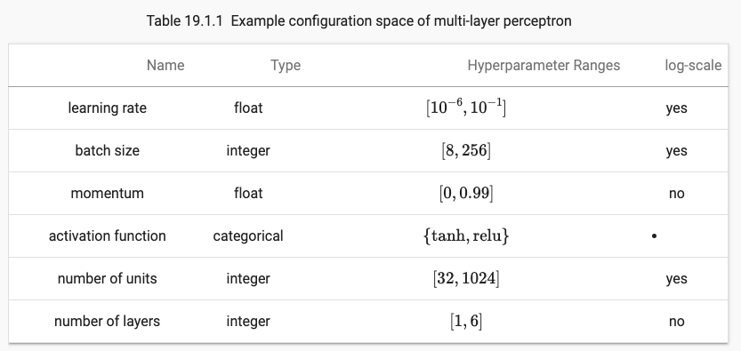
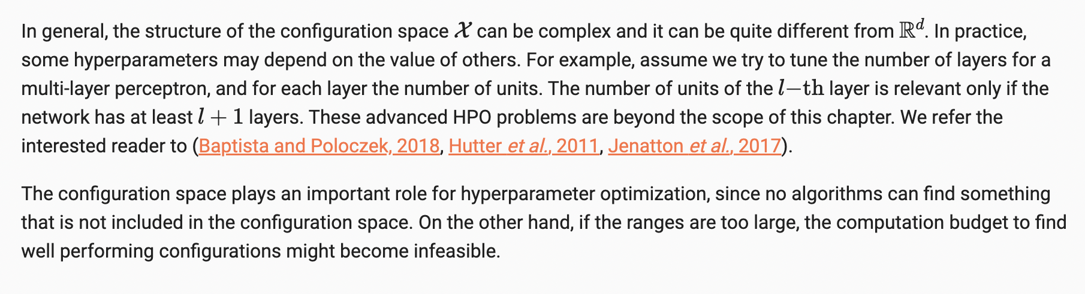
The optimization problem
Objective Function
Configuration (search) Space

Slide 5
Search techniques
Grid search
The hyperparameters space is predefined, and a set of hypermeter values are specified for each hyperparameter
The search algorithm exhaustively evaluates all possible combinations
Can be computationally expensive
May not be efficient in cases where certain hyperparameters are more influential than others
Random Search
Independently sample from the configuration space until a predefined budget (e.g. maximum number of iterations ) is exhausted, and to return the best observed configuration
All evaluations can be executed independently in parallel
In d2l: a sequential loop is used for simplicity
Does not adapt the sampling distribution based on the previous observations
Same amount of resources are spent for all configuration despite their performance
Bayesian optimization
More advanced and sophisticated approach
Efficiency:
Uses probabilistic model to guide the search
Exploitation vs Exploitation:
uses a surrogate model to approximate the objective function and employs an acquisition function to balance exploration and exploitation, leading to more informed decisions about which hyperparameter configurations to evaluate next.
Search Space Coverage:
Bayesian optimization intelligently explores the search space by using information from previous evaluations, leading to a more targeted and efficient search.
Sample Efficiency
Bayesian optimization is more sample-efficient compared to grid search and random search. It tends to require fewer function evaluations to find a good set of hyperparameters, especially in cases where the search space is large and complex.

Slide 6
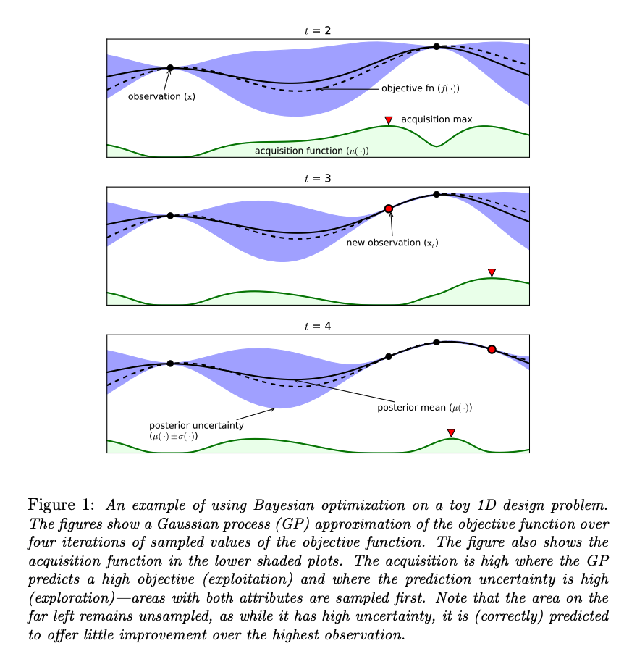
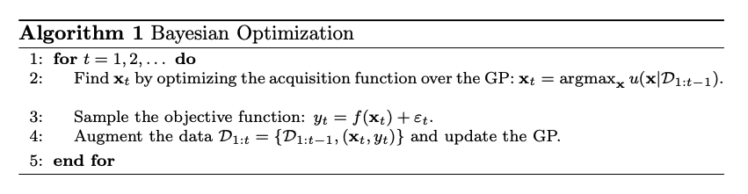
Bayesian optimization
Initialization
Random sampling of hyperparameter configurations
Surrogate Function (Probabilistic Model)
Also known as response surface
Approximates the complex expensive objective function behavior across the hyperparameter space
Surrogate models include:
Gaussian Processes
Tree-structured Parzen Estimators
Acquisition Function
The acquisition function determines the next set of hyperparameters to evaluate
Balances exploration vs exploitation
Explores region with high uncertainty to gather more information about the objective function
Exploits regions with potentially high rewards based on the surrogate model’s predictions
Common acquisition function:
Probability of improvement (PI)
Expected improvement (EI)
Upper confidence bound (UCB)
Convergence
Continue iteratively until a stopping criterion is met
Criterion can be:
Predefined maximum number of evaluations
Reaching a desired level of performance
Source

Slide 7
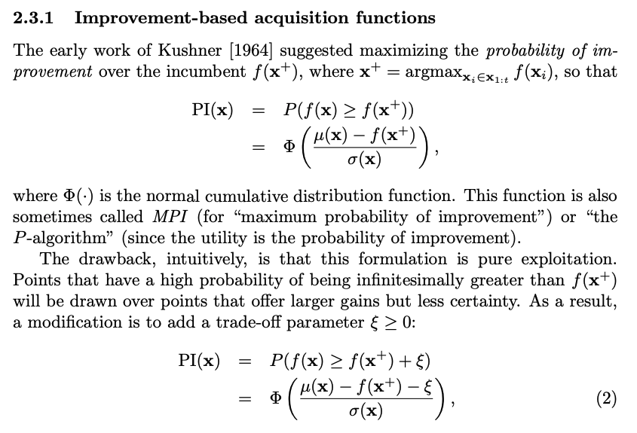
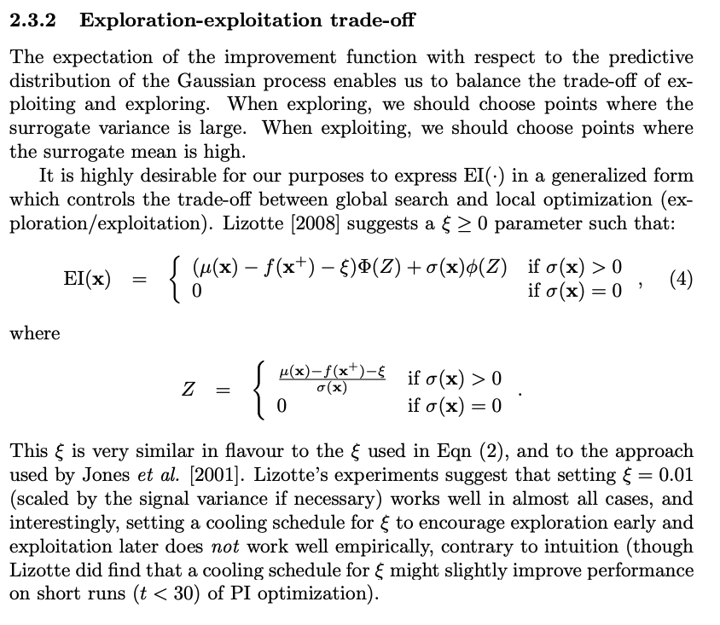
Acquisition functions
Source

Slide 8
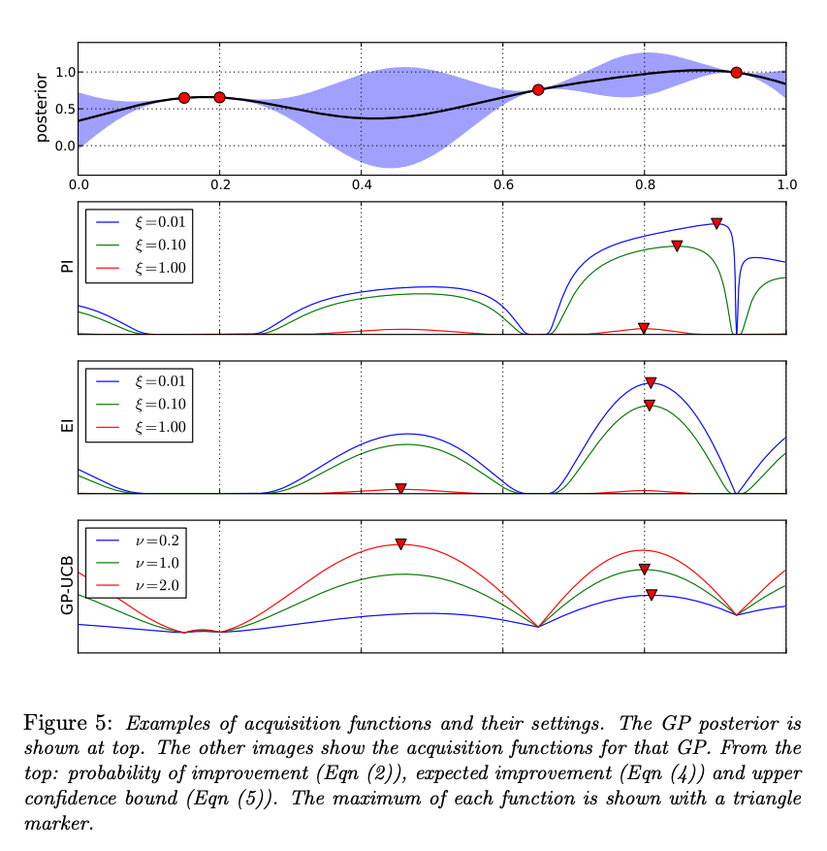
Acquisition Functions
Source

Slide 9
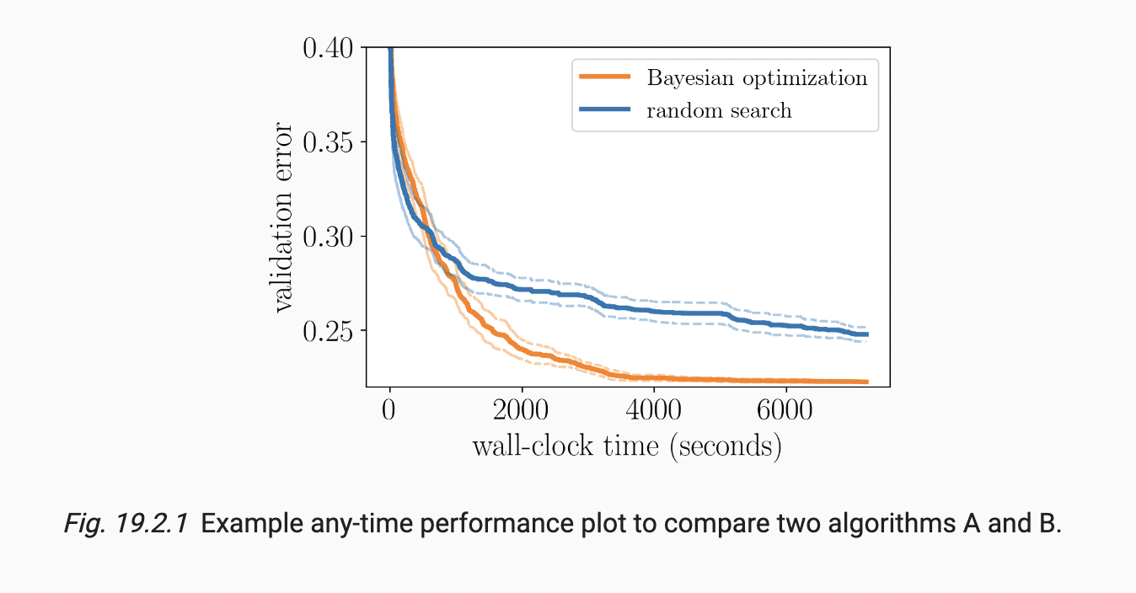
Hyperparameter Optimization API
Searcher
Provides a new candidate configuration
Scheduler
Decides when and for how long to run a trial
Tuner
A component that runs the scheduler/searcher and does some book-keeping of the results
Bookkeeping the performance of HPO algorithms

Slide 10
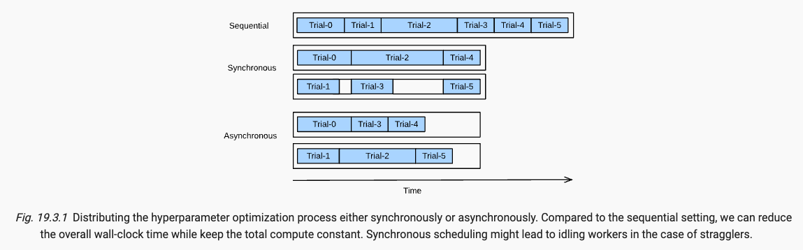
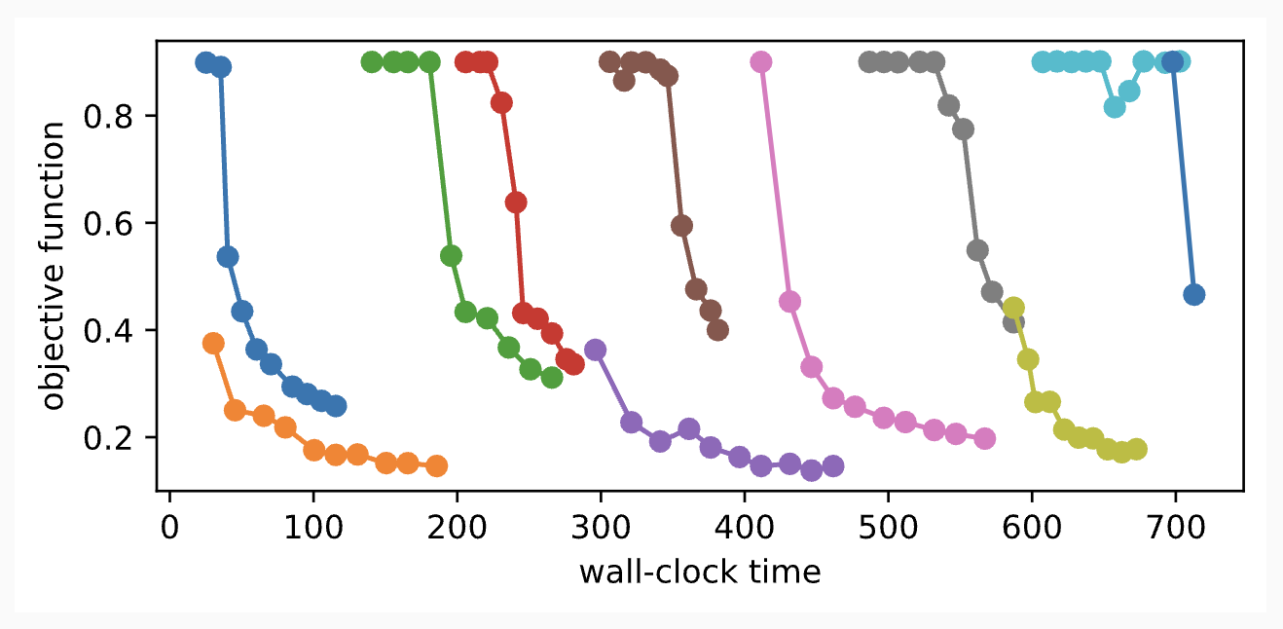
Asynchronous random search
Synchronous:
Wait for all concurrently running trials to finish before starting the next batch
Asynchronous:
Immediately schedule a new trial as soon as resources become available

Slide 11
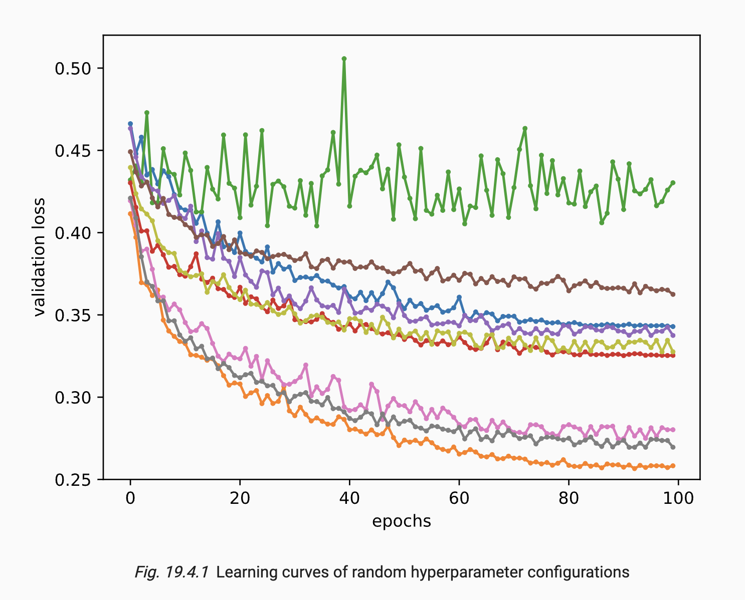
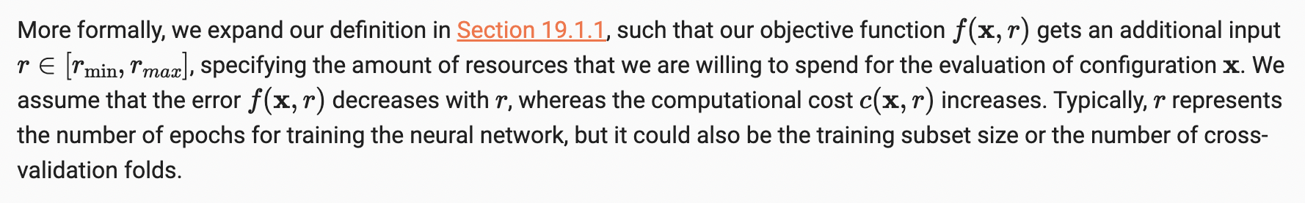
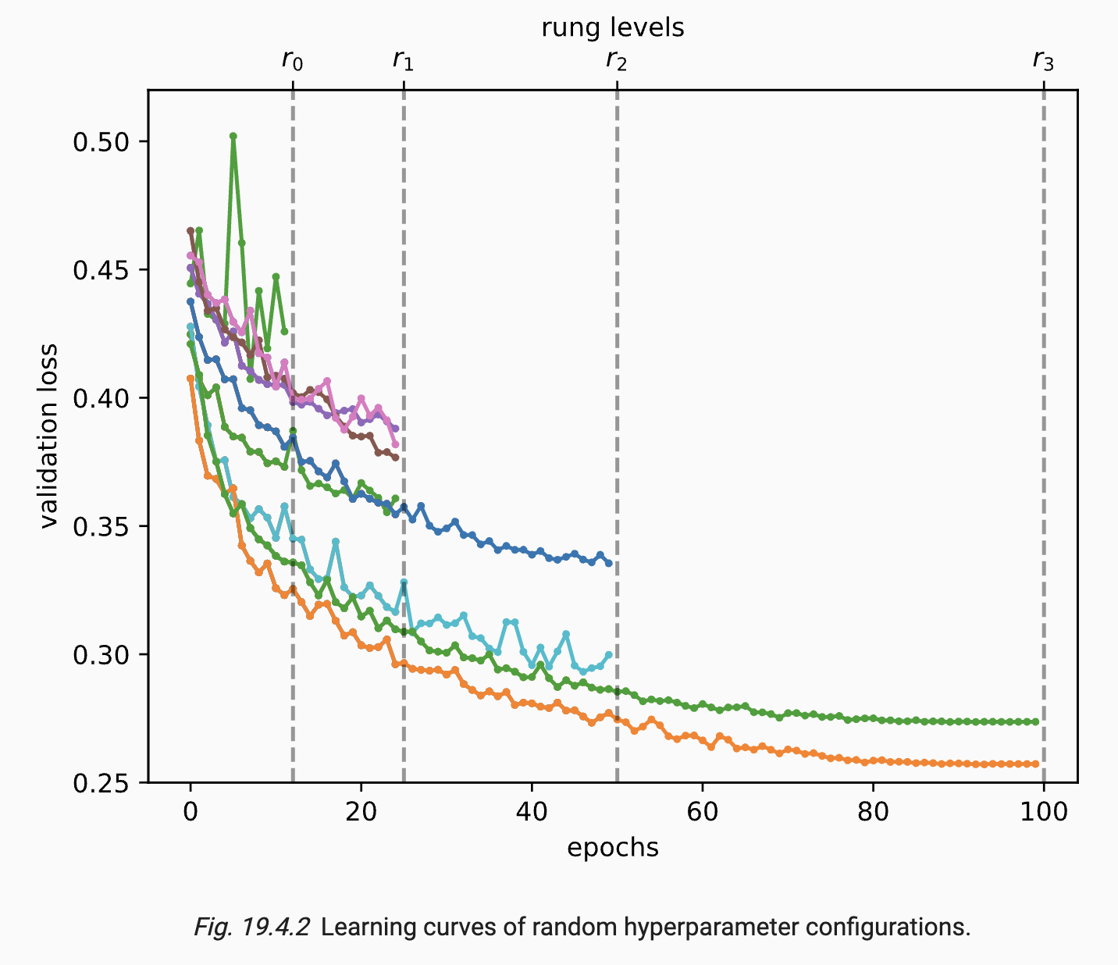
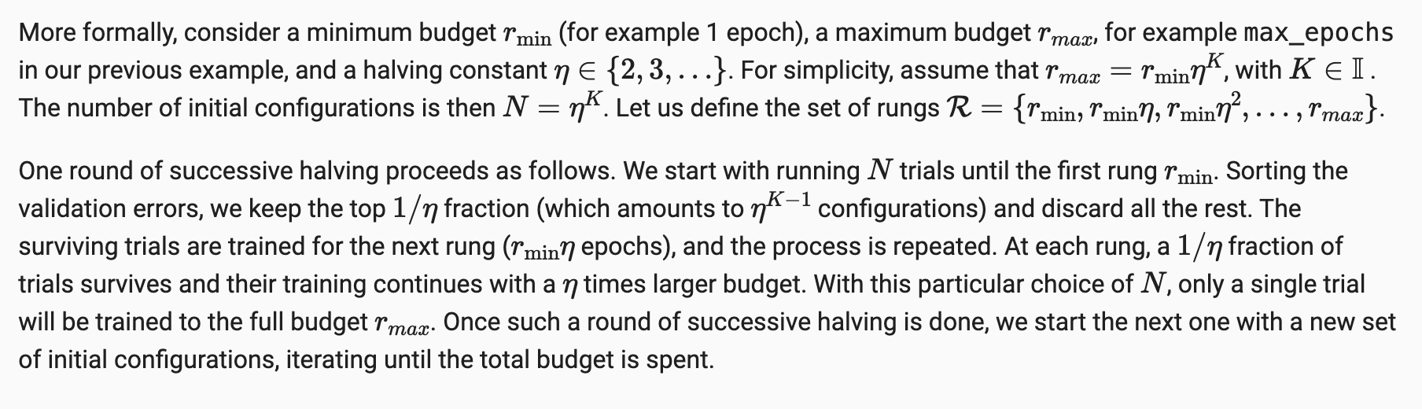
Multi-Fidelity Hyperparameter Optimization
Multi-fidelity hyperparameter optimization:
allocates more resources to promising configurations and
stop evaluations of poorly performing ones early.
This speeds up the optimization process, since we can try a larger number of configurations for the same total amount of resources.
Successive Halving
Discard a fraction of the worst performing trials after training minimum number of epochs

Slide 12
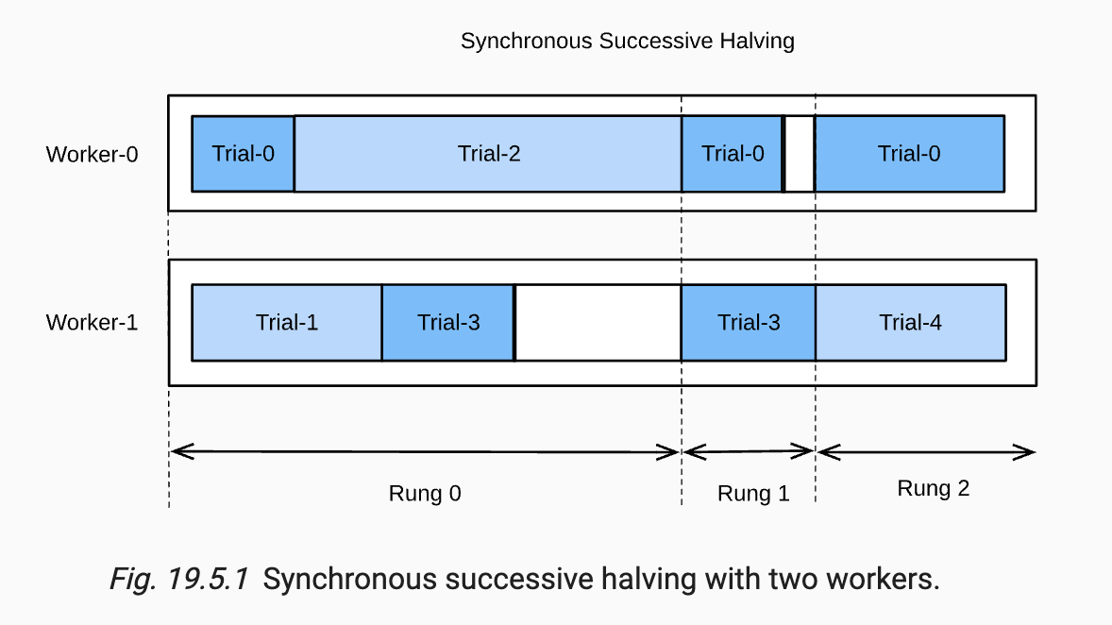
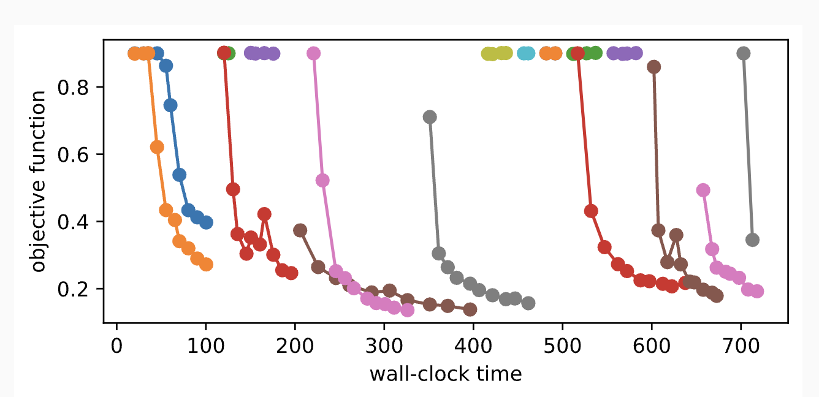
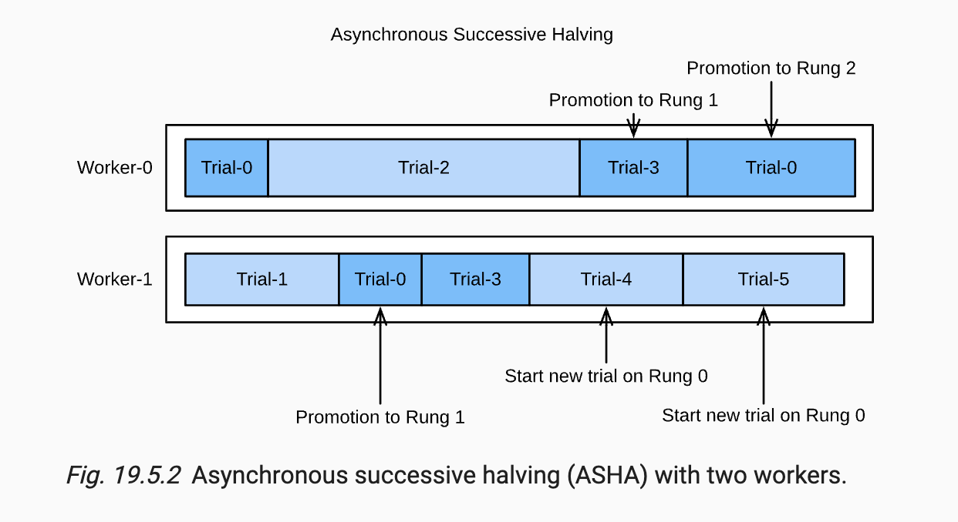
Asynchronous Successive Halving

