Slide 1
The macro minimum for quantitative research
Oualid Missaoui

Slide 2
Fixed Income Market
ECONOMY
Interest rates
Any market forces that causes the economy to grow more rapidly, or causes the inflation rate to rise, increases the likelihood that the Federal Reserve will raise interest rates and decrease prices in the fixed income markets.
Any market forces that causes economic activity to decline, or the inflation rate to drop, increases the likelihood that the federal reserve will lower interest rates and raise prices in the fixed-income markets.
Bond market
Interest rates
Bond market

Slide 3
The stock market is tied to corporate profits plus the economy, inflation, and interest rates
Economic Growth rises
Inflation declines
Interest rates decline
Corporate Profits Rise
Stock Prices Rise
Economic Growth declines
Inflation rises
Interest rates rise
Corporate profits decline
Stock Prices Decline

Slide 4
The dollar: depends on US interest rates relative to overseas rates
Demand for non dollar investments declines
US Interest rates relative to rates overseas rise
Demand for fixed income securities in the U.S. rises
Value of the dollar rises
US Interest rates relative to rates overseas decline
Value of the dollar declines
Demand for fixed income securities in the U.S. declines
Demand for non dollar investments rises

Slide 5
Inflation
Interventions
Federal reserve restraint
Wage and price controls
Price Guidelines
Causes
Oil shocks
Inflation
Inflation is the sustained increase in the general price level of goods and services in an economy over a period of time, resulting in a decrease in the purchasing power of a currency.
Drought
Labor costs
Medical care costs

Slide 6
Inflation impact
 |  | Market
 |  | Stock | Bond
Inflation | Increases: Erodes purchasing power of money. Future value of money decreases | Down: As high inflation may lead to higher interest rates, cost of capital for companies would increase making borrowing more expensive and potentially slowing down investment and expansions | Down: investors may demand higher yields to compensate for the expected loss in purchasing power. This lead to a decrease in bond prices. Also, Fed may raise interest rates to curb inflationary pressures.
 | Decreases: Increase in the real value of future money | Up: As low inflation may lead to lower interest rates this may lower the cost of capital for companies making it cheaper for them to borrow money for investments and expansion. This can be positive for stocks as it can boost corporate profitability and growth prospects. Also lower inflation can increase consumers’ purchasing power as their income can buy more goods and services. | Up: Investors may be willing to accept lower yields on bonds because the purchasing power of their future cash flow is expected to be higher. This can lead to an increase in bond prices. If inflation decreases significantly, the Fed may consider lowering interest rates to stimulate economic activity.

Slide 7
Inflation quantification
Price deflator
Implicit:
A combination of price changes and changes in the composition of GDP
Fixed-weight
Pure measure of inflation. Not tainted by changes in the composition of GDP. Basically, the Commerce Department tales all the goods that are included in the implicit deflatpr and holds the market weights constant, As a result, the fixed-weight deflator provides a measure of price changes for an extremely large basket of goods and services - over 5000 items are included. In terms of coverage, the fixed-weight deflator is clearly the ost important inflation measure that exists.
Consumer Price Index (CPI)
Is a measure of prices at the consumer level.
Producer Price Index (PPI)
Is a measure of prices at the producer level.

Slide 8
Comparison of inflation measures
 |  | Facts | Advantages | Disadvantages
PPI |  | 3,450 commodities wholesale prices | Broad-based measure | Goods only; No services
CPI |  | 365 goods and services | Includes goods as well as services. Includes some imported products | Small sample size
Deflator | Fixed-weight | 5000+ goods and services | Broadest measure of inflation | Domestic measure only. Includes no imported goods
 | Implicit | 5000+ goods and services | Captures changes in spending patterns caused by reaction to inflation. | Not a pure measure of inflation.

Slide 9
Coverage of the PPI versus the CPI
The CPI includes the prices of services and some imported goods, which are not in the PPI.
PPI includes prices of capital goods, which are not in CPI.
Imported consumer goods
Services
Domestically Produced Consumer Goods (Wholesale)
Domestically Produced Consumer Goods (Retail)
Capital Equipment
CPI
PPI

Slide 10
Release dates for Economic indicators in the US
Report | Release date | Source
Initial Unemployment claims | Weekly, every Thursday a | Department of labor
Car sales | Monthly, 1-3 business days after the end of the month | Individual auto-makers
Purchasing managers’ report | Monthly, 1st business day of following month | Institute of Supply Management
Employment | Monthly, first Friday of each month | US Bureau of labor Statistics
Producer Price Index (PPI) | Monthly, around 11th or 12th business day of the month | Bureau of labor statistics
Retail sales | Monthly, around the 12th business day | US Census Bureau, department of commerce
Industrial Production/ Capacity Utilization | Monthly, 16th, 17th business day | Federal Reserve, Board of Governors
Consumer sentiment | Monthly, 10th of each month | University of Michigan’s Survey Research Center
Housing starts/Building Permits | Monthly, around the 17th | US Census bureau and US department of housing and urban development
Consumer price index (CPI) | Monthly, 10th to 15th for each month | Bureau of Labors Statistics , US department of labor
Durable goods orders | Monthly, around 24th of the month | US Census Bureau, department of Commerce
GDP | Preliminary: released approximately 30 days after the end of the quarter Advanced: about a month after the preliminary estimate (more accurate) Final: two months after the advance estimate (most accurate) | Bureau of Economic Analysis, US department of Commerce
Personal Income/Consumption Spending (PCE) | Monthly, around the end of the month | Bureau of Economic Analysis, US department of Commerce
Leading Economic Index (LEI) | Monthly, around third week of the month | The conference board
New home sales | Monthly, around 25th of each month | US Census Bureau and US Department of housing and urban development
Construction spending | Monthly, around 1st of each month | US Census Bureau, Department of Commerce
Factory orders | Monthly, around 4th business day of each month | US Census Bureau, Department of Commerce
Business inventories/sales | Monthly, around the 15th of each month | US Census Bureau, Department of Commerce
Trade Balance | Monthly, around the 5th of each month | US Census Bureau, Department of Commerce
Nonfarm productivity / unit labor costs | Quarterly, first month following the end of a quarter | US Bureau of labor statistics

Slide 11
Classification
Leading | Coincident | Lagging
1. Initial Unemployment Claims: A rise in initial claims may suggest a weakening labor market and potential economic downturn. 2. Purchasing Managers’ Report (PMI): An increase in the PMI can signal economic expansion. 3. Consumer sentiment: Consumer sentiment can be a leading indicator as it reflects consumer expectations about the economy. 4. Housing starts/Building Permits: An increase in housing starts and permits may signal confidence in the economy and future demand. 5. Leading Economic Index (LEI): Designed to predict future economic activity, making it a leading indicator. | 1. Employment: Employment trends generally move in tandem with the overall economy. 2. Retail sales: Reflects current consumer spending patterns. 3. Industrial Production/ Capacity Utilization: Reflects current output levels in the industrial sector. | 1. CPI (Consumer Price Index): Inflation tends to be a lagging indicator, responding to changes in economic conditions after they have occurred. 2. Durable goods orders: Can be a leading or coincident indicator but may also exhibit lagging characteristics. 3. GDP: Typically considered a lagging indicator as it measures past economic performance. 4. Personal Income/Consumption Spending: Can be coincident or lagging, depending on the context. 5. New home sales: Can be a leading indicator but may also have lagging characteristics. 6. Construction spending: Reflects current construction activity but can have lagging elements. 7. Factory orders: Reflects current demand for manufactured goods but may also be influenced by lagging factors. 8. Business inventories/sales: Inventory levels can be both coincident and lagging indicators. 9.Trade Balance: Can be a lagging indicator, reflecting past trade imbalances. 10. Nonfarm productivity/unit labor costs: These can be coincident or lagging indicators.

Slide 12
Indicator quality
Several factors determine the quality of an economic indicator:
Accuracy: The indicator should accurately reflect the economic phenomenon it aims to measure. This involves using reliable data sources and appropriate methodologies for data collection and calculation.
Relevance: The indicator should be relevant to the aspect of the economy being analyzed. It should provide meaningful insights into economic activity or trends within a specific sector or the economy as a whole.
Timeliness: Timeliness refers to how quickly the indicator is released after the period it measures. Timely indicators are crucial for policymakers, investors, and analysts to make informed decisions. High-frequency data can provide more up-to-date information but may sacrifice depth or accuracy.
Frequency: Frequency refers to how often the data is collected and reported. Higher frequency data allows for more granular analysis and can capture short-term fluctuations in economic activity. However, higher frequency data may also be more volatile and subject to revisions.
Volatility: Volatility measures the degree of variation or fluctuation in the indicator over time. While some volatility is expected in economic indicators due to the dynamic nature of the economy, excessive volatility can make it difficult to interpret the underlying trends or patterns accurately.
Lead/Lag: Lead/lag refers to whether the indicator precedes, coincides with, or lags behind changes in the economy. Leading indicators provide insights into future economic trends and are valuable for forecasting. Coincident indicators move in tandem with overall economic activity and provide a real-time snapshot of the economy. Lagging indicators confirm trends that have already occurred and are useful for assessing the timing and magnitude of economic shifts.
Consistency: Consistency refers to the stability and reliability of the indicator's behavior over time. Consistent indicators are easier to interpret and incorporate into economic models or analyses.
Accessibility: The indicator should be readily available and accessible to policymakers, analysts, and the general public. Accessibility ensures transparency and facilitates widespread use and understanding of the indicator's implications.

Slide 13
Gross Domestic Product (GDP)
GDP = C+I+G+X-M
C: Consumption
Durable goods: items expected to last three years or more (automobiles, furniture , golf clubs etc)
Nondurable goods: which are expected to last less than three years (food, clothing, and aspirin)
Services: medical care, haircuts, and legal fees
I: investment
Nonresidential : includes spending on plant and equipment (auto factories, computers, and oil rigs)
Residential : single family and multi-family home building
Business inventories
G: Government spending
Entitlement (social security, medicare, and veterans benefits)
defense (aircraft carriers, bombs, and tanks)
Discretionary spending (NASA, the Park service, the IRS, and the FBI)
Interest payments
X: exports
M: Imports
 |  | Market
 |  | Stock | Bond | Dollar
GDP | Up | Up | Down | Up
 | Down | Down | Up | Down
Positive GDP growth
Indicates a healthy economy which can lead to increased corporate profits, consumer spending and foreign investment
Central banks may raise interest rates to prevent the economy from overheating and to control inflation
Negative GDP growth
It can lead to a decrease in investors confidence in future profitability of companies and increases risk-aversion
Central banks may lower interest rates to stimulate economic activity
Foreign investors may seek assets in other currencies or regions with stronger economic prospects

Slide 14
Initial Unemployment Claims
Initial unemployment claims are a measure of how many people are filing or unemployment benefits for the first time in any given week
A leading indicator of economic activity
Weekly data is notoriously volatile
 |  | Market
 |  | Stock | Bond | Dollar
Initial Claims | Up | No reaction | Up | No reaction
 | Down | No reaction | Down | No reaction
Increase in initial unemployment claims
Indicates that the labor market conditions are beginning to soften, presumably in response to a dropoff in the demand for goods and services.
Theoretically indicates the pace of the economic activity is slowing
Decrease in initial unemployment claims
Suggests fewer individuals are filing for unemployment benefits, indicating an improvement in the labor market

Slide 15
Car/Truck Sales
 |  | Market
 |  | Stock | Bond | Dollar
Car/Truck Sales | Up | Up | Down | Up
 | Down | Down | Up | Down
Unit car and truck sales tell us the number of cars and trucks that were sold during a particular month
Provides us with an important clue concerning the retail sales and personal consumption expenditures (PCE)
Automotives sales are very sensitive to changes in interest rates and consumer psychology
If consumers become nervous about the economic outlook, or are bothered by rising interest rates, one of the first things they do is cancel plans to buy a new car.
This makes sense because automobiles and housing are the biggest ticket items in the family budget.
Tends to be a leading indicator of economic activity
They are timely
Stronger-than-expected car and truck sales
A pick-up in car sales would imply a stronger economy that , in turn , leads to higher profits
A more rapid pace of car sales implies faster growth of both the consumption component of GDP and GDP itself
A pickup in the pace of the economic activity could induce the Federal Reserve to tighten monetary policy by increasing interest rates.
Weaker than expected car and truck sales
The opposite of the above takes place

Slide 16
The purchasing managers’ index
The National Association of Purchasing Management (NAPM)Provides the first comprehensive look at the manufacturing sector via its “diffusion index”
The NAPM index tracks the economy’s ups and downs fairly well
Obtained directly from purchasing executives in over 250 industrial companies
21 industries in 50 states are represented on the business survey committee
Participants respond to a questionnaire regarding production, orders, commodity prices, inventories, vendor performance, and employment by generally characterizing activity in each category as up, down or unchanged.
Timely
 |  | Market
 |  | Stock | Bond | Dollar
PM index | Up | Up | Down | Up
 | Down | Down | Up | Down
A reading of 50 can be thought of as a swing point
A reading above 50 implies an orders increase
A reading below 50 indicates an orders decline
As a rule of thumb, when the NAPM index approaches 60, you can bet investors will begin to worry about the consequences of an overheated economy – higher inflation, bottlenecks, and a Fed Reserve leaning in the direction of tighter credit
A slide towards 40 strongly suggests that a recession is near at hand.

Slide 17
Employment (1) (The king of the kings)
 |  | Market
 |  | Stock | Bond | Dollar
Payroll | Up | Up | Down | Up
 | Down | Down | Up | Down
Payroll employment
Coincident indicator

Slide 18
Employment (2) (The king of the kings)
 |  | Market
 |  | Stock | Bond | Dollar
Unemployment rate | Up | Down | Up | Down
 | Down | Up | Down | Up
Unemployment rate

Slide 19
Producer Price Index (PPI) Sneak Preview of Inflation
 |  | Market
 |  | Stock | Bond | Dollar
PPI | Up | Down | Down | Uncertain
 | Down | Up | Up | Uncertain

Slide 20
Retail Sales what is the consumer up to ?
 |  | Market
 |  | Stock | Bond | Dollar
Retail Sales | Up | Up | Down | Little reaction
 | Down | Down | Up | Little reaction

Slide 21
Industrial Production and Capacity Utilization The Fed’s takes the economy’s temperature
 |  | Market
 |  | Stock | Bond | Dollar
Industrial Production | Up | Up | Down | Little reaction
 | Down | Down | Up | Little reaction
 |  | Market
 |  | Stock | Bond | Dollar
Capacity Utilization | Up | Up | Down | Little reaction
 | Down | Down | Up | Little reaction

Slide 22
The Consumer sentiment
 |  | Market
 |  | Stock | Bond | Dollar
Consumer Sentiment | Up | Up | Down | Up
 | Down | Down | Up | Down

Slide 23
Housing Starts/Building Permits
 |  | Market
 |  | Stock | Bond | Dollar
Housing Starts | Up | Up | Down | No reaction
 | Down | Down | Up | No reaction

Slide 24
The consumer price index (CPI)
 |  | Market
 |  | Stock | Bond | Dollar
CPI | Up | Down | Down | Uncertain
 | Down | Up | Up | Uncertain

Slide 25
Durable goods orders
 |  | Market
 |  | Stock | Bond | Dollar
Durable goods orders | Up | Down | Down | No reaction
 | Down | Up | Up | No reaction

Slide 26
Personal Income and Consumption Expenditures
 |  | Market
 |  | Stock | Bond | Dollar
Personal Income | Up | Up | Down | Up
 | Down | Down | Up | Down
 |  | Market
 |  | Stock | Bond | Dollar
Consumption Expenditures | Up | Up | Down | Up
 | Down | Down | Up | Down

Slide 27
The index of leading economic indicators
 |  | Market
 |  | Stock | Bond | Dollar
LEI | Up | Up | Down | Up
 | Down | Down | Up | Down

Slide 28
New Home Sales The heart beat of America
 |  | Market
 |  | Stock | Bond | Dollar
LEI | Up | No reaction | Down | No reaction
 | Down | No reaction | Up | No reaction

Slide 29
Construction Spending
 |  | Market
 |  | Stock | Bond | Dollar
Construction Spending | Up | No reaction | No reaction | No reaction
 | Down | No reaction | No reaction | No reaction

Slide 30
Factory orders and manufacturing inventoris
 |  | Market
 |  | Stock | Bond | Dollar
Factory orders | Up | No reaction | Down | No reaction
 | Down | No reaction | Up | No reaction

Slide 31
Business inventories and sales
 |  | Market
 |  | Stock | Bond | Dollar
Business inventories | Up | No reaction | No reaction | No reaction
 | Down | No reaction | No reaction | No reaction

Slide 32
Merchandise trade balance
 |  | Market
 |  | Stock | Bond | Dollar
Exports | Up |  | Down
 | Down |  | Up
 |  | Market
 |  | Stock | Bond | Dollar
Trade balance | Up | Up | Uncertain | Up
 | Down | Down | Uncertain | Down
 |  | Market
 |  | Stock | Bond | Dollar
Imports | Up |  | Up
 | Down |  | Down

Slide 33
Non farm Productivity/Unit labor costs
 |  | Market
 |  | Stock | Bond | Dollar
Productivity | Up | No reaction | No reaction | No reaction
 | Down | No reaction | No reaction | No reaction
 |  | Market
 |  | Stock | Bond | Dollar
Unit labor costs | Up | No reaction | Down | No reaction
 | Down | No reaction | Up | No reaction

Slide 34
Fed tools to implement the monetary policy
 | Open Market Operations | Discount Rate | Reserve Requirement
Expansionary | Buy U.S. Treasury securities and increase reserves | Lower discount rate | Lower reserve requirements
Contractionary | Sell U.S. treasury securities and decrease reserves | Raise discount rate | Raise Reserve requirements

Slide 35
Depository bank
Deposit required reserves
Central Bank
(Fed)
Receives interest IORB
Depository bank
Pays discount interest
Depository bank
Borrows from the discount window

Slide 36
If the Fed decreases the discount rate, the depository banks are incentivized to borrow from the fed than other depository banks, and therefore the funds fed rate will tend to go down.
If the fed decreases the IORB

Slide 37
Fed and Monetary Policy
Discount rate: The interest rate charged by the Federal Reserve to banks for loans obtained through the Federal Reserve's discount window.
Discount window: Federal Reserve lending to depository institutions to support the liquidity and stability of the banking system and the effective implementation of monetary policy.
Federal funds rate (FFR): The interest rate at which depository institutions lend reserve balances to other depository institutions overnight.
Open market operations: The buying and selling of government securities by the Federal Reserve.

Slide 38
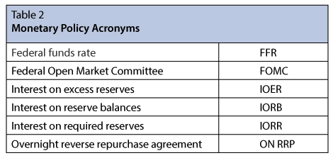
Administered Rates
Interest on reserve balances (IORB)
Applies to both IORR and IOER
Overnight reverse repurchase agreement (ON RRP)

Slide 39
Ceiling/Floor to FFR
If discount rate falls behind FFR, depository banks may find it more attractive to borrow from the fed than each other, which will push FFR below the discount rate
If FFR falls below IORB, depository banks may find it attractive to borrow in the federal funds market and deposit those reserves at the Fed and earn IORB-FFR
Discount Rate
Ceiling
Because of
arbitrage
FFR
Administered Rates:
- IORB
- ON RRP
Floor
Source

Slide 40
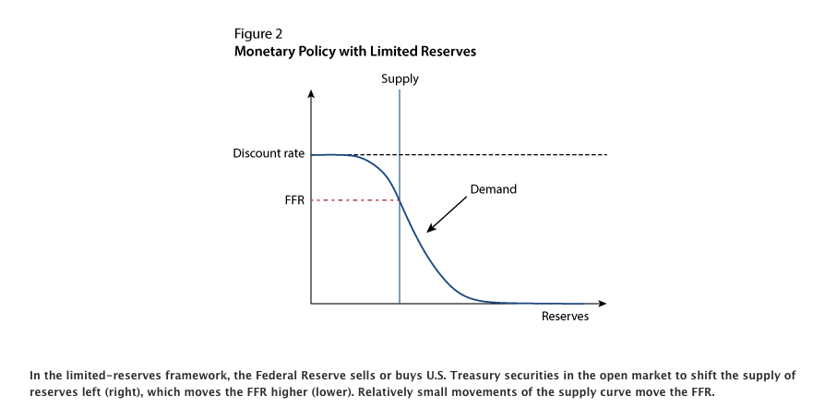
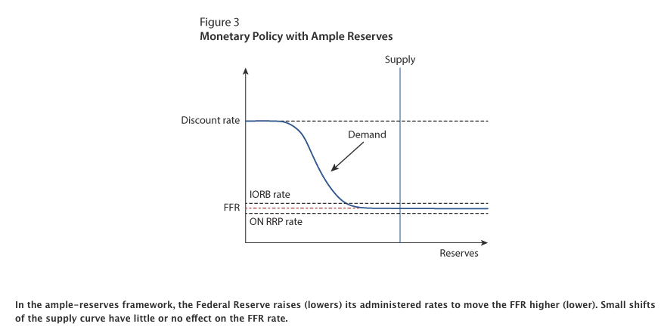
Monetary policy evolution

Slide 41
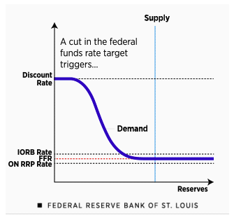
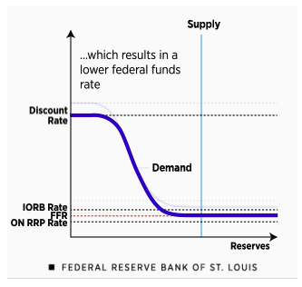
Expansionary Monetary policy
Source

Slide 42
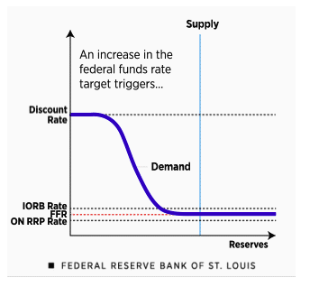
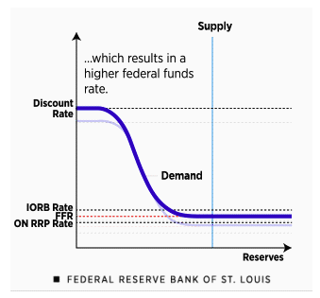
Contractionary monetary policy
Source

Slide 43
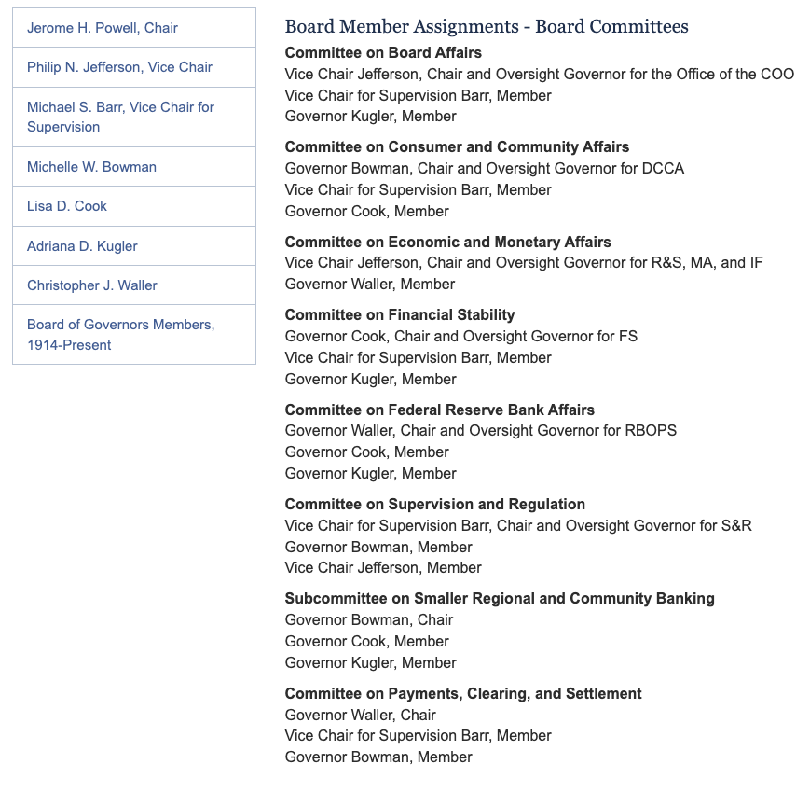
Fed board
source

Slide 44
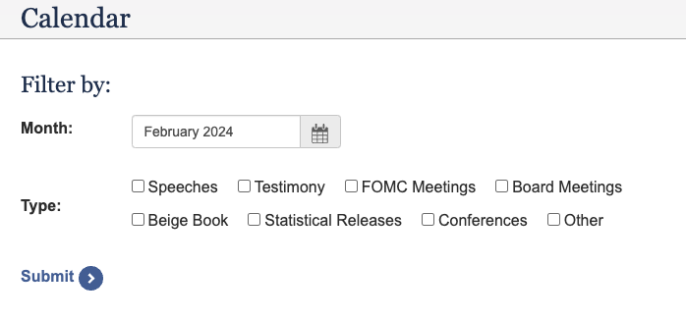
Fed events
source

Slide 45
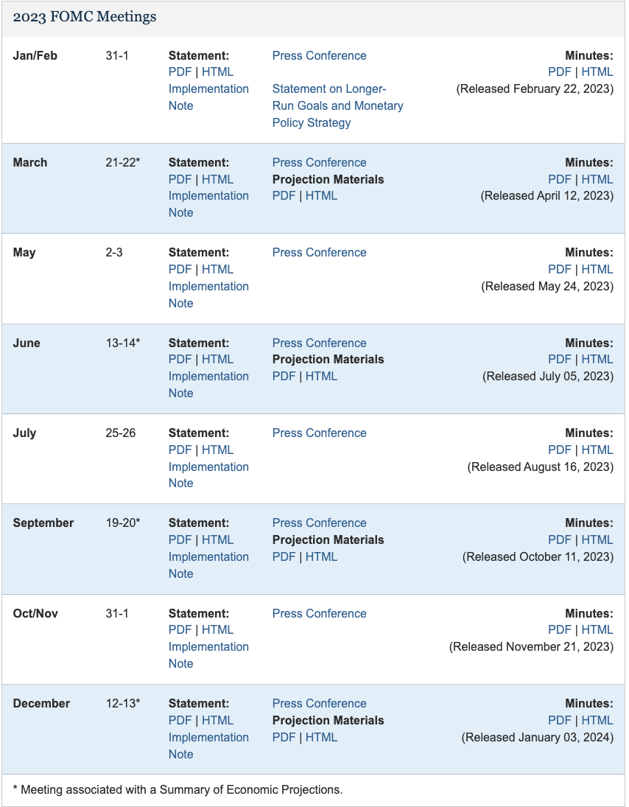
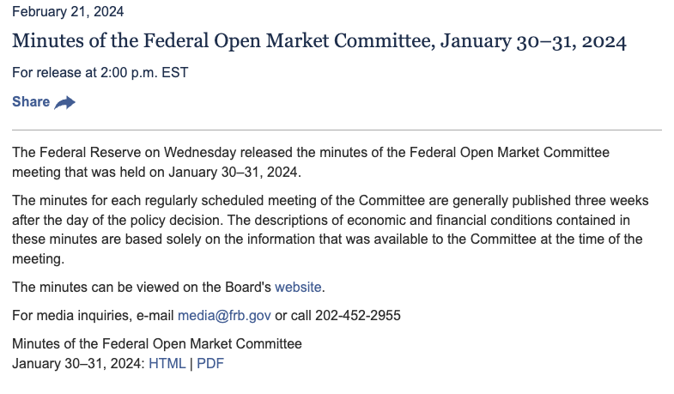
FOMC Calendar
Eight meetings a year
Press conference after each meeting
Minutes released three weeks later
Projection material on four of the meetings
source

Slide 46
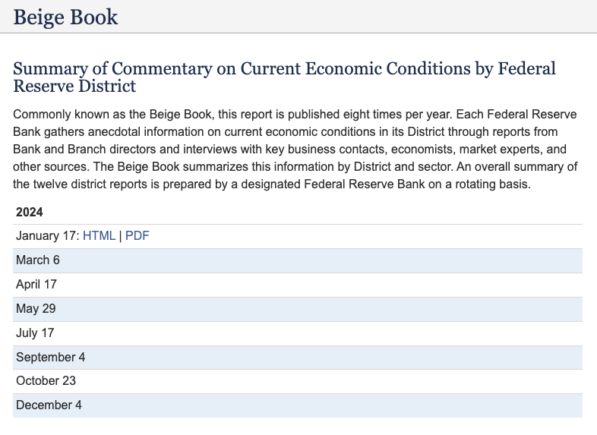
Beige book calendar
source

Slide 47
Reference
Stephen D. Slifer and W. Stansbury Carnes, By the numbers, A survival guide to economic indicators. International Financial Press, 1995

