Slide 1
FOMC – March 2024
Oualid Missaoui

Slide 2
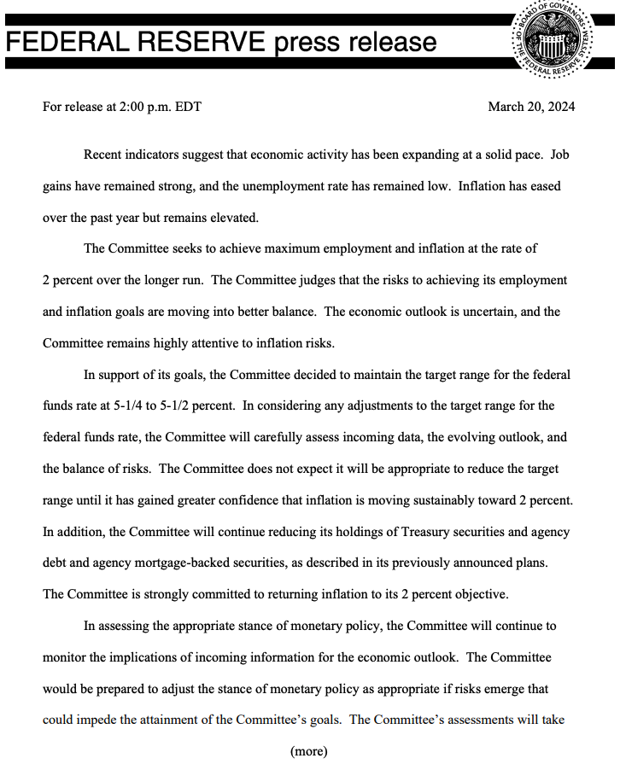
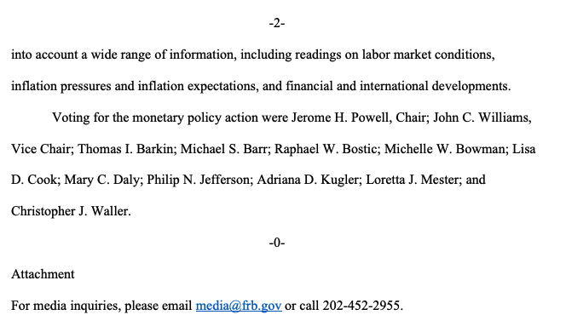
Statement

Slide 3
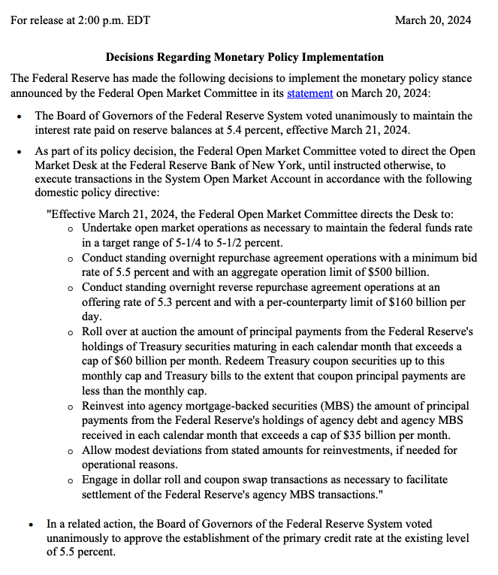
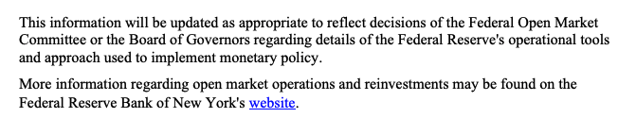
Implementation statement

Slide 4
Takeaways

Slide 5
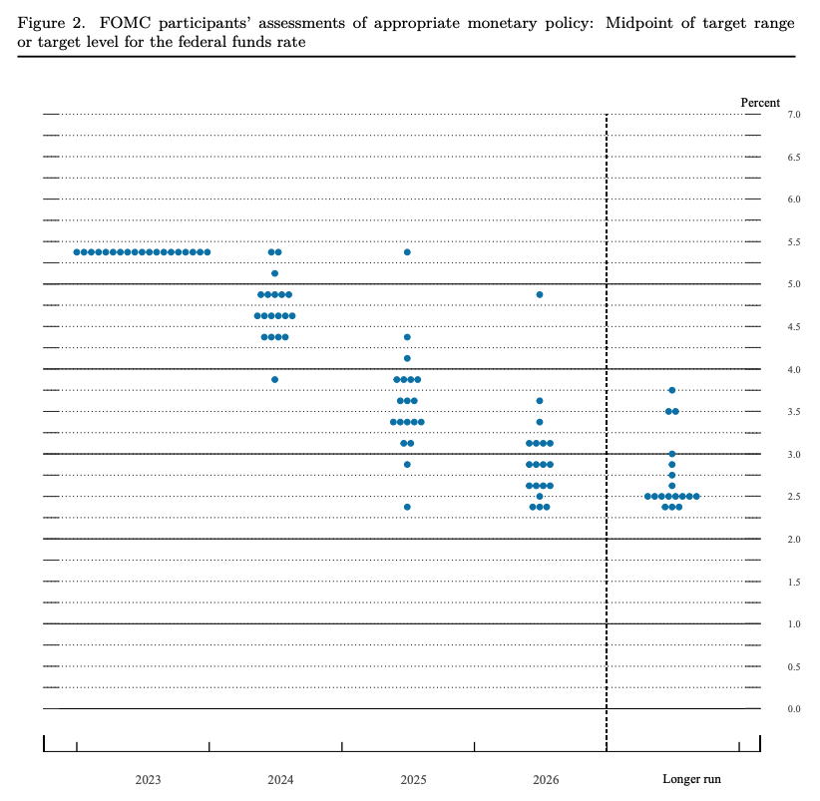
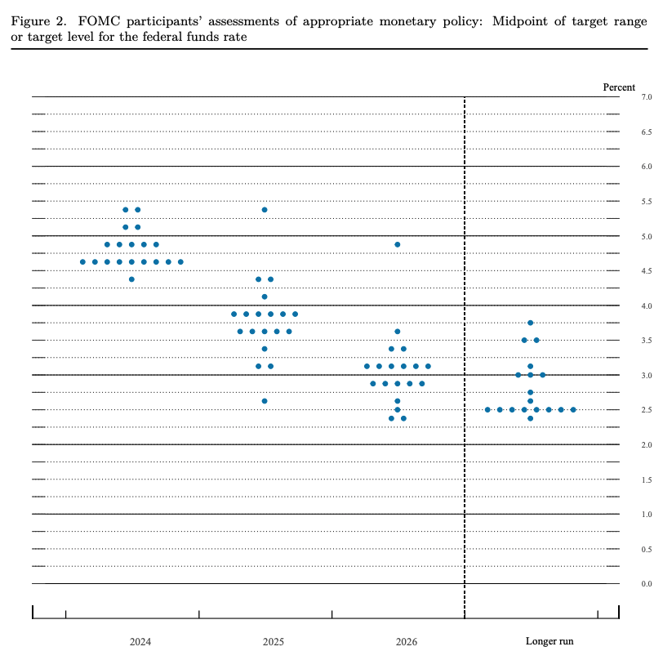
Dot-Plot
December - 2023
March - 2024
Current target
5.25-5.50%
6/19
9/19
75 Bps

Slide 6
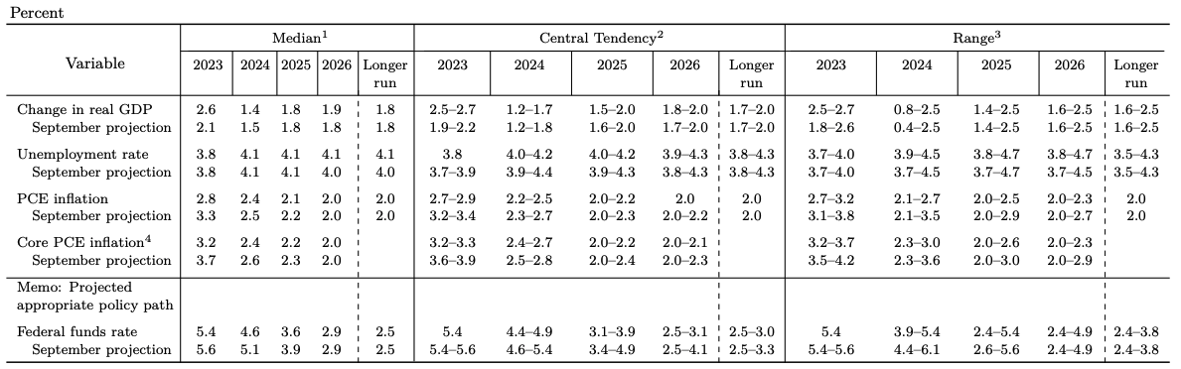
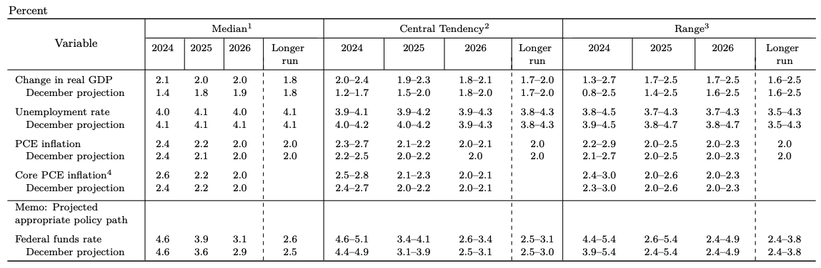
Economic projections
December-2023
March-2024

Slide 7
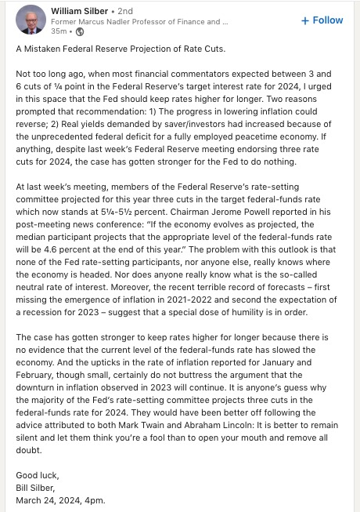
Contrarian view
Arguments:
The progress in lowering inflation could reverse:
as interest rates go down, borrowing will be easier and demand could increase pushing prices up again
Real yields demanded by savers/investors had increased because of the unprecedented federal deficit for a fully employed peacetime economy:
We have a huge unprecedented federal deficit that is funded for the most part by US treasuries
This has triggered inflation and consequently interest rates are high
Therefore, savers and investors are demanded high real yield
Cutting interest rates too soon would affect the profitability of lenders and complicate the lending ecosystem

Slide 8
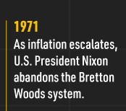
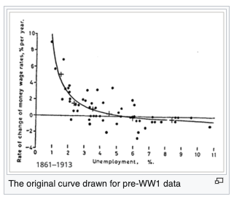
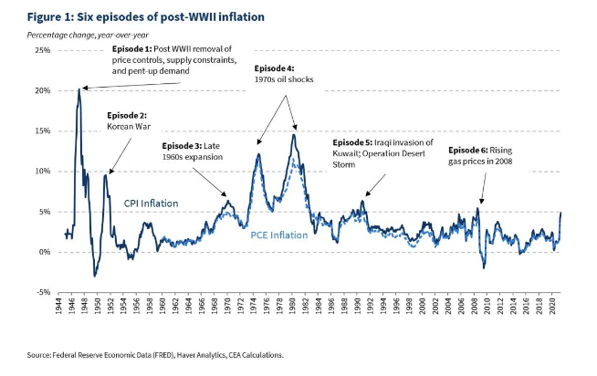
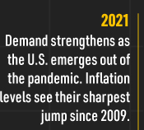
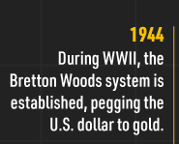
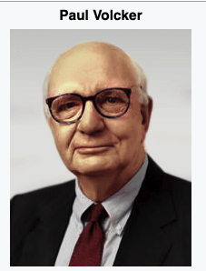
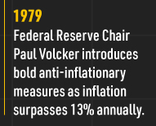
Historical note
Source
Source

Slide 9
References
https://www.jpmorgan.com/insights/outlook/economic-outlook/fed-meeting-march-2024
https://www.barrons.com/livecoverage/fed-fomc-meeting-rate-decision-powell-speech-today
https://www.forbes.com/advisor/investing/fomc-meeting-federal-reserve/
https://www.wellsfargoadvisors.com/research-analysis/reports/fed-rate.htm
https://www.nuveen.com/en-us/insights/investment-outlook/fed-update
https://economics.td.com/us-fomc-statement

