Slide 1

Ch6: Feature importance

Slide 2
Agenda
Feature importance in linear models: p-values
Caveats of p-values
Decision trees
Mean Decrease Impurity (MDI)
Mean Decrease Accuracy (MDA)
Clustered MDI & MDA
References

Slide 3



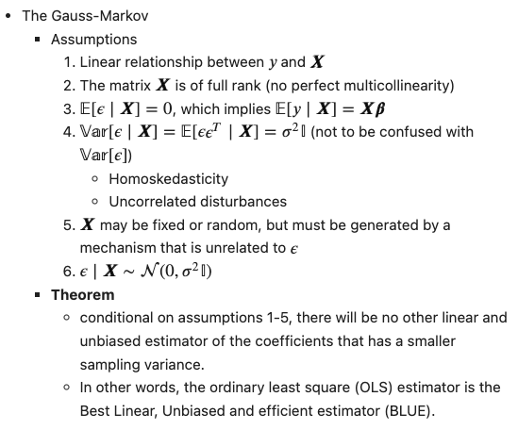
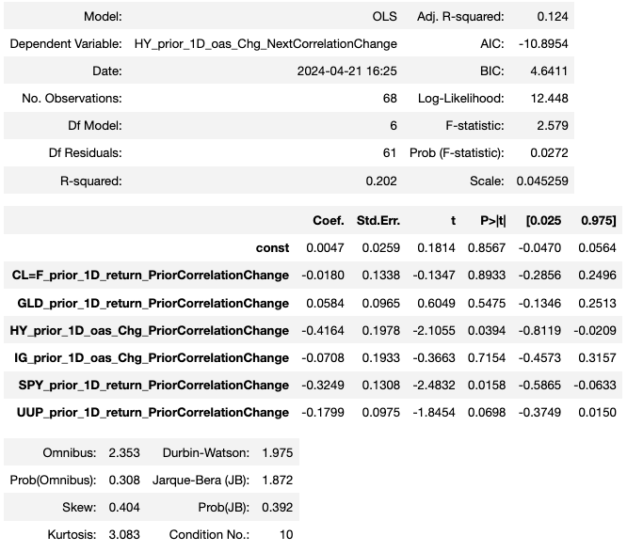
Linear modeling

Slide 4
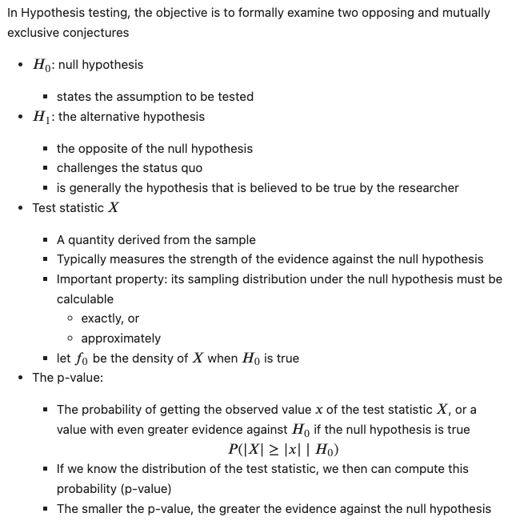
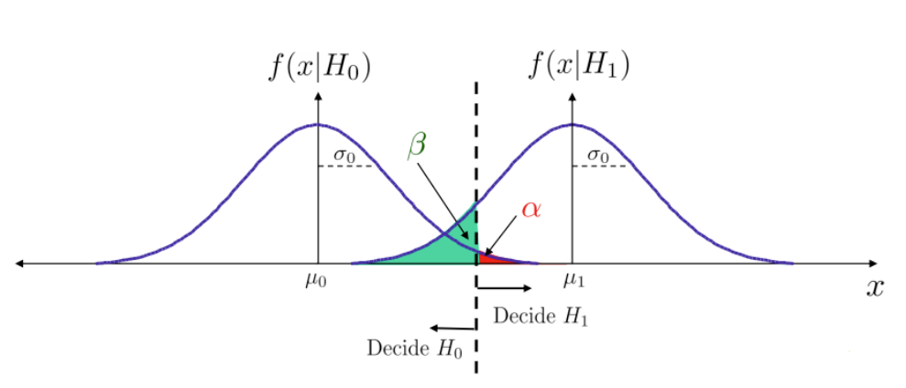


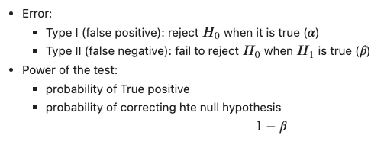
P-values

Slide 5
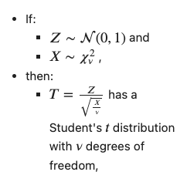
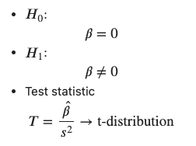
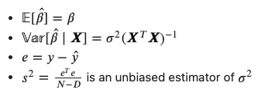
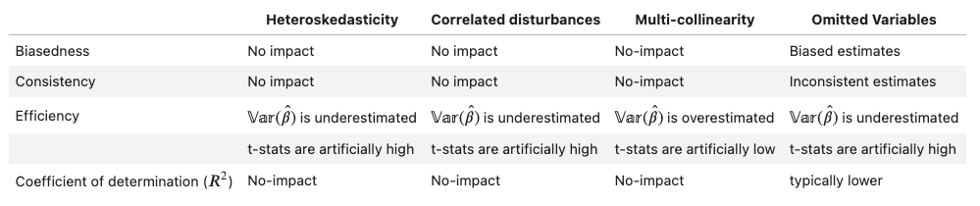
P-values and linear modeling
WLS
Ridge (no p-values)
Causal inference

Slide 6
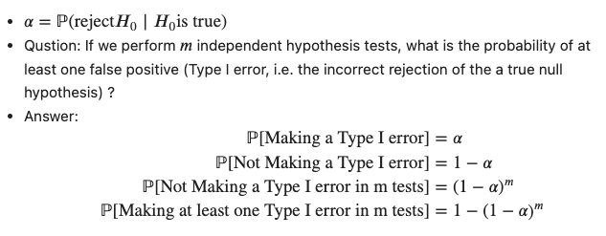
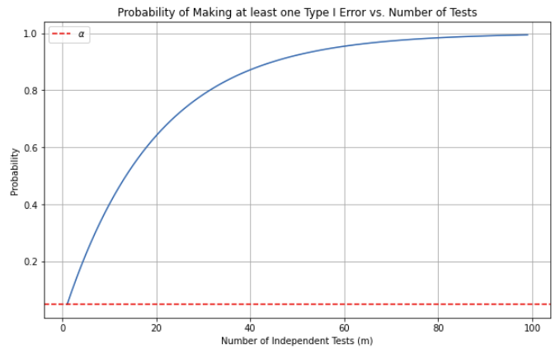
P-hacking

Slide 7


Caveats of p-values
Reliance on strong assumptions that may not be true for real world problems and data
Cannot handle multi-collinearity (mutually correlated dependent variables)
The probability evaluated by a p-value might not be relevant
4. It asses significance in-sample
Prone to overfitting and it is desirable to have an out-of-sample assessment

Slide 8
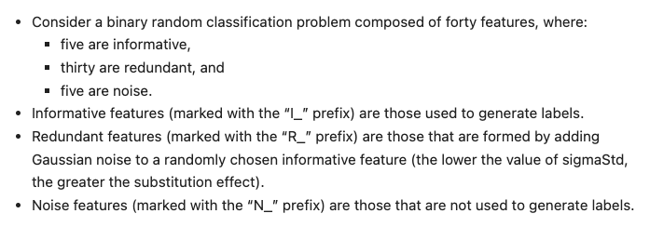
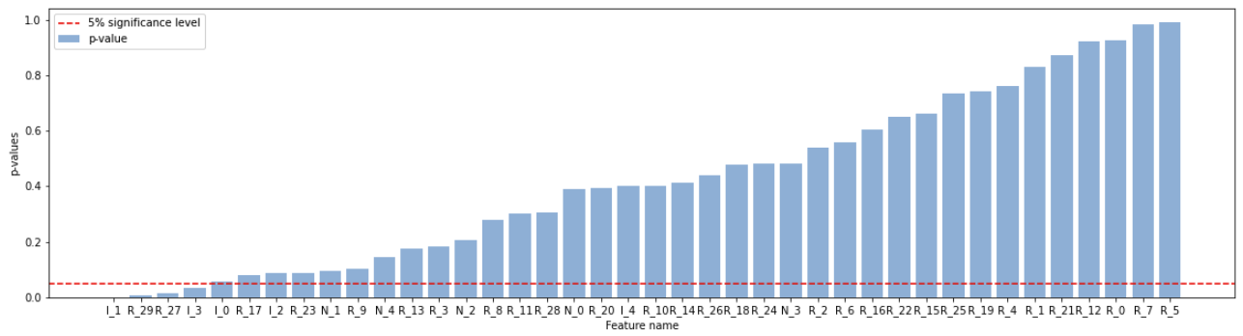
Example

Slide 9
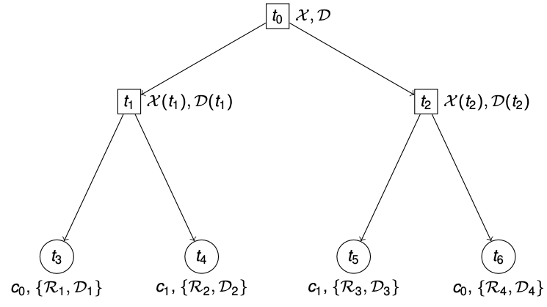
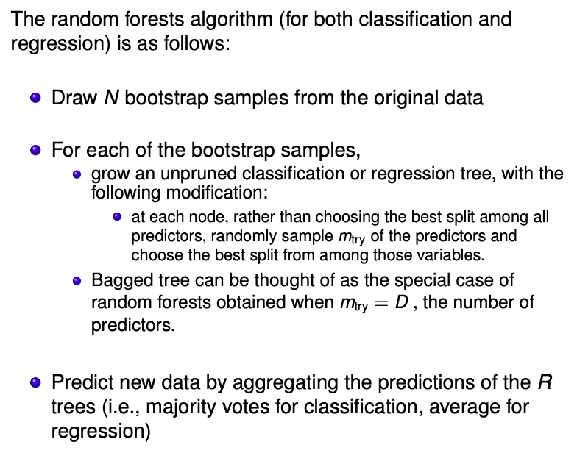
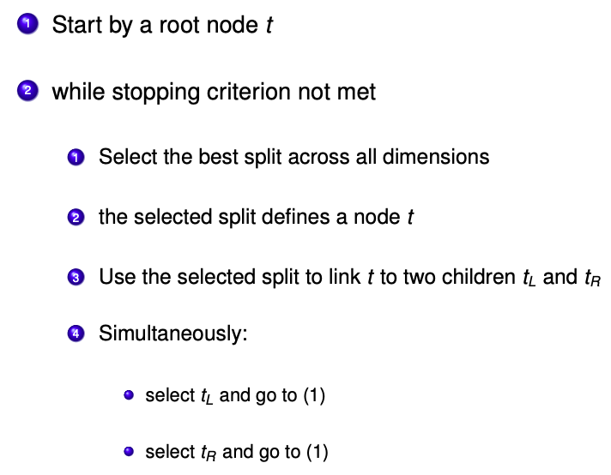
Decision trees and Random Forest

Slide 10
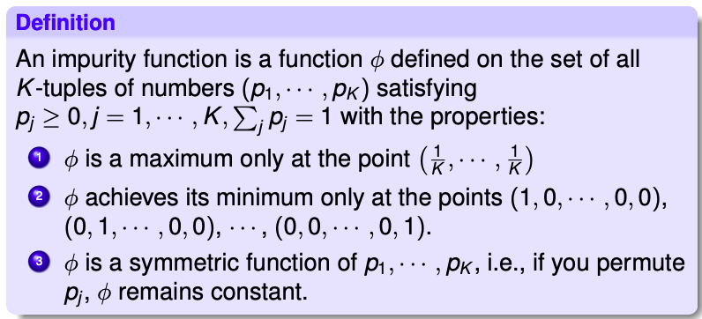
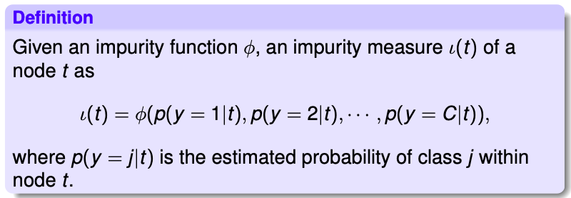
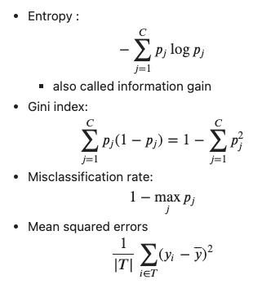
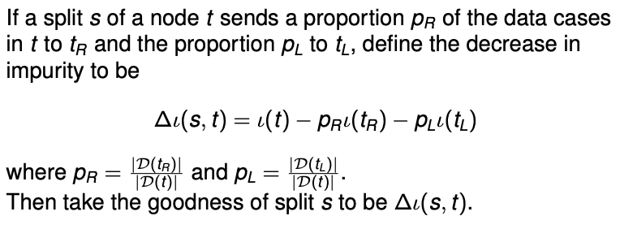
Impurity measurement
Impurity function
Impurity measure
Possible impurity functions
Splitting Criterion

Slide 11
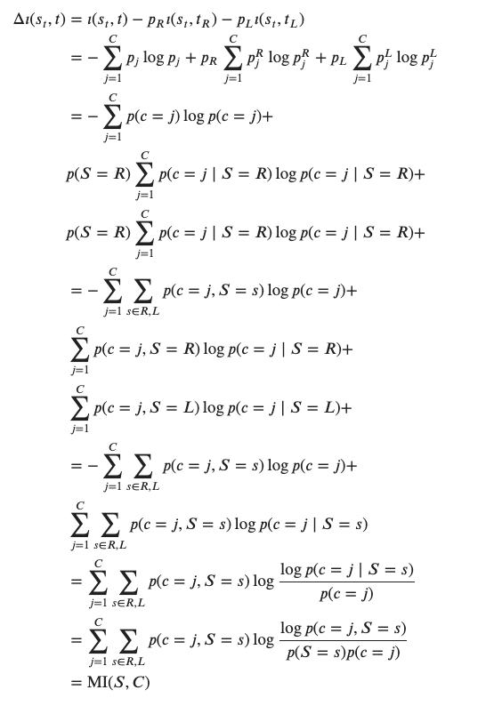
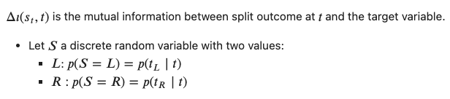
Theoretical tangent

Slide 12
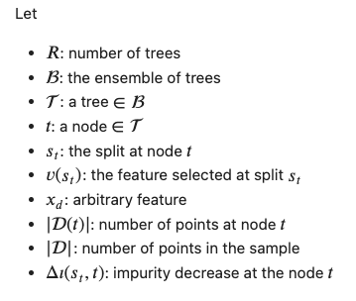
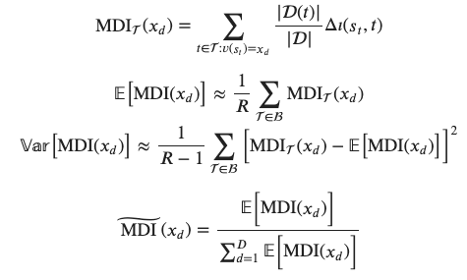

Mean decrease impurity (MDI)

Slide 13
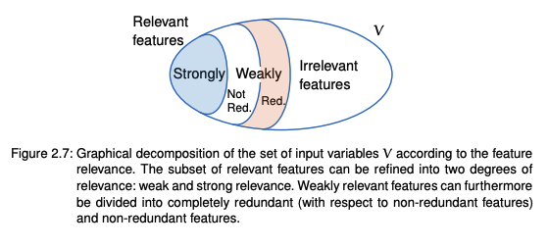
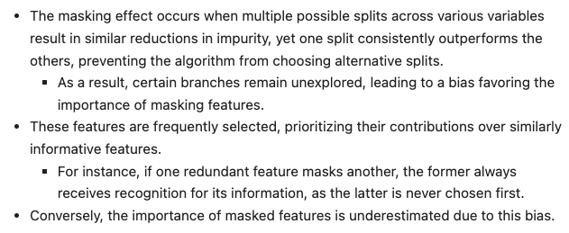
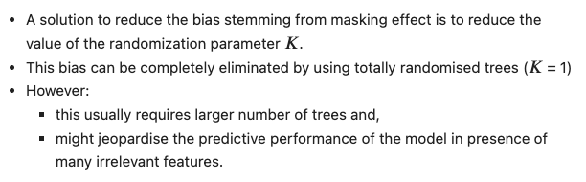
Masking effect
Phenomenon
Source: Antonio Sutera (2021), Importance Measures derived from Random Forests,
Phd dissertation, University of Liege
 |  | Masking effect |  | overfitting
Relevance | Redundancy | MDI (K>1) | MDI (K=1) | Yes , they are in-sample methods
Strong | Redundant | Yes | Partial
 | Non-redundant | No | No
Weak | Redundant | Yes | Partial
 | Non-redundant | Yes | No
Remedy

Slide 14
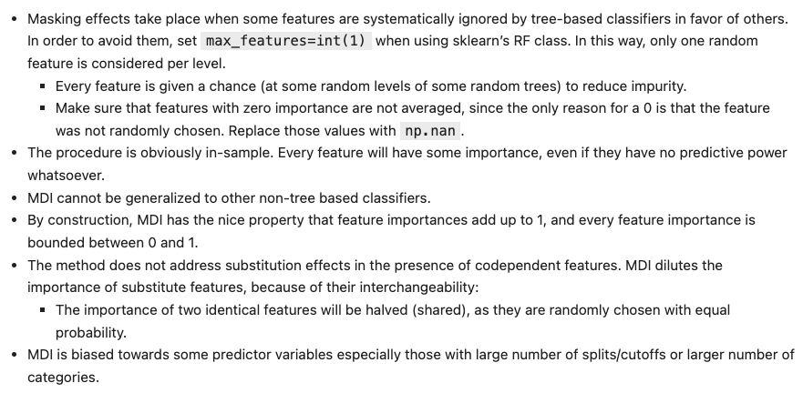
Practical considerations for the MDI

Slide 15
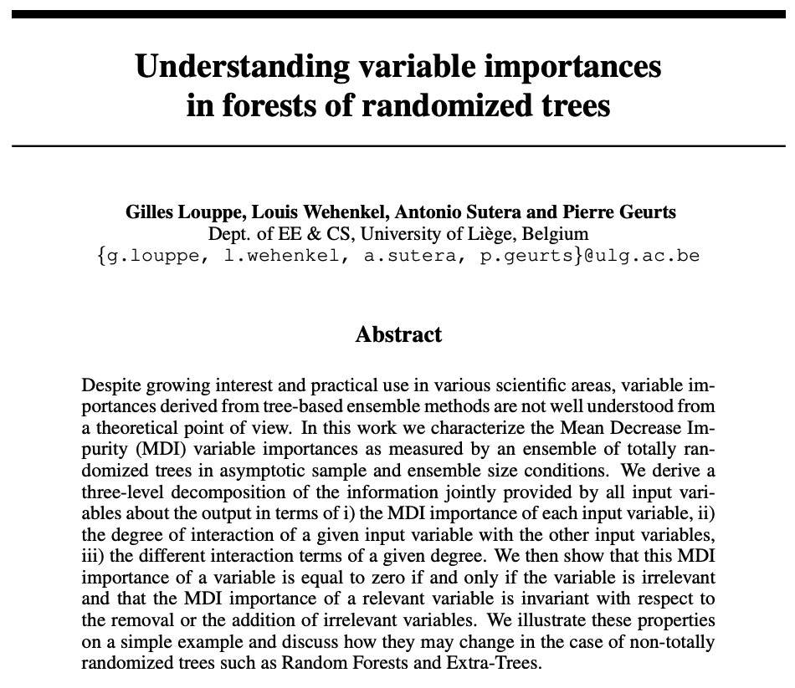
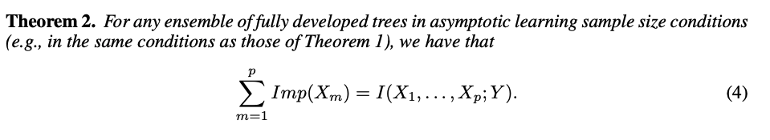
Theoretical Tangent
Source: Gilles Louppe et al (2013), Understanding variable importances in forest of randomized trees , NIPS

Slide 16
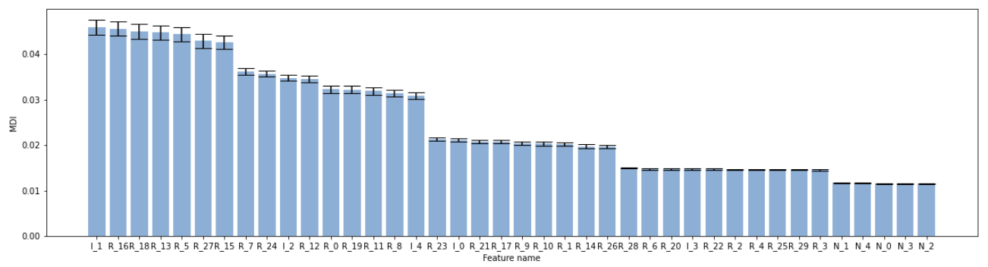
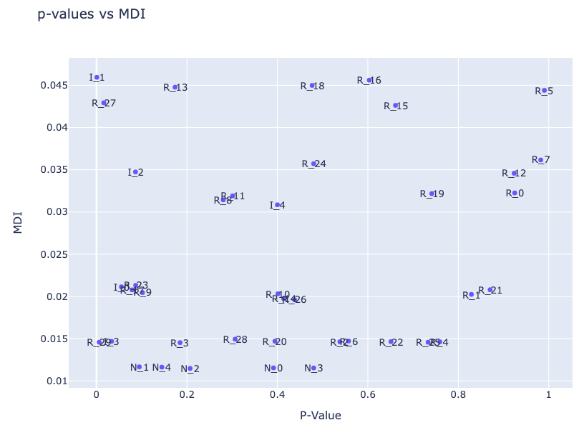
Example revisited

Slide 17
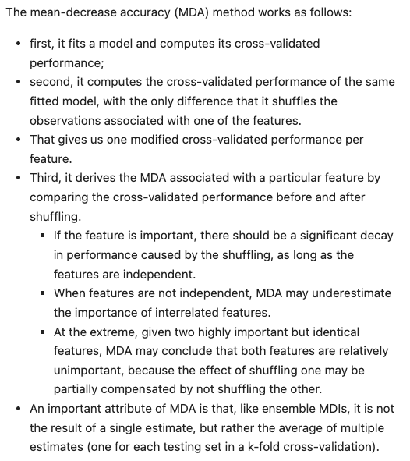
Mean decrease accuracy (MDA)
CV scores on full model
Shuffle Feature 1
Shuffle Feature n
Shuffle Feature N
CV scores
CV scores
CV scores
MDA Feature 1
MDA Feature n
MDA Feature N
 |  | Masking effect |  |  | overfitting
Relevance | Redundancy | MDI (K>1) | MDI (K=1) | MDA | MDI (K>=0) | MDA
Strong | Redundant | Yes | Partial | Yes | Yes | No
 | Non-redundant | No | No | No | Yes | No
Weak | Redundant | Yes | Partial | Yes | Yes | No
 | Non-redundant | Yes | No | No | Yes | No

Slide 18
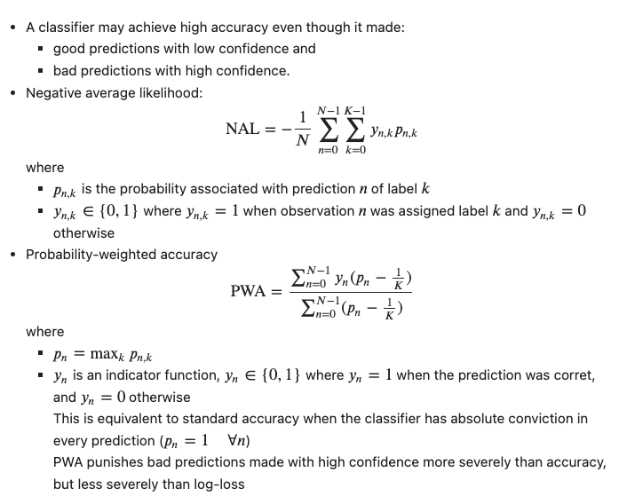
Alternative performance metrics for the MDA
Area under ROC or precision/recall curves are more robust for severely imbalanced classification problems.

Slide 19
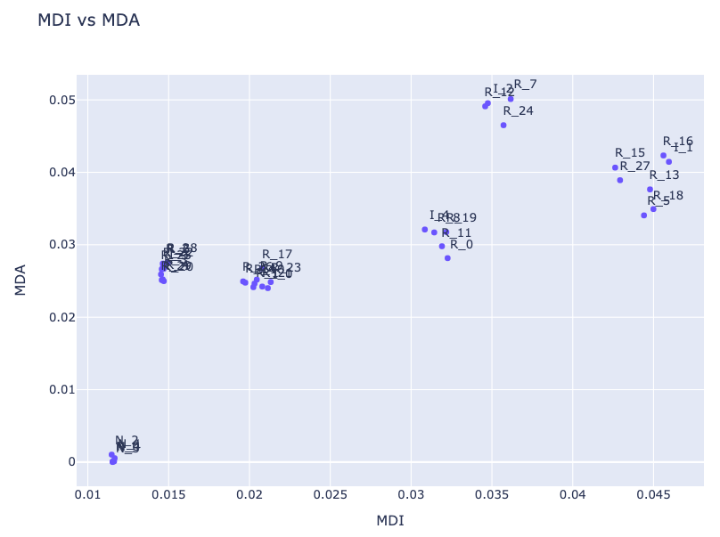
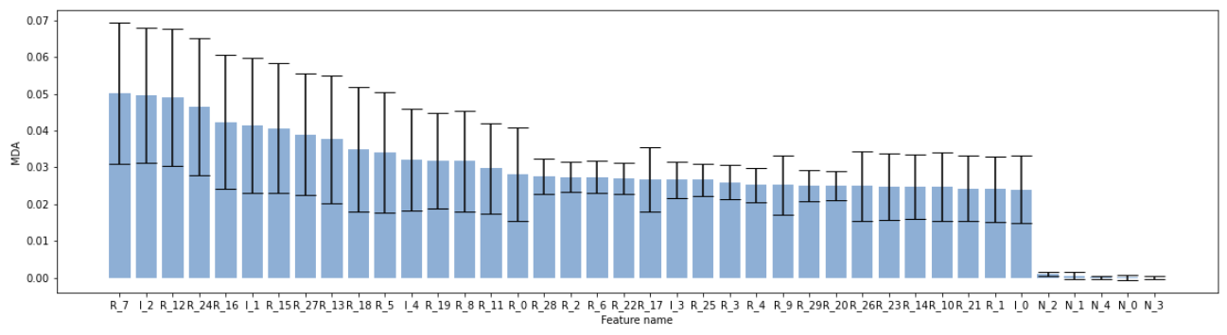
Example revisited

Slide 20
Solving the substitution effect
Step (1):
Clustering Features
Step (2):
Applying MDI/MDA to clustered features
Clustered MDI: in-sample importance
Clustered MDA: OOS importance

Slide 21
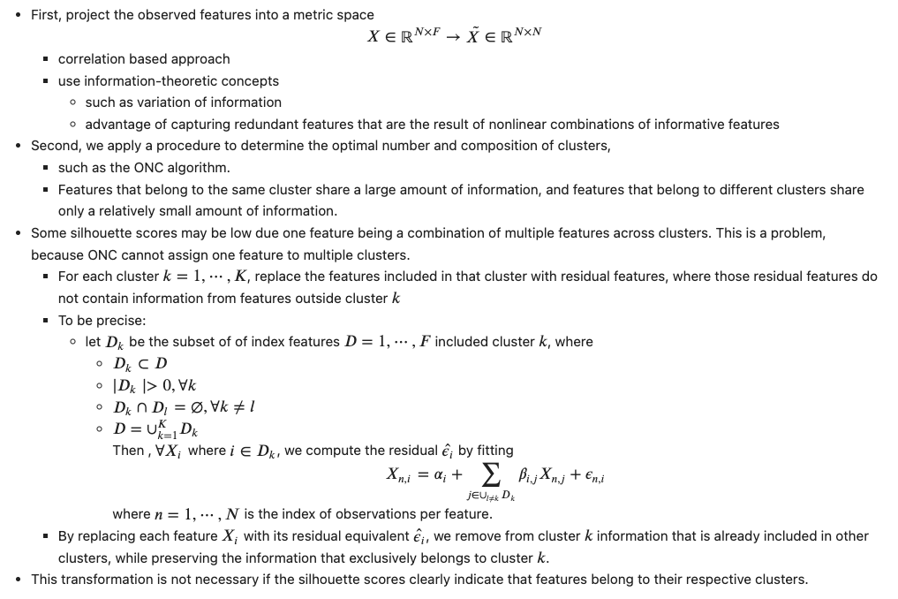
Solving the substitution effect – Step (1)

Slide 22
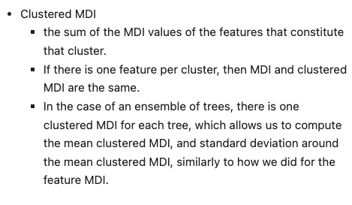
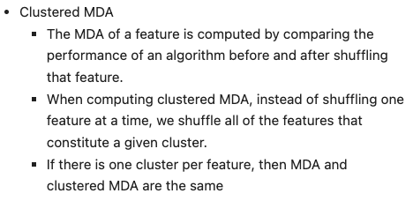
Solving the substitution effect – Step (2)

Slide 23
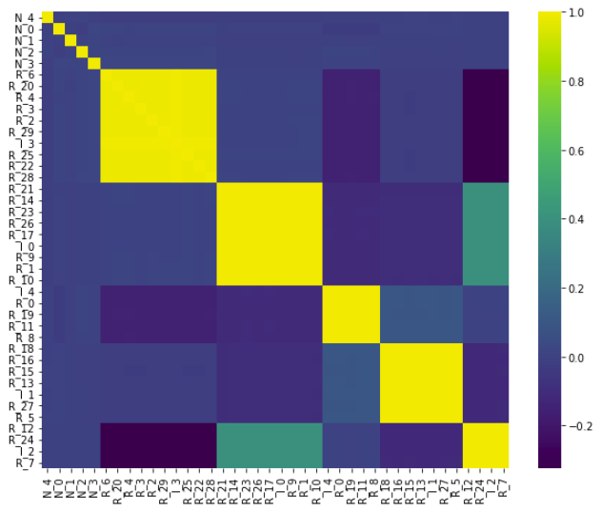
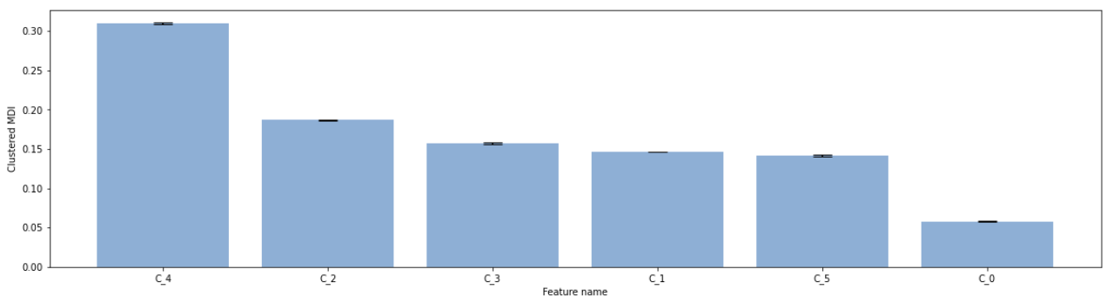
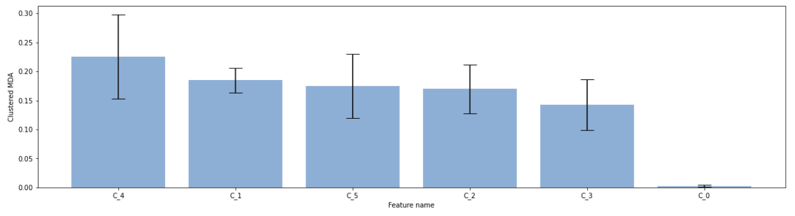
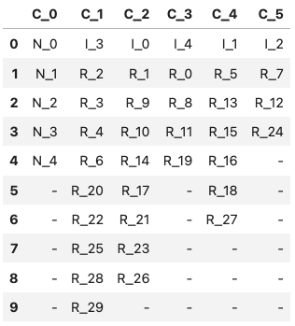
Example revisited

Slide 24
References
Kevin Murphy, 2022, Probabilistic Machine Learning, An Introduction, The MIT Press
Marcos Lopez de Prado, Machine learning for asset managers, Cambridge elements
John Lee et al, 2007, Non-linear dimensionality reduction, Springer
Isabelle Guyon et al, 2006, Feature extraction, foundations and applications, Springer

