Slide 1
Assets correlation structure and dynamic

Slide 2
10 years Treasury yield typical correlation
 | US 10 years Treasury yield
 | Correlation Direction | Explanation
Gold | Negative | An increase in interest rates which makes holding non-interest bearing instruments (like gold) less attractive
Oil | Positive | During economic growth, demand for oil can lead to higher prices , which can be accompanied with expectations of higher future inflation and interest rates.
SPY | Positive | When Treasury yields rise due to expectations of higher inflation or stronger economic growth, it can signal positive sentiment about the economy. This optimism can translate into higher stock prices as investors anticipate improved corporate earnings and economic performance.
IG Spread | Negative | When Treasury yields rise, it can indicate improving economic conditions or expectations of higher interest rates. In such scenarios, the perceived risk of default for investment grade corporate bonds may remain stable or decrease due to stronger corporate fundamentals, leading to narrower credit spreads and a negative correlation with Treasury yields. During periods of economic uncertainty or market stress, investors often seek safety in risk-free assets like Treasury bonds, leading to increased demand and lower yields. This flight to quality can coincide with widening credit spreads as investors become more risk-averse and demand higher compensation for holding corporate bonds.
HY Spread | Negative | When Treasury yields rise, it can indicate improving economic conditions or expectations of higher interest rates. In such scenarios, the perceived risk of default for investment grade corporate bonds may remain stable or decrease due to stronger corporate fundamentals, leading to narrower credit spreads and a negative correlation with Treasury yields. Similar to investment grade bonds, during periods of economic uncertainty or market stress, investors tend to flock to risk-free assets like Treasury bonds, driving down Treasury yields. This flight to quality can coincide with widening credit spreads for high yield bonds as investors become more risk-averse and demand higher compensation for holding riskier assets.
US Dollar | Positive | When the 10-year Treasury yield rises, it indicates higher interest rates in the US, which can attract capital inflows from foreign investors seeking higher returns. This increased demand for US assets, including bonds and equities, can strengthen the US dollar as foreign investors purchase dollars to invest in US markets. The US dollar is often considered a safe-haven currency during periods of uncertainty or market volatility. When global economic or geopolitical risks rise, investors may flock to safe-haven assets denominated in USD, such as US Treasury securities. This increased demand for USD-denominated assets can contribute to a stronger US dollar.

Slide 3
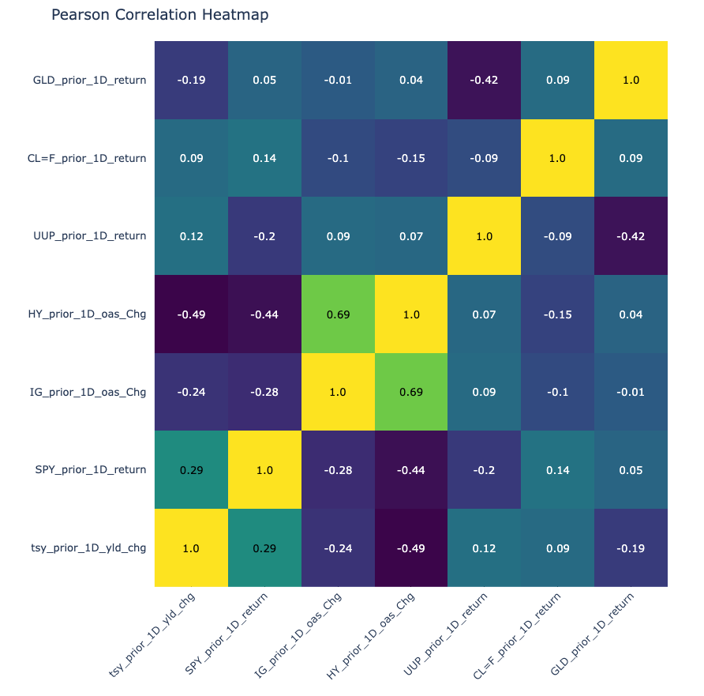
Assets correlation heatmap
Gold: GLD (Yahoo Finance)
Oil: CL1 (Yahoo Finance)
US Dollar: UUP (Yahoo Finance)
High Yield: HY OAS (Fred)
Investment Grade: IG OAS (Fred)
Equity: SPY (Yahoo Finance)
10 years Yield US Treasury (Fred)
Data spans 2000 through 2024.

Slide 4
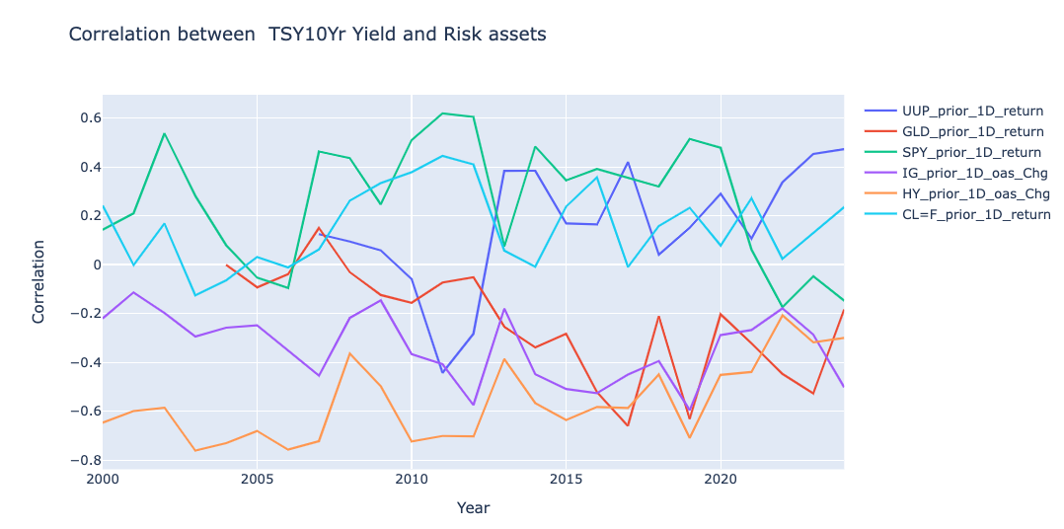
Yearly correlation with tsy 10yr yld dynamic

Slide 5
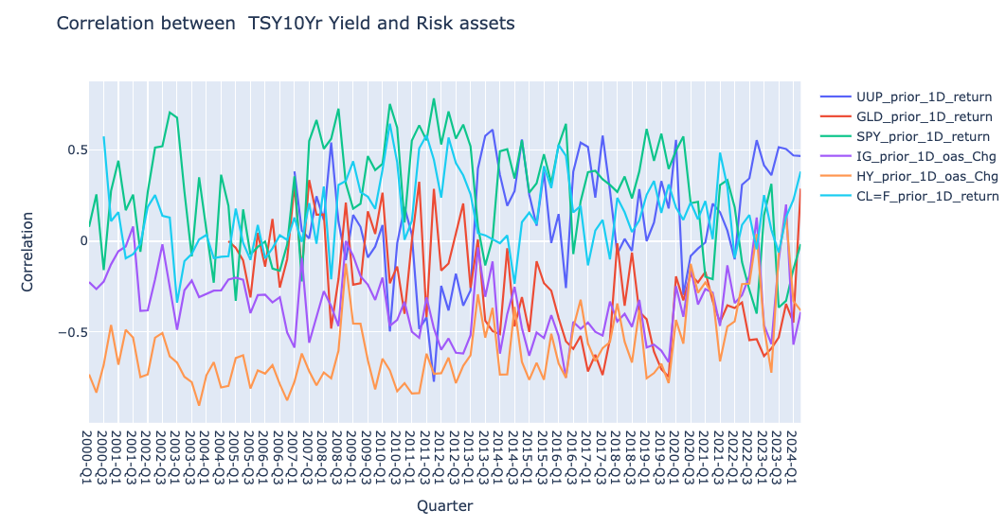
Quarterly correlation with tsy 10yr yld dynamic

Slide 6
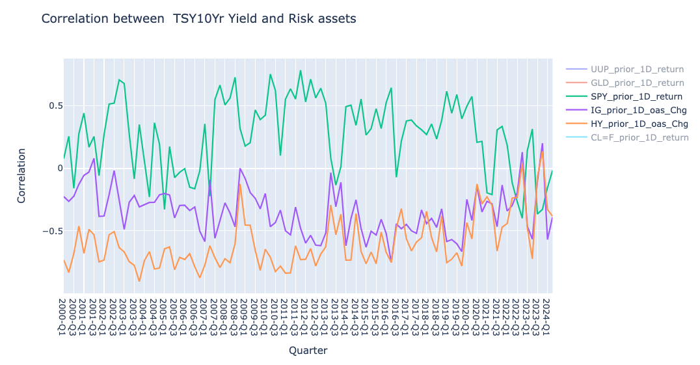
SPY/IG/HY vs US 10Yr Yield

Slide 7
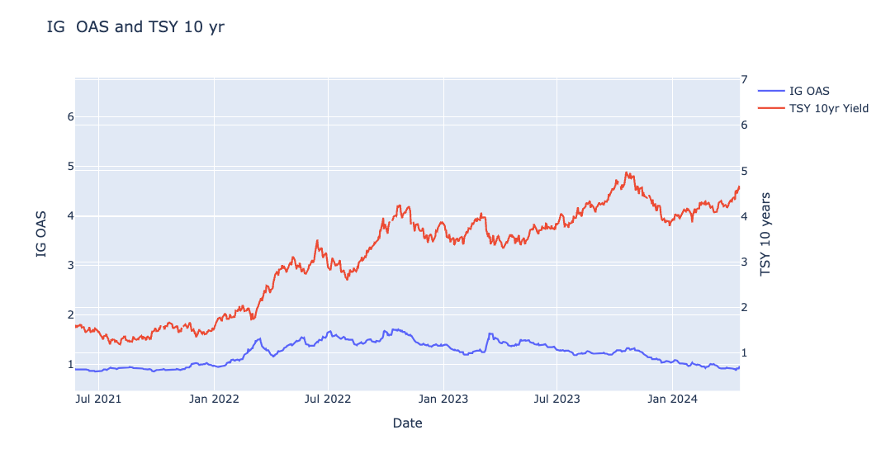
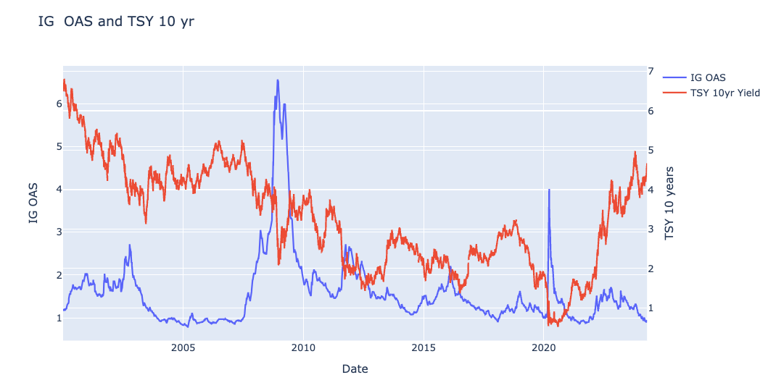
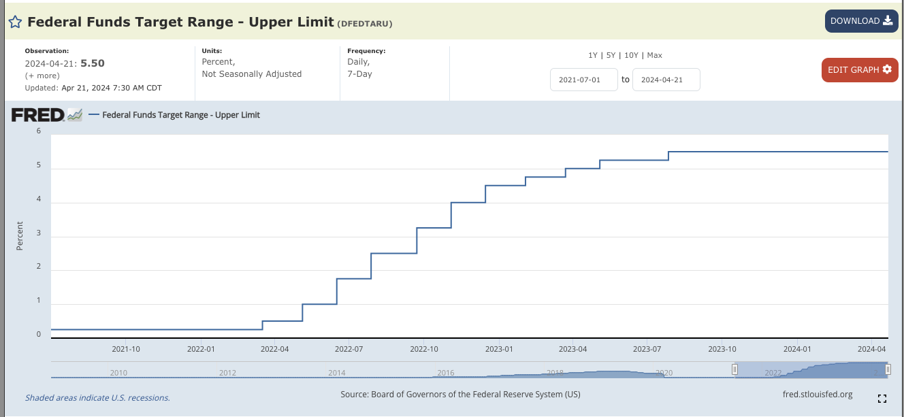
IG vs TSY 10yr Yield
Econ data Nov 2023
(slowdown, signaling
potential cut)
FOMC Sept 2023
(Pause , higher for longer)
FOMC September 2023: higher for longer
November:
FOMC Nov 1st: paused hiking
Econ data
ISM: lower than expected
NFP: lower than expected
unemployment rate: higher than expected
CPI less than expected
PP less than expected

Slide 8
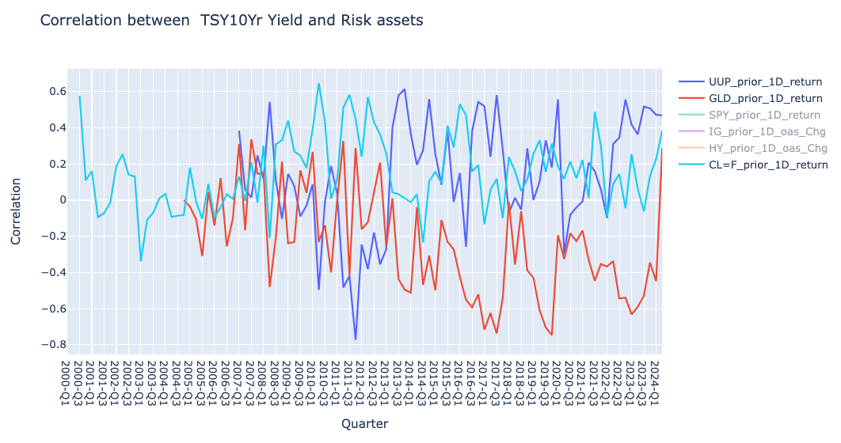
Gold/Oil/Dollar vs US 10Yr Yield

Slide 9
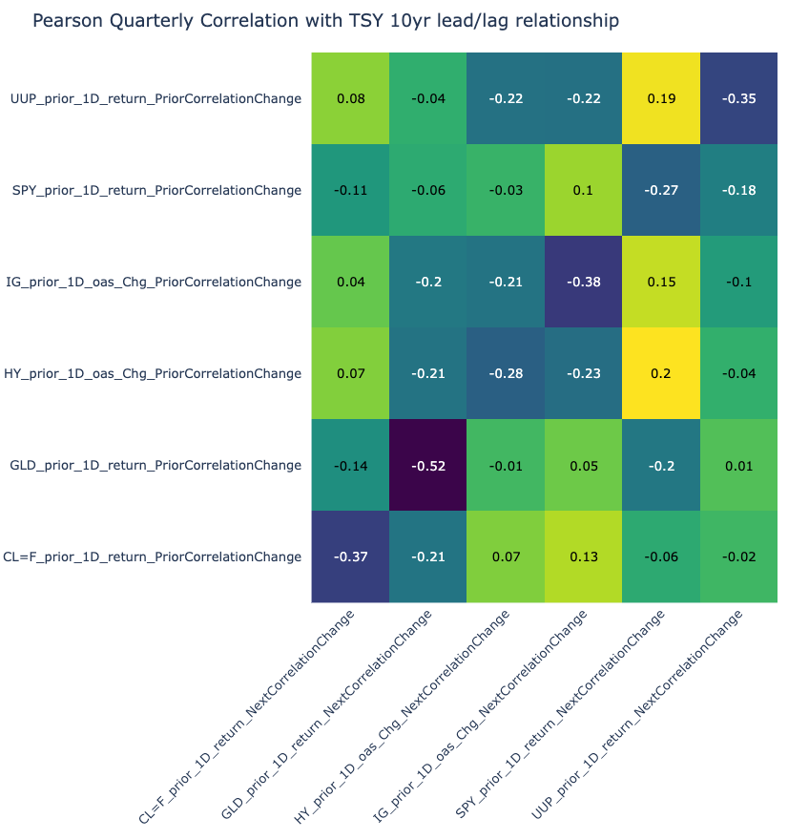
Quarterly Correlation with US 10 yr yield lead/lag relationship
Interesting mean-reversion:
The quarterly correlation(*) change reverts/flips Q/Q
(*) correlation with US 10yr TSY yield

Slide 10
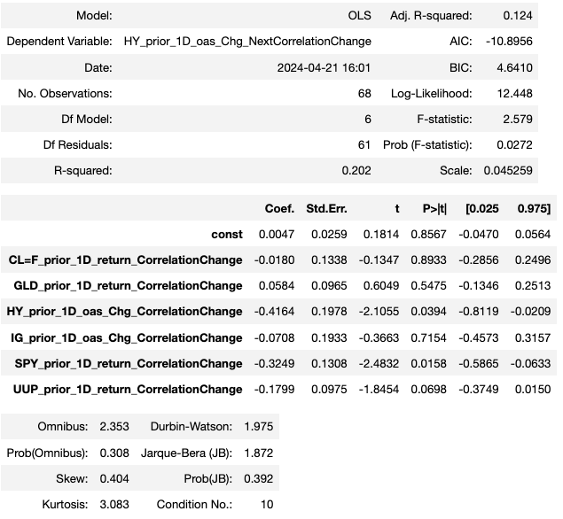
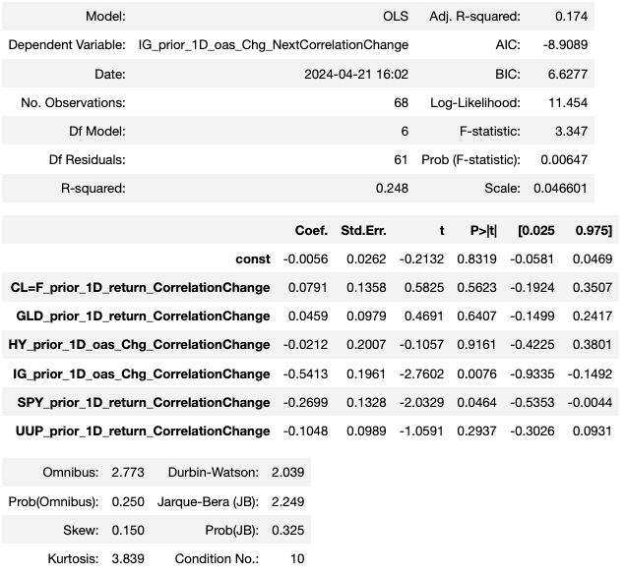
Can we model next quarter credit/tsy correlations ?

Slide 11
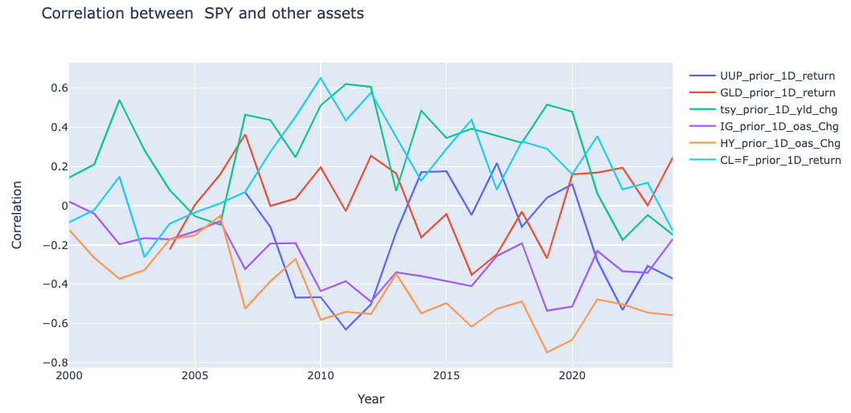
SPY & the rest: correlation dynamic

Slide 12
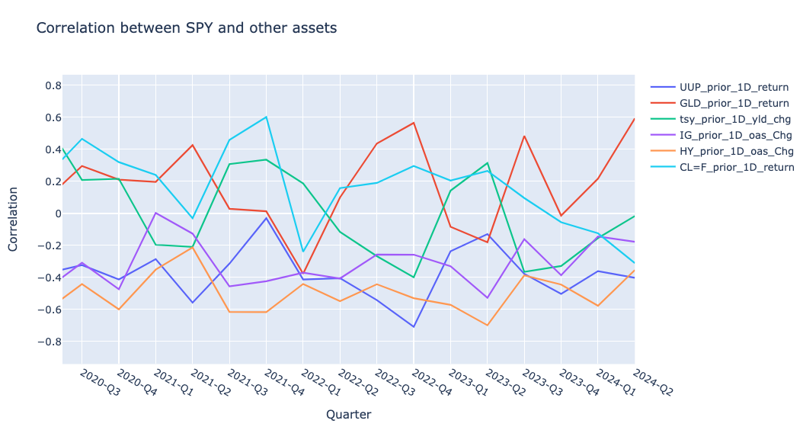
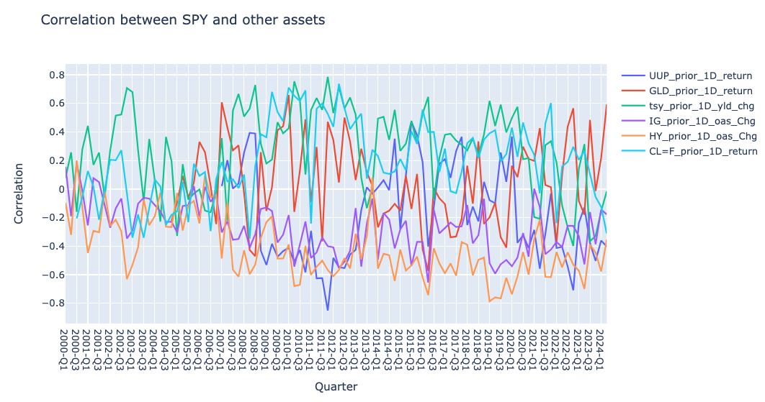
SPY vs the rest quarterly correlation

Slide 13
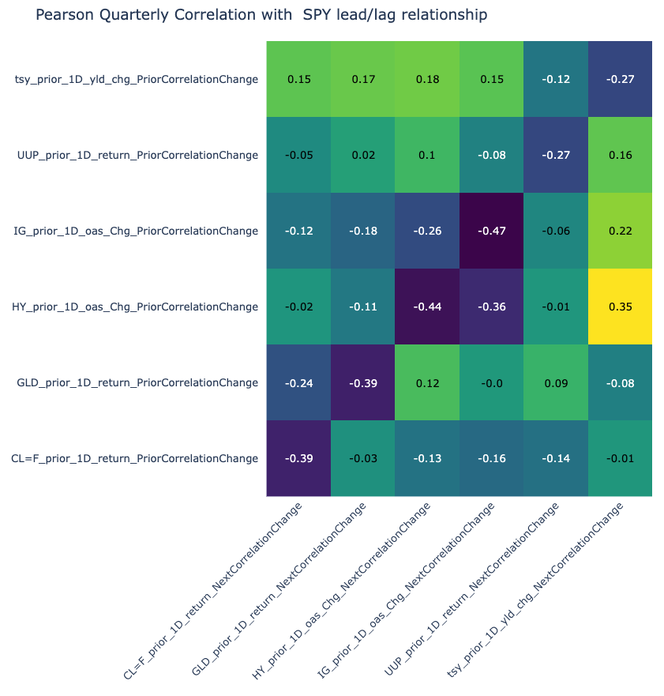
Quarterly Correlation with SPY lead/lag relationship
Significant mean-reversion
Significant lead/lag relationship between IG and HY correlations to SPY.

Slide 14
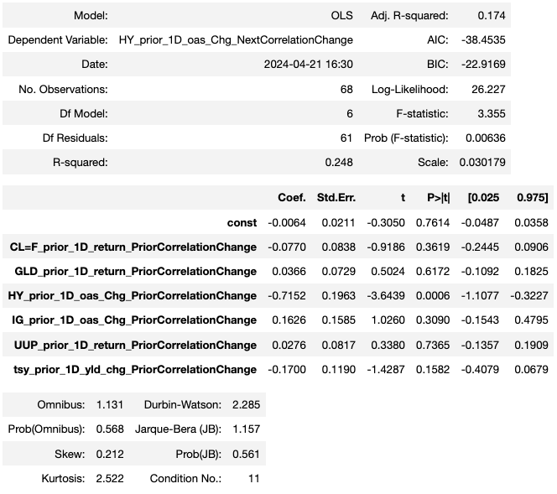
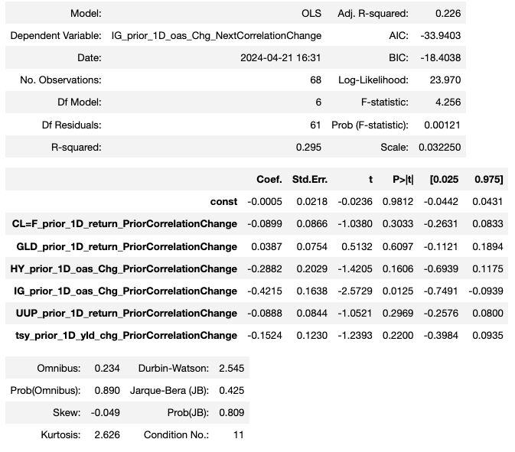
Can we model next quarter credit/equity correlations ?

Slide 15
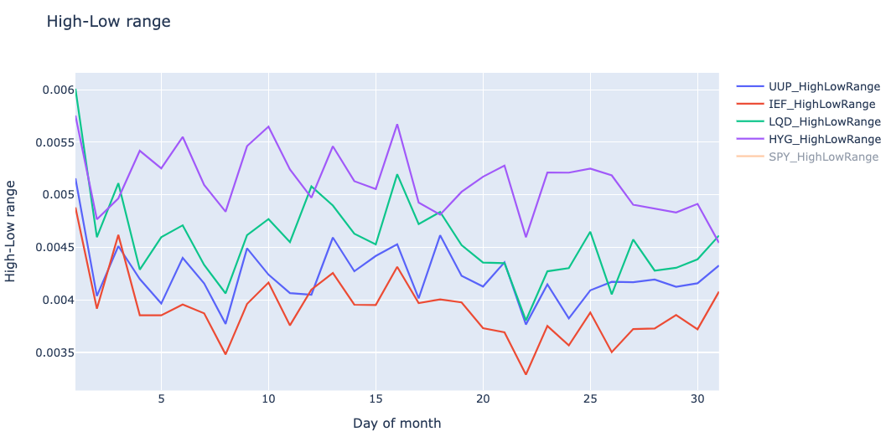
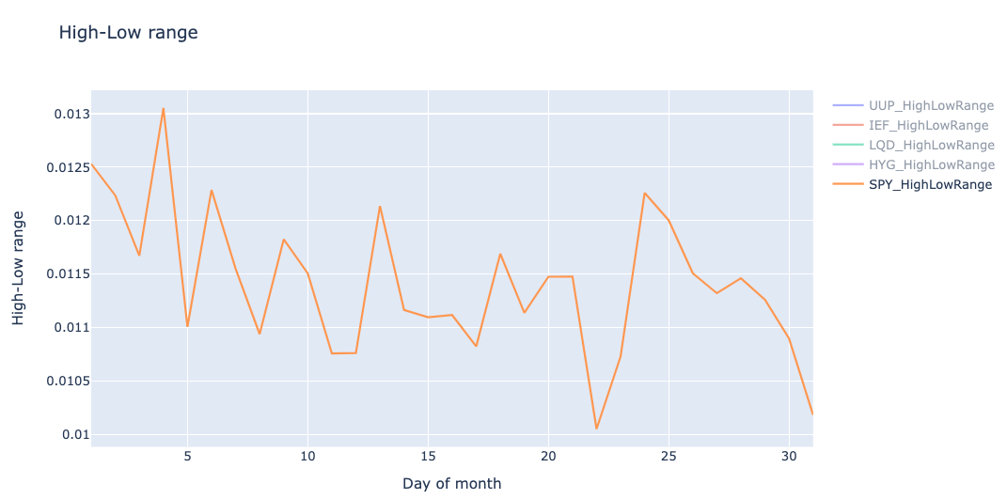
Volatility during the month
Typically ,
the month starts with ISM, NFP,
Then CPI/PPI in the middle
And PCE toward the end of month (but it is predictable from CPI and PPI)
Data spans 2010 through 2024

