Slide 1
Optimal Clustering

Slide 2
Agenda

Slide 3
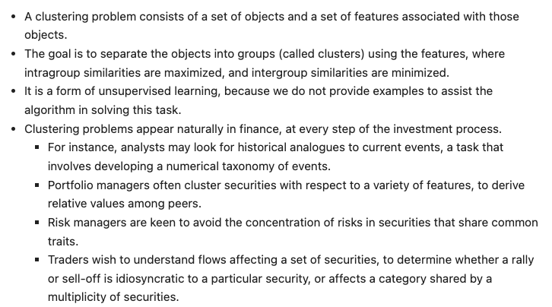
Motivation

Slide 4
Taxonomy of clustering algorithms

Slide 5
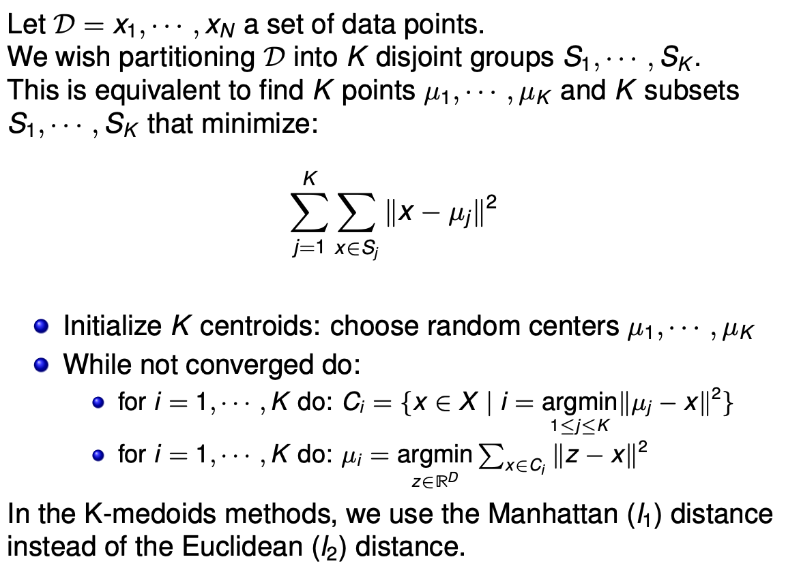
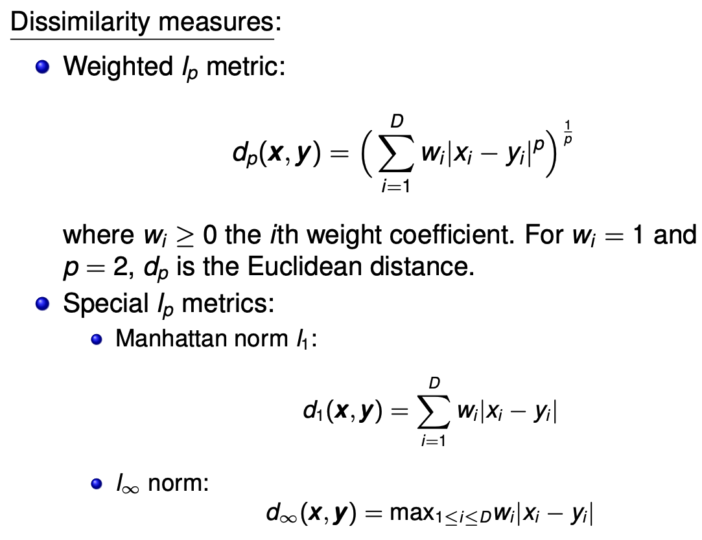
K-means

Slide 6
K-means limitations
The algorithm requires an user-set number of clusters K, which is not necessarily optimal a priori
The initialization is random, and hence the effectiveness of the algorithm can be similarly random

Slide 7
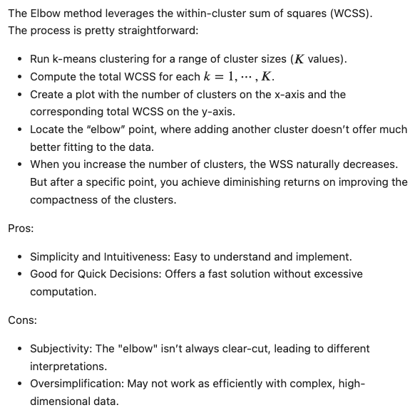
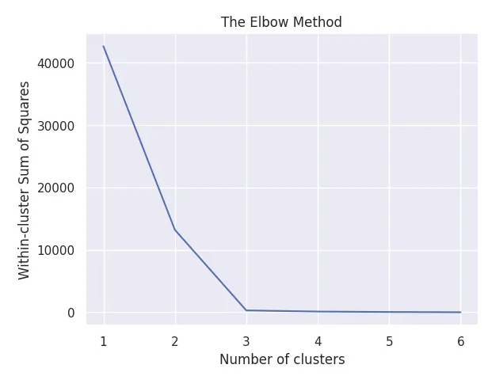
The Elbow method
source
source

Slide 8
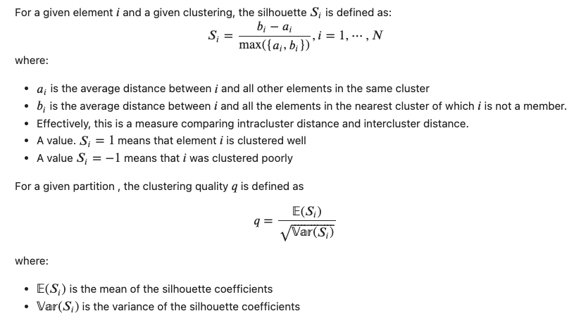
Silhouette score

Slide 9
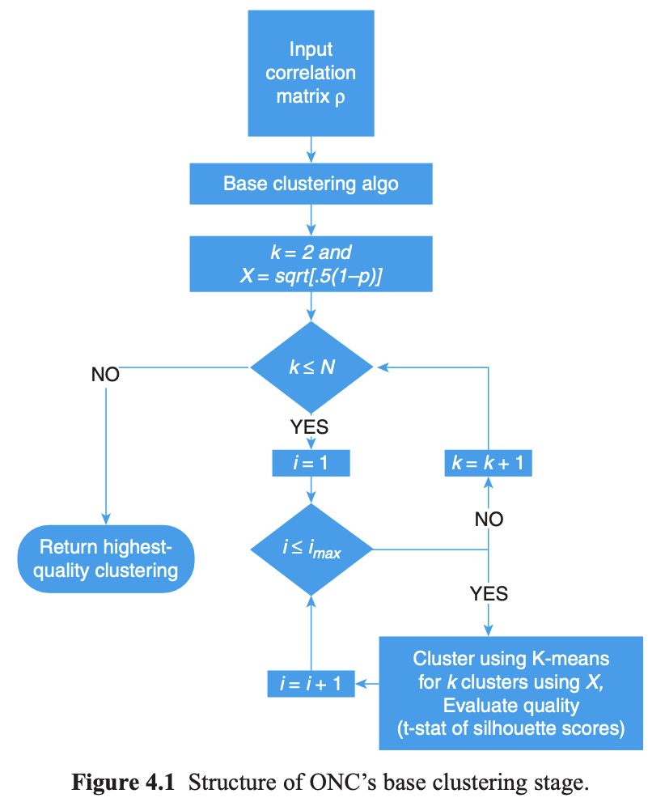
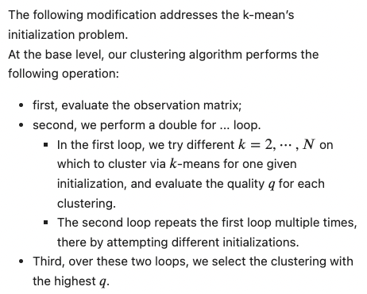
Base clustering

Slide 10
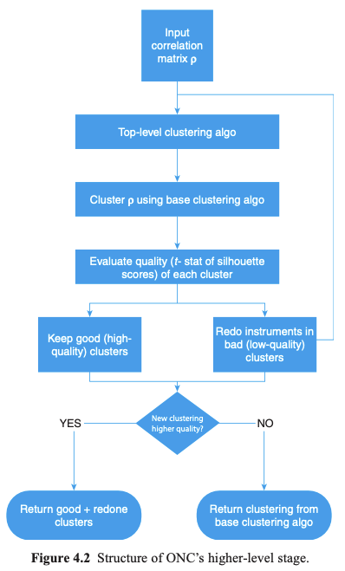
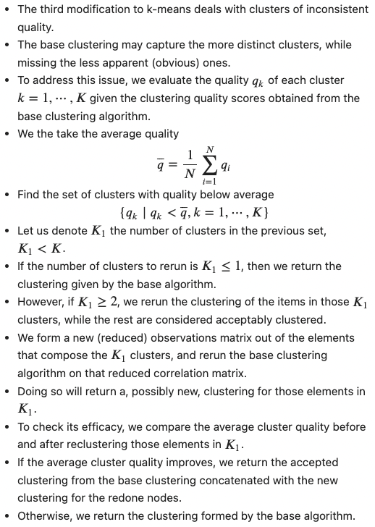
Higher-level clustering

Slide 12
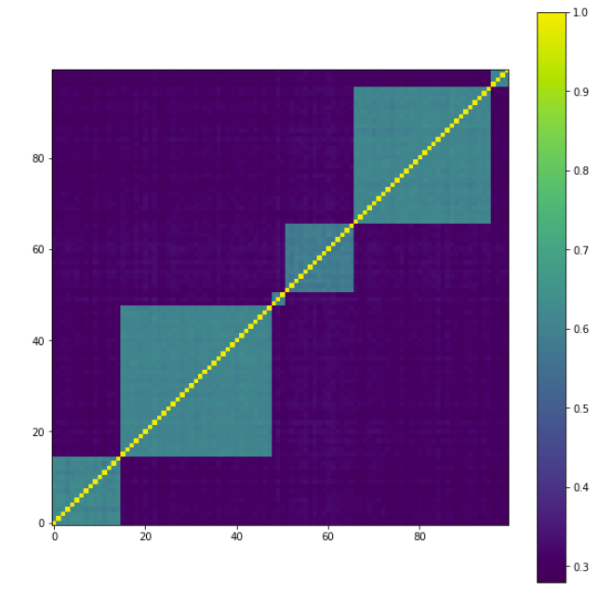
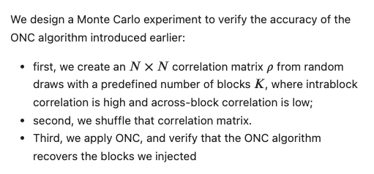
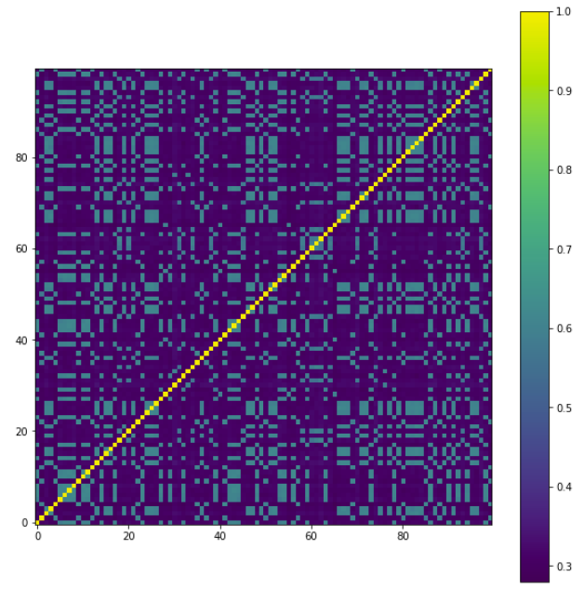
Experiment – setup

Slide 13
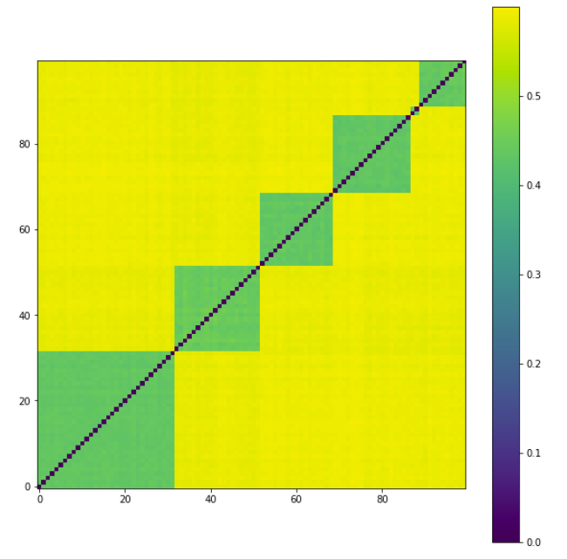
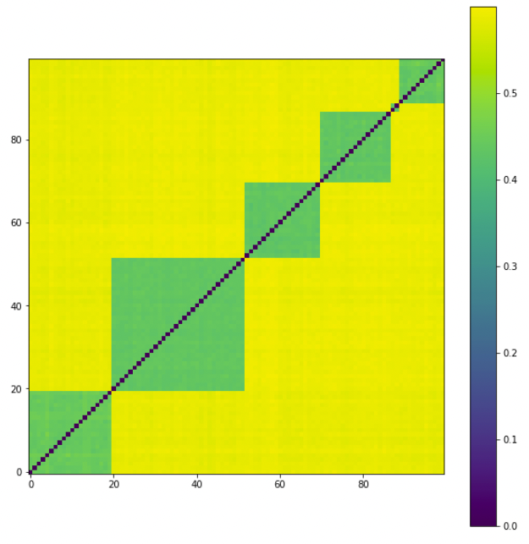
Experiment – Results
Base clustering
Pruned Base clustering

Slide 14
References

Slide 15
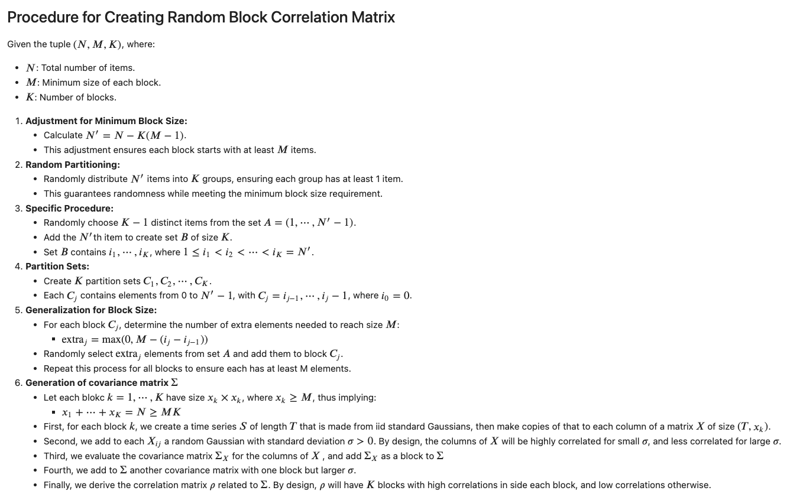
Appendix

