Slide 1
Modern CNN Architectures

Slide 2
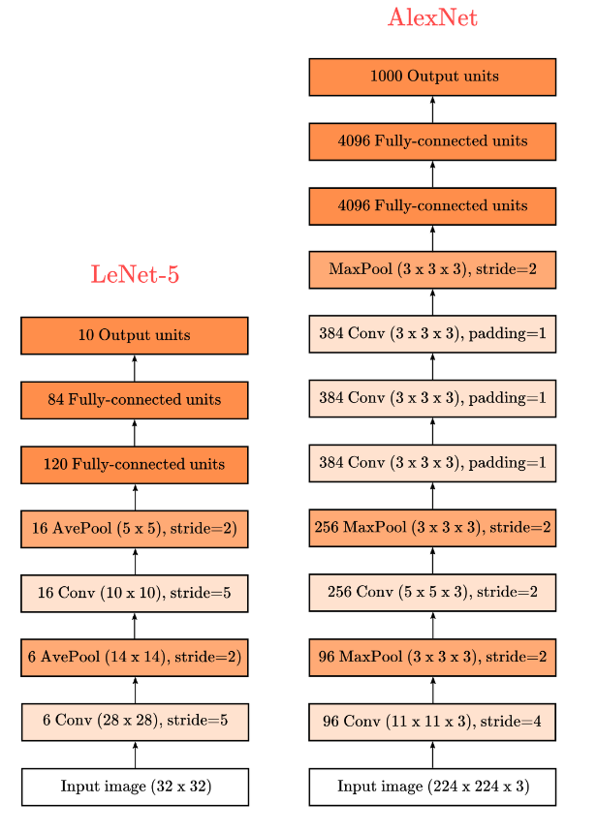
AlexNet
Deeper and wider
Uses ReLu (non linearity after convolution)
Uses dropout

Slide 3
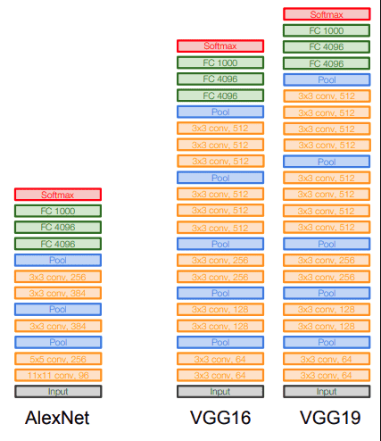
VGG
Deeper and thinner
Uses ReLu (non linearity after convolution)
Uses dropout

Slide 4
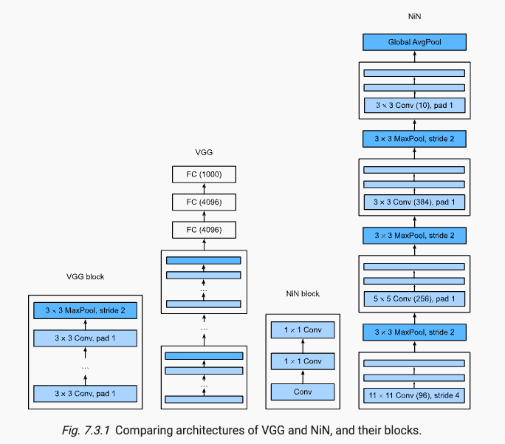
NiN
Introducing the 1x1 Convolution
Removes the FC layers
Uses ReLu (non linearity after convolution)
Uses dropout

Slide 5
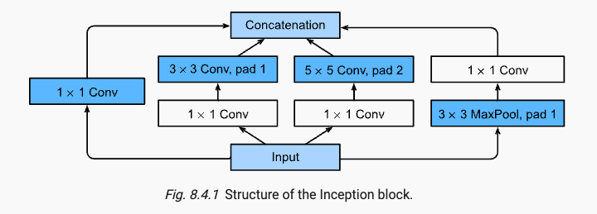
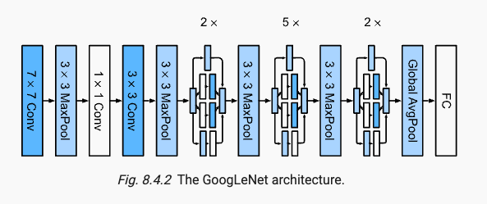
GoogLeNet
Inception block:
Multiple-views on low level features
Uses ReLu
Uses MaxPooling
No dropout !

Slide 6
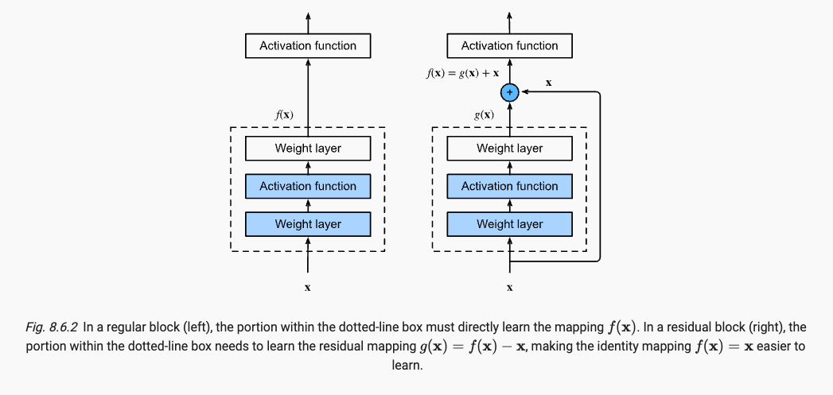
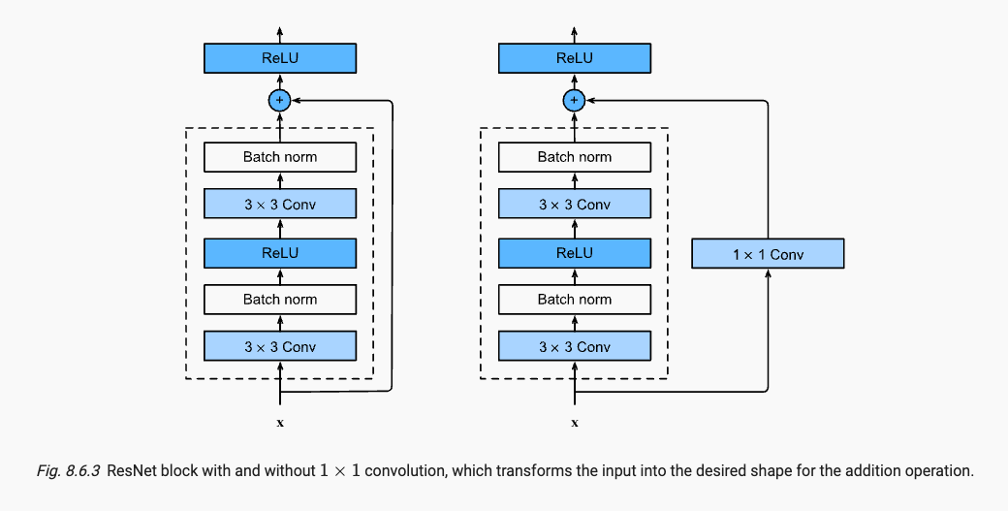
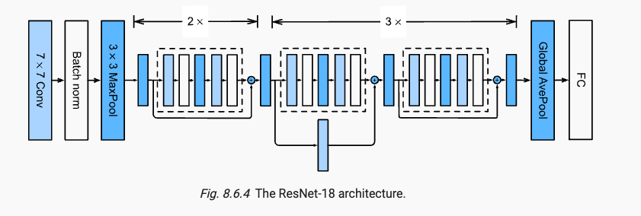
ResNet

Slide 7
ResNet
Residual block:
Boosting like mechanism
Uses ReLU
Uses BatchNormalization

Slide 8
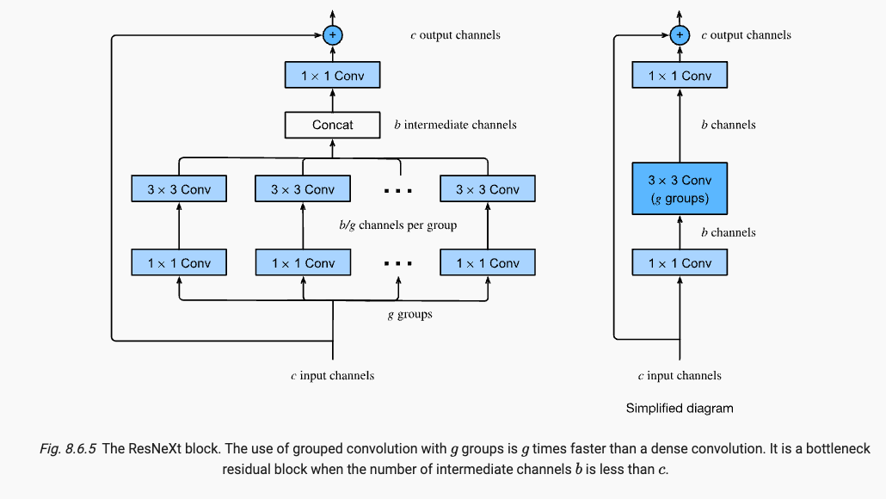
ResNetXt
The ResNeXt borrows the inception block multi-views

Slide 9
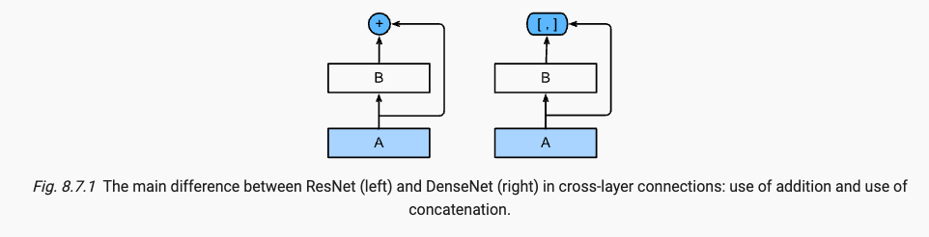
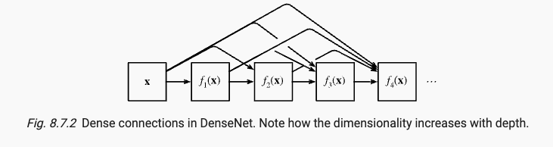
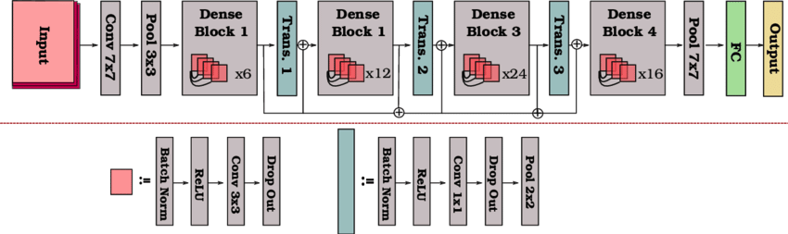
DenseNet

Slide 10
High level overview
Since AlexNet beat conventional computer vision models on ImageNet, it became popular to construct very deep networks by stacking blocks of convolutions, all designed by the same pattern.
In particular, 3×3 convolutions were popularized by VGG networks.
NiN showed that even 1×1 convolutions could be beneficial by adding local nonlinearities. Moreover, NiN solved the problem of aggregating information at the head of a network by aggregation across all locations.
GoogLeNet added multiple branches of different convolution width, combining the advantages of VGG and NiN in its Inception block.
ResNets changed the inductive bias towards the identity mapping (from f(x)=0). This allowed for very deep networks. Almost a decade later, the ResNet design is still popular, a testament to its design.
Lastly, ResNeXt added grouped convolutions, offering a better trade-off between parameters and computation.
A precursor to Transformers for vision, the Squeeze-and-Excitation Networks (SENets) allow for efficient information transfer between locations (Hu et al., 2018). They accomplished this by computing a per-channel global attention function.

Slide 11
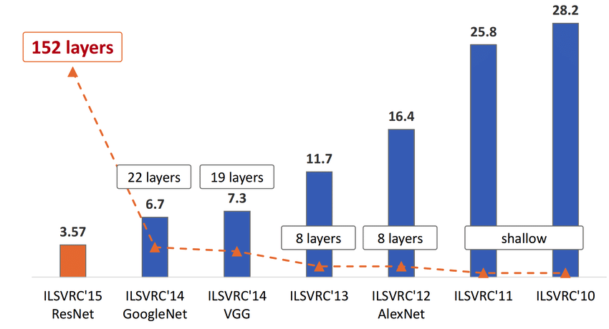
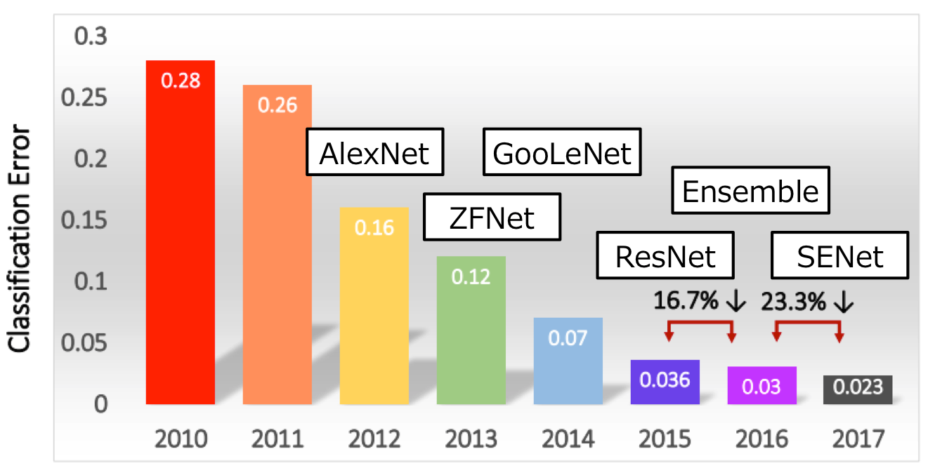
Performance Evolution

Slide 12
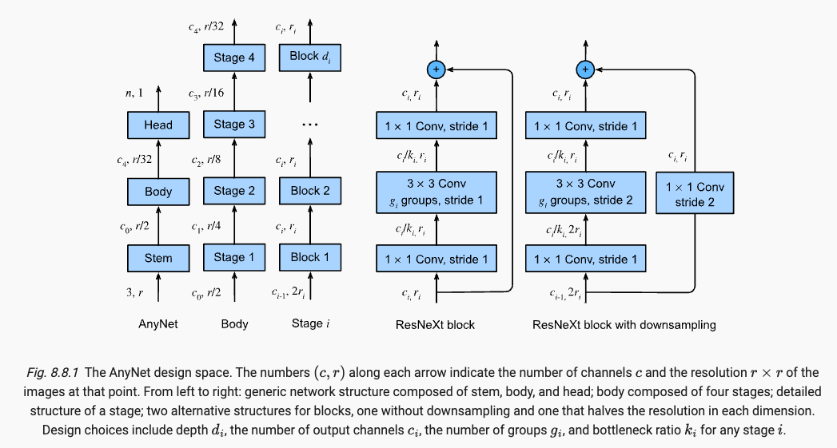
Designing CNN architectures
Radosavovic, I., Kosaraju, R. P., Girshick, R., He, K., & Dollár, P. (2020). Designing network design spaces. Proceedings of the IEEE/CVF Conference on Computer Vision and Pattern Recognition (pp. 10428–10436).

