Slide 1
NLP: Pre-Training
Oualid Missaoui

Slide 2
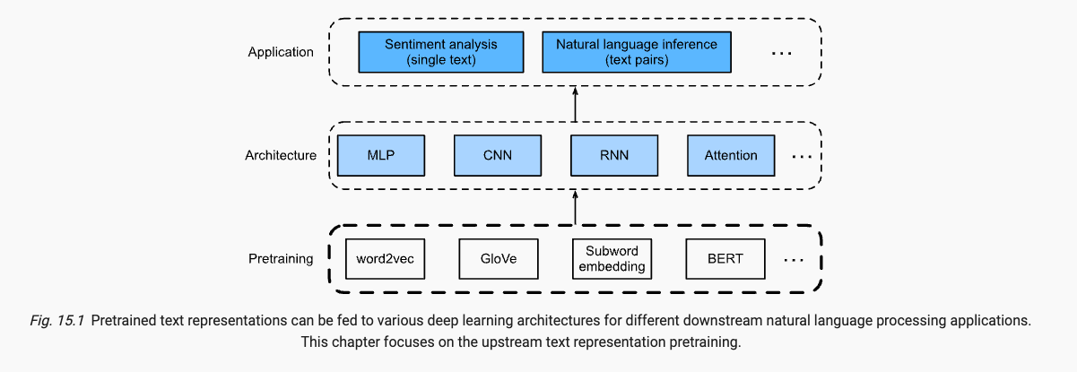

Slide 3
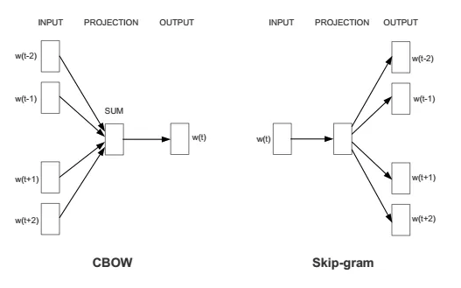
word2vec

Slide 4
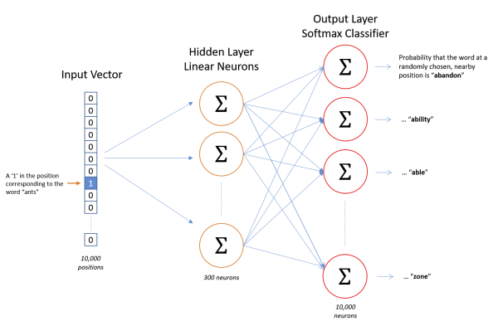
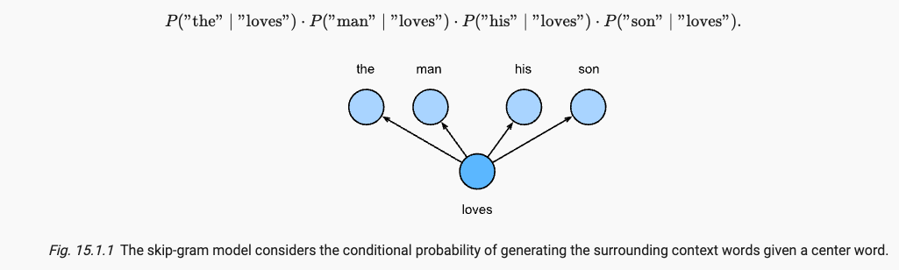
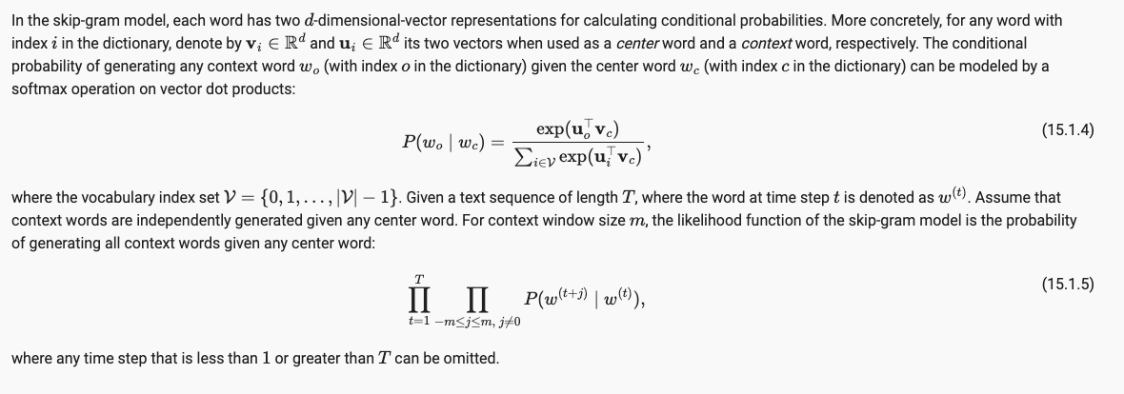
Skip-Gram

Slide 5
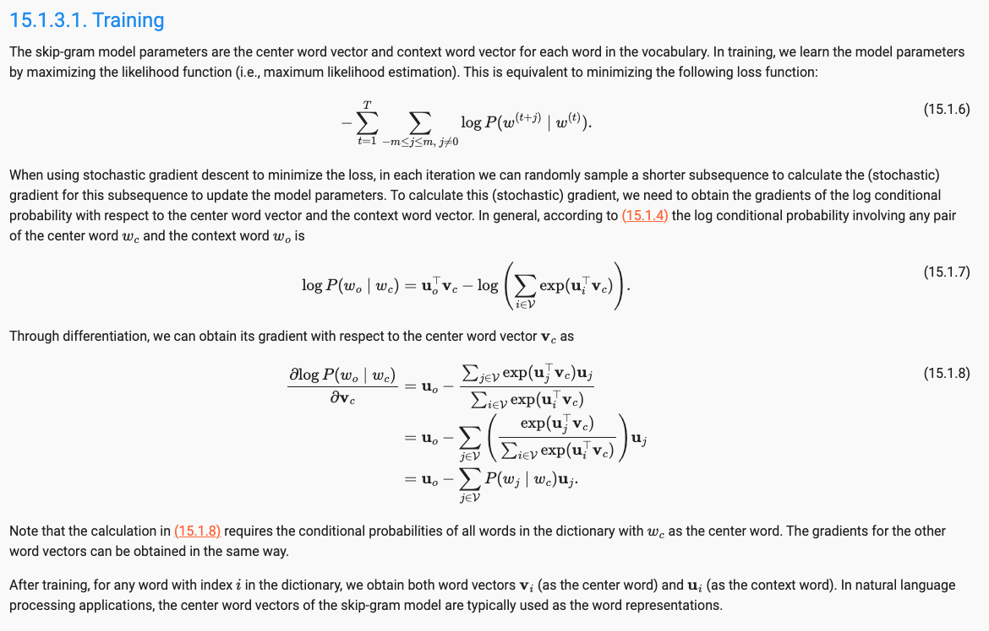
Skip-gram
Center word vectors are used for embedding

Slide 6
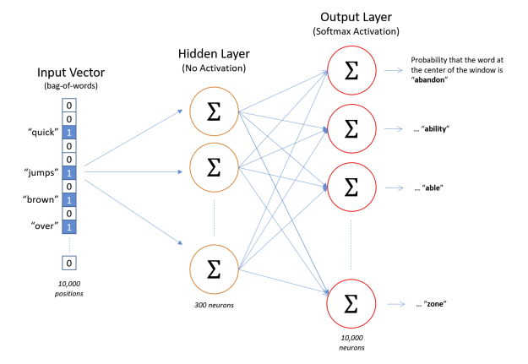
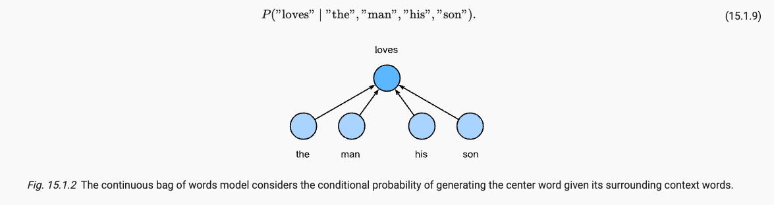
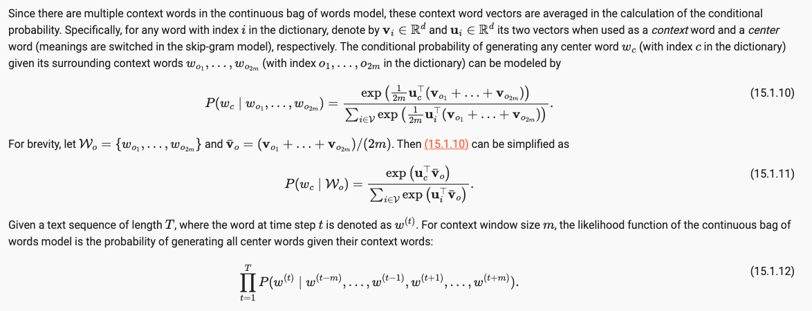
CBOW

Slide 7
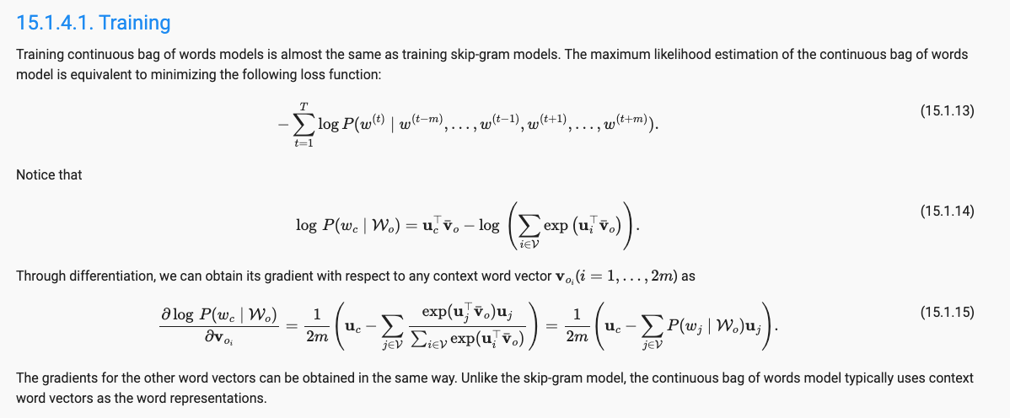
CBOW
Context vectors are used for embedding

Slide 8

Approximate training – Negative sampling
When training the network on word pairs (center, context), the label or correct output of the network is a one-hot vector. That is , for the output neuron corresponding to “context” to output a 1, and for all the other large number of output neurons to output a zero.
With negative sampling, we are instead going to randomly select just a small number of negative words (let s say five) to update the weights for.
Essentially, we go from multi-classification problem to multiple binary classification problems

Slide 9
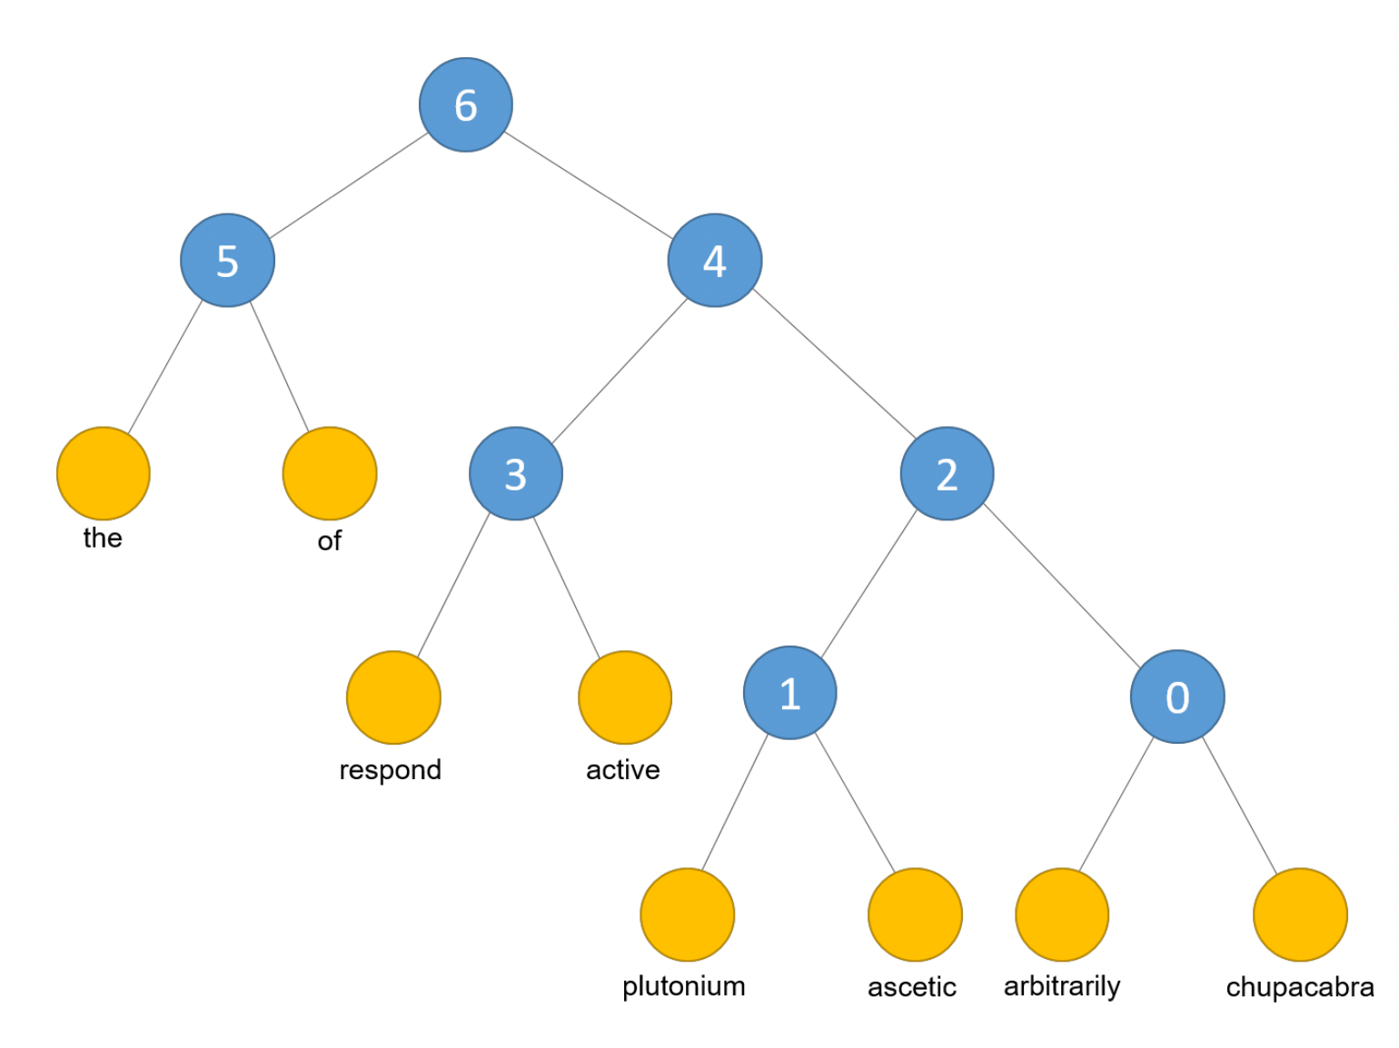
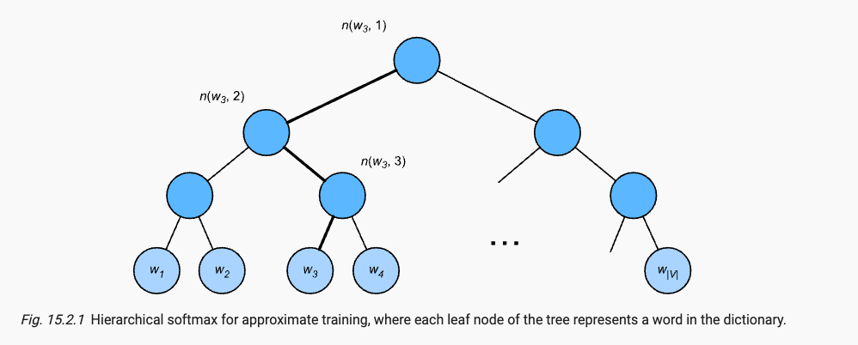
Hierarchical softmax
Reduces computational overhead by using a binary tree (Huffman) but keeps the soft-max objective

Slide 10
Skip-gram vs CBOW
Skip-gram generates many more samples than CBOW. The number of samples generated by skip-gram depends on the window size, whereas for CBOW there is only one sample per word in the sentence.
Practical differences:
Skip-gram takes much longer to train because it produces many more training samples
Skip-gram may perform better when the training set is small
Skip-gram may create better representations for rare words

Slide 11
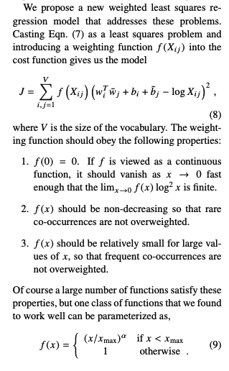
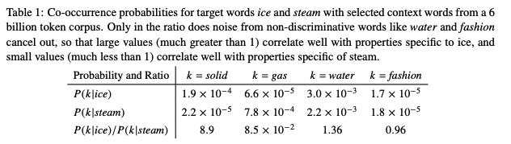
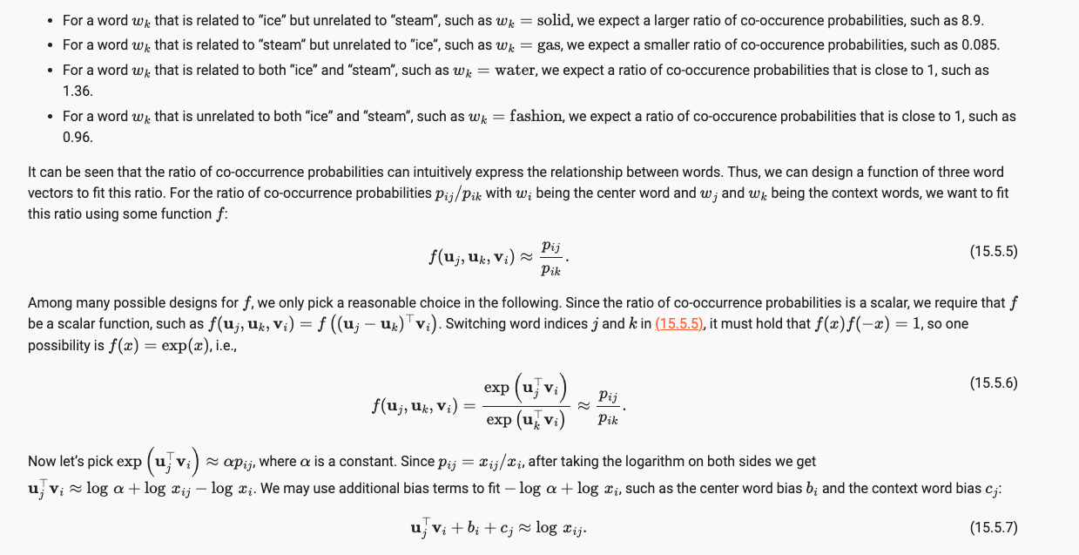
GloVe

Slide 12
fastText
Subword-level skip-gram

Slide 13
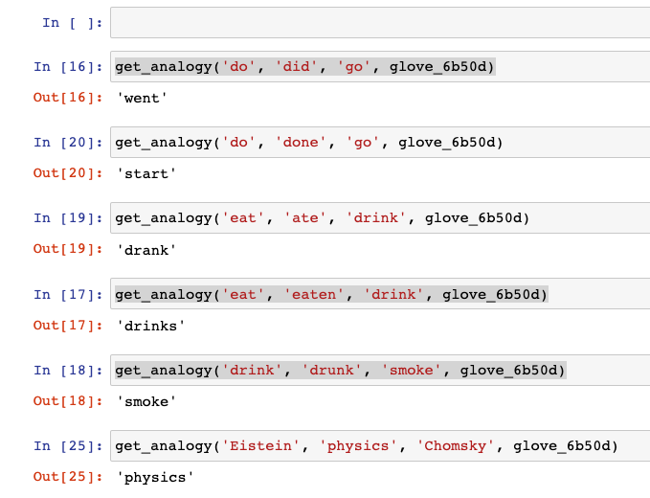
Similarity vs Analogy
Similarity
Embed, then cosine similarities between vectors
Analogy
For an analogy (a-b, c-d), given the first three words a,b,c , find d:
The word whose vector is most similar to vec(c ) + vec( b ) – vec ( a )

Slide 14
Context-sensitivity
Word2vec and GloVe are context-independent
Context-sensitive representations:
TagLM (language-model-augmented sequence tagger)
CoVe (Context Vectors)
ELMo (Embeddings from Language Models)

Slide 15
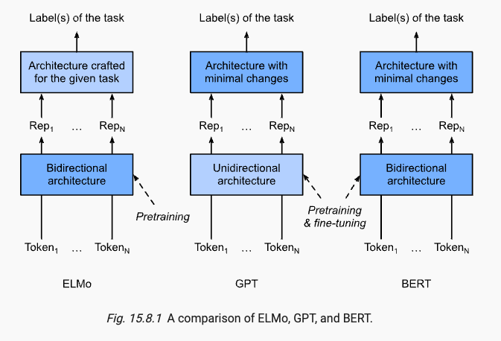
BERT
Pretraining:
Masked language modeling
Next sequence prediction

Slide 16
References
Blog posts
A mathematical introduction to word2vec model
How to train the word2vec model
The illustrated word2vec
Word2vec tutorial – The skip-gram model
Word2vec tutorial part2 – negative sampling
Intuitive Guide to Understanding GloVe Embeddings
Papers
Word2vec
Original publications
Mikolov et al., 2013, Efficient estimation of word representations in vector space.
Mikolov et al., 2013, Distributed Representations of Words and Phrases and their Compositionality.
Explanatory
Method Yoav Goldberg and Omer Levy, 2014, word2vec Explained: Deriving Mikolov et al.’s Negative-Sampling Word-Embedding
Glove
Original paper
Jeffrey Pennington et al, GloVe: Global Vectors for Word Representation
fastText
Original paper
Piotr Bojanowski et al, Enriching Word Vectors with Subword Information

