Slide 1
Optimal Clustering

Slide 2
Agenda
Motivation
Taxonomy of clustering algorithms
K-means
  Algorithm
  Limitations
Elbow method
Slihouette score
Base clustering: optimal number of clusters (ONC)
High level clustering: Pruned ONC

Slide 3
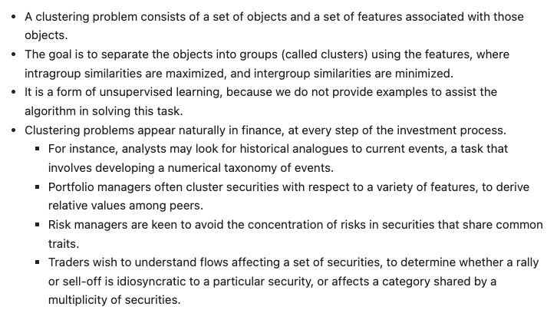
Motivation

Slide 4
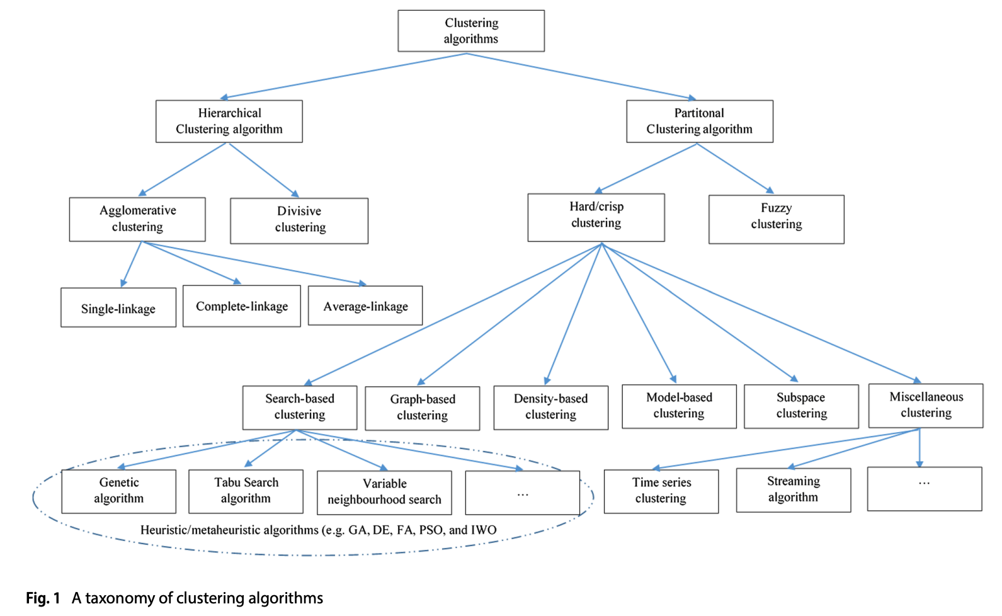
Taxonomy of clustering algorithms
source

Slide 5
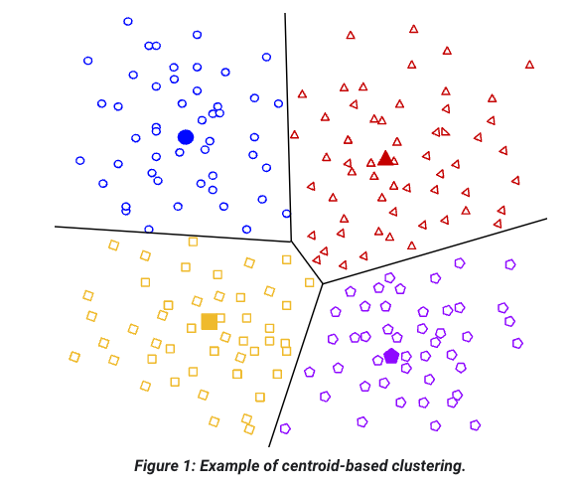
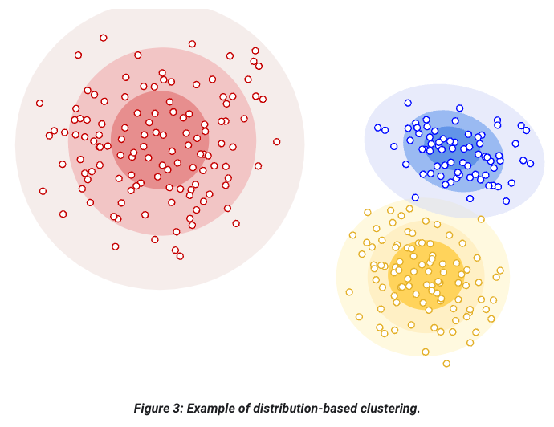
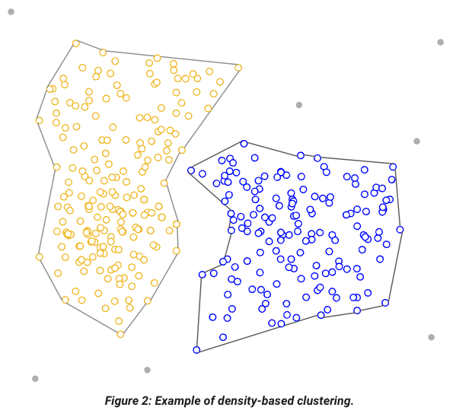
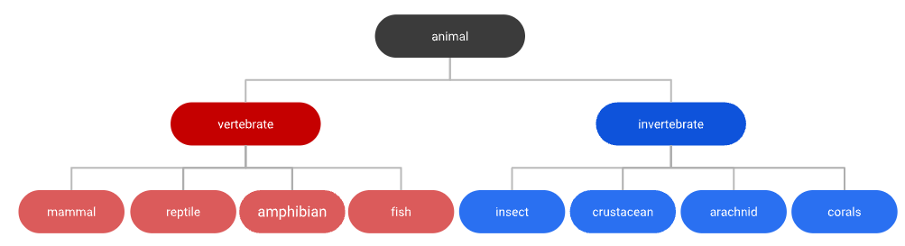
source

Slide 6
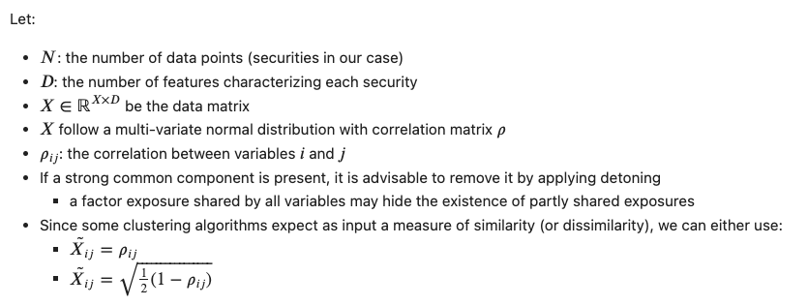
Setup

Slide 7
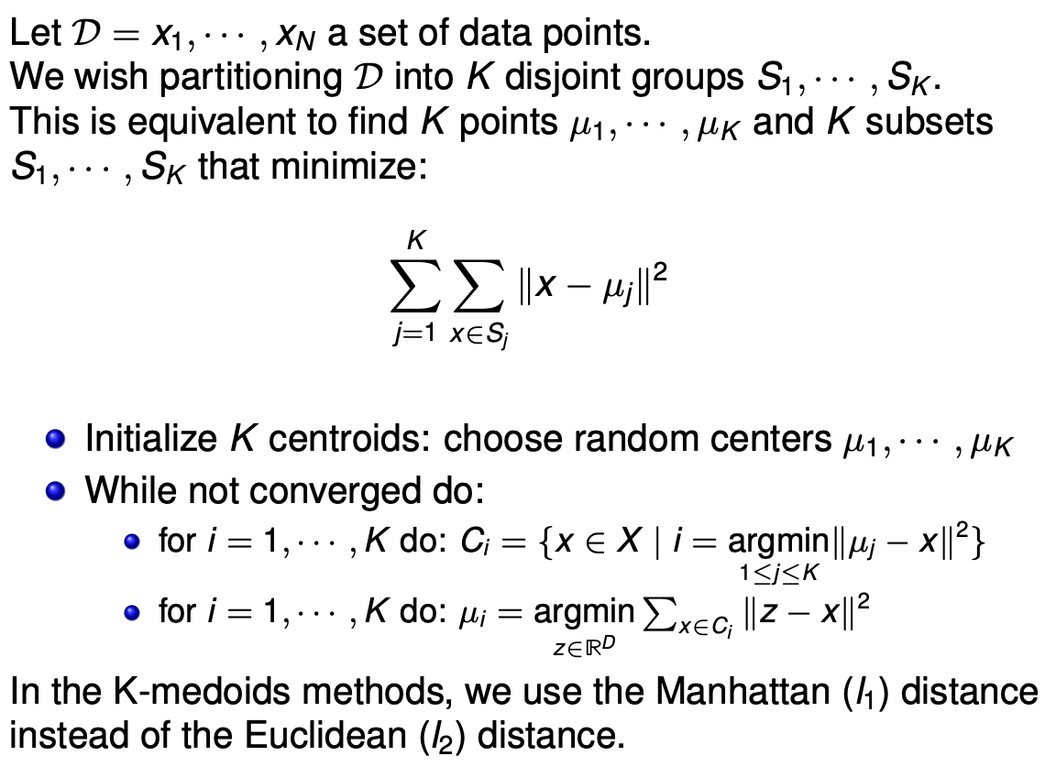
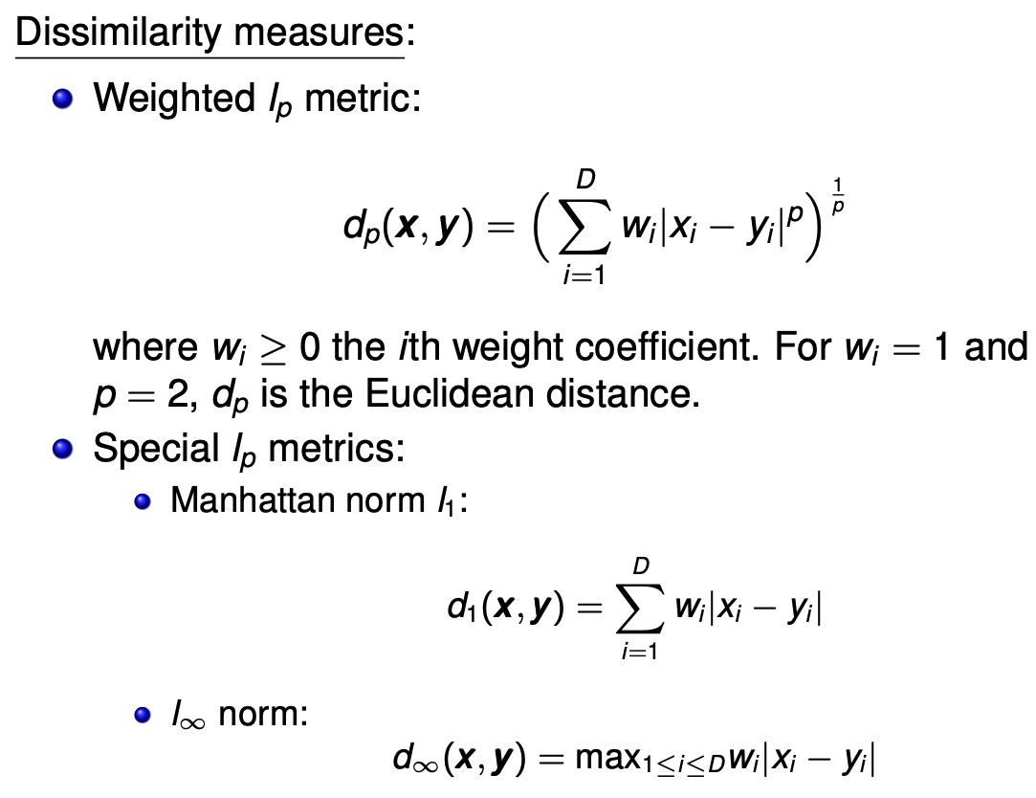
K-means

Slide 8
K-means limitations
The algorithm requires an user-set number of clusters K, which is not necessarily optimal a priori
The initialization is random, and hence the effectiveness of the algorithm can be similarly random

Slide 9
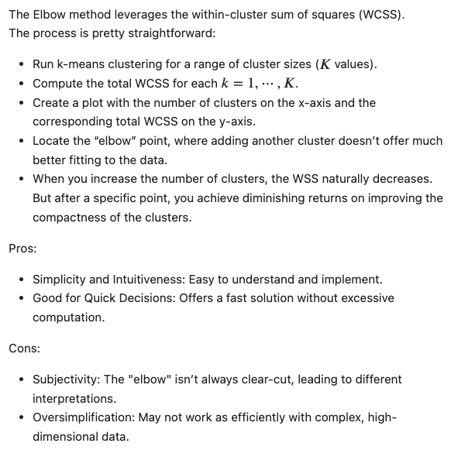
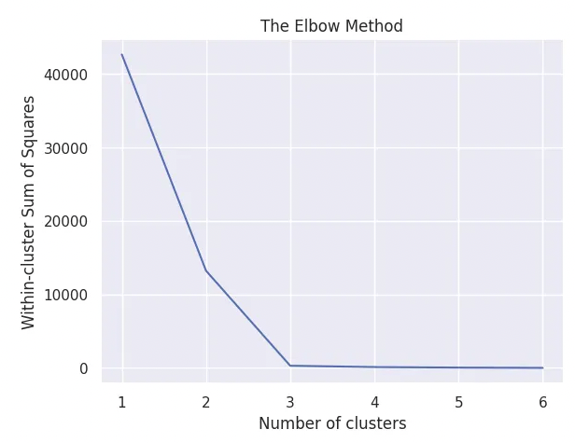
The Elbow method
source
source

Slide 10
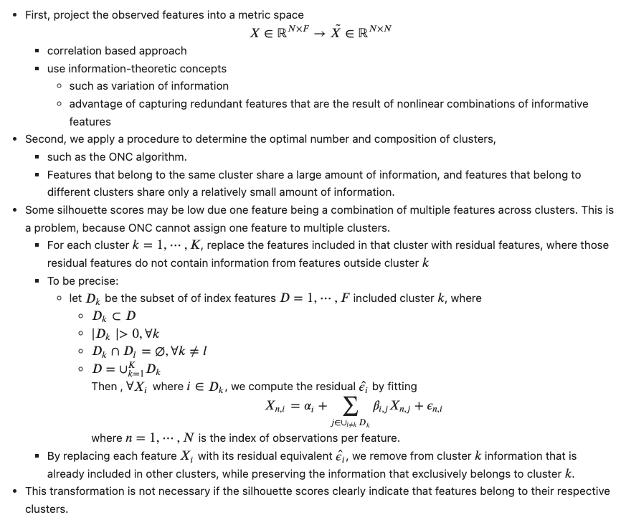
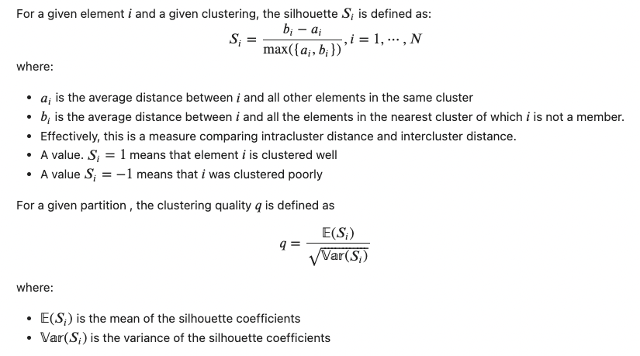
Silhouette score

Slide 12
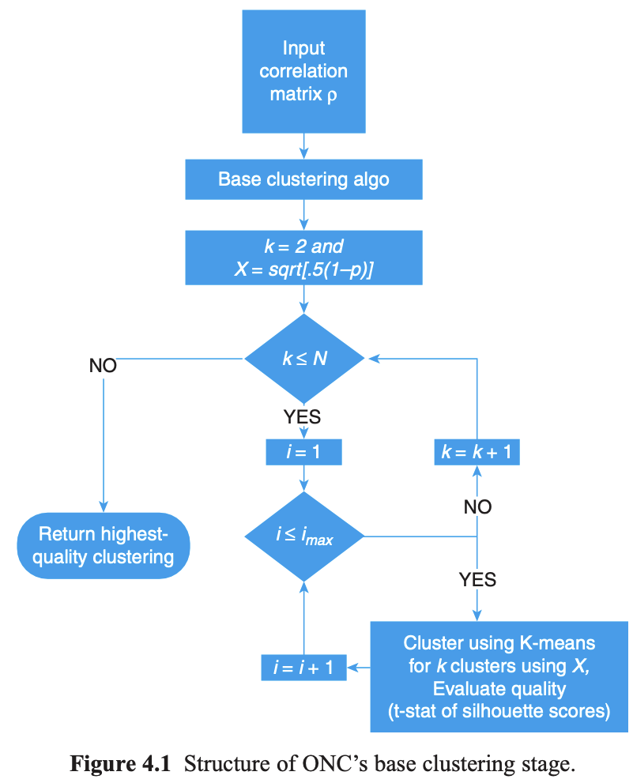
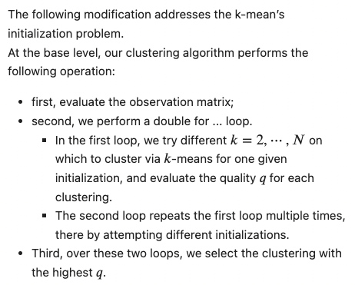
Base clustering

Slide 13
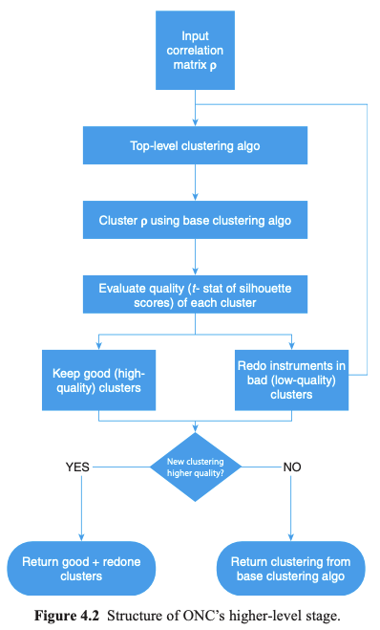
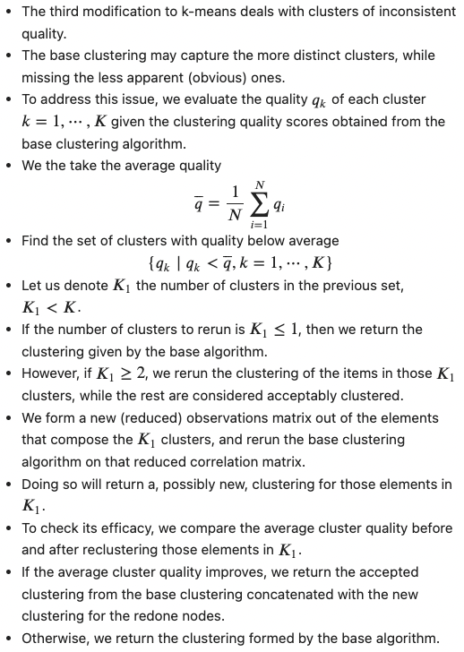
Higher-level clustering

Slide 14
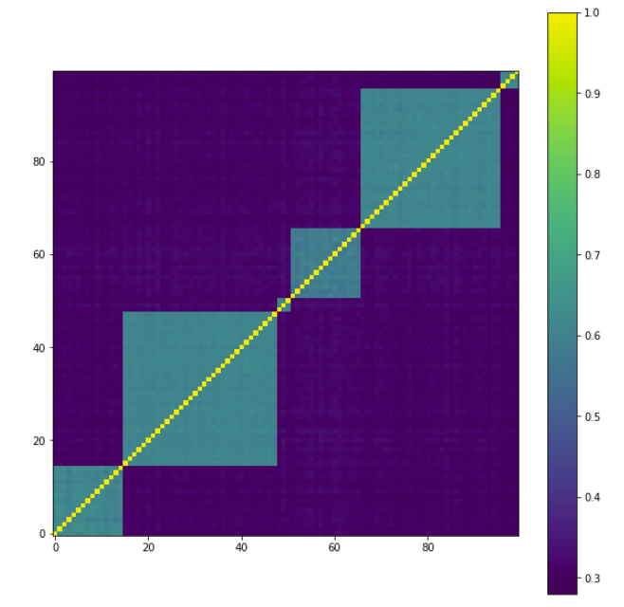
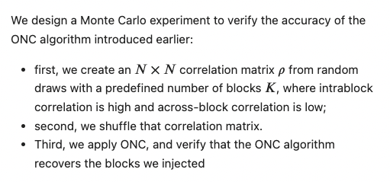
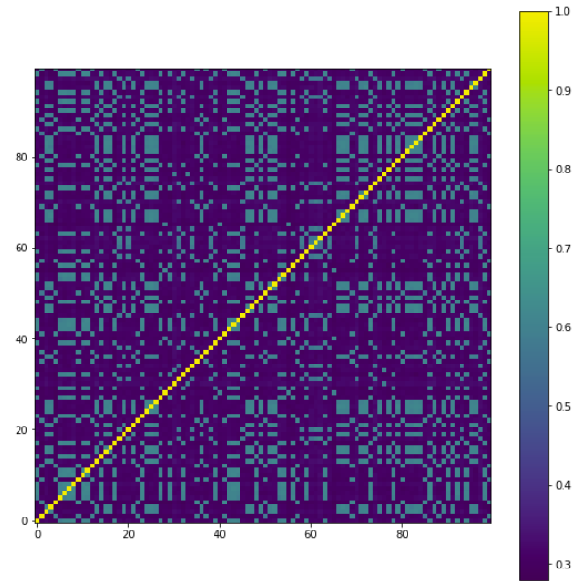
Experiment – setup

Slide 15
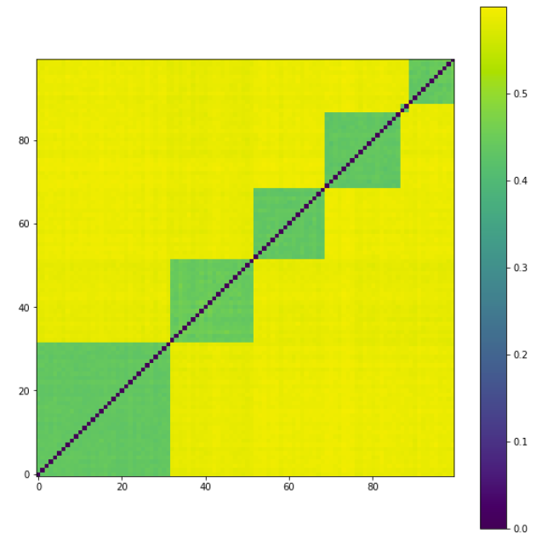
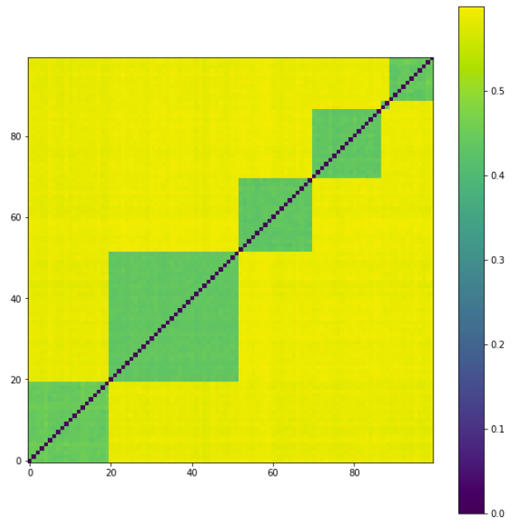
Experiment – Results
Base clustering
Pruned Base clustering

Slide 16
References
Geoffrey McLachlan and Thriyambakam Krishnan, The EM Algorithm and Extensions, 2008
Geoffrey McLachlan and David Peel, Finite Mixture Models, 2000
Sergios Theodoridis, Konstantinos Koutroumbas Pattern Recognition, fourth Edition, Elsevier. 2008
Charu Aggarwal, Chandan Reddy, Data Clustering: Algorithms and Applications, Chapman & Hall/CRC , 2013

Slide 17
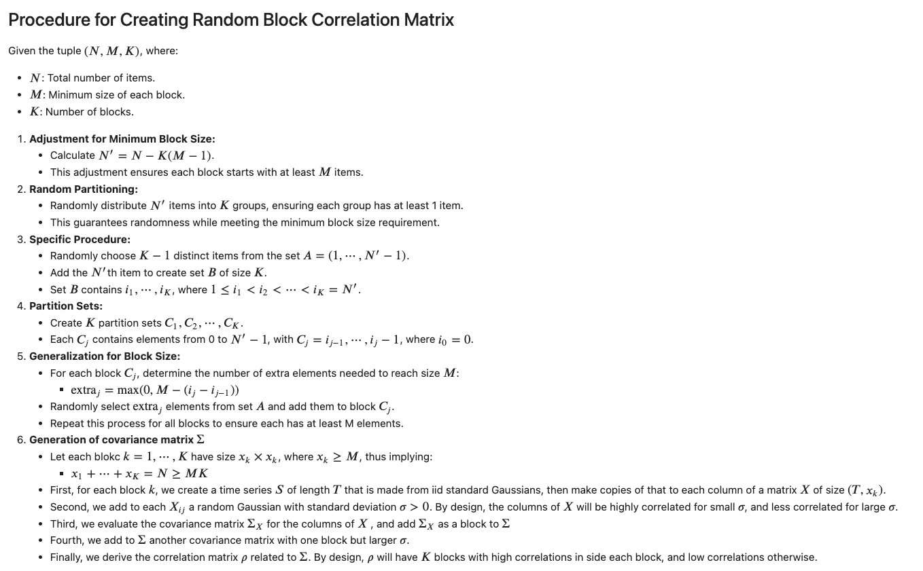
Appendix

