Slide 1
Symbolic Execution of Higher-order Functions in Big Data Systems
Omar Erminy

Slide 2
Introduction
Problem
Big data applications have become crucial in several areas, however, program verification techniques are seldom adapted to their context.
Notes:
Although big data has gained a lot of relevance lately. There has been very little research related to verification techniques that improve the quality of a program.
We believe there is a good opportunity to collaborate in this area by applying symbolic execution techniques.
Aim
This thesis aims to identify if symbolic execution techniques can be used in the context of Apache Spark as a big data framework to generate reduced input datasets that enforce full path coverage.
As in any other software, applications written for distributed big data frameworks are susceptible to bugs and errors. Although several program testing techniques have been ported to the context of distributed programming and have been the subject of research studies, program analysis approaches have received less attention both in the industry and the academia. Formal methods and code analyses could also prove useful towards the goal of improving code quality and their automated nature could provide a mechanism for a continuous evaluation.

Slide 3
Introduction
Research Questions
Is symbolic execution suitable for Spark applications?
What are its particular characteristics?
Is there a symbolic execution framework that can be adapted?
If so, what are its advantages and disadvantages?

Slide 4
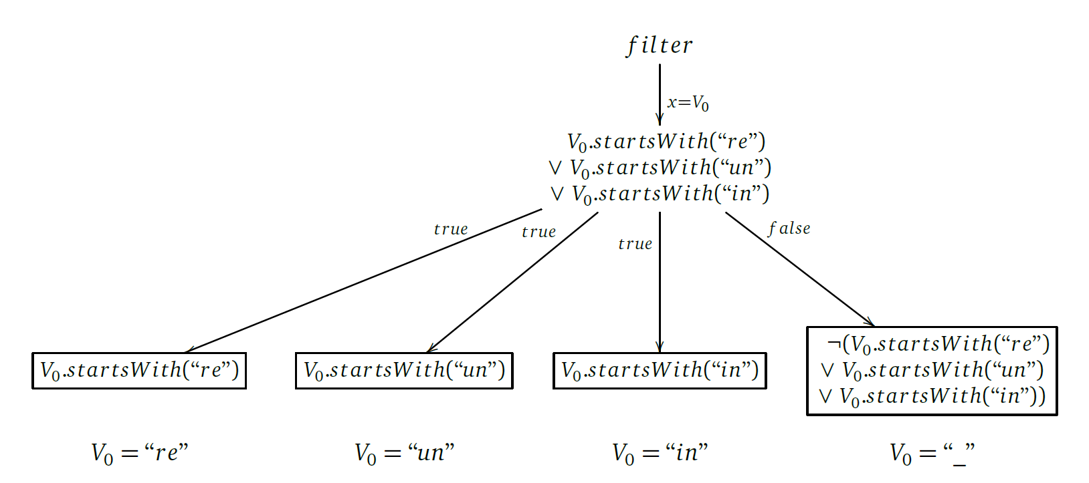
Symbolic Execution of Spark Programs
Example – Extended Word Count
1 JavaRDD <String > textFile = sc.textFile("hdfs://...");
2 JavaPairRDD <String , Integer > counts = textFile
3 .flatMap(s -> Arrays.asList(s.split(" ")).iterator())
Symbolic Execution Tree
4 .filter(x -> x.startsWith("re") || x.startsWith("un")
|| x.startsWith("in"))
5 .mapToPair(word -> new Tuple2 <>(word , 1))
6 .reduceByKey((a, b) -> a + b);
7 counts.saveAsTextFile("hdfs://...");
Minimal Input Dataset = {“re un in _”}
Example adapted from [3]
Notes:
I would like to show an example of a Spark program and how the application of a symbolic execution analysis will look.
Word count algorithm has become the de facto example used in studies related to big data frameworks and distributed processing
flatMap -> Source file to Words
mapToPair -> words to pairs of words and the number 1
reduceByKey -> each word and its total number of occurrences
I included a filter operation that imposes a conditional statement on the structure of the words.
Execute, instead with concrete parameters, with a symbolic variables that collect the transformations done to the input.
Symbolic executions can be visualized with a symbolic execution tree.
Symbolic Execution Tree:
Node -> branching instructions
Edges -> Transformations
Leaves -> Path conditions
Word count [16] has become the de facto example used in studies related to big data frameworks and distributed processing. We present a modified version of the regular word count example that allows us to illustrate the use case of symbolic execution in Spark programs. The goal of the word count algorithm is to process a document or group of documents to determine how many times each word appeared in the analyzed data. The modification we introduce puts a restriction on the structure of the words that are counted; only words that begin with a certain prefix are considered in the algorithm. This modification permits the existence of multiple paths while still keeping the original notion of the word count example.
The filter operation will filter out all words except those who begin with the “re”, “un”, and “in” prefixes. The only condition imposed on the structure of the input data is introduced by this action, hence it is only relevant to analyze the filter transformation in order to determine all possible execution paths.

Slide 5

Background
Big Data Framework
Analysis Framework
Java PathFinder
References [1, 5]
Notes:
Our research is based in two technologies.
Spark as the big data framework
Java PathFinder as the program verification environment

Slide 6
Apache Spark
It is a distributed large-scale data processing framework.
It makes use of a shared memory abstraction called Resilient Distributed Dataset (RDD).
Many of the operations defined on its API are defined as higher-order functions.
References [1, 10]
Notes:
It is a distributed large-scale data processing framework, first developed at Berkeley University and later donated to the Apache Foundation.
A shared memory abstraction called RDD is used to represent collections of data. The use of RDDs allows Spark to operate very fast.
Its API is designed following functional programming paradigms to operate collections which rely in the uses of higher-order functions. The operations are divided in transformations that operate in single element of the RDD independently and actions that operate on the whole RDD. (usually aggregate functions)
Spark is a distributed data processing framework that was first introduced in 2012 [68]. Similar to other systems, such as MapReduce [16] and Dryad [29], it aims to provide a clean and flexible abstraction to distributed computations on large datasets. However, Spark offers two advantages in comparison to such systems: It makes use of a shared memory abstraction that improves performance by avoiding persisting intermediate sets.
The working units in Spark are called Resilient Distributed Datasets, better known as RDDs. These units represent an immutable partitioned collection of elements in a distributed memory space. RDDs can only be created through a set of deterministic operations, known as transformations. Additionally, RDDs can be made persistent into storage or can be operated to produce a value. This kind of operations are known as actions.
To interact with the RDD abstraction, Spark provides several APIs for different programming languages. Many of the operations defined on the APIs come from principles in functional programming languages that define abstractions to interact with data collections. These abstractions are mostly implemented through the use of higher-order functions.

Slide 7
Java PathFinder (JPF)
It is an execution environment for verification and analysis of Java bytecode programs.
Its default mode of operation is explicit state model checking.
References [4, 5, 6]
Notes:
What is JPF?
It is an execution environment for verification and analysis of Java bytecode programs.
Developed by NASA‘s Ames Research Center.
It is implemented as an instrumentalized JVM that executes the bytecode.
It default mode of operation is explicit state model checking, which among many things explores all the possible values a primitive can get, for example.
What is a state in JPF?
A state is characterized by three aspects: the information of existing threads, the contents of the heap, and the sequence of previous states that led to the current execution point (also known as path).
Developed at NASA’s Ames Research Center [43], Java PathFinder (JPF) is an execution environment for verification and analysis of Java bytecode programs [62, 32]. Since its publication in the year 2000 [26], JPF has evolved from being a model translator to a fully fledged, highly customizable virtual machine capable of controlling and augmenting the execution of a program.
The default mode of operation of JPF is explicit state model checking. This means that JPF keeps track of the execution status of a program, commonly referred to as a state, to check for violations of predefined properties.

Slide 8
Java PathFinder (JPF)
Example – Random Numbers
1 import java.util.Random;
2
3 public class RandomExample {
4 public static void main(String[] args) {
5 Random random = new Random();
6 int a = random.nextInt(2);
7 int b = random.nextInt(3);
8 int c = a/(b+a-2);
9 }
10 }
ArithmeticException: division by zero For values:
a = 0 and b = 2 a = 1 and b = 1
Example taken from [5]
Notes:
Random Example
The analyzed program represents a trivial division of two random values. However, the problem relies on the fact that, under some specific values, the operation could yield invalid. Problems like this, where computations depend on random and unbounded values, are common sources of bugs in real software and, in many cases, are difficult to identify.
Line 8 could lead to an ArithmeticException, division by 0

Slide 9
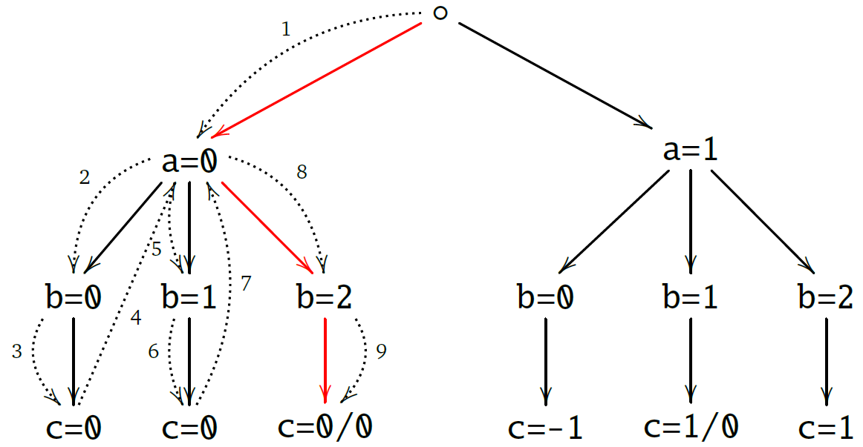
Java PathFinder (JPF)
Example – Random Numbers
1 import java.util.Random;
2
3 public class RandomExample {
4 public static void main(String[] args) {
5 Random random = new Random();
6 int a = random.nextInt(2);
7 int b = random.nextInt(3);
8 int c = a/(b+a-2);
9 }
10 }
Example taken from [5]
Notes:
Random Example
JPF starts executing the program until it finds a nextInt invocation. It sets a checkpoint and takes the first possible value. The same happens in the next nextInt. If the program finishes and there has no exception JPF backtracks to the latest checkpoint and tries a different value.
Eventually, the combination of values is found and the potential exception is detected.
Figure 2.5 depicts how JPF explores the state space of the program shown in Listing 2.4. JPF starts checking the state space whenever the conditions that trigger the property to be validated are found; in this case, using random values. The nextInt instruction causes JPF to register a Choice Generator and start exploring the state space of the possible options. The dashed edges represent the search strategy used to explore the state space; in this case depth-first search. If a given execution path gets to an end and no unexpected behavior is found, JPF backtracks to the latest instruction where a Choice Generator was registered and tries a different value. The red arrows point to the first execution that triggers an error. Whenever an error is found JPF halts the validation and reports its findings.

Slide 10
Java PathFinder (JPF)
Components
Bytecode Factories: Semantics
Choice Generators: Checkpoints and state exploration
Listeners: Property validation
Native Peers
Publishers
Search Strategies
References [4, 5]
Notes:
JPF Components.
• Bytecode Factories: Define the semantics of the instructions executed by JPF.
• Choice Generators: Defines a checkpoint in the program as well as a set of possible values.
• Listeners: React to particular events triggered during the execution of an analysis. Useful for asserting properties.

Slide 11
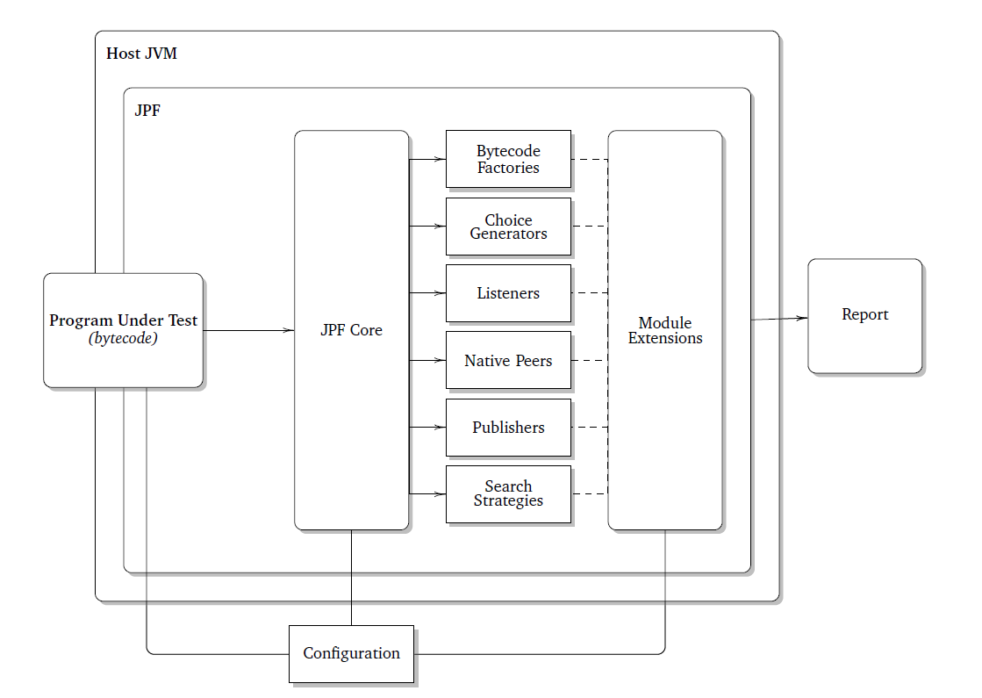
Java PathFinder (JPF)
Example adapted from [5]
Notes:
JPF Components.
Relevant from here is to mention the module extensions.
Figure 2.4 depicts the components that participate in a verification process using JPF. The program under test, taken as bytecode, is loaded into the JPF Virtual Machine which is in turn executed on top of the host JVM. The instructions of the program are executed one by one until an execution choice is found. At this point, JPF records the current state and attempts to resume execution, exploring all possible scenarios based on the choice criteria. Once a chosen path has been completely explored, JPF backtracks to a recorded state in order to explore a new path. Libraries used in the program under test need to be visible to the core in order to be able to execute the program correctly. Note that the core is comprised of several components in charge of directing the execution of the analysis. The behavior of these components could be extended by including modules. The final output is a report in its general sense; this could range from simple console output to automatic test generation.

Slide 12
Symbolic PathFinder (SPF)
Extensions
Bytecode Factory: Full implementation of the symbolic semantics
Choice Generators: Registered whenever a branching instruction is executed (PCChoiceGenerator)
Solvers: Third-party constraint solvers used to process the path conditions (Choco, Coral, CVC3)
References [2, 7, 8, 9]
Notes:
Bytecode Factory: Full implementation of symbolic semantics. Take for instance the IADD bytecode instruction that sums two integers. If one of the inputs to sum is a symbolic value then the result is a symbolic expression.
Choice Generators: Set checkpoints on symbolic conditions and build the path conditions by indicating which path was chosen; the one that yields true or the one that yields false.
Solvers: In charge of solving the path conditions to identify a concrete value that represents the path.
The introduction of symbolic semantics is achieved through the use of the SymbolicInstructionFactory class; an extension to the default bytecode instruction set that interacts with symbolic values and expressions. SPF supports symbolic operations on several primitive types: booleans, integers, and doubles. Nevertheless,
only limited support to symbolic data structures and String operations is offered in the latest SPF version.
For example, operating two symbolic integers using the IADD bytecode instruction results in the creation of a symbolic expression that represents the sum of those integers. Furthermore, symbolic values and expressions are assigned to variables and fields, instead of the corresponding concrete representation that would result from a normal execution.
The interpretation of branching instructions is a key point of symbolic execution because it determines how the subsequent paths ought to be explored. SPF processes branches by generating a special choice generator called PCChoiceGenerator every time a conditional instruction is found. The choices registered
by the choice generator correspond to the evaluation of the predicate and its negation respectively, where each choice is linked to a path condition reflecting how the predicate was evaluated.
SPF checks the satisfiability of path conditions using third-party constraint solvers like Choco [47], CORAL [55], and CVC3 [7]. Most of these solvers are geared towards solving complex numerical constraints while solving structural constraints (like String predicates) are limited at best or incompatible at worst. If a path condition is unsatisfiable, SPF backtracks to the latest branching point and tries out a different choice.

Slide 13
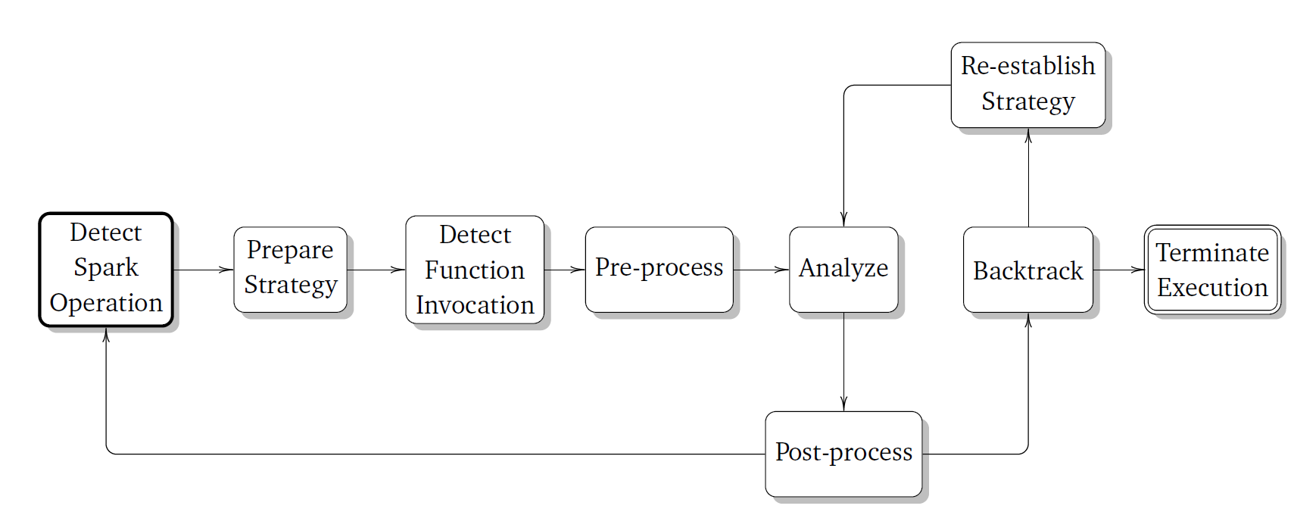
Symbolic Execution of Spark Programs
How to do it? – Conceptual Process
Notes:
We have seen that some operations have intrinsic control flow semantics, such as the case of filter.
Additionally, given that the operations are higher-order functions, control flow instructions be included in the function passed to the operations.
Based on the way JPF works, this diagram shows how the design of the analysis would look like.
The starting point of the analysis consists in detecting that a Spark operation of interest is being executed; relevant operations can be defined by the user beforehand. Once this has happened, the next step is to prepare for the exact operation that was detected, for example, indicating what function was passed to
the detected operation and prepare the SPF analysis to consider its input parameters as symbolic values. Generally, these two steps occur simultaneously but given their semantic differences in the process, it was important to highlight them as different states of the analysis.
The real analysis begins once the passed function is invoked. The process is split into three stages: preprocessing, analysis and post-processing. During the pre-processing stage, we must ensure that the parameters passed to the function are correctly instantiated; for example, if a map and a filter transformations took place in that order, we must ensure that the input symbolic expression passed to the function executed by the filter is the output of the function invoked by the map transformation. This guarantees a coherent inter-methodical analysis. The subsequent stage is the core analysis, which proceeds in the same way as an analysis of a regular method in SPF would do. Lastly, during the post-processing stage the framework makes all the necessary preparations to be able to continue the symbolic execution of subsequent Spark operations.
Once the analysis of a Spark operation is done, the framework continues to explore the program. This can lead to the detection of another relevant Spark operation. Finally, once the execution has finished, JPF will backtrack to any decision points defined by the Choice Generators. These points always take place
inside one of the functions passed to any Spark operation; this is why the framework has to re-establish a strategy corresponding the Spark operation containing the invoked function. The analysis continues as usual once the strategy has been re-established. After all choices have been explored, the execution terminates and the analysis provides an output.

Slide 14
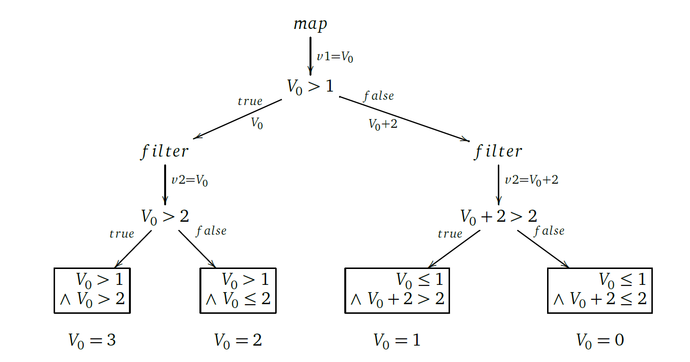
Symbolic Execution of Spark Programs
Example – Multiple Operations
Symbolic Execution Tree
1 numbers.map(v1 -> {
2 if(v1 > 1) return v1;
3 else return v1+2;
4 })
5 .filter(v2 -> v2 > 2);
Minimal Input Dataset = {3, 2, 1, 0}
Notes:
The selective word count algorithm is a good example to convey the usefulness of symbolic execution analyses in the context of big data programs. However, it is not capable of illustrating some particular considerations given the lack of connected constraints between operations.
The trivial example presented in Listing 3.2 depicts a simple Spark program with no purpose in itself. Nonetheless, this simple example allows us to better explain how the analysis will be carried out when several relevant operations are present in the program under test. The relevant Spark operations in this example are the map and filter transformations in lines 4 and 8 respectively. All other operations related to Spark are not relevant.
The first operation detected during the analysis is the map transformation in line 4. At this point, the analysis opts for a “map” strategy and prepares itself for the imminent invocation of the function passed to the map. Once the function is invoked, the framework proceeds to the pre-processing stage, however, because no previous operations were executed, the initial input for the function is a trivial symbolic reference (V0).
During the symbolic execution of the function, we find that there is a branching instruction in line 5. This represents a decision point and, for this reason, a choice generator is registered with two options: one where V0 is greater than one and another where it is less than or equals to one. The control flow continues with one of the paths and stores the other for a later exploration. Given the nature of the map transformation, the input parameter might suffer a certain transformation which, in turn, is the returned value as it is shown in line 6. During the post-processing of the operation, the symbolic expression V0 + 2 is then set to be the input value of the immediate Spark operation, which in this case is a filter. The filter transformation is processed in a similar fashion except that in this case the input value used in its function is instantiated to whatever output generated the map transformation.
The function passed to the filter transformation returns a boolean that depends on the symbolic input value. Given the nature of this kind of instruction, SPF registers a choice generator in order to explore the possible outcomes of evaluating the boolean condition. Again, one of the paths is chosen and the analysis
continues. At this point, there are no more relevant Spark operations and the execution comes to an end, thus, triggering a backtrack to the last unexplored path. Finally, the analysis continues until there are no more unexplored paths left.
When observed in this way, the analysis of the program turns out to be similar to the sequential execution of the respective input functions of each of the Spark operations in the program. However, this is not always the case given that some operations have particular semantic implications, for example, flatMap produces multiple symbolic outputs, hence, making it impossible to simply connect the function passed to a flatMap as it is, to any following operation.
After the analysis is done, the module can solve the resulting path conditions and obtain a representative value in the range to produce a reduced input dataset that is able to offer full path coverage of the program.

Slide 15
Symbolic Execution of Spark Programs
How to do it? – JPF-SymSpark
JPF-SymSpark is a JPF module built on top of SPF whose goal is to coordinate the symbolic execution of Apache Spark programs.
Programs must be written for the Java’s RDD API.
It produces a reduced input dataset that ensures full path coverage.
Notes:
JPF-SymSpark is a JPF module whose goal is to coordinate the symbolic execution of Apache Spark programs written for its Java API to produce a reduced input dataset that ensures full path coverage on a regular execution. It builds on top of SPF to delegate the handling of symbolic expressions while it focuses on how to interconnect Spark’s transformations and actions in order to reason coherently over the execution flow of the program.

Slide 16
JPF-SymSpark
Extensions
Bytecode Factory: Detection of Spark operations. Only interested in the INVOKEVIRTUAL instruction
Listeners: Stateless orchestrator of the symbolic execution of a sequence of Spark operations
Choice Generators: Used to correctly reproduce the behavior of some of the Spark operations
Publishers: Produce a reduced input dataset and notify unfeasible path conditions
Notes:
Bytecode Factory: We implemented the SparkSymbolicInstructionFactory class, which extends from the SymbolicInstructionFactory class defined in the SPF module. The goal of this class is to solely intercept calls to the INVOKEVIRTUAL bytecode instruction and validate if they intend to dispatch one of the Spark operations relevant to the analysis. Given that all relevant operations in the concrete JavaRDD class are implemented as non-static methods, the bytecode instruction of interest is INVOKEVIRTUAL. The user must define in a configuration file the method names of the operations of interest (e.g., map, filter) in order to indicate this type of methods should be analyzed. When one of this instructions is executed we need to prepare for the subsequent execution of the function passed as a parameter to the Spark operation. To do this, we manipulate the JPF configuration programatically in order to take advantage of the configuration properties used by SPF to define which methods are supposed to be analyzed by the symbolic engine.
Listeners: The overall process of the JPF-SymSpark module is implemented by the SparkMethodListener and the MethodSequenceCoordinator. The listener acts as a stateless interpreter of the analysis’ progress while the coordinator behaves as a stateful control node that provides coherence to the whole process. Both entities work together closely, being the listener just an entry point that dispatches actions to the coordinator based on a selected few relevant events. The events detected are: instructionExecuted (preprocessing), methodExited (postprocessing), stateAdvanced (end state reached), and stateBacktracked (backtracking)
Choice Generators: In some cases, additional choice generators must be registered in order to correctly reproduce the behavior of some of the Spark operations. Such is the case of the SparkMultipleOutputChoiceGenerator class, which is used when analyzing a flatMap transformation, given that it can potentially produce multiple outputs. Also the SparkIterativeChoiceGenerator to store the progress of multiple iterations during the execution of a iterative reduce.
Publishers: There are two types of datasets that can be generated as an output of the analysis depending on which strategy was chosen: the regular dataset and the iterative datasets. A regular dataset contains one representative element of each equivalence classes defined by the satisfiable path conditions found during the symbolic execution of the program under test. This dataset is produced when the program under test does not contain a reduce action or the analysis was not set to conduct an iterative symbolic execution of the said operation. On the contrary, iterative datasets are produced when the analysis is set to conduct symbolic executions of iterative actions. In this case, the interrelation between the elements of the dataset is relevant to possible path conditions defined over accumulated values. For this reason, we decided to produce a dataset for each path condition found during the execution of the program under test, where each element of the dataset corresponds to a symbolic input that participated in the cumulative action. Additionally, JPF-SymSpark also reports those path conditions that were not satisfiable.

Slide 17
JPF-SymSpark
Components
Surrogate Spark Library: Minimize external dependencies and native calls. Replace irrelevant implementations with simplified versions.
Method Coordinator: Select the adequate strategy and keeps a global state of the analysis.
Method Strategies: Define how operations deal with their symbolic input and output parameters
Notes:
Surrogate Spark Library: When executing an analysis using JPF, the whole program is run under an instrumented JVM that keeps track of the execution state of the program. JPF considers every executed program statement, even if it is executed by third-party libraries or dependencies indirectly invoked by the system under test. These libraries must be included in the JPF’s classpath (which is a different classpath than the normal Java classpath of the system under test) because otherwise JPF will fail indicating that it is not able to find certain references during execution. We decided to mock up the Spark library, in order to mimic some of the classes that participate in a Spark program. The idea is to minimize the number of external dependencies and native calls while at the same time replacing the implementations of methods irrelevant to the analyses with simplified versions of themselves, thus reducing number of instructions executed by JPF. Bound to Spark 2.0.2 version.
Method Coordinator: The MethodSequenceCoordinator class was created as a stateful control structure used to keep track of the progress and results of the analysis. Although it is heavily influenced by the events detected in the listener, the idea was to keep it detached from the event-flow responsibilities of the listener, focusing only on the module’s process state. The goal of the coordinator is to switch to the adequate strategy based on the Spark operations.
Method Strategies: The different strategies actually do the heavy-lifting in the analysis and are in charge of handling the behavior of each particular operation correctly. The method strategies specify the concrete behavior of the analysis for each relevant Spark operation. They implement how the analysis is to be carried out, particularly during the pre-processing and post-processing phases. Additionally, they maintain a reference to the input and output values of the operation. The supported Spark operations are: filter, map, reduce and flatMap.

Slide 18
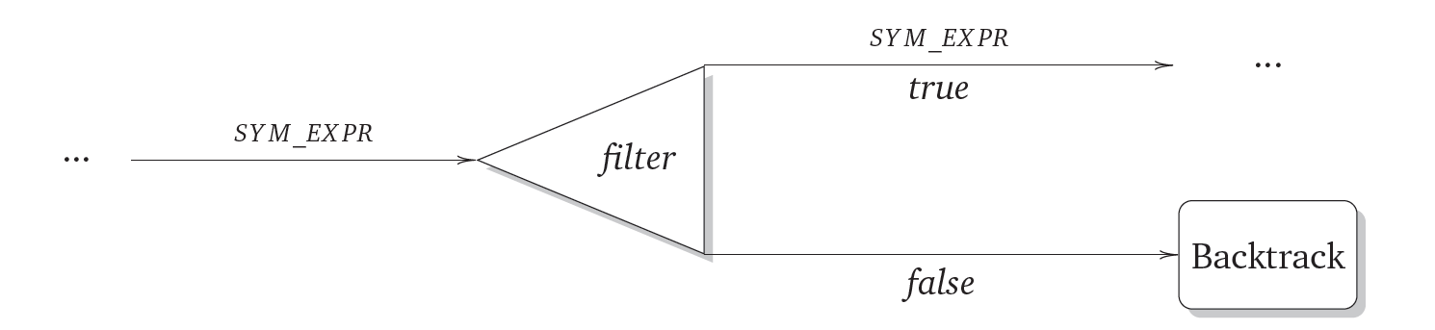
JPF-SymSpark - Strategies
Filter Strategy
Pre-processing: Set input to symbolic expression passed by the coordinator.
Post-processing: Pass the same expression if true, backtrack if false.
Notes:
Pre-processing: Set the right input symbolic expression
Post-processing: Percolate the same input expression if true, backtrack otherwise because it will be an unfeasible path.
The purpose of the filter transformation is to produce a new RDD containing only the elements that satisfy a given predicate. The predicate is passed to the transformation in the form of a boolean function that is invoked for each element of the RDD. Because of this reason, the filter transformation itself always implies at least two possible execution paths, one for those who satisfy the predicate and one for those who do not.
Pre-processing
During the pre-processing phase, the filter strategy only checks for the invocation of the parameter function and validates if it is coming from an invokevirtual or an invokestatic bytecode instruction. If it is coming from an invokevirtual (the function was implemented as an anonymous class), the strategy manipulates the stack frame of the current invocation and replaces the element in the second position with the symbolic expression passed by the coordinator. This element corresponds to the input parameter of the passed function (i.e., an element of the RDD). The replacement of the second element is necessary because, if this is not done, SPF will call the function with a new symbolic expression instead, breaking the continuity of the analysis.
Post-processing
On the post-processing phase, the strategy checks if the exited method is actually the filter transformation and proceeds to obtain the last registered choice generator. As explained above, this choice generator will always be a path condition choice generator registered by SPF. Then the strategy proceeds to validate if
the path currently executing corresponds to the negative evaluation of the predicate, in which case the execution of the thread is abruptly interrupted and a backtrack action is forced. The reason for this relies upon the fact that exploring a path with a negative filter condition is not relevant given that this path will never be executed in a Spark program. However, by forcing the backtrack action, the analysis is guided to find a solution that satisfies that path, which ends in a value that does not pass the filter (necessary for full path coverage).

Slide 19
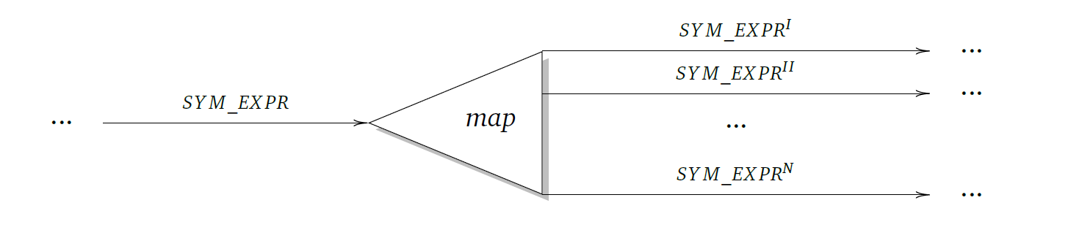
JPF-SymSpark - Strategies
Map Strategy
Pre-processing: Set input to symbolic expression passed by the coordinator.
Post-processing: Pass the symbolic expression resulting from the application of the function to the coordinator.
Notes:
Pre-processing: Set the right input symbolic expression
Post-processing: Percolate the corresponding symbolic expression after its manipulation.
The map transformation constructs a new RDD containing the result of applying the parameter function to each element of the initial RDD.
Pre-processing
The pre-processing phase is identical to the pre-processing phase of the filter strategy.
Post-processing
In the post-processing phase, the map strategy waits until the passed function finishes its execution. This is done by checking if the exited method matches the full descriptor of the call method in either the anonymous class or lambda expression that represents the passed function. Once it detects the right exited method then it stores its output value in an attribute of the strategy. This value will be used the next time strategies are switched and it will be used as the input value of the next Spark operation.
A map transformation does not have a branching condition necessarily; it might be the case that the RDD is just manipulated and an output value returned. However, even in this case, the transformation of the symbolic input needs to be tracked in order to percolate it to the next Spark operation. Chaining output and input values between Spark operations is of utmost importance in order to build precise path conditions that faithfully represent the control flow of the program.
In the case the map transformation incurs in any branching condition, then SPF will register the respective choice generators and all the options will be explored accordingly. Such a case leads to potentially different outputs depending on which path was taken.

Slide 20
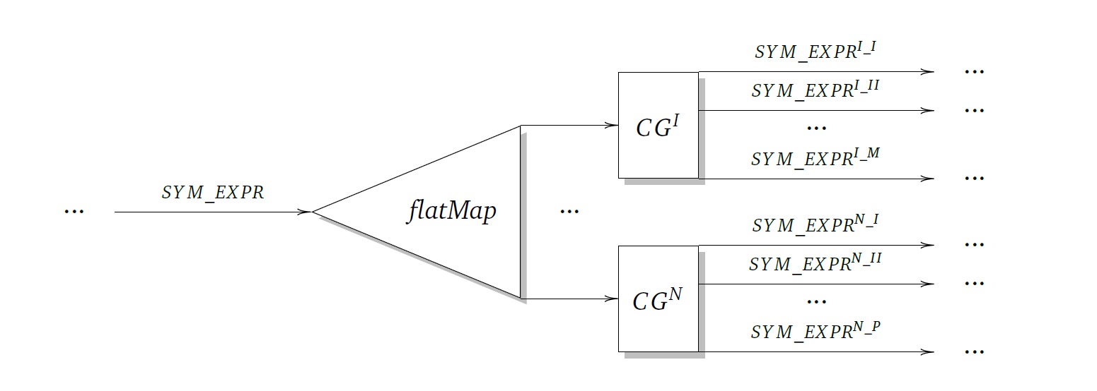
JPF-SymSpark - Strategies
FlatMap Strategy
Pre-processing: Set input to symbolic expression passed by the coordinator.
Post-processing: Register a SparkMultipleOutputChoiceGenerator with all different symbolic expressions representing the different manipulations of the input value.
Notes:
flatMap is a little bit different. It returns multiple outputs for a single input.
Pre-processing: Set the right input symbolic expression
Post-processing: Explore each element in each returned collection and percolate each of the to the subsequent operation.
The flatMap transformation behaves similarly to the map action, the only difference is that the function passed to the flatMap has a collection of elements as an output value instead of a single element. These elements could have undergone different transformations even though they are returned in the same collection.
Pre-processing
The pre-processing phase is identical to the pre-processing phase of the filter strategy.
Post-processing
The post-processing phase of this strategy behaves quite differently from all the other strategies so far. The idea would be to obtain all the different symbolic expressions inside the iterable object returned by the function and use each of them to feed subsequent Spark operations. For this purpose, the strategy relies on how the mocked up flatMap transformation is implemented in JavaRDD class. In this implementation, the returned iterable is completely traversed using the next method forcing the execution to bring each element of the collection into the stack frame of the flatMap method. This implementation does not deviate starkly from the original flatMap operation given that in the case of the regular Spark library, the whole iterator is explored to build a new RDD.
Lastly, when the flatMap transformation exits, the strategy registers a new custom-made choice generator whose possible values are the collected output values. Registering a choice generator at this point ensures that, after backtracking, a new option from the collection will be chosen exactly at the end of the flatMap transformation. The selected value will be used as input for any subsequent Spark operations and the analysis will continue accordingly.
The choice generator used in this scenario is called SparkMultipleOutputChoiceGenerator; it extends the IntIntervalGenerator of the JPF core. It contains a list of symbolic expressions representing the different manipulations of the input value and uses the integer range to select one of this options every time a backtrack occurs. The range is defined between zero and the size of the list minus one.

Slide 21
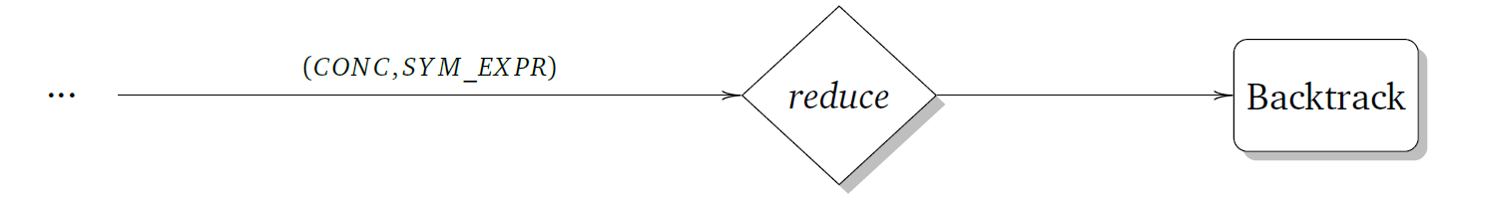
JPF-SymSpark - Strategies
Reduce Strategy
1) Non-Iterative
Pre-processing: Set single input to symbolic expression passed by the coordinator and the accumulated input as a concrete value.
Post-processing: Pass the same expression if true, backtrack if false
Notes:
Pre-processing: Set the right input symbolic expression for the single input and a concrete value for the accumulated input.
Post-processing: Backtrack
The reduce action produces a single output value resulting from the combination of all the elements in the RDD. The combination is defined in the function passed to action, which has to fulfill the properties of being commutative and associative. The function passed to the action implements the Function2 interface,
whose main difference is that it takes two input parameters: the first is the accumulated value of the operation so far, and the second represents one element in the RDD.
Reduce actions can be analyzed following two different strategies: one where the accumulated parameter of the function is not considered as a symbolic variable and another where it is. The user indicates which mode to use by specifying it in the configuration file.
Non-iterative
Pre-processing
This strategy considers the input parameter corresponding to a single element in the RDD as the percolated symbolic expression, however, the parameter corresponding to the accumulated value of the reduce action is considered as a concrete input. The analysis takes advantage of the concolic operational mode of SPF by defining the method to be inspected with the first parameter as a concrete input.
Post-processing
Independently of the output of the reduce action, the post-processing phase of the reduce strategy always triggers a termination of the current execution thread and a backtrack. This is because of the nature of Spark actions which indicate the culmination of the processing of an RDD. However, during the analysis of the reduce action, there might be branching operations executed on the single parameter, which will cause SPF to register a choice generator and explore all the possible paths.

Slide 22
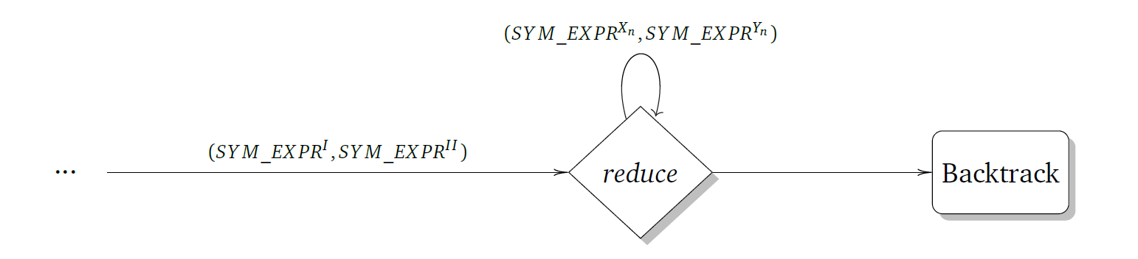
JPF-SymSpark - Strategies
Reduce Strategy
2) Iterative
Pre-processing: Register a SparkIterativeChoiceGenerator used to count the iterations. Set the accumulated and input parameters based on the iteration.
Post-processing: Update the choice generator with the output of each iteration and the update their respective path conditions.
Notes:
Pre-processing: Set the right input symbolic expression for the single input and the accumulated input. Also instantiate the choice generator with the number of iterations to be executed and the relevant parameters.
Post-processing: Backtrack
The second strategy that can be used when analyzing reduce actions considers both parameters of the passed function as symbolic. The direct consequence of this consideration is that the symbolic engine has to reason now over a variable that represents an accumulated value resulting from the application of the
passed function several times. Reduce actions can be analyzed following two different strategies: one where the accumulated parameter of the function is not considered as a symbolic variable and another where it is. The user indicates which mode to use by specifying it in the configuration file.
The complexity of this strategy is noticeable in comparison to the other strategies. The expected output dataset now becomes a family of datasets corresponding to the number of elements indicated to be in the RDD. The path conditions take into consideration multiple symbolic variables that have to comply with all the transformations and constraints collected so far.
Iterative
Pre-processing
As mentioned before, this strategy considers both parameters of the function passed to the reduce action as symbolic variables. Once the reduce actions is detected, a new choice generator called SparkIterativeChoiceGenerator is registered. This choice generator is used to keep a counter with the number of times the function has to be executed and it also keeps track of the output of each of the iterations. The current path condition, if any, is also kept in the choice generator along with the single symbolic variable used so far.
Once the execution of the call method is detected, the strategy follows one of two approaches: If there are no accumulated values registered in the SparkIterativeChoiceGenerator choice generator then a new symbolic expression is created taking into consideration the base structure of the percolated expression. This new expression is used as the first accumulated value while the percolated expression is used as the single input value. On the other case, an output value (representing the result of a previous iteration) is taken from the choice generator and set as the accumulated value while a new symbolic expression is produced and set as the regular single input value of the function.
Post-processing
Once the call method finishes execution the current path condition is extended by enforcing the same initial constraints on the newly generated expressions for this iteration. Additionally, any constraints accumulated from a previous iteration must also be included in the current path condition. This has to be done at this point because JPF is not really executing an iteration, instead the iteration is simulated with the SparkIterativeChoiceGenerator, which will cause the path conditions to be solved after the method finishes and the engine is set to backtrack to the latest point (most likely the point where the SparkIterativeChoiceGenerator was registered), hence missing interconnection between the iterations. Including this conditions ensure that the right path in the symbolic execution tree is taken.
Lastly, the output expression of the method is stored in the choice generator along with the current path condition. This will serve as an input for a subsequent iteration in case the maximum number of iterations has not been reached yet.

Slide 23
Evaluation
Qualitative
Quantitative
References [1, 5]
Notes:
Two aspects

Slide 24
Qualitative Evaluation
Requirements
R.6 The framework shall be able to reason over symbolic Strings
Partially fulfilled. Support on symbolic String operations is constrained by the limitations of SPF.
Notes:
Support on symbolic String operations is constrained by the limitations of SPF. This poses a major limitation for the adoption of the tool given that many big data tasks rely on text processing.

Slide 25
Qualitative Evaluation
Requirements
R.7 The framework shall be able to reason over symbolic data structures
Not fulfilled. Support to symbolic data structures in SPF is faulty; as a consequence, JPF-SymSpark is not capable of reasoning on RDDs of any complex data structures.
Notes:
Symbolic data structures

Slide 26
Qualitative Evaluation
Requirements
R.8 The framework should support all Spark programs that compile correctly
Partially fulfilled. This surrogate library is not exhaustive, for this reason, there will be unsupported operations that compile under the regular Spark library. Other Spark APIs are not supported.
Notes:
Support all compiling Spark programs

Slide 27
Qualitative Evaluation
Requirements
R.9 The framework shall be able to process iterative and cumulative actions
Partially fulfilled. Only actions that work on primitive values are supported. The symbolic output of aggregate functions is not percolated beyond the boundaries of the operation.
Notes:
Iterative

Slide 28
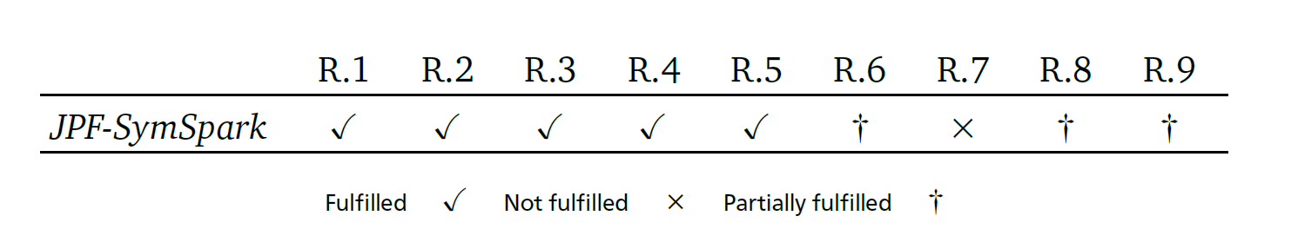
Qualitative Evaluation
Summary
Partially or not met requirements limit the applicability of the tool.
Most of the unfulfilled requirements result from limitations of SPF.
The proposed process serves as a starting point for further research.
Notes:
Although most of the requirements are met, those that are only partially met or not met at all represent severe obstacles to the applicability of the tool on less trivial Spark programs. With the exception of requirement R.8, the rest of the requirements that are not fully met are obstructed by limitations of the underlying tools and frameworks used to conduct the analysis. Improving the symbolic execution framework and the constraint solvers is mandatory for the fulfillment of all the defined requirements. Nevertheless, the proposed process and the foundation of JPF-SymSpark lay the ground for further research on this topic.

Slide 29
Quantitative Evaluation
Setup
• Iterative Reduce with Non-Cumulative Condition (IRNC): Single reduce action with a conditional defined on its non cumulative symbolic variable.
• Iterative Reduce with Cumulative Condition (IRC): Single reduce action with a conditional defined on its cumulative symbolic variable.
• Iterative Map and Reduce with Non-Cumulative Condition (IMRNC): A map and a reduce action with a conditional on its non cumulative symbolical variable.
• Iterative Map and Reduce with Cumulative Condition (IMRC): A map and a reduce action with a conditional on its cumulative symbolic variable.
Notes:
Two groups: Only reduce and Map and educe
The first two scenarios determine what kind of performance effects generate from solving constraints based on cumulative and non cumulative constraints.
The second determine the impact of previous operations in iterative symbolic executions.
Applied on trivial programs on defined for Integers.
The process carried out by the iterative reduce strategy resembles a loop unwinding technique, where an iterative behavior is taken out of a loop and executed sequentially without the need of accumulators or counters. This evaluation focuses on the behavior of the iterative reduce strategy and it aims to identify the major aspects that pose performance losses. It illustrates how an increment in the number of iterations to be considered in the analysis has a direct impact on the number and size of path conditions, as well as in the performance of the constraint solvers. Moreover, it serves as an example to identify path explosion in symbolic executions.
The first two scenarios aim to determine what kind of performance effects generate from solving constraints based on cumulative and non cumulative constraints. The last two scenarios are used to measure the relevance of previous transformations that manipulate the symbolic variable and also introduce a condition to the path before the reduce action. All the scenarios were implemented as trivial Spark programs processing only integer values. Furthermore, the conditional statements between operations were defined in a way that unsatisfiable path conditions would be generated eventually.
Each scenario was executed for 2, 3, 5, 8 and 13 iterations respectively, repeating each case ten times and taking the average of the execution time as the result. This range follows a Fibonacci sequence and was chosen to space out the iterations enough to make any trend distinguishable. Additionally, for each case, the number of satisfiable and unsatisfiable path conditions was registered. The experiments were carried out in a laptop computer with an Intel Core-i7-6500U processor at 2.50GHz and assigning 1GB of memory to the JVM executing the analysis. JPF was triggered using the command line instead of the Eclipse JPF plugin in order to avoid wasting memory in processes inherent to the Eclipse IDE.

Slide 30
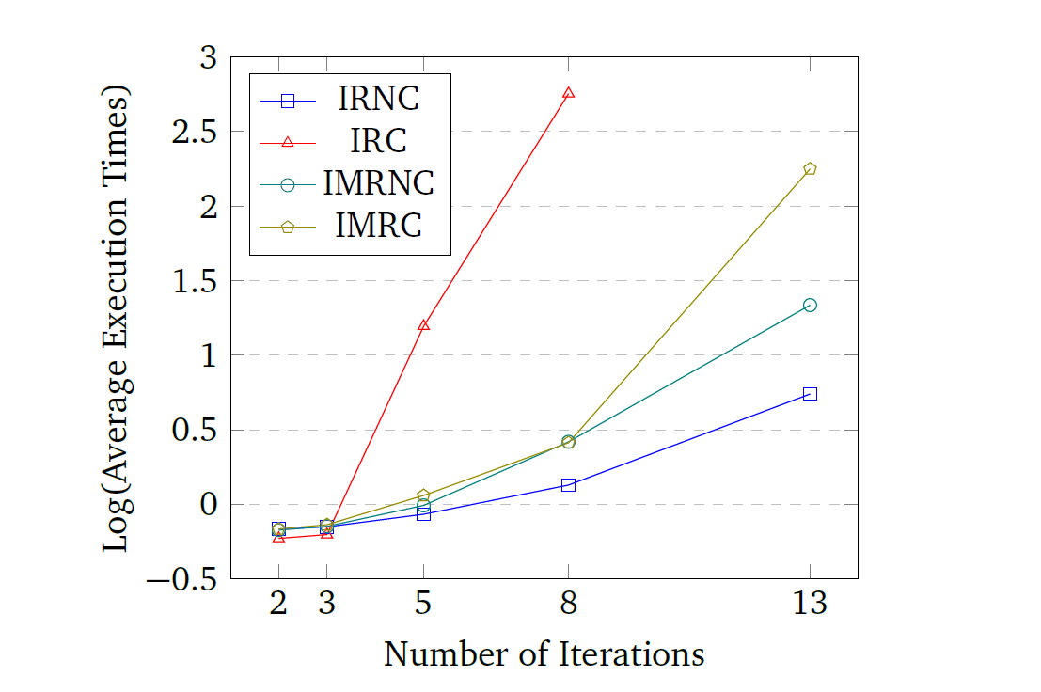
Quantitative Evaluation
Execution Times
Notes:
Each scenario was run 10 times for a different iterations and then the average was taken.
Average execution times in logarithmic scale.
Conclusion
IRC has a poor performance due of the complexity of path conditions. This applies to most cumulative cases.
Why IMRC was still able to be executed?
Average execution times in logarithmic scale. The disparity between the scenarios is easily perceived using a logarithmic scale while still preserving the notion of exponential growth.
All the scenarios have a similar performance up until three symbolic iterations. However, the performance of some scenarios starts to diverge after five iterations. The starkest difference is displayed by the IRC scenario, where the execution times increase several orders of magnitude in comparison to the other scenarios. In particular, the IRC scenario could not be executed for 13 iterations or more, resulting in executions that lasted several hours and culminating eventually in OutOfMemory exceptions.
The rest of the scenarios have a steady increase in their measurements until they reach 13 symbolic iterations, where the execution times start to grow exponentially. From the remaining three scenarios, the IMRC scenario displays the worst performance, taking almost three minutes to execute 13 symbolic
executions.

Slide 31
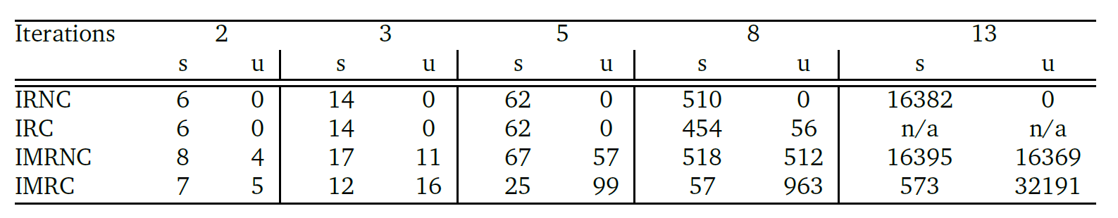
Quantitative Evaluation
Number of Path Conditions
Satisfiable (s), Unsatisfiable (u)
Notes:
Conclusion
Performance is better in non cumulative scenarios.
Constraint solvers are a bottleneck.
Unsatisfiable path conditions are easier to detect so more operations not necessarily means poorer performance.
As expected, the total number of path conditions grows exponentially over the number of iterations executed. The scenarios having a map transformation before the iterative action have double the total amount of path conditions than their counterparts without the transformation.
Nevertheless, the number of unsatisfiable path conditions varies strongly depending on the scenario being studied. In the case of the IRNC scenario, all path conditions are satisfiable, while for the IRC scenario, only a few in the case of 8 iterations are not satisfiable; most of these resulting from timeouts of the constraint solvers. On the contrary, the IMRNC and IMRC scenarios present high rates of unsatisfiable path conditions throughout the different number of iterations, ranging from 30% to 50% for the former and from 45% to 90% for the latter.
Conclusion
1. The performance of the framework is considerably better when the conditional statements defined in the aggregate function only affect the non-cumulative symbolic variable in the operation. This comes as a consequence of the kind of constraints generated in such cases. In the case of non-cumulative conditions, the constraints are defined over single independent symbolic variables that are joined in a conjunction on each iteration, while in the case of cumulative conditions,
after each iteration, the constraints include more symbolic variables related with each other.
2. The number of unsatisfiable path conditions in the IMRC scenario because, although this scenario has more path conditions than the IRC scenario, a large number of them are unsatisfiable, allowing the constraint solver to conclude faster. This result indicates that having more path conditions does not necessarily translates into worse performance; it depends on how complex the path conditions are and how many of them are actually satisfiable.
The performance of the constraint solver, as well as the complexity of the path conditions, are the major factors that affect the overall performance of iterative symbolic executions in JPF-SymSpark. Moreover, the construction of aggregate functions with conditional statements has to be properly evaluated in terms
of the congruency of the operation. Conditions applied to a cumulative value can break the associativity requirement of reducer functions, leading to invalid, non-parallelizable Spark programs.

Slide 32
Conclusion
Research Questions Revisited
Is symbolic execution a suitable for Spark applications?
Yes. As JPF-SymSpark demonstrates, the technique can be used to analyze Apache Spark programs
Notes:
Yes. As JPF-SymSpark demonstrates, the technique can be used to analyze Apache Spark programs although an additional reasoning on the structure of the operations had to be included in order to produce any valuable result.

Slide 33
Conclusion
Research Questions Revisited
What are the particular characteristics?
Two characteristics: Control flow instructions of an application can be contained inside the functions and some Spark operations have control flow semantics defined intrinsically.
Notes:
There are two particular characteristics that differentiate the symbolic execution of Spark programs from other programs. The first is that the control flow instructions of an application can be contained inside the functions that are passed as parameters to Spark operations. Such a situation requires path
conditions and symbolic transformations to be percolated between Spark operations. The second characteristic is that some Spark operations, in particular aggregation functions, have control flow semantics defined intrinsically. One example is the reduce action, that defines an iterative behavior and accumulates a value resulting from the application of the passed user-defined function. In a symbolic execution, this iterative behavior needs to be considered in order to control undesirable results, as is the case of the symbolic state explosion.

Slide 34
Conclusion
Research Questions Revisited
Is there a symbolic execution framework that can be adapted?
Symbolic PathFinder is the most complete framework available and with the most amount of documentation.
Notes:
Spark provides several implementations for different programming languages, being the most common for the Scala and Java programming languages. Both of this languages compile to the Java Virtual Machine. There are only a few symbolic execution frameworks that can be applied to Java programs or their respective compiled bytecode versions. SPF is the most complete framework available and with the most amount of documentation.

Slide 35
Conclusion
Research Questions Revisited
If so, what are its advantages and disadvantages?
Powerful tool with full symbolic semantics for most of the primitive types.
Convenient management of path conditions
Limited support of symbolic Strings and data structures
Sporadic new releases and decaying codebase
Notes:
SPF is a powerful framework that is able to replace the whole instruction set of the Java bytecode for its symbolic counterparts. A wide variety of symbolic operations for all the primitive types are supported as well as a subset of the operations defined for Strings. It takes care of the identification of branching instructions and, with the help of JPF’s state generation engine, is capable of exploring the different paths. It also provides a convenient set of mechanisms to consult and manipulate the execution state if needed. This is particularly useful when percolating path conditions among Spark operations.
However, SPF does not support symbolic data structures and only supports symbolic Strings partially. This presents a major limitation given that most of the realistic Spark programs operate to a certain extent this type of data. Additionally, SPF has undergone several development iterations and its codebase starts to show hints of code decay. Code comments used as a communication mechanisms between developers, frequent code duplication and outdated examples prove to be serious obstacles for the further improvement of the tool.

Slide 36
Conclusion
The lack of support of symbolic data structures and partial support of symbolic String operations pose as major limitations.
Cumulative symbolic variables translate into more complex path conditions resulting in poor time performance.
Higher numbers of unsatisfiable path conditions allow a faster exploration of the state space.
Symbolic constraint solvers pose as the main bottlenecks.
Notes:
Additional conclusions

Slide 37
References
Apache Spark™ - Lightning-Fast Cluster Computing. U R L: http://spark.apache.org/ (visited on 2017).
Barrett, C. and Tinelli, C. “CVC3”. In: Proceedings of the 19th International Conference on Computer Aided Verification. CAV’07. Berlin, Germany: Springer-Verlag, 2007, pp. 298–302. I S B N: 978-3-540-73367-6.
Dean, J. and Ghemawat, S. “MapReduce: Simplified Data Processing on Large Clusters”. In: Communications of the ACM 51.1 (Jan. 2008), pp. 107–113. I S S N: 0001-0782. D O I: 10.1145/1327452.1327492.
Havelund, K. and Pressburger, T. “Model checking JAVA programs using JAVA PathFinder”. In: International Journal on Software Tools for Technology Transfer 2.4 (2000), pp. 366–381. I S S N: 1433-2779. D O I: 10.1007/s100090050043.
Java PathFinder. National Aeronautics and Space Administration. U R L: http://babelfish.arc.nasa.gov/trac/jpf/wiki (visited on 2017).
NASA’s Ames Research Center. National Aeronautics and Space Administration. U R L: https://www.nasa.gov/centers/ames/home/index.html (visited on 2017).
Păsăreanu, C. S. and Rungta, N. “Symbolic PathFinder: Symbolic Execution of Java Bytecode”. In: Proceedings of the IEEE/ACM International Conference on Automated Software Engineering. ASE ’10. Antwerp, Belgium: ACM, 2010, pp. 179–180. I S B N: 978-1-4503-0116-9. D O I: 10.1145/1858996.1859035.
Prud’homme, C., Fages, J.-G., and Lorca, X. Choco Documentation. TASC, INRIA Rennes, LINA CNRS UMR 6241, COSLING S.A.S. 2016.

Slide 38
References
Souza, M. et al. “CORAL: Solving Complex Constraints for Symbolic PathFinder”. In: NASA Formal Methods: Third International Symposium, NFM 2011, Pasadena, CA, USA, April 18-20, 2011. Proceedings. Ed. by Bobaru, M. et al. Berlin, Heidelberg: Springer Berlin Heidelberg, 2011, pp. 359–374. I S B N: 978-3-642-20398-5. D O I: 10.1007/978-3-642-20398-5_26.
Zaharia, M. et al. “Resilient distributed datasets: A fault-tolerant abstraction for in-memory cluster computing”. In: NSDI’12 Proceedings of the 9th USENIX conference on Networked Systems Design and Implementation (2012), pp. 2–2. I S S N: 00221112. D O I: 10.1111/j.1095-8649.2005.00662.x.

Slide 39
Questions

Slide 40
Content
Introduction
Background
Apache Spark
Java PathFinder (JPF)
Symbolic PathFinder (SPF)
Symbolic Execution of Spark Programs
Conceptual Process
JPF-SymSpark
Evaluation
Conclusion

Slide 41
Introduction
Aim
To identify if symbolic execution techniques can be used in the context of Apache Spark as a big data framework to generate reduced input datasets that enforce full path coverage.
Notes:
As in any other software, applications written for distributed big data frameworks are susceptible to bugs and errors. Although several program testing techniques have been ported to the context of distributed programming and have been the subject of research studies, program analysis approaches have received less attention both in the industry and the academia. Formal methods and code analyses could also prove useful towards the goal of improving code quality and their automated nature could provide a mechanism for a continuous evaluation.
Aim
This thesis aims to identify if symbolic execution techniques can be used in the context of Apache Spark as a big data framework to generate reduced input datasets that enforce full path coverage.

Slide 42
Apache Spark
Word Count Pipeline
Data source
“an eagle is an animal”
“an”
“eagle”
“is”
“an”
“animal”
(“an”, 1)
(“eagle,1)
(“is”, 1)
(“an”, 1)
(“animal”, 1)
(“an”, 2)
(“eagle,1)
(“is”, 1)
(“animal”, 1)
flatMap
mapToPair
reduceByKey
saveTextFile
References [1, 10]

Slide 43
Symbolic PathFinder (SPF)
Example – Symbolic Execution
1 public void trivial(boolean a, int b, boolean c) {
2 int x = 0, y = 0, z = b + 1;
3 if (a) { x = -1; }
4 if (z > 5) {
5 if (!a && c) { y = -1; }
6 }
7 assert x + y != 0;
8 }
Notes:
As one of the earliest extension modules, Symbolic PathFinder (SPF) integrates symbolic execution principles into JPF. Although it has undergone several modifications throughout the years [33, 49, 2], its current mode of operation consists of replacing the concrete execution semantics of the default JPF model checker with a corresponding symbolic interpretation [48].

Slide 44
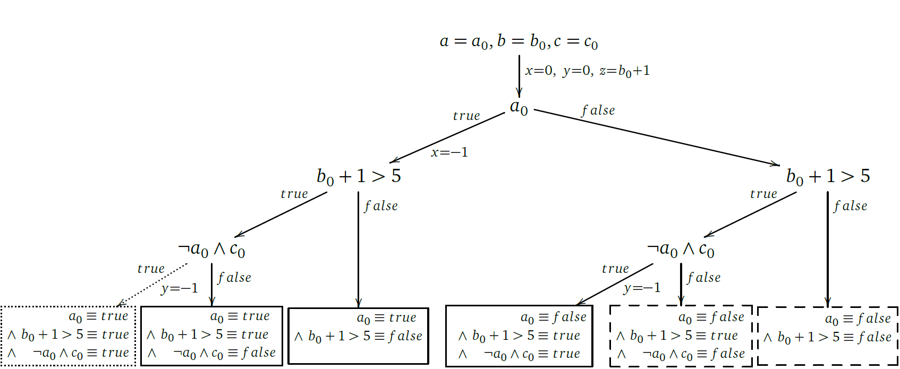
Symbolic PathFinder (SPF)
Example – Symbolic Execution
Notes:
Figure 2.3 shows the symbolic execution tree of the program in Listing 2.3. The root node represents the input parameters as symbolic values while the intermediate nodes illustrate the control flow of the program evaluated on these symbolic parameters wherever possible. Each intermediate node branches into two options, each corresponding to the predicate evaluating to true or false respectively. Also, each branch is labeled with the executed statements following one of the evaluations. More importantly, the leaves collect the predicates that form the path condition for that particular execution.
Mention unfeasible paths.

Slide 45
Symbolic Execution of Spark Programs
What needs to be done?
Identify the Spark operation
Carry out the symbolic execution of the passed function
Take special considerations based on the executed Spark operation
Ensure the correct connection to any subsequent Spark operation
Notes:
We have seen that some operations have intrinsic control flow semantics, such as the case of filter.
Additionally, given that the operations are higher-order functions, control flow instructions be included in the function passed to the operations.
Having this in mind, the general approach could be summarized in the following four steps:
1. Identify the Spark operation
2. Carry out the symbolic execution of the passed function
3. Take special considerations based on the executed Spark operation
4. Ensure the correct connection to any subsequent Spark operation
The precise behavior of most operations is defined by the programmer. Given that most of Spark’s actions and transformations are higher order functions, the programmers define a custom function that fulfills the contract of the specific operation. For example, again the filter transformation expects as a parameter a function that takes an element of the same type as the type of the elements in the collection handled by the RDD and returns a boolean value. When the filter transformation is later invoked, it calls the passed function with each element in the RDD and, depending on the output, it decides if the value is filtered or not.
Having this in mind, the symbolic execution of an isolated Spark operation depends solely on the behavior of the function passed by the user. However, when analyzing a whole program, special considerations for every particular operation must be taken into account. These considerations are different in nature but mostly refer to how output values are percolated to the subsequent operations in order to ensure the correct analysis of the next functions.

Slide 46
Qualitative Evaluation
Requirements
R.1 The framework should produce a reduced input dataset that ensures full path coverage of the program under test Fulfilled. Two types of output produces: Single input dataset and family of input datasets in an iterative context.
Notes:
Reduced input datasets

Slide 47
Qualitative Evaluation
Requirements
R.2 The framework should report unfeasible path conditions in case there are any
Fulfilled. Unfeasible path conditions are reported as soon as they are found.
Notes:
Unfeasible path conditions

Slide 48
Qualitative Evaluation
Requirements
R.3 The framework shall conduct a symbolic execution of all the operations that conform the program, ensuring the correct interconnection between consecutive transformations and actions
Fulfilled. The main contribution of JPF-SymSpark is to provide a framework capable of interconnecting symbolic executions.
Notes:
Correct interconnection

Slide 49
Qualitative Evaluation
Requirements
R.4 The framework shall conduct a symbolic execution of the program under test without requiring any modification to its source code
Fulfilled. JPF-SymSpark was designed to work as a black-box tool.
Notes:
Mention that the analyzed programs are considered a black box but not the Spark library. This fact has its own limitations.

Slide 50
Qualitative Evaluation
Requirements
R.5 The framework shall be able to reason over symbolic primitive types
Fulfilled. Spark operations over RDDs of Integer, Long, Float, Double and Boolean wrapper classes are supported
Notes:
Primitive types

Slide 51
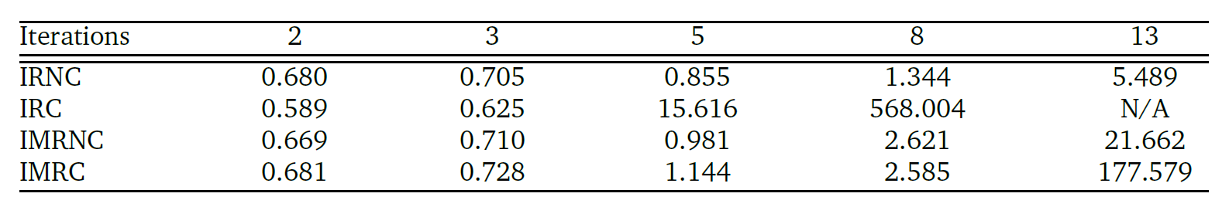
Quantitative Evaluation
Execution Times

Slide 52
Future Work
Symbolic Execution of data structures
Support of more Spark operations
Provide a Java annotation to analyze single methods
Support Scala bytecode

Slide 53
Additional Contributions
Detection of synthetic bridge methods
Symbolic execution of lambda expressions and anonymous classes
Consistent ordering of String path conditions
Improvements to the visitor pattern in the symbolic constraints

