Slide 1

REST API’s
- Omkar Sahasrabudhe (1001661919)

Slide 2
REST API
A set of rules , developers follow when they create their API : Set of rules that allow programs to talk to each other.
Representational State Transfer Application Programming Interface

Slide 3
A REST API should be one with:
Uniform Interface : Interface between clients and servers which enables each part to evolve independently.
Stateless : The necessary state to handle the request is contained within the request itself.
Cacheable : Implicitly or explicitly, define themselves as cacheable.
Client-Server : The uniform interface separates clients from servers.
Layered System: Layers may enforce security policies.
Code on Demand (optional): Return the code logic along with requested value.

Slide 4
The Three Fundamental Aspects of the REST Design Pattern
Resources
URLs
Simple Operations

Slide 5
Restful Services
 | Collection URI | Element URI
GET | List the URIs of collection members | Retrieves the resource (collection member) represented by the requested media type
PUT | Replace the collection with another collection | Replace the collection member with the given resource. If the collection does not contain a resource with given URI, create a new collection element
POST | Create a new entry in the collection (its URL created automatically and usually returned as return value) | Typically not used Treat the addressed resource as a collection and create a new entry in it
DELETE | Delete the whole collection | Delete the resource (collection member)
http://en.wikipedia.org/wiki/Representational_state_transfer

Slide 6
Implementing REST API in Project 5 :
Request Data Using API (GET : PET STORE ADDRESS)
3rd party Application
PET STORE Web
Send the value Using REST API for requested Token .
For Example : 3rd Party Application like Google Maps wants address of the pet store to provide GPS coordinates to its map users.

Slide 7

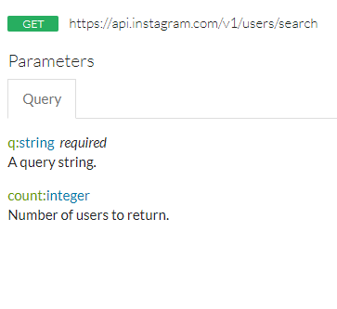
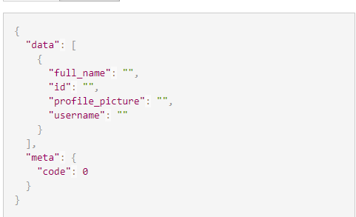
Other Implementations of REST API

Slide 8

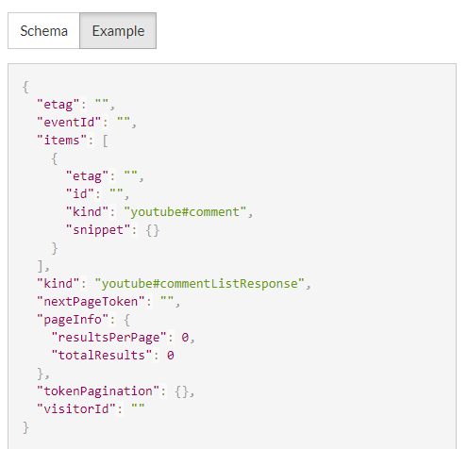
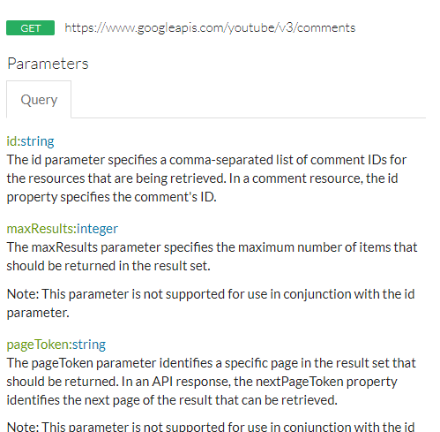
Other Implementations of REST API

Slide 9
Advantages of Using REST API
Separation between the client and the server
Visibility, reliability and scalability.
The REST API is always independent of the type of platform or languages

Slide 10
References
https://www.slideshare.net/cebartling/rest-web-services
https://www.restapitutorial.com/
http://en.wikipedia.org/wiki/Representational_state_transfer
https://any-api.com/

Slide 11
Tienen alguna pregunta ?

Slide 12
Thankyou!

