Slide 1

IT-205 Capstone project apexcoderz
P-7 Sleep Inducer Project

Slide 2
Daksh ubhadia 202301014
Om santoki 202301019
Parva raval 202301055
Diyen pambhar 202301113
Group Members

Slide 3
You are to build a Sleep Inducer. There are N inmates in total. Each has his/her own sleep time (randomly initialized). The Sleep Inducer is installed in a hostel with M sleeping dorms. It notes every inmate’s daily sleeping habits and starts sleep-inducing music at bedtime. It works for multiple inmates. However, the music should not continue beyond p minutes after going to bed (assuming it takes that much time for every inmate to fall asleep). The Sleep Inducer should be able to play for all of them without disturbing anyone (i.e., playing music while someone is asleep). Therefore, the correct number of inmates for each dorm must be assigned before starting to operate.
Problem Statement

Slide 4
1) Arrays -Fundamental data structure,used for storing data of the same type in contiguous memory. -In our project, H[] and M[] arrays store hours and minutes of sleep for each day. -Facilitates efficient access to sleep time data for each day, aiding in sleep pattern calculations. 2) Vectors -Dynamic arrays that resize as needed. -Applied in the delete_inmate function for flexible data management. -Enables easy addition, removal, and access of elements from the input text file.
Data Structures Utilized in Our Project

Slide 5
3)Pairs: -Composite data structure for grouping different data types into a single entity. -Employed to store inmate information (name, dorm, sleep time) efficiently. -Utilized within an unordered_map<string, pair<pair<string, string>, pair<string,string>>> for inmate data storage. 4)Hash Tables (Unordered Maps): -Efficiently stores inmate information by IDs using hashing. -Provides constant-time complexity for insertion and searching operations. -Enhances performance in handling inmate data lookup and management tasks.
Data Structures Utilized in Our Project

Slide 6
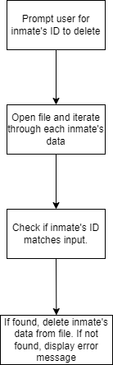
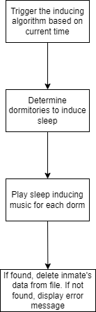
Algorithms
Deletion Flowchart: Inducing Flowchart:
3)Deletion Algorithm:
This algorithm allows the user to delete an inmate’s data from the system. It prompts the user for the inmate’s ID, searches for the ID in the file, and deletes the corresponding data if found.
2)Inducing Algorithm:
The inducing algorithm simulates an inducer function that starts at 9pm. It determines the active dorm to sleep based on the current time and plays corresponding music to induce sleep for the inmates in that dorm.

Slide 7
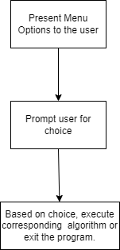
Algorithms
Menu-Based Algorithm Flowchart:
5)Menu-Based Algorithm:
The main function of the program presents a menu-based interface to the user, allowing them to choose from various options such as adding new inmates, showing inmate data, searching for inmates, deleting inmates, setting auto dorm, starting the inducer, and exiting the program.

Slide 8
Time and Space Complexities of various functions
Function Name | Time Complexity | Space Complexity
ifexist() | O(n) | O(1)
insert | O(1) | O(1)
search | O(k) | O(n)
show | O(n) | O(1)
delete | O(n) | O(n)
Setdorm | O(n) | O(n)
inducer | O(n) | O(1)

Slide 9
THANK YOU

