Slide 1
Unit-1
Introduction to Object-Oriented Programming – Programming Paradigms, Data Types, Variables, Constants, Operators, Decision Statements & Control Structures, Arrays, Namespace, Default Arguments, Constant Arguments, Parameter passing techniques, Features of Object-Oriented Programming.

Slide 2
C++ is an object oriented programming language, C++ was developed by BJarne Stroustrup in 1983 at AT & T Bell laboratories, USA.
C++ was developed from C and simula 67 language. C++ was early called ‘C with classes’.
C++ is derived from C Language. It is a Superset of C.
In C++, the major change was the addition of classes and a mechanism for inheriting class objects into other classes.
C++ expressions are the same as C expressions.
All C operators are valid in C++.

Slide 3
1. Programming Paradigms
The programming paradigm is the way of writing computer programs. There are four programming paradigms and they are as follows.
Monolithic programming paradigm
Structured-oriented programming paradigm
Procedural-oriented programming paradigm
Object-oriented programming paradigm
1.Monolithic Programming Paradigm
The Monolithic programming paradigm is the oldest.It is also known as the imperative programming paradigm.

Slide 4
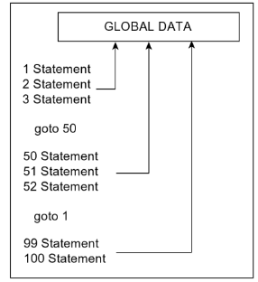
In this programming paradigm, the whole program is written in a single block.
We use the goto statement to jump from one statement to another statement.
It uses all data as global data which leads to data insecurity.
There are no flow control statements like if, switch, for, and while statements in this paradigm.
There is no concept of data types.
An example of a Monolithic programming paradigm is Assembly Language

Slide 5
2.Structure-oriented Programming Paradigm
The Structure-oriented programming paradigm is the advanced paradigm of the monolithic paradigm.
This paradigm introduces a modular programming concept where a larger program is divided into smaller modules.
It provides the concept of code reusability.
It is introduced with the concept of data types.
It also provides flow control statements that provide more control to the user.
In this paradigm, all the data is used as global data which leads to data insecurity.
Examples of a structured-oriented programming paradigm is ALGOL, Pascal, PL/I and Ada.

Slide 6
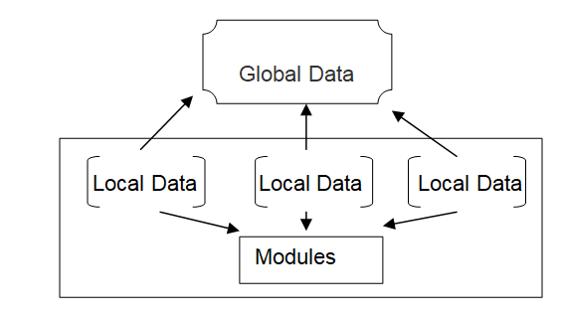
3.Procedure-oriented Programming Paradigm
The procedure-oriented programming paradigm is the advanced paradigm of a structure-oriented paradigm.
It follows all the concepts of structure-oriented programming paradigm but the data is defined as global data, and also local data to the individual modules.
In this paradigm, functions may transform data from one form to another
Examples of procedure-oriented programming paradigm is C, visual basic, FORTRAN, etc.

Slide 7
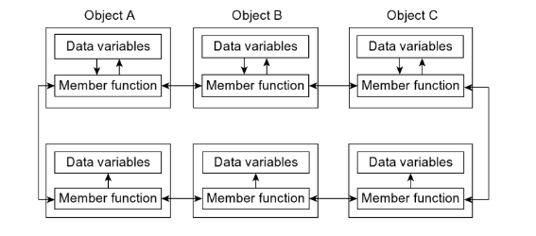
4. Object-oriented Programming Paradigm
The object-oriented programming paradigm is the most popular.

Slide 8
In this paradigm, the whole program is created on the concept of objects.
In this paradigm, objects may communicate with each other through member functions.
This paradigm mainly focuses on data rather than functionality.
In this paradigm, programs are divided into what are known as objects.
It follows the bottom-up flow of execution.
It introduces concepts like data abstraction, inheritance, and overloading of functions and operators overloading.
In this paradigm, data is hidden and cannot be accessed by an external function.
It has the concept of friend functions and virtual functions.
In this paradigm, every thing belongs to objects.

Slide 9
Procedure-oriented Programming | Object-oriented Programming
It is often known as POP (procedure-oriented programming). | It is often known as OOP (object-oriented programming).
It follows the top-bottom flow of execution. | It follows the bottom-top flow of execution.
Larger programs have divided into smaller modules called as functions. | The larger program has divided into objects.
The main focus is on solving the problem. | The main focus is on data security.
It doesn’t support data abstraction. | It supports data abstraction using access specifiers that are public, protected, and private.
It doesn’t support inheritance. | It supports the inheritance .
Overloading is not supported. | It supports the overloading function and also the operator.
There is no concept of friend function and virtual functions. | It has the concept of friend function and virtual functions.
Examples - C, FORTRAN | Examples - C++ , Java , VB.net, C#.net, Python, R Programming, etc.

Slide 10
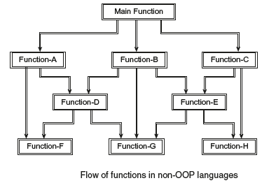
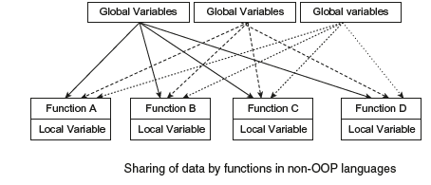
DisaDvantage of conventional Programming
Huge programs are divided into
smaller programs known as functions. These functions can call one another. Hence security is not provided.
(2) No importance is given to security of data and importance is laid on doing things.
(3) Data passes globally from function to function.
(4) Most function accesses global data.

Slide 11
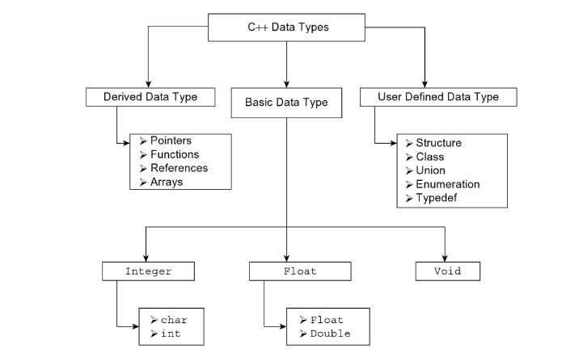
2. Data Types
Data are collections of characters, digits, symbols, etc. The data are used to represent information.

Slide 12
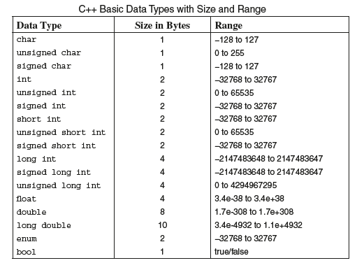
a) Basic Data Types

Slide 13
The void Data Type:The type void is empty data type. It can be used in three ways:
When specified as a function return type, void means that the function does not return a value.
The void keyword also uses as argument for function. When found in a function heading, void means the function does not take any arguments.
When specified as a function return type and in function heading, that is, the function neither returns a value nor requires any argument.

Slide 14
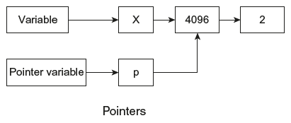
b).Derived Data Type
The derived data types are pointers, functions, arrays, and references.
Pointers
A pointer is a memory variable that stores a memory address. it is always denoted by ‘*’ operator.
Ex:
int x;
float *p;
p=&x

Slide 15
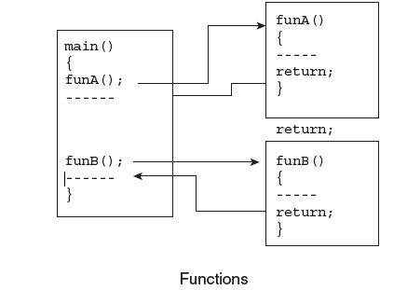
Functions
A function is a self-contained block or a sub-program of one or more statements that perform a special task when called.
It is possible to use the same name with multiple definitions known as function overloading.

Slide 16
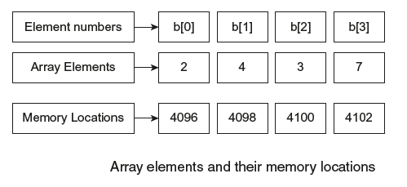
Arrays
Array is a collection of elements of similar data type in which each element is located in separate memory location, for example
Ex:
int b[4]={2,4,3,7};
The above statement declares an array b[] which can hold four integer values.

Slide 17
Referencing operator (&): The referencing operator is used to define referencing variable. A reference variable prepares an alternative (alias) name for previously defined variable.
Syntax:
Data-type & reference-variable-name = variable name;
Example:
int qty=10;
int & qt=qty;
Dereferencing operator (*): The asterisk (*) in a variable expression is used to declare a pointer to a given type.
int *x;
Where, x is a pointer of integer type.

Slide 18
c).User-Defined Data Type
Structure
struct is a keyword and used to combine variables of different data types into a single record.
Syntax:
struct < struct name >
{
<data-type> <variable-name1, variable-name 2>;
<data-type> <variable-name3, variable-name 4>;
} <structure variable declarations>;
class:
The class is a new keyword introduced in C++. Its use is the same as struct keyword.
Syntax:
<class keyword> <class- name> [<:base classlist>]
{<member variable list>}

Slide 19
Union
A union is same as compared to a struct, but the only difference is that it allows the user to declare variables that share the same memory space.
Syntax:
union [<union name>]
{
<data-type> <variable names>;
} [<union variables name>];
Enumerated Data Type
It is used for declaring enumeration data types. The programmer can declare new data type and define the variables of these data types that can hold.
For example,the user can define the material as new data type. Its variable may be solid, liquid, and gas.
enum logical { false,true};
enum components{solid,liquid,gas};

Slide 20
3.Variables
A variable is named memory location, where the user can store different values of the specified data type. In simple words, a variable is a value holder. Every variable in the program has the following properties.
Every variable has a name (user-specified) and an address.
Every variable must be created with a data type.
Every variable is allocated with a memory based on the data type of it.
Every variable has a value.
Types of Variables
Based on the location of variable declaration, variables are classified into five types.
Local Variables
Global Variables
Formal Variables
Member Variables
Instance Variables

Slide 21
Local Variables
The variables that are declared inside a function or a block are called local variables. The local variable is visible only inside the function or block in which it is declared.
Global Variables
The variables that are declared outside a function are called global variables. The global variable is visible inside all the functions that are defined after its declaration.
Formal Variables
The variables that are created in the function definition as receivers to the parameter values are called formal variables. The formal variables are also known as formal parameters, and they act as local variables inside the function.
Member Variables
The variables that are created in a class are known as member variables. The member variables are accessible to all the methods of that class. The member variables are also accessible to the methods of other classes using inheritance mechanism.
Instance Variables
The instance variable is a special type of variable of a user-defined data type called class. That means an instance variable is a variable of class type. The instance variables are also known as objects. The instance variables are used to access the class members from outside the class.

Slide 22
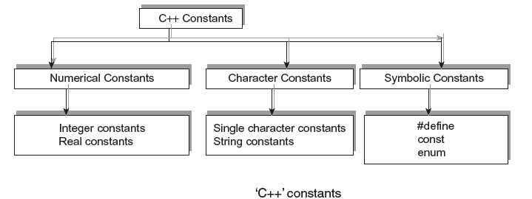
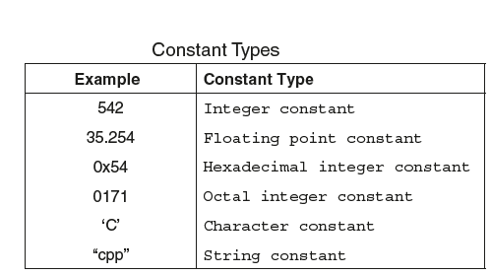
4. Constants
The constants in ‘C++’ are applicable to the values that do not change during execution of a program. There are several types of constants in ‘C++’. They are classified into the following groups.

Slide 23
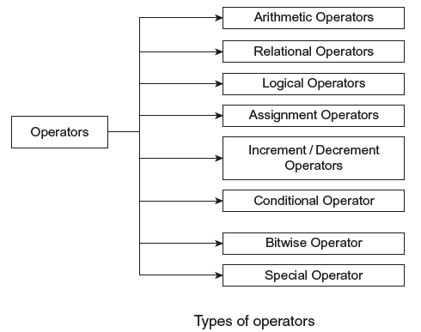
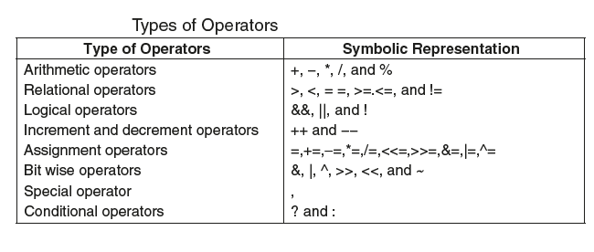
5.Operators

Slide 24
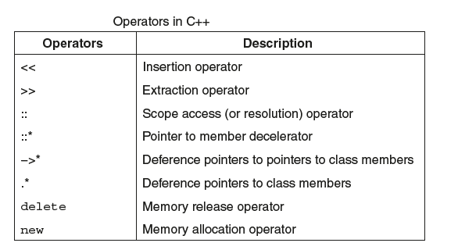

Slide 25
Scope Resolution Operator (: :)
The scope resolution operator in C++ is used to access the global variable when both local and global variables are having the same name, to refer to the static members of a class, and to define a function definition outside the class. We discuss in detail about scope resolution operator in the later tutorial in this series.
Special Operators (sizeof, pointer, comma, dot, etc.)
The following are the special operators in c programming language.
sizeof operator
This operator is used to find the size of the memory (in bytes) allocated for a variable. This operator is used with the following syntax.sizeof(variableName);
Example
sizeof(A); // ⇒ the result is 2 if A is an integer
Pointer operator (*)
This operator is used to define pointer variables in c programming language.
Comma operator (,)
This operator is used to separate variables while they are declaring, separate the expressions in function calls, etc.
Dot operator (.)
This operator is used to access members of a class, and structure.

Slide 26
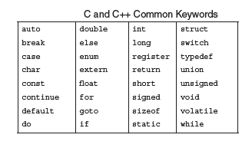
Keywords
The ‘C++’ keywords are reserved words by the compiler and are assigned fixed meanings. All ‘C’ keywords are valid in C++. The programmer may not apply them in the programs for defining variable names; however, few ‘C++’ compilers permit to declare variable names that exactly match with the 32 keywords.

Slide 27
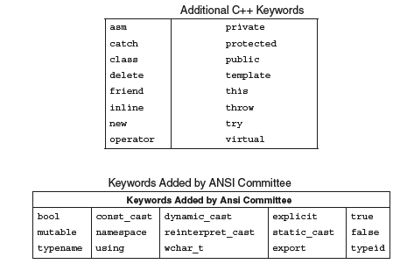

Slide 28
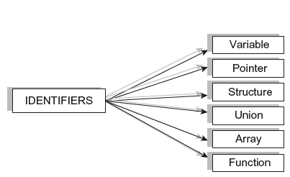
Identifiers are names of variables, functions, arrays, etc. In other words , identifiers refer to variety of entities such as structures, unions, enumeration, constants,typedef names, functions, and objects.

Slide 29
6. Decision Statements &Control Loop Structures
Decision Statements:
The if statement
The if-else statement
The nested if-else statements.
The else-if ladder
The switch case statement.
The break statement
The default keyword

Slide 30
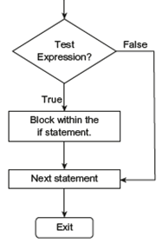
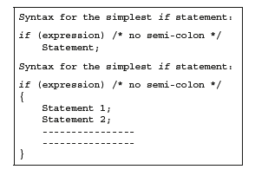
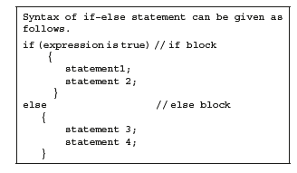
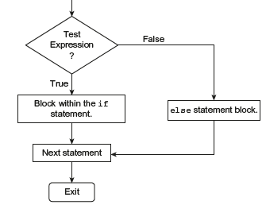

Slide 31
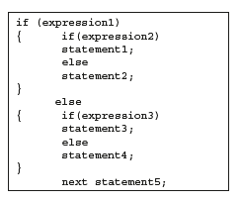
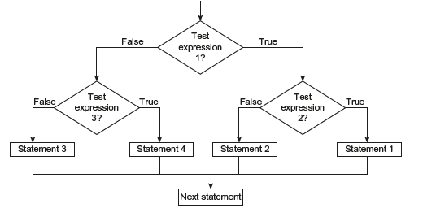
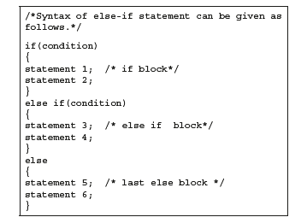

Slide 32
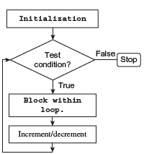
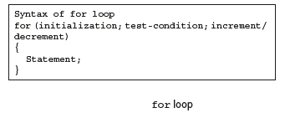
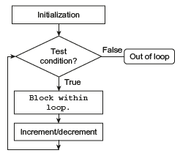
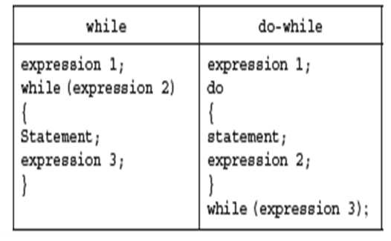
Control Loop Structures

Slide 33
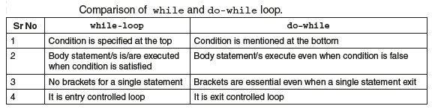

Slide 34
The break Statement
The break statement allows the programmer to terminate the loop. The break skips from the loop or the block in which it is defined. The control then automatically passes on to the first statement after the loop or the block.
The break can be associated with all the conditional statements (especially switch case).
We can also use break statements in the nested loops. If we use break statement in the innermost loop, then the control of the program is terminated from that loop only and resumes at the next statement following that loop

Slide 35
The continue Statement
The continue statement works somewhat like the break statement. Instead of forcing the control to the end of the loop (as it is in case of break), the continue case causes the control to pass on to the beginning of the block/loop.
In the case of for loop, the continue case initiates the testing condition and increment on steps has to be executed (while rest of the statement following the continue are neglected).
For while and do-while, the continue case causes control to pass on to conditional tests.

Slide 36
THE switch STATEMENT
The switch statement is a multi-way branch statement and an alternative to if-else if ladder in many situations.
The expression of switch contains only one argument,which is then checked with a number of switch cases.
The switch statement evaluates the expression and then looks for its value among the case constants. If the value is matched with a particular case constant, then those case statements are executed until a break statement is found or until the end of switch block is reached. If not, then simply the default (if present) is executed (if a default is not present, then the control flows out of the switch block).
The default is normally present at the bottom of the switch case structure. But we can also define default statement anywhere in the switch structure.
The default block must not be empty.
Every case statement terminates with a ‘:’ (colon)

Slide 37
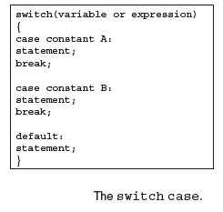
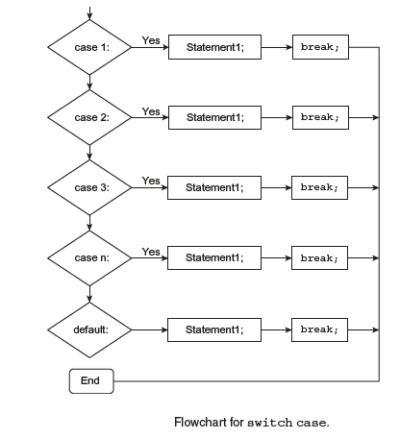

Slide 38
7. Arrays
An array is a very popular, linear, homogenous, and useful data structure that is used to store similar types of data elements in contiguous memory locations under one variable name.
An array can be declared to be of any standard or custom data type.
The array of characters (string) type works somewhat differently from the array of integers, floating numbers, and so on.

Slide 39
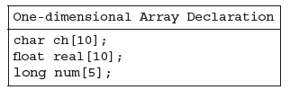

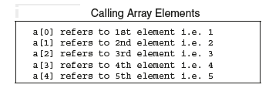

Slide 40

CHARACTERISTICS OF ARRAYS
(1) The Declaration int a[5] is nothing but a creation of five variables of integer types. Instead of declaring five variables for five values, the programmer can define them in an array.
(2) All the elements of an array share the same name, and they are distinguished from one another with the help of an element number.
(3) The element number in an array plays a major role for calling each element.
(4) Any particular element of an array can be modified separately without disturbing the other elements.
For example, int a[5] = {1,2,3,4,8};
If the programmer needs to replace 8 with 10, he/she is not required to change all the other elements except 8. To carry out this task, the statement a[4] = 10 can be used.
Here, the other four elements are left unchanged.
(5) Any element of an array a[] can be assigned/equated to another ordinary variable or an array variable of its type.
(6)The array elements are stored in contiguous memory locations. The amount of storage required for holding the elements of the array depends on its type and size. The total size in bytes for a single-dimensional array is computed as shown below.

Slide 41
ACCESSING ARRAY ELEMENTS THROUGH POINTERS
We can quickly and easily access array elements using pointers, as these elements are stored in contiguous memory locations.
A pointer variable contains an address, and it is easy to manipulate data with the help of addresses. When a pointer is incremented, the address gets incremented, and we can access the contents of memory locations. This particular method requires less memory;hence, execution is fast.
Program to display elements of an array using pointer. Display addresses of elements.
#include<iostream.h>
int main()
{
int *p,num[5]={1,2,3,4,5},j;
p=&num[0];
cout<<“\nNumber Address”<<endl;
for (j=0;j<5;j++)
cout<<“ ”<<*(p+j) <<“ ”<<unsigned(p+j)<<endl;
return 0;
}

Slide 42
ARRAYS OF POINTERS
the ‘C++’ language also supports arrays of pointers. It is nothing but a collection of addresses. Here, we store the addresses of variables for which we have to declare arrays as pointers.
Write a program to store addresses of different elements of an array using array of pointers.
#include<iostream.h>
int main()
{
int *ap[3];
int a[3]={5,10,15},k;
for(k=0;k<3;k++)
ap[k]=a+k;
cout<<“\n\t Address Element”<<endl;
for (k=0;k<3;k++)
{
cout<<“\t” <<unsigned(ap[k]);
cout<<“\t”<<*(ap[k])<<endl;
}
return 0;
}

Slide 43
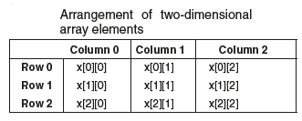
TWO-DIMENSIONAL ARRAYS
Two-dimensional arrays can be considered a rectangular display of elements with rows and columns, and this is also known as a matrix.
int x[3][3];

Slide 44
THREE- OR MULTI-DIMENSIONAL ARRAYS
The ‘C++’ program helps in creating an array of multi dimensions. The compiler determines the restrictions on it. The syntax of the declaration of multi-dimensional arrays is as follows:
Data Type_Arrayname [S1][S2][S3]...[Si];
where Si is the size of the ith dimensions.
Three-dimensional arrays can be initialized as follows.
int mat[3][3][3] = { 1,2,3, 4,5,6, 7,8,9, 1,4,7, 2,5,8,
3,6,9, 1,4,4, 2,4,7, 8,8,5};
A three-dimensional array can be considered an array of arrays of arrays. The outer array contains three elements. The inner array is two dimensional with regard to size [3][3].

Slide 45
6.Namespace
There are two students with the same name in a classroom. To distinguish the two students, we need to call them by their names and surnames.
A situation like this can occur in C++ as well. It might happen that a function we created with the name sqrt(), but this is already present in the cmath library of C++. In this case, the compiler cannot differentiate between the two function names. Hence, it will yield an error. To avoid this confusion, namespaces are used.
Namespaces provide a method to avoid name conflicts . Namespaces in C++ are used as additional information to differentiate two or more variables, functions, or classes having the same names.
All the items within the namespace have public visibility and the items declared within the namespace must include the C++ standard library and directives like using namespace std;.
Syntax of namespace is very similar to the classes or struct. The keyword namespace is followed by a namespace name, an opening curly brace, and terminated with closing brace without
semicolon.

Slide 46
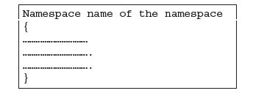
2)#include<iostream.h>
namespace window
{
int v=20;
float f=2.5;
}
namespace wind
{
int v=20;
float f=2.5;
}
int main()
{
cout<<“ Additon of two numbers:”<<endl;
cout<<window::v+wind::v<<endl;
cout<<“Multiplication of two numbers”<<endl;
cout<<window::f*wind::f<<endl;
return 0;
}
1)#include<iostream.h>
namespace window
{
int v=20;
float f=30;
}
int main()
{
cout<<window::v<<endl;
cout<<window::f;
return 0;
}

Slide 47
Namespaces can be nested where you can define one namespace inside another name space as follows:
SYNTAX:
namespace namespace_name1 {
// code declarations
Namespace namespace_name2 {
// code declarations
}
}

Slide 48
#include <iostream>
using namespace std;
// first name space
namespace first_space
{
void func()
{
cout << "Inside first_space" << endl;
}
// second name space
namespace second_space
{
void func()
{
cout << "Inside second_space" << endl;
}
}
}
using namespace first_space::second_space;
int main ()
{
// This calls function from second name space.
func();
return 0;
}

Slide 49
Using namespace std;
Here std is a name space whose members are used in the programs. Those members are cout,cin,endl etc..This namespace present in iostream.h header file
namespace std
{
ostream cout;
istream cin;
…
..
}

Slide 50
7. Default Arguments
A default argument is a value in the function declaration automatically assigned by the compiler if the calling function does not pass any value to that argument.
Characteristics for defining the default arguments
The values passed in the default arguments are not constant. These values can be overwritten if the value is passed to the function. If not, the previously declared value retains.
During the calling of function, the values are copied from left to right. All the values that will be given default value will be on the right.

Slide 51
#include<iostream>
using namespace std;
int sum(int x, int y, int z=0, int w=0) // Here there are two values in the default arguments
{
// Both z and w are initialised to zero
return (x + y + z + w); // return sum of all parameter values
}
int main()
{
cout << sum(10, 15) << endl; // x = 10, y = 15, z = 0, w = 0
cout << sum(10, 15, 25) << endl; // x = 10, y = 15, z = 25, w = 0
cout << sum(10, 15, 25, 30) << endl; // x = 10, y = 15, z = 25, w = 30
return 0;
}

Slide 52
8. Constant Arguments
A constant argument is the one whose modification cannot take place by the function. Furthermore, in order to make an argument constant to a function, the use of a keyword const can take place like- int sum (const int a, const int b).
#include<iostream>
using namespace std;
float area(int r,const int pi=3.14);// function declaration int main()
{
int r;
cout<<"Enter radius of a circle:";
cin>>r;
cout<<"The area of circle is :"<<area(r);
return 0;
}
float area(int r,const int pi)
{
return pi*r*r;//pi++ cannot be done as it is constant;
}

Slide 53
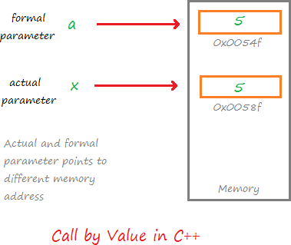
9. Parameter passing techniques
//Call by Value #include <iostream> using namespace std; void increment(int a) { a++; cout << "Value in Function increment: "<< a <<endl; } int main() { int x = 5; increment(x); cout << "Value in Function main: "<< x <<endl; return 0; }
When a function is called in the call by value, the value of the actual parameters is copied into formal parameters.
Both the actual and formal parameters have their own copies of values, therefore any change in one of the types of parameters will not be reflected by the other.

Slide 54
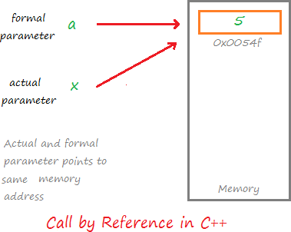
//Call by Reference #include <iostream> using namespace std; void increment(int &a) { a++; cout << "Value in Function increment: "<< a <<endl; } int main() { int x = 5; increment(x); cout << "Value in Function main: "<< x <<endl; return 0; }
Both the actual and formal parameter points to the same address in the memory. That means any change on one type of parameter will also be reflected by other.

Slide 55
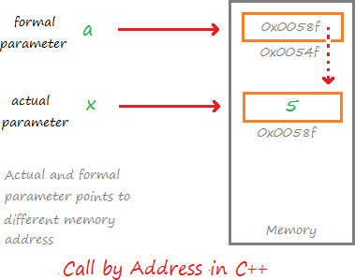
//Call by Address #include <iostream> using namespace std; void increment(int *a) { (*a)++; cout << "Value in Function increment: "<< *a <<endl; } int main() { int x = 5; increment(&x); //Passing address of x cout << "Value in Function main: "<< x <<endl; return 0; }
In this type of call mechanism, pointer variables are used as formal parameters.
The formal pointer variable holds the address of the actual parameter, hence the changes done by the formal parameter is also reflected in the actual parameter

Slide 56
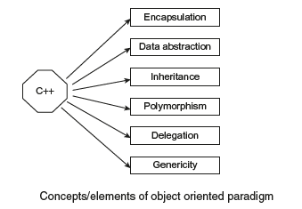
10. Features of Object-Oriented Programming or Key concePts of object orienteD Programming

Slide 57
Object:
Objects are primary run-time entities in object-oriented programming.
Some examples are a spot, a person, any data item related to the program including user-defined data types.
Programming issues are analyzed in terms of object and the type of transmission between them.
Objects occupy space in memory.
Every object has its own properties or features that illustrate what the object can do.
Objects communicate with each other by sending messages.

Slide 58
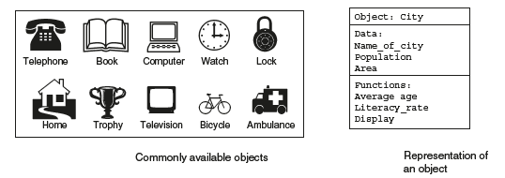
The name of the above object is city. Its data members are name_of_city, population, and area.
The various functions associated with the city are average age, literacy_ rate, and display.

Slide 59
Class:
A class is a grouping of objects that have identical properties, common behavior, and shared relationship.
class is the accomplishment of abstract data type. It defines the nature and methods that act on the data structure and abstract data type, respectively.
Specimens are also called as objects.
For example, Tata’s Swift, Maruti’s Alto etc. are the members of a class car.
The entire group of data and code of an object can be built as a user-defined data type using class.
Objects are nothing but variables of type class. Once a class has been declared, the programmer can create a number of objects associated with that class

Slide 60
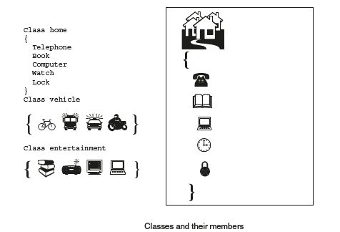

Slide 61
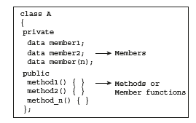
Method:
An operation required for an object or entity when coded in a class is called a method.
The operations that are required for an object are to be defined in the class. All objects in a class carry out certain common actions or operations.
Each action needs an object that becomes a function in the class that defines it and is referred to as a method.

Slide 62
Data Abstraction:
Data Abstraction is a process of providing only the essential details to the outside world and hiding the internal details, i.e., representing only the essential details in the program.
Data Abstraction is a programming technique that depends on the seperation of the interface and implementation details of the program.
Let's take a real life example of AC, which can be turned ON or OFF, change the temperature, change the mode, and other external components such as fan, swing. But, we don't know the internal details of the AC, i.e., how it works internally. Thus, we can say that AC seperates the implementation details from the external interface.
C++ provides a great level of abstraction. For example, pow() function is used to calculate the power of a number without knowing the algorithm the function follows.

Slide 63
Encapsulation:
The packing of data and functions into a single component is known as encapsulation.
The data is not reachable by the outside functions.
Only those functions that are able to access the data are defined within the class.
These functions prepare the interface between the object’s data and the program.
With encapsulation we can accomplish data hiding.
Data hiding is an important feature using which an object can be used without the user knowing how it works internally.

Slide 64
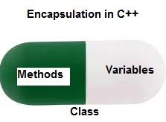

Slide 65
Inheritance:
Inheritance is the method by which objects of one class get the properties of objects of another class.
In object oriented programming inheritance provides the thought of reusability.
The programmer can add new properties to the existing class without changing it.
This can be achieved by deriving a new class from the existing one.
The new class will possess features of both the classes. The actual power of the inheritance is that it permits the programmer to reuse a class

Slide 66
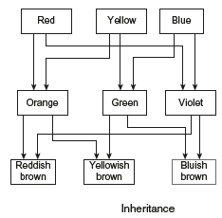

Slide 67
Polymorphism:
Polymorphism means the ability to take many forms. Polymorphism allows to take different implementations for same name.poly -> many morphism -> forms
There are two types of polymorphism, Compile time polymorphism and run time polymorphism.
In Compile time polymorphism binding is done at compile time and in runtime polymorphism binding is done at runtime.
e.g.: Function overloading, operator overloading
Function Overloading: Function overloading is a part of polymorphism. Same function name having different implementations with different number and type of arguments.

Slide 68
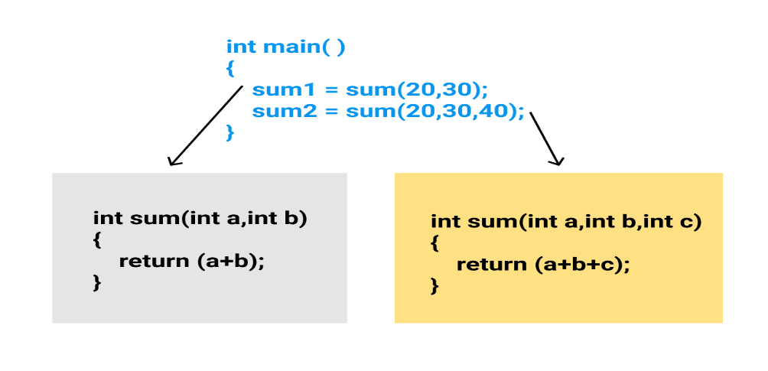
Operator Overloading:
Operator overloading is a part of polymorphism. Same operator can have different implementations with different data types.

Slide 69
Dynamic binding:
Dynamic binding is also known as late binding. The code present in the specified program is unknown till it is executed.
message passing
An object oriented programming includes objects.
The objects communicate with one another.
The programming with these objects should be followed with following steps.
(1) Declaring classes that define objects and their actions.
(2) Declaring objects from classes.
(3) Implementing relation between objects.

Slide 70
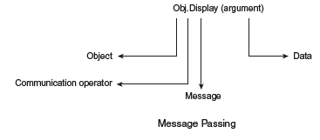

Slide 71
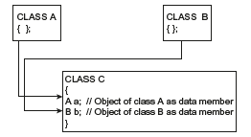
Delegation:
When object of one class is used as data member in the other class, such composition of objects is known as delegation.
These two data members are objects of class A and B, such relationship between the classes known as has a relationship.
Genericity:
The software components of a program have more than one version depending on the data types of arguments.
This feature allows declaration of variables without specifying exact
data type.
The compiler identifies the data type at run time. The programmer can create a function that can be used for any type of data.
The template feature in C++ allows generic programming.

