Slide 1
PROJECT
Predicting the Performance of
Quarterbacks in the NFL

Slide 2
Data mining goal
We wanted to identify variables that have the largest impact on NFL Quarterbacks (QBs) and predict their performance in a game
We focused on game day weather factors (wind, temperature, humidity)
Metric of “performance” was how many passing yards they throw in comparison to their season average
We integrated “quality of defense” factors
Our analysis will help NFL Fantasy Football participants in deciding whether they should start a QB for their weekly matchup, based on other game-specific variables

Slide 3
Datasets - Preprocessing
We used 4 different source datasets that were joined on matching key variables
A significant amount of preprocessing was required, which included steps such as:
Converting formats of attribute values (e.g. dates from string to date value)
Imputing values of 0, and dropping rows with NA or null values
Remove stats for games played in a dome
Coerce common values between tables for joining (e.g. “BUF” -> “Buffalo”)
Remove irrelevant columns and filter on rows of interest (e.g. only regular season games)
Normalize strength of defense and passing stats (e.g. QB passing yards deviation from season avg)
Discretizing and Binning numeric values (e.g. 50-70 degrees -> “warm”)
Attributes of interest that were binned were yards deviation, defense strength, humidity, temperature, wind, and completion percentage
Results for both equal width and equal depth binning were compared
Final unpartitioned training dataset had 23 attributes and 3,409 rows

Slide 4
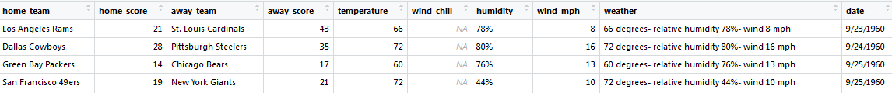
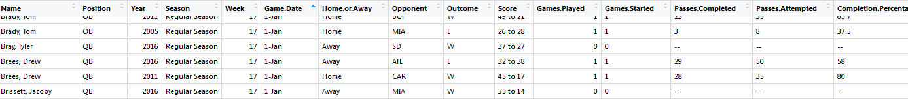
Datasets - Screenshots
Weather Dataset
Game Logs:
Career Stats
Defense (13 datasets for 2012 - 2013 season)

Slide 5
Discretization
Yards thrown deviation from season average- passing yards/game. Units: passing yards | Opponent Defense Strength based on Z-Score for average passing yards allowed | Temperature | Humidity | Wind (mph) | Completion pct (no predefined levels; system chose 5 bins based on range) Units: accuracy
excellent game | top tier defense | really cold | dry | low wind | Excellent game
>= 150 | 2.05 | below 10 | 0-20 | 0-7.5 | 5th bin floor ->
great game | very good defense | cold | below normal humidity | breezy | Good game
>= 100 to < 150 | 0.83 to 2.05 | 10-30 | 20-40 | 7.5-15 | 4th bin floor - 5th bin
good game | good defense | cool | normal humidity | windy | Average game
>= 50 to < 100 | -0.39 to 0.83 | 30-50 | 40-60 | 15-22.5 | 3rd bin floor - 4th bin
slightly above average game | average defense | warm | humid | very windy | Below average game
>= 0 to < 50 | -1.62 to -0.39 | 50-70 | 60-80 | 22.5+ | 2nd bin floor - 3rd bin
slightly below average game | poor defense | hot | very humid |  | poor game
<= 0 to > -50 | -2.85 to -1.62 | 70+ | 80-100 |  | 1st bin floor- 2nd bin
bad game
<= -50 to > -100
awful game
<= -100 to > -150
horrendous game
<= -150

Slide 6
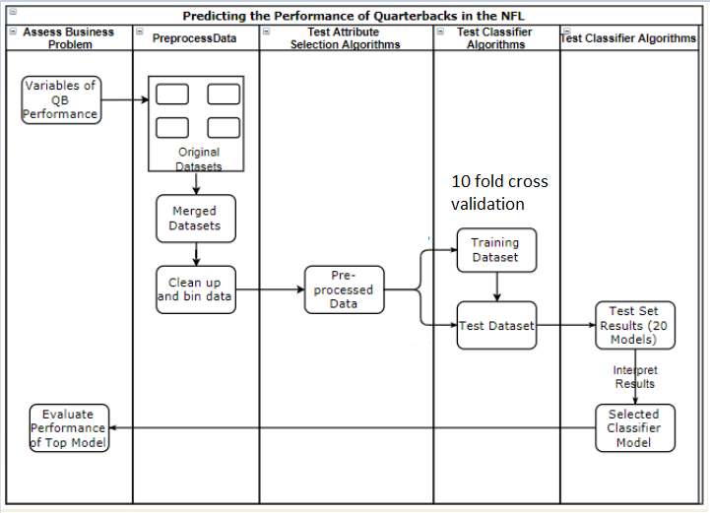
WOrkflow

Slide 7
Attribute Algorithm results
ONE R (Ranker search w/ranked weights) | CFS SUBSET EVAL- BEST FIRST (Greedy Stepwise search) | INFO GAIN | CORRELATION ATTRIBUTE EVAL (Ranker search w/ranked weights) | OUR SELECTED ATTRIBUTES
 |  | (Ranker search w/ranked weights)
33.5582 15 game_passes_attempted | home_score | 0.290774 15 game_passes_attempted | 0.1728 15 game_passes_attempted | Wind
29.3634 23 game_completion_pct_cat | away_score | 0.173422 4 qb_name | 0.09789 23 game_completion_pct_cat | Defense quality
28.4248 13 away_score | game_passes_attempted | 0.097417 3 game_completion_pct | 0.09514 3 game_completion_pct | Temperature
28.3661 22 defense_quality | wind_mph_cat | 0.096595 23 game_completion_pct_cat | 0.08394 13 away_score | Humidity
27.6034 21 wind_mph_cat | defense_quality | 0.053466 5 qb_team | 0.05205 12 home_score
27.0461 2 opponent_acr | game_completion_pct | 0.052243 2 opponent_acr | 0.03992 22 defense_quality
26.694 3 game_completion_pct |  | 0.052212 11 away_team | 0.03684 14 outcome
26.43 5 qb_team |  | 0.04141 22 defense_quality | 0.01684 9 week
26.3714 7 game_date_month |  | 0.038307 13 away_score | 0.0168 21 wind_mph_cat
26.342 6 game_date_year |  | 0.029048 12 home_score | 0.01555 17 season_completion_pct
26.166 10 home.or.away |  | 0.013613 21 wind_mph_cat | 0.01519 19 temperature_cat
25.726 4 qb_name |  | 0.009728 14 outcome | 0.01515 2 opponent_acr

Slide 8
ATTRIBUTE EXPLANATION
Yards deviation (cat): the number of yards to QB deviated from his normalized season average, broken into 8 categories
Game completion pct: the percentage of that particular game the QB played
Defense Quality: Analyzed, normalized and discretized team rankings derived from season summary data
Game passes attempted: total number of passes thrown (regardless of completion)

Slide 9
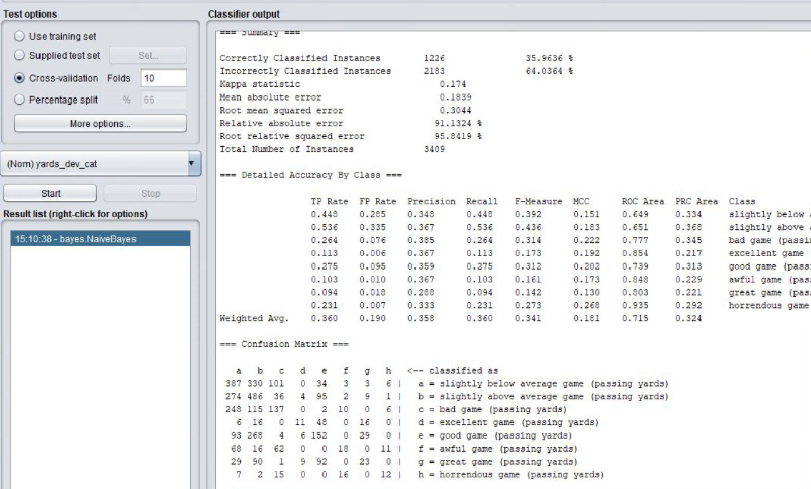
TEST METHOD
We chose to use 10 fold cross-validation method for testing.
We felt we would have a more robust analysis if all of the data was tested.

Slide 10
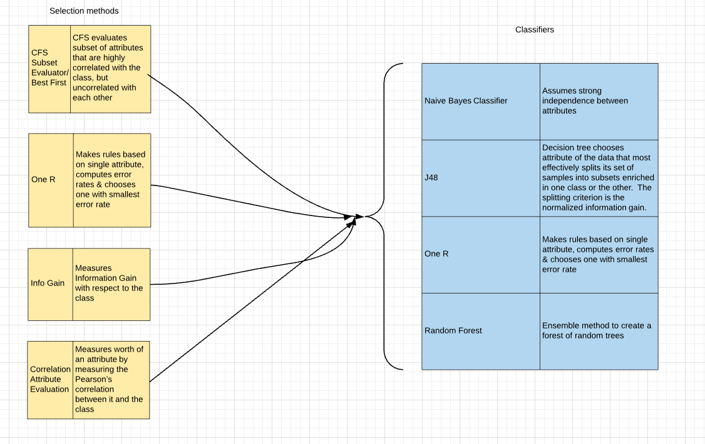
CLASSIFIERS

Slide 11
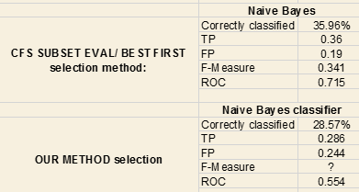
Classifiers
We chose CFS Subset Eval/Best First paired with Naïve Bayes as our classification algorithm of choice.
CFS evaluates subset of attributes that are highly correlated with the class, but uncorrelated with each other
Naive Bayes assumes the attributes are all independent of each other
Had the highest TP rate and ROC value
Though it had low TP accuracy, it had a low FP rate
This algorithm performed significant better than Naïve Bayes paired with our attributes of choice. We suspect this is because CFS Subset included attributes that were not truly independent of game performance, such as game passes attempted, and game pass completion percentage

Slide 12
Performance accuracy

Slide 13
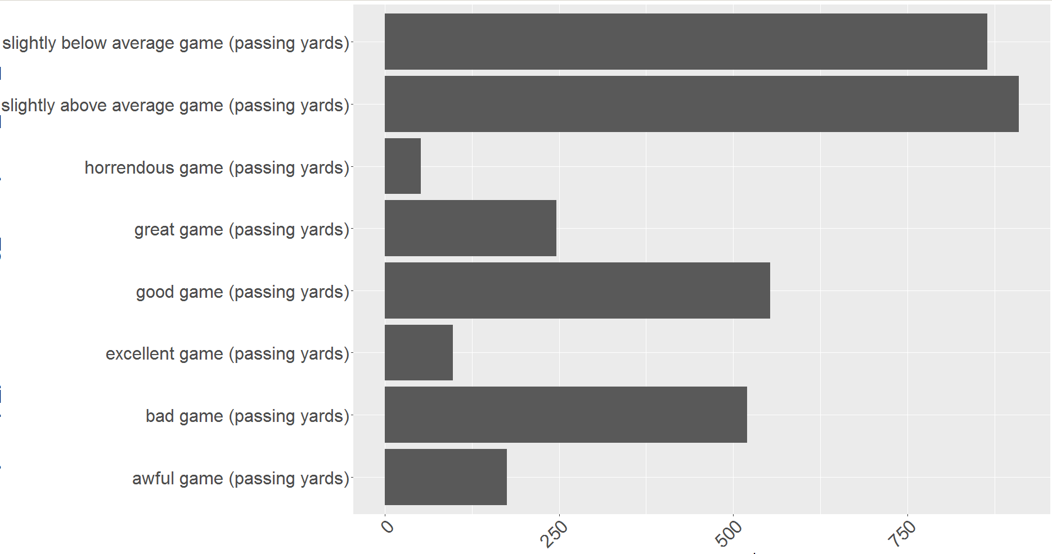
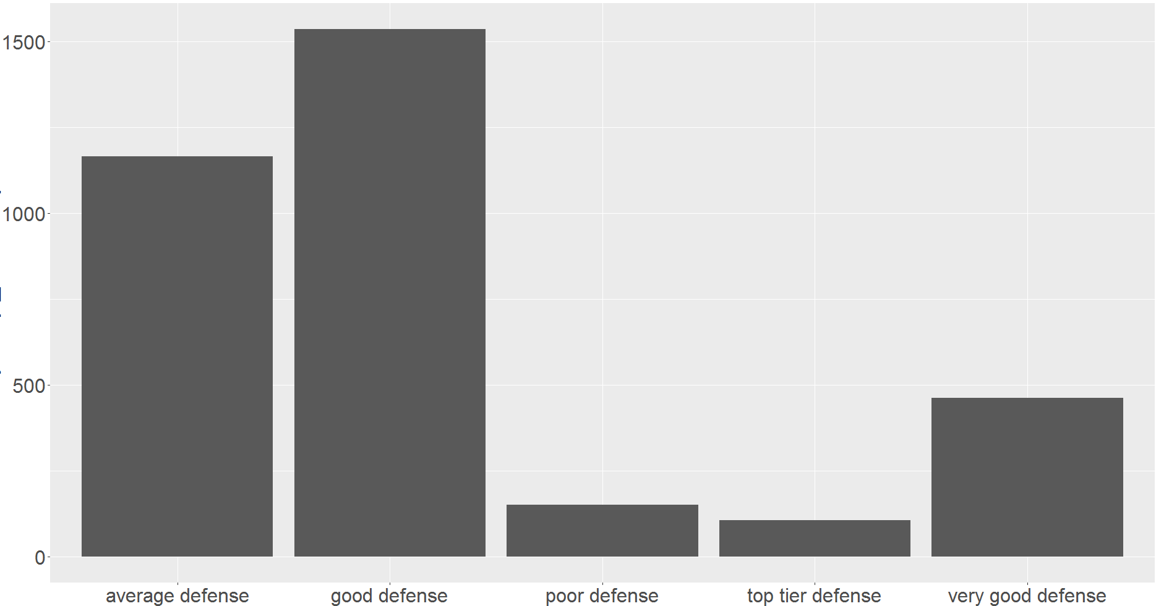
Observations of accuracy
Each classification algorithm had a very low True-Positive accuracy rate (between 28%-36%)
We original suspected this was due to class imbalance, as depicted in examples below. However re-running our analysis with Equal-Depth binning resulted in even worse accuracy (average 16%)
We suspect that the many discretized values among 6 attributes played a factor
To evaluate root cause of poor performance, we analyzed confusion matrix

Slide 14
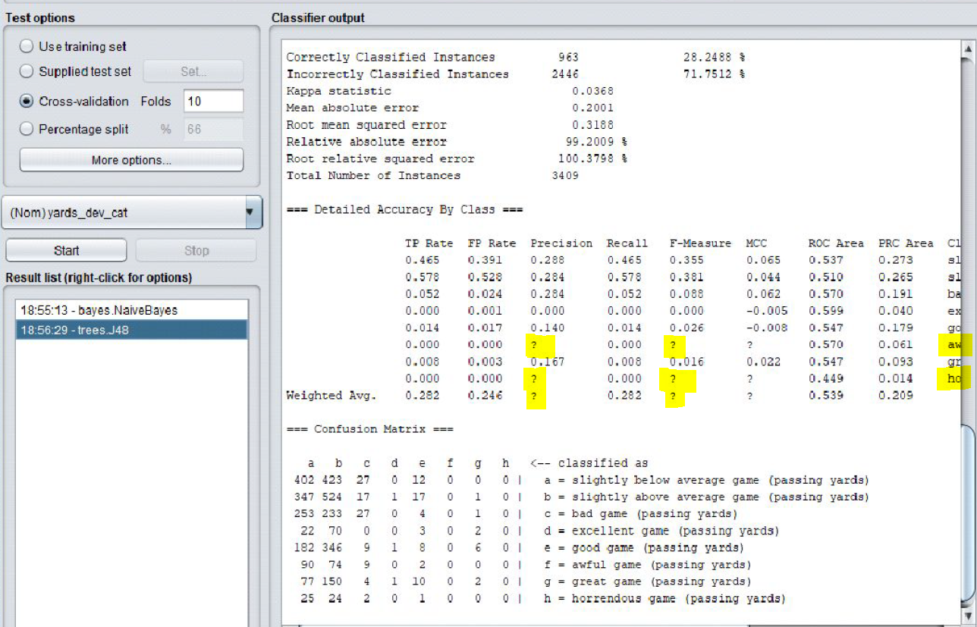
observation
Our chosen classifier could not calculate the precision in 3 of the 4 situations using our selected attributes
There were so few examples in these categories (awful game and horrendous game); both True Positive Rate and False Positive Rate were 0

Slide 15
Confusion Matrix
We re-ordered Weka’s confusion matrix output to assess patterns based on ordinal categories
Middle categories had high TP rates, but also high FP rates

Slide 16
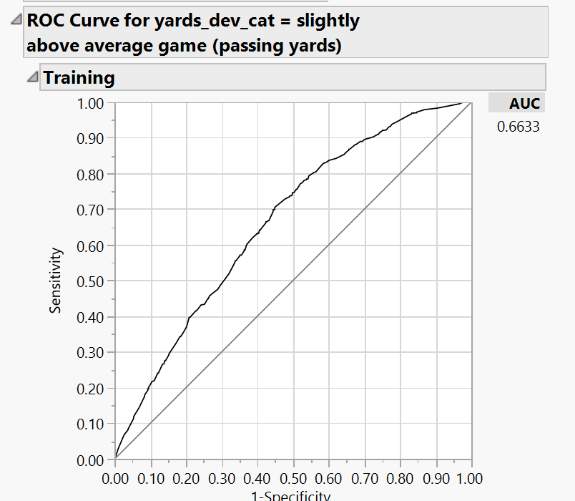
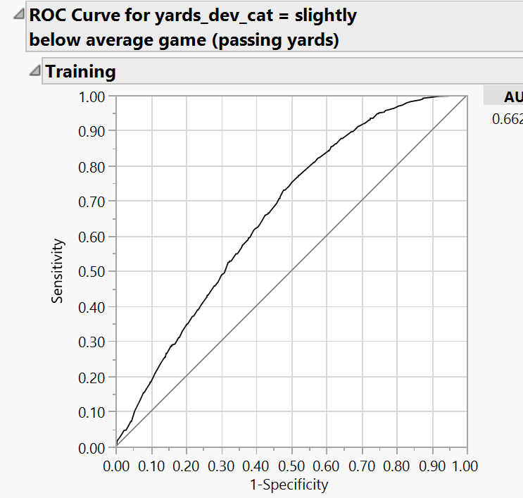
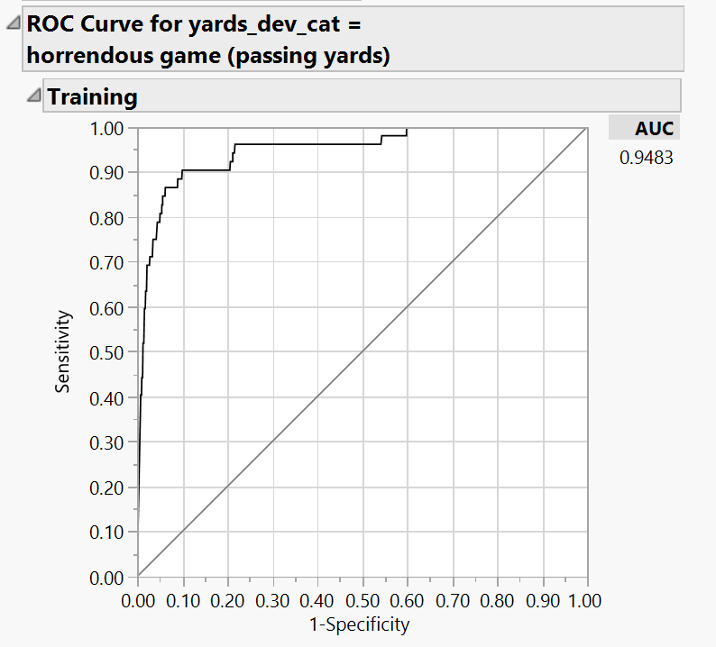
ROC analysis
While classifier had low TP accuracy, some of them did have decent ROC values
Outlier categories had especially high ROC values

Slide 17
Conclusion/Lessons Learned
Before concluding whether game weather and opponent defense has a significant impact on QB performance, we would like to explore the following:
Tweak binning methods used. This includes reducing the number of bins, and also restricting them to outlier classes (really bad or good games) that may be easier to predict more accurately
Reevaluate input data and manually include variables which are less correlated with each other
Integrate more robust Defense data/metrics
We were unable to definitely prove if weather and defense quality are influential factors in our class variable. It appears that game score and other QB performance metrics were the best indicators of yards thrown deviation.

Slide 18
Questions?
Tools used:
R/Rstudio, Weka, JMP Pro
Data sources:
http://www.nflsavant.com/about.php
https://www.kaggle.com/kendallgillies/nflstatistics
https://www.kaggle.com/kendallgillies/nflstatistics
https://www.pro-football-reference.com/years/2013/opp.htm
Additional Bibliography:
https://www.cs.waikato.ac.nz/~mhall/thesis.pdf
https://www.cs.waikato.ac.nz/~ml/weka/
https://en.wikipedia.org/wiki/C4.5_algorithm

