Slide 1
Attention Score Acceleration using an FPGA
Samarth, Rijul, Om and Satyarth RC19

Slide 2
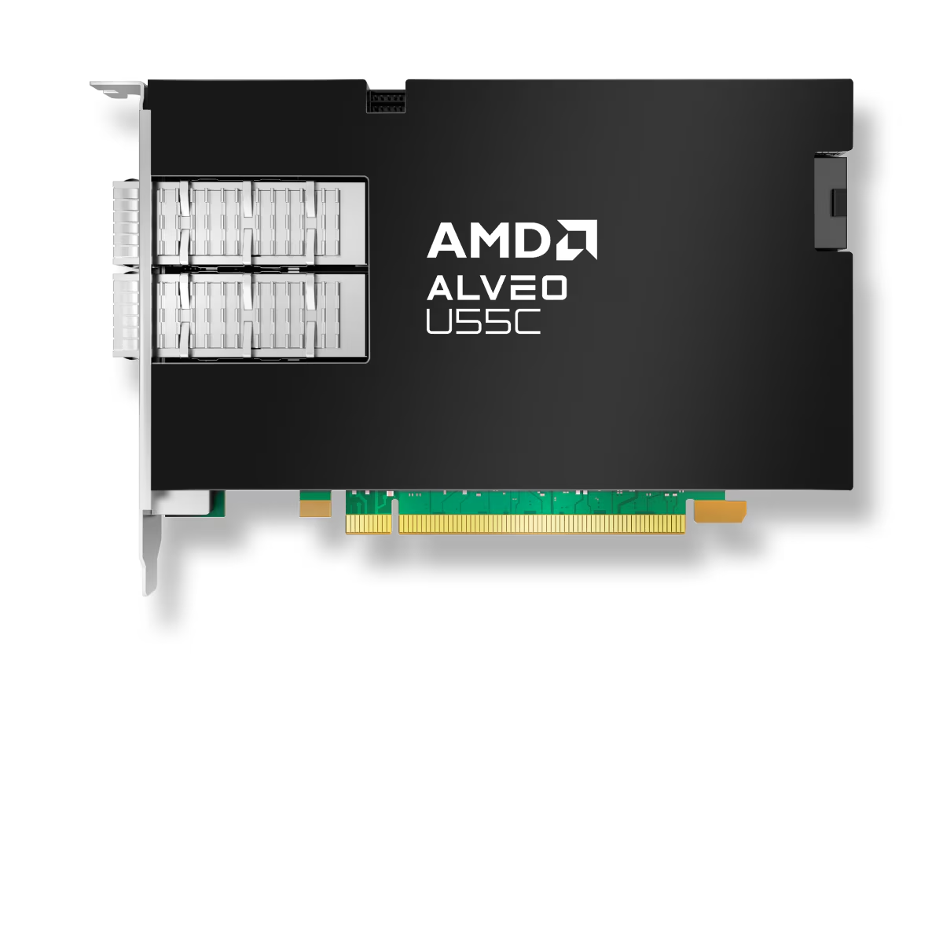
Project Overview
Built a standalone one-head attention accelerator for the AMD/Xilinx U55C FPGA.
The FPGA takes one attention head’s query, key, and value data from TinyLlama and produces the corresponding one-head attention output.
Verified synthetic sequence lengths S = 8, 64, 128, 256, 512 and real TinyLlama vectors.

Slide 3
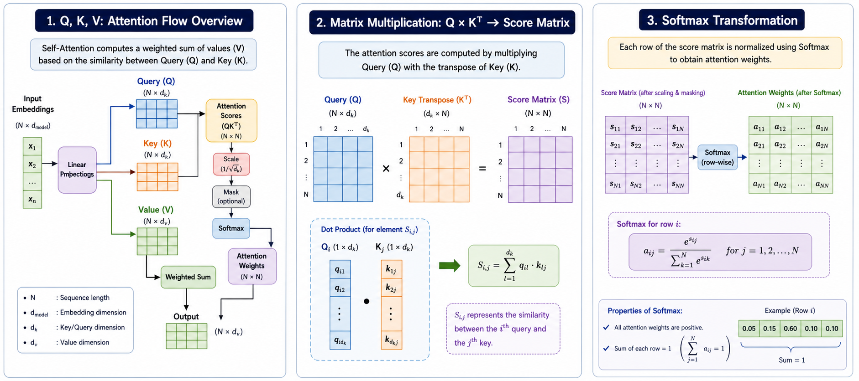
Background
Transformer models rely on the self-attention mechanism to capture relationships between tokens in a sequence
Input embeddings are projected into Query (Q), Key (K), and Value (V) representations
Attention scores are computed using a matrix multiplication: Q × Kᵀ, which measures similarity between tokens
The scores are scaled, optionally masked, and passed through a softmax function to produce normalized attention weights
These weights are used to compute a weighted combination of Value (V) vectors, forming the final attention output
The Q × Kᵀ operation dominates computation, with complexity O(N²d), making it the primary performance bottleneck

Slide 4
Motivation
Edge LLMs need efficient local inference.
Attention cost grows quickly with sequence length.
FPGAs can exploit custom dataflow, parallelism, quantization, and HBM.
We isolate one TinyLlama attention head to measure correctness, resource use, and performance on real U55C hardware.

Slide 5
Methodology & Implementation
Fused Score + Mask/Scale
Computes QK^T, applies causal mask, and scales logits in one kernel.
Full-Row Softmax
Normalizes across all S keys, required for S > 64.
softmax @ V
Consumes attention weights and V tiles to produce one-head attn_out.
Tiling
Q chunks: 8 rows. K/V chunks: 64 columns. Supports S up to 512.
Verification:
Host compares logits, softmax weights, and attn_out against Python references.

Slide 6
Architecture
Input Source
Synthetic S
Or TinyLlama Q/K/V data
Host + XRT
Create Tiles
Launch Kernels
Verify Tensors
HBM Bank Mapping
Q, K, Logits, row staging, weights, V, partial output spread across HBM[0] to HBM[7]
Kernel 1
score_mask_scale
QKᵀ tile
causal mask
scale to FP32 logits
Host Row Assembly
Collect K chunks
into one 8 × S
logit block
Kernel 2
softmax_full_row
Normalize across
all S keys
S ≤ 512
Kernel 3
v_weighted_sum
Apply attention
weights to V tiles
accumulate output
Output
attn_out
S × 64
one head
HBM layout
HBM[0]
HBM[1]
HBM[2]
HBM[3]
HBM[4]
HBM[5]
HBM[6]
HBM[7]
Q tile
K tile
unused
logits
row staging
weights
V tile
partial out

Slide 7
Current status
Track | Status | Notes
Track A: speedup + tiling | Steps 1–5 hardware-verified | Includes packed I/O, merged mask+scale, tiling, full-row softmax, pass-1 double buffering, and fused score+mask/scale.
Track B: softmax @ V | Complete | V weighted-sum kernel integrated; synthetic S=8..512 and vector modes verify final attn_out.
Track C: real TinyLlama inputs | Complete for current scope | TinyLlama Q/K/V extraction, INT8 Q/K quantization, real-vector export, and U55C runs for single-tile, S=16, S=64.
Track D: baselines/results | Staged design complete; fused retiming partially captured | Fused hardware timings are available from AGENTS/U55C run logs; Track D tables should be refreshed for fused-vs-staged comparison.
Future integration | Not implemented | Full TinyLlama subgraph, KV-cache-aware decode, and decoder-layer integration remain future work.

Slide 8
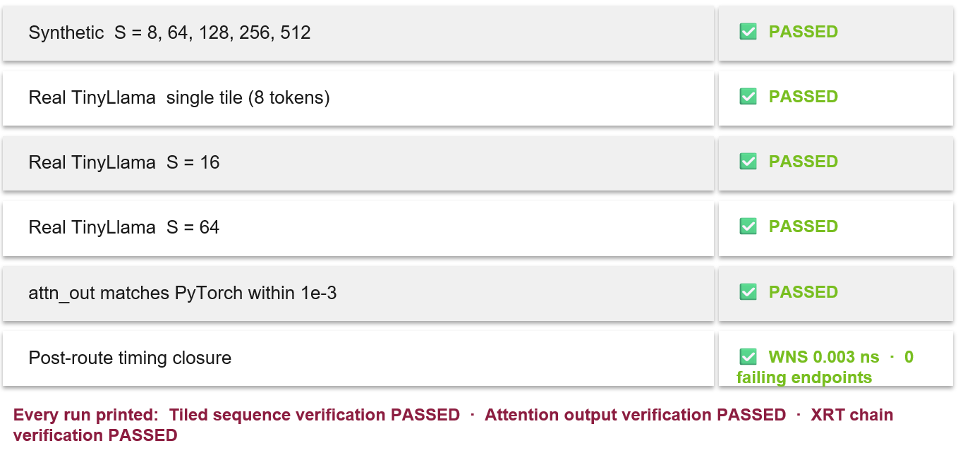
Results

Slide 9
CPU/GPU/FPGA Comparison
S | CPU full attn (ms) | GPU full attn (ms) | Staged FPGA total (ms) | Fused FPGA total (ms)
8 | 0.0322 | 0.3349 | 0.803 | 0.296
64 | 0.2920 | 0.2507 | 2.864 | 2.364
128 | 2.5009 | 0.2998 | 6.992 | 5.484
256 | 3.9523 | 0.2726 | 20.570 | 17.307
512 | 12.3290 | 0.2461 | 72.941 | 60.328
The FPGA path is correct, but still slower than CPU/GPU because the design uses many tile-level launches and host-visible HBM transfers.

Slide 10
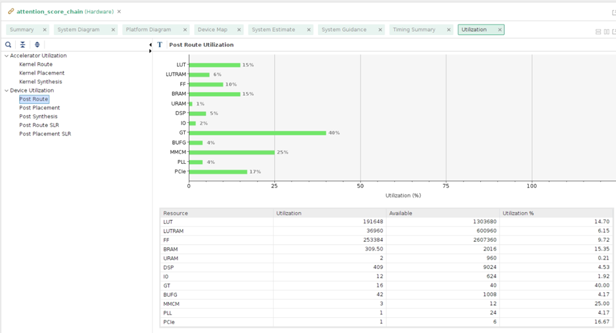
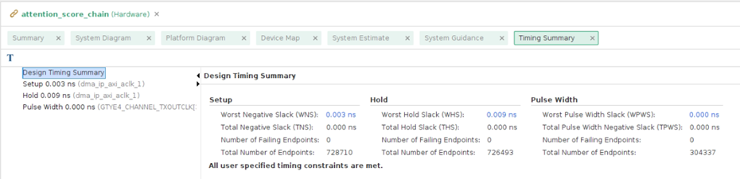
Utilization Report
Full routed design: 14.70% LUTs, 9.72% FF, 15.35% BRAM, 0.21% URAM, 4.53% DSP.
The V weighted-sum dominates DSP usage: 320 DSP.
Post-route timing closed: WNS 0.003 ns at kernel target clock: 300 Mhz.
Resource | Utilization | Available | Utilization %
LUT | 191648 | 1303680 | 14.70
LUTRAM | 36960 | 600960 | 6.15
FF | 253384 | 2607360 | 9.72
BRAM | 309.50 | 2016 | 15.35
URAM | 2 | 960 | 0.21
DSP | 409 | 9024 | 4.53
IO | 12 | 624 | 1.92
GT | 16 | 40 | 40.00
BUFG | 42 | 1008 | 4.17
MMCM | 3 | 12 | 25.00
PLL | 1 | 24 | 4.17
PCIe | 1 | 6 | 16.67
Table: Post-route utilization report

Slide 11
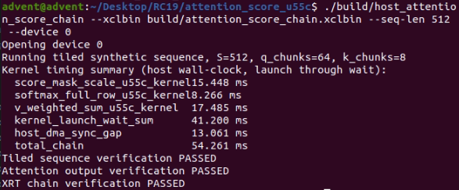
Verification Strategy
Python reference verifies full-sequence tiling at S=8, 64, 128, 256, 512
Each HLS kernel tested independently against exported vectors. All pass locally before touching hardware.
Hardware emulation, to test interaction between host and device:
Fused hardware emulation passed vector mode and S=8 sequence mode
On-board execution:
Synthetic sweep passed S=8, 64, 128, 256, 512
TinyLlama vector runs passed for real S = 8, 64, 128

Slide 12
Challenges and Limitations
Challenges
Limitations
Debugging HLS Kernels
Limited visibility compared to software debugging
Requires waveform or simulation-based debugging
Standalone one-head block only
Not yet integrated to full TinyLlama decoder.
Long Compilation Times
FPGA synthesis takes a long time, slowing iteration
No KV-cache decode flow yet
Precision Trade-Offs
Balancing accuracy with performance when using INT8/FP32
Slower than CPU and GPU baseline

Slide 13
Next Steps
Reduce Host Transfers:
Keep Q/K/V, logits, probabilities, and attn_out resident on FPGA memory.
Reduce Kernel Launch Count
Move from many tile-level launches toward larger fused kernels.
Fuse Softmax and V accumulation
Avoid writing full attention weights back through host-visible buffers.
Full Model Integration
Connect the accelerated block into TinyLlama decoder flow after performance improves.

Slide 14
References
[1] http://neuralnetworksanddeeplearning.com/
[2] https://jalammar.github.io/illustrated-transformer/
[3] https://medium.com/@cristianleo120/the-math-behind-transformers-6d7710682a1f

Slide 15
THANK YOU!
Any Questions?

