Slide 1
ASC 2026
UNIT 1

Slide 2
  Unit - I Units and Measurements
1.1 Unit, physical quantities: fundamental and derived quantities
and their units Systems of units: CGS, MKS and SI .
1.2 Scalar and Vector Physical Quantities, vector operation
(addition,substraction, multiplication).
1.3 Dimensions, dimensional formula ,Applications of dimensional
analysis; correctness of physical equations ,conversion factor for
interconversion of units in different systems of units.
1.4 Errors, types of errors: instrumental, systematic and random
error, estimation of errors: absolute, relative and percentage error,
significant figures.
1.5 Ancient astronomical instruments:Chakra, Dhanuryatra , Yasti
and Phalaka yantra .
1.6 Applications of Vernier calipers , Screw gauge .

Slide 3
1.1 Unit, physical quantities: fundamental and derived quantities
Physical Quantities and Units

Slide 4
11P02.1 Physical Quantities and Units
Physical Quantity

Slide 5
11P02.1 Physical Quantities and Units
Physical Quantity
Can be Measured

Slide 6
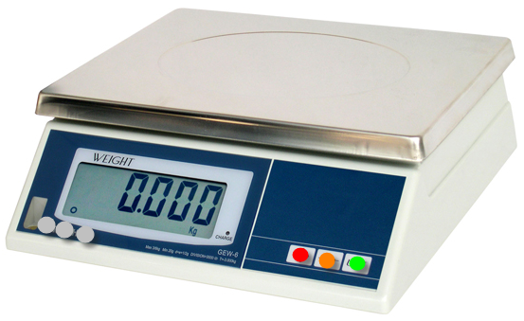
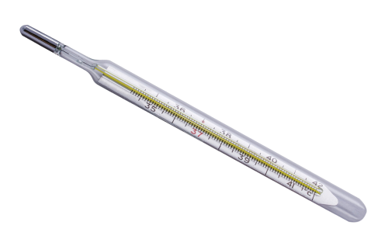
11P02.1 Physical Quantities and Units
Physical Quantity
Can be Measured
Is Mass a Physical Quantity?
Is Fever a Physical Quantity?
Yes, Mass is a physical quantity we can measure mass by balance and weighing machines
No, Doctor did not measure fever he measures temperature. Temperature is a Physical Quantity which is measured by the thermometer

Slide 7
11P02.1 Physical Quantities and Units
Physical Quantity

Slide 8
11P02.1 Physical Quantities and Units
Physical Quantity
Fundamental Quantity

Slide 9
11P02.1 Physical Quantities and Units
Physical Quantity
Fundamental Quantity
Derived Quantity

Slide 10
11P02.1 Physical Quantities and Units
Physical Quantity
Fundamental Quantity
Derived Quantity
Example: Mass, length,time etc.

Slide 11
11P02.1 Physical Quantities and Units
Physical Quantity
Fundamental Quantity
Derived Quantity
Example: Mass, length,time etc.
Example: Velocity, Force,work etc.

Slide 12

11P02.1 Physical Quantities and Units
Physical Quantity
Fundamental Quantity
Derived Quantity
Example: Mass, length,time etc.
Example: Velocity, Force,work etc.
$$v=\frac{Distance}{time}$$

Slide 13
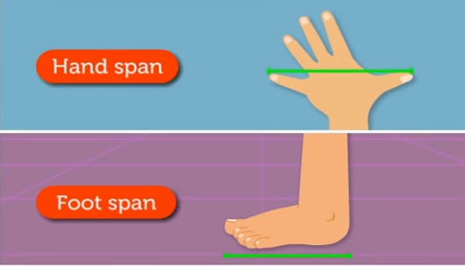
11P02.1 Physical Quantities and Units
Measuring a Physical Quantity

Slide 14
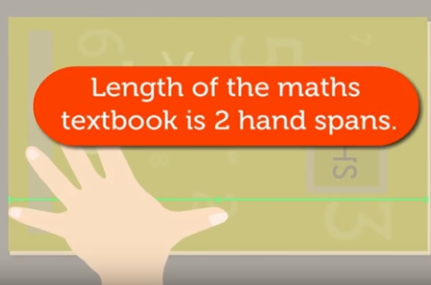
11P02.1 Physical Quantities and Units
Measuring a Physical Quantity

Slide 15
11P02.1 Physical Quantities and Units
Measuring a Physical Quantity
Comparison

Slide 16
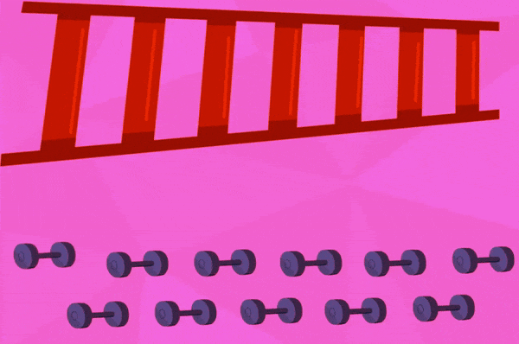
11P02.1 Physical Quantities and Units
Measuring a Physical Quantity
Comparison

Slide 17
11P02.1 Physical Quantities and Units
Measuring a Physical Quantity
Comparison
Unit

Slide 18
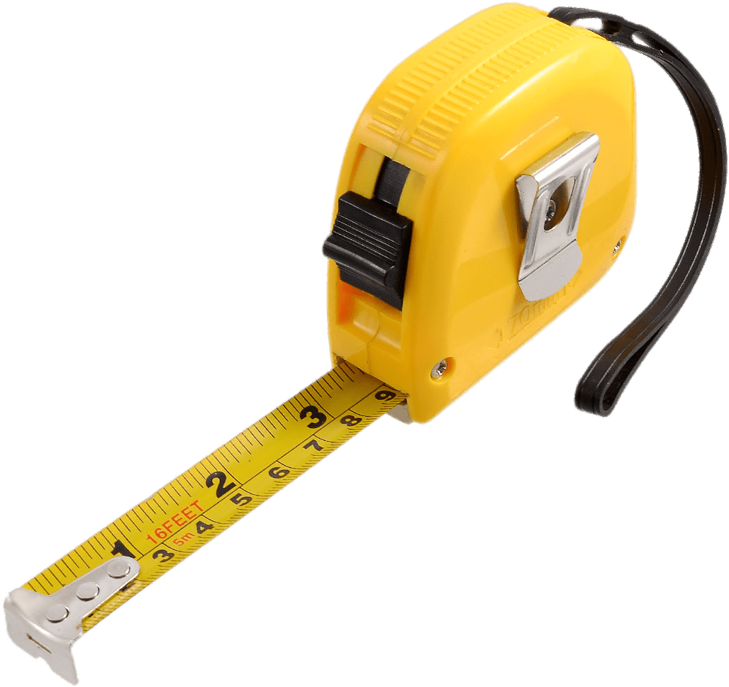
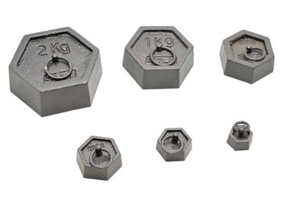
11P02.1 Physical Quantities and Units
Comparison with Reference Standard

Slide 19
11P02.1 Physical Quantities and Units
Physical Quantity = Magnitude(n) × Unit(u) = n u

Slide 20
11P02.1 Physical Quantities and Units
Example:Length = 28 m
Physical Quantity = Magnitude(n) × Unit(u) = n u
Magnitude
Unit

Slide 21
Fundamental Units in SI system
 | Quantity | Symbol | SI unit | Symbol
Main units | Length | L | metre | m
 | Mass | M | kilogramme | kg
 | Time | T | second | s
 | Electric Current | A | ampere | A
 | Thermodynamic Temperature | K | kelvin | K
 | Light Intensity | Cd | candela | cd
 | Amount of substance | mole | mole | mol
Supplementary units | Plane angle | dθ | radian | rad
 | Solid angle | dΩ | steradian | sr
Home
Next
Previous

Slide 22
Definition of SI Units
Metre
The metre is the length of the path travelled by light in vacuum during a time interval of 1/299,792,458 of a second. (1983)
Kilogramme
The kilogram is equal to the mass of the international prototype of the kilogram (a platinum-iridium alloy cylinder) kept at international Bureau of Weights and Measures, at Sevres, near Paris, France. (1889)
Second
The second is the duration of 9,192,631,770 periods of the radiation corresponding to the transition between the two hyperfine levels of the ground state of the cesium-133 atom. (1967)
Ampere
The ampere is that constant current which, if maintained in two straight parallel conductors of infinite length, of negligible circular cross-section, and placed 1 metre apart in vacuum, would produce between these conductors a force equal to 2×10^{–7} newton per metre of length. (1948)
Home
Next
Previous

Slide 23
Kelvin
The kelvin, is the fraction 1/273.16 of the thermodynamic temperature of the triple point of water. (1967)
Candela
The candela is the luminous intensity, in a given direction, of a source that emits monochromatic radiation of frequency 540×10¹² hertz and that has a radiant intensity in that direction of 1/683 watt per steradian. (1979)
Mole
The mole is the amount of substance of a system, which contains as many elementary entities as there are atoms in 0.012 kilogramme of carbon-12. (1971)
Home
Next
Previous

Slide 24
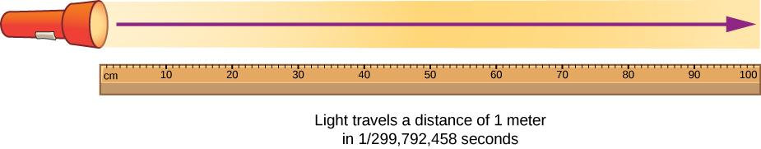
11P02.1 Physical Quantities and Units

Slide 25
11P02.1 Physical Quantities and Units
Units

Slide 26
11P02.1 Physical Quantities and Units
Units
Fundamental/Base Units

Slide 27
11P02.1 Physical Quantities and Units
Units
Fundamental/Base Units
Metre, Kilogram etc.

Slide 28
11P02.1 Physical Quantities and Units
Units
Fundamental/Base Units
Derived Units
Metre, Kilogram etc.

Slide 29
11P02.1 Physical Quantities and Units
Units
Fundamental/Base Units
Derived Units
Metre, Kilogram etc.
Newton (kg ms⁻²), ms⁻¹ etc.

Slide 30
11P02.1 Physical Quantities and Units
System of Units

Slide 31
11P02.1 Physical Quantities and Units
Complete set of units
System of Units

Slide 32
11P02.1 Physical Quantities and Units
Complete set of units
MKS
System of Units

Slide 33
11P02.1 Physical Quantities and Units
Complete set of units
MKS
System of Units
CGS

Slide 34
11P02.1 Physical Quantities and Units
Complete set of units
MKS
System of Units
CGS
FPS

Slide 35
11P02.1 Physical Quantities and Units
Base units for length, mass and time
Complete set of units
MKS
Metre, kilogram and second respectively
System of Units
CGS
FPS

Slide 36
11P02.1 Physical Quantities and Units
Base units for length, mass and time
Complete set of units
MKS
Metre, kilogram and second respectively
System of Units
CGS
Centimetre, gram and second respectively
FPS

Slide 37
11P02.1 Physical Quantities and Units
Base units for length, mass and time
Complete set of units
MKS
Metre, kilogram and second respectively
System of Units
CGS
Centimetre, gram and second respectively
FPS
Foot, pound and second respectively

Slide 38
11P02.1 Physical Quantities and Units
SI System

Slide 39
11P02.1 Physical Quantities and Units
International System of units
SI System

Slide 40
11P02.1 Physical Quantities and Units
Seven Fundamental Units and two Supplementary Units
International System of units
SI System

Slide 41
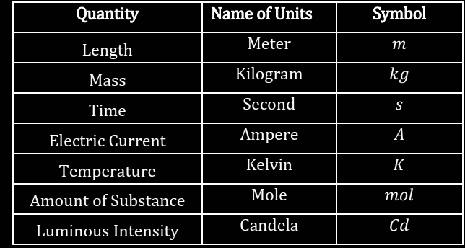
11P02.1 Physical Quantities and Units
Seven Fundamental Units and two Supplementary Units
International System of units
SI System
Fundamental unit

Slide 42
11P02.1 Physical Quantities and Units
Seven Fundamental Units and two Supplementary Units
International System of units
SI System
Fundamental unit
Supplimentry Units
Quantity | Name of units | Symbol
Plane angle | Radian | rad
Solid angle | Steradian | sr

Slide 43




11P02.1 Physical Quantities and Units
Plane angle
$$s$$
$$θ=\frac{s}{r} rad$$
$$θ$$
$$r$$

Slide 44
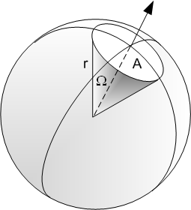

11P02.1 Physical Quantities and Units
Solid angle
$$Ω=\frac{A}{r^{2}} sr$$

Slide 45
Range and Order of Lengths
(L_{longest} : L_{shortest} = 10⁴¹ : 1)
S.No | Size of the object or distance | Length (m)
1 | Size of proton | 10⁻¹⁵
2 | Size of atomic nucleus | 10⁻¹⁴
3 | Size of the Hydrogen atom | 10⁻¹⁰
4 | Length of a typical virus | 10⁻⁸
5 | Wavelength of a light | 10⁻⁷
6 | Size of the red blood corpuscle | 10⁻⁵
7 | Thickness of a paper | 10⁻⁴
8 | Height of the Mount Everest from sea level | 10⁴
9 | Radius of the Earth | 10⁷
10 | Distance of the moon from the earth | 10⁸
11 | Distance of the Sun from the earth | 10¹¹
12 | Distance of the Pluto from the Sun | 10¹³
13 | Size of our Galaxy | 10²¹
14 | Distance of the Andromeda galaxy | 10²²
15 | Distance of the boundary of observable universe | 10²⁶
Home
Next
Previous

Slide 46
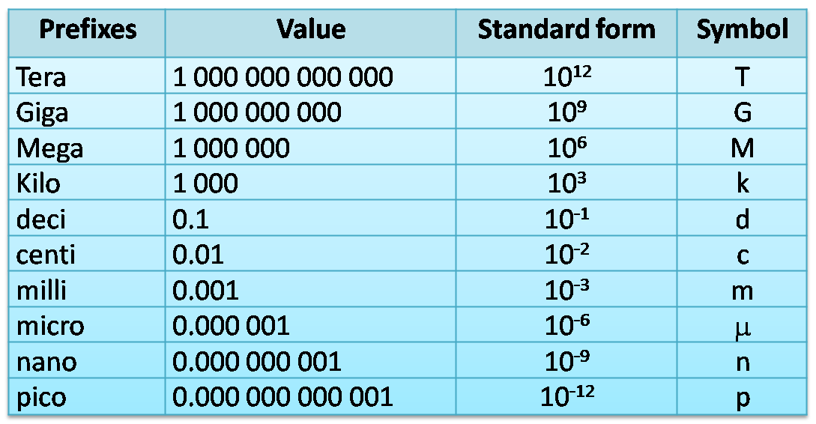

Slide 47
DIMENSIONS OF PHYSICAL QUANTITIES
The nature of a physical quantity is described by its dimensions.
All the physical quantities can be expressed in terms of the seven base or fundamental quantities viz. mass, length, time, electric current, thermodynamic temperature, intensity of light and amount of substance, raised to some power.
The dimensions of a physical quantity are the powers (or exponents) to which the fundamental or base quantities are raised to represent that quantity.
Note:
Using the square brackets [ ] around a quantity means that we are dealing with ‘the dimensions of’ the quantity.
Example:
The dimensions of volume of an object are [L³]
The dimensions of force are [MLT⁻²]
The dimensions of energy are [ML²T⁻²]
Home
Next
Previous

Slide 48
Dimensional Quantity
Dimensional quantity is a physical quantity which has dimensions.
For example: Speed, acceleration, momentum, torque, etc.
Dimensionless Quantity
Dimensionless quantity is a physical quantity which has no dimensions.
For example: Relative density, refractive index, strain, etc.
Dimensional Constant
Dimensional constant is a constant which has dimensions.
For example: Universal Gravitational constant, Planck’s constant, Hubble constant, Stefan constant, Wien constant, Boltzmann constant, Universal Gas constant, Faraday constant, etc.
Dimensionless Constant
Dimensionless constant is a constant which has no dimensions.
For example: 5, -.0.38, e, π, etc.
Home
Next
Previous

Slide 49
11P02.5 Dimensional Analysis and its Application
Symbolic Representation of Dimension:
Fundamental Quantity | Dimension
Mass | [M]
Length | [L]
Time | [T]
Current | [I]
Temperature | [K]
Amount of Substance | [mol]
Luminous Intensity | [cd]

Slide 50
Dimensional formulae for some physical quantities
 | Physical quantity | Symbol | Formula | Dimensional formula | Unit
General | Length | L | Fundamental | [M⁰LT⁰] | m
 | Mass | M | Fundamental | [ML⁰T⁰] | kg
 | Time | T | Fundamental | [M⁰L⁰T] | s
 | Area | A | Length x breadth | [M⁰L²T⁰] | m²
 | Volume | V | Length x breadth x height | [M⁰L³T⁰] | m³
 | Linear density |  | Mass / length | [ML^{–1}T⁰] | kg m^{–1}
 | Mass Density | ρ | Mass / volume | [ML^{–3}T⁰] | Kg m^{–3}
 | Specific gravity or relative density | RD | Density of the substance / density of water | [MºLºTº] | ––
 | Specific volume |  | 1 / density | [M^{–1}L³T⁰] | kg^{–1} m³
 | Time period | T | Time taken for 1 oscillation | [M⁰L⁰T] | s
 | Frequency | ν | 1 / time period | [M⁰L⁰T^{–1}] | Hz or s⁻¹
Home
Next
Previous

Slide 51
Mechanics | Distance, displacement, wavelength, focal length | s, λ, f |  | [M⁰LT⁰] | m
 | Speed | v | Distance / time | [M⁰LT^{–1}] | m s^{–1}
 | Velocity | v | Displacement / time | [M⁰LT^{–1}] | m s^{–1}
 | Velocity gradient |  | dv / dx | [M⁰L⁰T^{–1}] | s^{–1}
 | Acceleration or acceleration due to gravity | a or g | Velocity / time | [M⁰LT^{–2}] | m s^{–2}
 | Momentum | p | Mass x velocity | [MLT^{–1}] | kg m s^{–1}
 | Force | F | Mass x acceleration | [MLT^{–2}] | kg m s^{–2} or newton (N)
 | Force constant or spring constant | K | Force / extension | [ML⁰T^{–2}] | N m^{–1}
 | Impulse | j | Force x time | [MLT^{–1}] | N s or kg m s^{–1}
Home
Next
Previous

Slide 52
Mechanics | Work | W | Force x Displacement | [ML²T^{–2}] | kg m²s^{–2} or joule (J)
 | Energy | E | Capacity to do work | [ML²T^{–2}] | joule (J)
 | Energy density |  | Energy / volume | [ML^{–1}T^{–2}] | J m^{–3}
 | Power | P | (Work or energy) / time | [ML²T^{–3}] | J s^{–1} or Watt (W)
 | Pressure | P | Force / area | [ML^{–1}T^{–2}] | N m^{–2} or Pascal (Pa)
 | Pressure head |  |  | [MºLTº] | m
Gravitation | Gravitational potential |  | G P E / mass | [M⁰L²T^{–2}] | J kg^{–1}
 | Universal gravitational constant | G | G = F d²/(m₁m₂) | [M^{–1}L³T^{–2}] | N m² kg^{–2}
 | Intensity of gravitational field |  | F / m | [M⁰L¹T^{–2}] | N kg^{–1}
Home
Next
Previous

Slide 53
DIMENSIONAL FORMULAE AND DIMENSIONAL EQUATIONS
The expression which shows how and which of the base quantities represent the dimensions of a physical quantity is called the dimensional formula of the given physical quantity.
Example:
The dimensional formula of the volume is [M° L³ T°],
The dimensional formula of speed or velocity is [M° L T⁻¹]
(iii) The dimensional formula of acceleration is [M° L T^{–2}]
An equation obtained by equating a physical quantity with its dimensional formula is called the dimensional equation of the physical quantity.
Example:
(i) [V] = [M° L³ T°]
(ii) [v] = [M° L T⁻¹]
(iii) [a] = [M° L T^{–2}]
Home
Next
Previous

Slide 54
Quantities having the same dimensional formulae
Impulse and momentum
Work, energy, torque, moment of force
Angular momentum, Planck’s constant, rotational impulse
Stress, pressure, modulus of elasticity, energy density
Force constant, surface tension, surface energy
Angular velocity, frequency, velocity gradient
Gravitational potential, latent heat
Thermal capacity, entropy, universal gas constant and Boltzmann’s const.
Force, thrust
Power, luminous flux
Dimensional formulae for physical quantities often used in Physics are given at the end. (From Slide 63)
Home
Next
Previous

Slide 55
DIMENSIONAL ANALYSIS AND ITS APPLICATIONS
Dimensional analysis is a tool to find or check relations among physical quantities by using their dimensions.
When magnitudes of two or more physical quantities are multiplied, their units should be treated in the same manner as ordinary algebraic symbols.
We can cancel identical units in the numerator and denominator.
Similarly, physical quantities represented by symbols on both sides of a mathematical equation must have the same dimensions.
Dimensional Analysis can be used-
To check the dimensional consistency of equations
(Principle of homogeneity of dimensions).
2. To convert units in one system into another system.
3. To derive the relation between physical quantities based on certain
reasonable assumptions.
Home
Next
Previous

Slide 56
I. Checking the Dimensional Consistency of Equations
The principle of homogeneity of dimensions:
The magnitudes of physical quantities may be added together or subtracted from one another only if they have the same dimensions.
For example, initial velocity can be added to or subtracted from final velocity because they have same dimensional formula [M⁰LT⁻¹] .
But, force and momentum can not be added because their dimensional formulae are different and are [MLT⁻²] and [MLT⁻¹] respectively.
Home
Next
Previous

Slide 57
Example:
1. To check the dimensional consistency of v² = u² + 2as
The dimensions of the quantities involved in the equation are:
[u] = [M⁰LT⁻¹]
[v] = [M⁰LT⁻¹]
[a] = [M⁰LT⁻²]
[s] = [M⁰LT⁰]
Substituting the dimensions in the given equation,
[M⁰LT⁻¹]² = [M⁰LT⁻¹]² + [M⁰LT⁻²] [M⁰LT⁰]
[M⁰L²T⁻²] = [M⁰L²T⁻²] + [M⁰L²T⁻²]
Each term of the above equation is having same dimensions.
Therefore, the given equation is dimensionally correct or dimensionally consistent.
(Note that the constant 2 in the term ‘2as’ does not have dimensions)
Home
Next
Previous

Slide 58
Note:
If an equation fails the consistency test, it is proved wrong;
But if it passes, it is not proved right.
Thus, a dimensionally correct equation need not be actually an exact (correct) equation, but a dimensionally wrong (incorrect) or inconsistent equation must be wrong.
Example: Equations v² = u² - 2as or v² = u² + ½as are dimensionally consistent but are incorrect equations in mechanics.
Albert Einstein tried his famous mass-energy equation as
E = m / c², E = m² / c, E = m² c, etc.
Finally he settled with E = m c² using dimensions and then proved it with the help of Calculus.
Home
Next
Previous

Slide 59
2. To check the dimensional consistency of ½ mv² = mgh
The dimensions of the quantities involved in the equation are:
[m] = [ML⁰T⁰]
[v] = [M⁰LT⁻¹]
[g] = [M⁰LT⁻²]
[h] = [M⁰LT⁰]
Substituting the dimensions in the given equation,
[ML⁰T⁰] [M⁰LT⁻¹]² ⁼ [ML⁰T⁰] [M⁰LT⁻²] [M⁰LT⁰]
[ML²T⁻²] = [ML²T⁻²]
Each term of the above equation is having same dimensions.
Therefore, the given equation is dimensionally correct or dimensionally consistent.
(Note that the constant ½ in the term ‘½ mv² ’ does not have dimensions)
Home
Next
Previous

Slide 60
II. Conversion of units in one system into another system
Units are derived from the dimensions and the dimensions are derived from the actual formulae of physical quantities.
If the dimensions are known for a physical quantity, then it is easy to express it in fps, cgs, mks, SI systems or any other arbitrary chosen system.
n₁[M₁ªL₁^{b}T₁^{c}] = n₂[M₂ªL₂^{b}T₂^{c}]
a b c
M₁
L₁
T₁
n₂ = n₁
M₂
L₂
T₂
n₁ and n₂ are the magnitudes in the respective systems of units.
Smaller the unit bigger the magnitude of a physical quantity and vice versa.
For example, 1 m = 100 cm (m is the bigger unit and cm is the smaller one)
1 N = 10⁵ dynes (Newton is bigger and dyne is smaller)
Home
Next
Previous

Slide 61
Example:
1. To convert 1 joule in erg.
‘joule’ is unit of energy or work in SI system and ‘erg’ is the unit in cgs system.
The dimensional formula of energy or work is [ML²T⁻²].
The units from dimensions in SI and cgs systems are kg m² s⁻² and g cm² s⁻² respectively.
Let n₁ joule = n₂ erg
 | SI System | cgs System
Magnitude | n₁ = 1 | n₂ = ?
Mass (M) | 1 kg (=1000 g) | 1 g
Length (L) | 1 m (= 100 cm) | 1 cm
Time (T) | 1 s | 1 s
[MªL^{b}T^{c}] = [ML²T⁻²] Therefore, a=1, b=2, c=-2
a b c
n₂ = 1 (1000)¹ (100)² (1)⁻²
M₁
L₁
T₁
n₂ = n₁
M₂
L₂
T₂
n₂ = 10⁷
1000 g
1 2 -2
100 cm
1 s
1 joule = 10⁷ erg
n₂ = 1
1 g
1 cm
1 s
Home
Next
Previous

Slide 62
2. To convert 1 newton into a system where mass is measured in
mg, length in km and time in minute
‘newton or kg m s⁻²’ is unit of force in SI system and ‘mg km min⁻²’ is the unit in the new system.
The dimensional formula of force is [MLT⁻²].
Let n₁ newton = n₂ mg km min⁻²
 | SI System | New System
Magnitude | n₁ = 1 | n₂ = ?
Mass (M) | 1 kg (=10⁶ mg) | 1 mg
Length (L) | 1 m (= 1/1000 km) | 1 km
Time (T) | 1 s (= 1/60) | 1 s
[MªL^{b}T^{c}] = [MLT⁻²] Therefore, a=1, b=1, c=-2
a b c
M₁
L₁
T₁
n₂ = 1 (10⁶ )¹ (10⁻³)¹ (60)²
n₂ = n₁
M₂
L₂
T₂
n₂ = 3.6 x 10⁶
1 1 -2
10⁶ mg
1/1000 km
1/60 s
n₂ = 1
1 newton =3.6x10⁶mg km min⁻²
1 mg
1 km
1 s
Home
Next
Previous

Slide 63
III. Deducing Relation among the Physical Quantities
The method of dimensions can sometimes be used to deduce relation among the physical quantities.
For this we should know the dependence of the physical quantity on other quantities (upto three physical quantities or linearly independent variables) and consider it as a product type of the dependence.
Example:
1. Consider a simple pendulum, having a bob attached to a string that oscillates under the action of the force of gravity. Suppose that the period of oscillation of the simple pendulum depends on its length (l), mass of the bob (m) and acceleration due to gravity (g). Derive the expression for its time period using method of dimensions.
The dependence of time period T on the quantities l, g and m as a product may be written as:
T = k l^{x} m^{y} g^{z}
where k is dimensionless constant and x, y and z are the exponents.
Home
Next
Previous

Slide 64
The dimensions of the quantities involved in the equation are:
[m] = [ML⁰T⁰]
[l] = [M⁰LT⁰]
[g] = [M⁰LT⁻²]
[T] = [M⁰L⁰T]
By substituting dimensions on both sides of T = k l^{x} m^{y} g^{z}, we have
[M⁰L⁰T] = [M⁰LT⁰]^{x} [ML⁰T⁰]^{y} [M⁰LT⁻²]^{z}
[M⁰L⁰T] = [M]^{y} [L]^{x+z} [T]^{-2z}
On equating the dimensions on both sides, we have
y = 0
x + z = 0
–2z = 1
So that x = ½ , y = 0, z = -½
Then, T = k l^{½} g^{–½}
Or
l
The value of k is 2π and
determined from other
methods.
l
T = k
T = 2π
g
g
Home
Next
Previous

Slide 65
Errors in Measurements
Theory of Errors
Errors

Slide 66
11P02.3 Errors in Measurements
Theory of Errors
Errors
Systematic Errors

Slide 67
11P02.3 Errors in Measurements
Theory of Errors
Errors
Systematic Errors
Random Errors

Slide 68
11P02.3 Errors in Measurements
Systematic Errors

Slide 69
11P02.3 Errors in Measurements
Errors tend to be in one direction, either positive or negative
Systematic Errors

Slide 70
11P02.3 Errors in Measurements
Errors tend to be in one direction, either positive or negative
Instrumental errors
Source
Systematic Errors

Slide 71
11P02.3 Errors in Measurements
Errors tend to be in one direction, either positive or negative
Instrumental errors
Error due to Imperfection in experimental technique
Source
Systematic Errors

Slide 72
11P02.3 Errors in Measurements
Errors tend to be in one direction, either positive or negative
Instrumental errors
Error due to Imperfection in experimental technique
Source
Systematic Errors
Personal errors

Slide 73
11P02.3 Errors in Measurements
Errors tend to be in one direction, either positive or negative
Instrumental errors
Error due to Imperfection in experimental technique
Source
Systematic Errors
Can be minimised by improving experimental techniques, selecting better instruments
Personal errors

Slide 74
11P02.3 Errors in Measurements
Random errors

Slide 75
11P02.3 Errors in Measurements
Random with respect
to sign and size
Due to random and unpredictable fluctuations in experimental conditions
Random errors
Can be minimized by repeatedly taking readings

Slide 76
11P02.3 Errors in Measurements
Least Count

Slide 77
11P02.3 Errors in Measurements
Smallest value which can be measure by the Instrument
Least Count

Slide 78
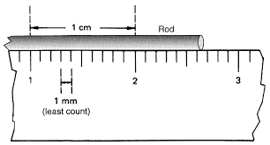
11P02.3 Errors in Measurements
Smallest value which can be measure by the Instrument
Least Count

Slide 79
11P02.3 Errors in Measurements
Smallest value which can be measure by the Instrument
In the measurement of the object, it is shown between two division lines, so then the observer needs to take the approximation for the measurement.
Least Count
2.6 2.7
When a measurement falls between two divisions, then errors due to approximate measurement made by the observer
Least Count Error

Slide 80
Calculation of Errors

Slide 81





11P02.3 Errors in Measurements
MEASUREMENT OF ERRORS
Values obtained in several measurements are
The magnitude of the difference between the individual measurement and the true value of the quantity is called the absolute error of the measurement
Absolute Error
$$a_{1}, a_{2}, a_{3}, …,a_{n}$$
$$a_{mean}=\frac{a_{1}+a_{2}+a_{3}+…+a_{n}}{n}$$
$$∆a_{1}=a_{1}−a_{mean},$$
$$∆a_{2}=a_{2}−a_{mean},$$
…. .… ….
…. .… ….
$$∆a_{n}=a_{n}−a_{mean}$$
$${|∆a}_{mean}|=\frac{\left|∆a_{1}\right|+|∆a_{2}|+|∆a_{3}|+…+|∆a_{n}|}{n}$$
$$a=a_{mean}±∆a_{mean}$$

Slide 82

11P02.3 Errors in Measurements
MEASUREMENT OF ERRORS
The relative error is the ratio of the mean absolute error ∆a_{mean} to the mean value a_{mean} of the quantity measured
Relative error
$$\text{Relative} \text{Error}=\frac{∆a_{mean}}{a_{mean}}$$

Slide 83

11P02.3 Errors in Measurements
MEASUREMENT OF ERRORS
When the relative error is expressed in percent, it is called the percentage error (δa)
Percentage error
$$\text{Percentage} \text{Error} δ=\frac{∆a_{mean}}{a_{mean}}×100\%$$

Slide 84

Q. We measure the period of oscillation of a simple pendulum. In successive measurements, the readings turn out to be $2.63 s,$ $2.56 s, 2.42 s, 2.71 s$and $2.80 s.$ Calculate the absolute errors, relative error and percentage error.
Time Duration : 5 Minutes

Slide 85
Slide 1: Rules for Determining Significant Figures
Heading: Rules for Significant Figures
Rule 1: All non-zero digits are significant.
Rule 2: All zeros between non-zero digits are significant.
Rule 3: Zeros to the extreme left are not significant.
Rule 4: Zeros to the extreme right are significant only if there is a decimal point.
Rule 5: In scientific notation, ignore the power of 10 and follow the above rules.

Slide 86
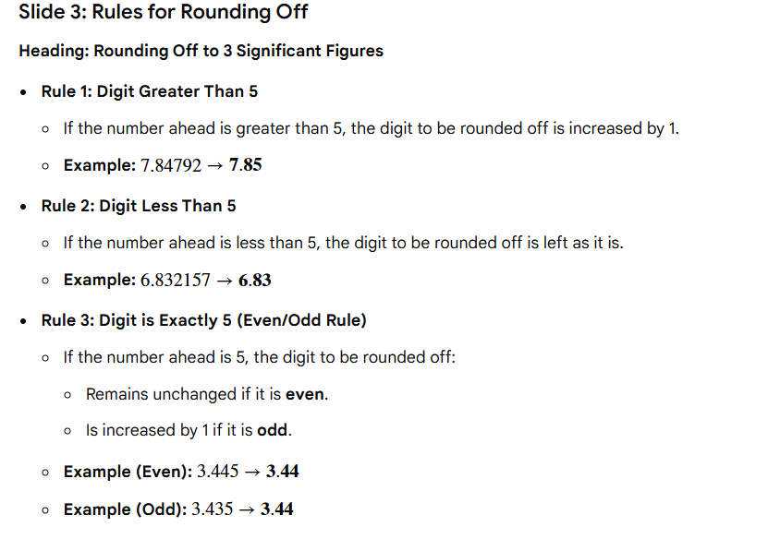

Slide 87
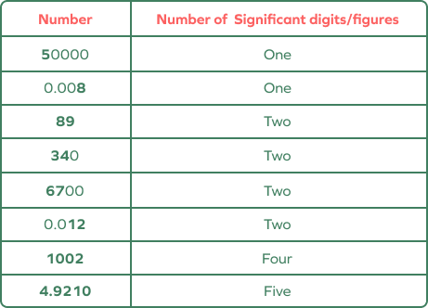

Slide 88
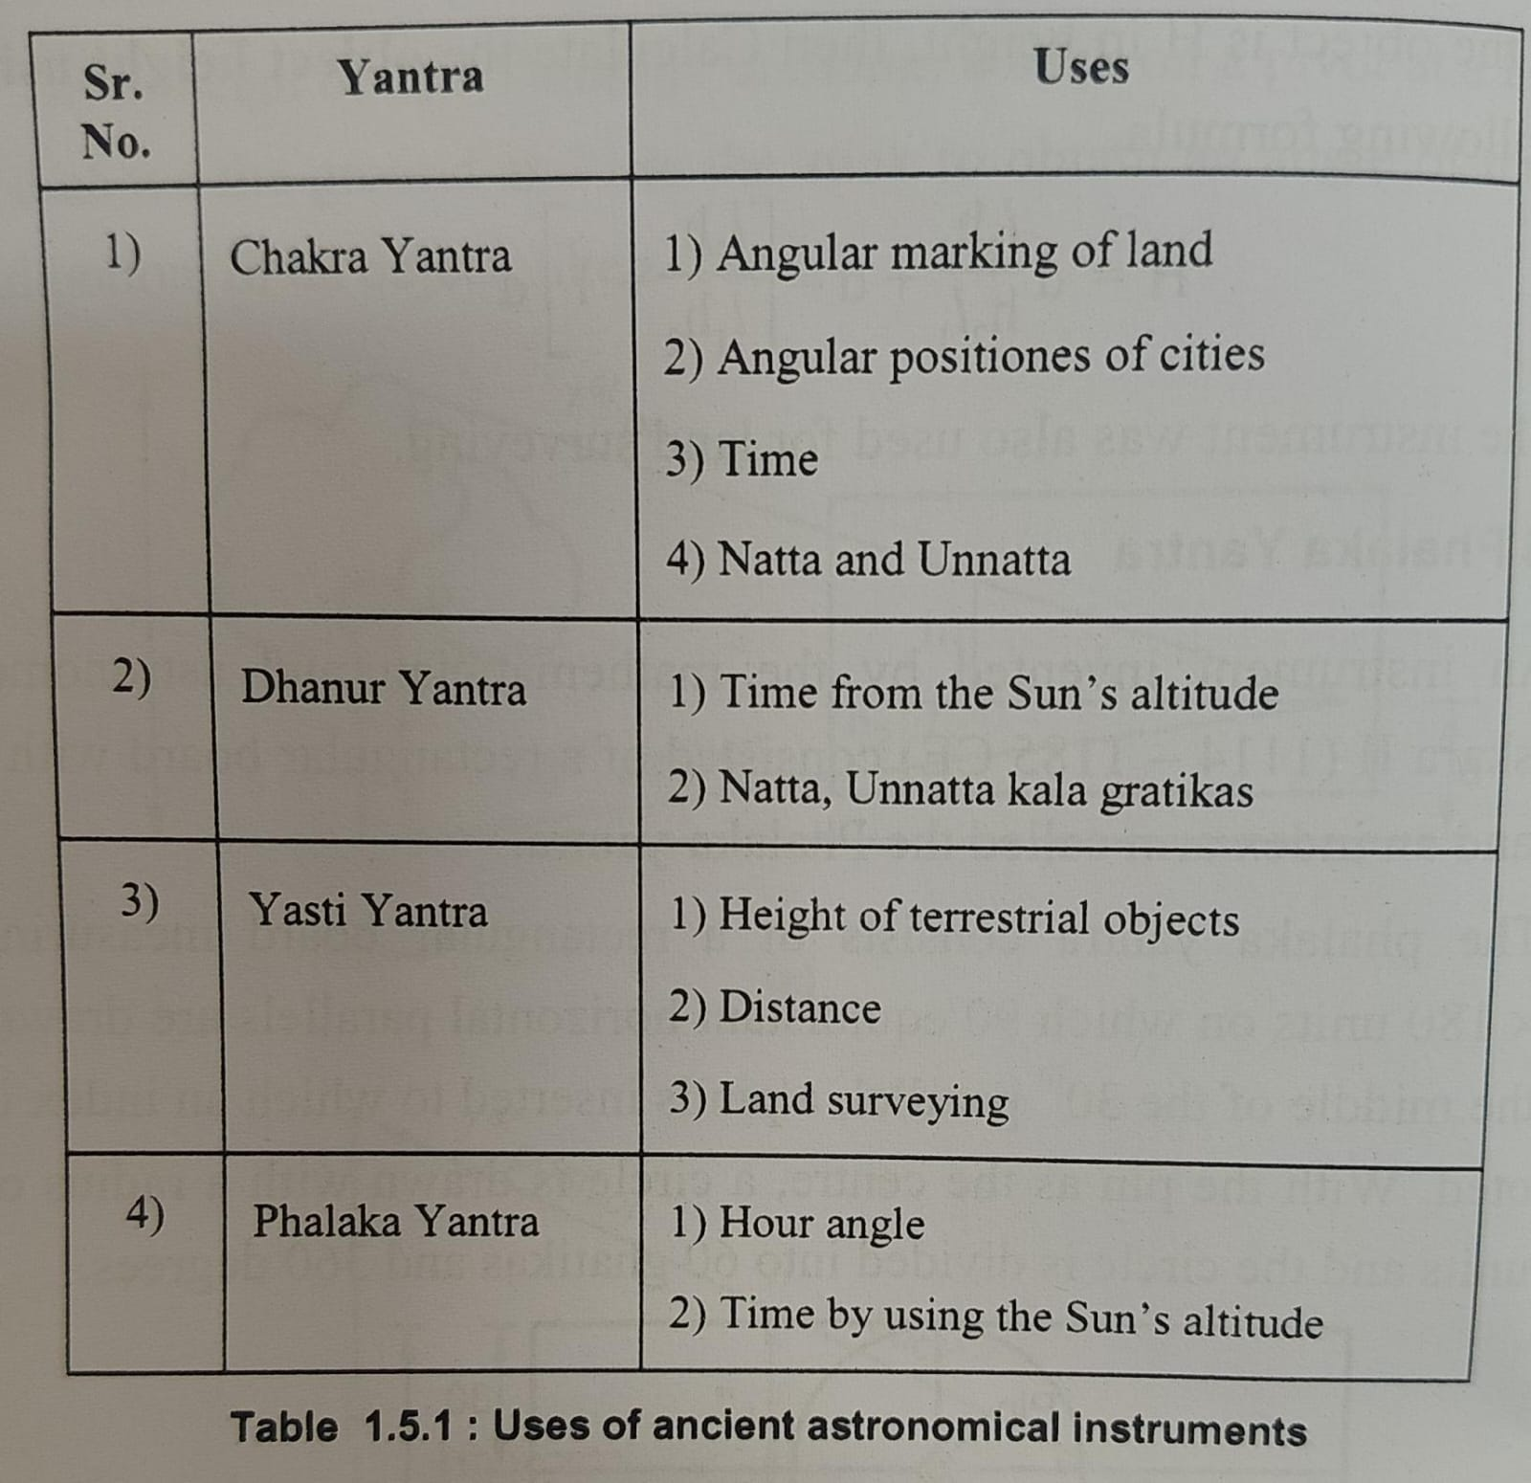

Slide 89
SCALARS AND VECTORS
All the physical quantities can be divided into two types.
They are:
(i) Scalars and
(ii) Vectors
The basic difference between them is the ′direction′.
Scalar
A physical quantity which has a magnitude but no direction is called scalar.
Example: Mass, length, temperature, time, density, work, specific heat, etc.
A scalar may be positive or negative. Scalars can be added, subtracted, multiplied or divided according to rules of ordinary algebra.
Addition and subtraction of scalars make sense only for quantities of same nature.
However, multiplication and division can be performed with different quantities.
Home
Next
Previous

Slide 90
Vector
A physical quantity which has both magnitude and direction is called vector.
Example: Velocity, acceleration, displacement, force, momentum, torque, etc.
Vectors cannot be added, subtracted, multiplied or divided according to simple rules of algebra.
Vectors can be added, subtracted or multiplied according to the rules of vector algebra.
A vector cannot be divided by another vector as it is not a valid operation in vector algebra.
A vector quantity obeys the ′triangle law of addition′ or equivalently the ′parallelogram law of addition′.
A vector is represented as a bold face type.
For example, velocity vector is represented as v.
While writing it is difficult to reproduce bold face type. Therefore, a vector can also be represented as .
v
Magnitude (scalar part) of a vector is represented as a light face type.
For example, magnitude of velocity vector is represented as v or .
| v |
Home
Next
Previous

Slide 91
Position and Displacement Vectors
Y
A
To describe the motion of an object in a plane, its position with respect to origin can be chosen conveniently.
Let P be the position of the object in X-Y plane at time t.
Draw a straight line from origin O to P and place an arrow head at P on the line OP.
r′
r
-
P′
P
r
r′
B
O
X
The point O of OP is called ′tail′ and the point P of OP is called ′head′ of vector .
OP
OP
is called ′position vector′ of the object. It is represented by r or .
r
Let the object move from P to P′ through the path PAP′ in time t′- t.
Now the position vector of the object at time t′ is given by or .
OP′
r′
Displacement vector is or .
r′
r
PP′
-
Note that the displacement vector is same even if the object moves through different courses from P to P′ , say PBP′ or any other infinite number of paths.
The position vector of the object provides following information:
(i) It gives straight line distance of the object from the origin.
(ii) It gives the direction of the object with respect to the origin.
Home
Next
Previous

Slide 92
Equality of Vectors
P
S
Two vectors A and B are said to be equal if, and only if, they have the same magnitude and the same direction.
A
B
The figure shows two equal vectors A and B.
To check their equality, shift B parallel to itself until its tail Q coincides with that of A,
i.e. Q coincides with O.
O
Q
P′
Since their heads S and P also coincide, the two vectors are said to be equal.
A′
In general, equality is indicated as A = B.
B′
S′
Vectors A′ and B′ have the same magnitude but they are not equal because they have different directions.
O′
Q′
Even if we shift B′ parallel to itself so that its tail Q′ coincides with the tail O′ of A′, the tip S′ of B′ does not coincide with the tip P′ of A′.
A″
O″
P″
Q″
B″
S″
Vectors A″ and B″ have the same direction but they are not equal because they have different magnitudes.
Home
Next
Previous

Slide 93
FEW FUNDAMENTAL DEFINITIONS IN VECTOR ALGEBRA
P
P
(i) Negative Vector
A
O
The negative of a vector is defined as another vector having the same magnitude but drawn in the opposite direction.
A
A
+ (-
A
) = 0
-A
Example: The negative vector of
A
A
is -
O
O
(ii) Equal Vectors
P
Two vectors A and B are said to be equal if, and only if, they have the same magnitude and the same direction. (Refer to previous slide)
P
S
A
B
(iii) Co-initial Vectors
Two vectors are said to be co-initial, if they have a common initial point.
O
O
(iv) Co-terminal Vectors
A
Two vectors are said to be co-terminal, if they terminate at a common point.
P
B
(v) Co-planar Vectors
S
The vectors are said to be co-planar, if they lie in the same plane.
The vectors drawn in this slide are all co-planar vectors.
Home
Next
Previous

Slide 94
(vi) Collinear Vectors
A″
Two vectors having equal or unequal magnitudes, which either act along the same line or along the parallel lines in the same direction or along the parallel lines in opposite direction are called collinear vectors.
O″
P″
Q″
B″
S″
A″
O″
P″
Q″
B″
S″
(vii) Unit Vector
A vector divided by its magnitude is called a unit vector along the direction of the vector.
or
A unit vector is a vector of unit magnitude pointing in a particular direction.
A
A =
| A |
Y
It has no dimension or unit. It is used to specify a direction only.
Unit vectors along the x-, y- and z-axes of a rectangular coordinate system are denoted by
j
i,
j,
k
respectively.
X
k
O
i
The magnitude of the unit vector is one unit and its direction is same as that of the given vector.
Since these are unit vectors,
Z
| i | =
| j | =
| k | = 1
Home
Next
Previous

Slide 95
(viii) Zero Vector or Null Vector
Y
A
Consider the position vectors in a plane as shown in the figure.
r′
r
P′
-
P
Now suppose an object which is at P at time t, moves to P′ through the path PAP′ and then comes back to P through the path P′BP.
r
B
r′
Then, what is its displacement? Find!
Since the initial and final positions coincide, the displacement is a ″null vector″.
O
X
P
P
A
O
A
The illustration of negative vector justifies the need of a ′zero vector′.
A
+ (-
A
) = 0
-A
A + 0 = 0
+ A = A
O
O
λ 0 = 0
| 0 | = 0
P
0 A = 0
(ix) Free Vector and Localised Vector
In our study, vectors do not have fixed locations. So shifting a vector parallel to itself leaves the vector unchanged. Such vectors are called ′free vectors′.
However, in some physical applications, location of a vector is important. Such vectors are called ′localised vectors′.
Home
Next
Previous

Slide 96
ADDITION AND SUBTRACTION OF VECTORS — GRAPHICAL METHOD
Addition of Vectors
Two or more vectors may be added graphically or geometrically by using the following laws of vector addition:
Triangle Law of Vector Addition
If two vectors can be represented by the two sides of a triangle taken in the same order, then the resultant is represented completely (both in magnitude and direction) by the third side of the triangle taken in the opposite order.
Example:
Addition of two vectors A and B.
A
P
To add vector B to vector A, move vector B parallel to itself so as to place the tail of B on head of A.
O
B
Join the tail of A to the head of B. Let this be vector OR or R. This gives the resultant R or the sum of the vectors A and B.
R = A + B
R
This graphical method is called the ′head-to-tail method′.
The two vectors and their resultant form three sides of a triangle, so this method is also known as triangle method of vector addition.
Home
Next
Previous

Slide 97
Commutative Property of Vectors
The Resultant vector will be the same even if A is shifted to place on B.
O
A
P
A
R = B + A
O
B
B
R
P
R = A + B
R
Note that the resultant R is equal in both magnitude and direction.
R = A + B
= B + A
The above relation of addition proves that the vectors are commutative.
The property that the vector addition is independent of the order in which the vectors are added is called the commutative property of vector addition.
Home
Next
Previous

Slide 98
Associative Property of Vectors
A
P
A
P
P
O
O
B
B + C
B
A + B
Q
Q
R=(A+B)+C
R= A+(B+C)
C
C
R
R
R
Note that the resultant R is equal in both magnitude and direction.
R = (A + B) + C
= A + (B + C)
The above relation of addition proves that the vectors are associative.
A
P
O
A + B
B
B + C
Q
R= A+B+C
C
R
Home
Next
Previous

Slide 99
2. Parallelogram Law of Vector Addition
If the two vectors (to be added) can be represented both in magnitude and direction by the two adjacent sides of a parallelogram, then the resultant is represented completely (both in magnitude and direction) by the diagonal of the parallelogram passing through the starting point of the vectors.
Example:
Addition of two vectors A and B.
A
P
To add vector B to vector A, move vector B parallel to itself so as to place the tail of B on tail of A.
O
R=A+B
B
R
Complete the parallelogram OQRP.
Draw the diagonal passing through the common point O (meeting point of tails).
Q
The diagonal represents the resultant or sum of the given two vectors.
Note that the resultant is the same as obtained by triangle law of vectors.
The two vectors are represented by the adjacent sides of a parallelogram and the resultant is given by the diagonal, so this method is known as parallelogram method of vector addition.
Home
Next
Previous

Slide 100
Subtraction of Vectors
Subtraction of vectors can be defined by vector addition of one vector with the negative vector of the other.
Example:
Subtraction of vector B from A
To subtract vector B from vector A, find negative vector of B.
R
Displace –B parallel to itself so as to place the tail of –B on head of A.
R=A - B
P
A
B
Join the tail of A to the head of -B. Let this be vector OR or R. This gives the resultant R or the difference of the vectors A and B.
O
-B
A
+ (–
B)
A – B =
A
A
+ (–
) = 0
Home
Next
Previous

Slide 101
Magnitude and Direction of the Resultant of Two Vectors A and B in terms of their Magnitudes and Angle θ between them
In right triangle ODR,
Q
R
OR² = OD² + RD²
β
B
R
R² = (A + B cosθ)² + (B sin θ)²
B sinθ
R² = A² + 2AB cosθ + B² cos²θ + B² sin²θ
θ
θ
α
R² = A² + 2AB cosθ + B² cos²θ + B² sin²θ
O
P
D
A
B cosθ
R² = A² + 2AB cosθ + B² (cos²θ + sin²θ)
R² = A² + 2AB cosθ + B²
( since cos²θ + sin²θ = 1)
R² = A² + B² + 2AB cosθ
The magnitude of vector R is
R =
A² + B² + 2 A B cos θ
(Law of cosines)
B sin θ
The direction of vector R is
tan α =
A + B cos θ
R
A
B
and
=
=
(Law of sines)
sin θ
sin β
sin α
Home
Next
Previous

Slide 102
]
PRODUCT OF TWO VECTORS
In Physics, at Class XI level, there will be two types of product of vectors.
They are:
Dot or Scalar Product and
Cross or Vector Product
1. Dot Product or Scalar Product
In dot product, the symbol of multiplication between the vectors is represented by ‘ . ‘ The result of the product is a scalar value.
Eg.
Work is defined as the product of force and displacement.
Here force and displacement are vectors and work is a scalar.
P
Consider two vectors A and B making an angle θ with each other.
A
The dot or scalar product is given by
θ
A . B = | A | | B | cos θ
O
B
Q
A . B
and
cos θ =
| A | | B |
Home
Next
Previous

Slide 103
Properties of Dot Product
Dot product results in a scalar value.
Dot product or Scalar product is commutative.
A . B =
B . A
3. Dot product is distributive.
A . (B + C) =
A . B +
A . C
.
.
.
4.
i
i
=
j
j
=
k
k
= 1
.
.
.
5.
i
j
=
j
k
=
k
i
= 0
A . B
6. Component of A along B =
| A | cos θ =
=
A . B
| B |
A . B
7. Component of B along A =
| B | cos θ =
=
B . A
| A |
a
= a_{x}
+ a_{y}
+ a_{z}
8. If
i
j
k
b
= b_{x}
+ b_{y}
+ b_{z}
i
j
k
then
a . b = (a_{x} b_{x} + a_{y} b_{y} + a_{z} b_{z})
a . a = (a_{x} a_{x} + a_{y} a_{y} + a_{z} a_{z})
a² = (a_{x}² + a_{y}² + a_{z}²)
b . b = (b_{x} b_{x} + b_{y} b_{y} + b_{z} b_{z})
b² = (b_{x}² + b_{y}² + b_{z}²)
Home
Next
Previous

Slide 104
2. Cross Product or Vector Product
In vector product, the symbol of multiplication between the vectors is represented by ‘ x ‘. The result of the product is a vector.
Eg. Torque is defined as the product of force and moment arm.
Here force, moment arm and torque are all vectors.
P
Consider two vectors A and B making an angle θ with each other.
A
The cross or vector product is given by
θ
n
O
n
where is the unit vector along a direction which is perpendicular to plane containing A and B.
A x B = | A | | B | sin θ
B
Q
|
|
A x B
and
sin θ =
| A | | B |
A x B
means the vector A is rotated towards B and its effect is taken on B.
By Right Hand Thumb Rule or Maxwell’s Cork Screw Rule, the direction of the resultant in this case is perpendicular and into the plane of the diagram.
B x A
means the vector B is rotated towards A and its effect is taken on A.
The resultant in this case is perpendicular and emerging out of the plane of the diagram.
Closing and opening a tap is the best example.
Home
Next
Previous

Slide 105
Properties of Cross Product
Vector product results in a vector.
Vector product or Cross product is not commutative.
A x B =
- B x A
i
i
j
j
x
3.
x
=
x
=
k
k
= 0
4.
i
j
k
x
=
5.
j
- k
x
i
=
j
k
i
x
=
x
j
k
=
- i
i
j
x
=
k
x
k
i
=
- j
a
= a_{x}
+ a_{y}
+ a_{z}
6. If
i
j
k
b
= b_{x}
+ b_{y}
+ b_{z}
i
j
k
a x b =
i
j
k
= (a_{y} b_{z} – a_{z} b_{y}) i – (a_{x} b_{z} – a_{z} b_{x}) j + (a_{x} b_{y} – a_{y}b_{x}) k
a_{x} a_{y} a_{z}
b_{x} b_{y} b_{z}
| a x b |
= (a_{y} b_{z} – a_{z} b_{y})² + (a_{x} b_{z} – a_{z} b_{x})² + (a_{x} b_{y} – a_{y}b_{x})²
Home
Next
Previous

