Slide 1
Unit - II Electricity, Magnetism
2.1 Concept of charge, Coulomb's inverse square law, Electric
field, Electric field intensity, potential and potential difference.
2.2 Magnetic field and magnetic field intensity and its units,
magnetic lines of force, magnetic flux .
2.3 Electric current, Ohm's law, specific resistance, laws of series
and parallel combination of resistance, conversion of galvanometer
into ammeter and voltmeter, Heating effect of electric current .

Slide 2
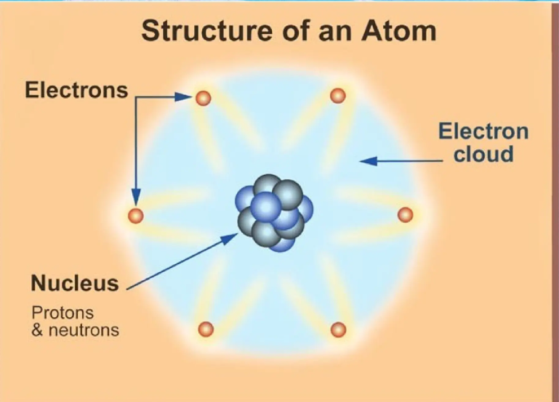

Slide 3
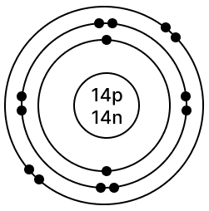

Slide 4
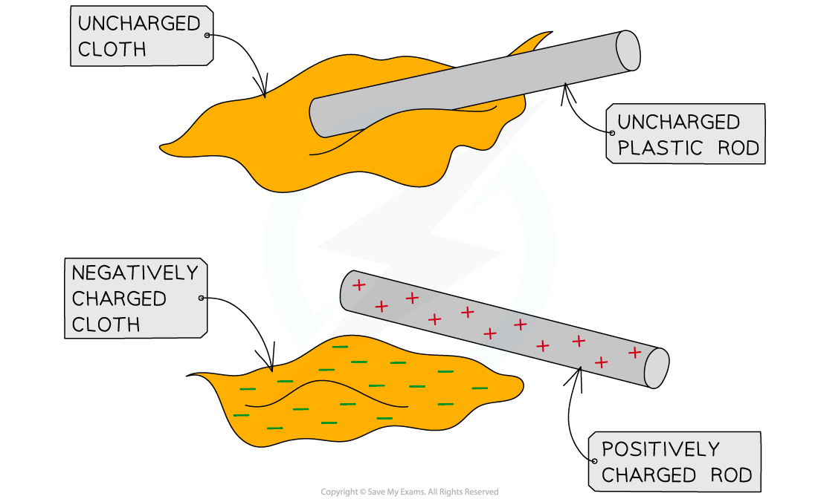

Slide 5
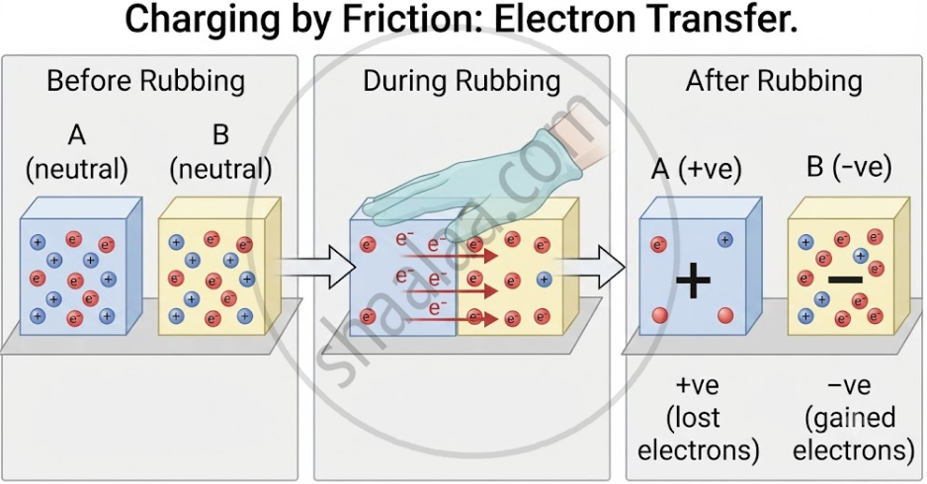

Slide 6
Properties of Charges:
There exists only two types of charges, namely positive and negative.
Like charges repel and unlike charges attract each other.
Charge is a scalar quantity.
Charge is additive in nature. eg. +2 C + 5 C – 3 C = +4 C
Charge is quantized.
i.e. Electric charge exists in discrete packets rather than in continuous amount.
It can be expressed in integral multiples fundamental electronic charge (e = 1.6 x 10⁻¹⁹ C)
q = ± ne where n = 1, 2, 3, …………
Charge is conserved.
i.e. The algebraic sum of positive and negative charges in an isolated system remains constant.
eg. When a glass rod is rubbed with silk, negative charge appears on the silk and an equal amount of positive charge appear on the glass rod. The net charge on the glass-silk system remains zero before and after rubbing.
It does not change with velocity also.

Slide 7
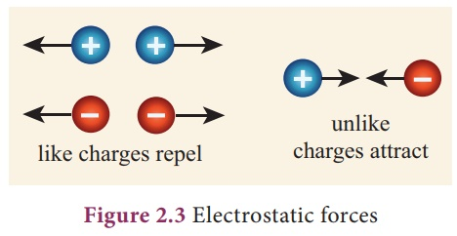

Slide 8
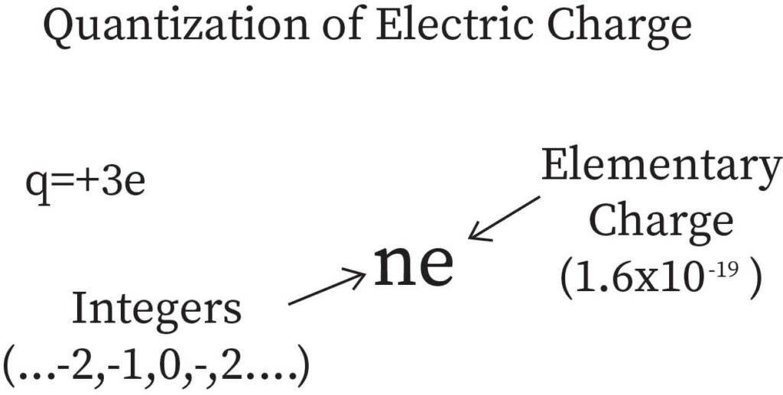

Slide 9
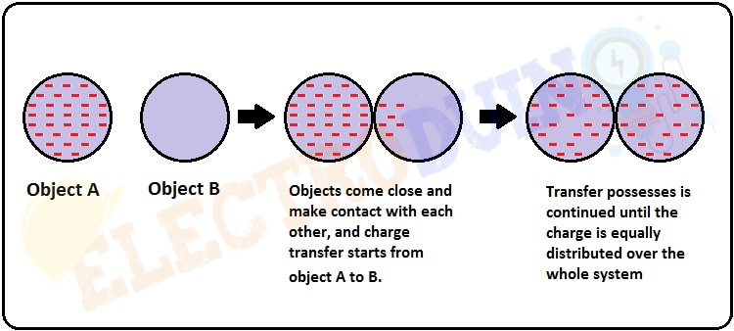

Slide 10
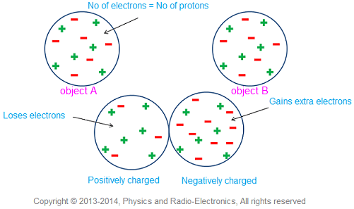

Slide 11
Note: Recently, the existence of quarks of charge ⅓ e and ⅔ e has been postulated. If the quarks are detected in any experiment with concrete practical evidence, then the minimum value of ‘quantum of charge’ will be either ⅓ e or ⅔ e. However, the law of quantization will hold good.
Coulomb’s Law – Force between two point electric charges:
The electrostatic force of interaction (attraction or repulsion) between two point electric charges is directly proportional to the product of the charges, inversely proportional to the square of the distance between them and acts along the line joining the two charges.
Strictly speaking, Coulomb’s law applies to stationary point charges.
q₁
q₂
F α q₁ q₂
F α 1 / r²
r
q₁ q₂
q₁ q₂
where k is a positive constant of proportionality called electrostatic force constant or Coulomb constant.
or
F α
or
F = k
r²
r²
1
In vacuum, k =
where ε₀ is the permittivity of free space
4πε₀

Slide 12
1
where ε is the absolute electric permittivity of the dielectric medium
In medium, k =
4πε
The dielectric constant or relative permittivity or specific inductive capacity or dielectric coefficient is given by
ε
K = ε_{r} =
ε₀
1
q₁ q₂
In vacuum,
F =
4πε₀
r²
1
q₁ q₂
In medium,
F =
4πε₀ε_{r}
r²
ε₀ = 8.8542 x 10⁻¹² C² N⁻¹ m⁻²
1
or
1
= 8.9875 x 10⁹ N m² C⁻²
= 9 x 10⁹ N m² C⁻²
4πε₀
4πε₀

Slide 13
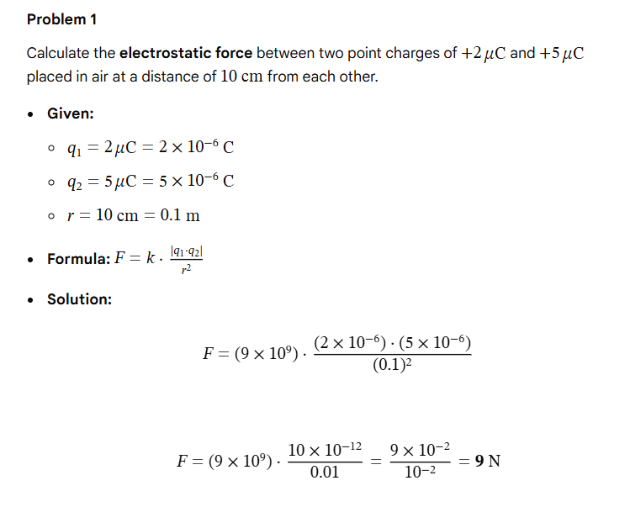

Slide 14
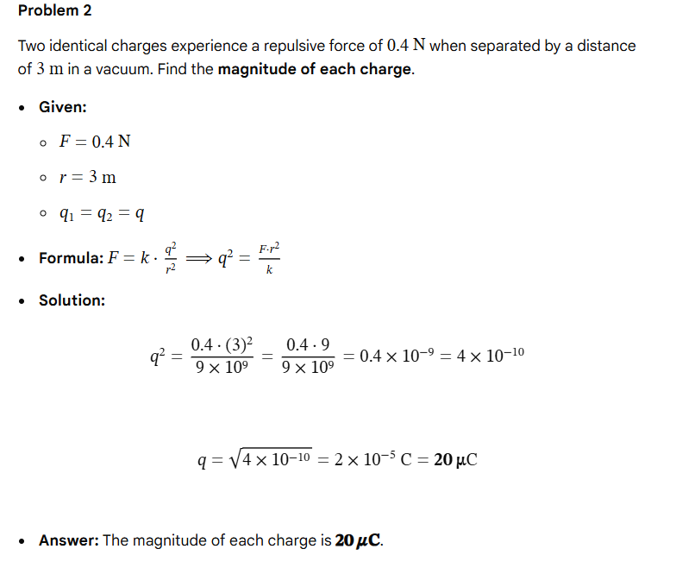

Slide 15
Units of Charge:
In SI system, the unit of charge is coulomb (C).
One coulomb of charge is that charge which when placed at rest in vacuum at a distance of one metre from an equal and similar stationary charge repels it and is repelled by it with a force of 9 x 10⁹ newton.
In cgs electrostatic system, the unit of charge is ‘statcoulomb’ or ‘esu of charge’.
In cgs electrostatic system, k = 1 / K where K is ‘dielectric constant’.
For vacuum, K = 1.
q₁ q₂
F =
r²
If q₁ = q₂ = q (say), r = 1 cm and F = 1 dyne, then q = ± 1 statcoulomb.
In cgs electromagnetic system, the unit of charge is ‘abcoulomb’ or ‘emu of charge’.

Slide 16
1 emu of charge = c esu of charge
1 emu of charge = 3 x 10¹⁰ esu of charge
1 coulomb of charge = 3 x 10⁹ statcoulomb
1 abcoulomb = 10 coulomb
Relative Permittivity or Dielectric Constant or Specific Inductive Capacity or Dielectric Coefficient:
The dielectric constant or relative permittivity or specific inductive capacity or dielectric coefficient is given by the ratio of the absolute permittivity of the medium to the permittivity of free space.
ε
K = ε_{r} =
ε₀
The dielectric constant or relative permittivity or specific inductive capacity or dielectric coefficient can also be defined as the ratio of the electrostatic force between two charges separated by a certain distance in vacuum to the electrostatic force between the same two charges separated by the same distance in that medium.
F_{v}
K = ε_{r} =
Dielectric constant has no unit.
F_{m}

Slide 17
Electric Field:
Electric field is a region of space around a charge or a system of charges within which other charged particles experience electrostatic forces.
Theoretically, electric field extends upto infinity but practically it is limited to a certain distance.
Electric Field Strength or Electric Field Intensity or Electric Field:
Electric field strength at a point in an electric field is the electrostatic force per unit positive charge acting on a vanishingly small positive test charge placed at that point.
+ q
+ q₀
- q
+ q₀
F
F
q – Source charge, q₀ – Test charge, F – Force & E - Field
1
q
Lt
F
F
or
E =
r
E =
or
E =
4πε₀
r²
∆q → 0
∆q
q₀
The test charge is considered to be vanishingly small because its presence should not alter the configuration of the charge(s) and thus the electric field which is intended to be measured.

Slide 18
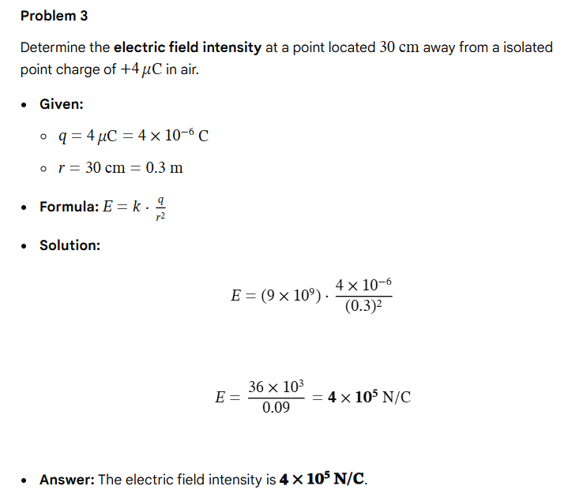

Slide 19
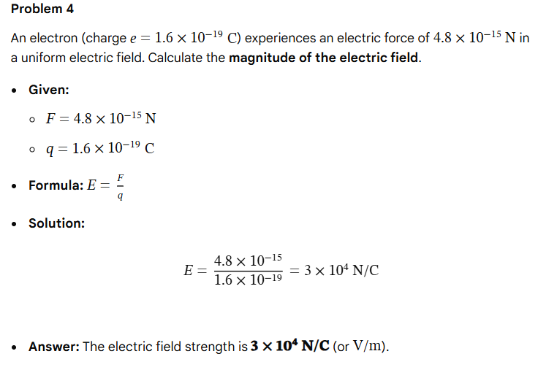

Slide 20
Note:
Since q₀ is taken positive, the direction of electric field ( E ) is along the direction of electrostatic force ( F ).
Electrostatic force on a negatively charged particle will be opposite to the direction of electric field.
Electric field is a vector quantity whose magnitude and direction are uniquely determined at every point in the field.
4. SI unit of electric field is newton / coulomb ( N C⁻¹ ).

Slide 21
Note:
The interactions must be on the charge which is to be studied due to other charges.
The charge on which the influence due to other charges is to be found is assumed to be floating charge and others are rigidly fixed.
For eg. 1st charge (floating) is repelled away by q₂ and q₄ and attracted towards q₃ and q₅.
The interactions between the other charges (among themselves) must be ignored. i.e. F₂₃, F₂₄, F₂₅, F₃₄, F₃₅ and F₄₅ are ignored.
Superposition principle holds good for electric field also.
Electric Lines of Force:
An electric line of force is an imaginary straight or curved path along which a unit positive charge is supposed to move when free to do so in an electric field.
Electric lines of force do not physically exist but they represent real situations.
E
E
Electric Lines of Force

Slide 22
1. Electric Lines of Force due to a Point Charge:
Representation of electric field in terms of field vectors:
The size of the arrow represents the strength of electric field.
q > 0
q < 0
Representation of electric field in terms of field lines
(Easy way of drawing)

Slide 23
Electric Lines of Force due to a pair of Equal and Unlike Charges: (Dipole)
3. Electric Lines of Force due to a pair of Equal and Like Charges:
+ q
P
+ q
E
.
N
+ q
- q
Electric lines of force contract lengthwise to represent attraction between two unlike charges.
Electric lines of force exert lateral (sideways) pressure to represent repulsion between two like charges.

Slide 24
4. Electric Lines of Force due to a Uniform Field:
E
++++
- - - -
Properties of Electric Lines of Force or Field Lines:
+1 C
The electric lines of force are imaginary lines.
A unit positive charge placed in the electric field tends to follow a path along the field line if it is free to do so.
The electric lines of force emanate from a positive charge and terminate on a negative charge.
The tangent to an electric field line at any point gives the direction of the electric field at that point.
.
E
P
Two electric lines of force can never cross each other. If they do, then at the point of intersection, there will be two tangents. It means there are two values of the electric field at that point, which is not possible.
Further, electric field being a vector quantity, there can be only one resultant field at the given point, represented by one tangent at the given point for the given line of force.
E₁
E
NOT POSSIBLE
E₂

Slide 25
Electric lines of force are closer (crowded) where the electric field is stronger and the lines spread out where the electric field is weaker.
Electric lines of force are perpendicular to the surface of a positively or negatively charged body.
Q
q
Q > q
Electric lines of force contract lengthwise to represent attraction between two unlike charges.
Electric lines of force exert lateral (sideways) pressure to represent repulsion between two like charges.

Slide 26
The number of lines per unit cross – sectional area perpendicular to the field lines (i.e. density of lines of force) is directly proportional to the magnitude of the intensity of electric field in that region.
11. Electric lines of force do not pass through a conductor. Hence, the interior of the conductor is free from the influence of the electric field.
∆N
α E
∆A
E
E
- - - - - - -
++++ + + +
- - - -
++++
Solid or hollow conductor
No Field
(Electrostatic Shielding)
12. Electric lines of force can pass through an insulator.

Slide 27
Electric Potential:
Electric potential is a physical quantity which determines the flow of charges from one body to another.
It is a physical quantity that determines the degree of electrification of a body.
Electric Potential at a point in the electric field is defined as the work done in moving (without any acceleration) a unit positive charge from infinity to that point against the electrostatic force irrespective of the path followed.
B
qq₀
[
1
1
]
W_{AB}
q
[
1
1
]
W_{AB} = -
=
-
E . dl
r_{B}
r_{A}
or
q₀
=
-
4πε₀
4πε₀
r_{B}
r_{A}
A
According to definition,
r_{A} = ∞ and r_{B} = r
(where r is the distance from the source charge and the point of consideration)
W_{∞B}
q
W_{∞B}
=
= V
V =
q₀
4πε₀ r
q₀
SI unit of electric potential is volt (V) or J C⁻¹ or Nm C⁻¹.
Electric potential at a point is one volt if one joule of work is done in moving one coulomb charge from infinity to that point in the electric field.

Slide 28
Electric Potential Difference:
Electric Potential Difference between any two points in the electric field is defined as the work done in moving (without any acceleration) a unit positive charge from one point to the other against the electrostatic force irrespective of the path followed.
B
qq₀
[
1
1
]
W_{AB}
q
[
1
1
]
W_{AB} = -
=
-
E . dl
r_{B}
r_{A}
or
q₀
=
-
4πε₀
4πε₀
r_{B}
r_{A}
A
W_{AB}
q
1
q
1
q₀
=
-
= V_{B} - V_{A}
4πε₀
r_{B}
4πε₀
r_{A}
W_{AB}
V_{B} - V_{A} = ∆V =
q₀
Electric potential and potential difference are scalar quantities.
Electric potential at infinity is zero.
Electric potential near an isolated positive charge (q > 0) is positive and that near an isolated negative charge (q < 0) is negative.
cgs unit of electric potential is stat volt. 1 stat volt = 1 erg / stat coulomb

Slide 29
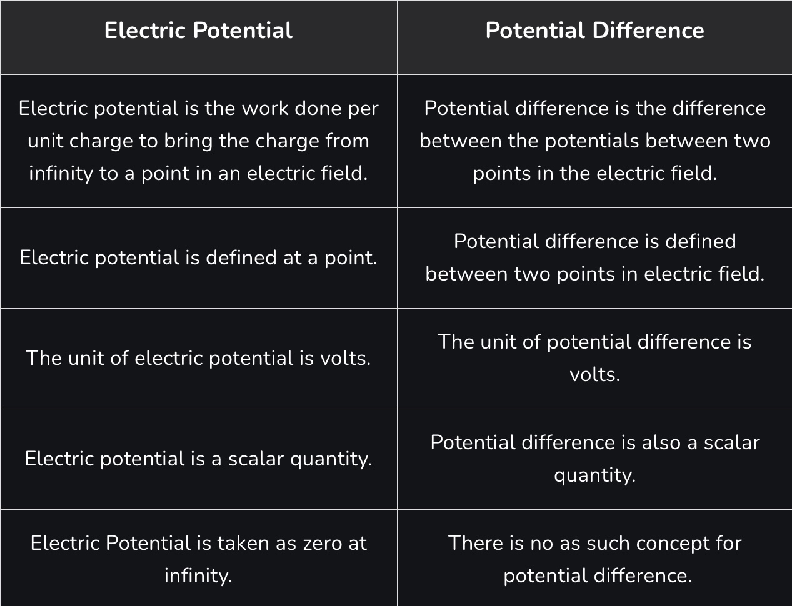

Slide 30
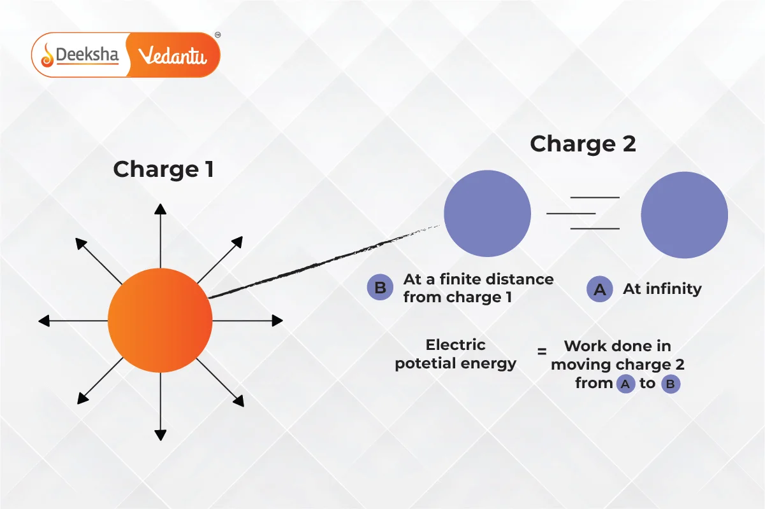

Slide 31
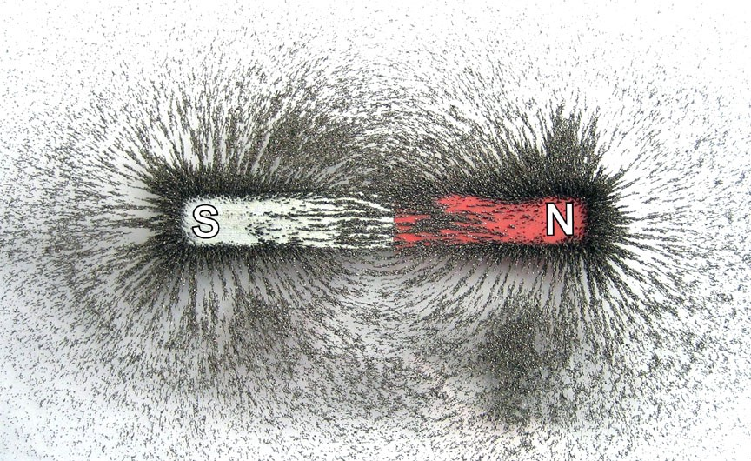

Slide 32
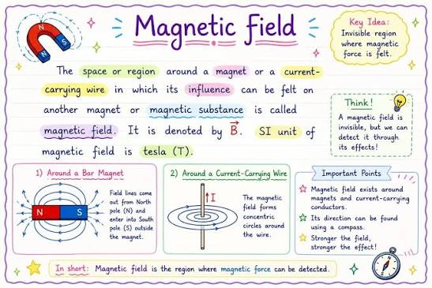

Slide 33
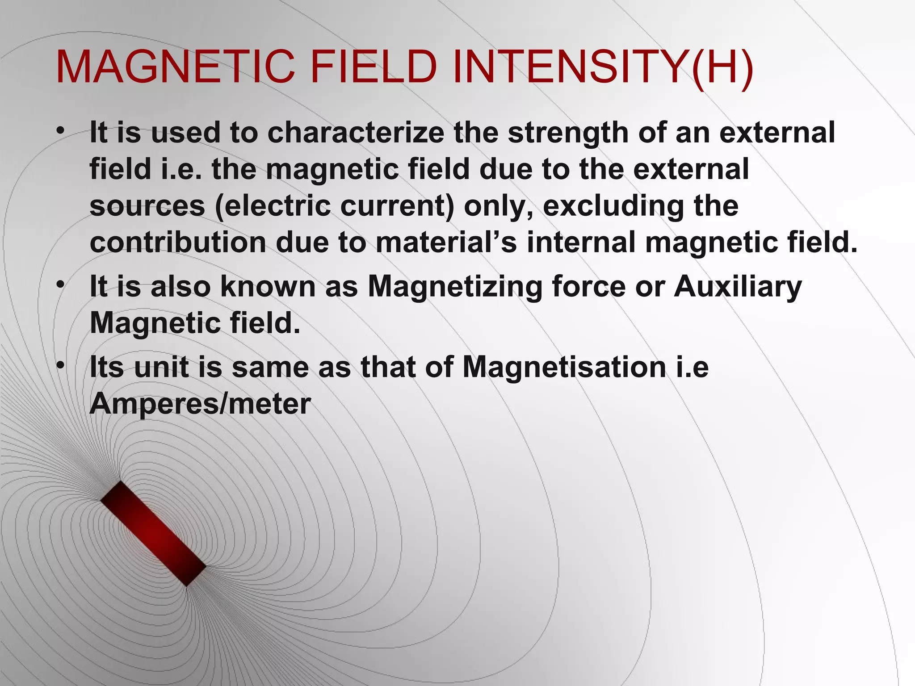

Slide 34
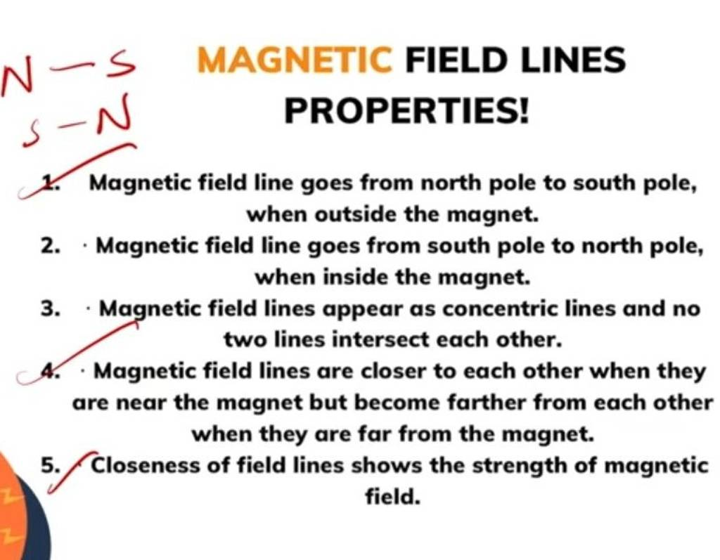

Slide 35
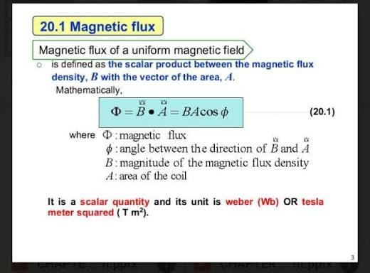

Slide 36
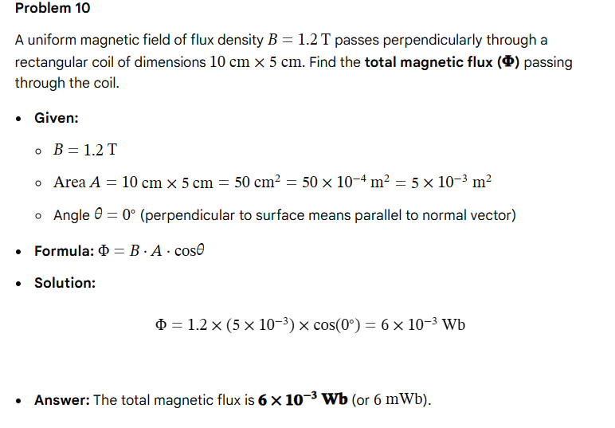

Slide 37
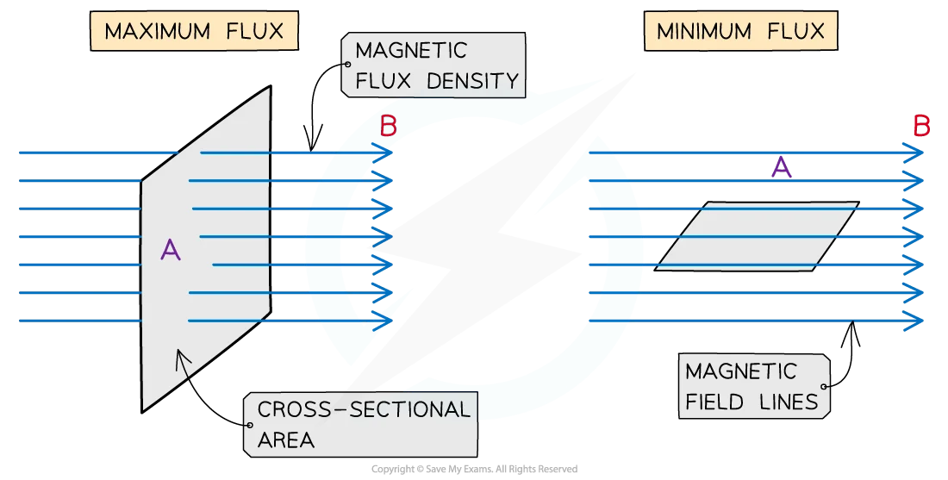

Slide 38
Electric Current:
The electric current is defined as the charge flowing through any section of the conductor in one second.
I = q / t (if the rate of flow of charge is steady)
I = dq / dt (if the rate of flow of charge varies with time)
Different types of current:
Steady current which does not vary with time
I
b
c
a
b) & c) Varying current whose
magnitude varies with time
d
d) Alternating current whose magnitude varies continuously and direction changes periodically
0
t

Slide 39
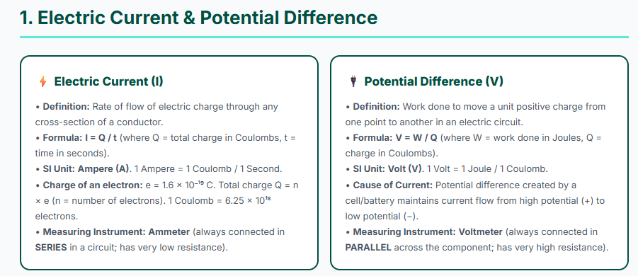

Slide 40
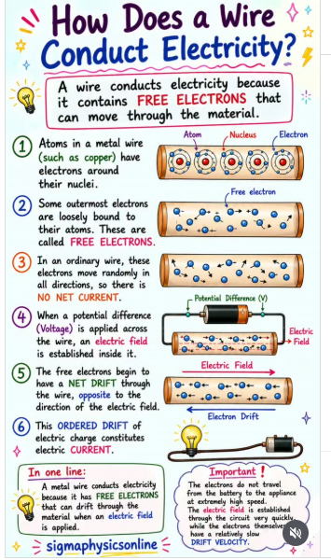

Slide 41
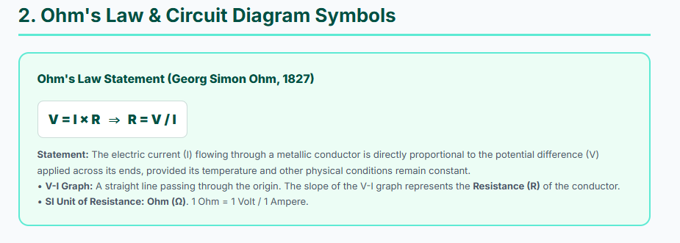

Slide 42
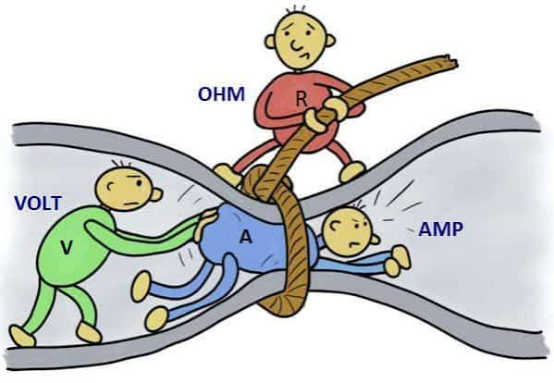

Slide 43
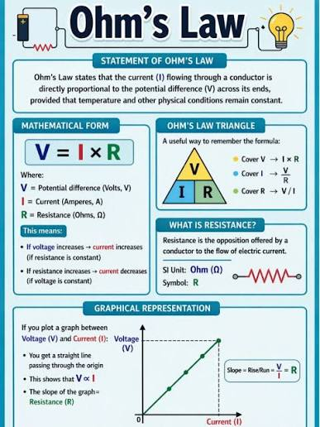

Slide 44
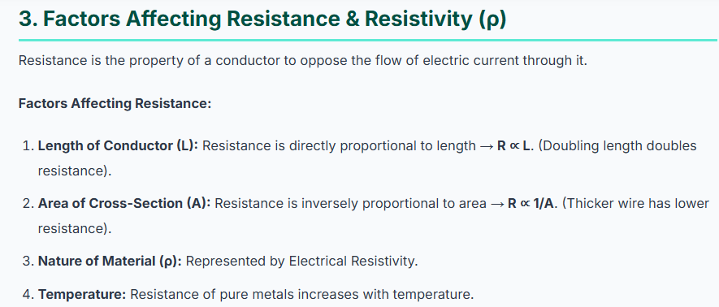

Slide 45
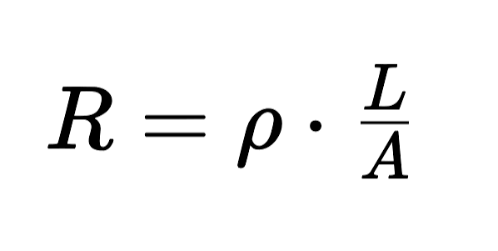

Slide 46
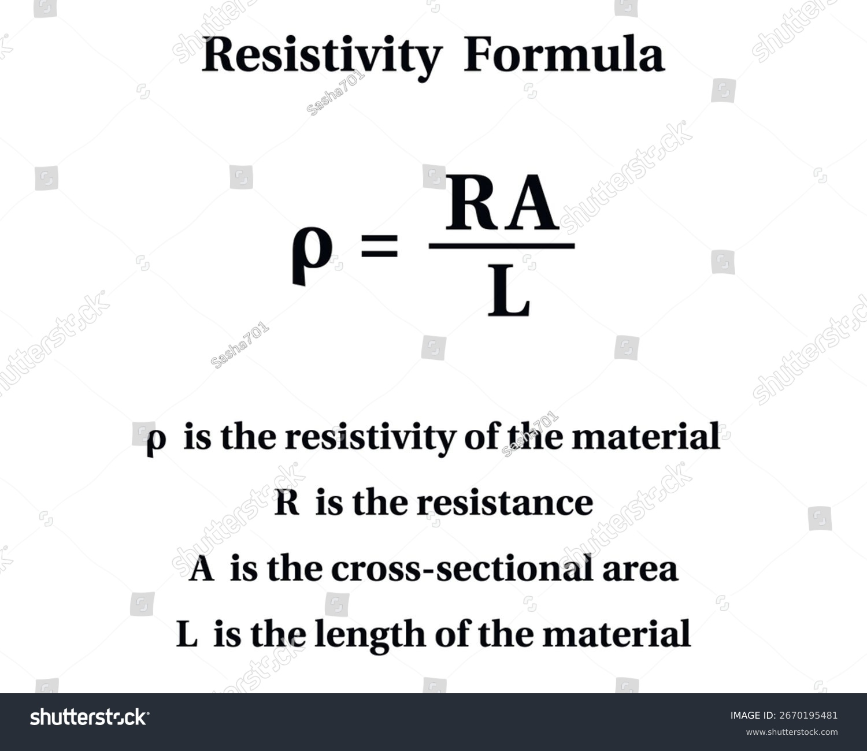

Slide 47
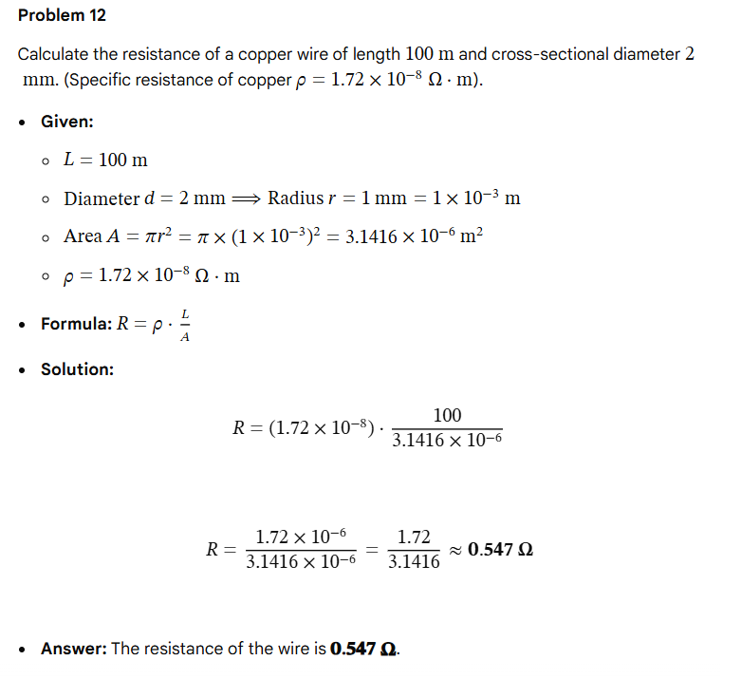

Slide 48
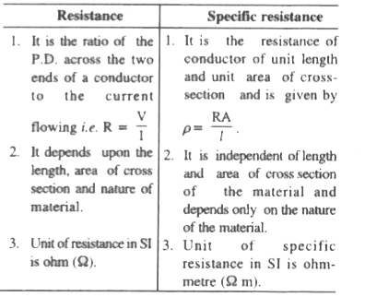

Slide 49
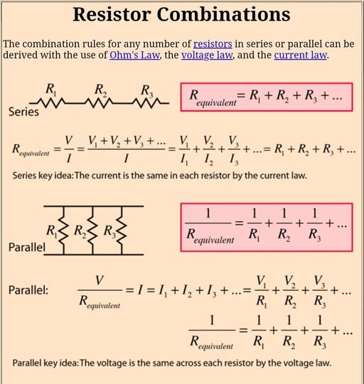

Slide 50
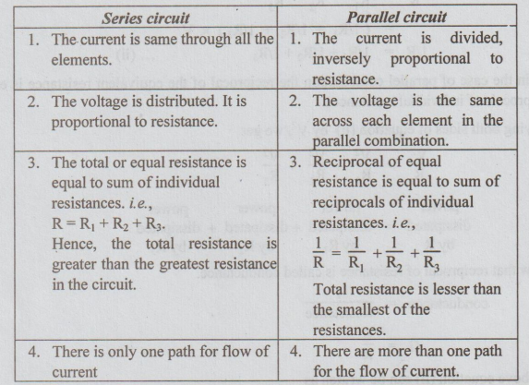

Slide 51
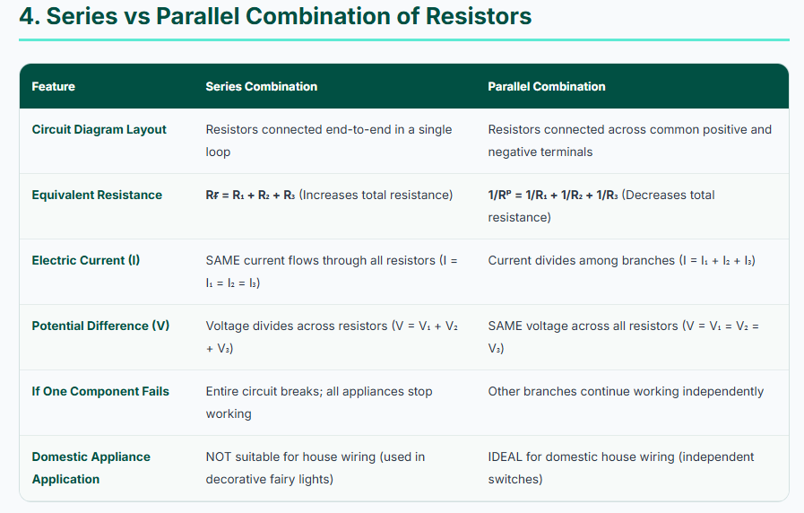

Slide 52
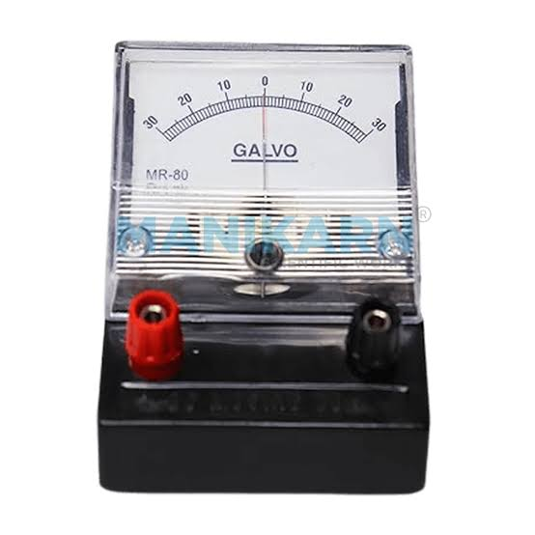

Slide 53
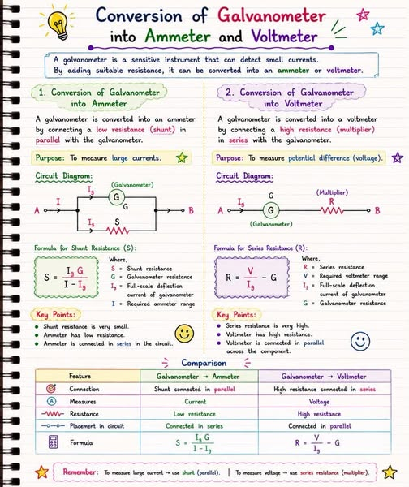

Slide 54
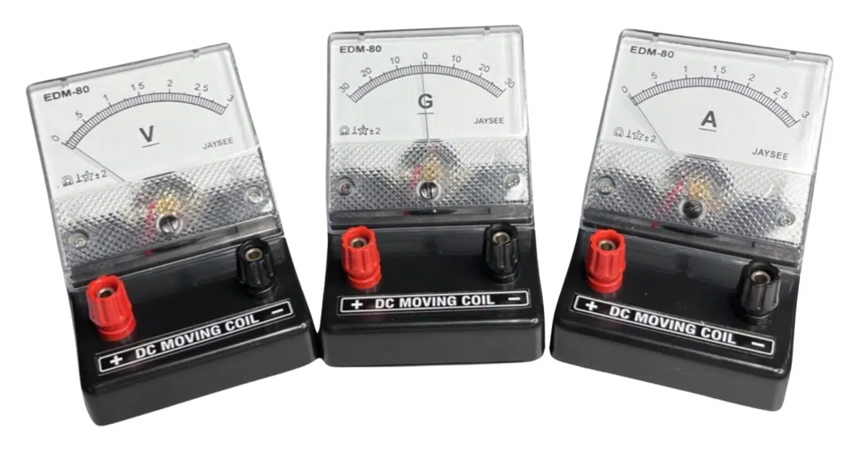

Slide 55
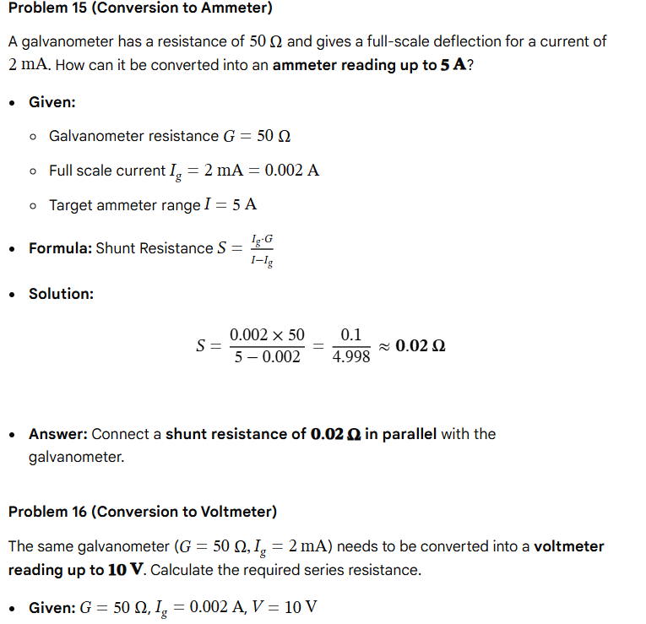

Slide 56
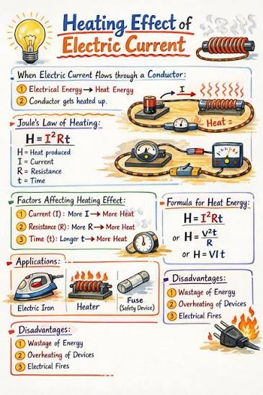

Slide 57
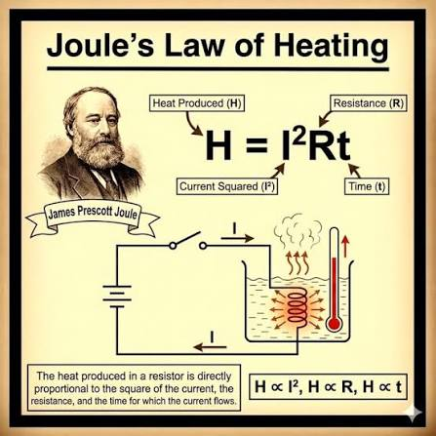

Slide 58
