Slide 1
Unit1
Basics Of Communication
Pratik Shah
I – A
2024-2025

Slide 2
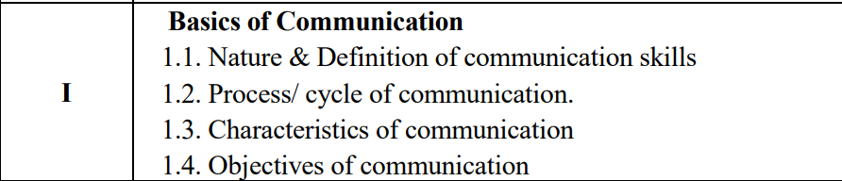

Slide 3
1.1
Nature & Definition of Communication skills

Slide 4
Communication:
The word communication originates from the latin word "communis" which means common.
So communication is an act by which two or more people share knowledge, feelings, ideas, information, etc, in ways such that each gains a common understanding of the meaning, intent and use of the message.
It is very difficult and sometimes impossible to establish commonness because it is not important what we give but what one receives and perceives is important.
In a broad sense, communication means transmission of ideas, information, emotions and skills by use of symbols, words, pictures, figures, graphs, etc.
For example, ringing of an alarm clock communicates to us that we have to get up, the touch of a pot whether hot or cold, communicates to us whether it can be handled or not, the sense of smell communicates knowledge of aroma to the sensory organs

Slide 5
Nature/ Features of Communication
Communication is the process through which an exchange of information takes place.
It is the sharing information, ideas, concepts and messages where Two or more persons are involved in it.
The one who initiates the exchange is the sender of the message (speaker/ writer) and the one who receives and interprets it is the receiver of the message (listener/ reader).
It is a two-way process.

Slide 6
1.2
Process/Cycle of Communication

Slide 7
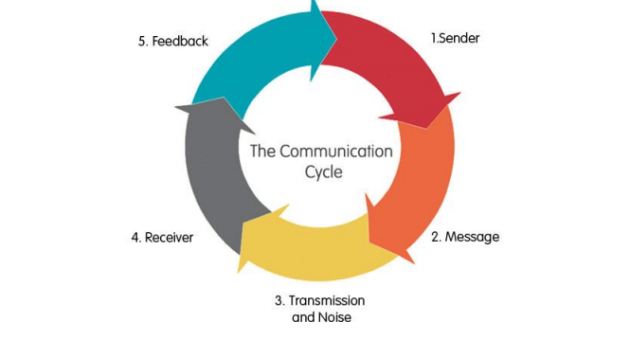
Communication Cycle

Slide 8
Sender
The sender is the individual who wishes to communicate a message.
To send effective messages, it is important to have:
A knowledge of the audience for that particular message.
Failure to understand the audience will result in delivering messages that can be misunderstood.
A clear idea of the purpose of the message, i.e. what they wish the receiver to do with the information contained in the message.

Slide 9
Message
The message is the information the sender wishes the audience to receive and understand.
The message is encoded by the sender, i.e. the sender chooses the words and medium that suit the message they wish to convey.
Written, oral and nonverbal communications are all affected by individual communication styles such as the sender’s tone, the way they present the message, what information is contained in the communication and what has been omitted.

Slide 10
Transmission and noise
The transmission of the message is the actual process of sending it.
This could be done via various verbal and written communication channels;
for example: email, letters, text, reports, face-to-face, telephone and videoconferencing.
It is important to transmit the message clearly and at an appropriate time, considering any distractions that could make communication difficult.
Noise is one such distraction.
This can include physical noise such as buzzing on a telephone line or a mobile phone reception breaking up, to more personal noise such as an individual’s accent, personal experience, feelings, culture, level of education, etc. which can all interfere with how the message is perceived

Slide 11
Receiver
The receiver tries to interpret the message by decoding the words and symbols used.
However, the receiver will also take into account their own previous experience, emotions, ideas and beliefs when trying to make sense of the message.

Slide 12
Feedback
The receiver feeds back their understanding of the message to the sender, to make sure that the message they received was the same message as the sender intended.
This feedback can be a verbal or non-verbal response
for example saying yes or nodding the head.

Slide 13
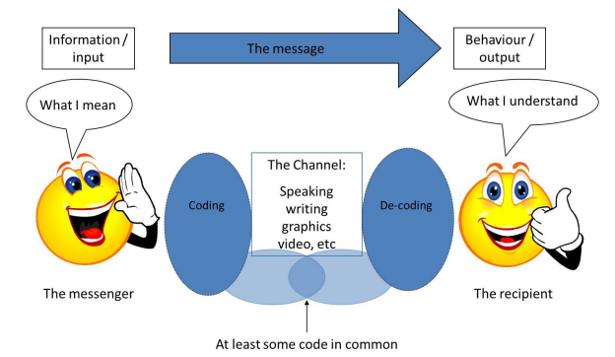

Slide 14
1.3
Characteristics of Communication

Slide 15
Characteristics of Communication
1. Communication involves at least two persons: Communication involves at least two persons-the sender and the receiver. The sender sends the message and is known as the communicator. The receiver receives the message and is known as communicate.
2. Communication is a two way process: Communication is essentially a two way process. It does not merely means sending and receiving messages. It is not complete unless and until the message has been understood by the receiver in the same sense.
3. Purpose of communication: Message is a Must. A message is the subject matter of communication. e.g., the contents of the letter or speech, order, instructions or the suggestions.
4. Form of communication: Communication may take several forms e.g. order, instruction, report, queries etc. It may be verbal or written. It may be formal or informal.
5. Scope of communication: Communication noticeable to all human relationship. It is essential in all type of organizational and at all levels of management.
6. Communication is a dynamic process: Communication is influenced by the mood and thinking of the sender and receiver. The way a message is accepted depends upon the fact that which of the fine sensory organs of the receiver is active at that time.

Slide 16
7. Communication is much more than words: Communication is not merely sending or receiving facts, expressed in words. Communication May be Written, Oral or Gestural. It also involves ideas and emotions. A lot of communication is done through signs, symbols and gestures.
8. Communication’s primary purpose is to motivate a response: The primary purpose of communication is to motivate response or influence human behaviour. To create understanding, communication should be relevant to the situation.
9. Communication is conversational: Communication sets up a link between facts, ideas, and thus helps the communicator and communicates to progress logically.
10. Communication is an interdisciplinary science: Communication to be effective derives knowledge from several sciences like-anthropology (study of body language), sociology (study of human behaviour), psychology (study of attitude) etc
11. Communication may be formal or informal: Formal communication follows the formal channels provided in the organization structure. For example, the Managing Director communicates with the departmental heads,
In simple words, in informal communication, there is no direct communication between the Managing Director and the accounts clerks. Informal communication flows from informal channels of communication which are not provided in the organization structure. These channels develop among members because of personal contacts through working with each other.
12. It flows up and down and also from side to side: Communication flows downward from a superior to subordinate and upward from subordinate to a superior. It also flows between two or more persons operating at the same level of authority.

Slide 17
1.4
Objective of Communication

Slide 18
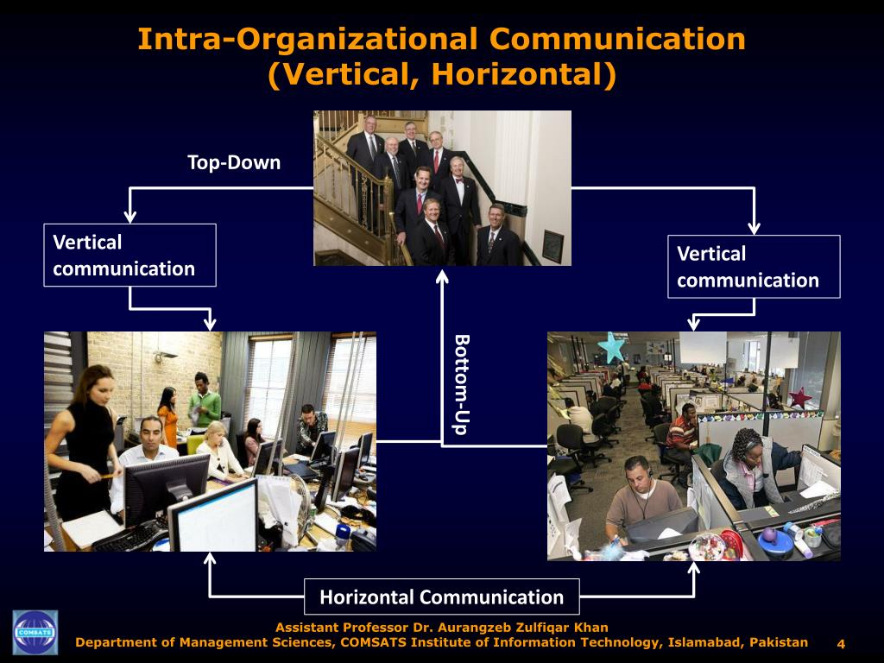
Objectives of Communication
Communication is carried out with some purpose or objective.
The communication activity of an organization fall into three broad categories:
1. Intraorganizational Communication: This takes place within an organization. It takes place in the form of orders, circulars, notices, emails, etc.

Slide 19
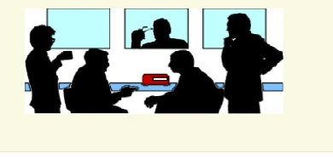

2. Interorganizational communication: This takes place between a business organization and people outside the organization. It can take place in the form of company presentations, advertisements, displays, project reports, etc.
3 Personal communication: This communication is undertaken without a specific objective. Personal conversations, gossip, grapevine communication are examples of personal communication.

Slide 20

Importance of Communication
In the fast changing world, managers communicate changes in technology, structure or people to the subordinates.
If the communication system is well organized, it becomes easier for subordinates to understand and act upon the message.
Communication plays important role in the lives of individuals and organizations.

Slide 21
1. Basis for planning
Planning is the basic function of management. If plans are well designed and communicated for their implementation, it leads to organizational success.
2. Motivation to work:
Employees are motivated to work if their needs are satisfied.
3. Job satisfaction:
Exchange of information develops trust, confidence and faith amongst managers and subordinates.
4. Training and development:
Imparting training and development facilities to employees depends upon how well their superiors communicate with them

Slide 22
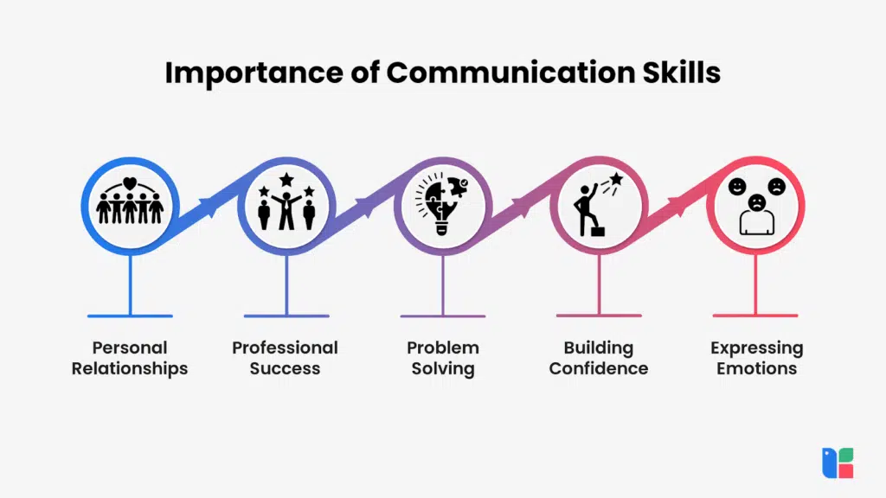
5. Facilitates leadership:
Effective leaders interact with followers, guide and inspire them to perform the individual and organizational goals.
6. Adaptability to external environment:
In order to survive in the changing, dynamic environment, managers continuously interact with external parties like government, suppliers, customers, etc

Slide 23
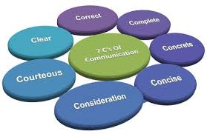
Principles of communication/ The 7 Cs of Communication
The 7 Cs provide a checklist for making sure that your meetings , emails , conference calls , reports , and presentations are well constructed and clear – so your audience gets your message.
According to the 7 Cs, communication needs to be:
1. Clear
2. Concise
3. Concrete
4. Correct
5. Coherent
6. Complete
7. Courteous

Slide 24
1. Clear
When writing or speaking to someone, be clear about your goal or message. What is your purpose in communicating with this person? If you're not sure, then your audience won't be sure either.
To be clear, try to minimize the number of ideas in each sentence. Make sure that it's easy for reader to understand the meaning
2. Concise
When you're concise in your communication, you stick to the point and keep it brief. Your audience doesn't want to read six sentences when you could communicate your message in three.
3. Concrete
When your message is concrete, then your audience has a clear picture of what you're telling them. There are details (but not too many!) and powerful facts, and there's laser-like focus. Your message is solid

Slide 25
4. Correct
When your communication is correct, it fits your audience. And correct communication is also error-free communication.
5. Coherent
When your communication is coherent, it's logical. All points are connected and relevant to the main topic, and the tone and flow of the text is consistent.
6. Complete
In a complete message, the audience has everything they need to be informed and, if applicable, take action.
7. Courteous
Courteous communication is friendly, open, and honest. There are no hidden insults or passive aggressive tones. You keep your reader's viewpoint in mind, and you’re empathetic to their needs.

Slide 26
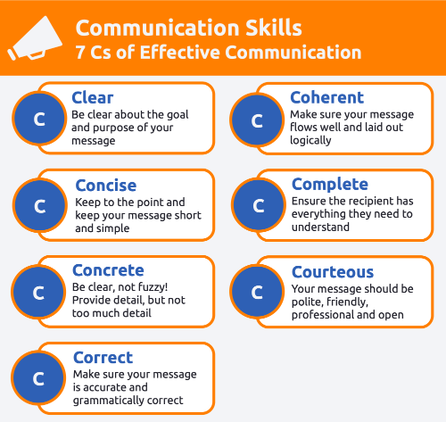

Slide 27
1. Clear
Bad Example
Hi Peter,
I would like to schedule a meeting with you in regards to yesterday’s conversation. The topics you covered were great, and I’d like to speak about them in detail. Please let me know when you would like to have this meet.
Regards
Chris
Good Example
Hi Peter,
I would like to schedule a meeting with you in regards to your presentation on email marketing. The topics you covered were great, and I would like to discuss implementation on our current clients. Please let me know when you have the time so that we can discuss it in detail.
Regards
Chris
In the above example, we do not know which conversation Chris is referring to. If Chris had met Peter on multiple occasions that day then he wouldn’t know what Chris is actually talking about.

Slide 28
2. Concise
Bad Example
Dear Bharat,
I wanted to talk about the video editing ideas we sort of planned out the other day. Don’t you think it would make a lot of sense to also add additional elements to the videos? I mean, I think that would sort of improve the quality of the videos as well as have a stronger impact on the client’s message.
For instance, we could add a dissolve transition to each movie, which would then give it a seamless flow. This would then make the video cleaner and be more appealing in the minds of the people. The impact would just be a lot greater. This makes a lot more sense according to me.
What do you think?
Regards
Aaron
Good Example
Dear Bharat,
I wanted to discuss the video editing ideas we planned out yesterday. It would be better to add additional elements to the video in order to have a stronger impact on the client’s message.
A dissolve transition would give a seamless flow to each movie and make the videos cleaner and appealing in the minds of the target audience.
What do you think?
Regards
Aaron
There is a lot of repetition in this email and it is quite long. The email can be made shorter and to the point.

Slide 29
3. Concrete
Bad Example
Save time with the Indicator Master Every Day
This kind of tagline does not give the user any details. There are no facts and it’s vague. People might not download this application since it’s not concrete enough to entice the user.
Good Example
Have you ever been late for a meeting just because you didn’t know the train schedule? Hate waiting for a bus because you don’t know its timings? Then download the Indicator Master app. It will give you all the train and bus schedules so that you can avoid delays and save time!

Slide 30
4. Correct
Bad Example
Hi Sam,
It was wonderful meeting you last weak. I had a good time. I’m sure we will be able to do some great work on this project. Let me know weather you need any supplies from the company and I’ll get them delivered as soon as possible.
Thanks again, speak to you soon!
Regards
Chris
If you have noticed in the email, there are two errors. The first one is the writer has spelled week incorrectly and the second is the use of the word weather instead of whether. Spell checkers don’t always work so make sure you proofread everything.

Slide 31
5. Coherent
Bad Example
Dear Namita,
Thanks for submitting the industry report. Finn will give you some feedback on it. Finn also wanted to find out if you will be available for the client meeting tomorrow. We will be discussing the budget for the next phase of the project.
Regards
Aaron
Good Example
Dear Namita,
Thanks for submitting the industry report. Finn will give you some feedback on it. You will be receiving an email from him with detailed comments.
Regards
Aaron
This email talks only about the report. Therefore, Namita knows that her report has been viewed and needs to wait for feedback.
The email was supposed to be about the industry report which was submitted and the feedback for it. The question about the meeting had come out of nowhere and will now distract Nam and her priorities.

Slide 32
6. Complete
Bad Example
Hi Guys,
Please make sure to carry all the items tomorrow for the meeting.
Regards
Amar
The message is clearly incomplete. There are no details as to what items, which meeting, and at what time.
Good Example
Hi Guys,
Just a reminder that we have a meeting scheduled at 10.00 am tomorrow to discuss the Britannia event. Please make sure you get all the event props that need to be presented to the client.
Regards
Amar

Slide 33
7. Courteous
Bad Example
Dear Suzie,
I have noticed that there are always delays in the orders. You need to focus on the orders department as a priority. Please get all the orders cleared ASAP!
Regards
Greg
There is a very good chance that the reader will get angry if they receive a message like this. It might result in creating a toxic environment rather than solving any issues. Here is another way you can convey the same message:
Good Example
Dear Suzie,
Thank you for your work at the book fair. I have noticed that there are orders pending which need to be cleared on priority. I would appreciate it if you could focus on getting these cleared so that we can avoid any delays to the customer.
Thanks a lot, and please let me know if you have any questions regarding the same.
Best,
Greg

Slide 34
Conclusion
The way we communicate is a huge factor in how successful we are in life. If we communicate effectively, it gives us more credibility in our jobs as well as personal life.
Using the 7 C’s of communication, that is when you’re clear, concise, concrete, correct, consider the speaker, complete and courteous, with your message, you will become an effective communicator and find more success in your interactions with people.

Slide 35
THANK YOU !!!!

