Slide 1
Unit 2
Methods of Communication
Pratik Shah
I – B
2024-2025

Slide 2
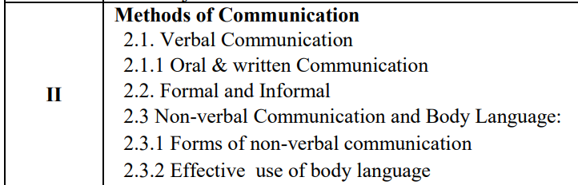

Slide 3
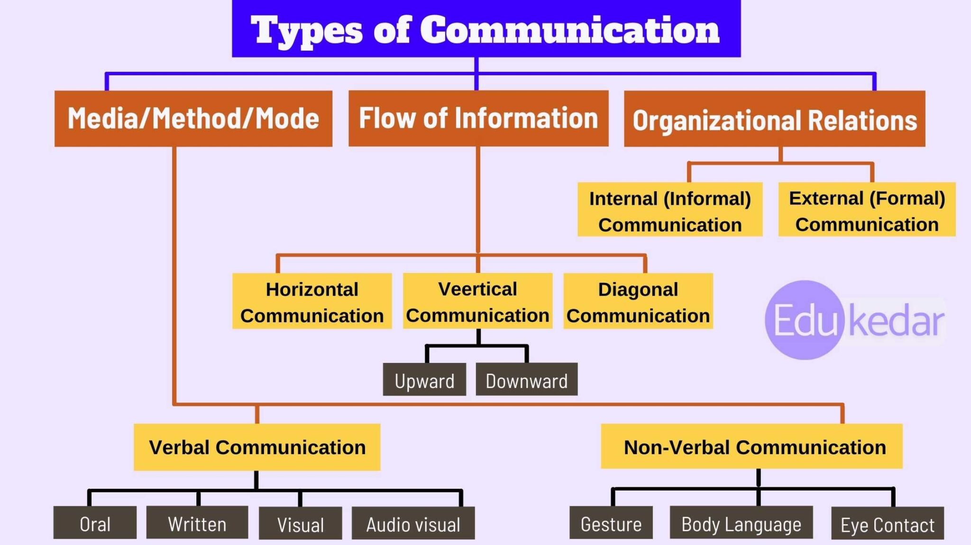

Slide 4
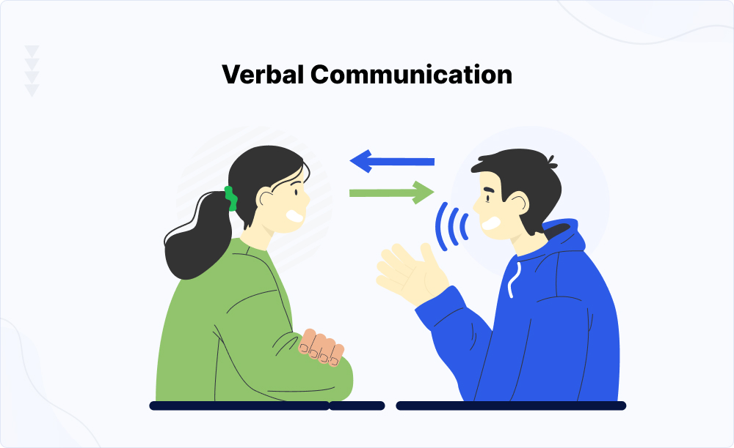
2.1
Verbal Communication

Slide 5
Verbal Communication:
Verbal communication refers to the form of communication in which message is transmitted verbally;
communication is done by word of mouth and writing.
Objective of every communication is to have people understand what we are trying to convey
In verbal communication always remember the acronym KISS - keep it short and simple.

Slide 6
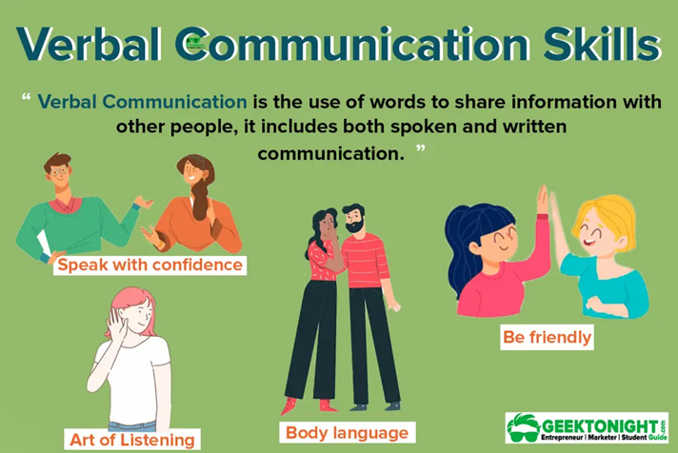
When we talk to others, we assume that others understand what we are saying because we know what we are saying.
But this is not the case for audience.
Usually people bring their own attitude, perception, emotions and thoughts about the topic and hence creates barrier in delivering the right meaning.
We need to think from the receivers point of view.
Would he understand the message?
How will it sound on the other side of the table?

Slide 7
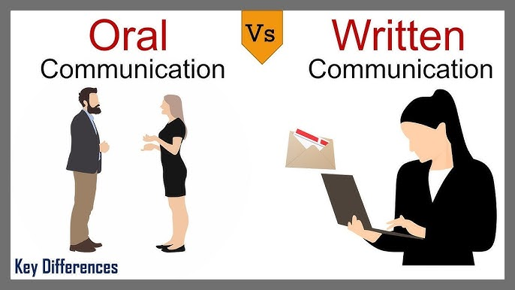
2.1.1
Oral & Written Communication

Slide 8
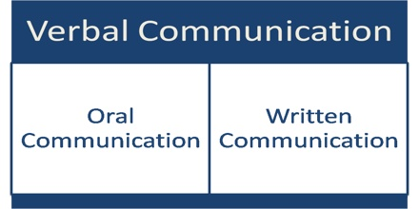
Types of verbal communication

Slide 9
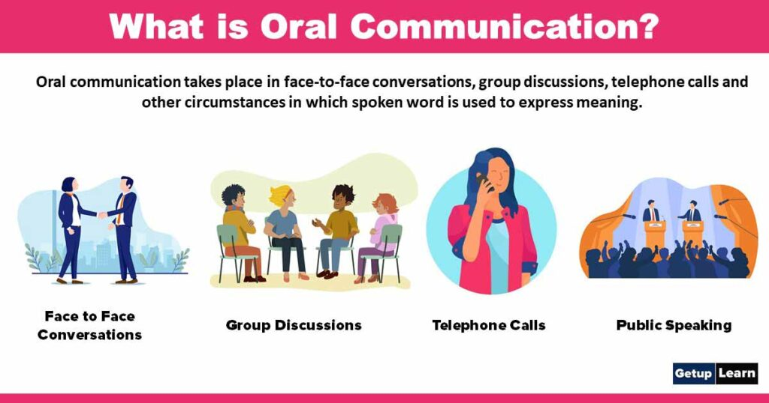
Oral communication
Oral communication is the exchange of information through oral use of words.
Generally, oral communication takes place in face-to-face conversation, meeting, interviews, telephonic conversation etc.
In case of oral communication, information is exchanged between sender and receiver directly.
The effectiveness of oral conversations depends on the clarity of speech, voice modulation, pitch, volume, speed, and even non-verbal communications such as body language and visual clues.

Slide 10


Advantages of Oral communication
#1 Time-Saving
If immediate action is required, oral communication is the most effective method. On the other hand, handwritten correspondence takes a long time to reach its sender. You can easily do oral communication via phone calls or conversations with subordinates, which saves time, which is crucial for business.
#2 Reduction of Cost
Oral communication does not require the acquisition and upkeep of pens, paper, or typewriters; money is saved. It can also be accomplished without traveling to communicate with people outside the organization. Thus, oral communication can be a cheaper form of communication than other forms.
#3 Easiness
Oral communication requires little preparation to send a message. It is an easy method of communication. It does not require a pen, pencil, or other writing instrument, like written communication. Hence, verbal communication reduces or eliminates the need for written communication, making the job much easier.
#4 Quick Feedback
It provides quick feedback in verbal messages, another significant advantage. As a result, the sender or speaker can make quick decisions regarding other choices. In most situations, such as meetings and phone calls, oral or spoken communication facilitates instant feedback.

Slide 11
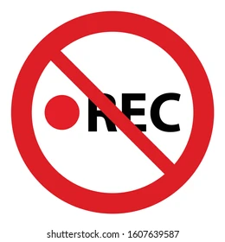
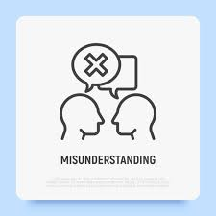
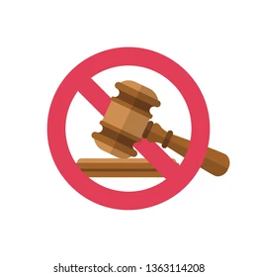
Disadvantages of oral communication
#1 No Record
Informal communication is typically carried out through oral means. Messages exchanged are not recorded or included in the record book. In the future, these messages cannot be retrieved. There is no evidence of a statement or information left in the event of future disagreements or confusion.
#2 Misunderstanding
Due to limits in human memory, verbal communications cannot be retained in their complete context. Communication will only be possible due to proper attention to the oral statements; hence, it may result in misunderstandings when communicating lengthy messages or information. This is because the receiver might need to remember long-spoken messages.
#3 No Legal Validity
Oral communication has no legal standing as verbal messages are not documented, and the speaker can easily refuse them if the situation goes against him. Oral communication, thus, has no legal value and cannot be used legally in the future unless it is recorded.

Slide 12
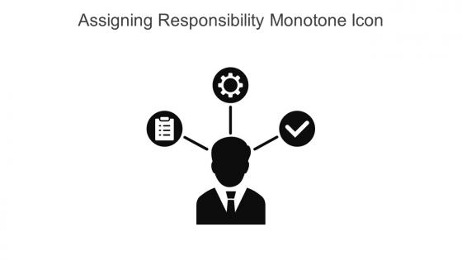
#4 Assigning Responsibility
Since there is no evidence to support oral communication, holding someone accountable can take a lot of work. Despite the ease with which it can be carried out, oral communication also has the drawback of making it easier to assign responsibilities.

Slide 13
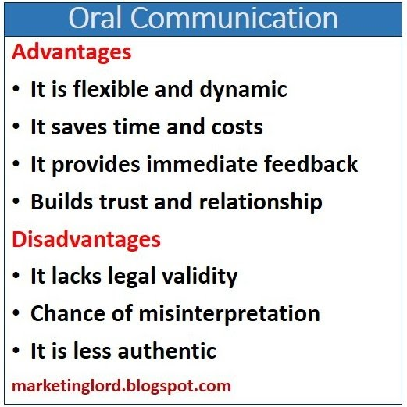

Slide 14

Oral communication image

Slide 15
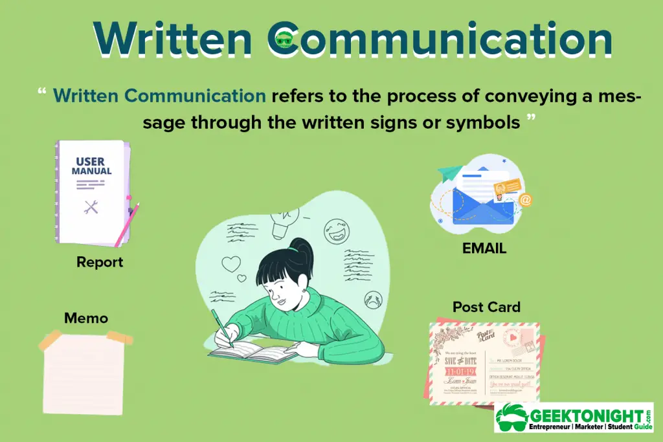
Written communication
Written communication means exchanging information in written words.
This type of communication is essential for formal business communications and issuing legal instructions.
In this method of communication, words are used not orally but in written form.
So by written communication we mean meaningful application of written words in communication.
Here communicator presents all his thoughts, views, opinions etc. in written form.
Without reading the message, receiver cannot understand it.

Slide 16
Advantages of written communication
1) Easy to Preserve:-
One of the main advantages of written communication is that the documents are easy to preserve if they are in written form. Oral and Non-verbal communication is not preserved.
2)Clarity and Clear Understanding:-
Another advantage of written communication is it provides a clear and comprehensive grasp of the message to be conveyed. Written communication provides us a facility to read the message many times until the recipient fully comprehends it.
3) Permanent Record:-
Another important advantage of written communication is that the documents of written communication act as a permanent record.
4)Makes Presentation Easy:-
Written communication provides us the advantage of representing any complex matter or information easily and more attractively. For business organizations, the executives can present the information more accurately and clearly through written communication
5) Serves as a Legal document:-
Documents in the written format serve as legal evidence for important business activities and transactions. In the event of a lawsuit, the one which is used as admissible evidence is written communication

Slide 17
6) No wastage of time and money:-
Written communication can serve another advantage as it prevents waste of time and money. It is because all the parties or members communicating their ideas or data can share it even without meeting each other.
7) Ease in verification –
you might have easily guessed this advantage of written communication. You can easily verify if there is some confusion. You can refer to the written record and verify if something acclaimed or said is true or not. It is easy to verify in case any misunderstanding occurs between the parties.

Slide 18
Disadvantages of written communication
1) Expensive:-
One of the disadvantages of written communication is being costlier than other communications. For written communication, paper, pen, ink, typewriters, printing machines, and maintaining such equipment and machinery, a computer and a large number of employees are necessary for its execution. Also, it is expensive as a group of individuals to prepare and distribute the organization’s letters which is quite costly for any organization.
2) Time Consuming:-
Written communication is not only expensive but also very time-consuming. Drafting and forming a message in written form takes much more time than conveying orally. A written message can take two or three days to reach its intended recipient, but an oral communication message can be conveyed in a matter of seconds over the phone.
3) Lack of confidentiality:-
Keeping the information confidential is not always possible in written communication which serves as one of the biggest disadvantages of written communication. Since written communication is forwarded to every person who is concerned with the information or particular matter, there is a possibility of leakage of information by any employees, which is likely to have negative effects on the organization and may also lead to losses.
4) Delay in response and decision making:-
If the recipient of the message lives far at a distance and has any doubt which is required to be clear, the response is not spontaneous as there is a lack of immediate response, which eventually leads to a delay in further decision making.

Slide 19
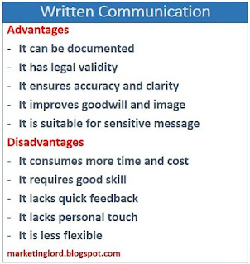

Slide 20

Written communication image

Slide 21
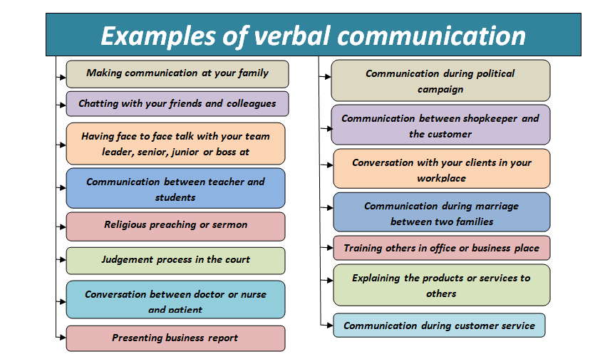

Slide 22
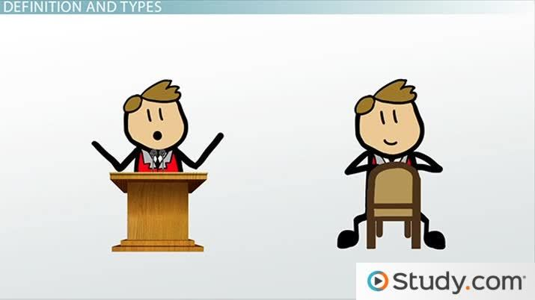
2.2
Formal and Informal

Slide 23
What is formal communication?
Formal communication refers to the flow of official information through proper, predefined channels and routes.
The flow of information is controlled and needs deliberate effort to be properly communicated.
Formal communication follows a hierarchical structure and chain of command.
The structure is typically top down, from leaders in various departments and senior staff in the organization, which funnel down to lower level employees.
Employees are bound to follow formal communication channels while performing their duties.
Formal communication is considered effective as it is a timely and systematic flow of communication.

Slide 24



Slide 25
What is informal communication?
Informal communication refers to communication which is multi-dimensional.
Informal Communication in the workplace refers to the exchanging of information outside formal channels such as office memos or scheduled meetings. It can take many forms, such as casual conversations between colleagues, watercooler discussions, or social media interactions.
Informal Communication plays an essential role in developing relationships, creating a positive work culture, and sharing creative ideas.
Informal communication is considered effective as employees can discuss work-related issues which saves the organization time and money. It also helps to build more productive and healthy relationships in the workforce.

Slide 26
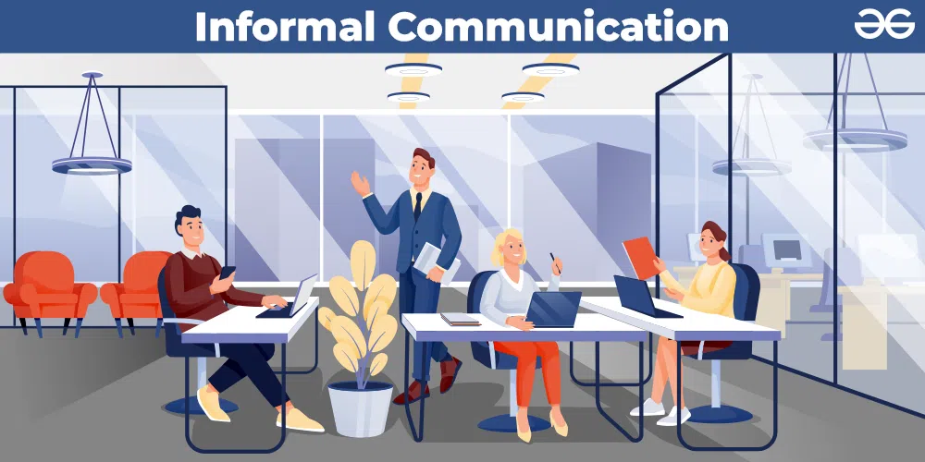



Slide 27
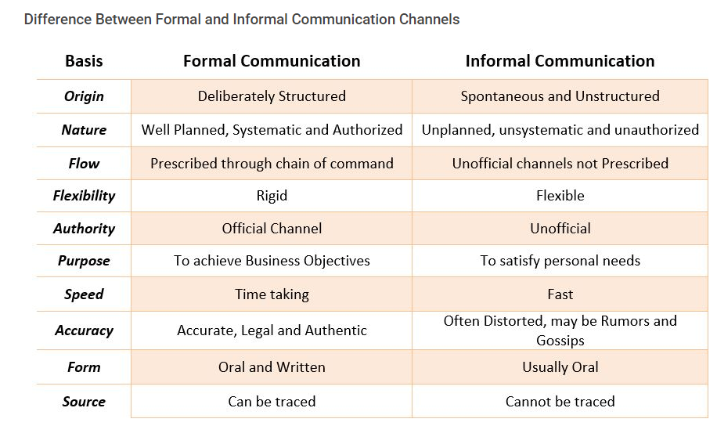

Slide 28
2.3
Non-verbal Communication and Body Language
2.3.1
Forms of Non-Verbal Communication
2.3.2
Effective use of body language

Slide 29
What Is Non Verbal Communication?
Non-verbal communication is the sending or receiving of wordless messages.
We can say that communication other than oral and written, as gesture, body language, posture, tone of voice or facial expressions, is called non-verbal communication.

Slide 30
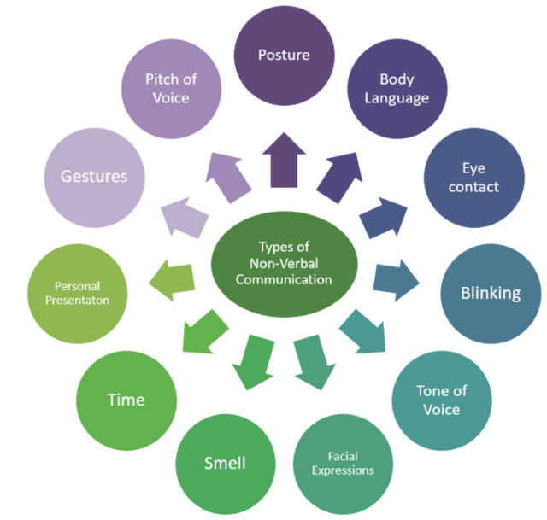
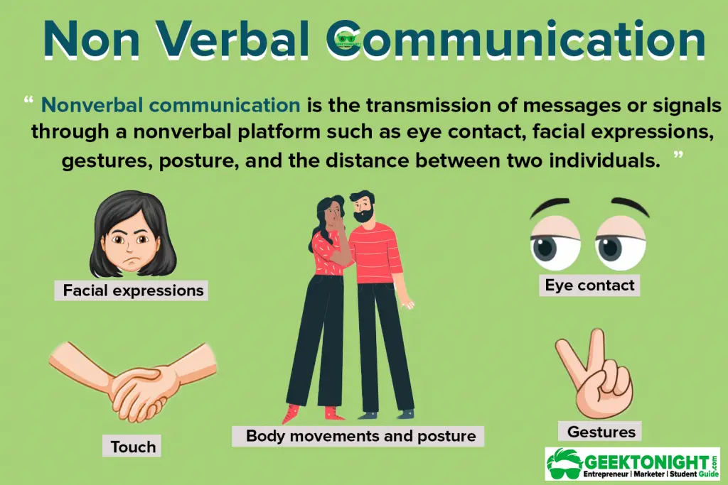
Non Verbal Communication

Slide 31
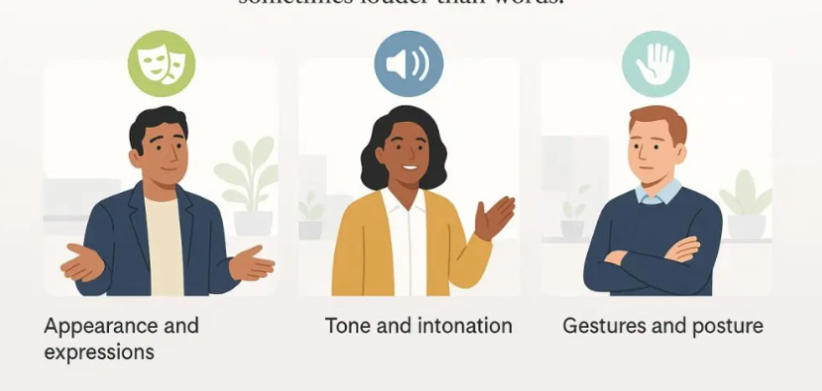
Elements Of Non Verbal Communication
Appearance: clothing, hairstyle, neatness, use of cosmetics. Surrounding: room size, lighting, decorations, furnishings.
Body Language: Facial expressions, gestures, postures.
Sounds: Voice tone, Volume, Speech rate.

Slide 32
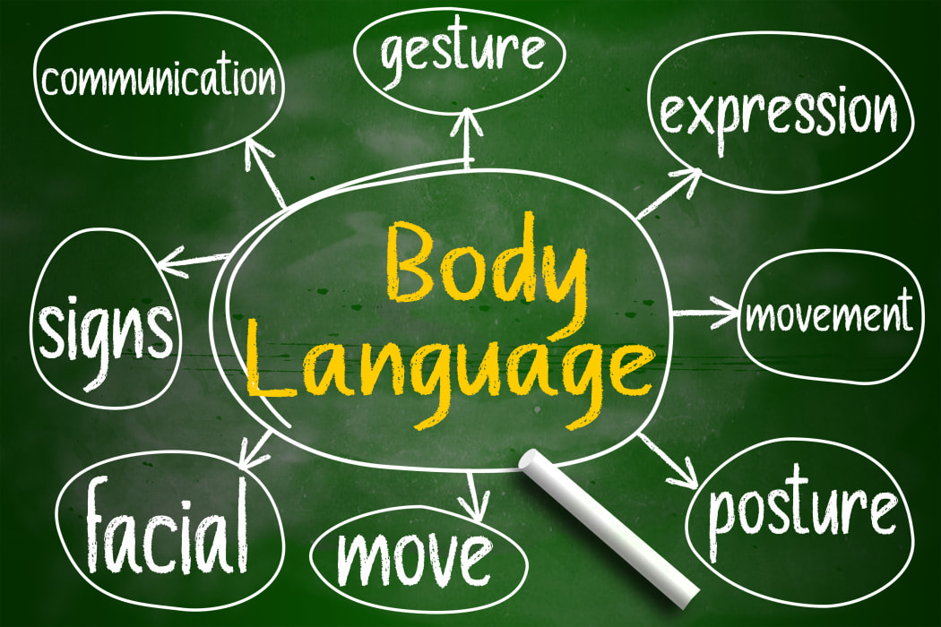
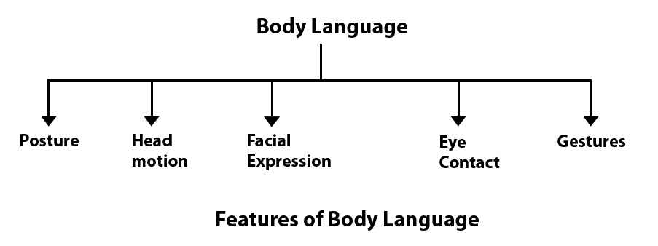
Body Language

Slide 33
Body language in different cultures around the world:
What is body language?
Body language is the unspoken language we use through gestures, expressions, and movements.
It adds depth to our words, showing emotions and intentions.
It bridges gaps in cross-cultural communication and enhances your connection with others.
Nonverbal communication includes facial expressions, gestures, posture, eye contact, and touch.
Does culture impact body language and non verbal communication?
Some aspects of nonverbal communication are universal, like basic facial expressions. For instance, a smile can work wonders pretty much anywhere!
However, others vary culturally. Different cultures have their own set of norms, values, and social expectations, which influence how people express themselves nonverbally.

Slide 34
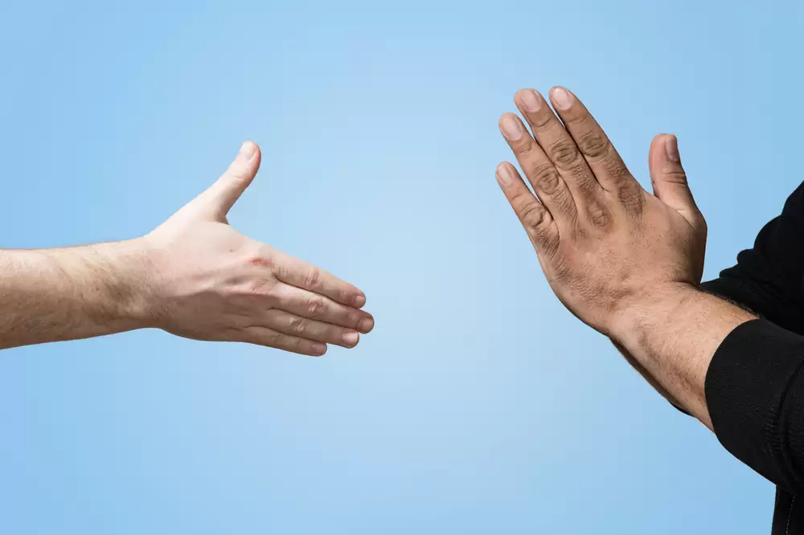
Body language in different cultures around the world
As mentioned, culture has a significant impact on nonverbal communication.
Sometimes, nonverbal is even contradictory from one country to another.
Some gestures are even considered offensive
Hence the importance of culture training if you work with people from different nationalities.
Below is an overview of body language cultural differences. We won’t mention laughing, as it universally expresses joy, amusement and connection. Unless it’s a sarcastic or evil laugh, of course!

Slide 35

Facial expressions and head movements
North America
Smile: Happiness, friendliness, agreement.
Eye contact: Sign of attentiveness, confidence, and honesty.
Nodding: Agreement or understanding.
Raised eyebrows: Surprise or curiosity.
Europe
Smile: Similar to North America, although some countries might smile less than what you’re used to in America
Eye contact: Generally interpreted as attentiveness and honesty. Uncommon in Russia.
Nodding: Agreement or acknowledgment.

Slide 36
Asia
Japan: Controlled smiling, blushing can signify embarrassment or shyness.
China: Smiles can indicate politeness, respect, or discomfort.
South Korea: Minimal smiling, nodding to show understanding.
India: Nodding can mean acknowledgment more than agreement
Middle East
Smile: Reserved for close relationships, less common with strangers.
Eye contact: Varies across cultures, can show respect or challenge.
Nodding: Often slower and more deliberate, indicating agreement.

Slide 37
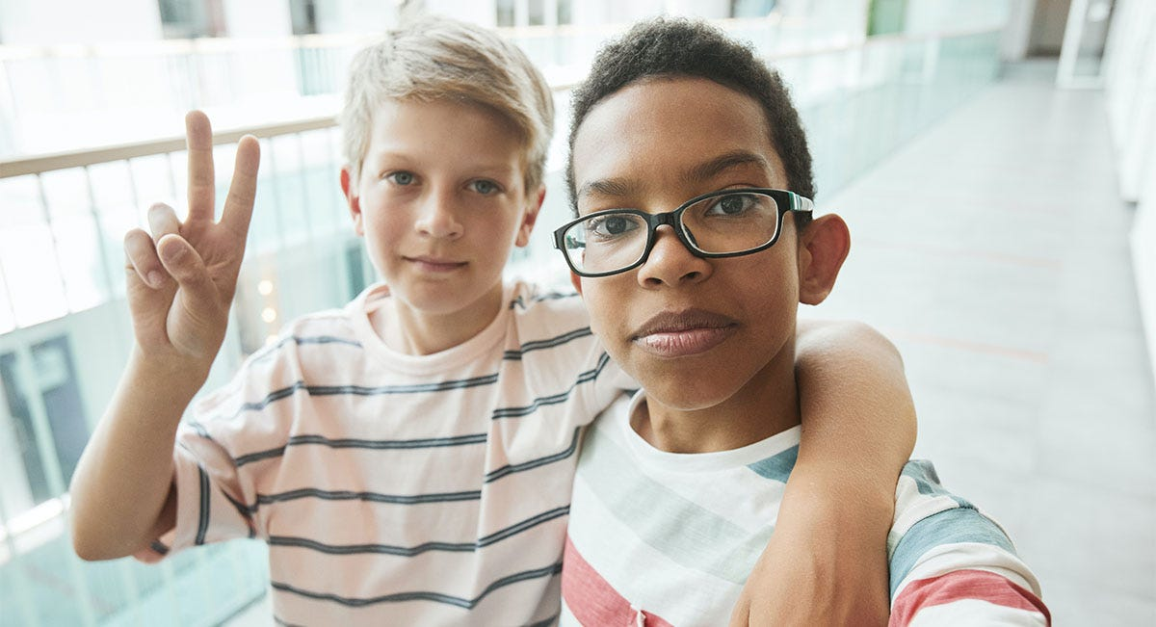
Hand gestures

Slide 38
North America
Thumbs up: Approval, agreement, or positivity.
Peace sign (V for Victory): Generally means peace or victory.
Europe
A-OK Sign (thumb and forefinger forming a circle): In some countries, it means "okay" or "good," but can be offensive in others. In France, as mentioned, it can mean “zero”.
Crossed fingers: Symbolizing luck or wishing for good fortune.
Asia
China: Beckoning gesture (palm down and to the side, fingers moving toward you): Used to call someone over.
South Korea: The same gesture can be seen as rude.
Middle East
Hand on heart: Used to show sincerity or emphasize a statement.
Hand to mouth: Can indicate surprise or disbelief.

Slide 39

Silence

Slide 40
North America
Silence in conversations: May indicate discomfort, awkwardness, or a pause for reflection.
Silence in public spaces: Generally seen as normal, with no specific cultural connotations.
Europe
Silence in conversations: May be perceived as listening attentively or needing time to think.
Silence in public spaces: Considered normal, with variations based on context. For example, in countries like Spain or Italy, it’s unlikely to find a silent public space.
Asia
Japan: Silence is valued and often used to convey respect, seriousness, or consideration.
China: Silence might signal agreement, disagreement, or respect for the speaker.
India: Silence in conversations can mean agreement, thoughtfulness, or attentiveness.
Middle East
Silence in conversations: Pauses are common, allowing speakers to gather their thoughts.
Silence in public spaces: Considered normal, with variations based on cultural practices.

Slide 41

Greetings

Slide 42
North America
Handshake: Common greeting in professional and social settings.
Hugs: Common among friends and family.
Europe
Handshake: Common, varying in strength.
Asia
Japan: Bowing is common for greetings.
India: "Namaste" is a common greeting.
Middle East
Handshake: Common, but varies between men and women due to cultural norms.

Slide 43

Personal space

Slide 44
North America
Personal space: Generally larger, especially in public settings.
Queueing: People maintain distance while waiting in lines.
Europe
Personal space: Varies across countries; Northern Europe tends to have larger personal space, Southern Europe generally has smaller.
Public transport: Personal space may be limited due to crowded transportation.
Asia
Personal space: Generally smaller, especially in crowded urban areas.
Crowded environments: Limited personal space in markets, public transport, etc.
Middle East
Personal space: Smaller, especially in social and conversational settings. Might vary across genders.
Close conversations: Standing closer during conversations is common.

Slide 45
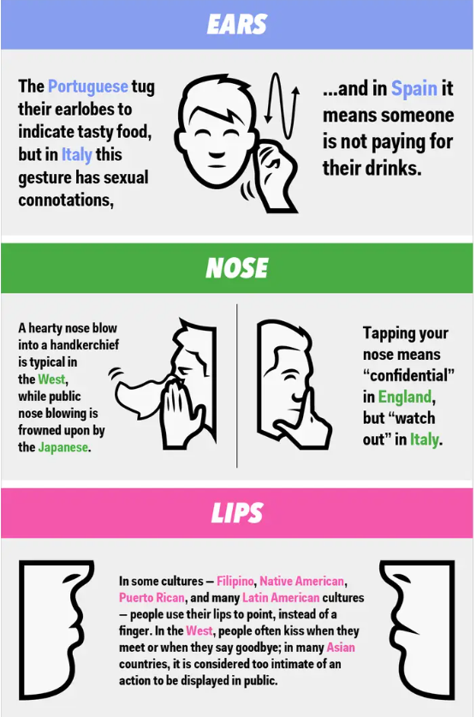
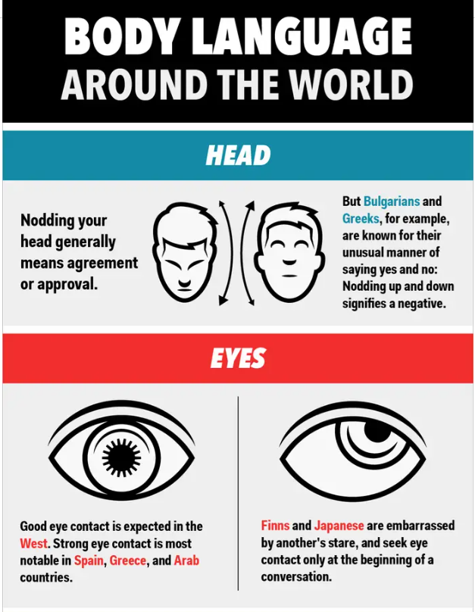

Slide 46
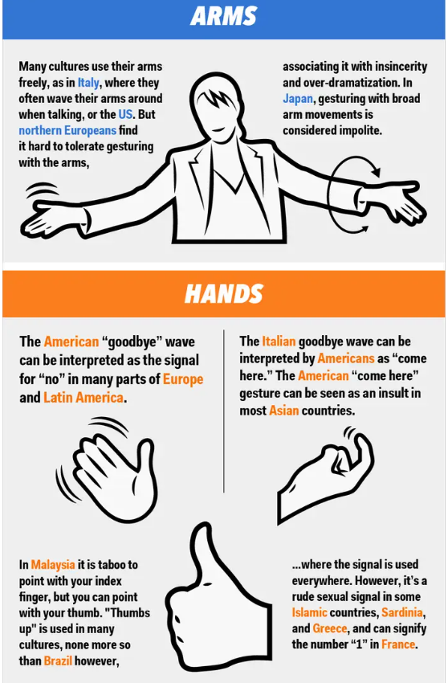
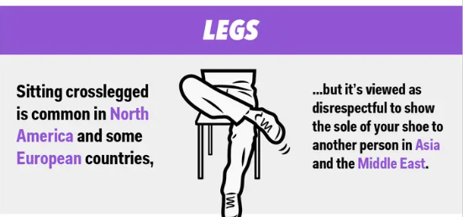

Slide 47
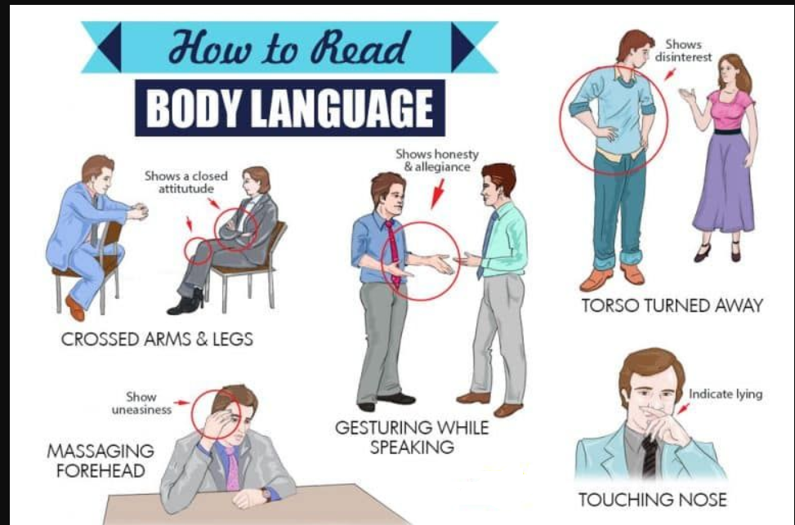

Slide 48
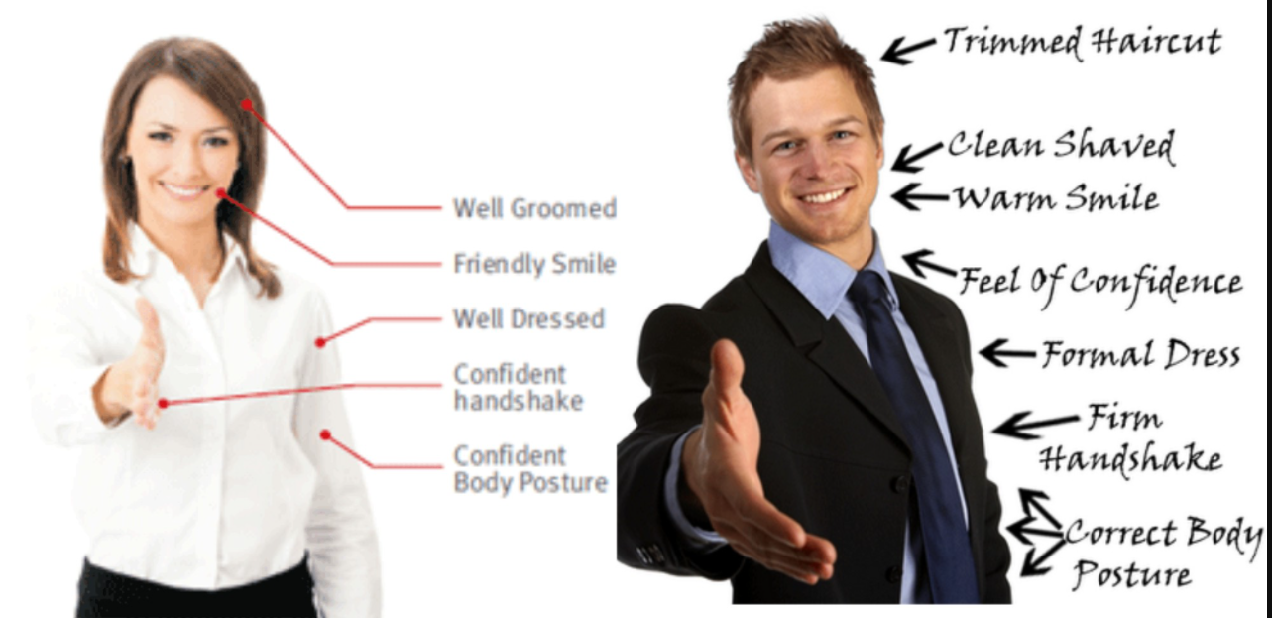

Slide 49
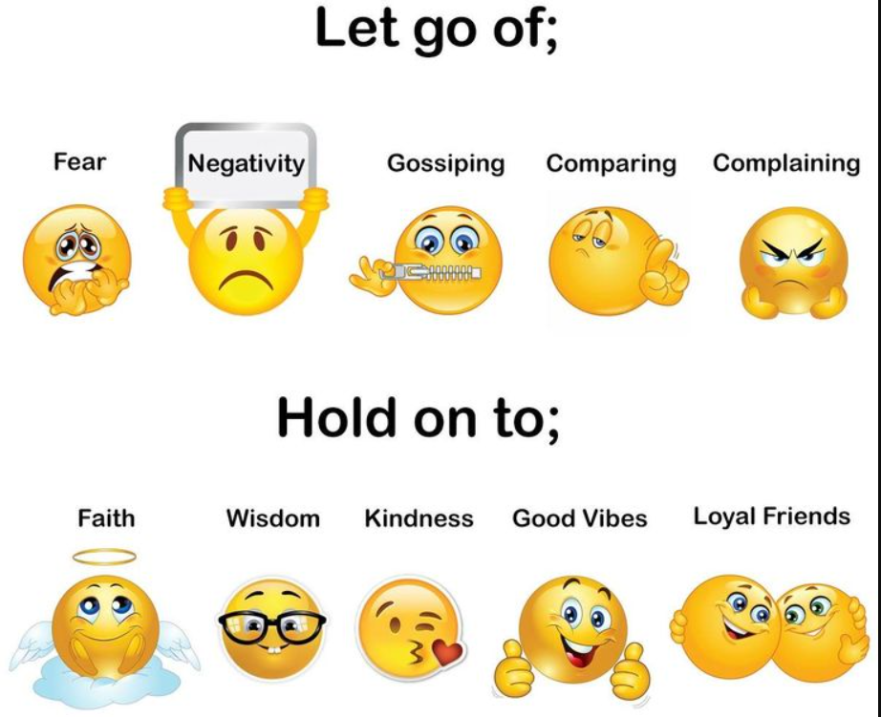

Slide 50
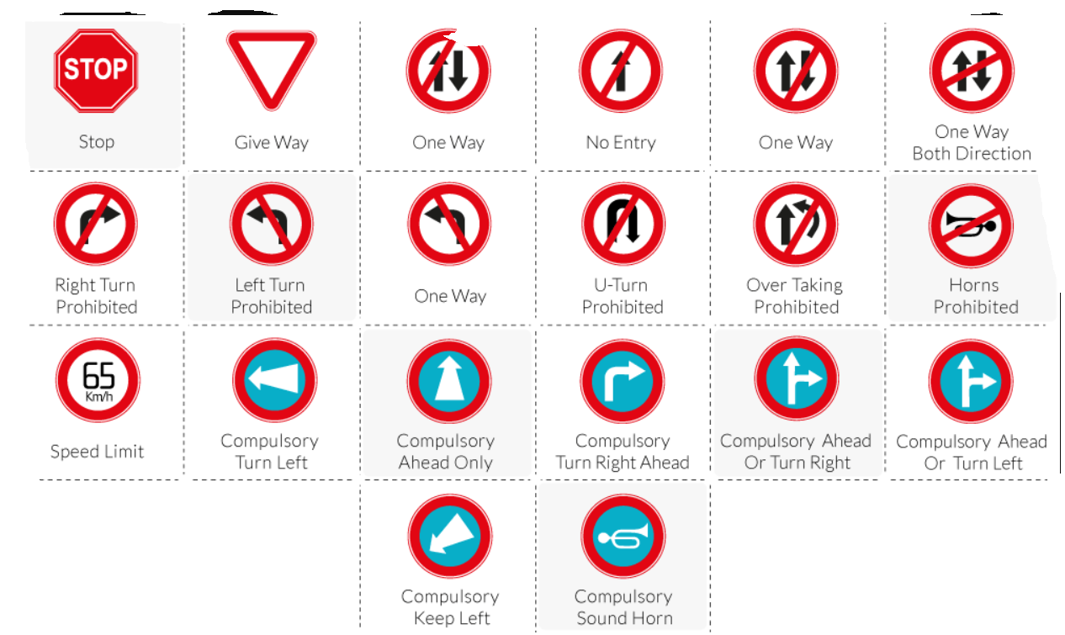

Slide 51
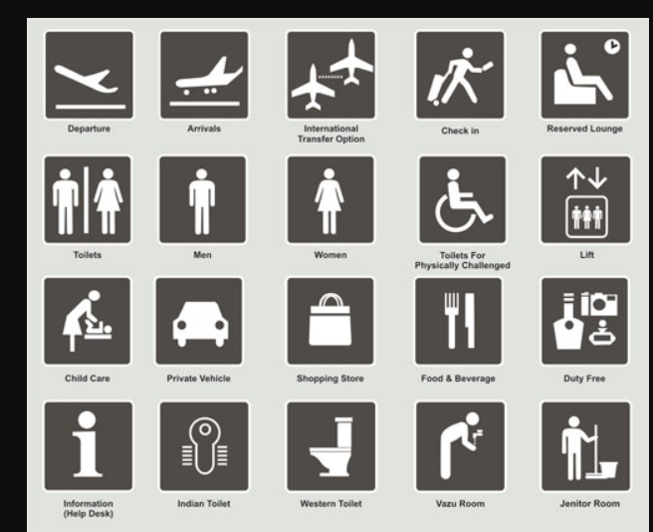

Slide 52
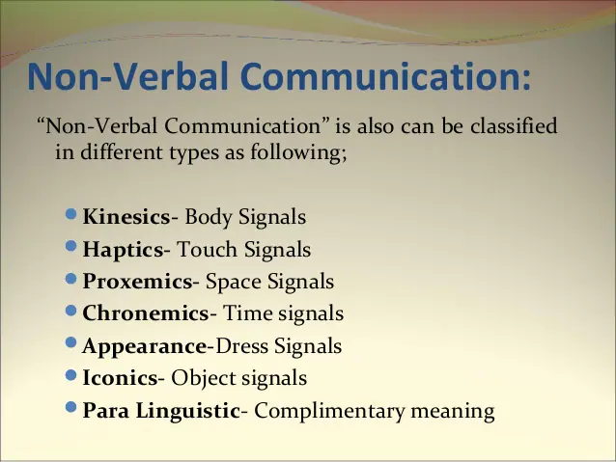

Slide 53
The word kinesics comes from the root word kinesis, which means "movement," and refers to the study of hand, arm, body, and face movements.
Haptics
Means by which people and other animals communicate via touching.
Touch is an extremely important sense for humans; as well as providing information about surfaces and textures it is a component of nonverbal communication in interpersonal relationships, and vital in conveying physical intimacy.
Socially acceptable levels of touching varies from one culture to another.

Slide 54
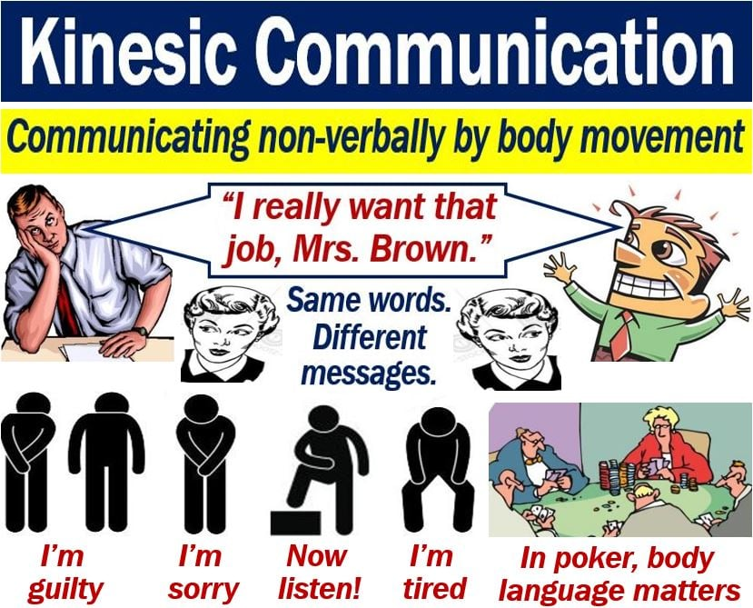


Slide 55
Proxemics
Study of how people use and perceive the physical space around them - space between sender and receiver of a message influences how message is interpreted.
Chronemics
The way we perceive time, structure our time and react to time is a powerful communication tool, and helps set the stage for the communication process.
Physical Appearance
Physical appearance includes clothing, ornaments, cosmetics, hairstyle etc. that a person puts together before appearing in public.

Slide 56
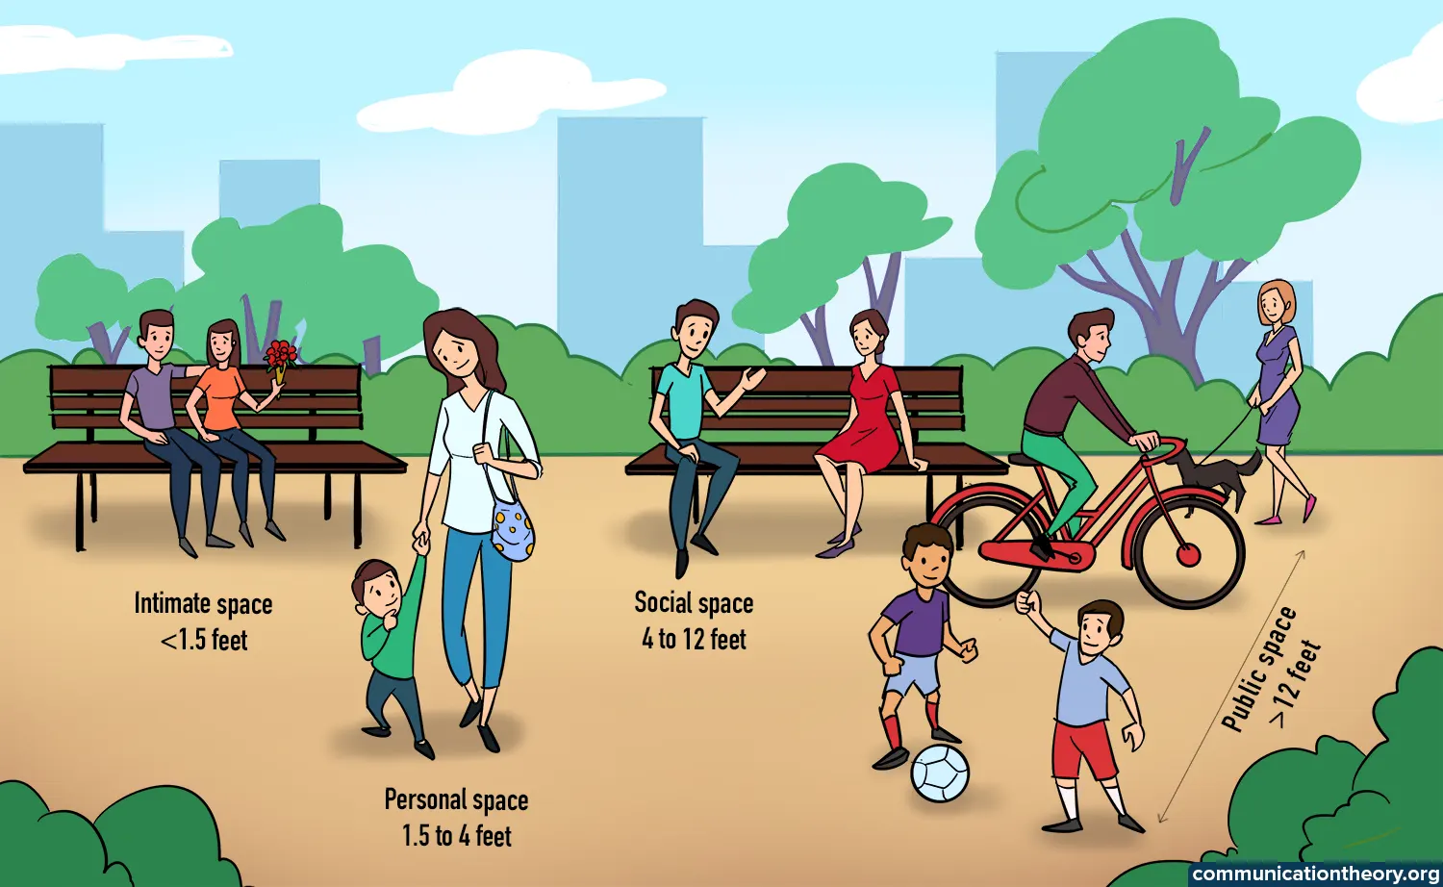

Proxemics
Chronemics

Slide 57
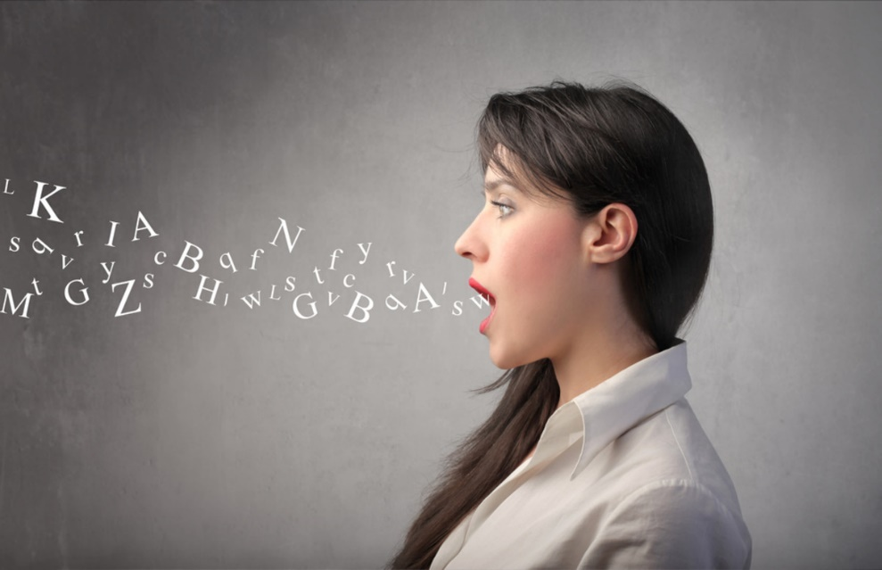
iconics
The meaning of an icon is being extracted immediately, because it is a 100% visual method in sending the information, and usually, this way of communication, the visual one, is the most developed one in the human being.
Para linguistic
It is concerned with the sound of the voice and the range of meanings that people convey through their voices rather than the words they use.

Slide 58
THANK YOU !!!!

