Slide 1
W3SCHOOLS:HTML Forms
Text
Pratik Shah
Password
••••••••
HTML Forms
Radio
◉ HTML ○ CSS
Collecting User Input for the Web
Checkbox
☑ Coding
<form> · <input> · <select> · <textarea> · <button>
Dropdown
Mumbai ▾
Date
30-09-2026
Notes:
Open with: forms are how a web page listens to the user. Content is based on the W3Schools HTML Forms tutorial.

Slide 2
What are HTML forms?
HTML forms collect user input and send it to a server for processing. A form is a set of controls wrapped in the <form> element.
USER
→
BROWSER
→
SERVER
Fills in the form controls
Sends the data with GET or POST
Receives and processes the data
A FORM CAN CONTAIN
Text fields
Password fields
Radio buttons
Checkboxes
Dropdown lists
Textareas
Submit buttons
Reset buttons
Date/time inputs
File uploads
Email, number, URL & search
<form method="post"> ...controls... </form>
2
Notes:
Walk the flow: user, browser, server. Then read out the controls a form can hold.

Slide 3
The <form> element
form.html
1
2
3
4
5
<form>
...form controls...
</form>
The <form> element wraps every control and tells the browser how to send the collected data.
Nothing is sent unless there is a submit button.
3
Notes:
method = how, name = key.

Slide 4
The <input> element
Type | Displays
type="text" | A single-line text input field
type="radio" | A radio button (select ONE of many choices)
type="checkbox" | A checkbox (select ZERO or MORE of many choices)
type="submit" | A submit button (submits the form)
type="button" | A clickable button
<input type="text" name="user">
4
Notes:
<input> is the most used form element. Its type attribute decides how it is displayed.

Slide 5
Text fields
BROWSER OUTPUT
text.html
example.com/contact
1
2
3
4
5
6
7
8
9
<form>
<h2>Contact us</h2>
<p>First name:<br>
<input type="text" name="fname"
placeholder="First name"></p>
<p>Last name:<br>
<input type="text" name="lname"
placeholder="Last name"></p>
</form>
MY WEBSITE
HOME ABOUT CONTACT
Contact us
First name:
First name
Last name:
Last name
<input type="text"> defines a single-line text field. The placeholder attribute shows a hint inside the field until the user types.
The hint disappears as soon as the user starts typing.
5
Notes:
<input type="text"> defines a single-line text field. The placeholder attribute shows a hint inside the field until the user types.

Slide 6
Text field attributes
Attribute | Description
type | Kind of control. For a text field it is set to text.
name | Names the control so the server can recognise its value.
value | Gives an initial value inside the control.
size | Width of the field, in characters.
maxlength | Maximum number of characters the user can enter.
<input type="text" name="user" value="Pratik" size="20" maxlength="30">
6
Notes:
Text field attributes

Slide 7
Password fields
BROWSER OUTPUT
login.html
example.com/login
1
2
3
4
5
6
<form>
<h2>Welcome Back</h2>
<input type="password" name="pwd"
placeholder="Password">
<input type="submit" value="Login">
</form>
MY WEBSITE
HOME ABOUT CONTACT
Welcome Back
Password
Login
type="password" hides the characters as dots or asterisks while the user types.
It only masks the text on screen. Use HTTPS to protect it.
7
Notes:
type="password" hides the characters as dots or asterisks while the user types.

Slide 8
Radio buttons
BROWSER OUTPUT
radio.html
example.com/course
1
2
3
4
5
<p>Choose a course:</p>
<input type="radio" name="course"
value="HTML" checked> HTML
<input type="radio" name="course"
value="CSS"> CSS
MY WEBSITE
HOME ABOUT CONTACT
Course
Choose a course:
HTML
CSS
Radio buttons let the user pick only ONE option. Buttons that share the same name form one group.
Add checked to preselect an option.
8
Notes:
Radio buttons let the user pick only ONE option. Buttons that share the same name form one group.

Slide 9
Checkboxes
BROWSER OUTPUT
checkbox.html
example.com/skills
1
2
3
4
5
<p>Select your skills:</p>
<input type="checkbox" name="skill1"
value="HTML" checked> HTML
<input type="checkbox" name="skill2"
value="CSS"> CSS
MY WEBSITE
HOME ABOUT CONTACT
Skills
Select your skills:
✓
HTML
CSS
Checkboxes let the user select ZERO or MORE options from a limited set of choices.
Each checkbox has its own name and value.
9
Notes:
Checkboxes let the user select ZERO or MORE options from a limited set of choices.

Slide 10
Dropdown lists
BROWSER OUTPUT
select.html
example.com/city
1
2
3
4
5
6
7
Choose a city:
<select name="city">
<option value="mumbai">Mumbai</option>
<option value="pune">Pune</option>
<option value="delhi"
selected>Delhi</option>
</select>
MY WEBSITE
HOME ABOUT CONTACT
Location
Choose a city:
Delhi
▾
Mumbai
Pune
Delhi
<select> creates a drop-down list. Each <option> is one choice, and selected marks the default.
Add the multiple attribute to allow several picks.
10
Notes:
<select> creates a drop-down list. Each <option> is one choice, and selected marks the default.

Slide 11
Select & option attributes
Attribute | Description
select name | Names the control sent to the server.
select size | Shows a scrolling list box with that many rows.
select multiple | Lets the user select several items.
option value | The value sent when that option is selected.
option selected | Makes the option the initial choice on page load.
<select name="dropdown" size="3" multiple>
11
Notes:
Select & option attributes

Slide 12
Textarea
BROWSER OUTPUT
textarea.html
example.com/feedback
1
2
3
4
<textarea name="msg" rows="4"
cols="30"
placeholder="Your message here...">
</textarea>
MY WEBSITE
HOME ABOUT CONTACT
Feedback
Your message here...
<textarea> holds multi-line text. rows sets the visible height and cols the visible width in characters.
The placeholder hint disappears when the user types.
12
Notes:
<textarea> holds multi-line text. rows sets the visible height and cols the visible width in characters.

Slide 13
Textarea attributes
Attribute | Description
name | Names the control sent to the server.
rows | Number of visible text rows in the box.
cols | Number of visible columns (width in characters).
<textarea name="description" rows="5" cols="50">
13
Notes:
rows and cols set the size of the box.

Slide 14
Submit & reset buttons
BROWSER OUTPUT
buttons.html
example.com/save
1
2
3
4
5
6
<h2> Profile </h2>
<form action="/save" method="post">
<input type="text" name="user"
value=“Parth">
<input type="submit" value="Submit">
<input type="reset" value="Reset">
</form>
MY WEBSITE
HOME ABOUT CONTACT
Profile
Parth
Submit
Reset
Submit → data goes to /save
Submit sends the form data to the server. Reset restores every field to its starting value.
Reset → fields go back to defaults
<button type="button"> can also run JavaScript.
14
Notes:
Submit sends the form data to the server. Reset restores every field to its starting value.

Slide 15
Button types
type | What it does
submit | Creates a button that submits the form.
reset | Resets all form controls to their initial values.
button | Triggers a client-side script when clicked.
image | A clickable button that uses an image as its background.
<input type="image" src="logo.png" alt="Submit">
15
Notes:
Button types

Slide 16
Date & time inputs
BROWSER OUTPUT
datetime.html
example.com/booking
1
2
3
4
5
6
7
Birthday:
<input type="date" name="bday">
Time:
<input type="time" name="t">
Meeting:
<input type="datetime-local"
name="meet">
MY WEBSITE
HOME ABOUT CONTACT
Book a slot
Birthday:
dd-mm-yyyy
Time:
--:-- --
Date and time types show a native picker. Others include month and week; min and max limit the range.
Meeting:
dd-mm-yyyy --:-- --
The value is always sent in a standard format.
16
Notes:
Date and time types show a native picker. Others include month and week; min and max limit the range.

Slide 17
File upload
BROWSER OUTPUT
upload.html
example.com/upload
1
2
3
4
5
6
7
8
9
<h2>UPLOAD A FILE</h2>
<p>Select File: </p>
<form action="/upload"
method="post"
enctype="multipart/form-data">
<input type="file" name="doc"
accept="image/*"><br><br>
<input type="submit">
</form>
MY WEBSITE
HOME ABOUT CONTACT
UPLOAD A FILE
Select File:
Choose File
No file chosen
Submit
type="file" lets the user pick a file to send with the form. accept limits the file types the server accepts.
Uploads need method="post" and enctype="multipart/form-data".
17
Notes:
type="file" lets the user pick a file to send with the form. accept limits the file types the server accepts.

Slide 18
Email, number, URL & search
BROWSER OUTPUT
types.html
example.com/signup
1
2
3
4
5
6
7
8
9
10
<form>
<p>Email<br><input type="email"
name="mail" placeholder="you@mail.com"></p>
<p>Number (1-10)<br><input type="number"
name="qty" min="1" max="10" value="5"></p>
<p>Website<br><input type="url"
name="site" placeholder="https://..."></p>
<p>Search<br><input type="search"
name="q" placeholder="Search..."></p>
</form>
MY WEBSITE
HOME ABOUT CONTACT
Email
you@mail.com
Number (1-10)
5
Website
https://...
These types validate the value or adapt the keyboard: email checks the format, number accepts numbers within min and max.
Search
Search...
placeholder shows a hint inside the empty field.
18
Notes:
These types validate the value or adapt the keyboard: email checks the format, number accepts numbers within min and max.

Slide 19
The <fieldset> tag
BROWSER OUTPUT
fieldset.html
example.com/personalia
1
2
3
4
5
6
7
8
<form action="/action_page.php">
<fieldset>
<legend>Personalia:</legend>
<input type="text" name="fname"
placeholder="First name">
<input type="submit">
</fieldset>
</form>
MY WEBSITE
HOME ABOUT CONTACT
Personalia:
First name
Submit
<fieldset> groups related elements and draws a box around them. <legend> gives that box a caption.
Great for splitting a long form into sections.
19
Notes:
<fieldset> groups related elements and draws a box around them. <legend> gives that box a caption.

Slide 20
The method attribute
Value | Description
get | Default. Appends the form-data to the URL in name/value pairs: URL?name=value&name=value
post | Sends the form-data as an HTTP post transaction (in the request body).
dialog | Inside a <dialog>: closes it and fires a submit event without sending data.
<form action="/action_page.php" method="get|post">
20
Notes:
method says HOW the data is sent to the page in action.

Slide 21
method="get"
BROWSER OUTPUT
get.html
example.com/action_page.php
1
2
3
4
5
6
7
8
<form action="/action_page.php"
method="get" target="_blank">
First name:
<input type="text" name="fname"><br>
Last name:
<input type="text" name="lname"><br>
<input type="submit" value="Submit">
</form>
MY WEBSITE
HOME ABOUT CONTACT
method="get"
First name:
Arham
Last name:
Desai
With GET the submitted data is appended to the URL as name=value pairs, so it is visible in the address bar.
Submit
?fname=Arham&lname=Desai
target="_blank" opens the result in a new tab.
21
Notes:
With GET the submitted data is appended to the URL as name=value pairs, so it is visible in the address bar.

Slide 22
method="post"
BROWSER OUTPUT
post.html
example.com/action_page.php
1
2
3
4
5
6
7
8
<form action="/action_page.php"
method="post" target="_blank">
First name:
<input type="text" name="fname"><br>
Last name:
<input type="text" name="lname"><br>
<input type="submit" value="Submit">
</form>
MY WEBSITE
HOME ABOUT CONTACT
method="post"
First name:
Dhairya
Last name:
Patel
With POST the data is sent inside the body of the HTTP request, so it is not shown in the URL.
Submit
Data travels in the request body
Compare the clean address bar with the GET example.
22
Notes:
With POST the data is sent inside the body of the HTTP request, so it is not shown in the URL.

Slide 23
When to use GET or POST?
GET
POST
The default method
Use it for private data
Data is visible in the page address field
URL length is limited (about 3000 characters)
Can be bookmarked
Never use it for sensitive data
Best for non-secure data, like search queries
Data is not shown in the URL
No size limitations, so it suits large data
Cannot be bookmarked
Always use it for sensitive or personal information
23
Notes:
When to use GET or POST?

Slide 24
The action attribute
BROWSER OUTPUT
action.html
example.com/form
1
2
3
4
5
6
7
8
9
<form action="/action_page.php">
First name:
<input type="text" id="fname"
name="fname"><br>
Last name:
<input type="text" id="lname"
name="lname"><br>
<input type="submit" value="Submit">
</form>
MY WEBSITE
HOME ABOUT CONTACT
The form action attribute
First name:
Clement
Last name:
Creado
action defines WHERE to send the form data when the form is submitted. The value is a URL.
Submit
→ sent to /action_page.php
Submit sends the data to action_page.php on the server.
24
Notes:
action defines WHERE to send the form data when the form is submitted. The value is a URL.

Slide 25
action: where the data is sent
save-form.html
action="/save.php"
1
2
3
4
5
6
<form action="/save.php"
method="post">
<input type="text"
name="user">
<input type="submit">
</form>
Relative URL. Points to a file on the same website, such as /save.php or process.php. The most common choice.
action="https://site.com/save"
Absolute URL. A full web address, so the data can be sent to another website or an API.
action left out
action is an attribute of the <form> tag. Its value is the URL of the page or program on the server (PHP, Python, Node...) that receives and processes the data when the user clicks Submit.
The form is submitted to the same page it is already on (its own URL).
action = WHERE the data goes, method = HOW it is sent.
25

Slide 26
A complete form
BROWSER OUTPUT
register.html
example.com/register
1
2
3
4
5
6
7
8
<h2> Register</h2>
<form action="/register" method="post">
<input type="text" placeholder="Name">
<input type="email" placeholder="Email“>
<input type="checkbox"> I agree <textarea rows="3"> </textarea>
<input type="submit" value="Register">
</form>
MY WEBSITE
HOME ABOUT CONTACT
Register
Name
Email
HTML
I agree
One <form> can mix many controls. Each has a name, and the submit button sends them all together.
Register
Test every control before publishing.
26
Notes:
One <form> can mix many controls. Each has a name, and the submit button sends them all together.

Slide 27
HTML Input Types
A quick reference for <input type="...">
Website Designing (WSD) · Semester I
27

Slide 28
Text & information inputs
Type | What it does | Example
text | Single-line text field (default) | <input type="text" name="username">
password | Hides characters as typed | <input type="password" name="user_pwd">
email | Email format; browser validates it | <input type="email" name="user_email">
url | Needs a valid absolute URL | <input type="url" name="website">
tel | Phone numbers; numeric keypad on mobile | <input type="tel" name="phone">
search | Search queries; may show a clear (X) | <input type="search" name="q">
28

Slide 29
Numeric & selection controls
Type | What it does | Example
number | Numbers only, with stepper | <input type="number" name="age" min="1" max="100">
range | Slider within set limits | <input type="range" name="volume" min="0" max="11">
checkbox | On/off; pick multiple options | <input type="checkbox" name="agree" value="yes">
radio | Pick one from a group (same name) | <input type="radio" name="gender" value="m">
color | Opens native color picker | <input type="color" name="theme_color">
29

Slide 30
Date, time & utility inputs
Type | What it does | Example
date | Calendar: day, month, year | <input type="date" name="birthday">
time | Hours and minutes | <input type="time" name="alarm">
datetime-local | Date + time, no timezone | <input type="datetime-local" name="appointment">
month / week | Month-year or week-year | <input type="month" name="expire_card">
file | Opens file browser to upload | <input type="file" name="avatar">
hidden | Invisible data sent to server | <input type="hidden" name="user_id" value="987">
image | Image used as submit button | <input type="image" src="btn.png" alt="Submit">
30

Slide 31
Action buttons & key tips
Type | What it does | Example
submit | Sends the form data to the server | <input type="submit" value="Send Form">
reset | Resets fields to initial values | <input type="reset" value="Reset Fields">
button | No default action; use with JavaScript | <input type="button" value="Click Me">
▸ Radio buttons need the same name to form a group
▸ Link every input to a <label> using for and id
▸ Use required, min, max, pattern for validation
▸ hidden is not secure: users can edit it in dev tools
31

Slide 32
HTML Forms · W3Schools
What we learnt?
<form>
wraps the whole form
<input>
text, radio, date, file...
<select>
drop-down list
Thank You
<textarea>
multi-line text
<button>
clickable button
<fieldset>
groups related controls
32
Notes:
Recap the elements, then invite questions.

Slide 33
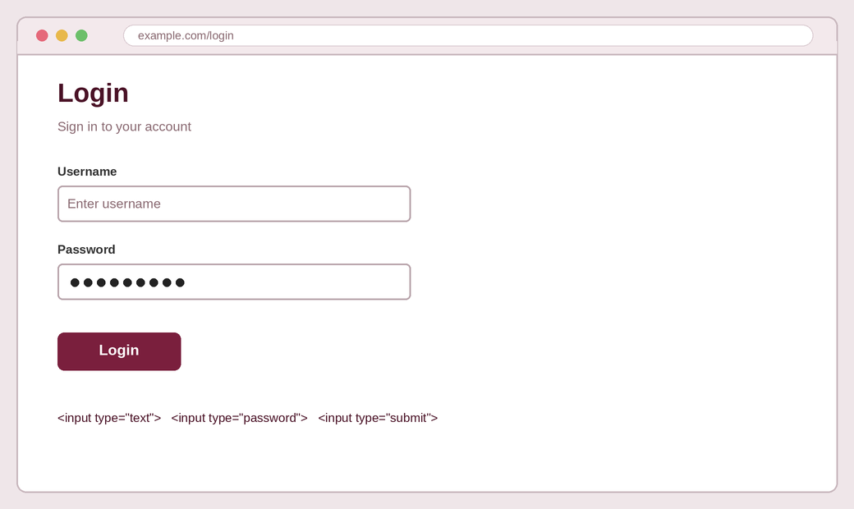
Practice 1: Login form
Simple
Create a login form with a username, a password and a Login button.
USE THESE
text · password · submit
33

Slide 34
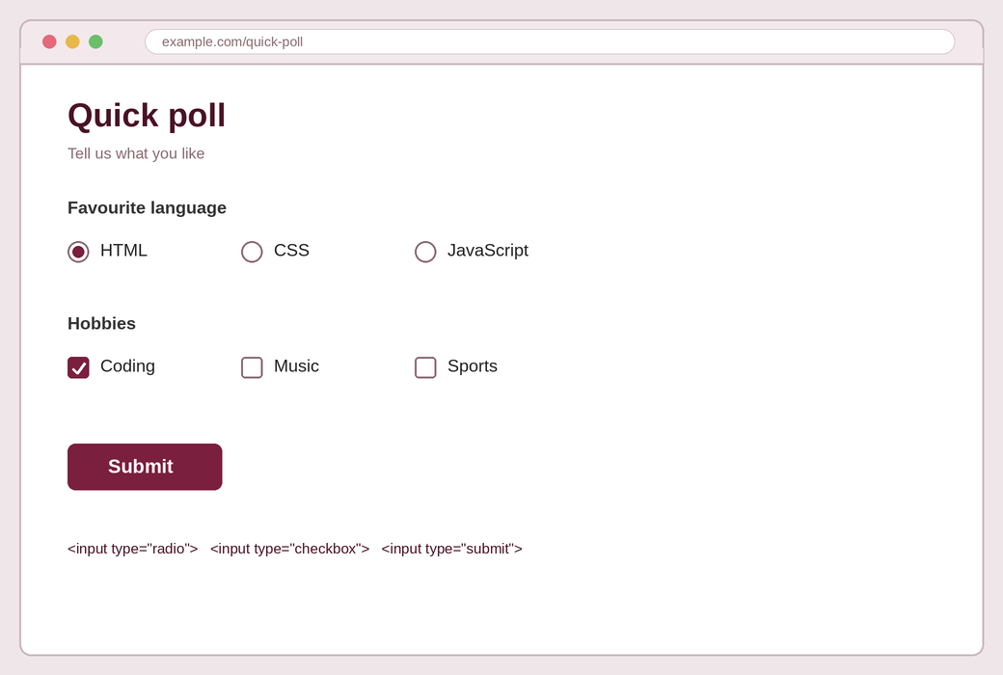
Practice 2: Quick poll
Simple
Create a poll where the user picks one favourite language and any number of hobbies.
USE THESE
radio · checkbox · submit
34

Slide 35
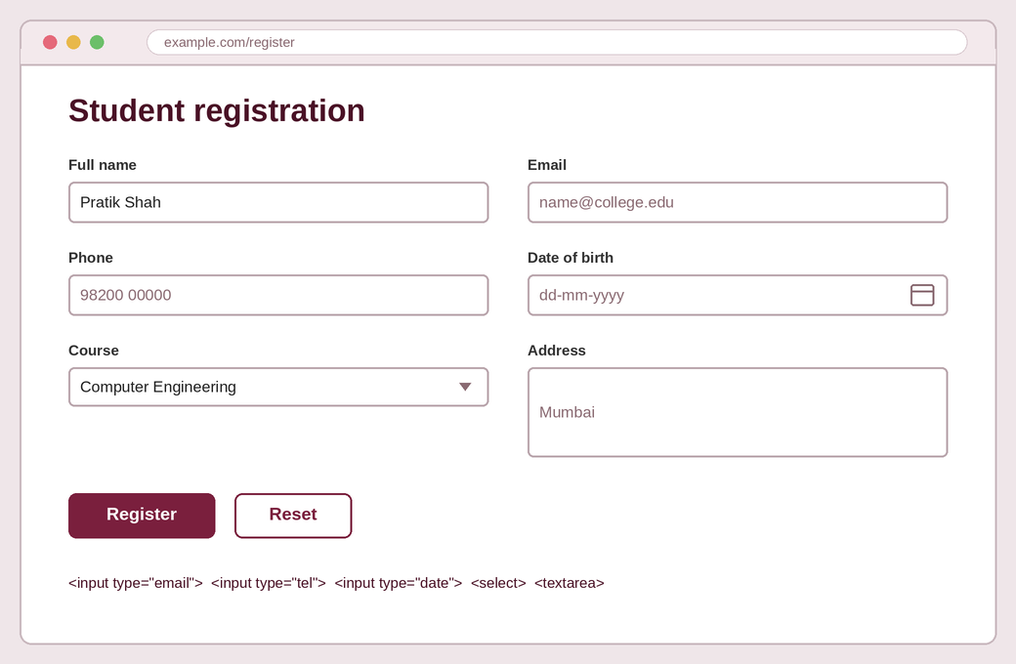
Practice 3: Student registration
Medium
Create a registration form with name, email, phone, date of birth, a course dropdown and an address.
USE THESE
text · email · tel · date · select · textarea · submit · reset
35

Slide 36
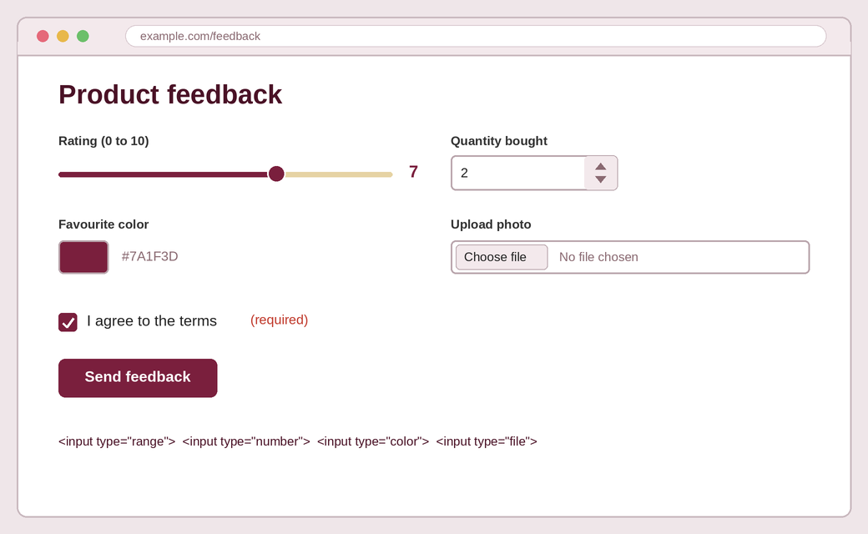
Practice 4: Product feedback
Medium
Create a feedback form with a rating slider, quantity, favourite colour, photo upload and a required agree box.
USE THESE
range · number · color · file · checkbox · required
36

Slide 37
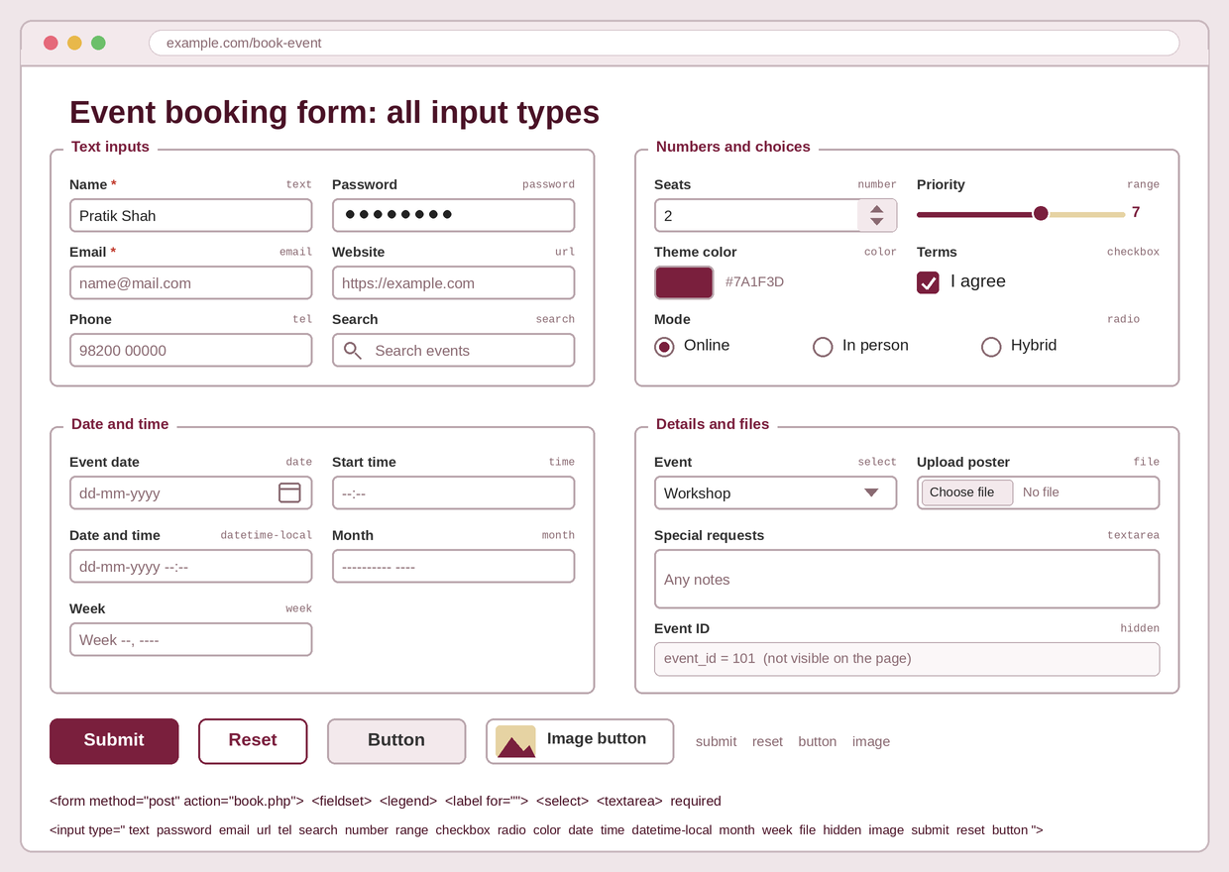
Practice 5: Event booking form
Hard
Create a booking form with two fieldsets: Your details and Booking. Link every label with for and id, make key fields required, and use method="post" with an action.
USE THESE
text · password · email · url · tel · search · number · range · color · checkbox · radio · date · time · datetime-local · month · week · file · hidden · image · submit · reset · button
37

Slide 38
