Slide 1
Healthcare App (Minor Project)
Supervisor:-
Mr. Vikas Hassija
Panel Teachers:-
Mr.Pawan Kumar Upadhyay
Mr. Pawan Singh Mehra
Presented By:
Mukund Madhav Goyal 18103138
Punit Jain 18103142
Shivam Singhal 18103149

Slide 2
Motive
Our main purpose of choosing this project is to help doctors to maintain their file work on a digital platform in an easier and efficient way.
This app would facilitate doctors to manage their appointments and maintain patients records on a regular basis.
Our motive is to digitalize the working of doctor patient relationship by creating transparency between doctor and patient.

Slide 3
Basic Flow of the application
We would be creating a mobile application to meet our motive.
We have divided our app into two main modules:
Doctor’s Module : This module with deal with all the facilities and functionalities related to doctors.
Patient’s Module : This module would allow patients to interact with the doctors on the app by using various functionalities as appointment booking, seeing the medical records etc.

Slide 4
Authenticating the users
We would be creating a login functionality for doctors and patients allowing them to access their accounts.
Their would be different sign-up processes which would include authentication methods like phone number authentication to verify the authenticity of the user (both doctor and patient). This will also include the basic sign – up process. After sign-up the user may proceed to the login once the id is active.

Slide 5
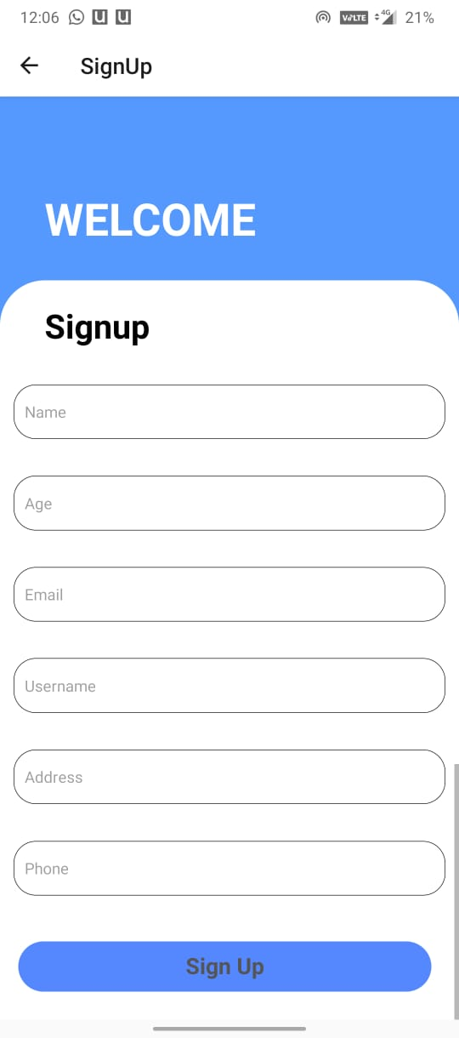
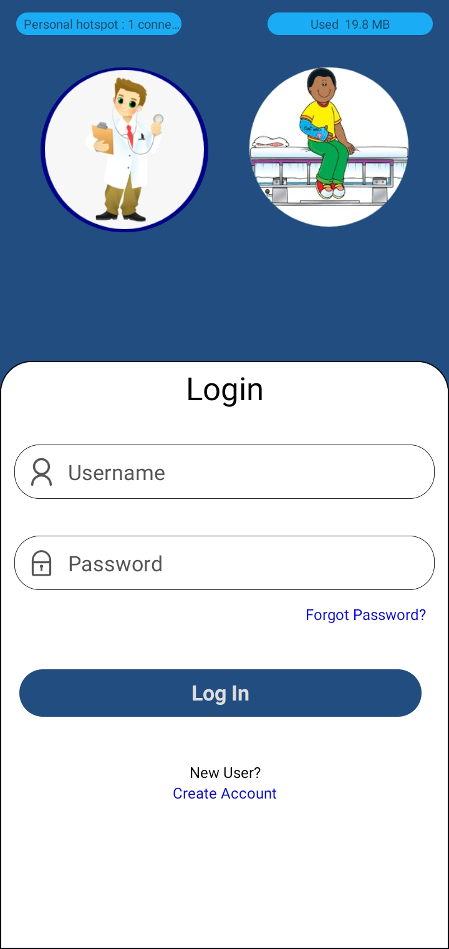
Login & Sign up

Slide 6
Module 1 : Doctor
After logging in once, doctor would be having various options such as maintaining their appointments, add patient data etc.
Appointments Managements :
The entrance page of the app would contain all the booked appointments of the doctor where doctor could accept or reject the appointments based on his free timings. Once the doctor accepts the appointment the appointment would be confirmed and the concerned patient would be well informed through notification about the same.
If the doctor rejects the appointment, doctor would be prompted to select his free timings and the same would be prompted to patient to rebook the appointment if interested.

Slide 7
Module 1 : Doctor (Cont.)
Doctor would be able to open the appointments once booked which would open the new window.
Data recording :
The new window would allow doctor to add the patients’ data. Doctor would be able to add medications related , diseases diagnosed , reports of the same depending upon the meeting.
Doctor would be able to add reports by clicking on add report button which would allow doctor to click picture of the report and upload it.
The uploaded report would then be stored as it is as well might be passed for OCR detection which would analysis the report and retrieve information from it.
Doctor could also write about the meeting or can use his speech to enter the data. We might be using speech to text recognition to convert the speech to text.

Slide 8
Module 1 : Doctor (Cont.)
Doctor would also be able to watch the old reports or diagnosis data added by him or shared by the patient.
This would enhance the diagnosis of the disease by the doctor providing him with all related information of the patient.
Doctor would have an option to share the data with the patient if prompted by the patient. Patient would have to share a key with the doctor to make the reports available to the patient.

Slide 9
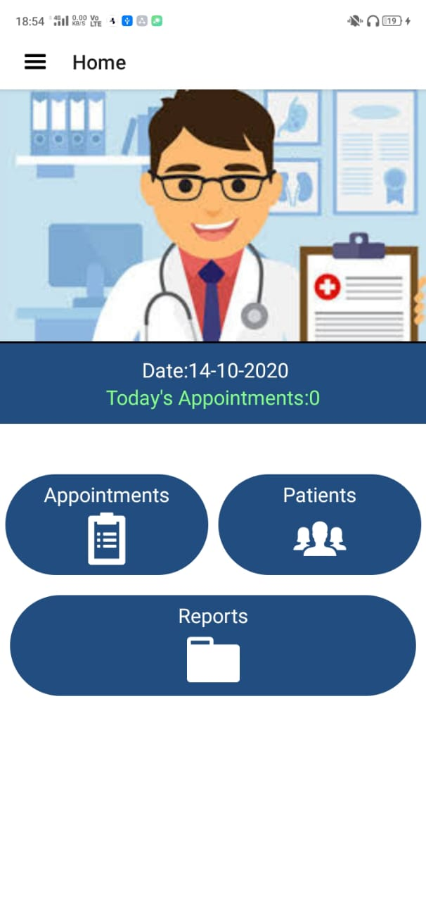

Slide 10
Module 2: Patient
Patient once logs in, would have various options like booking an appointment, access to his reports, his old appointments etc.

Slide 11
Module 2: Patient (Cont.)
Booking Appointments:
Patient on selecting book an appointment would be provided with list of diseases and type of doctors he is searching for.
From the list he could select a disease or dept. of doctor which would then show list of doctors and their related details.
From here patient can book appointments.
The appointments might get cancelled so the patient is well prompted the same to take care to consider the appointment booked only when doctor approves it.

Slide 12
Module 2: Patient (Cont.)
My Reports:
Patient would be able to watch over his old records and reports.
He would be able to share his reports with other doctors as well if the patient wishes.

Slide 13
Module 2: Patient (Cont.)
My Appointments:
Here all the booked appointments of the patient would be listed.

Slide 14
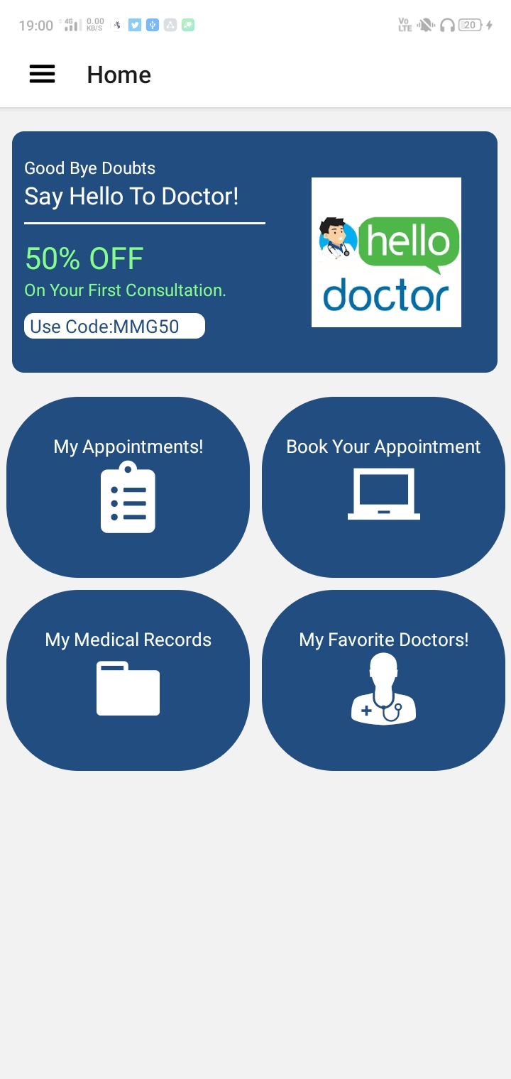
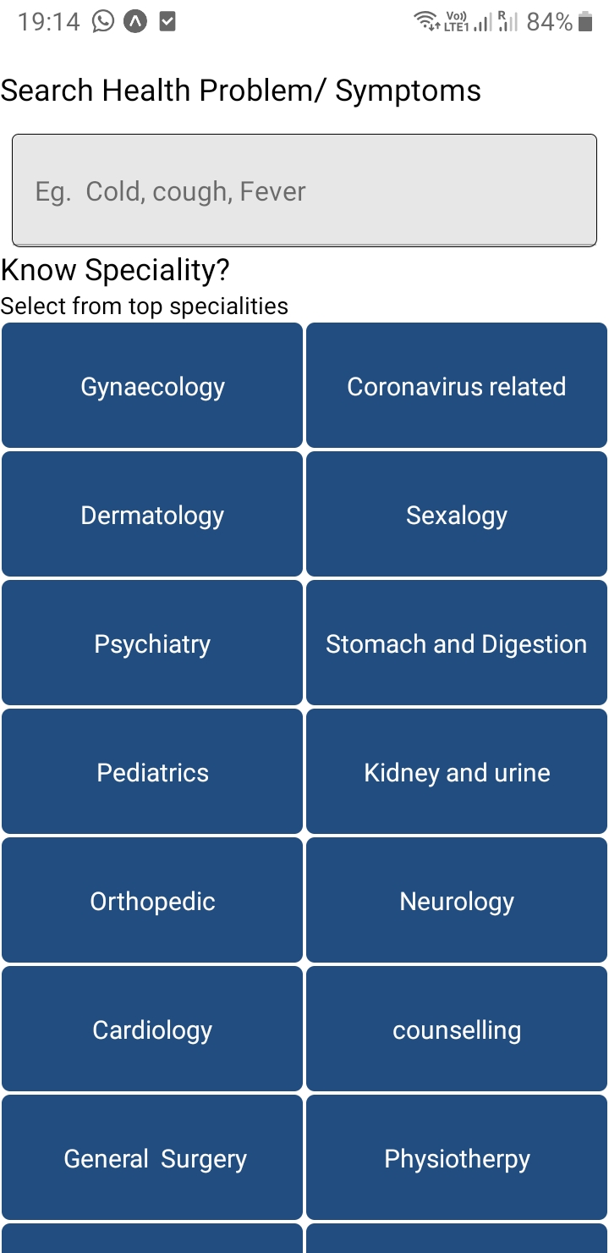

Slide 15
Technologies and Frameworks Used:
React Native – Front end library for creating native cross – platform app.
Redux
Other React Native supported Libraries
JavaScript – Basic manipulations
Node.js – Backend library to access database and other stuff.
Mongo DB : Database Management
Tesseract.js : OCR (image to text manipulation)
Speech to Text : for converting speech to text for easy data feeding.

Slide 16
Summary
This way we are aiming to create a mobile application which would digitalize the working of doctors and patients.
This would make it easy for doctors to keep their file work secure and systematically.
This is just a prototype of the application we are aiming to and this might change as we progress more and more towards the completion of the application.
Main features:
Reduce workload of doctors using easy and efficient data feeding.
More accurate diagnosis of disease.
Access medical records anywhere anytime.

Slide 17
Minor Project
Thank You
Presented By:
Mukund Madhav Goyal 18103138
Punit Jain 18103142
Shivam Singhal 18103149

