Slide 1
Normal Forms
First normal form
  Atomic values
    No repeating groups
Second line one
second line two
Galgotias University
17

Slide 2

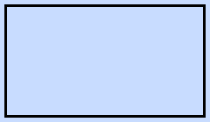
Keys
Key | Meaning | Example
PK | Unique row id | roll_no
FK | Link to parent | dept_id

Slide 3
Flowchart for the loop
i = 0
i < 10 ?
yes
print(i)
Loop runs ten times

Slide 4
Two plain boxes
Left box
Right box

