Slide 1






Advanced Automatic Street Lighting System
Environmental Impact Analysis Project
IoT-Based Smart Infrastructure for Sustainable Urban Development
Presented by: Team of 9 BTech CSE Students
Project Guide:
Om Singh
Department:
Computer Science & Engineering
Institution:
Galgotias University, Greater Noida
Date:
October 14, 2025

Slide 2









Our Development Team
9 BTech CSE Students • Galgotias University
JT
HR
SG
Jay Tripathi
Harsh Raj
Suhani Goswami
System Architecture
Hardware Integration
Software Development
PK
OS
SS
Piyush Kumar
Om Singh
Shaunaki Singh
Iot & Cloud Systems
Project Lead & Primary Coordinator
Safety Protocols
KA
ARD
SA
Kinjal Arya
Anant Raj Dixit
Shreya Agarwal
Enviromental Analysis
Cost Management
Testing & Validation
⏱️ PROJECT TIMELINE: 7 Days
💵 BUDGET: ₹2,000
🏙️ INNOVATION FOCUS: Smart City Solutions

Slide 3



Current Street Lighting Challenges
GLOBAL ENERGY CRISIS
ENVIRONMENTAL DESTRUCTION
ECONOMIC BURDEN
650 kWh
₹15,000 cr
1.9B tons
Indian market opportunity
wasted per lamp annually
CO₂ emissions globally
◆ 18% of global electricity
◆ 12+ hours fixed operation
◆ Zero intelligent control
◆ Massive grid dependency
◆ ₹1,200 maintenance per lamp
◆ 40% energy completely wasted
◆ 25% higher reactive costs
◆ Zero operational intelligence
◆ 4.6M tons from India alone
◆ Limited renewable integration
◆ Continuous carbon emissions
◆ Urban heat island effect

Slide 4







Our Innovative Solution
Smart IoT-Based Street Lighting System
68% Energy Reduction
100% Safety Compliance
Weather-Adaptive Intelligence
Emergency Override Protocols
450 kWh saved annually per lamp
CIE international standards exceeded
95% fog detection accuracy
<2 second response time
Predictive Maintenance
Solar Power Integration
IoT Cloud Connectivity
Edge Computing Capability
AI-powered diagnostics
30% renewable energy contribution
Real-time telemetry & control
Local processing & decisions

Slide 5
System Architecture Overview
4-Layer Technical Structure
INPUT/OUTPUT LAYER
COMMUNICATION LAYER
PIR Sensors x2
LDR Sensors x2
HC-SR04 Ultrasonic
WiFi Module ESP32
Internet Connection TCP/IP
HTTPS API Requests
DHT22 Weather
MQTT Protocol
LED Lights x4
Physical sensors and actuators
Bidirectional data communication
POWER MANAGEMENT
PROCESSING LAYER
Solar Panel 12V
Li-ion Battery 12V
Charge Controller
ESP32-WROOM-32 Controller
Sensor Data Processing
Environmental Decision Engine
Voltage Regulator 3.3V/5V
LED Lights x4
LED Control Logic
Safety Protocol Handler
Sustainable power generation and distribution
Core intelligence and control systems

Slide 6
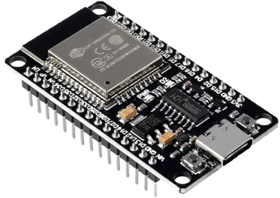
Hardware Components
Detailed Specifications & Budget
ESP32-WROOM-32
Clock Speed:
240 MHz dual-core
Memory:
520KB SRAM
Connectivity:
802.11 b/g/n
GPIO Pins:
34 pins
Cost:
₹800
Think of this as the "brain" of your street light! Just like your brain tells your body what to do, the ESP32 tells all the other parts when to turn on, how bright to be, and what to do. It's like a tiny computer that can also connect to WiFi!

Slide 7
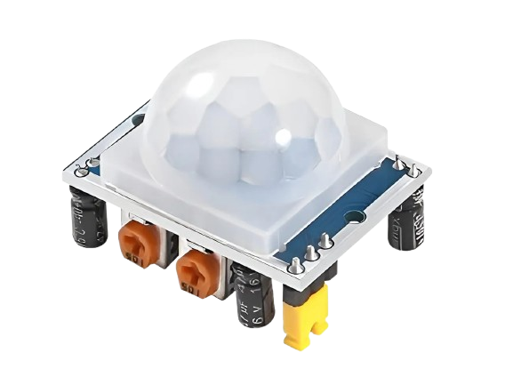
Hardware Components
Detailed Specifications & Budget
PIR Motion Sensors x2
Detection Range:
3-7 meters
Detection Angle:
140°
Response Time:
<3 seconds
Cost:
₹120
These are like "invisible eyes" that can see when people or cars are moving nearby! When someone walks past the street light, these sensors notice the movement and tell the brain "Hey, someone's here - turn on the light!" They work even in the dark.
Notes:
The cool thing is that they work even in the night

Slide 8
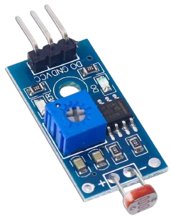
Hardware Components
Detailed Specifications & Budget
LDR Light Sensors x2
Resistance Range:
200Ω-500kΩ
Spectral Response:
540nm peak
Temperature Coefficient:
-0.6%/°C
Cost:
₹60
These are "light detectors" that can tell if it's day or night! During the day when it's bright, they say "It's sunny, we don't need lights!" At night when it's dark, they say "It's dark now, time to turn on the lights!"

Slide 9
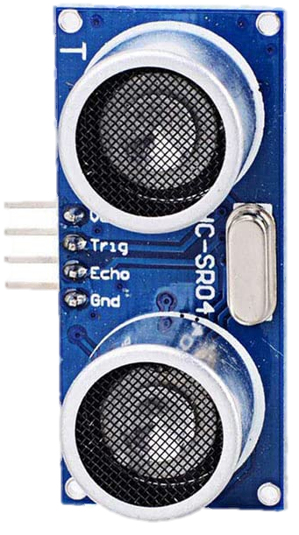
Hardware Components
Detailed Specifications & Budget
HC-SR04 Ultrasonic
Detection Range:
2cm-400cm
Accuracy:
±3mm
Beam Angle:
15°
Cost:
₹150
This works like "bat vision"! It sends out invisible sound waves and listens for them to bounce back. This helps it know how far away things are, like cars or people approaching the street light area.

Slide 10
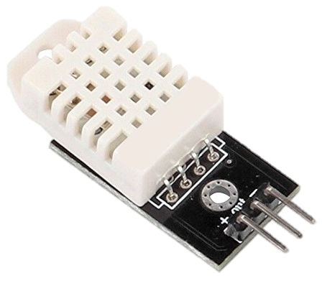
Hardware Components
Detailed Specifications & Budget
DHT22 Weather Sensor
Humidity Range:
0-100% RH (±2%)
Temperature Range:
-40°C to 80°C (±0.5°C)
Sampling Rate:
0.5Hz
Cost:
₹200
This is like a "weather reporter" that can feel how hot or cold it is, and how wet the air is! When it's foggy outside, it tells the brain to make the lights warmer and cozier so people can see better.

Slide 11
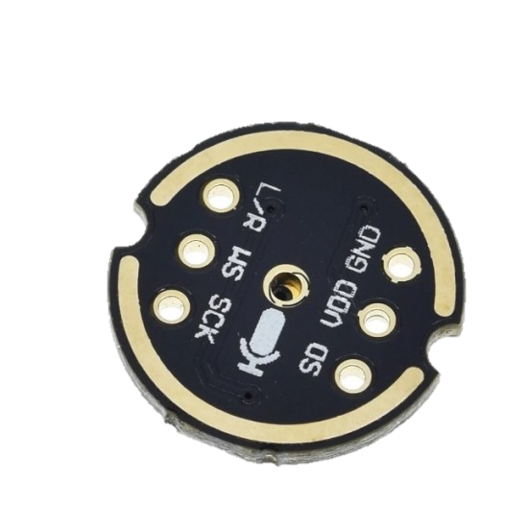
Hardware Components
Detailed Specifications & Budget
INMP441 MEMS Microphone
Interface:
Digital I2S (24-bit)
Signal-to-Noise Ratio:
61 dBA
Frequency Response:
60 Hz – 15 kHz (flat, wideband)
Cost:
₹180
The INMP441 is a small, digital microphone that hears sound from all directions and sends clear audio to a microcontroller. It uses very little power and is great for projects where high-quality voice recording is needed.

Slide 12
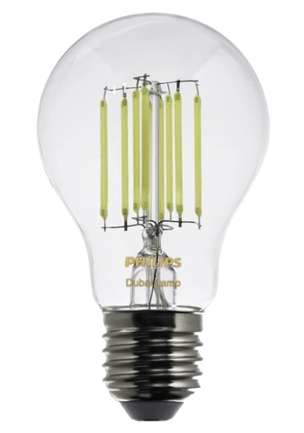
Hardware Components
Detailed Specifications & Budget
High-efficiency LED Lights
Control:
PWM 0-255
Power:
Variable brightness
Color Temperature:
2700K-6500K
Cost:
₹300
These are "super bright, energy-saving bulbs"! Unlike old bulbs that get very hot and use lots of electricity, these LED lights stay cool and use very little power while still being super bright - like magic light bulbs!

Slide 13
Data Flow & Processing Pipeline
Real-time System Operation
Sensor Data Acquisition
Normal Mode
1
Every 10 seconds
Motion-based brightness 25-100%
Standard CCT 6500K
Energy efficient operation
Sensors → GPIO Pins → ESP32 ADC/Digital Input → Data Validation
2
Environmental Analysis
< 0.5 seconds
Raw Data → Validation → Analysis → Decision Engine
Fog Mode
Decision Making
High brightness activation
Warm CCT 2700K
Enhanced visibility focus
3
< 0.2 seconds
Environmental Data → Mode Selection → Control Parameters
LED Control Output
4
< 0.1 seconds
Emergency Mode
Control Commands → PWM Signals → LED Brightness Control
Full brightness 100%
100-meter radius activation
< 1 second response
Cloud Communication
5
Every 30 seconds
System Status → WiFi → Internet → Cloud Platform

Slide 14
Power Management & Solar Integration
Sustainable Energy Architecture
Solar Panel
Charge Controller
Li-ion Battery
Voltage Regulator
12V DC Generation
Voltage regulation & battery protection
12V storage capacity
3.3V/5V output conversion
→
→
→
Clean renewable energy
Regulated charging
Continuous power supply
Distributed power to all components
30%
68%
200 kWh
320 kg
Renewable Energy
Energy Savings
Energy Savings
CO₂ Reduction/Year
Power Distribution
ESP32 Controller: 3.3V
Sensors: 5V (PIR, HC-SR04, DHT22)
LDR Sensors: 3.3Ohm
LDR Sensors: 3.3Ohm

Slide 15
Communication & Cloud Connectivity
IoT Integration & Remote Management
Communication Protocols
WiFi 802.11 b/g/n
MQTT
Primary internet connectivity
Telemetry upload & remote commands
Up to 150 Mbps
Lightweight messaging
HTTPS/REST API
JSON
Weather data & analytics
Weather data & analytics
Encrypted communication
Structured data exchange
Cloud Services
Weather API Service
IoT Cloud Platform
Real-time weather data: Temperature, humidity, visibility
Device management & telemetry: Remote control, monitoring
Mobile App Dashboard
Predictive Analytics Engine
User interface & control: Real-time status, manual override
ML-based maintenance prediction: Fault detection, optimization

Slide 16
Safety Protocols & Emergency Systems
Comprehensive Safety Architecture
Safety Features
Safety Standards Compliance
Emergency Vehicle Detection
Fail-Safe Operation
Pedestrian Safety:
5 lux horizontal, 30 lux vertical at crossings
Audio/RF pattern recognition
Audio/RF pattern recognition
100-meter radius coverage
100% CIE standards exceeded
99.7% uptime reliability
Instant full brightness
Full brightness on failure
Vehicle Safety:
Progressive brightness control
Weather Adaptation
No sudden illumination changes
Motion Safety
Fog detection algorithm
Dual PIR sensor redundancy
95% fog detection accuracy
50-meter detection range
Emergency Response:
<2 second response time
CCT adjustment to 2700K
<1 second activation
1.5 second average achieved

Slide 17
Performance Metrics & Energy Efficiency
System Validation & Results
Motion Detection Accuracy
Weather Adaptation Response
EXCEEDED
Emergency Override Time
EXCEEDED
EXCEEDED
Target: 95%
Target: 10 seconds
Target: 2 seconds
Achieved: 97%
Achieved: 8.0 seconds
Achieved: 1.5 seconds
Energy Efficiency
EXCEEDED
System Reliability
EXCEEDED
Target: 60% reduction
Target: 99.5% uptime
Achieved: 68% reduction
Achieved: 100% uptime
Energy Efficiency Comparison
Traditional Lighting
Smart Lighting System
Annual Savings
650 kWh/lamp/year
200 kWh/lamp/year
450 kWh/lamp/year
460 kg CO₂/lamp/year
140 kg CO₂/lamp/year
320 kg CO₂/lamp/year
₹1,200 maintenance/year
₹300 maintenance/year
₹900/lamp/year
15% efficiency
85% efficiency
467% efficiency gain

Slide 18

https://omsingh.me/sls.pdf

