Slide 1
Stemroom
Musicians keep their songs and projects in one place. Admins approve songs before they go public.
Review 1, online music collaboration platform (problem statement 22)
Team ByteForce
Om Singh, team lead
Aryan Sharma
Aditya Maurya

Slide 2
What it does
Musicians
Admins
Keep a portfolio of songs
Start projects and add people by email
Track each project status and deadline
Upload songs, which wait for admin approval
Manage accounts and roles
Approve or reject songs
Turn sign-ups on or off
Set how many projects each musician can own
Left for Review 2: editing and playing songs, sharing songs in a project, comments, notifications and the activity monitor.

Slide 3
Architecture
Browser
Pages and forms
AuthFilter
Checks login and role
Servlet
Handles the request
DAO
Runs the SQL
MySQL 8
Stores the data
A filter checks the login first. A servlet handles the request, a DAO runs the SQL, and a JSP page prints the result.

Slide 4
Database
owns
users
projects
Every new song starts as pending.
Deleting an account deletes what it owns.
id (PK)
name
email (unique)
role
id (PK)
title
owner_id (FK)
deadline
status
uploads
has
songs
project_members
id (PK)
owner_id (FK)
title
status
project_id (PK, FK)
user_id (PK, FK)

Slide 5
Code
public List<Project> findVisibleTo(int userId) {
return Db.query(SELECT
+ " WHERE p.owner_id = ? OR p.id IN"
+ " (SELECT project_id FROM project_members"
+ " WHERE user_id = ?)"
+ " ORDER BY p.id DESC",
ProjectDao::mapRow, userId, userId);
}
try (Connection c = connect();
PreparedStatement ps = c.prepareStatement(sql)) {
bind(ps, params); // fills the ? marks
try (ResultSet rs = ps.executeQuery()) {
while (rs.next()) rows.add(mapper.map(rs));
}
}
Values go in as parameters, so user input never becomes part of the SQL.

Slide 6
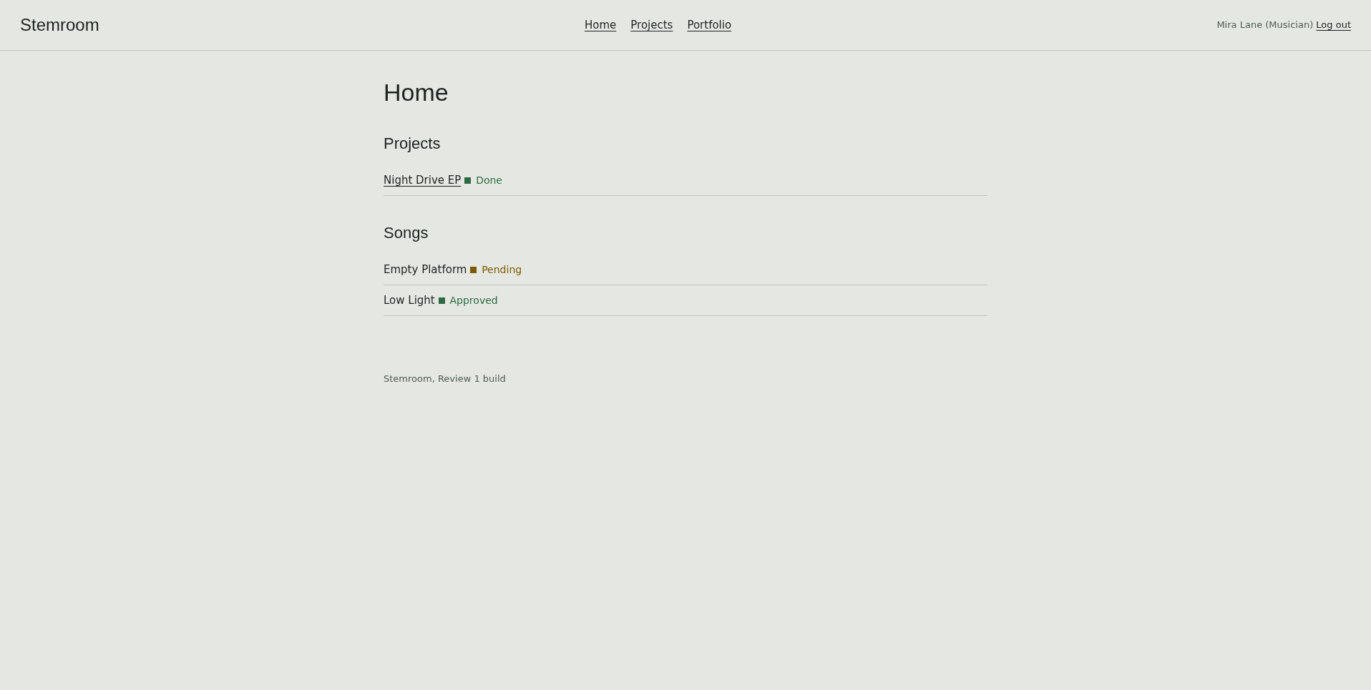
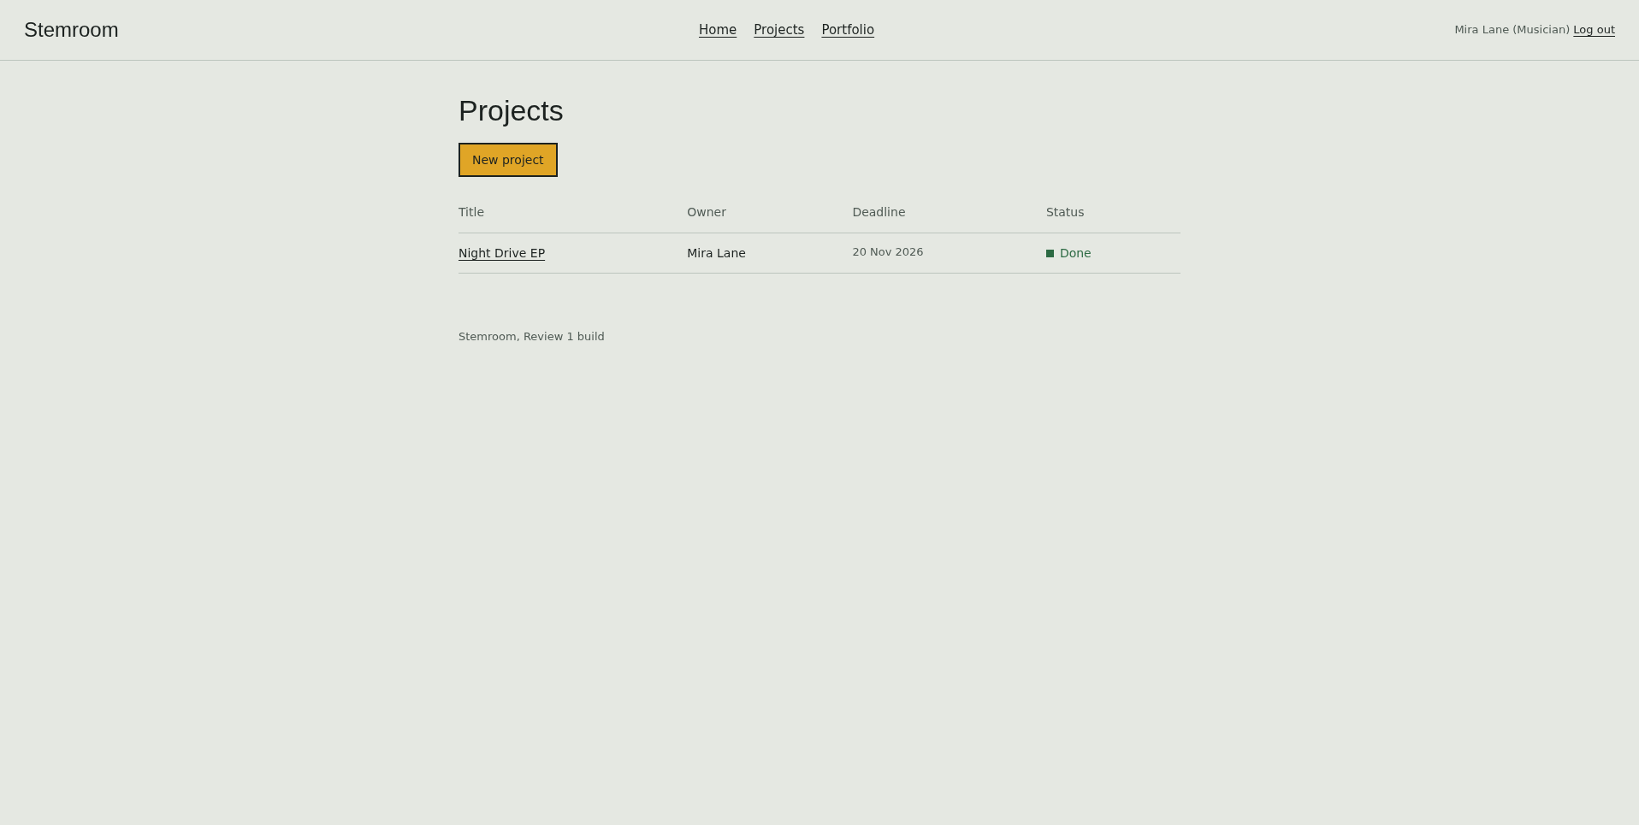
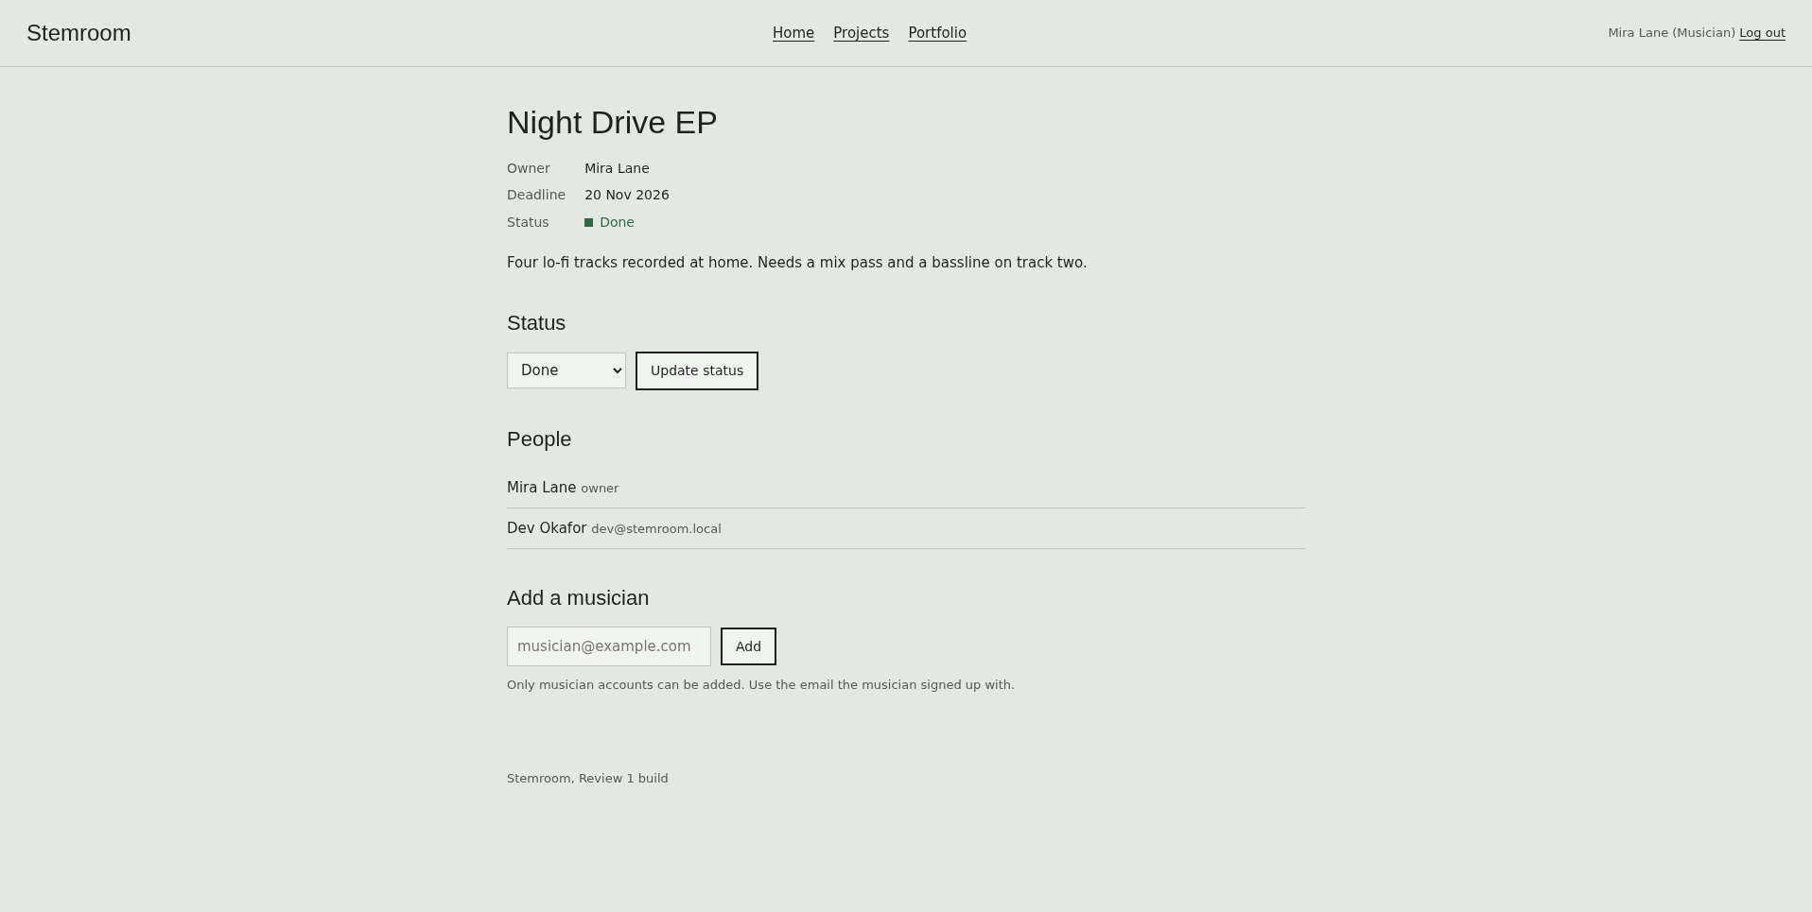
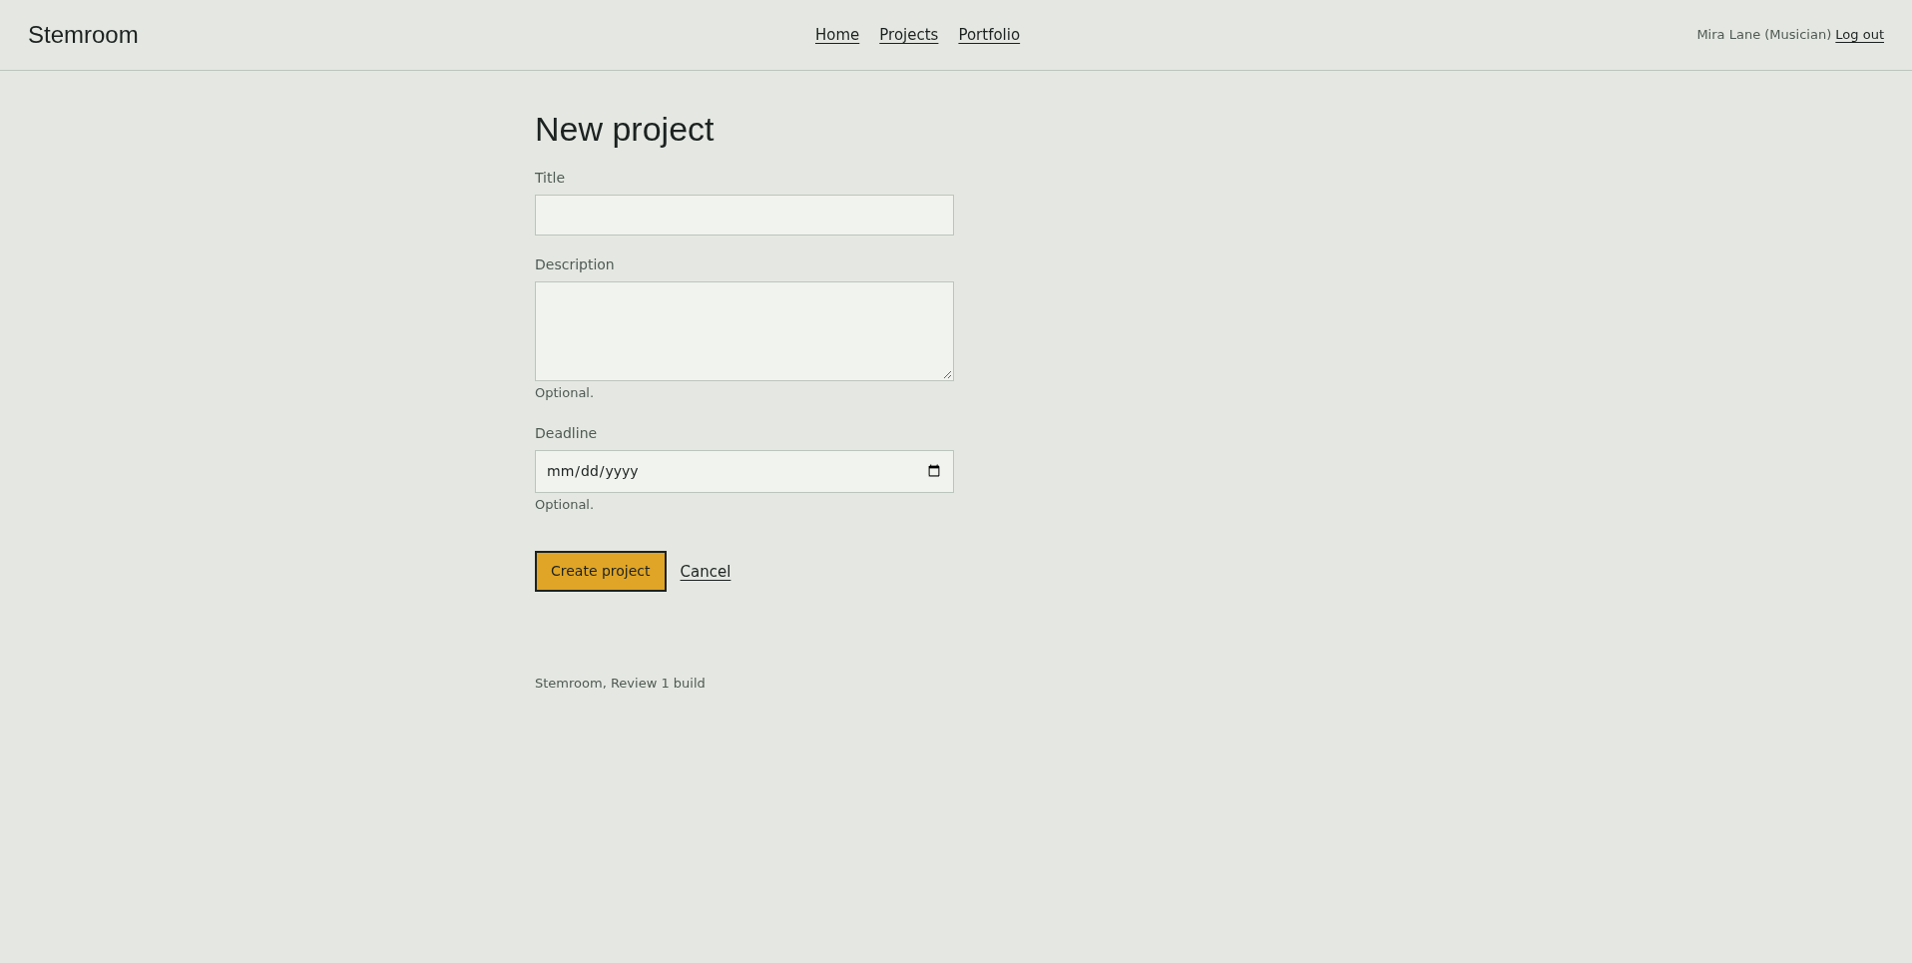
Musician screens

Slide 7
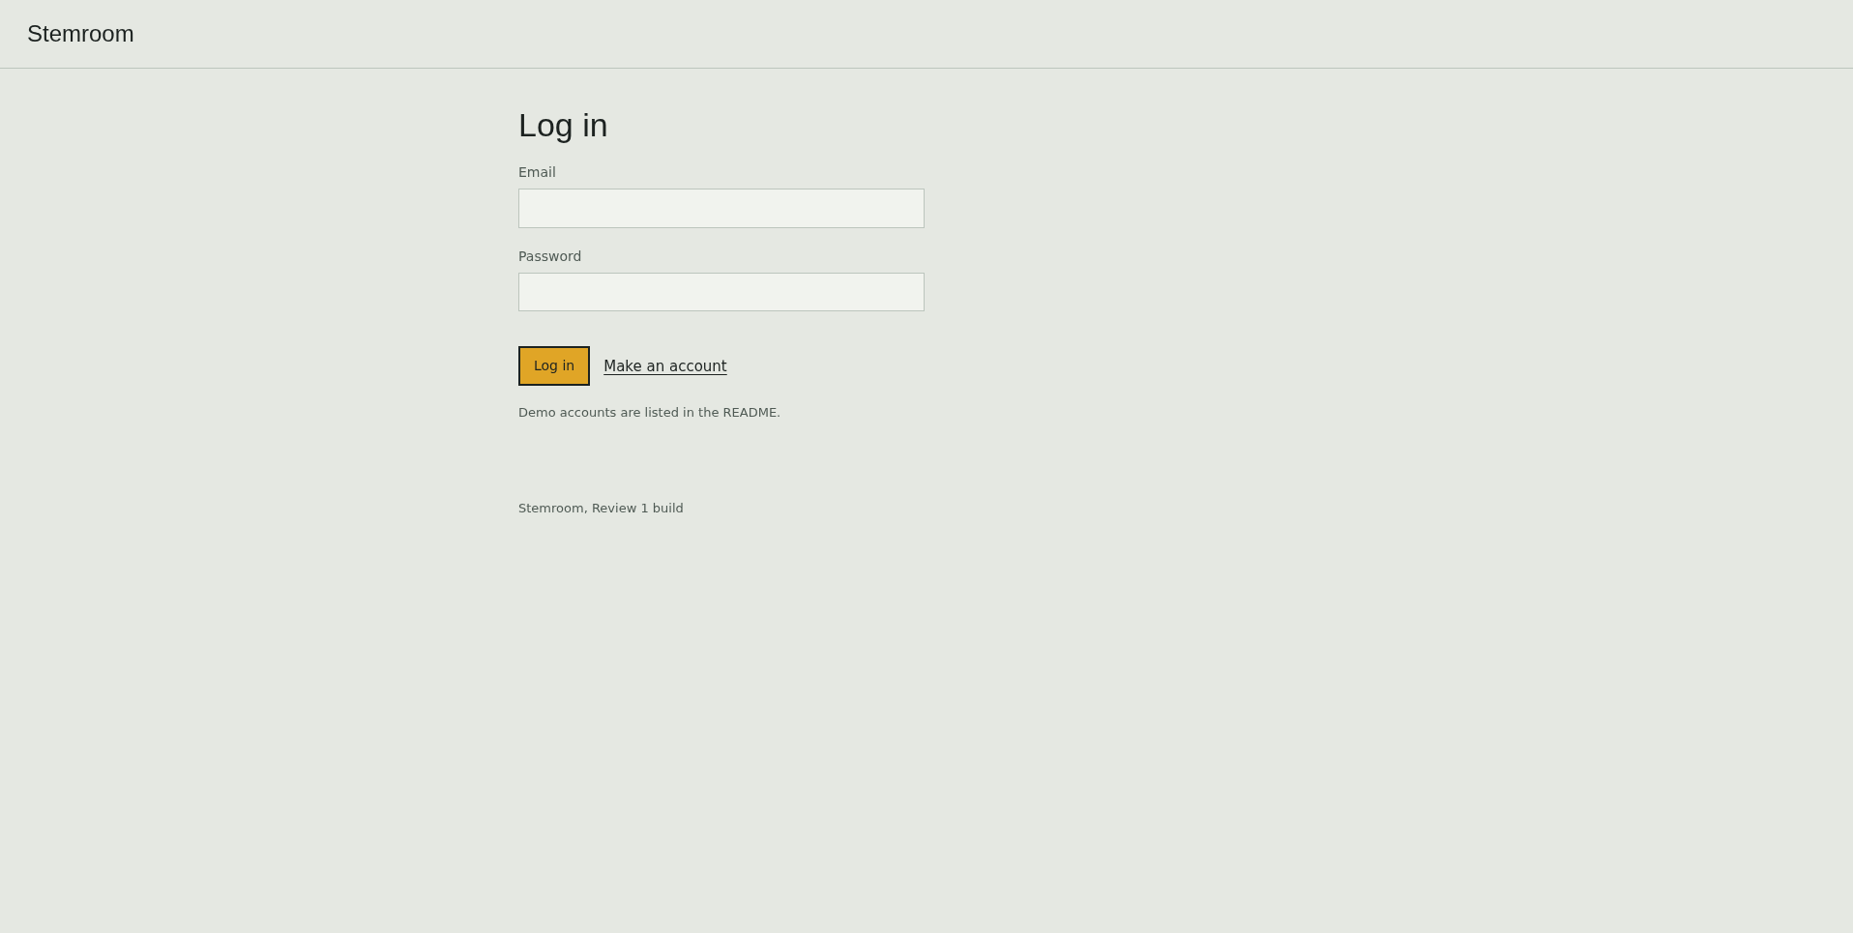
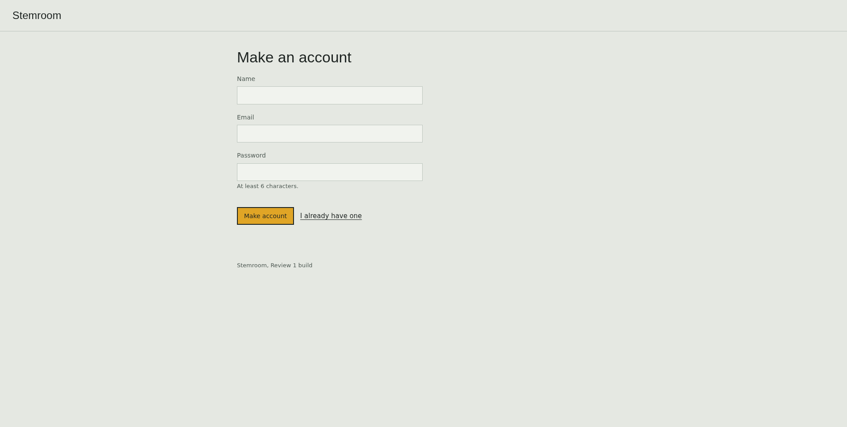
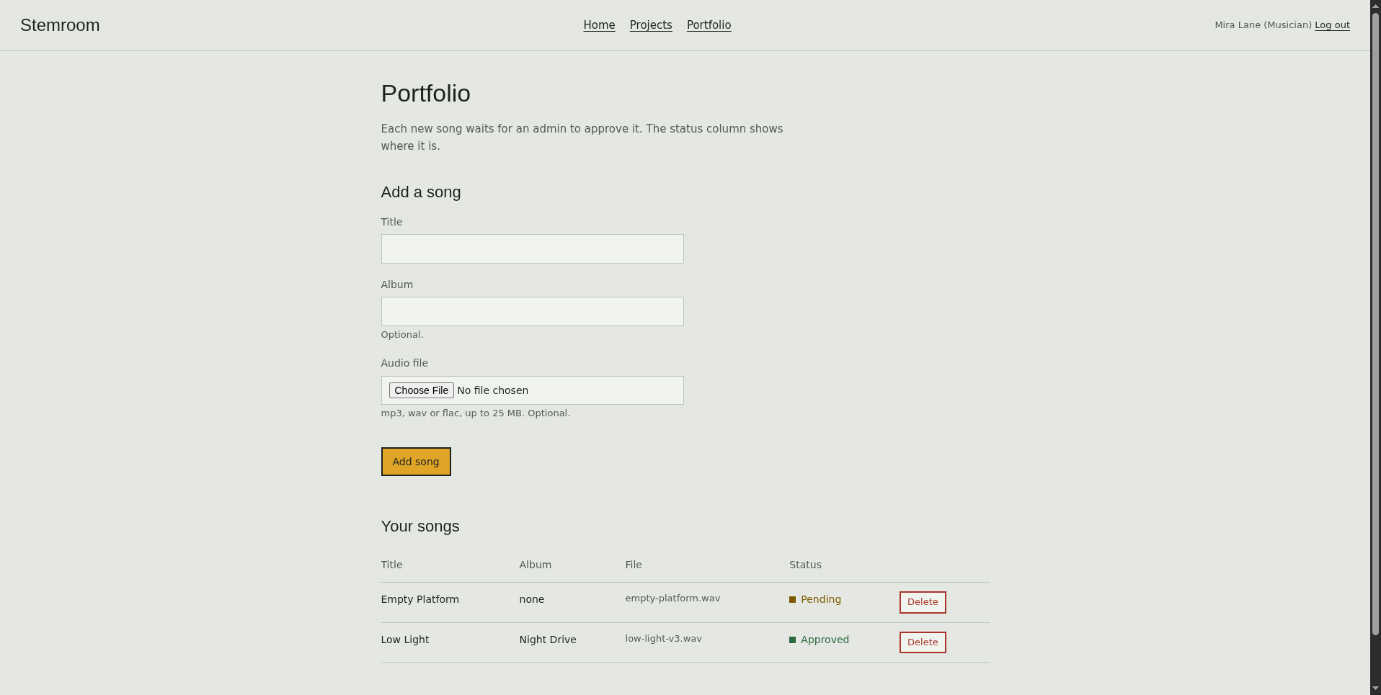
Sign-in and portfolio

Slide 8
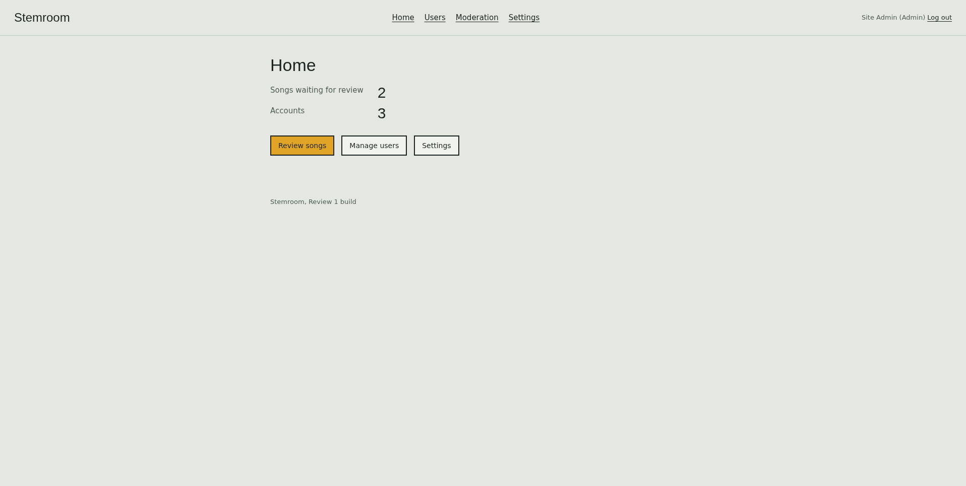
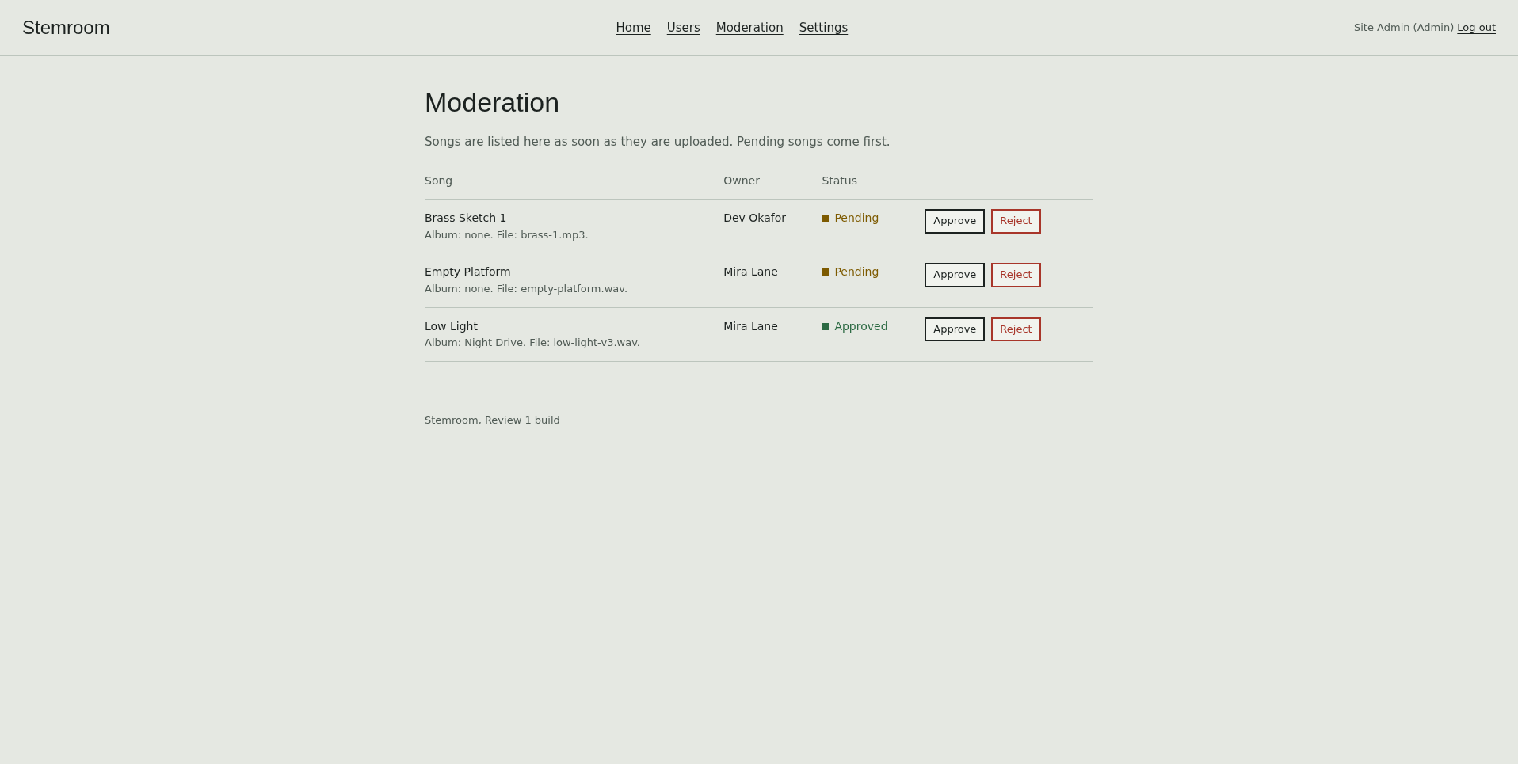
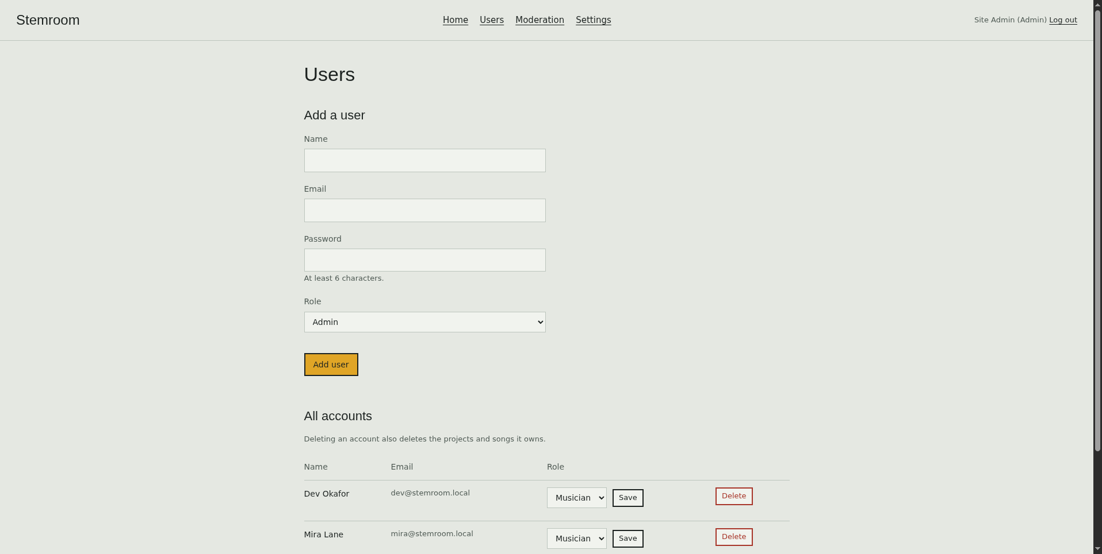
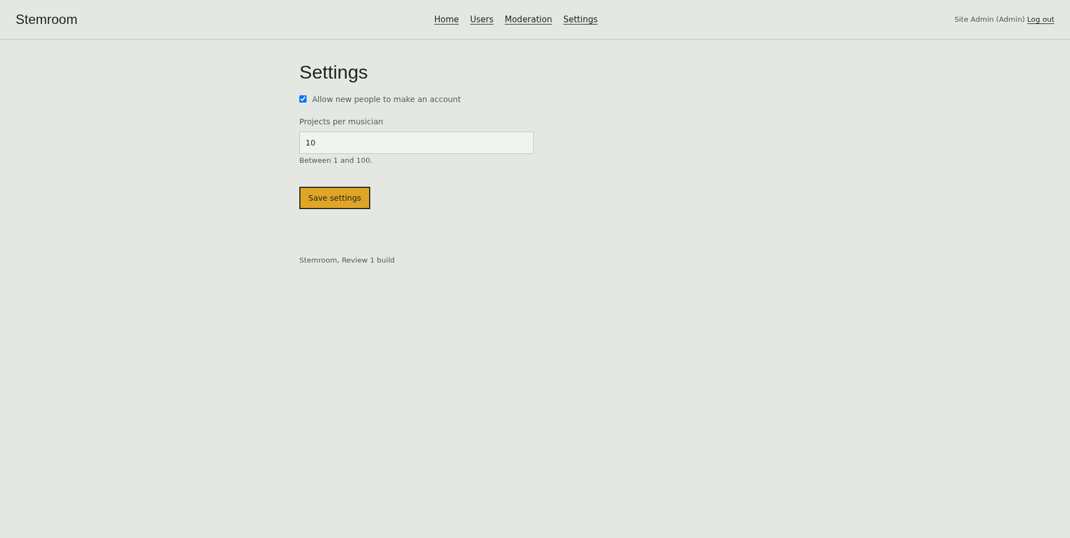
Admin screens

