Slide 1

Seasonal Agriculture Performance Analysis
Om Singhal
Panipat Institute of Engineering & Technology (PIET)
AICTE STU ID : [Add your AICTE Student ID]

Slide 2

PROBLEM STATEMENT
(Agricultural activities are influenced by seasonal variations in environmental conditions, farming practices, resource availability and market conditions. As a result, agricultural performance may differ from one season to another. However, raw agricultural data does not clearly explain how agricultural performance changes across seasons or what patterns can be observed in different seasonal conditions. The problem is to analyze the given agricultural dataset and investigate seasonal differences in agricultural performance by identifying meaningful patterns, trends, relationships and variations within the available data.

Slide 3
Project Description
Data-analytics project on 4,000 farm records across 8 Indian states and 8 crops in three seasons — Kharif, Rabi and Zaid. It explains how yield, resource use and profitability change from one season to another, tests whether the differences are statistically real, and turns the evidence into planning recommendations.
1
2
3
4
5
Explore
Clean & Prepare
Compare Seasons
Test & Relate
Recommend
Structure, types, distributions
Missing values, integrity, outliers, 7 new features
Yield, environment, resources, economics
Kruskal-Wallis, ANOVA, Spearman
Evidence-based seasonal planning
What the project delivers
• Crop-normalised Yield Index so Sugarcane (≈47 t/ha) does not distort cross-crop comparisons
• 10 charts covering yield, environment, inputs, profit, correlations, irrigation and state consistency
• Statistical evidence (p-values, effect size) behind every seasonal claim
• Fully documented Jupyter Notebook plus a cleaned dataset, ready to reproduce on GitHub

Slide 4

WHO ARE THE END USERS?
Farmers & Cooperatives
Agri Planners & Policymakers
Pick crops, irrigation and inputs that suit each season.
State agriculture departments planning seasonal schemes and support.
Extension Officers & Advisors
Agri-Input & Irrigation Companies
Give season-specific, data-backed advice to farmers.
Target seeds, fertilizers and drip/sprinkler solutions by season.
Banks & Crop Insurers
Researchers & Students
Assess seasonal loan and insurance risk (e.g. Zaid loss share 64%).
Reusable, documented analysis of seasonal agricultural data.

Slide 5

Technology Used
Python 3
Pandas
P
P
Core programming language
Loading, cleaning, grouping, pivots
NumPy
Matplotlib
N
M
Numerical operations
Figures and chart export
Seaborn
SciPy
S
S
Statistical visualisation, heatmaps
Kruskal-Wallis, ANOVA, Mann-Whitney, Spearman
Jupyter Notebook
Git & GitHub
J
G
Documented, reproducible analysis
Version control and project hosting

Slide 6
RESULTS
KHARIF Monsoon · wet & humid
RABI Winter · cool & moderate
ZAID Summer · hot & dry
1.11
Yield Index
0.96
Yield Index
0.79
Yield Index
Profit ₹21.9k / ha · Loss-making 42%
Profit ₹10.4k / ha · Loss-making 51%
Profit –₹2.6k / ha · Loss-making 64%
Data preparation
Seasonal_Agriculture_Performance_Analysis.ipynb
• 4,000 farms × 28 columns, 0 duplicates
• 120 missing values fixed: 32 yield (Production ÷ Area), 48 rainfall & 40 soil moisture (season median)
• Integrity checks passed (Production, Revenue, Profit)
• 7 features added, incl. Yield Index & profit/ha
# Yield = Production / Area (missing only)
clean['Yield_Tonnes_Ha'] = clean.Yield_Tonnes_Ha \
.fillna(clean.Production_Tonnes
/ clean.Farm_Area_Hectares)
# Rainfall / soil moisture: season median
for c in ['Rainfall_mm', 'Soil_Moisture_pct']:
clean[c] = clean[c].fillna(clean
.groupby('Season')[c].transform('median'))
# Crop-normalised Yield Index (1.0 = avg)
g = clean.groupby('Crop').Yield_Tonnes_Ha
clean['Yield_Index'] = clean.Yield_Tonnes_Ha \
/ g.transform('mean')

Slide 7
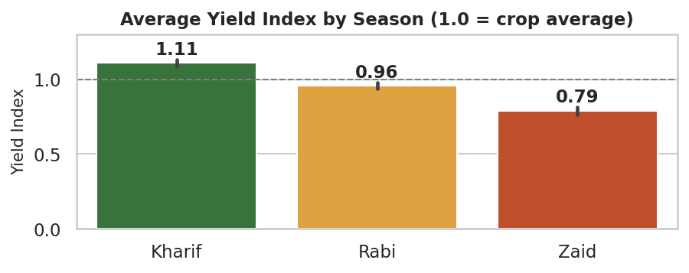
RESULTS
Q1–Q2 · Agricultural performance across seasons
Key findings
• Yield falls Kharif → Rabi → Zaid
• Zaid is 29% below Kharif
• Kruskal-Wallis p ≈ 2×10⁻⁵⁶ — not chance
• All 8 crops and all 8 states follow the same order
Season | Yield Index | vs Kharif | Median
Kharif | 1.11 | — | 1.17
Rabi | 0.96 | –13.8% | 0.99
Zaid | 0.79 | –28.9% | 0.82
Seasonal_Agriculture_Performance_Analysis.ipynb
groups = [clean.loc[clean.Season == s, 'Yield_Index'] for s in SEASON_ORDER]
h, p_kw = stats.kruskal(*groups) # Kruskal-Wallis H = 256.4, p = 2.15e-56
f, p_an = stats.f_oneway(*groups) # ANOVA F = 129.0, p = 5.03e-55
for a, b in combinations(SEASON_ORDER, 2): # pairwise Mann-Whitney, Bonferroni x3
u, p = stats.mannwhitneyu(clean.loc[clean.Season == a, 'Yield_Index'],
clean.loc[clean.Season == b, 'Yield_Index'])
sns.barplot(data=clean, x='Season', y='Yield_Index', order=SEASON_ORDER, errorbar=('ci', 95))

Slide 8
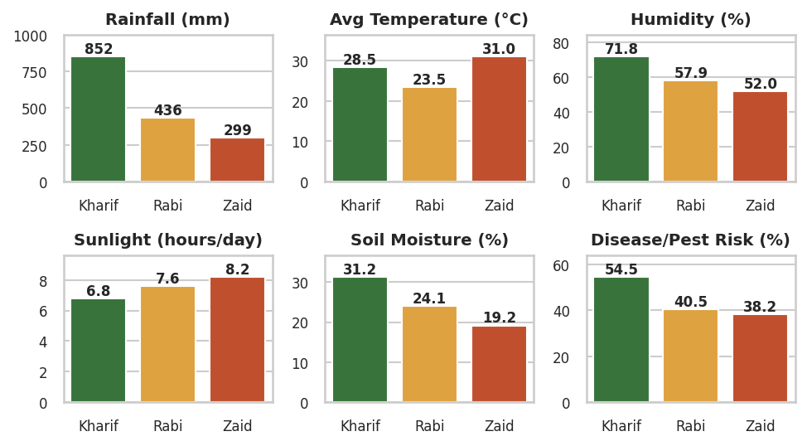
RESULTS
Q3 · Environmental conditions change sharply between seasons
Key findings
• Kharif: 852 mm rain, 72% humidity, highest pest risk (54%)
• Rabi: cool 23.5 °C, 436 mm rain
• Zaid: hot 31 °C, dry 299 mm, soil moisture 19%
• All differences significant (p ≈ 0)
Seasonal_Agriculture_Performance_Analysis.ipynb
env_cols = ['Rainfall_mm', 'Avg_Temperature_C', 'Humidity_pct',
'Sunlight_Hours_Day', 'Soil_Moisture_pct', 'Disease_Pest_Risk_pct']
env = clean.groupby('Season')[env_cols].mean().round(2)
fig, axes = plt.subplots(2, 3, figsize=(14, 7))
for ax, c in zip(axes.ravel(), env_cols):
sns.barplot(data=clean, x='Season', y=c, order=SEASON_ORDER, ax=ax)
# Kruskal-Wallis on every variable: p < 1e-100

Slide 9
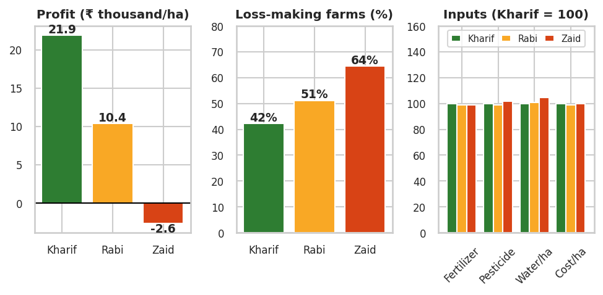
RESULTS
Q4–Q5 · Same inputs every season, very different profit
Key findings
• Fertilizer, pesticide, water & cost per ha are the same in every season (p > 0.05)
• Price is flat (≈ ₹44.7k/t, p = 0.94)
• Profit/ha: ₹21.9k → ₹10.4k → –₹2.6k
• Loss-making farms: 42% → 51% → 64%
Seasonal_Agriculture_Performance_Analysis.ipynb
eco = clean.groupby('Season').agg(
Avg_Profit_per_ha=('Profit_per_ha', 'mean'),
Median_Profit_per_ha=('Profit_per_ha', 'median'),
Loss_Making_Share_pct=('Loss_Making', lambda x: x.mean() * 100)).round(1)
res_cols = ['Fertilizer_kg_ha', 'Pesticide_Litre_ha', 'Water_per_ha', 'Cost_per_ha']
res = clean.groupby('Season')[res_cols].mean().round(2)
stats.kruskal(*[clean.loc[clean.Season == s, 'Cost_per_ha'] for s in SEASON_ORDER]) # p = 0.08

Slide 10
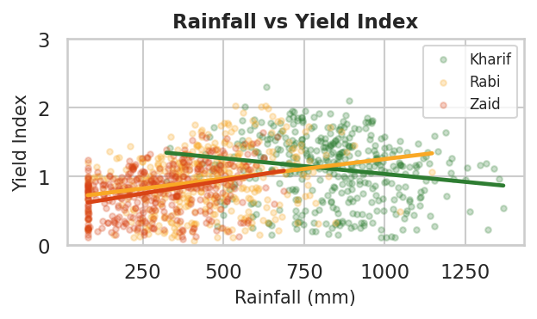
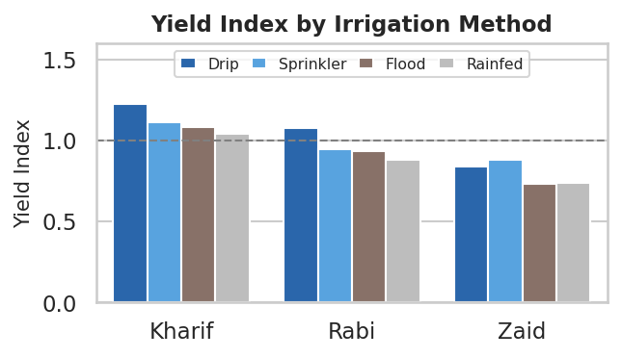
RESULTS
Q6–Q9 · Rainfall behaves differently by season; irrigation choice matters
Rainfall flips sign: Kharif ρ = –0.19, Rabi +0.27, Zaid +0.31 — excess water hurts in monsoon, scarcity limits yield in dry seasons.
Irrigation: drip leads in Kharif/Rabi (+18% / +22% vs rainfed); sprinkler leads in Zaid; flood & rainfed lag in every season.
Seasonal_Agriculture_Performance_Analysis.ipynb
pred = ['Rainfall_mm', 'Avg_Temperature_C', 'Humidity_pct', 'Soil_Moisture_pct', ...]
corr = pd.DataFrame({s: clean[clean.Season == s][pred + ['Yield_Index']]
.corr(method='spearman')['Yield_Index'] for s in SEASON_ORDER})
irr = clean.pivot_table(index='Irrigation_Method', columns='Season',
values='Yield_Index', aggfunc='mean')
# Rainfall vs Yield (Spearman): Kharif -0.191 | Rabi +0.271 | Zaid +0.308
# Drip advantage over Rainfed: Kharif +17.7% | Rabi +21.9% | Zaid +14.3%

Slide 11
Recommendations & Future Scope
Recommendations
Future Scope
• Plan crops by season: Chilli & Sugarcane profit in every season; Wheat, Rice & Maize are high-risk in Zaid
• Match irrigation to season: drip in Kharif/Rabi, sprinkler/drip in Zaid
• Season-specific input plans: heat & drought management in Zaid, drainage in Kharif
• Boost Kharif pest surveillance (risk ≈ 54%)
• Review the cost–price gap for Wheat & Rice (59–92% loss-making)
• Predictive models (Random Forest / XGBoost) for yield & profit
• Multi-year data to study climate trends and year-on-year change
• Interactive dashboard in Power BI or Streamlit for planners
• Crop-recommendation system by season, state and soil
• Validate on real data from government agriculture sources

Slide 12
GitHub Link
Add your GitHub repository URL here before submission

Slide 13
VOIS Course completion certificate -
Course name- Data Visualization

Slide 14
Thank you
.
.

