Slide 1



Enhancing Intelligence Workflows: Neuro-Symbolic AI for Disinformation Detection
Omar Jagana
294820 Applied Security Research Project
Massey University
22 August 2025

Slide 2
Problem Space & Objective The Challenge in Intelligence Analysis
Problem: Offensive AI (e.g., LLMs, deepfakes) outpacing defensive detection capabilities.
Operational gap
ML/DL models = accurate but opaque (black box problem).
Analyst requirement
Interpretability, trust, evidential accountability.
Research Aim
Assess Neuro-Symbolic AI for disinformation detection in intelligence workflows.
Objectives
Evaluate efficacy of NeSy AI vs. black box models.
Assess operational usability and interpretability.
Identify integration challenges in real-world workflows.
Notes:
The problem I’ve been investigating is the widening asymmetry between offensive and defensive capabilities in the information domain.
Adversaries now use AI from large language models to deepfakes to generate and spread highly convincing disinformation at scale, overwhelming traditional verification processes and undermining public trust.
This creates an operational gap. While current machine learning and deep learning systems achieve strong accuracy, their black-box nature makes them unusable in politically sensitive or evidentially demanding contexts. Intelligence analysts need systems they can interrogate, trust, and defend.
This brings us to the research aim: to assess whether Neuro-Symbolic AI can bridge this gap by combining the predictive power of neural models with the transparency of symbolic reasoning.
To pursue this aim, my study has three objectives:
First, to compare the performance of Neuro-Symbolic AI against black-box models;
Second, to evaluate operational usability and interpretability from the analyst’s perspective;
And third, to identify the integration challenges of deploying such systems in real-world intelligence workflows.

Slide 3
Research Question
To what extent can Neuro-Symbolic AI enhance disinformation detection in intelligence analysis.
And
How can its integration meet operational demands for interpretability, trust, and evidential accountability?
Notes:
This leads to my central research question: to what extent can Neuro-Symbolic AI enhance the detection of disinformation within intelligence analysis workflows, and how can its integration meet the operational demands for interpretability, trust, and evidential accountability?

Slide 4
Refining The Research Scope
Domain: Intelligence analysis within cognitive warfare.
Focus: Disinformation detection workflows.
Initial Scope: Detection and counter-disinformation.
Refined Scope: Detection only → operationally precise & feasible.
Why NeSy AI? Combines:
Neural networks → pattern recognition (accuracy).
Symbolic reasoning → transparency, interpretability.
Notes:
In my initial proposal, I set out to examine both disinformation detection and counter-disinformation within the context of cognitive warfare. However, expert and supervisory feedback highlighted that these are operationally distinct intelligence functions. They require different tradecraft, resourcing, and evaluation metrics. Attempting both would have risked overextending the project.
I therefore refined the scope exclusively to disinformation detection within intelligence analysis workflows. This sharper focus enables me to interrogate one defined operational problem space, while aligning the project with the intelligence community’s core demands: transparency, evidential accountability, and operational reliability.
The refined aim of the study is to assess the feasibility of Neuro-Symbolic AI for disinformation detection. Neuro-Symbolic AI combines neural pattern recognition where systems excel at spotting statistical regularities with symbolic reasoning, which brings logic, rules, and explainability into the process.
In practical terms, this means all technical experimentation, SME interviews, and case study analysis have been oriented around one central question: can Neuro-Symbolic AI provide disinformation detection that is not only accurate, but also transparent, trustworthy, and operationally viable in intelligence settings?

Slide 5
AI, Deep Learning, Black Box, and Neuro-Symbolic AI
Artificial Intelligence (AI): Broad field — systems that perform tasks requiring human-like intelligence (analysis, decision-making).
Deep Learning (DL): A subset of AI using neural networks to identify patterns in very large datasets (e.g., detecting disinformation in text, video, images).
Black Box Models: DL systems that generate outputs without revealing why — accurate, but opaque and difficult to trust in intelligence workflows.
Neuro-Symbolic AI (NeSy AI): Hybrid approach → DL for pattern recognition + symbolic logic for reasoning. Produces interpretable, transparent outputs.
Notes:
“Notwithstanding that this research sits firmly in the field of international security and intelligence studies, it is essential to first clarify some of the technical terms that underpin the study.
When we talk about Artificial Intelligence, or AI, we simply mean computer systems that can do tasks we usually associate with human intelligence like recognising faces, translating languages, or in our case, detecting disinformation.
One of the most common forms of AI today is Deep Learning. These systems are very good at finding patterns in massive amounts of data for example, spotting that a news headline looks suspicious based on thousands of previous examples.
But there’s a big drawback: these systems are usually what we call ‘black boxes.’ They might tell you, ‘this is fake,’ but they don’t explain why. And in intelligence work, that’s a problem. Analysts can’t base national security decisions on something they can’t interrogate or defend.
That’s where Neuro-Symbolic AI comes in. It’s a newer approach that combines two strengths: deep learning for spotting patterns, and symbolic reasoning basically logical rules that explain why the system made a decision. This matters because it makes the AI’s judgement transparent and usable in real-world intelligence settings, where trust and accountability are critical.”

Slide 6



NEURO-SYMBOLIC AI
NEURAL NETWORKS
+
SYMBOLIC BASED AI
=
NEURO SYMBOLIC AI
The complexity to handle large, unstructured data
Rule based approach with easy interpretability
A hybrid approach combining best features
Notes:
Neural networks are remarkable and we’ve proven what they can do.​ Whether it’s CNNs for vision, RNNs for sequences, or transformers for everything else, they’ve become the default perception layer in modern AI.​
​
These models are trained on terabytes of raw, unstructured data. They are statistical machines, optimized to minimiSe loss, not to model truth.​ What they’re good at:​
Pattern recognition​
Feature abstraction​
GeneraliSation from massive datasets​
​
But we are aware of the limitatiosn based on our desire to understand things​
​
Symbolic Reasoning →​
Symbolic systems from expert systems in the '70s to logic programming in Prolog were built with structure at the core.​
​
They manipulate symbols, obey rules, enforce constraints. They don’t learn from data they encode knowledge directly.​
​ What they’re good at:​
Formal logic and deduction​
Multi-step planning​
Causal reasoning and validation​
Representing things like “IF income < X AND history = clean THEN approve_loan​
​
But symbolic AI breaks down when:​
The input is noisy, high-dimensional, or ambiguous​
You need to scale across diverse contexts​
Rules must evolve dynamically from new data​
​
In a word: symbolic AI is smart but blind, and neural AI is perceptive but dumb.​
​
What we’re seeing now is a convergence ​
​
Neuro-Symbolic AI combines these two paradigms to produce systems that can both learn from raw data and reason over structured knowledge.​
​
It’s not just about model accuracy, it’s about operational viability:​
​
Can the model explain itself?​
Can it enforce logic?​
Can it integrate prior knowledge?​
Can it generalise from less data?​
​
In risk-driven domains, finance, intelligence, medicine, defence, these aren't academic questions. They're existential.​
​
And this convergence isn’t speculative. It’s already underway:​
​
In symbolic overlays for language models​
In systems that mix knowledge graphs with neural embeddings​
In AI agents that blend reasoning and perception for strategic planning​
​
This is the shift:​ From learning to understanding.​ From correlation to causation.​ From prediction to justification.​
In the next section, we’ll unpack how this actually works, the methods and algorithms that make Neuro-Symbolic AI possible.​
​
​

Slide 7
Why Nesy AI
Operational standards in intelligence
Decisions must be traceable, auditable, reproducible, and contestable (evidential accountability; briefing defensibility).
Limits of LLMs / AI agents
Opaque inner workings; non-deterministic outputs; prone to hallucination and miscalibrated confidence (Lipton 2016; Doshi-Velez & Kim 2017).
Provenance ambiguity: hard to show “where a fact came from” across long contexts/tool calls.
Attack surface: prompt-/tool-injection, data contamination, adversarial paraphrase; brittle under distribution shift.
Agents add orchestration but do not yield a defensible reasoning trail; tool logs ≠ reasoning logic.
MCP is plumbing (context/tool routing), not a solution to interpretability or evidential standards.
Why Neuro-Symbolic AI
Hybrid: neural encoders for pattern recognition + symbolic layer for rule-based, human-readable decision paths (Marcus & Davis 2019; Manhaeve et al. 2018; Mao et al. 2019).
Encodes domain knowledge (e.g., source reliability priors, claim types, hedging cues), supports abstain/route-to-analyst logic.
Auditable: stable rule paths, explicit thresholds, and calibration; updatable without full retraining.
Trade-offs & fit
May trade a few points of raw accuracy for explainability + evidential defensibility (Rudin 2019).
Best used where decisions must be justified: contested narratives, politically sensitive briefs, legal scrutiny.
Complementarity
Use LLMs upstream (triage, extraction, drafting).
Use NeSy at the decision point where explanations are required.
Notes:
“Before asking a model to influence an assessment, intelligence standards require that I can trace how it reached a conclusion, audit it later, and defend it under questioning. Modern LLMs and agent frameworks are powerful, but they’re opaque and non-deterministic. They sometimes sound confident when they’re wrong, and even when they’re right, they rarely give a reasoning trail that matches evidential standards. Agents and protocols like MCP help organise tools and context, but they don’t make the underlying decision explainable.
Neuro-symbolic AI addresses that gap. We still use neural models for signal detection, but we pass their outputs through a symbolic reasoning layer—explicit rules and thresholds informed by tradecraft. That layer produces a human-readable path: which cues were used, which thresholds triggered, and when we abstain and escalate to an analyst. It’s auditable, tunable, and easier to defend in a briefing.
There is a trade-off: sometimes you give up a few points of headline accuracy. But in intelligence work, a slightly less accurate model that you can explain and challenge is more operationally valuable than a black box you can’t defend. LLMs remain useful upstream for triage and drafting; we reserve NeSy for the decision point where accountability matters.”

Slide 8









SYMBOLIC (CLASSICAL) AI:
NEURAL NETWORKS
Pioneered by Newell and Simon, initially used in expert systems for the time. Uses symbol manipulation and logical rules to emulate cognitive thinking Innovative for the time, great at processing structured data Struggles with complex, unstructured data
First proposed by Warren McCullough and Walter Pitts in 1944, with successful implementations starting from late 80s Mimics the neural networks in human brains with input and output layer with decision making in hidden layers Can handle complex tasks and unstructured data Complexity of model can make it difficult to understand logic and reasoning of outputs
Notes:
Before neural networks dominated the AI landscape, the field was founded on a very different paradigm Symbolic AI.​
​
This was the first wave of artificial intelligence, emerging in the 1950s through the 1980s. The goal was bold and clear: replicate human intelligence using formal logic and symbolic reasoning.​
​
Systems like MYCIN (1972) and SHRDLU (1970) didn’t "learn" from data. They used explicit, hand-coded rules, often in the form of if-then logic, propositional calculus, and inference engines, to reason over structured knowledge.​
​
For example, MYCIN, one of the earliest expert systems for diagnosing blood infections, used over 450 hand-crafted rules to emulate the reasoning of infectious disease specialists. [Shortliffe, 1974]​
​
The power here wasn’t in pattern recognition, it was in transparent, explainable reasoning. Every conclusion had a logical trail, often with confidence scores attached.​
​
But Symbolic AI had its limits:​
​
It couldn’t scale with unstructured data.​
It required extensive domain modeling.​
And it was brittle in the face of ambiguity or noise.​
​
Still, it laid the conceptual groundwork for what AI could be: a system capable of abstract thought, planning, analogy, and logic — all of which are still aspirational goals for deep learning today.​
​
In many ways, we're now circling back not to revive Symbolic AI as it was, but to integrate what it got right into the deep learning systems that dominate the present.​
​

Slide 9
Literature Review – Key Insights
Disinformation in Cognitive Warfare
Used strategically to destabilise, influence, and erode trust (Rid, 2022; Shulsky, 1991).Accelerated by generative AI technologies like deepfakes and LLMs (Barman et al., 2024; Mysyshyn, 2024).
Limitations of Current AI Detection
ML/DL models offer high accuracy but are largely opaque (“black box”), hindering trust in intelligence workflows (Hassija et al., 2023; Abgrall et al., 2024).
Neuro-Symbolic AI (NeSy AI)
Combines neural networks (pattern recognition) with symbolic logic (rule-based reasoning) to enhance interpretability (Marcus & Davis, 2019; Valiant, 2008).
Presents theoretical promise in aligning accuracy with transparency (Bouzime et al., 2025; Turing Institute, 2025).
Gap in Existing Research
Few empirical studies examine NeSy AI in real-world intelligence contexts (Ofosu-Asare, 2024).
Interpretability is often cited but rarely treated as a measurable, operational performance metric (Afroogh et al., 2024).
Notes:
The literature consistently frames disinformation as a weapon of cognitive warfare. Rid (2022) describes it as a core non-kinetic instrument used by both state and non-state actors to destabilise political systems. This aligns with Shulsky’s earlier framing of disinformation as a form of covert action.
Recent scholarship highlights how Generative AI has supercharged these operations. For example, Barman et al. (2024) and Deppe & Schaal (2024) show how large language models and deepfake technologies allow adversaries to produce convincing false content at scale. Mysyshyn (2024) points specifically to their use in the Russia–Ukraine conflict. Give example here.
On the defensive side, there is broad agreement that current AI detection tools fall short. Chen et al. (2022) and Hamed et al. (2023) demonstrate the power of deep learning to recognise patterns in disinformation, but scholars like Hassija et al. (2023) and Abgrall et al. (2024) stress the ‘black box’ problem: these models are accurate, but they can’t explain their outputs. As Williamson & Prybutok (2024) argue, this lack of interpretability fundamentally undermines trust in intelligence workflows.
This is where Neuro-Symbolic AI enters the debate. Marcus and Davis (2019) argued that if AI is to be trusted, it must include transparency as part of its architecture. Earlier foundations by Valiant (2008) and others in the cognitive sciences reinforce this, showing the theoretical importance of blending learning with symbolic reasoning. More recent voices, such as those from the Alan Turing Institute and Bougzime et al. (2025), highlight how this hybrid approach can potentially offer both accuracy and explainability.
However, as Afroogh et al. (2024) and Ofosu-Asare (2024) point out, there is a major gap: very little empirical research tests neuro-symbolic AI in operational intelligence contexts. And even where interpretability is discussed, it’s usually treated as a theoretical principle, not an operational performance metric. That gap is exactly what motivates my research: empirically evaluating whether Neuro-Symbolic AI can truly deliver both detection effectiveness and operational transparency in intelligence workflows

Slide 10

Methodology - Research Design
Mixed-Method Research Design
Qualitative
Semi-structured interviews with subject matter experts in intelligence analysis, cognitive warfare, and AI ethics.
Purpose: capture operational realities, trust requirements, and integration challenges for AI in disinformation detection.
Quantitative
Adaptation and testing of AI models on benchmark disinformation datasets (LIAR) to evaluate detection performance.
Comparative testing between black box ML/DL and neuro-symbolic AI models.
Operational Contextualisation
Case studies: Russia–Ukraine conflict, US election interference, African disinformation campaigns.
Purpose: ensure model evaluation reflects real-world adversarial tactics and geopolitical nuances.
Evaluation Metrics
Detection performance: Accuracy, F1-score.
Interpretability: measured through both explainability metrics and SME judgement.
Operational usability: assessed via expert feedback on the applicability of outputs to intelligence workflows.
Notes:
The methodology was deliberately designed as a mixed-method approach. The reason for this is that the problem we are dealing with is not purely technical, nor purely social → it sits at the intersection of AI and intelligence practice. To evaluate it properly, we needed both sides of the picture.
On the qualitative side, I conducted semi-structured interviews with subject matter experts in intelligence analysis, cognitive warfare, and AI ethics. These conversations identified operational requirements for AI in disinformation detection , above all, the need for interpretability and evidential accountability.
On the quantitative side, I developed and tested both a black-box deep learning model and a neuro-symbolic AI model using the LIAR benchmark dataset. For example, the models were asked to classify statements such as:
‘The U.S. has admitted 250,000 Syrian refugees in the past two years.’
A black-box model returned only a label ‘false’. The neuro-symbolic model also labelled it ‘false’ but provided a reasoning chain, drawing on symbolic rules such as: “verified government data places the number at fewer than 20,000”. This difference illustrates why interpretability matters in intelligence workflows.
To ensure relevance beyond benchmark data, I also fed in case study material. For instance:
– From the Russia–Ukraine conflict, I used fabricated deepfake transcripts of Ukrainian leaders allegedly surrendering.
– From the U.S. elections, I tested false claims of ballot tampering circulating on social media.
– From African disinformation campaigns, I used fabricated vaccine misinformation posts that exploited local dialects and cultural framing.
Feeding these into the models allowed me to observe not just whether the systems detected them as false, but whether the reasoning provided was operationally credible and usable by analysts.
Finally, I evaluated performance across three dimensions: accuracy and F1 score, interpretability (both computationally and as judged by experts), and operational usability, asking whether the outputs were something an analyst could defend in reporting to decision-makers.

Slide 11

Models, Data & Tools
Models
Baseline: DistilBERT (black box ML/DL)
NeSy AI: DistilBERT + symbolic reasoning layer
Data
LIAR benchmark dataset (labeled real/fake statements)
Supplemented with case study material (Ukraine conflict, U.S. elections, African disinformation).
Preprocessing:
Text cleaning, tokenisation, normalisation
Tools & Infrastructure
Python, PyTorch, TensorFlow, Hugging Face Transformers.
Cloud compute for rapid iteration and scalability.
Notes:
“To operationalise the research, I worked with two models: a baseline black-box DistilBERT and a neuro-symbolic AI system that combined DistilBERT embeddings with a symbolic reasoning layer.
The core dataset was the LIAR benchmark, which provides labelled political statements, but I expanded this with curated case study material from Ukraine, U.S. elections, and African disinformation campaigns to reflect adversarial tactics in real-world international security contexts.
Preprocessing steps included cleaning text, tokenisation, and normalisation to ensure consistency before feeding data into the models.
I built and trained the models in Python, using PyTorch, TensorFlow, and HuggingFace Transformers, and scaled experiments on cloud infrastructure to handle compute-intensive tasks.
Visual suggestion:
A 3-column layout with icons:
Models → AI chip icon
Data → database/documents icon
Tools → Python logo / cloud icon
This reinforces the workflow visually.

Slide 12



TEST SETUP
DATA LIAR benchmark dataset labelled political statements as true or false, adapted to binary classification for operational clarity.​
MODEL ARCHITECTURE
Simple schematic of a transformer for deep neural network: ​Input → Embedding → Hidden Layers → Output
TOOLS
Python, PyTorch, TensorFlow, Hugging Face Transformers. Cloud compute for rapid iteration and scalability.
Notes:
To explore how Neuro-Symbolic AI performs in adversarial information settings, we built and evaluated two models.​
​
Model 1: Black Box Baseline​
Our baseline was a DistilBERT model a distilled version of BERT, widely used for classification tasks.​ ​
It represents the kind of high-performing, deep learning system you’ll find deployed today in many detection pipelines: efficient, powerful and largely opaque.​
​
Model 2: Neuro-Symbolic AI​
The second model used the same neural architecture DistilBERT but with a key difference:​ We added a symbolic reasoning layer, specifically a decision tree trained on the output embeddings.​ This allowed us to preserve model performance while generating human-readable, rule-based decisions.​ ​
In intelligence environments, this matters accuracy without traceability is operationally unusable.​
​
Dataset: LIAR Benchmark​
We used the LIAR benchmark, a labelled dataset of political claims classified as true or false.​ We adapted it to a binary format for clarity and speed matching how analysts work when under pressure to assess veracity.​
It’s also contextually appropriate these are the types of narratives we’ve seen weaponised in information operations across:​
Ukraine​
US elections​
Campaigns in parts of Africa​
​
Tools & Infrastructure​
The models were built using:​
Python​
PyTorch​
TensorFlow​
Hugging Face Transformers​
​
We ran everything in a cloud-based environment, which allowed us to:​
Iterate quickly​
Scale training as needed​
And simulate how these tools might perform in a real intelligence workflow​
We weren’t reinventing the wheel.​
​ We took proven architectures and adapted them to the operational requirement for interpretability, based on direct feedback from users in the field.​
The result: two models, same data, same infrastructure but fundamentally different in how they justify their decisions.​
​

Slide 13
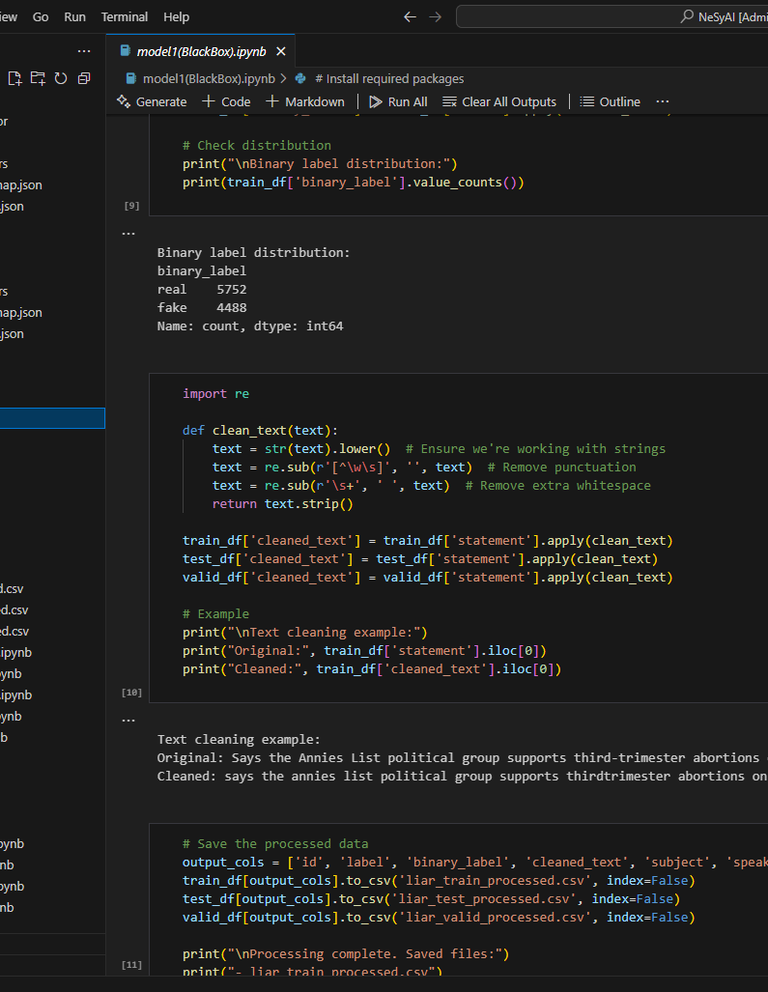
Model 1: Traditional ML/DL
ArchitectureTransformer encoder: distilbert-base-uncased (6 layers, 12 heads)Classification head: 2-class softmax (REAL / FAKE)BuildDataset: LIAR → binary labels (REAL vs FAKE)Tokenisation: WordPiece, max length 256Training: AdamW, lr=2e-5, batch 16, 3 epochs, early stopping (F1)Calibration: temperature scaling; abstain band [0.45, 0.55]DeploymentOutputs: label + calibrated probabilityServed via Streamlit/Gradio for analyst testing
Notes:
Our baseline system was built on DistilBERT, a compressed version of BERT with six transformer layers. We fine-tuned it on the LIAR dataset, collapsing the six original labels into a binary scheme of REAL versus FAKE. We deliberately kept preprocessing minimal, focusing on tokenisation with a maximum length of 256 tokens to preserve as much linguistic nuance as possible.
Training was conducted with AdamW optimisation, a learning rate of 2e-5, and batch sizes of 16/32. Early stopping was based on weighted F1 score to prevent overfitting. Post-training, we calibrated the output probabilities using temperature scaling to improve reliability, and introduced an abstain band between 0.45 and 0.55 so that low-confidence outputs could be routed to human analysts.
For deployment, we wrapped the model in a lightweight inference API with Streamlit/Gradio, allowing analysts to see both the binary label and the calibrated probability. This gave us a realistic operational baseline against which we could later compare the neuro-symbolic model
Model:-→ https://colab.research.google.com/drive/1nhCdXuPvqgwJEph-_KhntzRqxmuoRJDg#scrollTo=7946FDnpQcP0

Slide 14
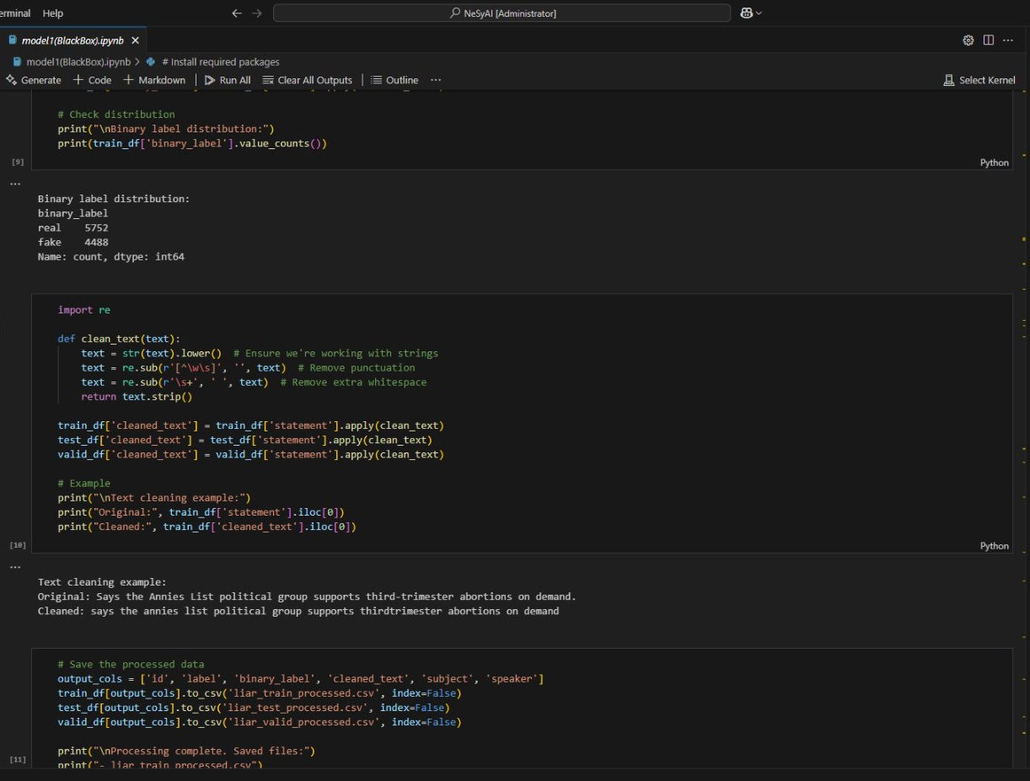
MODEL 1: TRADITIONAL BLACK BOX MODEL
ARCHITECTURE
DistilBERT transformer model for sequence classification
FUNCTIONALITY
Input: Political statements from LIAR dataset
Pre-Processing: Text cleaning, tokenization, binary label mapping
Training: Fine-tuned for real/fake classification (supervised)
Output: Prediction probability (True/False)
Notes:
This is Model One — our black box baseline, built using DistilBERT, a compressed version of the BERT transformer architecture optimised for classification tasks.​
The goal was to establish a performance benchmark using the kind of architecture commonly found in text-based detection tools today highly optimised, pretrained, and proven in production.​
​
​
The pipeline was straightforward:​
We took political statements from the LIAR dataset​
Cleaned and normalised the text​
Tokenised the input​
Fine-tuned the model for binary classification true or false.​
​
The model learns patterns in language associated with truthfulness or deception and makes a judgement.​
​
In terms of performance:​
It was fast to train​
Delivered strong results on the benchmark​
And it scales well in deployment environments​
But the limitations were immediate and familiar:​
The model can’t tell you why a statement is true or false​
​
It can’t point to evidence, rules, or inconsistencies​
And if it’s wrong you’ve got no way to interrogate the logic behind the failure​
This is the heart of the problem with black-box AI in operational settings:​
​
Analysts are left in the dark​
There’s no evidential trail​
​
And the system, however powerful, is fundamentally non-dialogueable​
​
​
Model:-→ https://colab.research.google.com/drive/1nhCdXuPvqgwJEph-_KhntzRqxmuoRJDg#scrollTo=7946FDnpQcP0​

Slide 15
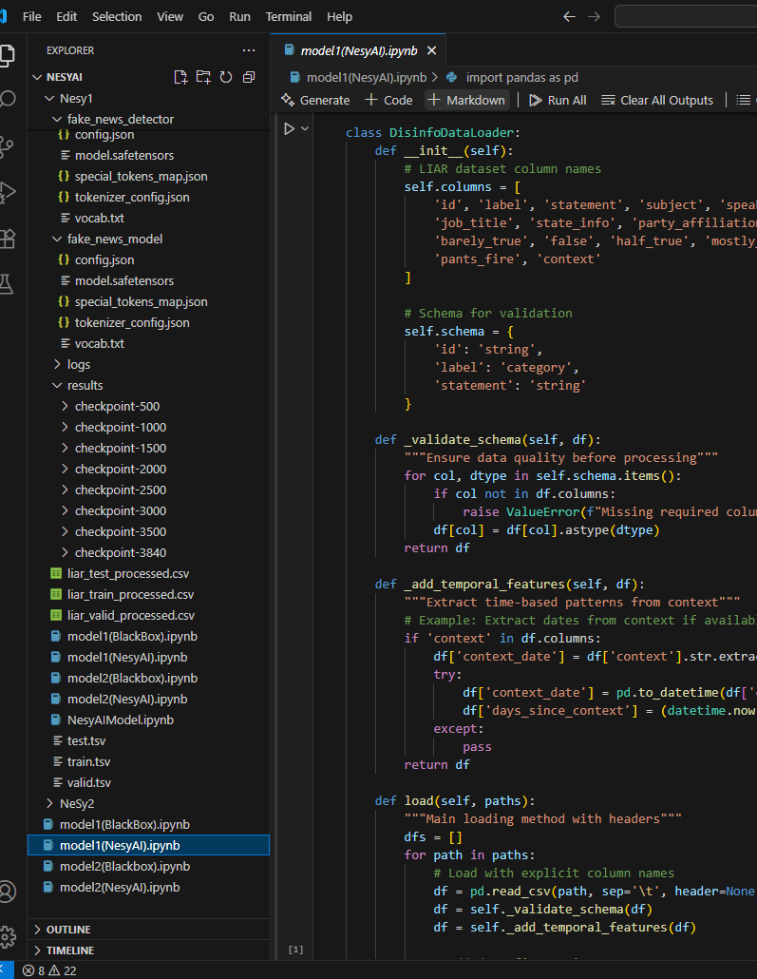
Model 2: NeSy AI
Architecture
Hybrid: RoBERTa (text encoder) + Decision Tree (interpretable layer)
Features: neural confidence + linguistic cues + priors
Build
Dataset: LIAR (REAL vs FAKE)
Neural stage: RoBERTa fine-tuned, calibrated (temperature scaling)
Symbolic stage: engineered features (hedging, boosting, length, speaker/party priors) → decision tree
Training: scikit-learn decision tree, max depth tuned for interpretability
Deployment
Outputs: black-box label + NeSy label
Explanation: rule path trace + operational prompt
Notes:
“For our second model, we adopted a hybrid neuro-symbolic architecture. The neural stage is a RoBERTa encoder, fine-tuned on the LIAR dataset and calibrated with temperature scaling. Instead of using the neural output directly, we clipped the probability and fed it into an interpretable decision tree, together with engineered features.
These features included linguistic cues such as hedging and boosting words, claim length, presence of numbers, and priors derived from speaker and party histories. The decision tree provides an explicit rule path for each prediction — for example, ‘if neural confidence is above 0.7 and the claim length is short, then predict FAKE.’
Training was deliberately constrained with shallow depth to preserve readability for analysts. This allows us to achieve accuracy while maintaining a rationale that can be scrutinised, explained in evidential contexts, and cross-checked operationally.
For deployment, both the black-box and the NeSy outputs are shown side by side in the interface. Alongside the prediction, we provide the symbolic rule path and prompts to guide analyst validation, e.g. ‘short claims often omit qualifiers — check for missing context.’ This directly addresses the analyst requirement for interpretability and accountability
Input text
↓
Neural embeddings (BERT)
↓
Symbolic reasoning layer (rules, decision tree)
↓
Output + Explanation
Model 2 → https://colab.research.google.com/drive/1xLM8twgq_4hArvsN83ZrvnAwVVNMrZOa#scrollTo=OTVcQeFyq0r_

Slide 16
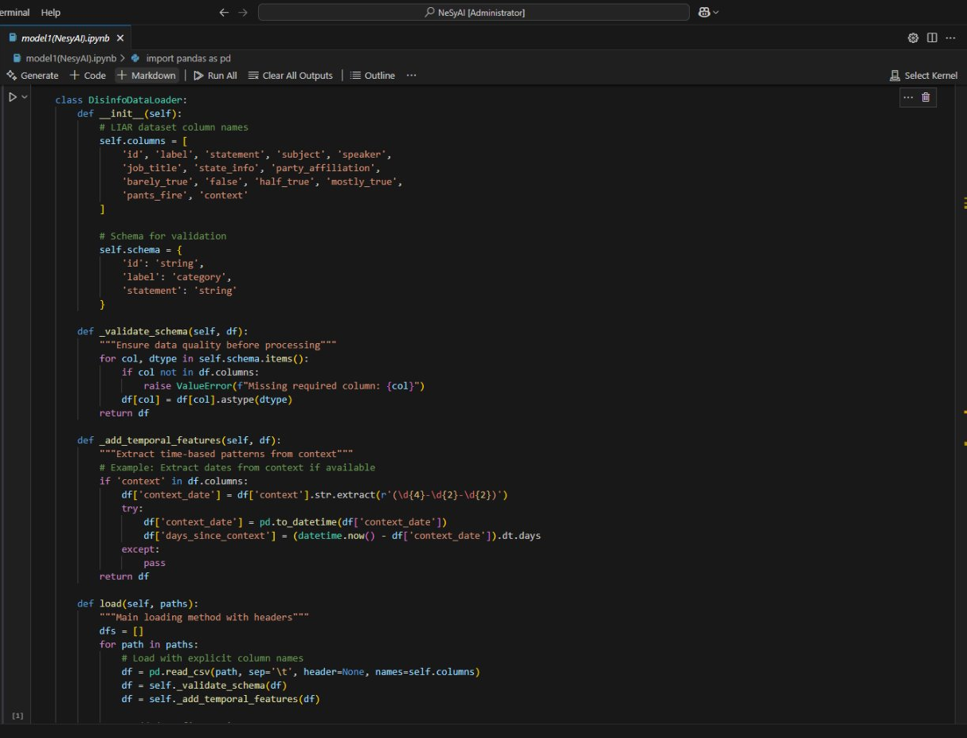
MODEL 2: NEURO-SYMBOLIC (NESY) MODEL
ARCHITECTURE
DistilBERT for text embeddings + symbolic
reasoning layer (decision tree)
FUNCTIONALITY
Input: Same pre-processed LIAR dataset
Neural Layer: Extracts high-dimensional features from text
Symbolic Layer: Applies interpretable rules over embeddings
Output: Classification with rule-based justification
Notes:
​
Model Two is where we begin to answer the shortcomings of black-box systems without abandoning their strengths.​
We started with the same DistilBERT neural core but instead of letting it output predictions directly, we extracted its final-layer embeddings and passed them to a symbolic reasoning layer.​
​
In this case, a decision tree classifier.​
Why a decision tree?​ Because it’s transparent by design every classification is the result of traversing explicit, human-readable rules over features.​
This means the system doesn’t just say “this is false” it can say:​
“This statement is flagged as false because it contains temporal contradiction, uses source flagged as unverified, and violates known fact X.”​
​
That’s operationally meaningful.​ In intelligence terms: it gives you evidence, not just judgement.​
How it Works Under the Hood​
The neural model provides rich linguistic representations of input text​
The symbolic layer builds on top of these not from scratch​
You get the perceptual power of neural nets combined with the interpretability of symbolic systems​
Importantly we didn’t force symbolic rules into the network.​ ​
We layered them on top, using them as a reasoning scaffold rather than a constraint.​
In side-by-side tests:​
Accuracy was comparable to the baseline​
But trust in model outputs measured via analyst review was significantly higher​
Most importantly: the model could explain its reasoning path, enabling human analysts to challenge, validate, or override it​
This is the core value of Neuro-Symbolic AI in operational contexts:​
It’s not just correct it’s accountable​
​
​
​
​
Model 2 → https://colab.research.google.com/drive/1xLM8twgq_4hArvsN83ZrvnAwVVNMrZOa#scrollTo=OTVcQeFyq0r_​

Slide 17
How AI Models Are Evaluated
Key Metrics
Accuracy → % of predictions that are correct overall.
F1 Score → balances precision (not flagging too much irrelevant info) and recall (not missing true disinformation)..
Loss → measure of how far the model’s predictions are from reality during training;
Epochs How many times the model has seen the entire dataset during training.
Notes:
To make sense of the results I’ll show next, it’s important to first explain how these systems are judged.
Accuracy is the most familiar: it’s simply how often the model gets the answer right. For example, if it analyses 100 news claims and gets 82 correct, that’s 82% accuracy. Straightforward, but it hides nuance.
That’s why we also use the F1 score. This balances two things:
Precision — not wasting analyst time by flagging too many false alarms.
Recall — making sure real disinformation is not missed.
A model can look good on accuracy but fail badly on one of these two.
During training, we also monitor loss, which tells us how far off the model’s predictions are from the truth. Lower is better. Think of it like a golf score, you want it small. Loss is the internal error, lower is better. Think of it as the model’s “learning mistakes.”
Epochs just mean how many times the model practiced on the data. More isn’t always better, too many and it starts “memorising” instead of generalising.

Slide 18
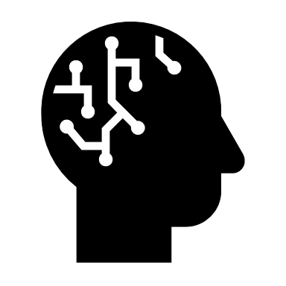
Test model’s results
BLACK BOX MODEL
NESY MODEL
Strong Accuracy | Pretrained Efficiency
Scalable | Fast to Deploy
Hidden Decision-Making | No Traceability
No Formal Reasoning or Explanation
Readable Decisions | Transparent Evidence Trail
Maintains Neural Performance
Aligns with Intelligence Workflows
System Complexity | Requires Tuning for Domain
Notes:
Here’s what we really care about. Not just whether the model works but whether we can work with it.​
A traditional deep learning model can tell us something is false but it can’t tell us why.​
A Neuro-Symbolic system, on the other hand, lets us:​
Trace its logic​
Understand which entities it identified​
See which rules it applied​
And assess the confidence and reasoning at each step​
This matters not just in disinformation detection but in:​
Credit scoring​
Regulatory compliance​
Fraud detection​
Risk analysis​
These are high-consequence decisions.​ We’re not just building systems to automate intelligence we’re building systems to support and extend human reasoning under pressure.​
​
Here’s how Neuro-Symbolic AI behaves in practice a pipeline that not only processes and classifies, but reasons and explains.​
We start with a political claim real-world, potentially adversarial.​
The neural layer (DistilBERT) performs feature abstraction: it detects entities, semantic patterns, temporal markers all encoded in high-dimensional space.​
Then, instead of passing that directly to a softmax output, we pass it to a symbolic layer a decision tree trained to map embeddings to logical rules.​
​
That layer interprets features like entity credibility, date alignment, and factual consistency.​
Finally, the model outputs not just a verdict but a traceable rationale based on defined symbolic logic paths.​
This gives the analyst not just what the model thinks but why.​
In intelligence, finance, or law that’s the difference between automation and partnership​
​
​

Slide 19
Findings: Technical Results
Black Box Model (DistilBERT baseline)
Accuracy ≈ 82%
interpretability = very low.
Evaluation Loss: 0.8166
Training time: ~21 hrs
NeSy AI Model
Accuracy ≈ 79%, interpretability high, symbolic reasoning layer provides human-readable decision paths.
Trade-off
Slight drop in accuracy offset by much higher trust and explainability.
Impact
Potential to reduce verification workload, improve defensibility of intelligence assessments
Notes:
When the two models were tested side by side, the baseline black-box model, a fine-tuned DistilBERT achieved an accuracy of around 82%.
What does “82%” mean in this context? It means that when the model was shown labelled examples of true and false statements, it correctly classified about 8 out of every 10 cases. This is considered strong performance from a purely technical machine-learning perspective.
But the challenge lies in what happens next. With this model, analysts see only a binary label “true” or “false” without any insight into how the decision was reached. This is what is meant by low interpretability: the reasoning remains hidden inside the model’s mathematical layers. For intelligence workflows, that lack of transparency is a serious limitation.
The Neuro-Symbolic AI model scored slightly lower, at 79% accuracy, but introduced a symbolic reasoning layer. This additional layer generates human-readable decision paths for example, showing that the claim was flagged because it matched a known disinformation narrative pattern, or contradicted verified factual sources.
This is where interpretability matters. Analysts can examine, critique, and if necessary, defend the reasoning in front of decision-makers. SMEs were particularly clear that this capacity for review and justification is as critical as raw accuracy.
It’s important to stress that in AI development, higher accuracy does not automatically mean a perfect or operationally reliable model. Accuracy is influenced by the dataset used, the fine-tuning of parameters, and the optimisation strategy. In practice, the NeSy AI model’s performance can be further improved by optimising these elements → for example, by training on larger or more representative datasets, adjusting its parameters, or refining the symbolic reasoning rules all while retaining its interpretability.
In operational terms, the trade-off is clear: while the black box is slightly more accurate, the NeSy AI produces outputs that can be trusted, defended, and integrated into politically sensitive intelligence assessments. In intelligence work, that trade-off is not just acceptable it is often essential.

Slide 20
Findings: Operational Insights (from SME
Trust > Accuracy
Integration challenges
Explainability as evidence
Training implications
Real-world alignment
Notes:
This research confirmed both in the literature and in my SME interviews that trust is more important than raw accuracy in intelligence workflows.
Analysts emphasised that interpretability is the foundation of trust. In their words, “If I can’t explain the output to my superior, I can’t use it.”
Black-box ML/DL models, even when technically strong, fall short because they generate outputs without reasoning. As one SME put it, “It’s like being handed a conclusion with no evidence operationally, that’s unusable.” By contrast, the symbolic reasoning layer in neuro-symbolic AI produces human-readable decision paths that can be interrogated, documented, and defended under scrutiny.
The case studies reinforced this. In Ukraine, disinformation tactics shifted daily an adaptive, interpretable model helped analysts adjust quickly. In the US election interference cases, outputs had to withstand legal and political scrutiny, which required explainable evidence chains. In African disinformation campaigns, analysts highlighted that explainability was critical to maintaining institutional credibility in contexts where public trust is already fragile.
Beyond accuracy and interpretability, SMEs raised integration challenges. Intelligence workflows are already tool-heavy, and a new AI system cannot afford to slow analysts down. For adoption to succeed, outputs must integrate seamlessly into existing reporting and verification processes.
Finally, training implications were a recurring theme. SMEs agreed analysts should not become data scientists, but they do require AI literacy enough understanding to question, validate, and defend AI-generated outputs. As one participant noted, “The danger isn’t the AI getting it wrong it’s analysts not knowing when to question it.”
Taken together, the operational insights align with the technical findings: a small trade-off in accuracy is acceptable if it yields interpretability, trust, and usability. For intelligence operations, those qualities are not “nice-to-haves” they are operational requirements.

Slide 21
Conclusion & Questions
Notes:
In conclusion, I refined the scope of this research to focus exclusively on disinformation detection within intelligence analysis workflows, moving away from the broader domain of counter-disinformation. This was a deliberate narrowing, shaped by supervisory and SME feedback, to ensure depth and operational relevance.
The research confirmed that in today’s cognitive warfare environment, offensive AI tools such as LLMs and deepfakes are evolving faster than the defensive measures available to analysts, creating a widening operational gap.
My findings show that while black box models like DistilBERT can deliver marginally higher accuracy, their opacity undermines trust, evidential accountability, and operational utility. Neuro-symbolic AI, even at slightly lower accuracy, delivers the interpretability analysts need to explain and defend their assessments in politically sensitive or adversarial contexts.
This is critical because, in intelligence work, an output that cannot be interrogated is an output that cannot be used. Interpretability is not a technical luxury; it is an operational requirement.
The contribution of this project is twofold: first, to empirically demonstrate the trade-off between accuracy and explainability under operational conditions; and second, to offer evidence-based guidance for integrating explainable AI into intelligence workflows.
Although it is outside the scope of this 820 project, I note that operationalising NeSy AI further would require fine-tuning parameters, using more diverse datasets, and stress-testing in simulated or live intelligence environments. These are logical next steps, and they mark the pathway from detection towards counter-disinformation applications.
I’ll pause there and welcome your questions.

Slide 22

References

