Slide 1
NEURO-SYMBOLIC AI
The Next Frontier in Explainability
Omar Jagana | Lydia Webber
Notes:
Welcome, everyone, to today's session on Glasgow Ignite AIML 'Neuro-Symbolic AI: The Next Frontier in Explainability.’
I’m joined by Lydia and we are excited to explore this cutting-edge topic with you, as it represents a significant advancement in the field of artificial intelligence. Neuro-symbolic AI combines the strengths of neural networks and symbolic reasoning, offering a promising solution to the challenges of explainability in AI systems. As AI continues to play a crucial role in various domains, understanding and interpreting its decisions becomes increasingly important.

Slide 2
AGENDA FOR SESSION
Background & Continuation from XAI
The Stakes: Why Explainability Still Matters
The Evolution of AI
Stepping Back: The Roots of Intelligence in Symbolic AI
The Convergence: Neuro-Symbolic AI Emerges
Inside the Machine: How Neuro-Symbolic AI Works
Algorithmic Pathways
Comparative Advantages
Use Cases in the Wild
Architecture Showdown
Demo
Q and A
Notes:
Let's take a moment to review our agenda for today's session. We'll begin with a background and continuation from our previous session on Explainable AI, led by our colleagues Xenia and Mohib. We'll then discuss why explainability still matters, especially in decision-critical domains. Following that, we'll explore the evolution of AI, stepping back to the roots of intelligence in symbolic AI, and the emergence of neuro-symbolic AI. We'll dive into the inner workings of neuro-symbolic AI, examining algorithmic pathways, comparative advantages, and use cases in the wild. We'll also have an architecture showdown, a live demo, and conclude with a Q&A session."

Slide 3
Disclaimer
Notes:
Before we proceed, I'd like to offer a brief disclaimer. The content presented today is intended for informational purposes and reflects the current understanding and research in the field of neuro-symbolic AI. While we strive to provide accurate and up-to-date information, AI is a rapidly evolving field, and new developments may emerge. We encourage you to engage with the material, ask questions, and explore further resources to deepen your understanding.
Please note that the material used in this session is not company-owned. All datasets are publicly accessible, and the libraries utilised may not be available within the JPMC setup. We advise you not to implement any of these on your system without proper guidance. Instead, seek advice from your AIML experts and ethics group to ensure compliance with organisational policies and ethical standards.

Slide 4
Background & Continuation from XAI
Explainable AI Session
Session Notes
Importance of Explainability
Continuation of Dialogue
Neuro-Symbolic AI
1
2
3
4
5
  AIML hosted a session on Explainable AI, led by Xenia and Mohib.
  Session notes shared with Glasgow Ignite members.
  Explainability is crucial for mitigating risks like bias.
  Continuation of a vital dialogue in AI deployment.
  Exploring limitations and introducing Neuro-Symbolic AI.
Notes:
A couple of weeks ago, AIML hosted a session on Explainable AI, led by our colleagues Xenia and Mohib. That session explored the fundamentals of what it means to build AI systems that are not just performant — but understandable and trustworthy. If you haven’t had a chance to check the session, please do so. All members of Glasgow Ignite would have been emailed the session notes. If you haven’t receive it, please reach out and if you haven’t joined ignite AIML, please do sure, otherwise you will be missing out.
Now, we want to be clear: this isn't some formal series we’re running. Instead, think of this as a continuation of a critical conversation one that is becoming increasingly relevant across all domains where AI is deployed.
In that session, we touched on why explainability matters how model decisions can impact users, customers, and stakeholders, and why transparency isn't just a “nice to have,” but often a regulatory, ethical, and operational necessity.
But we also surfaced a gap: many of our most advanced tools today from deep learning models to LLMs still function largely as black boxes. They’re powerful, yes, but opaque. And that’s a real problem when these systems are expected to make high-stakes decisions.
Today, we’re going to push further not just in recapping XAI, but in challenging the assumptions behind it, exploring its limitations, and introducing a fundamentally different approach that may help us bridge the gap between performance and interpretability.

Slide 5
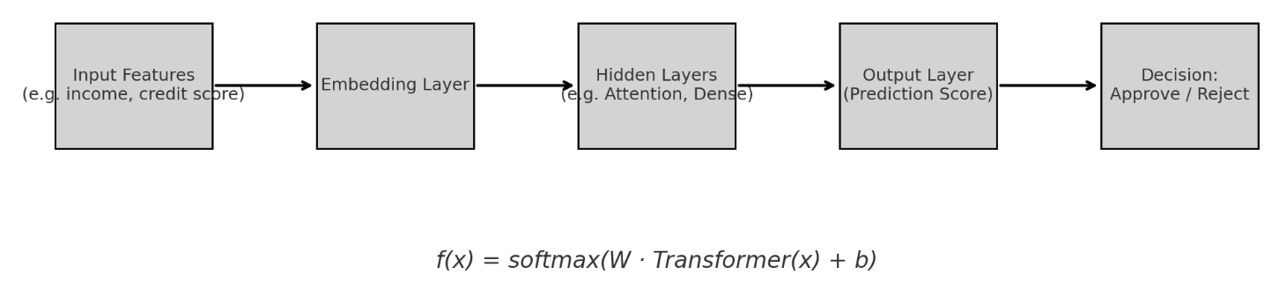
BlackBox Model Architecture Snapshot & Risk Scenario
Model Architecture Snapshot
Simple schematic of a transformer or deep neural network:
Input → Embedding → Hidden Layers → Output
(Prediction)Label: “Learned function 𝑓(𝑥)f(x)
- high-dimensional, non-transparent
Risk Scenario
Use Case: Loan rejection
Analyst's question: “Why was this rejected?
”Black Box response: “Pattern matched historical data”
❌ No rule
❌ No rationale
❌ No counterfactual
A model can predict accurately without understanding at all
Notes:
"Let's explore the black-box model architecture, a prevalent framework in AI systems today. We start with input features, such as income or credit score, which are processed through an embedding layer. This layer converts raw data into dense vector representations, preparing it for the hidden layers.
Within the hidden layers, which may include attention mechanisms and dense connections, the model learns complex patterns and relationships. These layers are essential for the model's predictive capabilities. The output layer then computes a prediction score, leading to a decision, such as approve or reject.
The learned function, f(x)=softmax(W⋅Transformer(x)+b)f(x)=softmax(W⋅Transformer(x)+b), encapsulates the model's operation. Here, WW represents the learned weights, xx is the input vector, and bb is the bias term. The softmax function transforms the output into a probability distribution, indicating the model's confidence in its predictions. Despite its power, this architecture is often criticized for being high-dimensional and non-transparent.
Consider a case study in loan rejection. An analyst might ask, 'Why was this loan rejected?' The black-box model's response could be, 'Pattern matched historical data,' offering no rule, rationale, or counterfactual explanation. This lack of transparency is a significant concern, as models can make accurate predictions without understanding the underlying reasons.
People may say, 'But that's what LLMs and agentic AI do,' and indeed, these models operate in a similar manner. They are probabilistic systems, relying on learned patterns to make predictions. This is precisely why we need explainable AI. We need systems that not only perform well but also provide insights into their decision-making processes. Explainable AI ensures that decisions are comprehensible and justifiable, reducing risks and enhancing trust in AI systems.
And hence, neuro-symbolic AI emerges as a promising solution. As we will explain, neuro-symbolic AI combines the strengths of neural networks with symbolic reasoning, offering a pathway to bridge the gap between performance and interpretability. By integrating these approaches, neuro-symbolic AI aims to provide transparent and understandable AI systems, addressing the challenges posed by traditional black-box models."

Slide 6
Why Explainability Still Matters
Lack of Explanation
  Lack of Explanation, Causal Trace, and Justification Black-box models fail to offer explanations or causal traces for their decisions, making it difficult for stakeholders to understand or trust the outcomes.
❌
Risk of Bias
📉
  Risk of Bias Without transparency, AI systems may perpetuate or exacerbate biases present in the training data, leading to unfair or discriminatory outcomes.
Regulatory Exposure
📉
  Regulatory Exposure Regulatory bodies are increasingly demanding explainability in AI systems to ensure compliance with ethical standards and legal requirements.
Notes:
Let’s bring this down to reality for a moment not abstract research papers, but the world we all work in every day.
Imagine you're an intelligence analyst, tasked with identifying and escalating disinformation campaigns during a geopolitical event. Or you're a credit risk officer, deciding whether to approve a high-value loan, with incomplete data, under pressure, and with a model that gives you nothing more than a score and a green light.
In both scenarios, you're relying on a black-box model a system that gives you a result, but no rationale. No traceability. No causal path you can interrogate. If the decision is wrong if the model was trained on a biased subset, or if it failed to detect contextual nuance you own that failure. And you can’t explain it.
Even our most advanced tools, like LLMs, are still black-box architectures at their core. They're trained on massive, noisy datasets. They're fine-tuned, prompted, and then expected to produce trustable, verifiable outputs in environments where the cost of error is measured in billions or in reputation.
Explainability isn’t a regulatory checkbox. It's not about debugging toy models. It’s about ensuring that when these systems are deployed in finance, defence, medicine, law, or public policy, they are accountable and that the humans working with them aren't left blindfolded.
The hard truth is: performance alone is not enough. We need AI that can reason, not just regress. That can articulate its logic, not just approximate. And that can help us trust the machine without surrendering to it.

Slide 7
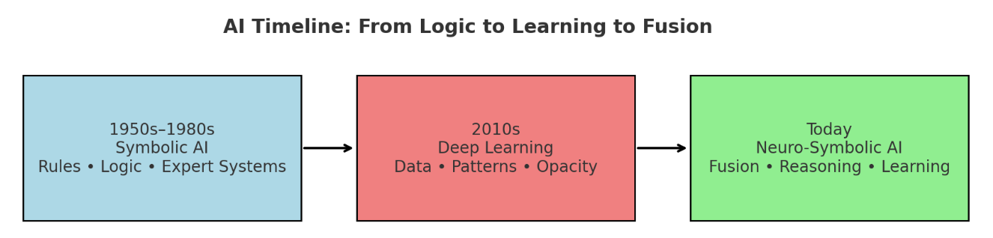
The Evolution of AI: From Symbolic to Neuro-Symbolic
Symbolic AI History
Neuro-Symbolic AI Emergence
  Foundation of Early AI
  Symbolic AI emerged in the 1950s, focusing on logic and reasoning using symbols and rules.
  Neuro-symbolic AI combines neural networks with symbolic reasoning, enhancing learning and logic.
Combining Neural Networks
  Key Developments
  The Dartmouth Conference in 1956 marked the formal beginning of AI research, with symbolic AI dominating early developments.
  Recent advancements focus on creating interpretable systems, addressing black-box model limitations.
Current Developments
  Complex Data Challenges
  Symbolic AI faced limitations with complex data, leading to the rise of machine learning in the 1980s.
Importance of Explainability
  Explainability is crucial for trustworthy AI, ensuring compliance with regulations and ethical standards.
Notes:
AI has evolved significantly from its inception in the 1950s, marked by symbolic AI's focus on logic and reasoning.
Rise of Machine Learning: The 1970s saw the integration of neural networks with symbolic reasoning, leading to the development of expert systems.
AI Winter: Despite challenges in the 1980s, foundational concepts like backpropagation emerged, setting the stage for future advancements.
Resurgence: The 2000s brought a resurgence in AI, driven by deep learning and big data, leading to breakthroughs in various applications.
Neuro-Symbolic AI: Today, neuro-symbolic AI represents a promising convergence, offering enhanced performance and explainability in AI systems.

Slide 8
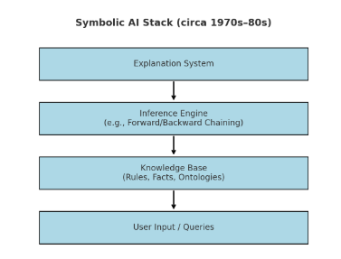







Stepping Back: The Roots of Intelligence in Symbolic AI
  Symbolic AI, or classical AI, relies on symbol manipulation and logical rules to solve problems, emulating human cognition through structured knowledge representation.
  Emerging in the mid-20th century, it was pivotal in developing expert systems for domains like medical diagnosis and financial forecasting.
  However, its reliance on predefined rules limited its ability to handle complex, real-world data, leading to the rise of machine learning approaches that offer greater flexibility and adaptability.
Symbolic AI Overview
Symbolic AI Overview
  Symbolic AI Principles
Definition and Principles
  Symbolic AI uses symbols and logic to emulate cognition.
Definition
Historical Significance
  Pioneered by Newell and Simon, used in expert systems.
  Historical Significance
History
Limitations
  Struggles with complex, unstructured data.
  Limitations of Symbolic AI
Transition to ML
  Led to machine learning rise, focusing on adaptability.
Limitations
Notes:
Before neural networks dominated the AI landscape, the field was founded on a very different paradigm Symbolic AI.
This was the first wave of artificial intelligence, emerging in the 1950s through the 1980s. The goal was bold and clear: replicate human intelligence using formal logic and symbolic reasoning.
Systems like MYCIN (1972) and SHRDLU (1970) didn’t "learn" from data. They used explicit, hand-coded rules, often in the form of if-then logic, propositional calculus, and inference engines, to reason over structured knowledge.
For example, MYCIN, one of the earliest expert systems for diagnosing blood infections, used over 450 hand-crafted rules to emulate the reasoning of infectious disease specialists. [Shortliffe, 1974]
The power here wasn’t in pattern recognition, it was in transparent, explainable reasoning. Every conclusion had a logical trail, often with confidence scores attached.
But Symbolic AI had its limits:
It couldn’t scale with unstructured data.
It required extensive domain modeling.
And it was brittle in the face of ambiguity or noise.
Still, it laid the conceptual groundwork for what AI could be: a system capable of abstract thought, planning, analogy, and logic — all of which are still aspirational goals for deep learning today.
In many ways, we're now circling back not to revive Symbolic AI as it was, but to integrate what it got right into the deep learning systems that dominate the present.

Slide 9



The Convergence: Neuro-Symbolic AI Emerges
Neuro-Symbolic AI is not just the intersection of learning and reasoning it’s the architecture that operationalises both
NEURAL NETWORKS
Symbolic Reasoning
NEURO - SYMBOLIC AI
An algorithm that mimics the neural networks seen brains: consisting of a layered web of interconnecting nodes acting as neurons which perform computations to process and analyse data.
Rule-based systems that operate over structured representations.
Capable of formal logic, causal inference, planning, and constraint enforcement.
Brittle, manually engineered, and poor at handling raw or ambiguous input.
An architectural fusion where neural networks handle perception and learning,and symbolic components manage reasoning, structure, and abstraction.
Bridged via mechanisms like lifting (NN → symbols) and compression (symbols → NN).Enables explainable, adaptable, and data-efficient AI..
Notes:
Neural networks are remarkable and we’ve proven what they can do.
Whether it’s CNNs for vision, RNNs for sequences, or transformers for everything else, they’ve become the default perception layer in modern AI.
These models are trained on terabytes of raw, unstructured data. They are statistical machines, optimized to minimiSe loss, not to model truth.
What they’re good at:
Pattern recognition
Feature abstraction
GeneraliSation from massive datasets
But we are aware of the limitatiosn based on our desire to understand things
Symbolic Reasoning →
Symbolic systems from expert systems in the '70s to logic programming in Prolog were built with structure at the core.
They manipulate symbols, obey rules, enforce constraints. They don’t learn from data they encode knowledge directly.
What they’re good at:
Formal logic and deduction
Multi-step planning
Causal reasoning and validation
Representing things like “IF income < X AND history = clean THEN approve_loan
But symbolic AI breaks down when:
The input is noisy, high-dimensional, or ambiguous
You need to scale across diverse contexts
Rules must evolve dynamically from new data
In a word: symbolic AI is smart but blind, and neural AI is perceptive but dumb.
What we’re seeing now is a convergence
Neuro-Symbolic AI combines these two paradigms to produce systems that can both learn from raw data and reason over structured knowledge.
It’s not just about model accuracy, it’s about operational viability:
Can the model explain itself?
Can it enforce logic?
Can it integrate prior knowledge?
Can it generalise from less data?
In risk-driven domains, finance, intelligence, medicine, defence, these aren't academic questions. They're existential.
And this convergence isn’t speculative. It’s already underway:
In symbolic overlays for language models
In systems that mix knowledge graphs with neural embeddings
In AI agents that blend reasoning and perception for strategic planning
This is the shift:
From learning to understanding.
From correlation to causation.
From prediction to justification.
In the next section, we’ll unpack how this actually works, the methods and algorithms that make Neuro-Symbolic AI possible.

Slide 10



WHY NEURO-SYMBOLIC AI?
THE BENEFITS TO THIS APPROACH
EXPLAINABLE
POWERFUL
RELIABLE
Explanation of solution due to symbolic approach
Can handle complex tasks due to neural networks
High accuracy with optimisation of tasks and data efficiency
Notes:
So, why are we even talking about Neuro-Symbolic AI?
First, explainability.
When a model gives you an output, particularly in high-stakes contexts credit decisions, fraud flags, or threat detection you need more than just a probability score.
Neuro-symbolic models allow us to generate outputs that come with reasoning. Not a vague “the model thinks this is correct,” but a structured, logic-based justification.
It’s not perfect, but it’s a step towards models that can be held to account and that’s a big deal in financial systems.
Now, we’re not abandoning neural networks.
Quite the opposite we’re keeping everything that makes them useful: their ability to ingest vast, messy datasets and surface complex patterns that would otherwise be invisible.
The symbolic layer doesn’t get in the way of that it sits on top of it, or alongside it, refining the output rather than restricting it.
So you’ve still got all the representational strength of deep learning, but with a structure that makes it usable in environments that demand more than “black box says yes.
And lastly reliability.
These systems don’t just work better because they’re clever — they work better because they waste less. Less data. Less drift. Less guesswork.
The symbolic component gives them a memory of rules, and rules don’t need retraining every quarter.
They also let you guardrail behaviours so even if your model’s learnt something questionable from the data, it can be overridden by hard logic.
If we’re going to keep using AI in places where lives, reputations, and billions of pounds are on the line, we need systems that can learn, but also think.

Slide 11



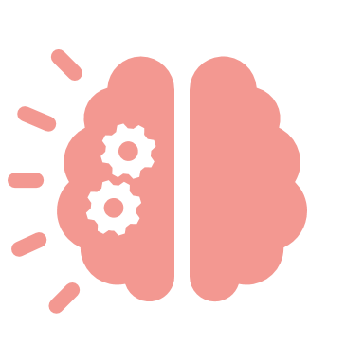
Comparative Advantages
Enhanced Explainability
Improved Accuracy
Data Flexibility
  Neuro-Symbolic AI combines interpretability with powerful pattern recognition, allowing for transparent AI systems.
  Unlike traditional models, it provides clear explanations and causal traces, fostering trust and accountability.
  Integrating symbolic reasoning enhances prediction accuracy by leveraging structured knowledge and logical rules.
  This reduces errors in complex scenarios, ensuring informed and reliable decisions.
  Adept at processing diverse data types, Neuro-Symbolic AI integrates structured, unstructured, and semi-structured data, enabling comprehensive analysis across domains like NLP and image recognition.
9

Slide 12
How Neuro-Symbolic AI Works
Architectural Operations and Integration Patterns
Lifting (Neural → Symbolic)
Compression (Symbolic → Neural
Extract information from neural patterns to map to structured symbolic knowledge to perform reasoning (neural to symbolic)
Compress structured symbolic knowledge to integrate into neural patterns to perform reasoning (symbolic to neural)
OPTION 1: DECOUPLED INTEGRATION
OPTION 1: GRAPH REPRESENTATION
Decoupled (separated) integration between neural and symbolic components
Compress knowledge expressed through graph representation into neural pattern
OPTION 2: INTERTWINED INTERGRATION
OPTION 2: LOGIC-BASED REPRESENTATION
Intertwined integration between neural and symbolic components
Compress knowledge of formal logic-based representations into neural pattern
Notes:
Let’s look under the hood of Neuro-Symbolic AI. There are two core operations that make this integration possible Lifting and Compression.
Lifting (Neural → Symbolic)
This is where we extract structure from neural outputs whether it’s classifying objects in an image or extracting entities from text.
The aim is to translate latent patterns into discrete, symbolic representations like graphs, facts, predicates, or rules that we can reason over.
There are two ways we can build the integration here:
Option 1: Decoupled Integration
Think of this as a pipeline: the neural model handles perception, and the symbolic component kicks in for reasoning. It’s clean, interpretable, and modular but the two parts don’t deeply inform each other.
Option 2: Intertwined Integration
This is more ambitious here, symbolic reasoning is embedded within the learning process itself.
The models are trained jointly. You get deeper synergy, but also increased complexity in implementation and optimisation.
On the flip side, compression is about embedding symbolic knowledge into the learning process not as metadata, but as learnable structure.
There are two key strategies here:
Option 1: Graph Representation
You embed structured knowledge say, from a knowledge graph directly into the model as a form of prior. Think of it as grounding the model in relational context.
Option 2: Logic-Based Representation
You distil formal logic rules, constraints, even theorem-like structures into a format that the neural model can learn from, shaping its internal representations.
This isn’t abstract theory. These methods are being tested in symbolic QA systems, scientific AI, and hybrid planning agents.
What we’re doing is building machines that don’t just see they understand, and they do so within defined logical boundaries.

Slide 13
Evaluating Neuro-Symbolic Approaches
BENEFITS TO EACH APPROACH
IMPLEMENTATION OF ALGORITHM
Approach | Large Scale Perception | Abstraction | Analogy | Planning
Decoupled Integration | Excellent | Good | Good | Good
Intertwined Integration | Excellent | Excellent | Excellent | Excellent
Compressed Graph | Excellent | Good | Good | Good
Compressed Logic-Based | Ok | Good | Good | Good
USABILITY OF MODEL / APPLICATION
Approach | Explainability | Domain Constraints | Scalability | Continual
Decoupled Integration | Good | Good | Excellent | Ok
Intertwined Integration | Excellent | Excellent | Excellent | Excellent
Compressed Graph | Ok | Good | Excellent | Excellent
Compressed Logic-Based | Ok | Ok | Ok | Ok
Notes:
What are the actual trade-offs between these pathways and how do you choose the right one?
Naturally, not all integration strategies are equal and the choice depends heavily on what you're optimising for: performance, scalability, transparency, or operational simplicity.
Implementation Trade-Offs
If you're focused on large-scale perception, nearly every method performs well they all leverage neural front-ends.
But if you care about:
Abstraction
Analogy
Multi-step Planning
Then intertwined integration is clearly superior. The symbolic layer doesn’t just reason after the fact it shapes the learning process.
Usability and Deployment
Here’s where trade-offs appear more visibly:
Decoupled Integration gives you strong modularity and excellent scalability. You can build and iterate quickly. But it doesn’t give you full explainability or domain enforcement.
Intertwined systems shine in explainability, domain fidelity, and continual learning, but at a cost: they’re harder to build, test, and retrain.
Compressed logic-based models are elegant, but can underperform when the symbolic priors don’t align well with the training data.
So again there’s no silver bullet. The key is in design alignment:
Choose the architecture that fits the domain’s constraints, the regulatory burden, and the required interpretability.

Slide 14


Algorithmic Pathways
Decoupled Integration
Neural model:
Symbolic module: ​ via logic rules or tree-based inference
Modular, auditable, not end-to-end trainable.
Intertwined Integration
Joint objective:
​Enables logic-aware learning via differentiable reasoning layers.
Graph-Based Compression
Encode knowledge graph 𝐺=(𝑉,𝐸) using GNNs:
Injects relational priors directly into latent space.
Logic-Based Compression
Embed logical constraints 𝜑 as soft penalties:
Enforces rule compliance during training with minimal data.
Notes:
Let’s now get into the core algorithmic pathways that enable Neuro-Symbolic AI.
You’ve seen Lifting and Compression now we’ll look at how those concepts are actually implemented.
Lifting is the process of taking neural outputs like embeddings or probability distributions and turning them into structured symbolic representations.
There are four dominant pathways, each built on a different structural foundation and integration strategy.
1. Decoupled Integration
This is the most modular and interpretable approach. You extract symbols after the neural model has processed the input.
Think of it as perception followed by reasoning.
You typically have a pre-trained neural model for perception (say, DistilBERT, ResNet, etc.), followed by a symbolic reasoner like a decision tree, logic program, or constraint solver.
Algorithmic Implementation:
Output embeddings → symbolic extraction (e.g. entity recognition, relation classification)
Feed into symbolic reasoning engine (e.g. Prolog, SAT solver, rule engine)
Final decision made via symbolic inference
This is often used in pipelines where auditability and control matter more than raw throughput e.g., intelligence analysis, structured fact-checking.
Example:
Use a neural network to extract entities from text
Then feed those into a symbolic decision engine (e.g. “IF person = PEP AND region = high-risk THEN flag”)
Mathematically, It’s highly explainable and modular — but not end-to-end trainable.
2. Intertwined Integration
This is where symbolic reasoning is part of the learning loop itself. You don’t just extract structure you enforce it during training.
This approach is architecturally ambitious. It combines differentiable reasoning modules inside the network itself.
You’re not just reasoning after the fact you’re training the network to reason.
Implementation Techniques:
Differentiable logic
Constraint-aware loss functions
Programmatic supervision
Example Loss Function:
This tight integration gives you models that learn logic, not just output symbols — but it comes at higher engineering and optimisation cost.
Examples Include:
Logic Tensor Networks
Neural Theorem Provers
Differentiable FOL (First Order Logic) modules
Neuro-symbolic program synthesis (e.g., DeepMind’s AlphaCode)
Here, symbolic constraints are soft or hard-attached to the training objective.
You’re learning not just from data, but from logic.
This is more complex to train, but gives you stronger generalisation and better reasoning under uncertainty.
Compression
Compression is the reverse: injecting structured knowledge into the neural model so that it can learn with greater efficiency and constraint.
3. Graph-Based Compression
Graph-based methods use structured representations like knowledge graphs or scene graphs and embed them into the network’s latent space.
SO what it means is You embed a knowledge graph or scene graph directly into your model using graph neural networks or transformers
Example:
G=(V,E)G = (V, E)G=(V,E) is a knowledge graph
GNN layers produce hvh_vhv​ for each entity
Those embeddings are fused with input data
You get relational grounding and contextual inference
Typical flow:
Encode structured knowledge (e.g. RDF triples, ontologies)
Use GNNs or Graph Transformers to create learned graph embeddings
Inject graph features into the model’s training loop
This is effective in domains like:
Knowledge-grounded QA
Drug discovery
Recommender systems
It gives you relational generalisation, without needing fully symbolic logic.
4. Logic-Based Compression
Here, you distil formal logical rules or ontologies into the model through symbolic supervision or logic-based loss terms
This is the most abstract and challenging: encoding formal logic such as rules, constraints, or propositions into the network's training process.
Approach:
Encode logical constraints directly in training:
IF A∧B⇒C, then penalise violation in model output\text{IF } A \land B \Rightarrow C, \text{ then penalise violation in model output}IF A∧B⇒C, then penalise violation in model output This supports generalisation with minimal data, but performance depends heavily on the quality and precision of your symbolic priors.
Approaches include:
Encoding constraints as loss terms (logic regularisation)
Distilling rules into the model using contrastive learning
Learning symbolic programs from neural outputs (e.g. via program induction)
This method pushes the boundary of how far we can inject structured reasoning into deep models without sacrificing learnability.
It's especially useful in safety-critical systems, legal tech, or embedded regulatory logic.
These aren’t separate research threads. They’re building blocks, and often combined in layered systems.
The point is: you have real architectural choice here and that choice is driven by the task, the data, and the domain constraints.
So whether you lift from neural to symbolic or compress from symbolic to neural, the end goal is the same:
A system that can see, understand, and justify its decisions not just predic

Slide 15

Architecture Showdown
Key Considerations
NSI Framework
Logic Tensor Networks
Hybrid Models
Performance Metrics
Embeds symbolic knowledge into neural networks for interpretable models.
Uses tensor representations to combine logical reasoning with deep learning.
Superior in tasks requiring logical reasoning.
Complexity vs. Explainability
Outperforms traditional models in accuracy and transparency.
Provides robust framework for complex problem-solving.
Improves diagnostic accuracy and decision support systems.
Recent Research Insights
Requires sophisticated algorithms and computational resources.
Challenges in scalability and real-time processing.
Transforms industries with reliable AI solutions.
Trade-offs
Optimizes architectures for better performance and scalability.
Promising results in autonomous systems and healthcare.
Enhances learning capabilities using advanced structures.
11

Slide 16
DEMONSTRATION & WALKTHROUGH
Notes:
Before we get to our architecture comparison, let’s start with why we built this.
Over the next two slides, we’ll walk you through a disinformation detection system we’ve built using two approaches:
A classic deep learning model
A Neuro-Symbolic pipeline
This isn’t a full demo just a structured walkthrough of how the models were designed, and what we learned from building them.
Why Disinformation?
We chose disinformation detection for two reasons:
It’s a real-world, high-complexity, high-consequence task
It shares fundamental challenges with domains like finance and risk where truth, credibility, and justifiability are everything
In both disinformation and finance:
You have to work with partial, noisy, often contradictory data
You must be able to explain and defend decisions
And your models must adapt to changing narratives whether in the news cycle or in market conditions
The parallels are sharp:
Imagine a model that flags a news article as false.
Now imagine a model that flags a financial statement as anomalous.
In both cases:
The source may be ambiguous
The implications are material
And the decision needs to be explainable, defensible, and auditable
Whether you’re fighting malicious influence campaigns or fraudulent market signals, the core challenge is the same:
You can’t make high-impact decisions with black-box models that can’t justify themselves.
1. Input
A factual claim enters the pipeline.
Example: "The UK base rate was cut in Q4 2025."
This type of claim might appear in newsfeeds, social media, or automated reports used in financial monitoring tools.
🔹 2. Neural Embedding
A DistilBERT-based model processes the text to generate contextual embeddings dense vector representations that capture the meaning, sentiment, entities, and relations in the claim.
These embeddings act as a semantic signal layer rich but opaque.
🔹 3. Symbolic Reasoning
Instead of going straight to prediction, we pass those embeddings into a symbolic layer in this case, a decision tree trained on verifiable rules.
Example rule:
IF date_conflict AND source_unverified THEN → label = FALSE (Rule R3.4)
This enables the system to reason explicitly based on conditions like:
Known economic data (from a symbolic knowledge base)
Source credibility
Historical consistency
🔹 4. Output & Verification
The output isn’t just a binary label. It includes:
Classification: FALSE
Confidence Score: e.g., 0.89
Traceable Explanation:
The claim contradicts verified macroeconomic data
The source could not be verified through institutional channels
This is what makes the system explainable and audit-ready analysts can trace why a claim was flagged, backed by logical inference paths, not just probability.

Slide 17
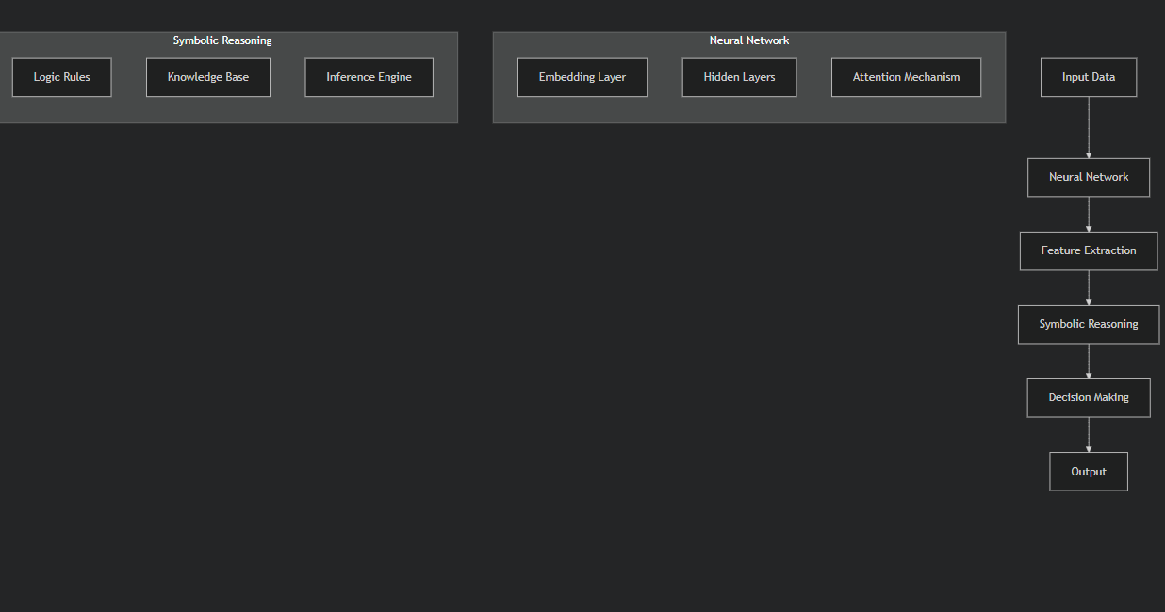
Models, Data & Tools
Models
Black Box Baseline: DistilBERT, chosen as a state-of-the-art transformer model for text classification to represent current ML/DL detection capabilities.
Neuro-Symbolic AI: DistilBERT + symbolic reasoning layer (decision tree) – designed to preserve accuracy while providing rule-based, interpretable outputs aligned with intelligence analysis needs.
Data
LIAR benchmark dataset labelled political statements as true or false, adapted to binary classification for operational clarity.
Case study alignment: representative of adversarial disinformation contexts in Ukraine, US elections, and African campaigns.
Tools & Infrastructure
Python, PyTorch, TensorFlow, Hugging Face Transformers.
Cloud compute for rapid iteration and scalability.
Notes:
To explore how Neuro-Symbolic AI performs in adversarial information settings, we built and evaluated two models.
Model 1: Black Box Baseline
Our baseline was a DistilBERT model a distilled version of BERT, widely used for classification tasks.
It represents the kind of high-performing, deep learning system you’ll find deployed today in many detection pipelines: efficient, powerful and largely opaque.
Model 2: Neuro-Symbolic AI
The second model used the same neural architecture DistilBERT but with a key difference:
We added a symbolic reasoning layer, specifically a decision tree trained on the output embeddings.
This allowed us to preserve model performance while generating human-readable, rule-based decisions.
In intelligence environments, this matters accuracy without traceability is operationally unusable.
Dataset: LIAR Benchmark
We used the LIAR benchmark, a labelled dataset of political claims classified as true or false.
We adapted it to a binary format for clarity and speed matching how analysts work when under pressure to assess veracity.
It’s also contextually appropriate these are the types of narratives we’ve seen weaponised in information operations across:
Ukraine
US elections
Campaigns in parts of Africa
Tools & Infrastructure
The models were built using:
Python
PyTorch
TensorFlow
Hugging Face Transformers
We ran everything in a cloud-based environment, which allowed us to:
Iterate quickly
Scale training as needed
And simulate how these tools might perform in a real intelligence workflow
We weren’t reinventing the wheel.
We took proven architectures and adapted them to the operational requirement for interpretability, based on direct feedback from users in the field.
The result: two models, same data, same infrastructure but fundamentally different in how they justify their decisions.

Slide 18
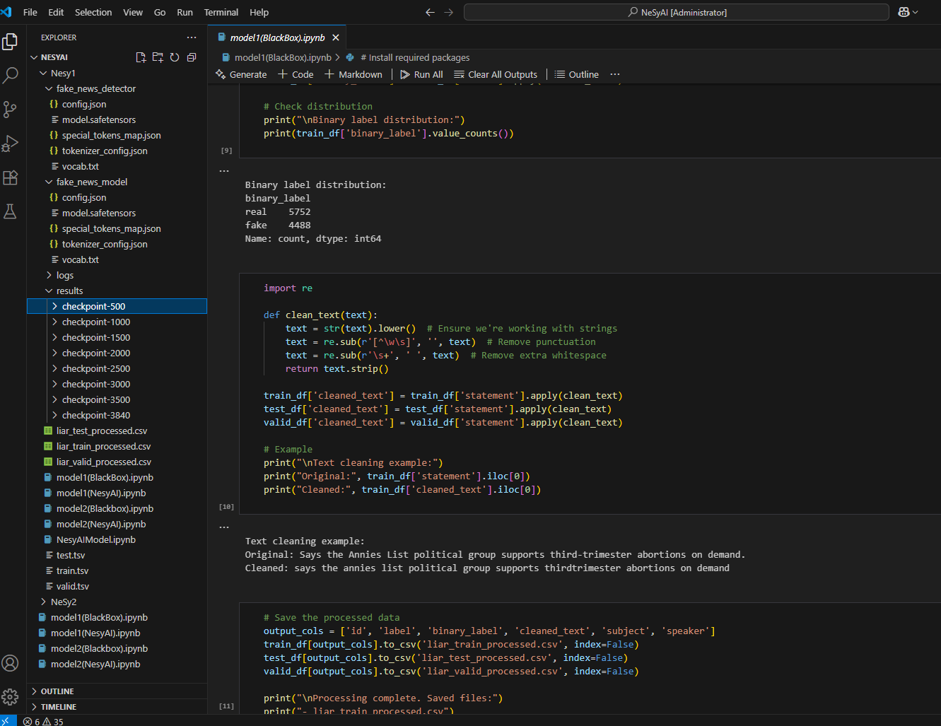
Model 1: Traditional ML/DL
Architecture: DistilBERT transformer model for sequence classification
Input: Political statements from LIAR dataset
Preprocessing: Text cleaning, tokenisation, binary label mapping
Training: Fine-tuned for real/fake classification (supervised)
Output: Prediction probability (True/False)
Strengths:
Strong accuracy
Pretrained efficiency
Scalable and fast to deploy
Limitations:
Opaque decision-making
No traceability
No formal reasoning or explanation
Notes:
This is Model One — our black box baseline, built using DistilBERT, a compressed version of the BERT transformer architecture optimised for classification tasks.
The goal was to establish a performance benchmark using the kind of architecture commonly found in text-based detection tools today highly optimised, pretrained, and proven in production.
The pipeline was straightforward:
We took political statements from the LIAR dataset
Cleaned and normalised the text
Tokenised the input
Fine-tuned the model for binary classification true or false.
The model learns patterns in language associated with truthfulness or deception and makes a judgement.
In terms of performance:
It was fast to train
Delivered strong results on the benchmark
And it scales well in deployment environments
But the limitations were immediate and familiar:
The model can’t tell you why a statement is true or false
It can’t point to evidence, rules, or inconsistencies
And if it’s wrong you’ve got no way to interrogate the logic behind the failure
This is the heart of the problem with black-box AI in operational settings:
Analysts are left in the dark
There’s no evidential trail
And the system, however powerful, is fundamentally non-dialogueable
Model:-→ https://colab.research.google.com/drive/1nhCdXuPvqgwJEph-_KhntzRqxmuoRJDg#scrollTo=7946FDnpQcP0

Slide 19
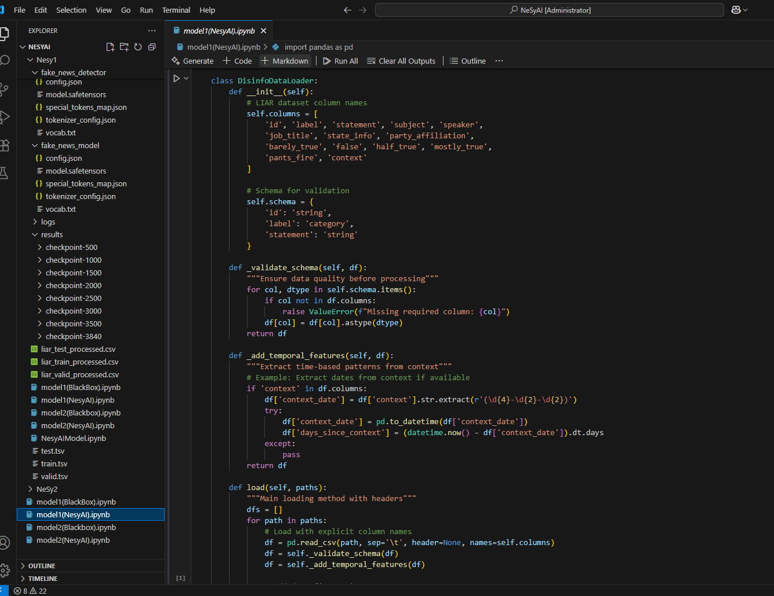
Model 2: NeSy AI
Architecture: DistilBERT for text embeddings + symbolic reasoning layer (decision tree)
Input: Same preprocessed LIAR dataset
Neural Layer: Extracts high-dimensional features from text
Symbolic Layer: Applies interpretable rules over embeddings
Output: Classification with rule-based justification
Strengths:
Human-readable decisions
Transparent evidence trail
Maintains neural performance
Aligns with intelligence workflows
Limitations:
Added system complexity
Symbolic layer requires tuning for domain
Notes:
Model Two is where we begin to answer the shortcomings of black-box systems without abandoning their strengths.
We started with the same DistilBERT neural core but instead of letting it output predictions directly, we extracted its final-layer embeddings and passed them to a symbolic reasoning layer.
In this case, a decision tree classifier.
Why a decision tree?
Because it’s transparent by design every classification is the result of traversing explicit, human-readable rules over features.
This means the system doesn’t just say “this is false” it can say:
“This statement is flagged as false because it contains temporal contradiction, uses source flagged as unverified, and violates known fact X.”
That’s operationally meaningful.
In intelligence terms: it gives you evidence, not just judgement.
How it Works Under the Hood
The neural model provides rich linguistic representations of input text
The symbolic layer builds on top of these not from scratch
You get the perceptual power of neural nets combined with the interpretability of symbolic systems
Importantly we didn’t force symbolic rules into the network.
We layered them on top, using them as a reasoning scaffold rather than a constraint.
In side-by-side tests:
Accuracy was comparable to the baseline
But trust in model outputs measured via analyst review was significantly higher
Most importantly: the model could explain its reasoning path, enabling human analysts to challenge, validate, or override it
This is the core value of Neuro-Symbolic AI in operational contexts:
It’s not just correct it’s accountable
Model 2 → https://colab.research.google.com/drive/1xLM8twgq_4hArvsN83ZrvnAwVVNMrZOa#scrollTo=OTVcQeFyq0r_

Slide 20
Traceable Intelligence – What Neuro-Symbolic AI Enables
Traditional Model | Neuro-Symbolic Model
Output: "False" | Output: "False"
🔒 No explanation | ✅ Explanation path shown
❌ No symbolic grounding | ✅ Linked to known rules
❓ No override mechanism | ✅ Human-in-the-loop capable
Notes:
Here’s what we really care about. Not just whether the model works but whether we can work with it.
A traditional deep learning model can tell us something is false but it can’t tell us why.
A Neuro-Symbolic system, on the other hand, lets us:
Trace its logic
Understand which entities it identified
See which rules it applied
And assess the confidence and reasoning at each step
This matters not just in disinformation detection but in:
Credit scoring
Regulatory compliance
Fraud detection
Risk analysis
These are high-consequence decisions.
We’re not just building systems to automate intelligence we’re building systems to support and extend human reasoning under pressure.
Here’s how Neuro-Symbolic AI behaves in practice a pipeline that not only processes and classifies, but reasons and explains.
We start with a political claim real-world, potentially adversarial.
The neural layer (DistilBERT) performs feature abstraction: it detects entities, semantic patterns, temporal markers all encoded in high-dimensional space.
Then, instead of passing that directly to a softmax output, we pass it to a symbolic layer a decision tree trained to map embeddings to logical rules.
That layer interprets features like entity credibility, date alignment, and factual consistency.
Finally, the model outputs not just a verdict but a traceable rationale based on defined symbolic logic paths.
This gives the analyst not just what the model thinks but why.
In intelligence, finance, or law that’s the difference between automation and partnership

Slide 21
THANK YOU
Notes:
“We’ve shown you a direction of travel not a finished map.”
Neuro-Symbolic AI is not a trend, nor a replacement for current systems it’s a response to real limitations in how we build, deploy, and trust intelligent systems today.
This is not about interpretability as a feature it’s about alignment, traceability, and structured reasoning as core computational requirements for any system that aims to operate in complex, regulated, or adversarial environments.
What we’ve walked through today is early, but grounded:
Architectures that combine statistical learning with formal logic
Real-world implementations where explanation matters as much as prediction
A shift from opaque prediction to structured, evidence-based inference
So let’s be clear this isn’t settled.
There are still open questions around scalability, constraint injection, continual reasoning under data drift, and symbolic generalisation.
But this is a serious, technical step forward and if you're building models that need to be right, explainable, and defensible, then this isn’t optional.
It’s inevitable.

