Slide 1
ABM Seminar Wrap Up
Selected Lecture Slides from
Dr. Sang-Yoon Yi

Slide 4
A Tale of Two Cities

Slide 10
Crowded Beach

Slide 15
Self-Organized Criticality Sand Pile Model

Slide 17
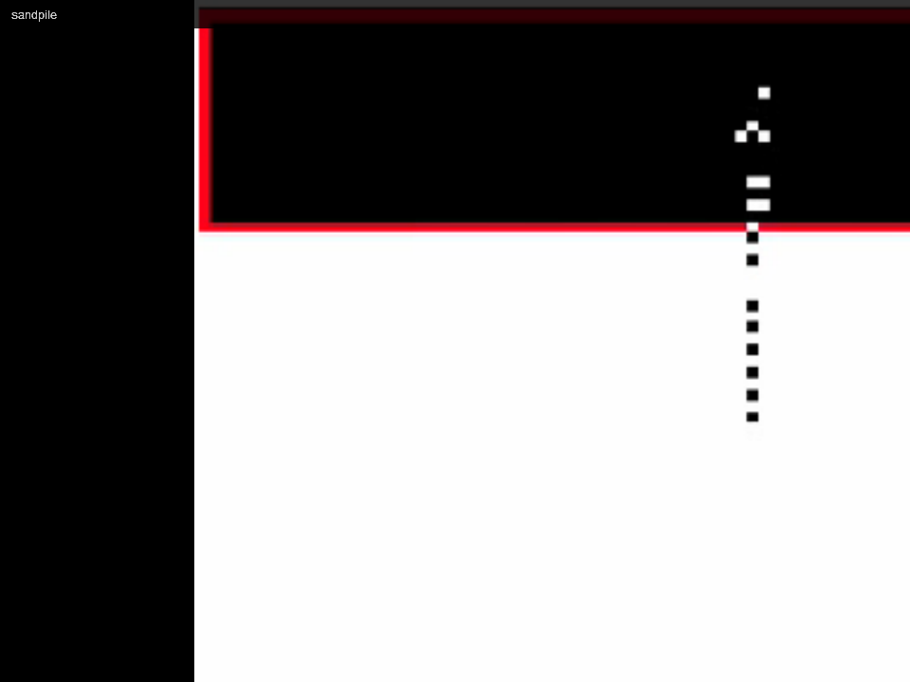

Slide 18
Connect the dots

