Slide 1
Introduction: Coding for Research
M. Kim
2014

Slide 2
(Traditional) Easy-Performance Tradeoff
Low level (machine) language
Machine code (matrix), Assembly
Hard to understand/write
Best performance
High level (human) language
Basic, Perl
Easy to understand/write
(Relatively) Low performance

Slide 3
What we have today..
Python, Ruby..
Specifically designed to reduce amount of coding
Reasonably fast (JIT compliers are so good)
So popular (so many modules)
In my opinion, Python is the language of choice in scientific research

Slide 4
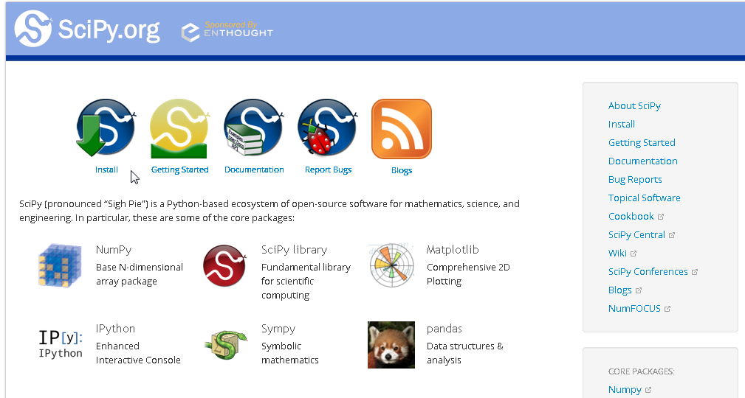
SciPy

Slide 5
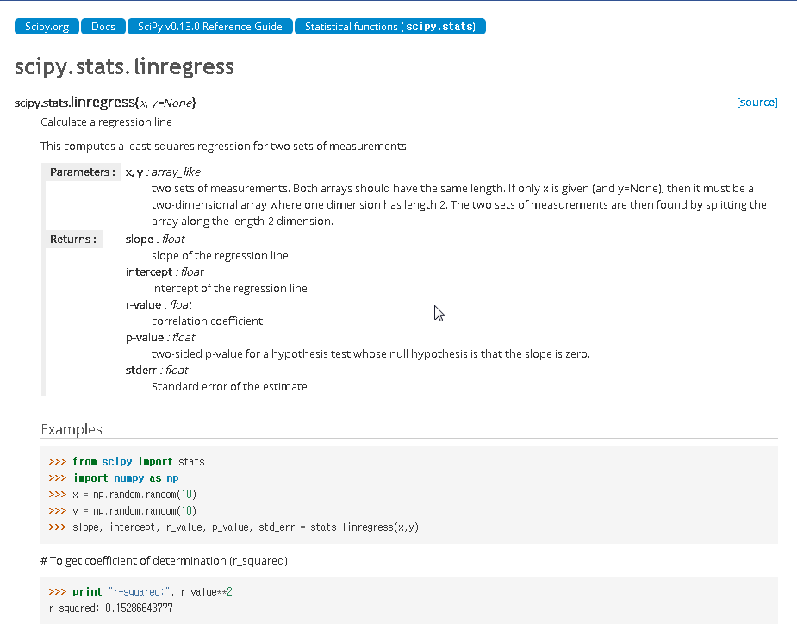

Slide 6
Vs. Matlab (or SAS)
Matlab
Has more specific functions (EE?)
Fast!
Pain in the ass to use 3rd party modules:
Has its own very weird language (hard to learn, no other uses)
A very comfortable box (like MacOS)
Not much can do outside of the box
Using Python as Matlab alternative
(should have) Less specific functions
Reasonably fast (maybe faster)
Unlimited extensions
The only limit is your imagination
Put your web-service engine, gaming log parser, DBMS and SciPy regression together

Slide 7
Database
Modern RDBMS
Can take away many data-related headaches from you (and your tool)
Python (almost) natively supports (almost all) RDBMS, with production performance
In addition, Google Storage support Python API
Matlab/SAS also supports RDBMS connection, however in a very crappy level (literally, only connection is supported)

Slide 8
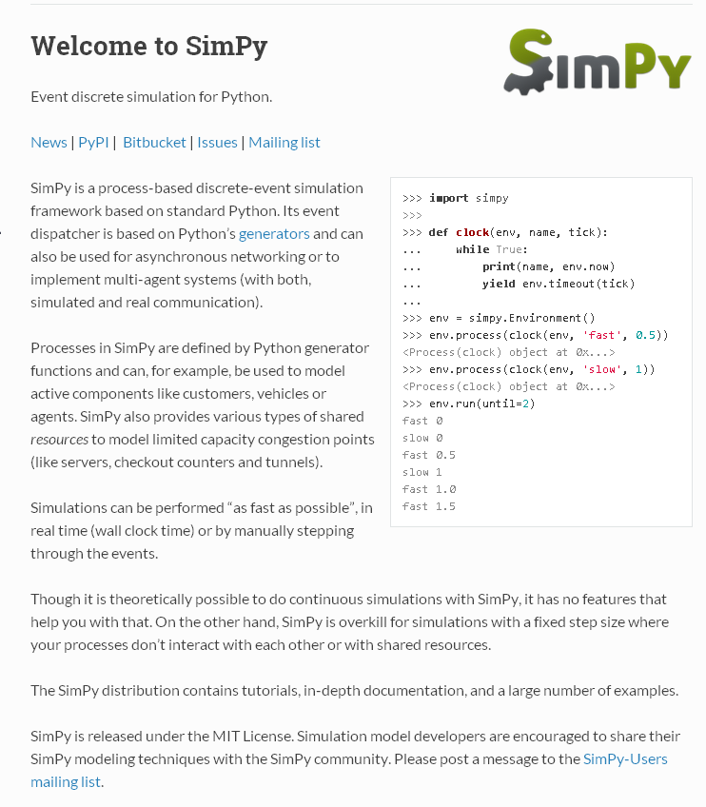
Simulation
SimPy Looks popular
Discrete-Event Simulation
Never have used these.. so not much comment..

Slide 9
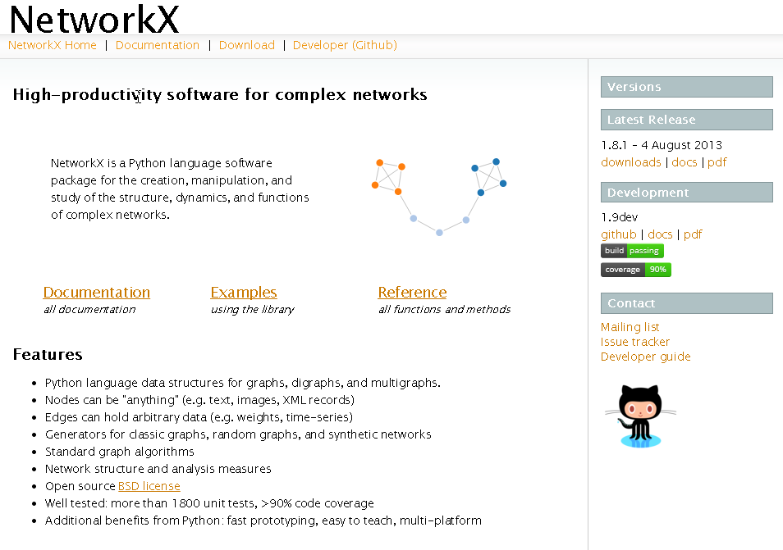
Network Analysis
NetworkX
Has a good set of functions
In fact, not many other usable tools around..

Slide 10
Standard Research Workflow
Crawler
Statistics
(SciPy)
Database
Simulation
(SimPy)
NetworkX
Data Gathering/
Generation
Analysis
Your Python Project

Slide 11
Next?
Big Data
Data so big that cannot be easily sorted / searched / joined
Parallel Processing
Data so big that the matrix (for example, regression) do not fit into the memory
My special skills !!
But no demands!! (ㅜ_ㅜ);;

Slide 12
Useful Links
Official Python
https://www.python.org/
Official Python Tutorial
https://docs.python.org/2/tutorial/
Unofficial Python Library Windows Build
http://www.lfd.uci.edu/~gohlke/pythonlibs/
SciPy Scientific Python Tutorial
http://scipy-lectures.github.io/
Github
https://github.com/
Github for Windows
https://windows.github.com/

