Slide 1
CHEST RADIOGRAPH SCREENING TRIAGE
Dhanvantari Vision
A tuberculosis screening tool, and an honest map of where it stops working.
Built in a day on a laptop GPU. Every number measured, with confidence intervals.
0.945
0.579
101s
AUROC, held-out
AUROC at a third site
to train on an RTX 3050
Research prototype on public NLM/NIH datasets · not a medical device · no clinical validation
Notes:
Don't explain the name. Go straight to the problem on slide 2.

Slide 2
THE PROBLEM
The bottleneck is readers, not machines
Chest radiography is the frontline tool for TB screening. A mobile screening van images around 400 people a day, with no radiologist on board.
Films are batched to a city hospital. Reports come back in days to weeks. By then many of those people cannot be traced again.
In TB programmes, losing people between screening and diagnosis kills more than reader accuracy does.
So we did not try to beat a radiologist.
We built something that decides who gives a sputum sample before they leave the van.
A triage tool, not a diagnostic one.
Notes:
40 seconds. Land the 'losing people between screening and diagnosis' line, then the sputum-sample framing, that sets up everything else.

Slide 3
HOW IT WORKS
Four steps, one of which is saying “I don’t know”
1
2
3
4
Preprocess
Score
Decide
Explain
Grayscale, CLAHE local-contrast normalisation, 512px. Partially normalises exposure between machines.
ResNet-18 fine-tuned on 800 real radiographs outputs one probability.
Threshold tuned for 90% sensitivity, plus an abstention band: 25% of cases are routed to a human instead of guessed.
Grad-CAM localises the finding; an LLM writes a clinical note using only the model's own numbers.
A screening tool that quietly guesses on an ambiguous film is dangerous. Accuracy on the cases it does decide: 94.4%.
Notes:
35 seconds. Land on step 3, the abstention band is what signals maturity.

Slide 4
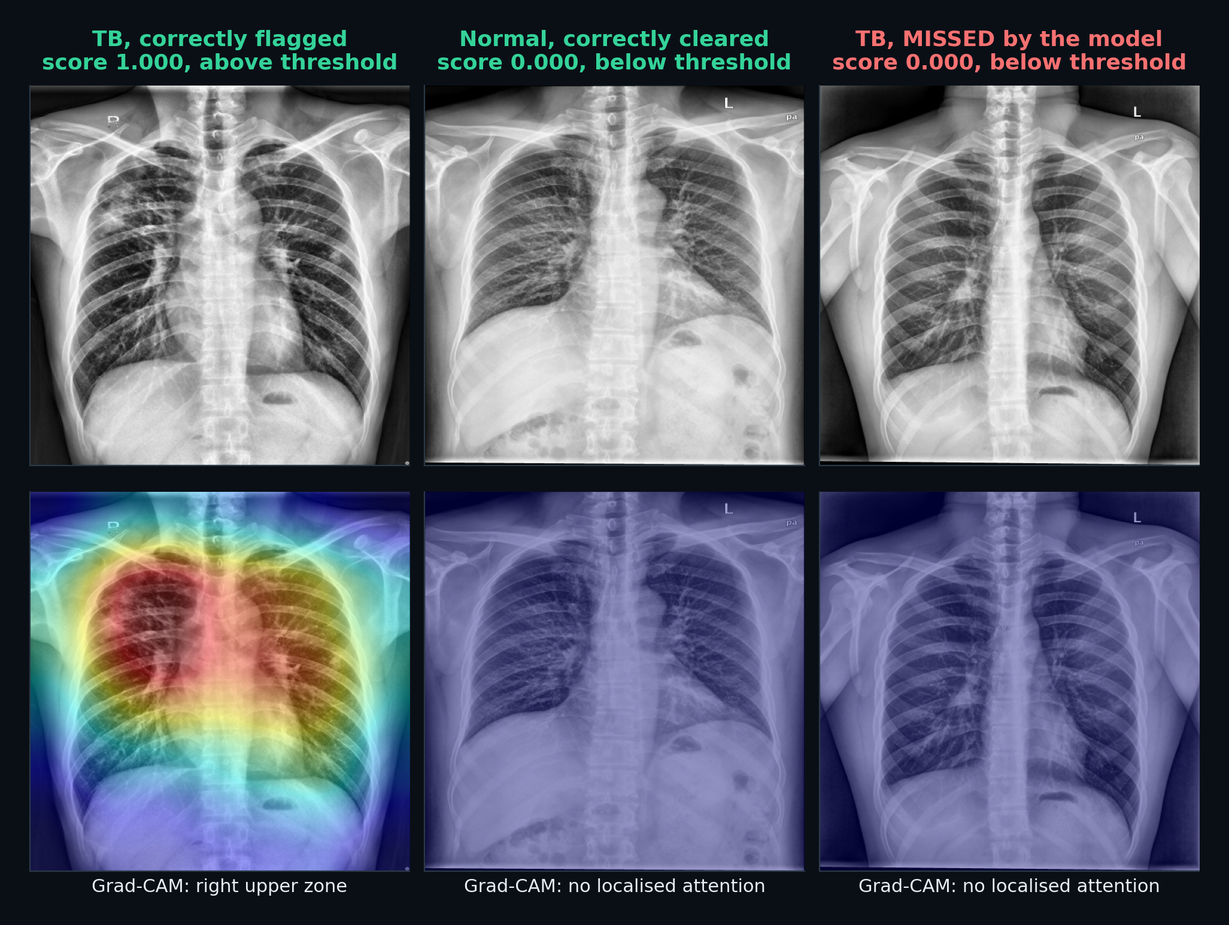
REAL OUTPUT
Three held-out films: two right, one wrong
Grad-CAM is not decoration.
Chest X-ray models are notorious for shortcut learning, one published case “detected” collapsed lung by spotting the drain inserted to treat it.
Every case shows it, so this can be checked rather than assumed.
We show the misses too.
10 of 59 TB films are missed. They sit at the bottom of the queue, the dangerous failure for a screening tool.
Notes:
Point at the left-hand film's upper-zone heatmap. Then the third column: a missed TB case. Volunteering the failure is stronger than hiding it, and a judge will ask about false negatives anyway.

Slide 5
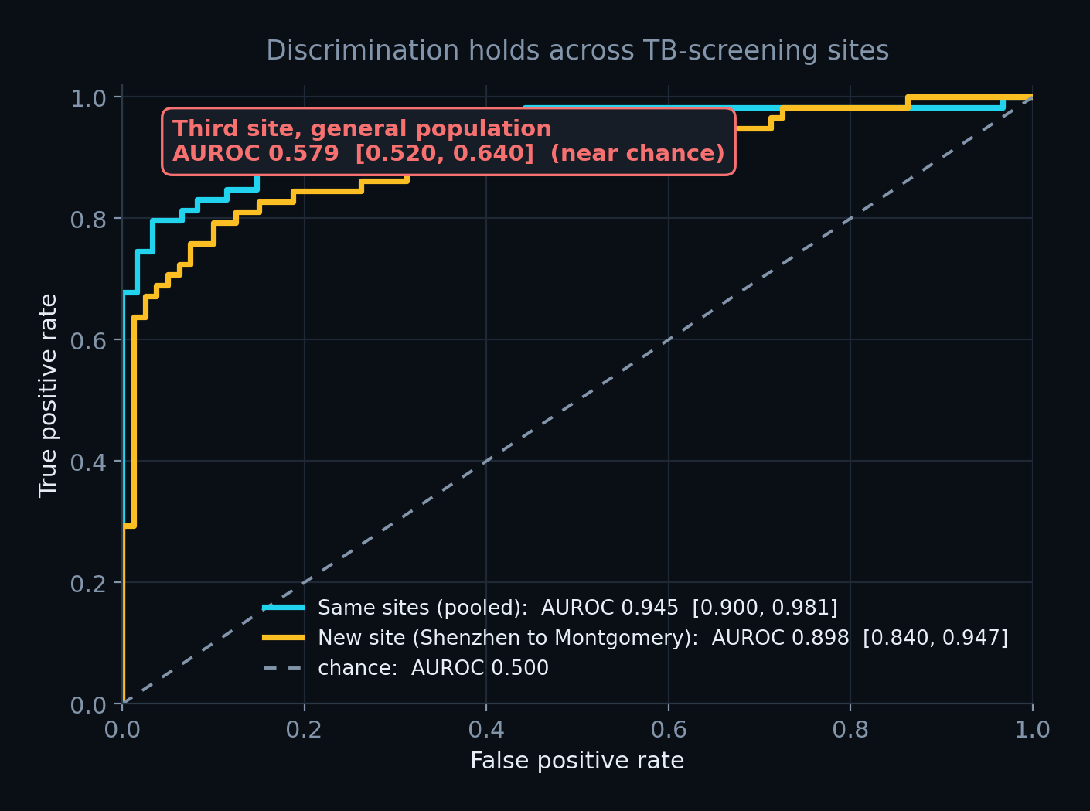
STAGE 1, THE TRAINED MODEL
A real model, trained locally, reported with intervals
Backbone
ResNet-18, ImageNet init, strict load
Dependency
no torchvision, architecture written out
Data
800 films, NLM Montgomery + Shenzhen
Train / val / test
560 / 120 / 120
Hardware
RTX 3050 6GB laptop
Training time
101 s for 14 epochs
Held-out AUROC
0.945 [0.900, 0.981]
Sens / spec
0.831 / 0.885
Two domain choices most pipelines get wrong:
no horizontal flips (the heart is on the left, so a mirrored chest film is anatomically impossible) and no cropping at evaluation (a crop can remove the apical zones where TB lives).
Notes:
30 seconds. The two augmentation decisions are your credibility here. Lead the metric with the interval, not the point estimate.

Slide 6
STAGE 2, GROUNDED GENERATION
The language model never sees the X-ray
An LLM cannot read a radiograph, so letting it interpret one would just be fabrication.
It receives a fixed evidence block: the probability, the operating threshold, the Grad-CAM zone distribution, and the model's own held-out performance. It may use nothing else.
Forbidden: inventing findings, naming a diagnosis, or stating the patient does or does not have TB. Required: name microbiological confirmation as the standard.
The UI shows that exact evidence block for every case, so the grounding is inspectable, not claimed.
GENERATED OUTPUT, VERBATIM
“Model attention was regional and left-sided, with the greatest saliency in the left upper zone (34% of total)… This upper-zone-predominant distribution aligns with the typical pattern of post-primary pulmonary tuberculosis… The recommended next step is microbiological confirmation.”
openai/gpt-oss-120b via Groq
Notes:
40 seconds. The key beat: it CAN'T see the image, so it has nothing to hallucinate from. Then: we show the judge the evidence block.

Slide 7
RESULTS
The interval is the result, not the point estimate
0.945
[0.90, 0.98]
0.831
0.885
held-out AUROC
95% confidence interval
sensitivity
specificity
Why we lead with the interval
Our first run used 138 films, 21 in test. It produced AUROC 0.889 with an interval from 0.689 to 1.000, a number that means nothing.
Scaling to 800 films is what tightened it. Not a better model.
Screening-appropriate evaluation
Threshold chosen on validation for 90% sensitivity, then applied unchanged to test. Missing a case costs far more than an extra test, so specificity is what we spend.
Confusion: 49 true positive, 7 false positive, 54 true negative, 10 false negative.
Notes:
30 seconds. Do NOT lead with 0.945. Lead with the interval and the story of the 138-image run.

Slide 8
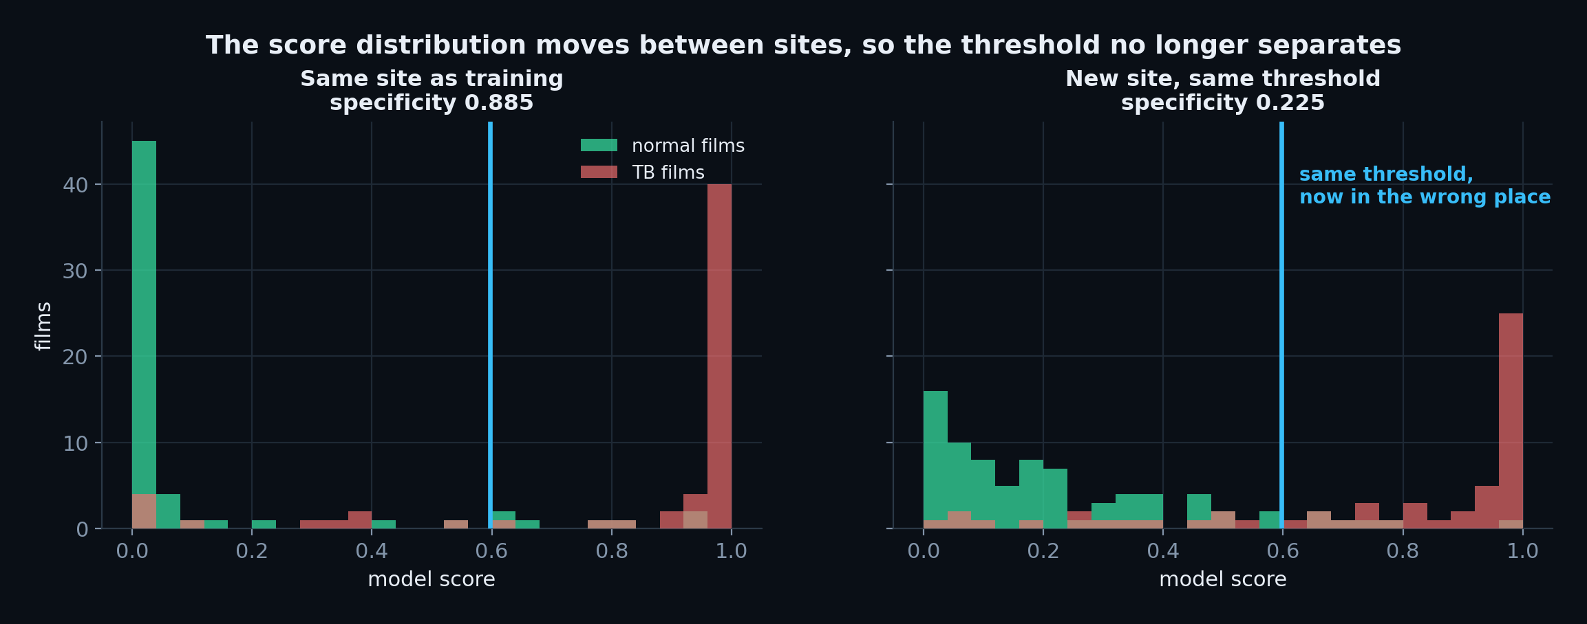
THE FINDING THAT MATTERS
Ranking transfers. Calibration does not.
0.945 → 0.898
0.885 → 0.225
62 of 80
AUROC, same site → new site. Barely moves: it is threshold-free.
Specificity at the same threshold. Collapses.
healthy people sent for unnecessary testing at the new site.
Trained on Shenzhen (China), tested on Montgomery County (USA), different scanner, population and country
Notes:
60 seconds, SLOW DOWN. AUROC 0.945 to 0.899, but specificity 0.885 to 0.225. Sixty-two of eighty healthy people. Pause. Then: 'the pooled number is the one that would have hurt people.'

Slide 9
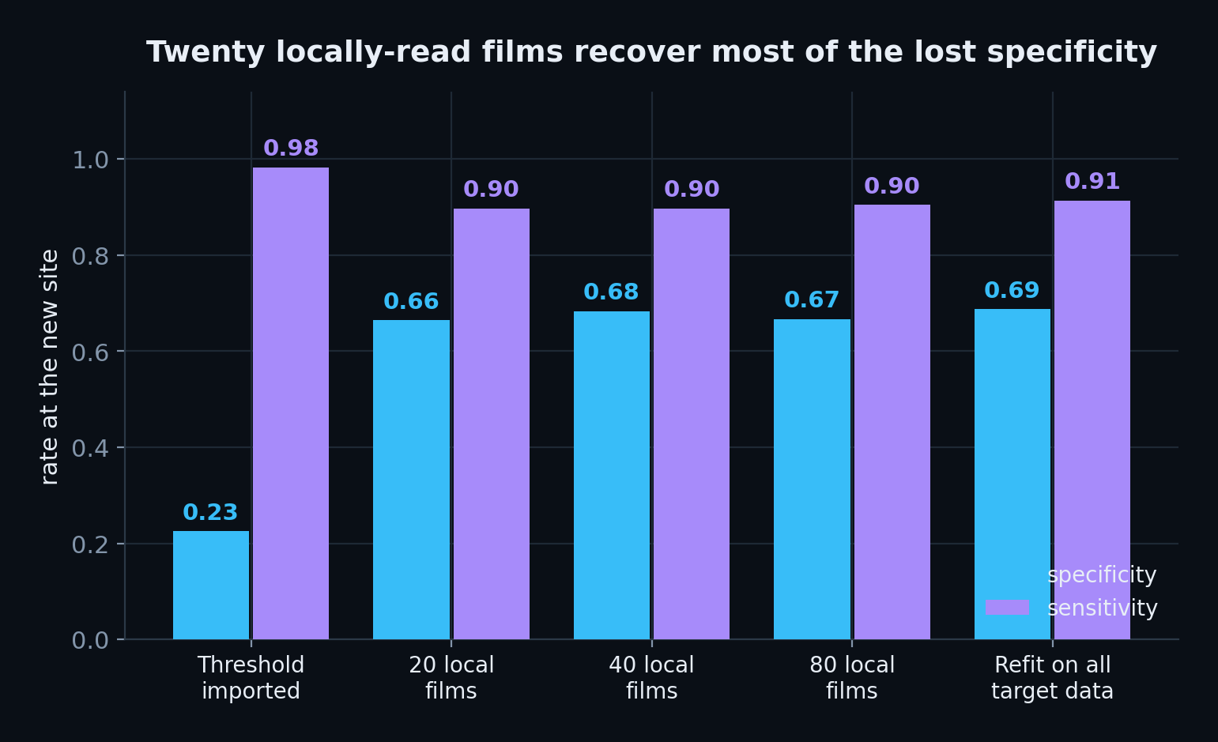
THE FIX
Twenty locally-read films recover most of it
So we do not ship a number.
We ship a calibration step.
Refitting on target-site data restores specificity to 0.688 at 0.914 sensitivity.
Deployment rule
Ship the model, but read 20 local films to recalibrate before trusting any decision it makes.
Notes:
30 seconds. This is a deployment checklist item that came out of measurement, no other team will have one.

Slide 10
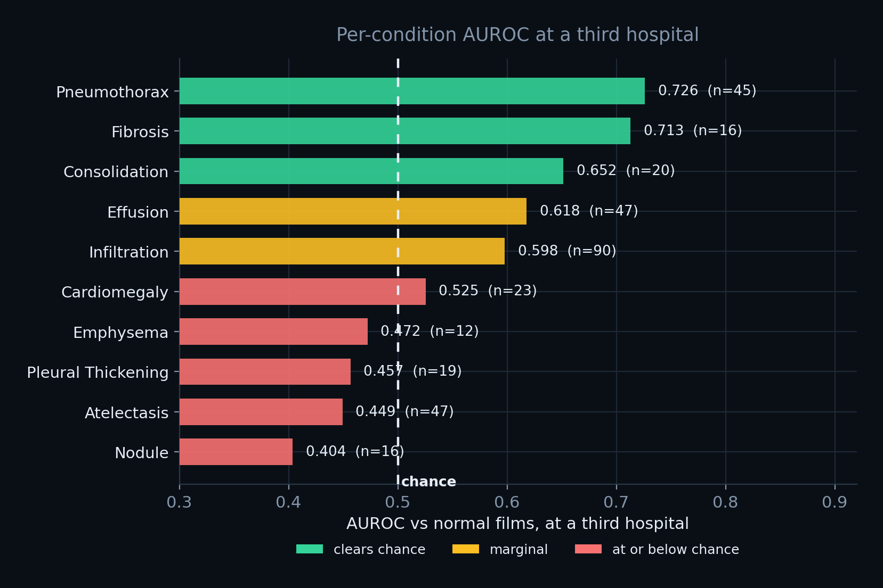
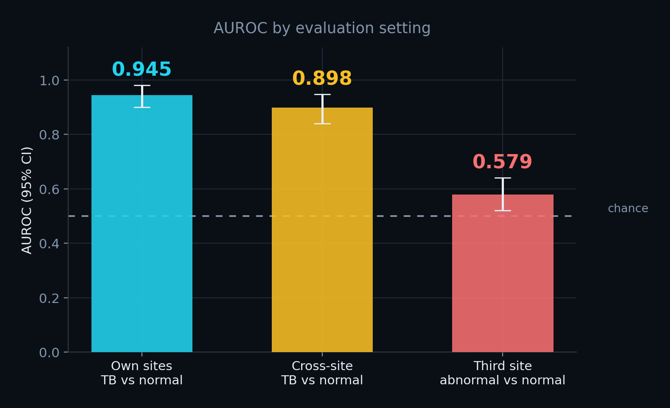
LIMITS OF TRANSFER
And then we found where it stops working
A discrimination failure, not a calibration one. At a third hospital with a general population the model separates any abnormality from normal at AUROC 0.579, near chance, with several conditions below 0.5. No threshold fixes that.
Notes:
50 seconds. NIH ChestX-ray14, third site, general population. It flags 46% of normal films there. No threshold fixes a broken ranking.

Slide 11
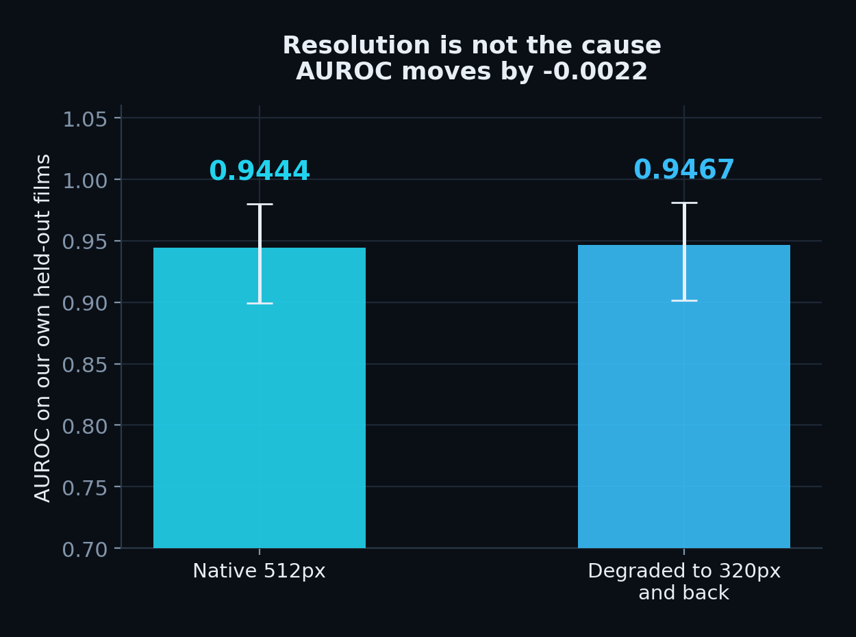
RULING OUT THE OBVIOUS EXPLANATION
We checked whether it was just resolution. It wasn’t.
The NIH mirror stores 320px images. Ours are 512px.
So we degraded our own held-out films through the same pipeline, 512 to 320 and back, and re-scored them.
AUROC moved by 0.0022 (0.944 to 0.947).
Resolution is not the cause. The failure is genuine site and population shift, and we only know that because we tested it.
This also killed one of our own claims. We had said it was just an “abnormal chest” detector. A general abnormality detector would not score 0.579.
Notes:
The self-correction plays very well, volunteer it. Judges rarely hear a team say 'the experiment proved us wrong'.

Slide 12
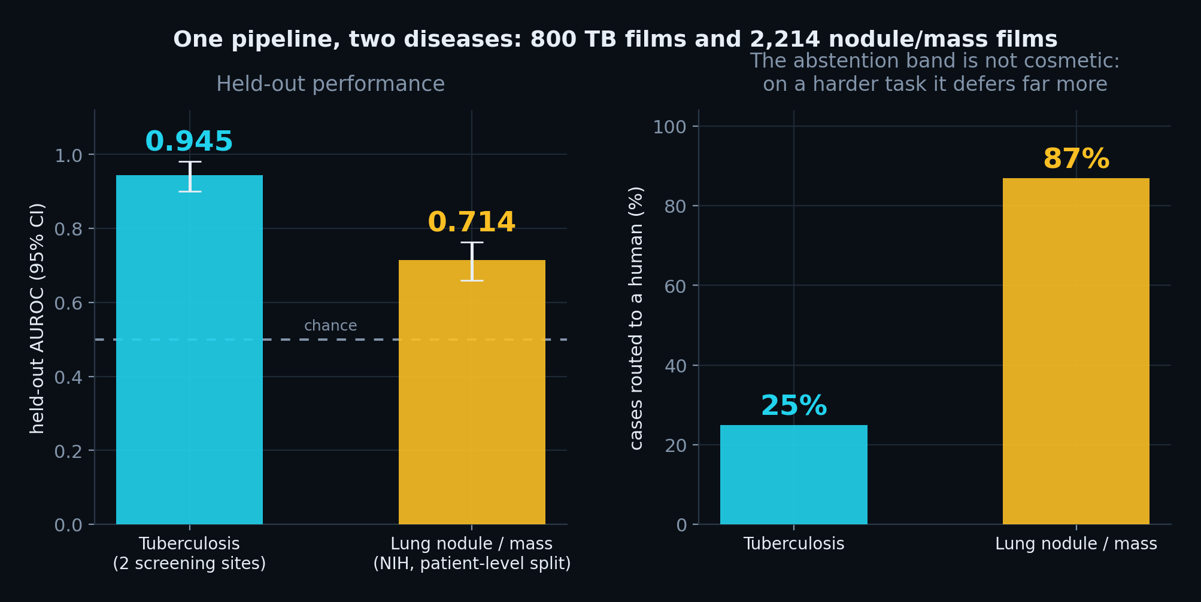
GENERALISING THE PIPELINE
A second disease, by swapping data, not code
Lung nodule / mass
2,214 films from 1,843 patients, NIH ChestX-ray14. Split BY PATIENT, so no patient appears in two splits.
Not cancer detection
The dataset has no cancer label and no stage. A nodule is the finding that sends a patient for a CT, which is where malignancy gets decided.
Patient-level splitting matters: the same patient appears in several films, and an image-level split leaks between train and test
Notes:
35 seconds. Two points: the pipeline extended to a new disease by swapping data, and the harder task produced an honestly worse number (0.714 vs 0.945) with far more abstention (87% vs 25%). If asked about cancer: no cancer label, no stage, it detects the finding that sends you for a CT.

Slide 13
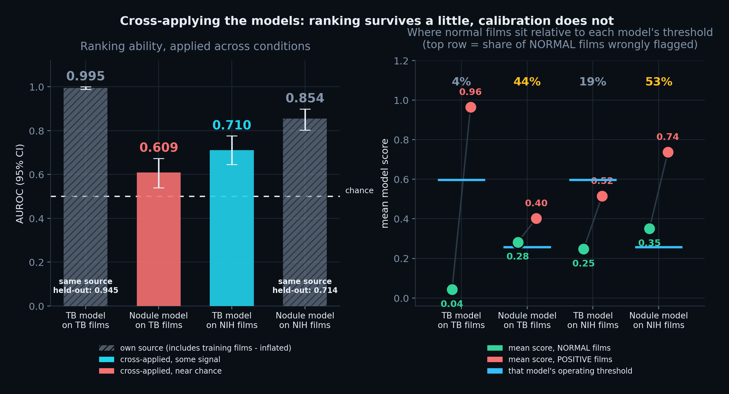
WHAT HAPPENS WHEN YOU POINT THEM AT THE WRONG FILMS
Ranking survives a little. Calibration does not.
A TB film scored 0.91 on the nodule model. Not because TB resembles a nodule, but because that model flags 44% of films from that hospital even when they are completely normal - its mean score on healthy chests there (0.28) already sits above its own threshold (0.26).
Notes:
45 seconds. This generalises the central finding from 'TB across two sites' to 'any model across any source'. The green dots against the blue threshold lines are the whole story: cross-applied, the average HEALTHY chest scores above threshold.

Slide 14
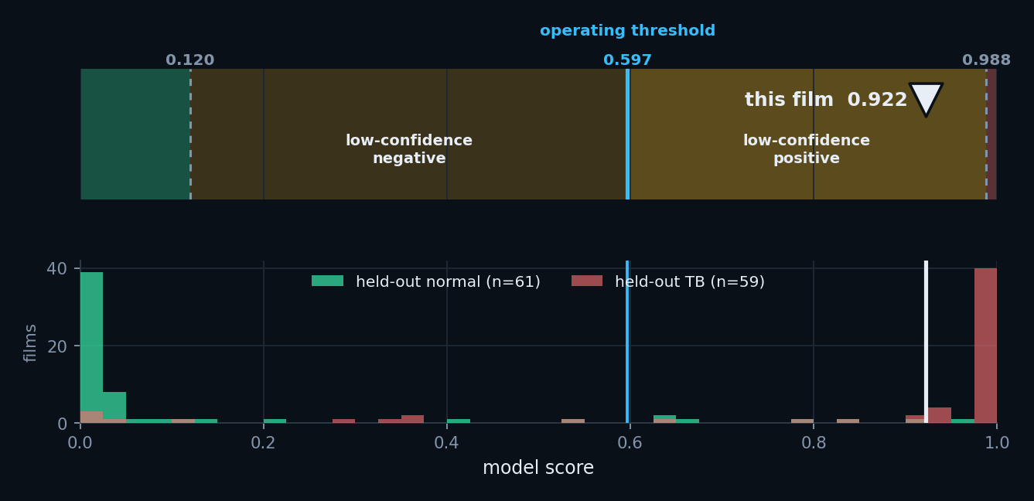
ENGINEERING FOR HONESTY
The tool tells you when not to trust it
Out-of-distribution guard
Two measured signals, thresholded at the 95th percentile of 320 real films: how much attention lands outside the lung fields, and how far the image profile is from training.
Why we built it
A radiograph pulled off the web scored 0.07 while its saliency map lit up both shoulders, where there is no lung. The score was meaningless and nothing said so. Now it refuses to present one.
Every result shows this strip. The decision has a direction AND a confidence, so the score is placed in one of four zones with their real boundaries, against the distribution of held-out films with known labels.
Notes:
30 seconds, and a good slide to cut first if short on time. The story: we tried a random web X-ray, got a meaningless score, and built the guard that catches it.

Slide 15
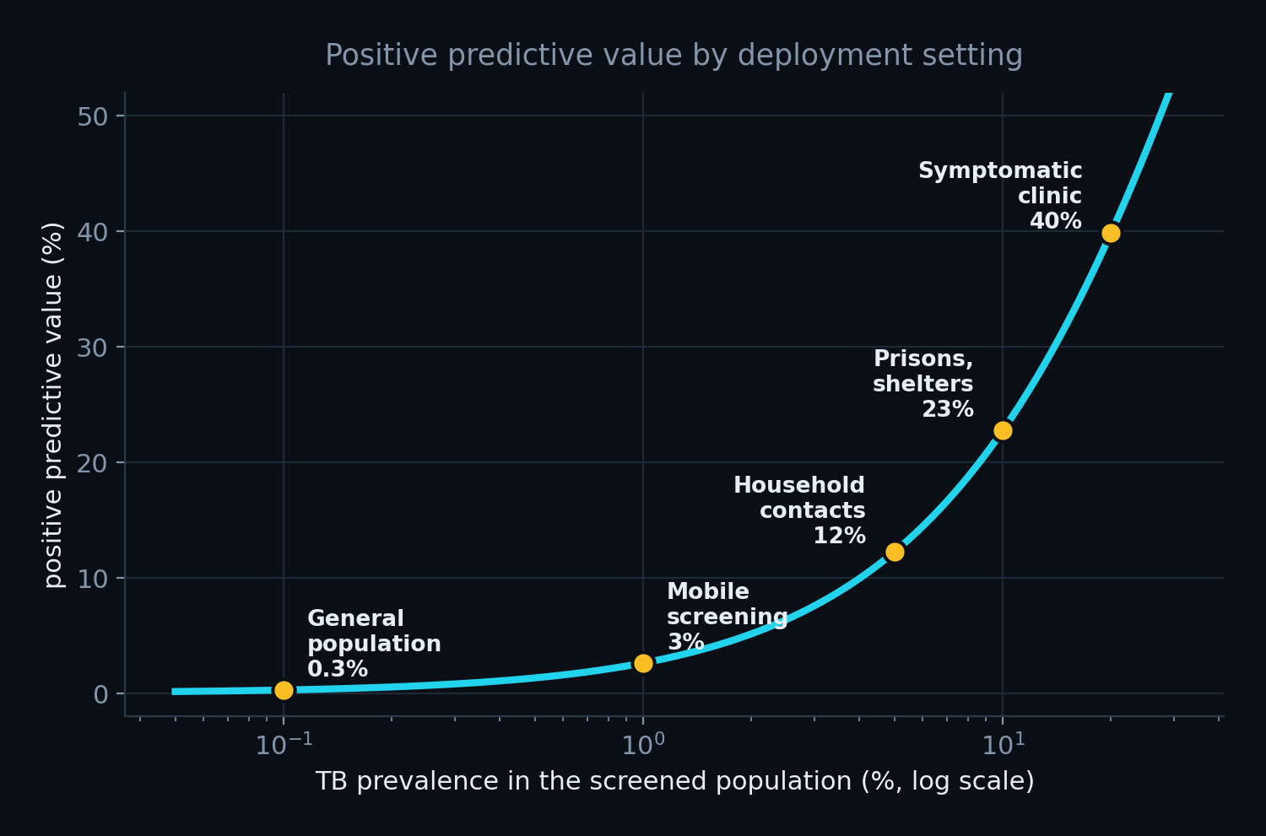
WHERE TO DEPLOY
Prevalence is the lever, not accuracy
Deploy here
Congregate settings, prisons, shelters, mining camps. Household contact tracing. Symptomatic clinic queues.
Not here
General hospital worklists. Children, the model has only seen adults. Diagnosis of any kind, ever.
PPV computed at sensitivity 0.90 and specificity 0.66, the cross-site, locally recalibrated operating point
Notes:
35 seconds. The same weights give 0.3% PPV in the general population and 23% in a prison. Being explicit about where it should NOT go reads as maturity.

Slide 16
WHAT IS REAL
Measured, not claimed
Radiographs
real, 800 films, NLM Montgomery + Shenzhen
Clinical validation
none
Labels
real, from the datasets
Regulatory clearance
none
Model
really trained, on this GPU
Paediatric use
not supported, untested
Metrics
real, held-out, bootstrap CIs
Diagnosis
not what this does
Cross-site validation
two sites plus one external
General worklists
measured as unsuitable
Transfer limits
measured, and stated
We found the boundary of where our model works, and the experiment that proves it is not an artifact.
That is the contribution. The accuracy number is the easy part.
Notes:
Close here or on the pneumonia demo case. Never close on the accuracy slide.

