Slide 1
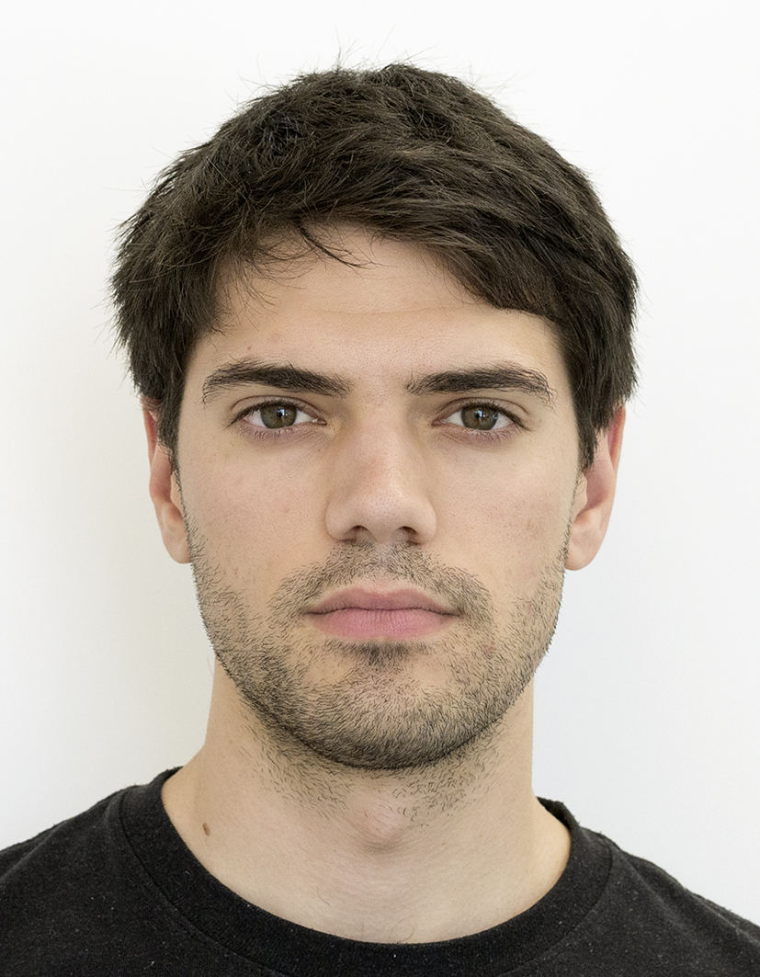
Encrypted Fast Covariance Intersection Without Leaking Fusion Weights
Int. Conf. on Multisensor Fusion and Integration (MFI2022)
Marko Ristic, Benjamin Noack
Prof. Dr.-Ing. Benjamin Noack
Autonomous Multisensor Systems Group (AMS)
Otto von Guericke University, Magdeburg, Germany (OVGU)
XX.09.2022

Slide 2










Context

Slide 3

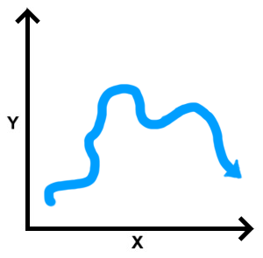




Problem
Estimate 1
Estimate 2
Fusion
Estimate n

Slide 4
Related Solutions

Slide 5
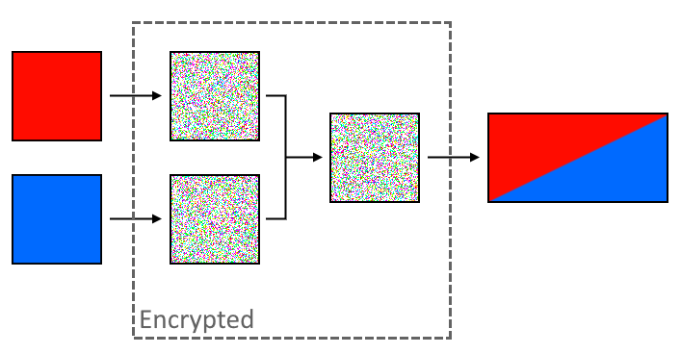

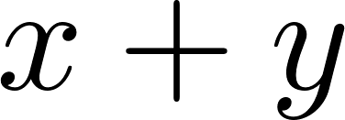

Covariance Intersection and Paillier Encryption

Slide 6
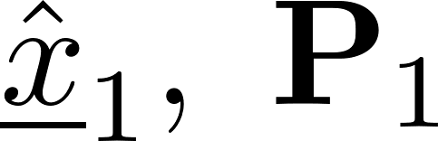

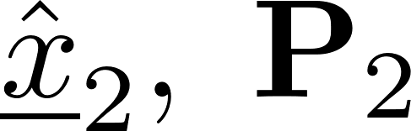
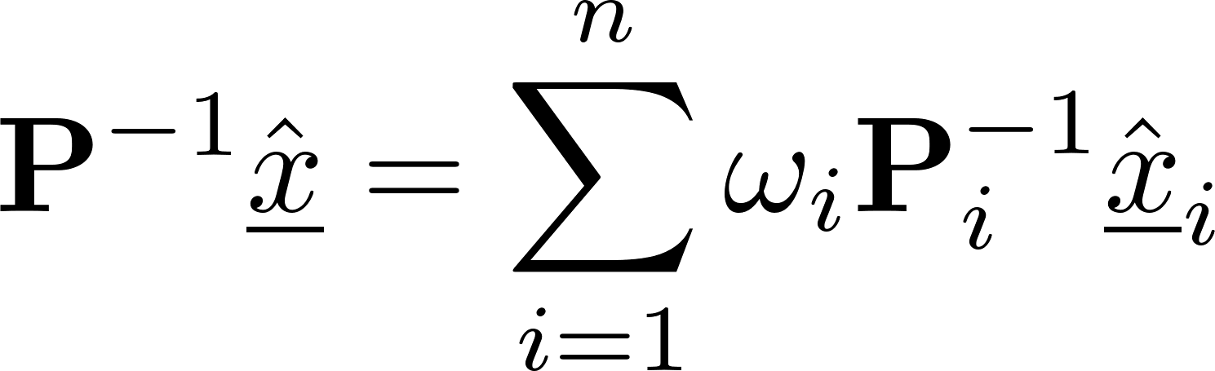
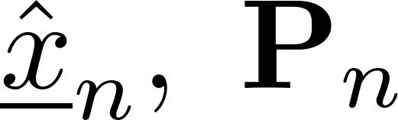
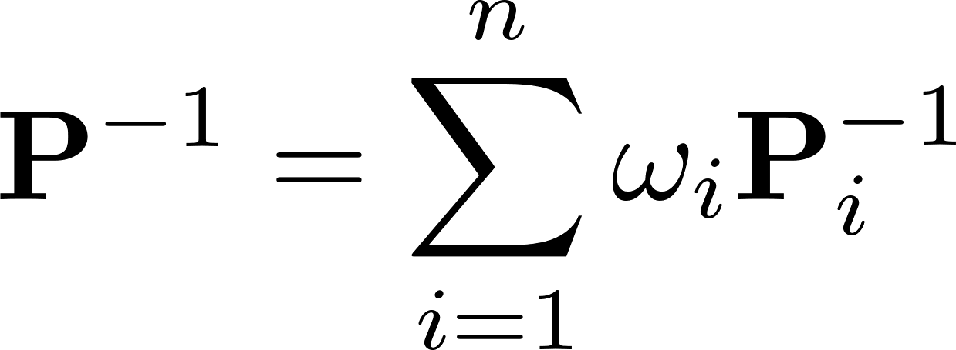
Information Form and Delayed Evaluation

Slide 7
Encryption Fast Covariance Intersection

Slide 8
Comparison
Weights not leaked
Leaked weights

Slide 9
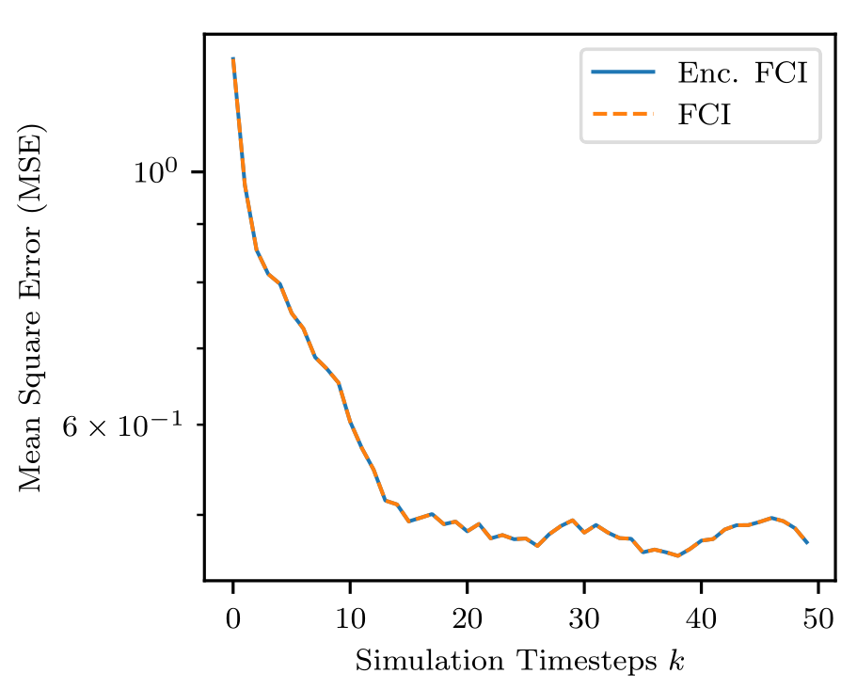
Estimation Performance

Slide 10
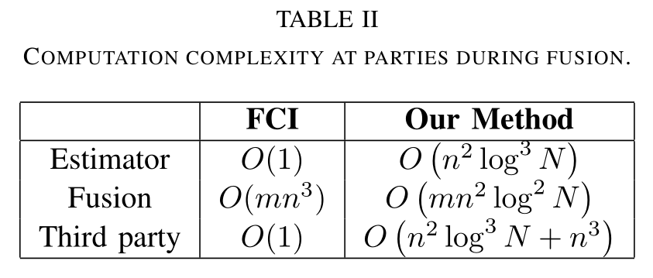
Complexity

Slide 11
Security

Slide 12
Thank You

