Slide 1
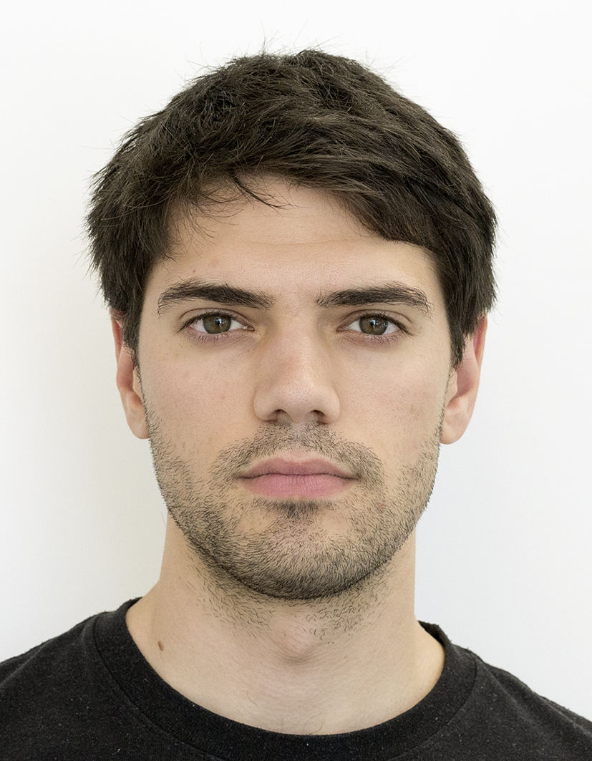
Encrypted Fast Covariance Intersection Without Leaking Fusion Weights
Int. Conf. on Multisensor Fusion and Integration (MFI2022)
Marko Ristic, Benjamin Noack
Prof. Dr.-Ing. Benjamin Noack
Autonomous Multisensor Systems Group (AMS)
Otto von Guericke University, Magdeburg, Germany (OVGU)
XX.09.2022

Slide 2
Context

Slide 3
Problem

Slide 4
Related solutions

Slide 5
Method

Slide 6
Comparison

Slide 7
Estimation performance

Slide 8
Complexity

Slide 9
Security

Slide 10
Thank you

