Slide 1
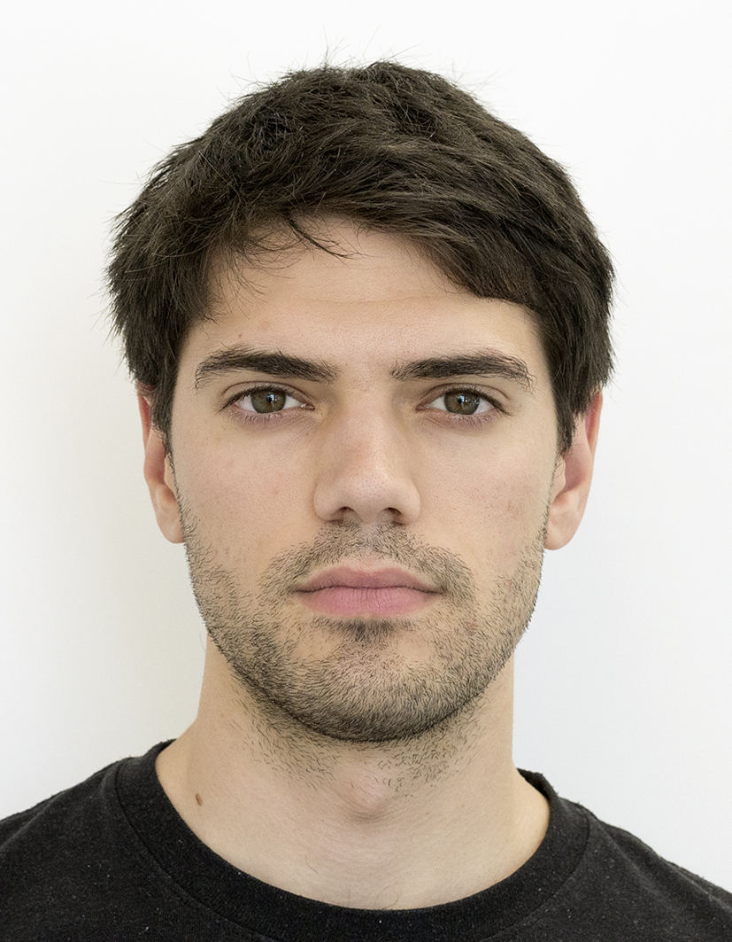
Encrypted Fast Covariance Intersection Without Leaking Fusion Weights
Int. Conf. on Multisensor Fusion and Integration (MFI2022)
Marko Ristic, Benjamin Noack
Prof. Dr.-Ing. Benjamin Noack
Autonomous Multisensor Systems Group (AMS)
Otto von Guericke University, Magdeburg, Germany (OVGU)
20.09.2022

Slide 2










Context
Growing number of public networks
Increasingly used by distributed sensors
State estimation and data fusion typically computed centrally
Untrusted server operators are a concern

Slide 3

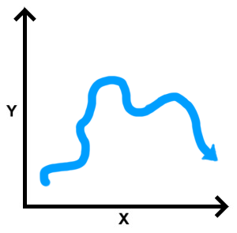




Problem
Fusion of distributed estimates
Centralised fusion with unknown cross-correlations
Untrusted fuser (cloud)
Trusted querying third-party
Estimate 1
Estimate 2
Fusion
Estimate m

Slide 4
Related Solutions
Fully homomorphic computation with encrypted data
Typically too computationally slow in practice
Solution with leakage of relative sensor errors
Covariance intersection algorithm
Two encryption schemes
Approximate weights leaked at fuser
Potentially identifying information leaked (state and sensor type inference a possibility)

Slide 5
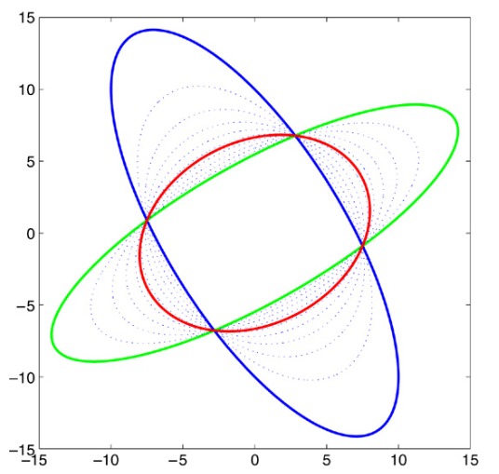
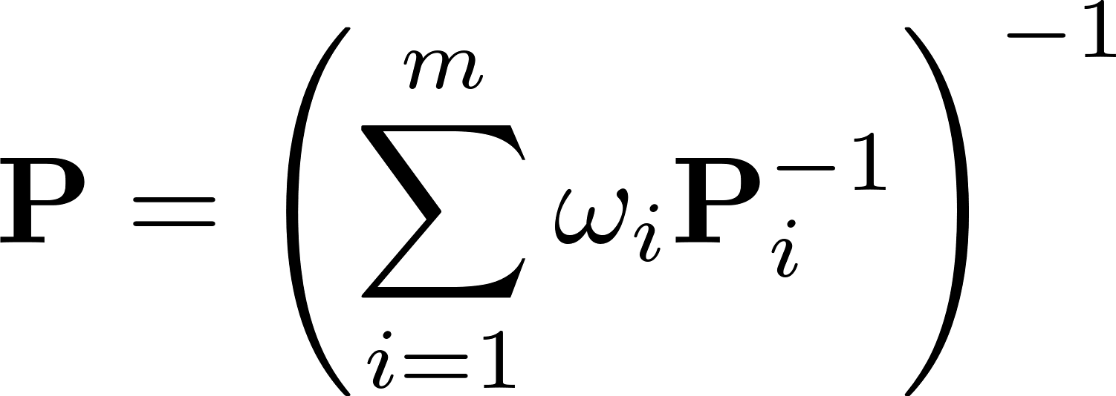
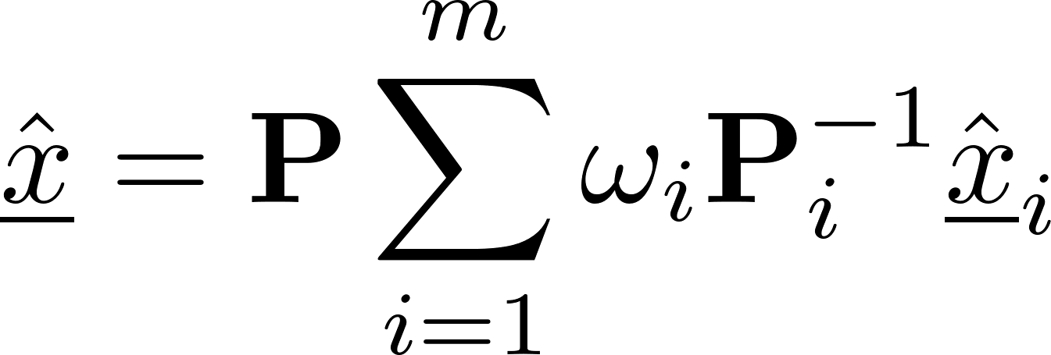
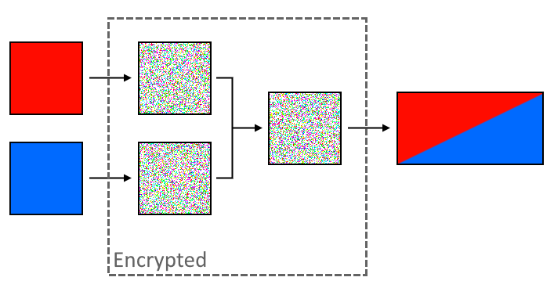

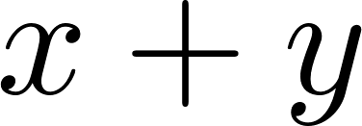

Covariance Intersection and Paillier Encryption
Covariance Intersection fuses conservatively when cross-correlations are unknown
Paillier encryption allows the homomorphic addition of cyphertexts without decryption

Slide 6
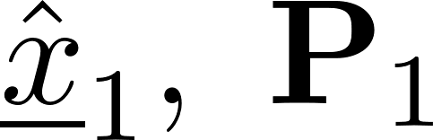

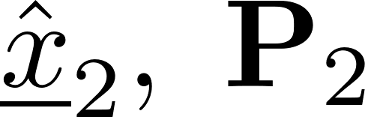
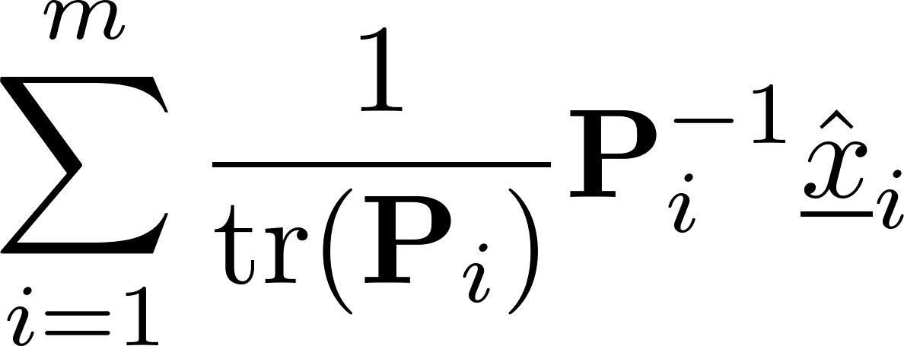
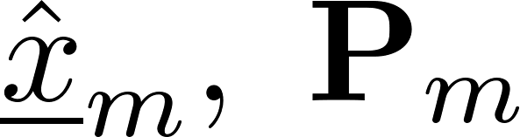
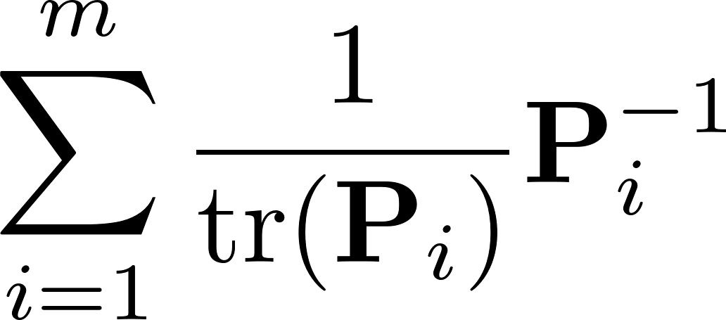
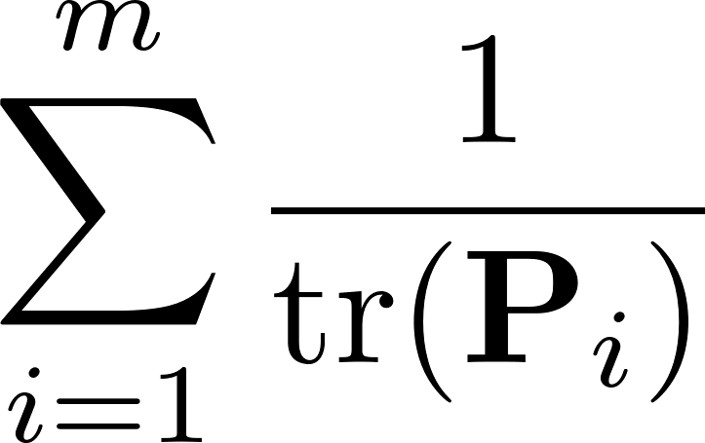
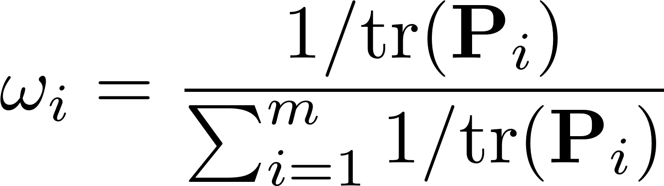
Information Form and Delayed Evaluation
Reduce fusion of information to summations

Slide 7
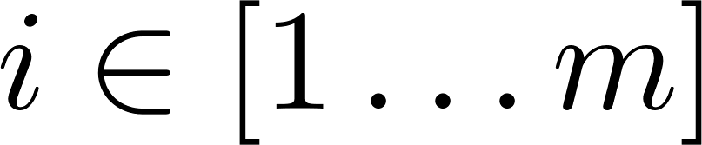
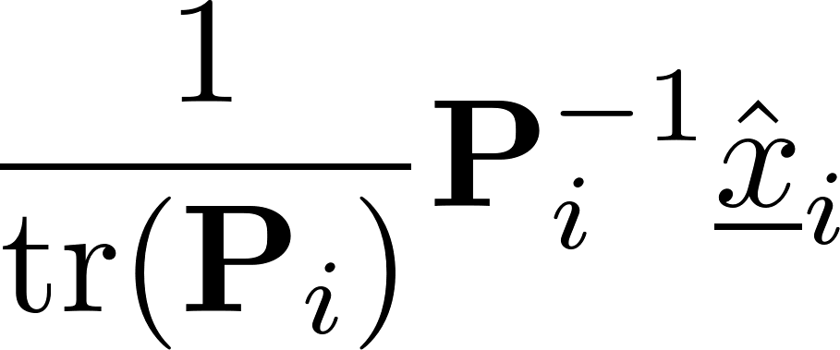
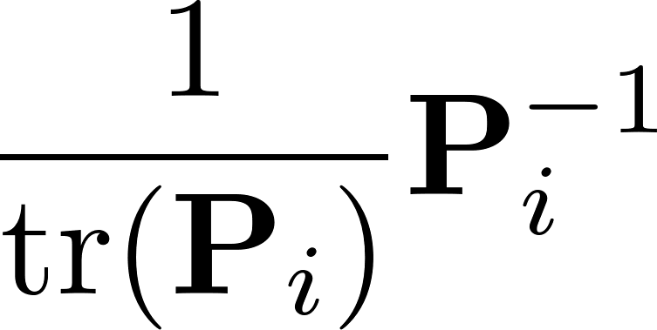
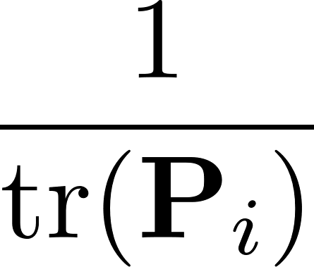
Encryption Fast Covariance Intersection
Compute fusion homomorphically with Paillier encryption scheme
Encrypt
Homomorphically fuse
Decrypt and evaluate

Slide 8
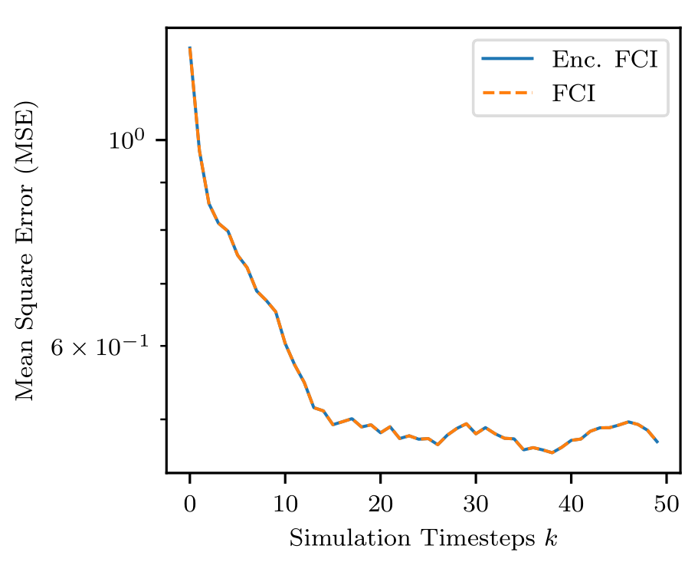
Estimation Performance
Quantisation error when encrypting
Weights computed exactly
Negligible estimation performance difference with sufficient key size

Slide 9

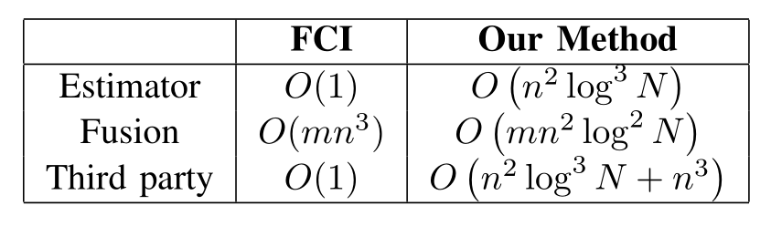


Complexity
Additional workloads
Encryption at sensor
Homomorphic addition at cloud
Decryption and matrix inversion by querying party
Which objects can query cloud need to be considered (power/memory requirements)
Encryption key length: Number of estimates:
Dimension of state:

Slide 10
Security
All individual sensor input is encrypted by Paillier encryption
Implicit leakage of state dimension and number of sensors connected remains
No identifying sensor information available to fuser or eavesdroppers
No individual sensor input available to querying party

Slide 11
Comparison with Leaking Weights
Weights not leaked
Leaked weights
Fuser learns no information about individual estimates
Third party requires additional computations to obtain result
Computational overhead for one encryption scheme
Fuser learns relative estimate errors (covariance traces)
Only decryption is required at third party
Computational overhead for two encryption schemes

Slide 12
Thank You
Questions
References
https://citeseerx.ist.psu.edu/viewdoc/download?doi=10.1.1.106.8515&rep=rep1&type=pdf
M. Ristic, B. Noack, and U. D. Hanebeck, ‘Secure Fast Covariance Intersection Using Partially Homomorphic and Order Revealing Encryption Schemes’, IEEE Control Systems Letters, vol. 5, no. 1, pp. 217–222, Jan. 2021, doi: 10.1109/LCSYS.2020.3000649.
Marko Ristic
Prof. Dr.-Ing. Benjamin Noack
Autonomous Multisensor Systems Group (AMS)
Otto von Guericke University, Magdeburg, Germany (OVGU)

