Slide 1
Privileged Estimate Fusion With Correlated Gaussian Keystreams
Conference on Decision and Control (CDC) 2022
Marko Ristic, Benjamin Noack
Autonomous Multisensor Systems Group
Institute for Intelligent Cooperating Systems
Faculty of Computer Science
Otto von Guericke University, Magdeburg
9.12.2021

Slide 2
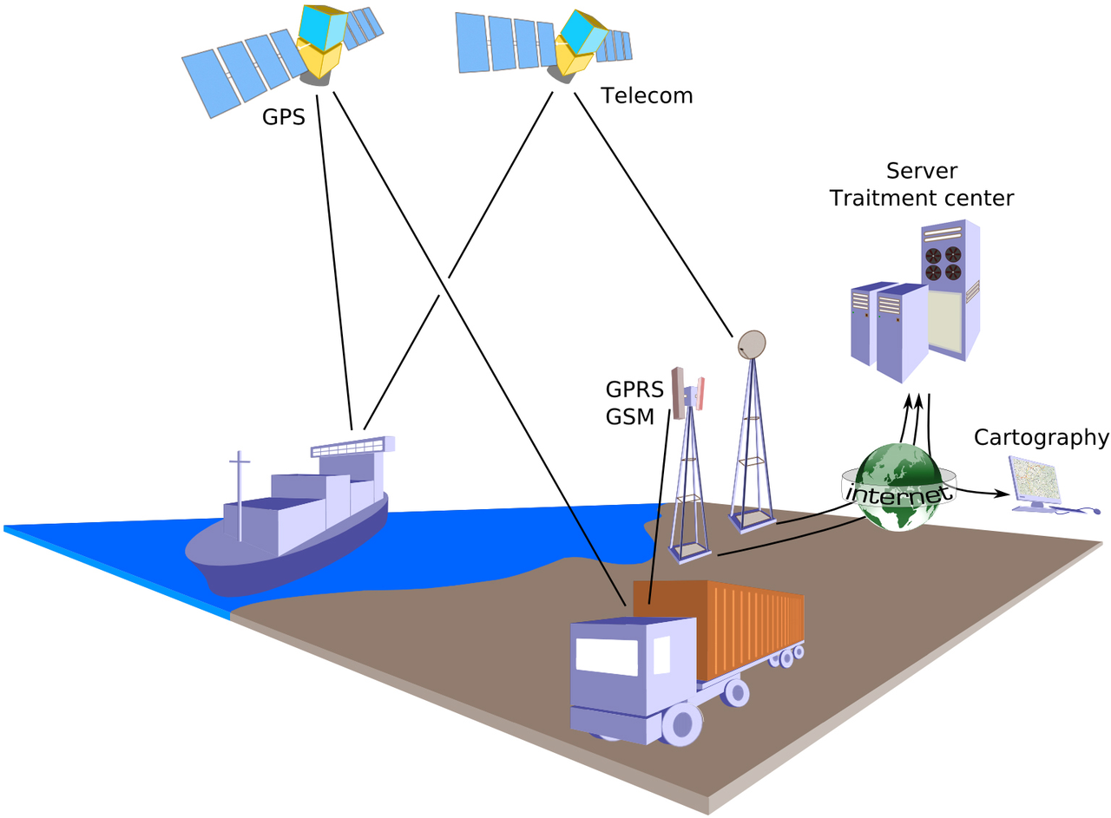



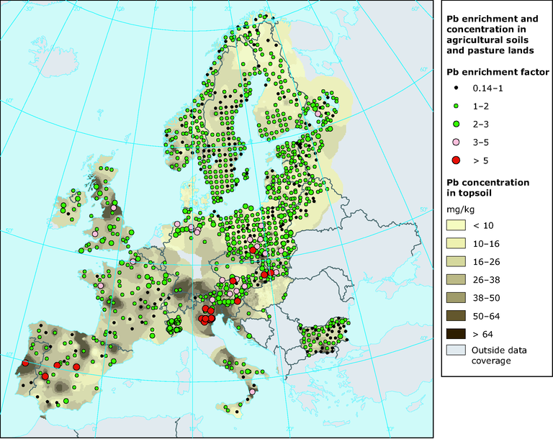







Security in Networks
https://fr.wikipedia.org/wiki/G%C3%A9olocalisation#/media/Fichier:Geolocation.png
Growing number of public networks
Increasingly used by distributed sensors, IoT devices, cloud computing, etc
Greater need for security guarantees
Affected users
Private
Commercial
Government
https://www.eea.europa.eu/data-and-maps/figures/soil-contamination-by-heavy-metals

Slide 3




Privilege in Estimation
Public measurements useable for state estimation
Trusted or special users may be granted privilege
Privileged users should perform better than unprivileged ones
“Bad” Estimate
Measurement
“Good” Estimate

Slide 4
Privilege in Estimation
Public measurements useable for state estimation
Trusted or special users may be granted privilege
Privileged users should perform better than unprivileged ones
Security guarantee concerns proving the minimum difference in performance
“Bad” Estimate
Measurement
“Good” Estimate

Slide 5
Single Sensor Privilege
Add generated Gaussian keystream to measurements
Anyone holding generation key can remove added noise

Slide 6
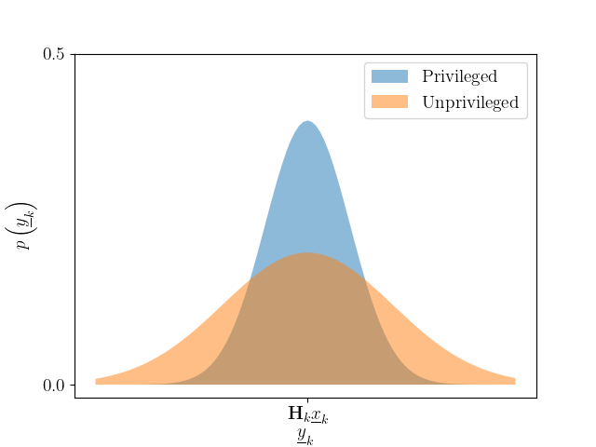
Single Sensor Privilege
Add generated Gaussian keystream to measurements
Anyone holding generation key can remove added noise
System
Measurement
Modified measurement

Slide 7
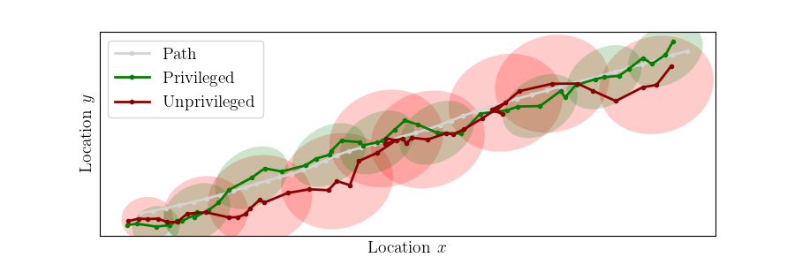
Single Sensor Performance
Leads to intuitive difference in performance
Less noise produces better estimates

Slide 8
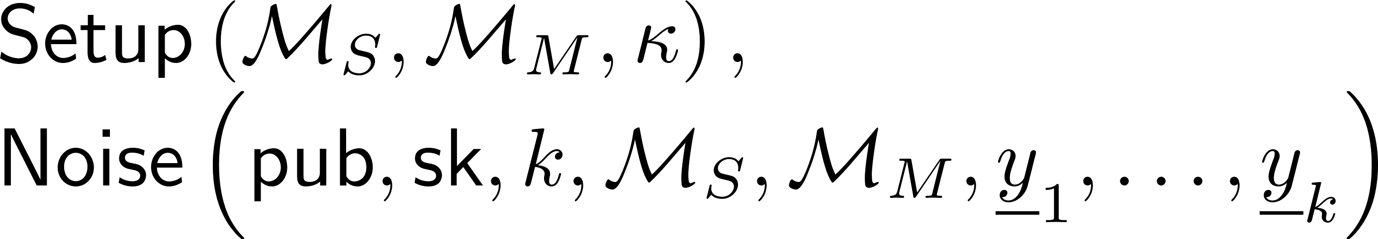
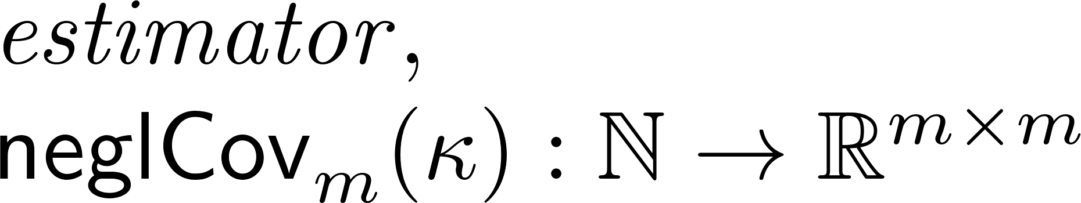
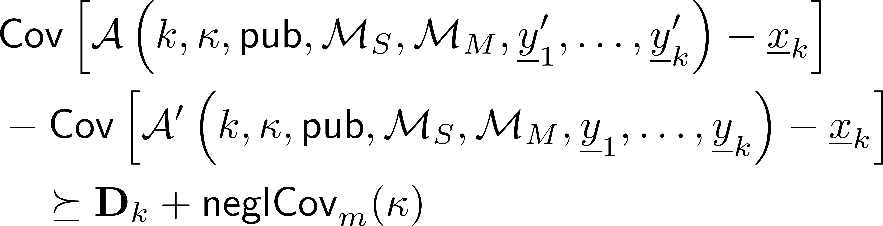
Cryptographic Definition for Performance
Algorithms
Definitions
Covariance Privilege

Slide 9
Complication of Fusion
Multiple privileged sensors each adding Gaussian keystream
Measurement 1
“Bad” Estimate
1
Measurement n
“Good” Estimate
n
1..n

Slide 10
Complication of Fusion
Multiple privileged sensors each adding Gaussian keystream
Two ways of getting better estimates
Hold keys to remove added noises (desired)
Fuse more measurements (desired only when keys are held as well)
Measurement 1
“Bad” Estimate
1
Measurement n
“Good” Estimate
n
1..n

Slide 11
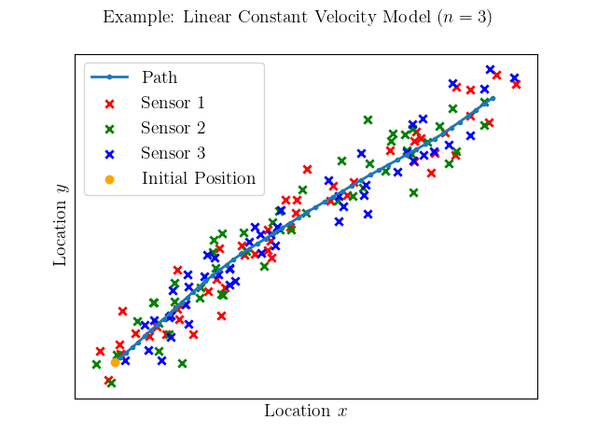
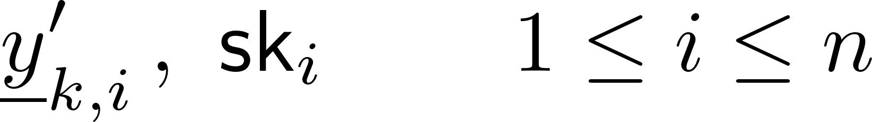
Multisensor Estimation Problem
Linear models considered
Kalman Filter optimality in proofs
System
Measurements
Modified measurements and keys

Slide 12

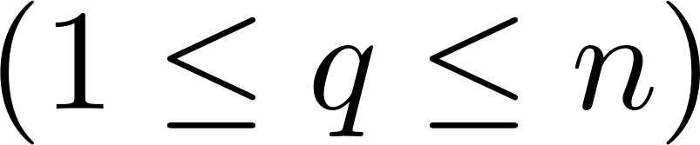

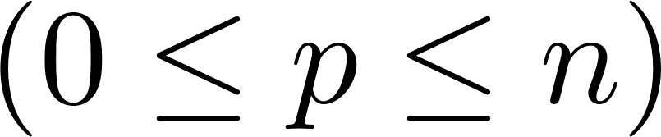

Sequential Assumption
Estimators can access measurements
Estimators have privilege (the number of keys they hold)

Slide 13
Sequential Assumption
Estimators can access measurements
Estimators have privilege (the number of keys they hold)
Estimators have access to sequential measurements
Estimators have access to all measurements for which they hold a key

Slide 14
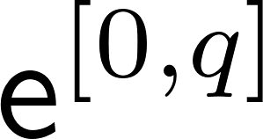
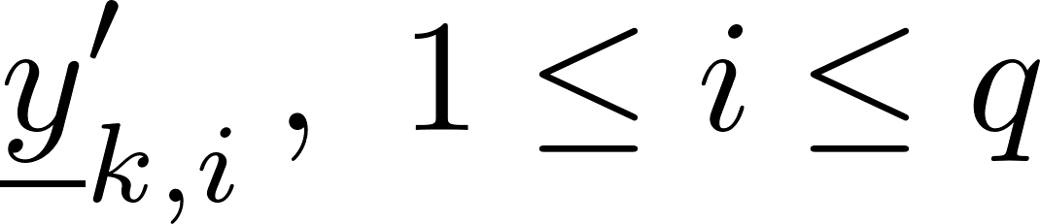
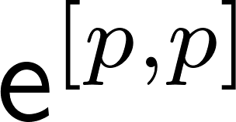
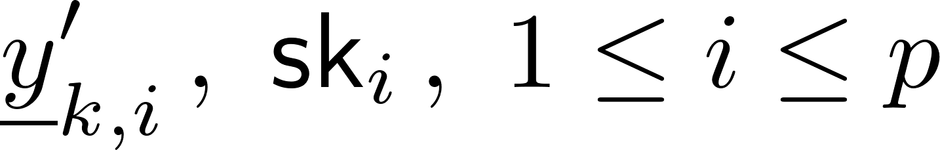
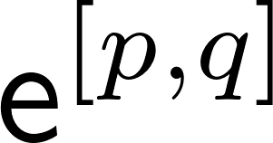
Sequential Assumption
Estimators can access measurements
Estimators have privilege (the number of keys they hold)
Estimators have access to sequential measurements
Estimators have access to all measurements for which they hold a key
Access to:
Access to:
Access to:

Slide 15
Bounds on Performance Loss and Gain
Capture desired performance differences in multisensor environment

Slide 16
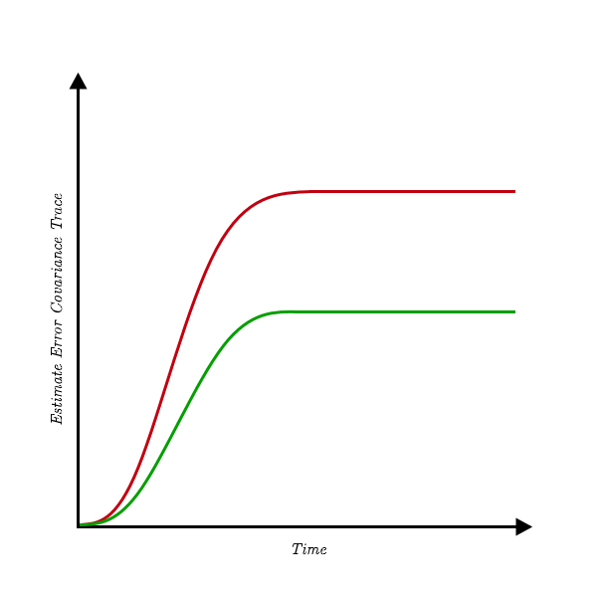
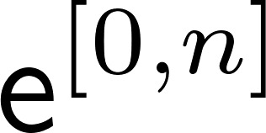
Bounds on Performance Loss and Gain
Capture desired performance differences in multisensor environment
Performance Loss Lower Bound
min

Slide 17
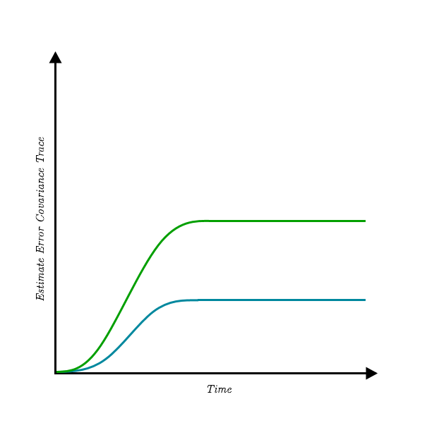
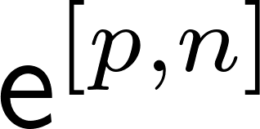
Bounds on Performance Loss and Gain
Capture desired performance differences in multisensor environment
Performance Loss Lower Bound
Performance Gain Upper Bound
min
max

Slide 18
Bounds on Performance Loss and Gain
Capture desired performance differences in multisensor environment
Both bounds desired for each privilege
Performance Loss Lower Bound
Performance Gain Upper Bound
min
max

Slide 19

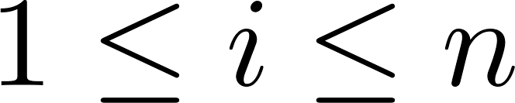
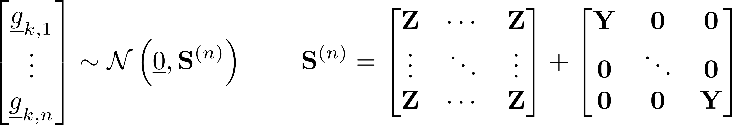
Correlated Noise Generation
Generate uniform keystreams from for
Correlated uniform keystreams with Box-Muller transform
Correlated component
Uncorrelated component

Slide 20
Correlated Noise Generation
Generate uniform keystreams from for
Correlated uniform keystreams with Box-Muller transform
Add generated keystreams to measurements
Correlated component
Uncorrelated component

Slide 21
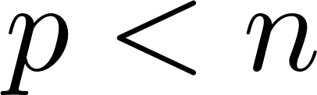
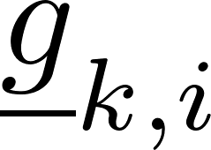
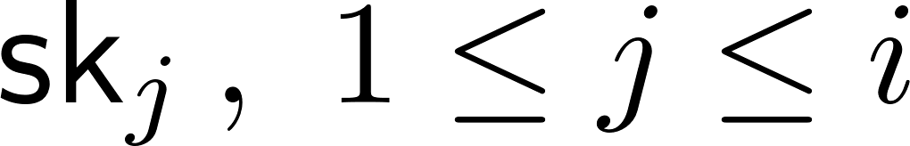
Correlated Noise Reconstruction
Each added noise depends on multiple keys!
Need to correctly reconstruct partial noises when
Lower-triangular decomposition (e.g. Cholesky) in Box-Muller transform ensures
depends on

Slide 22
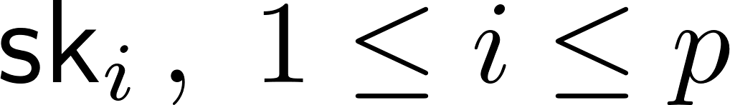
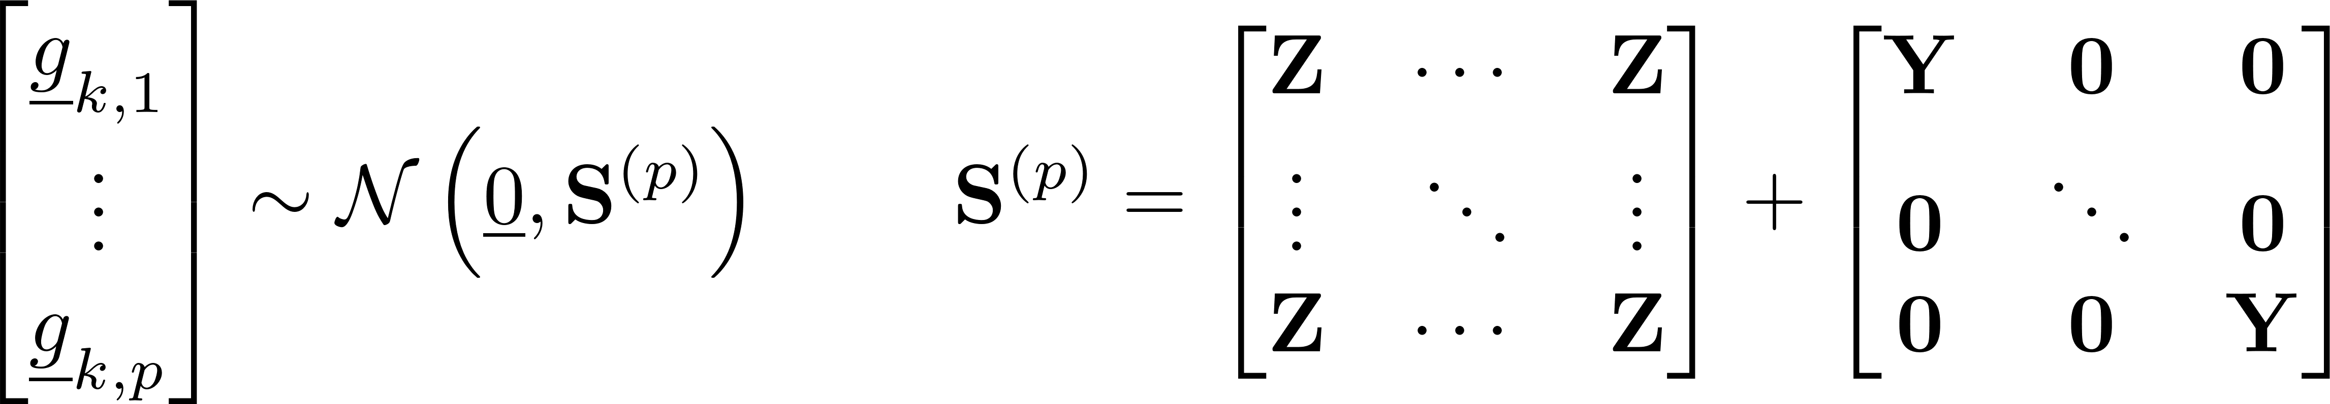
Correlated Noise Reconstruction
Each added noise depends on multiple keys!
Need to correctly reconstruct partial noises when
Lower-triangular decomposition (e.g. Cholesky) in Box-Muller transform ensures
Can reconstruct first noises with exactly (recall sequential assumption)
depends on

Slide 23
Observable Measurement Models
Gaussian keystream indistinguishable from random without key
Leads to three observable measurement models

Slide 24
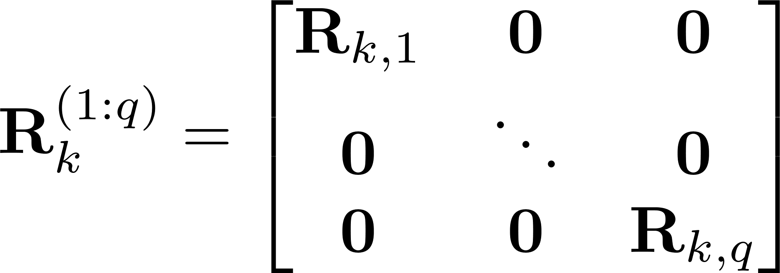
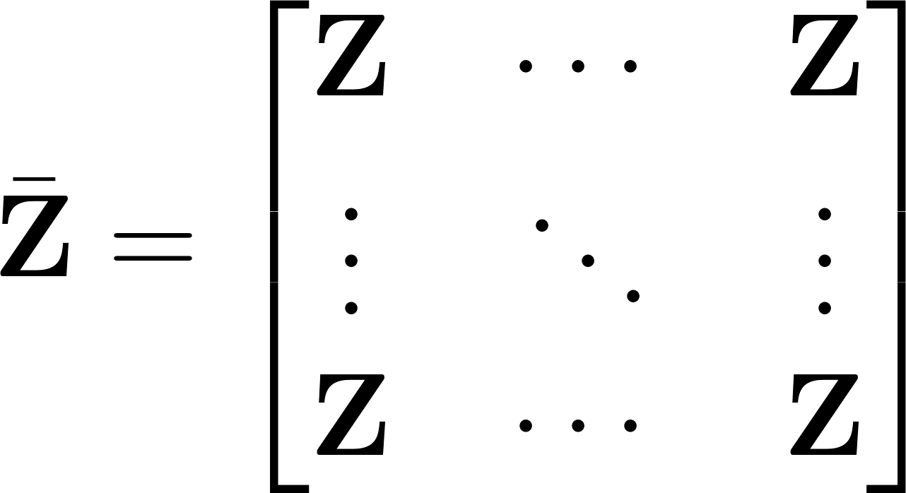
Observable Measurement Models
Notation
Gaussian keystream indistinguishable from random without key
Leads to three observable measurement models

Slide 25
Proving Performance Loss and Gain Bounds
Exact linear models mean optimal estimates

Slide 26

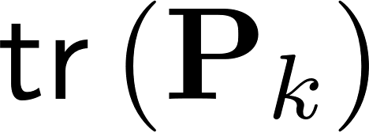
Proving Performance Loss and Gain Bounds
Exact linear models mean optimal estimates
Performance Loss Lower Bound
optimal
min
optimal
Lowest possible

Slide 27
Proving Performance Loss and Gain Bounds
Exact linear models mean optimal estimates
Performance Loss Lower Bound
Performance Gain Upper Bound
optimal
min
optimal
optimal
max
optimal
Lowest possible

Slide 28
Distributing Noise Samples
Keystreams depend on previous values
Multiple ways to generate

Slide 29
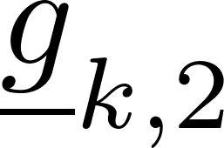
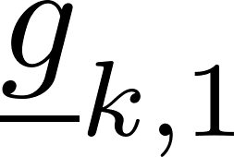
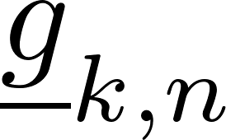
Distributing Noise Samples
Keystreams depend on previous values
Multiple ways to generate
Centralised

Slide 30
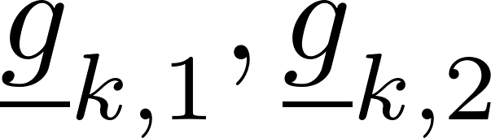
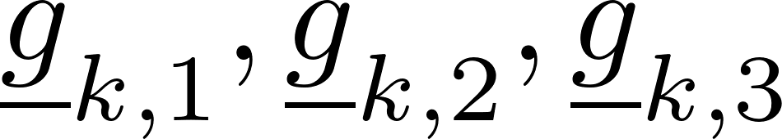
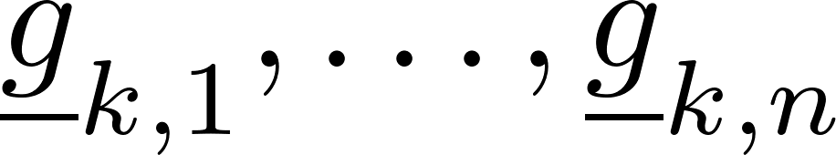
Distributing Noise Samples
Keystreams depend on previous values
Multiple ways to generate
Centralised
Sequential

Slide 31
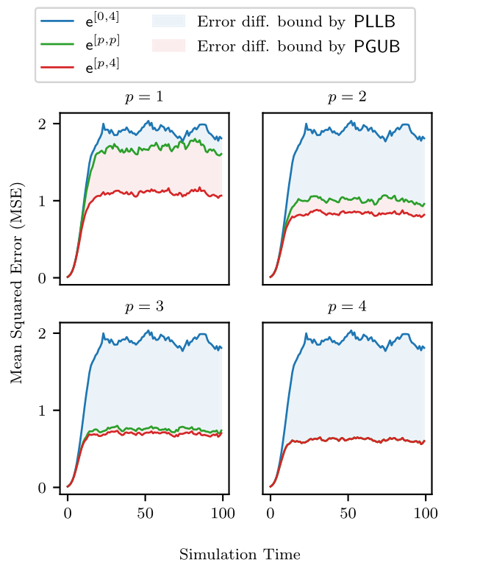
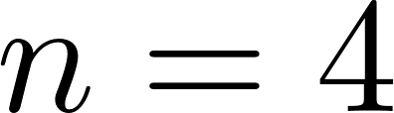


Simulation Results
Fixed fully correlated component and uncorrelated component

Slide 32
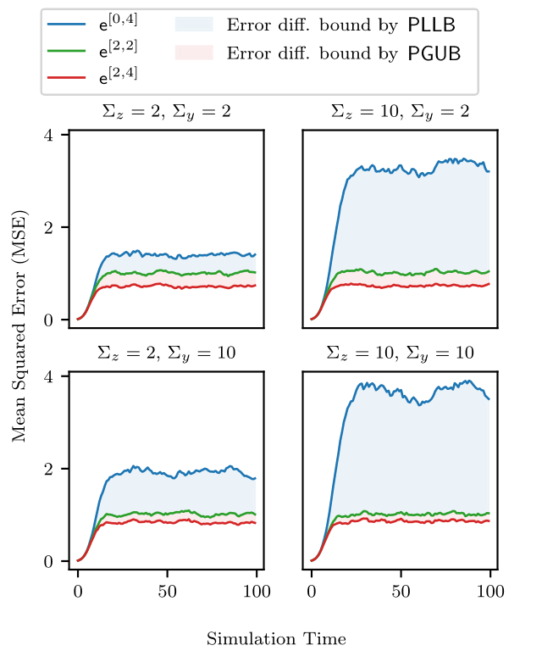


Simulation Results
Varied and

Slide 33
Simulation Results
Varied and
Effect of and on bounds?

Slide 34
Parameter Dependence
Consider traces of bounds

Slide 35
Parameter Dependence
Consider traces of bounds
Consider steady state of stable system

Slide 36
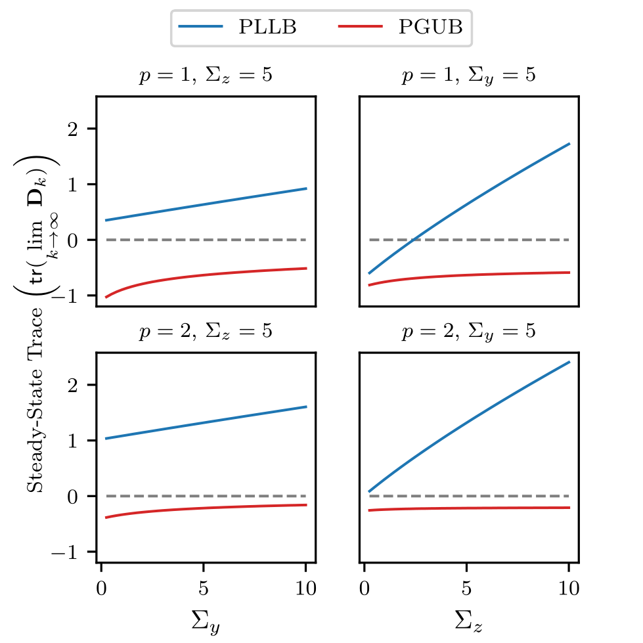
Parameter Dependence
Consider traces of bounds
Consider steady state of stable system
Vary and

Slide 37
Future Work
Search for correlation matrix parameters that affect bounds independently
Relaxations of sequential assumption
Efficient decentralised noise generation

Slide 38
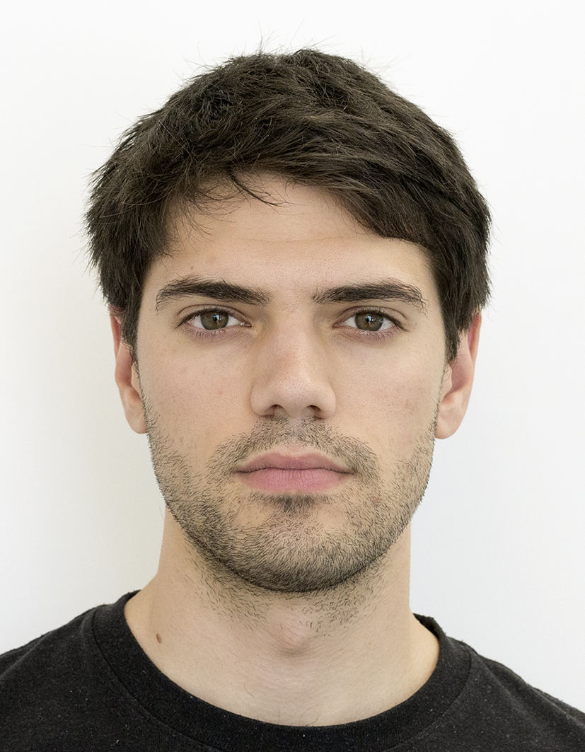
Future Work
Search for correlation matrix parameters that affect bounds independently
Relaxations of sequential assumption
Efficient decentralised noise generation
Phone: +49 391 67 57591
Email: marko.ristic@ovgu.de
Web: https://ams.ovgu.de
Thank you!

