Slide 1
Lung Cancer PREDICTION
University Name
Submitted by:

Slide 2
Research Hypothesis
Male is the leading gender with lung cancer diseases.
People between the age of 40-50 are the leading age group with lung cancer disease.
People who smoke are the leading group with lung cancer.

Slide 3
CONT
NULL HYPOTHESIS: Male is the leading gender with lung cancer diseases.
ALTERNATE HYPOTHESIS: Male is the leading gender with lung cancer diseases
NULL HYPOTHESIS: People who smoke are the leading group with lung cancer.
ALTERNATE HYPOTHESIS: People who smoke are not the leading group with lung cancer.
NULL HYPOTHESIS: People between the age of 40-50 are the leading age group with lung cancer disease.
ALTERNATE HYPOTHESIS: People between the age of 40-50 are not the leading age group with lung cancer disease.

Slide 4
Classification techniques
In this research study, I implemented Lung Cancer prediction project using three distinct classification techniques;
Random Forest classifier.
Decision Tree classifier.
Naïve Bayes.

Slide 5
Classification techniques evaluation
The three implemented distinct classification techniques were evaluated to get their performance compare the performance and select the best among them.
In this project implementation;
I used accuracy score,
Prediction test data set results
Confusion matrix. Where I compared the true labels with the predicted labels in order to understand how accurate my techniques are.

Slide 6
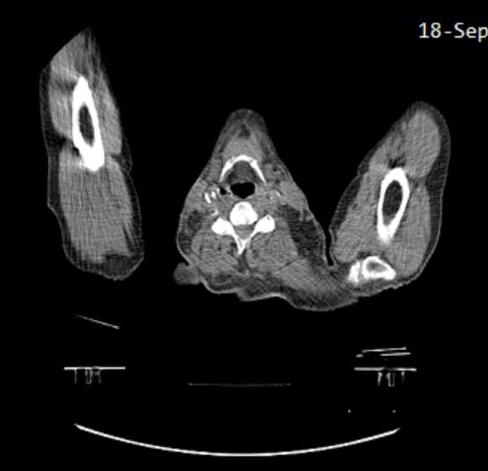
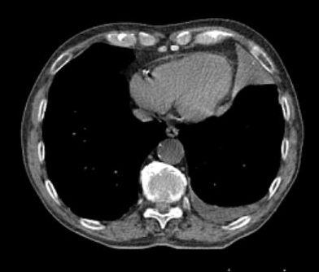
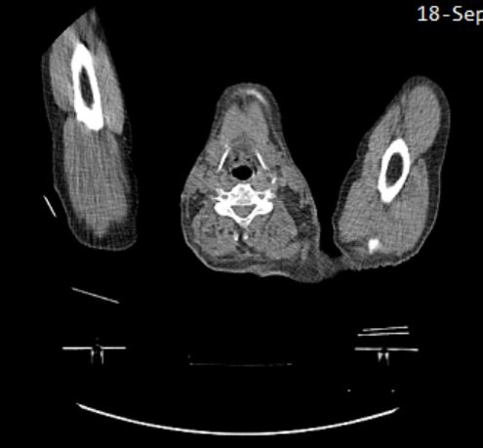
The Problem
Lung Cancer prediction as a result of Smoke.
I collected Survey lung Cancer Dataset from Kaggle. This is the primary dataset used in the project implementation.

Slide 7
Challenges
Data related to medical problems such as lung cancer diseases and many more is hardly made available to open source. Acquiring the dataset I wanted in order to work on my project using techniques such CNN(Convolutional Neural Networks) become a time wasting factor. CNN works best in data related images which isn’t made available as open source.

Slide 8
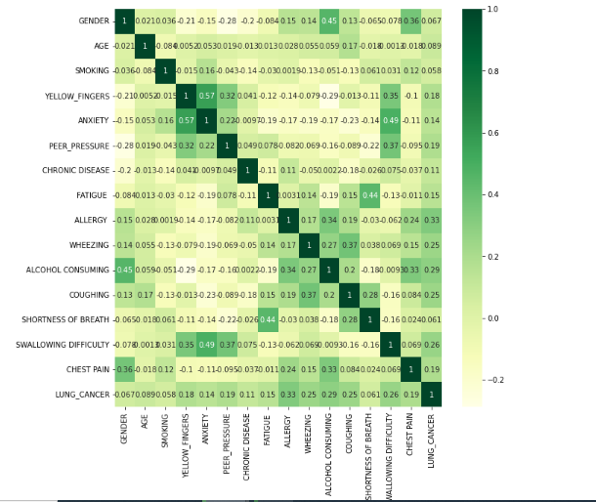
Data Feature Correlation
The above diagram shows the correlation of the data set features explained as follows. From the scatter plot above, we observe that, there is a positive high correlation between anxiety and wallowing difficulty. This means that, whenever someone gets anxious, he/she is likely to experience difficulty in wallowing. There is a positive high correlation between anxiety and yellow fingers, the same case applies between fatigue and shortness of breath.

Slide 9
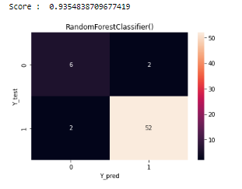
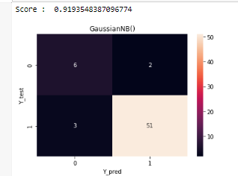
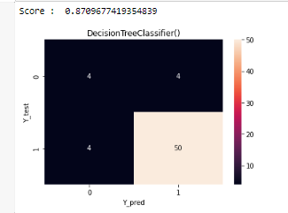
Classification techniques evaluation

Slide 10
Inferences.
From the previous slide, its evident that Random forest classifier out performs Naïve Bayes and Decision tree classifier with an accuracy of 93.5%, followed by Naïve Bayes with 91.9% and then decision tree closes with 87.1%.
This means that both three models can predict correct results for almost all the cases. But, the accuracy score of Random forest model is better than the one for naïve Bayes and decision trees which implies that the Random forest model is better than Naïve Bayes and Decisions tree.
In conclusion, We observe that, in lung cancer detection, the choice of dataset features impacts the results much more. Higher the number of features, more is the training time required to train the model. We also confirm that, smoking plays a big role cancer development.

Slide 11
Thank You

