Slide 1
Traffic Prediction Analysis using Machine Learning techniques
University Name
Submitted By: Group Name

Slide 2
Introduction
The primary purpose of this project is to predict traffic congestion at junction areas on road networks by implementing various predictive models using distinct machine learning models.
The most performing model among those implemented will be considered and selected as the best model for this task. .
In order to choose the best model, several techniques like Mean Absolute Error, Mean Squared Error and accuracy prediction were employed. Using these techniques we were able to observe and select the best model performing model.

Slide 3
Research Questions
How are machine learning techniques applied in traffic forecasting and prediction using historical and real-time data?
How data visualization can help cities identify trends and anomalies, compare activities at a single site over several days, and better plan for anticipated changes in traffic flow.
How has the proposed solution improved traffic control in metropolitan areas?

Slide 4
Methodology
This study concentrates on the research questions to obtain solutions and explain significant findings. Our projects use machine learning techniques to build predictive models using data from many data sources, including mapping data, traffic data, meteorological data, and various Real-time traffic data sources. This strategy helps in traffic forecasting and the implementation of effective actions to enhance traffic conditions mainly in urban cities.

Slide 5
Literature Review
Traffic congestion areas are the most vulnerable areas affected by traffic. Most research studies have been doing research mostly in urban centers of the country. This is because of the perspective that urban areas are the most congested places where traffic gets transmitted easily.
However, the junction areas on road networks have been neglected and not considered as one of the areas that can generate traffic and be transmitted to the other points connected to the junction.
In this research project, we identified the gap and decided to work on the traffic congestion at the junction areas as another source of traffic generation and transmission on road networks.

Slide 6
Project Work Flow
Data Pre Processing
Data Collection from data science platforms
Exploratory Analysis
Model Training
Model Evaluation
Model selection

Slide 7
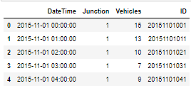
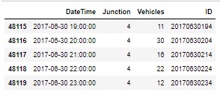

Data Collection
1. Data Collection:
We collected the junction dataset from Kaggle , the link is provided as follows; https://www.kaggle.com/datasets/fedesoriano/traffic-prediction-dataset
Below shows the first 4 entries, last 4 entries, and sample of a cleaned data.
Sample data

Slide 8
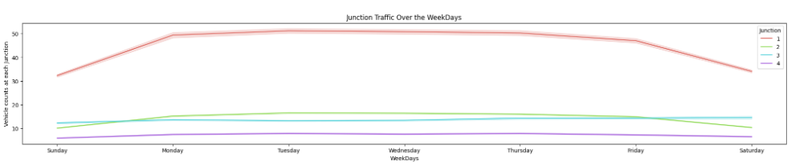
Data Visualization
1. Junction Traffic Over the Weekdays
It is confirming the above findings that Saturday & Sunday there is less traffic across all the Junctions as compare to the weekdays (Monday-Friday).
Notes:
import geonamescache
from city_to_state import city_to_state_dict

Slide 9
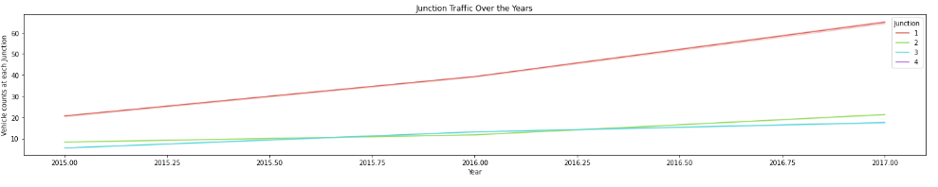
Data Visualization
2. Junction Traffic Over the Years
From the graph it is evident that traffic is increasing every year and more so at Junction-1
Notes:
For the classification of tweets according to their security relevance, two classifiers have been explored:

Slide 10
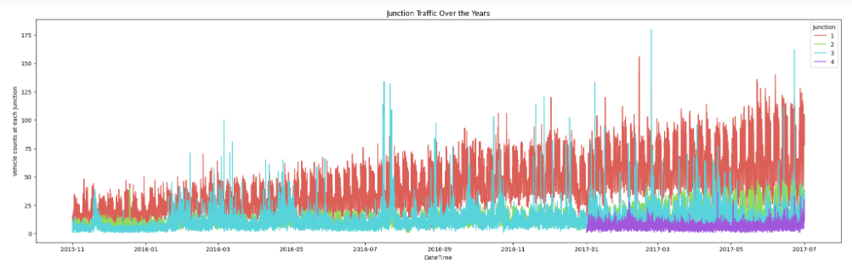
Data Visualization
3. Junction Traffic Over the Years
We discovered that the first junction had the highest overall vehicle counts, as seen in the below group by. It also has an upward trend, implying that traffic will continue to increase over time. The second junction has the greatest peak bars, indicating a high number of cars for a specific month - these can be classified as outliers. The third junction shows a modest upward trend but a consistent flow throughout time. The fourth junction contains little data, as we observed in our previous study section; only 2017 incomplete data is present.
Notes:
For the classification of tweets according to their security relevance, two classifiers have been explored:

Slide 11
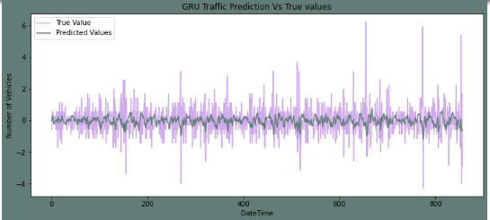
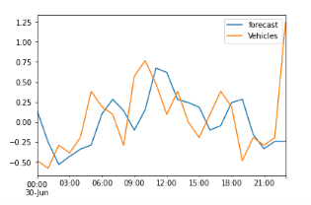
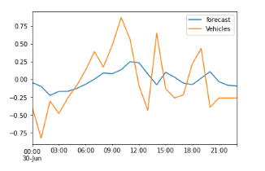
Machine Learning Techniques
Models created
GRU model
ARMA model
LSTM
Based on the outcomes of our suggested research, we can see that both LSTM and GRU NNs perform better than the ARIMA model, with GRU slightly outperforming LSTM NN. Meanwhile, GRU NNS outperform LSTM NNs on 84% of all time series.
Notes:
VADER sentimental analysis relies on a dictionary that maps lexical features to emotion intensities known as sentiment scores. The sentiment score of a text can be obtained by summing up the intensity of each word in the text.
Notice that VADER:
It is case sensitive. The sentence This is great has a different score than the sentence This is GREAT.
Punctuation matters. The exclamation marks for example have a positive score
The emojis have also a score and actually very strong sentiments. Try the <3, :) , :p and :(
Words after @ and # have a neutral score.

Slide 12
Conclusion
Based on the analysis and predictions done, we learned that:
LSTM NNs and GRU NNS are superior to ARIMA model. On average, GRU NNs have a 5% lower MAE than the LSTM NN model and a 10% lower MAE than the ARIMA model.
There are numerous ways in which the proposed strategy will enhance traffic management. The proposed model analyzes data and updates its predictions of how traffic will behave every hour. People also receive a monthly forecast that considers the upcoming week, weekend, and holidays.
Congestion will lessen as a result of earlier information and better planning based on such information. The length-variable time sequence inputs may aid RNNs in automatically determining the ideal time lags in future work testing RNNs with more hidden states.

Slide 13
Future Work
Conduct the analysis on combination of both junction datasets and the urban centers road network datasets.
Compare between junction and Urban centers the most affected areas with traffic as well the most cause of traffic and how transmission occurs to the closest points.

Slide 14
References
B. Feng, J. Xu, Y. Lin, & P. Li. (2020). A Period-Specific Combined Traffic Flow Prediction Based on Travel Speed Clustering. 85880-85889.
G. Dai, C. Ma, & Xu, X. (2019). Short-Term Traffic Flow Prediction Method for Urban Road Sections Based on Space-Time Analysis and GRU. 143025-143035..

Slide 15
Thank You!

