Slide 1
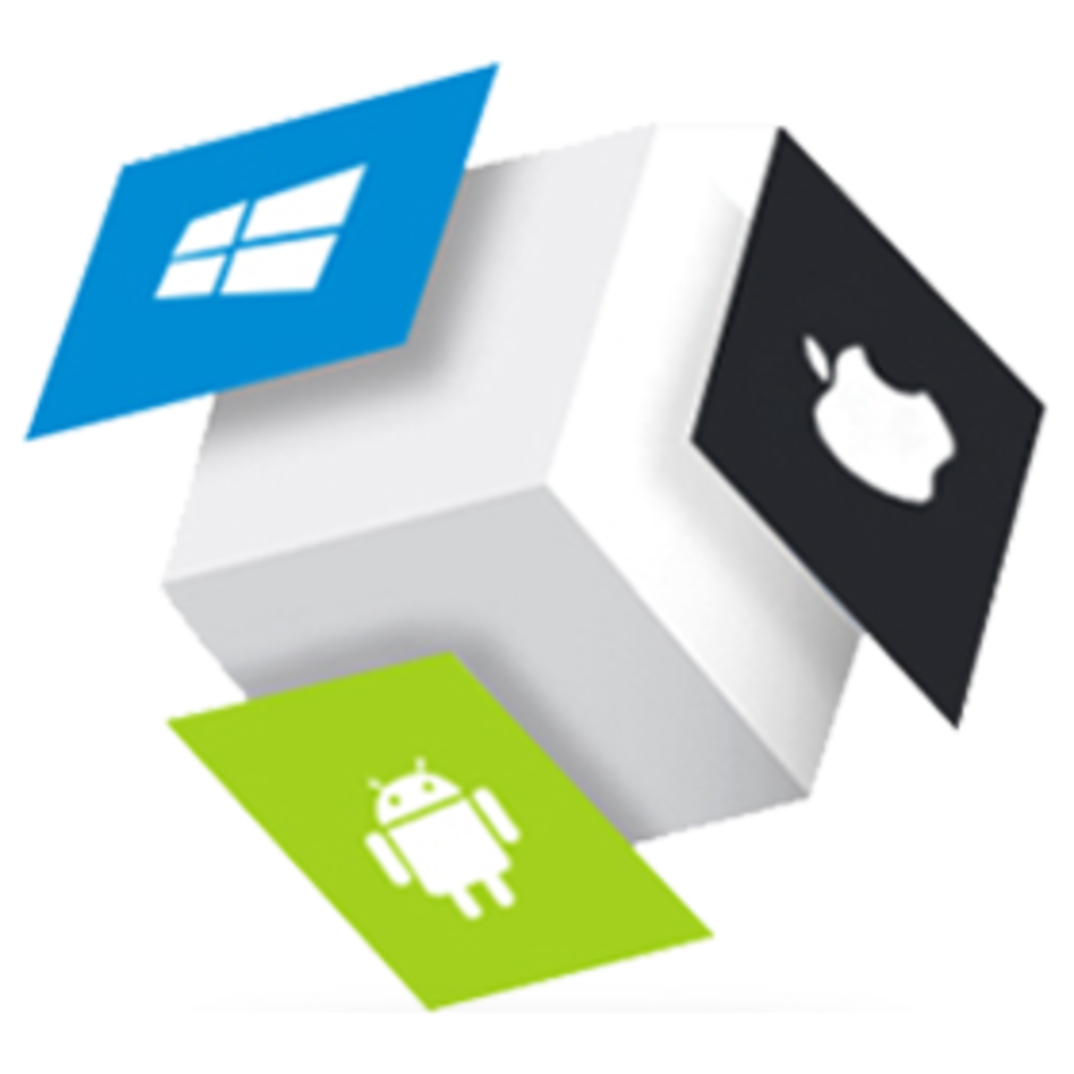
Mini Project- Flutter “FOODIE!”
Submitted by:
Deepak Parihar(201500206)
Suchita Khare(201500712)
Akash Rathour(201500060)
Nitish Baghel(201500453)
Omveer Singh(201500459)
Submitted to:
Mr. Bhanu Kapoor

Slide 2

FLUTTER
Google's free and open-source UI framework

Slide 3
Flutter is a UI toolkit for building fast, beautiful, natively
compiled applications for mobile, web, and desktop with
one programing language and single codebase
It is free and open-source
Flutter is different from other frameworks because it neither
uses Web View nor the OEM widgets that shipped with the
device.

Slide 4
Instead, it uses its own high-performance rendering engine to draw widgets
It also comes with a rich set of customizable widgets, all build from a modern reactive framework
Stateful Hot Reload widget allows you to change your code and see it come to life in less than a second, without loosing the state of the app

Slide 5

Highlights of Flutter
Advanced Image Formatting Capabilities
Advanced Image Formatting Capabilities
Advanced Image Formatting Capabilities
Layered Architecture
Wide range of IDEs
Multiplatform UI toolkits
Wide range of IDEs
Wide range of IDEs
Flutter doctor for dependencies
Customizable Widgets
Flutter doctor for dependencies
Flutter doctor for dependencies

Slide 6

DART PROGRAMMING LANGUAGE
Client-optimized language for developing
fast applications

Slide 7
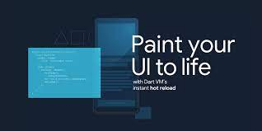
It is an open-source, general-purpose, object-oriented programming language with C-style syntax developed by Google in 2011.
The purpose of Dart programming is to create frontend user interfaces for the web and mobile apps.
It supports most of the common concepts of programming languages like classes, interfaces, functions, unlike other programming languages.

Slide 8

SWOT ANALYSIS
STRENGTHS
Creates a frontend user interface for the web and mobile apps.
WEAKNESSES
It does not support arrays directly.
S
W
It supports collection . It is used to replicate data structures such as arrays, generics , and optional typing.
OPPORTUNITIES
IT is mainly used to develop applications like Gmail, Google maps , and Google Instant Search etc.
APPLICATIONS
O
T

Slide 9


FOODIE!- A Pre-Ordering Application
The Foodie! application provides a pre-order feature which is one of the latest features which saves the customer's time, maximize customer satisfaction and increases the sales .
Busy corporate customers stepping out for short lunches, customers placing large group orders which causes overcrowding in kitchens or customers who simply don't like waiting.
This will help you save your time. Enjoy your meal at your place.

Slide 10
ROADMAP
Splash Screen of Foodie!
Enter time and
select quantity
Home Screen
1
3
5
2
4
6
Sign-In Screen
Product Detail
Pickup your meal

Slide 11
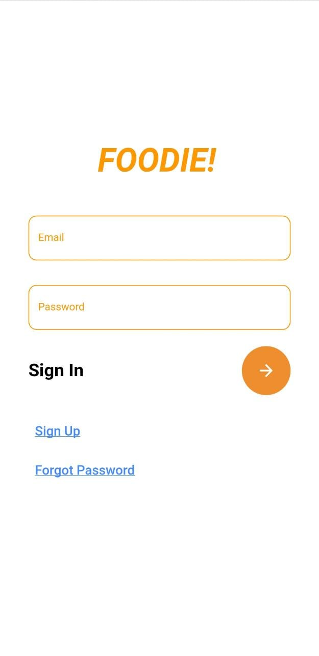
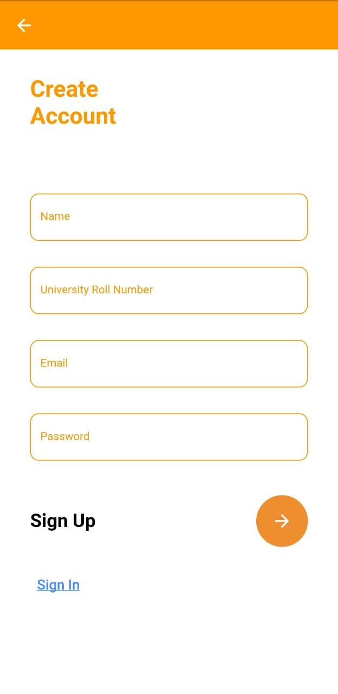
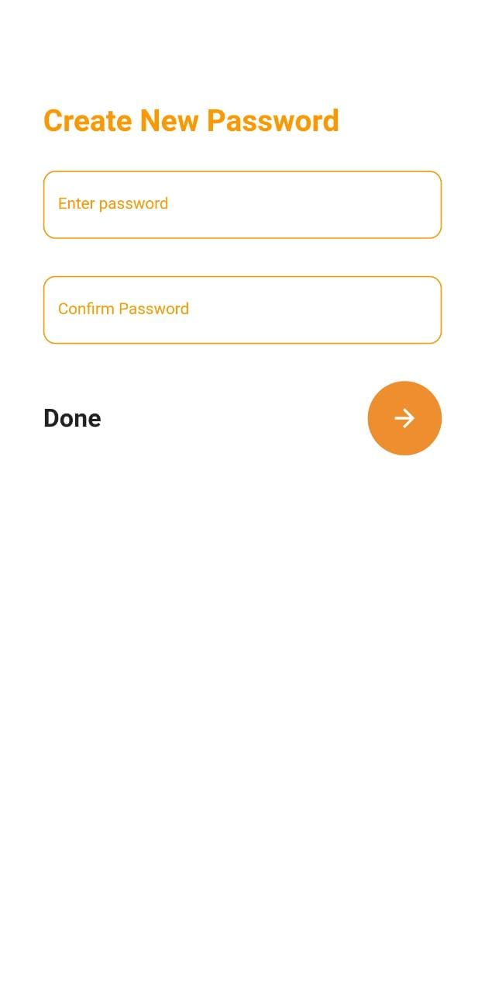
Screens for sign-up

Slide 12
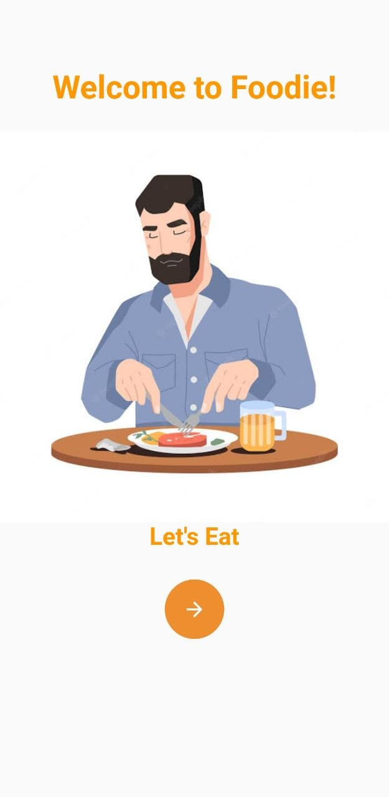
Welcome Page
Sign In Page
On starting the application,this is the first screen to be displayed.
Welcomes the user and has a tab ‘continue’ which redirects to the login page.
The user can Sign- In to the app
using email and
password.
If you forget password ,you can reset it.

Slide 13
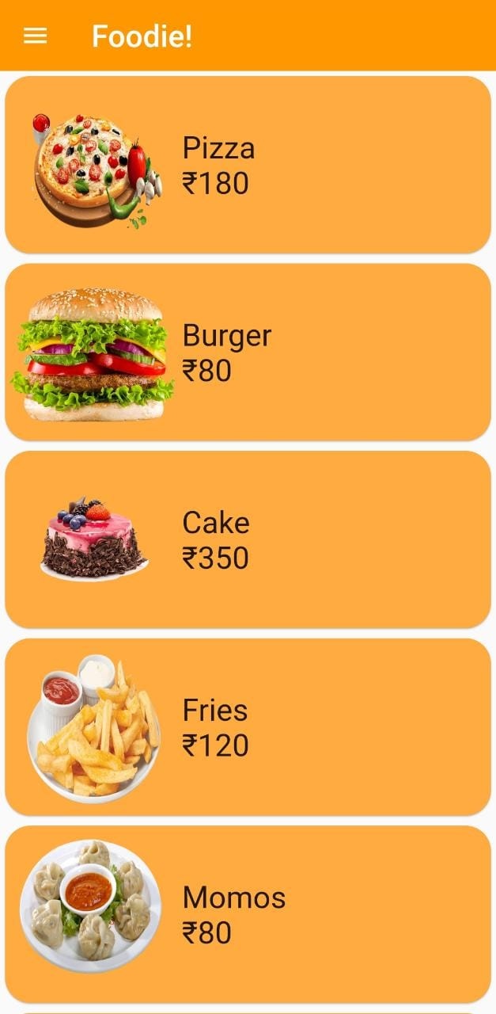
Home Screen
A clean,organized user-friendly UI
Multiple items that redirect to different screens for item details.
Where you can select the time as well as the quantity.
On top left corner you can find the pop up icon where you can find Help,contact us and about section.

Slide 14
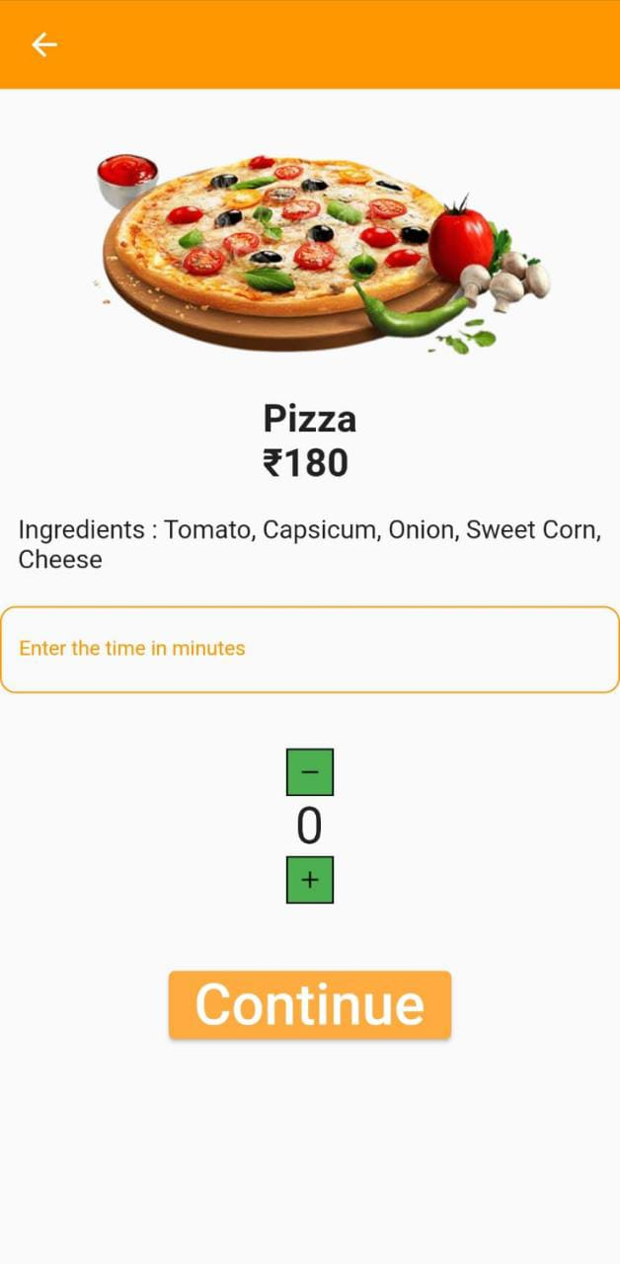
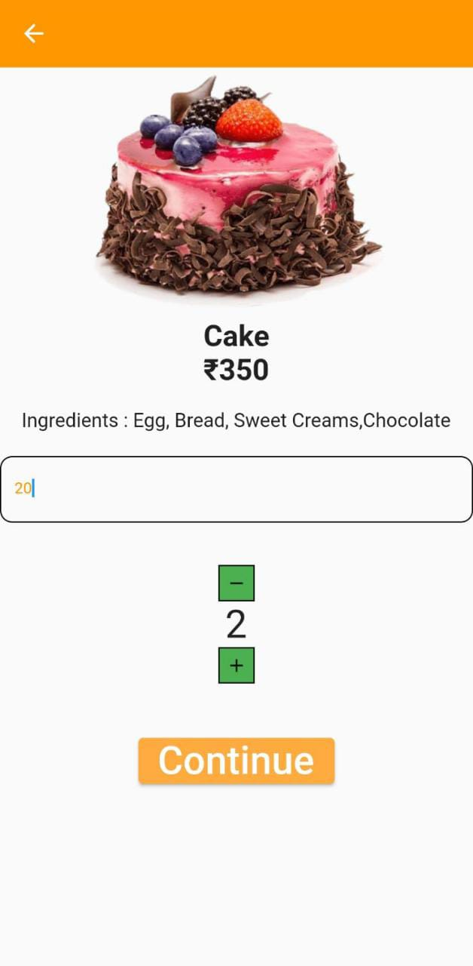
Product Description
Pages:-
Enter Time
And select quantity
Proceed to continue

Slide 15
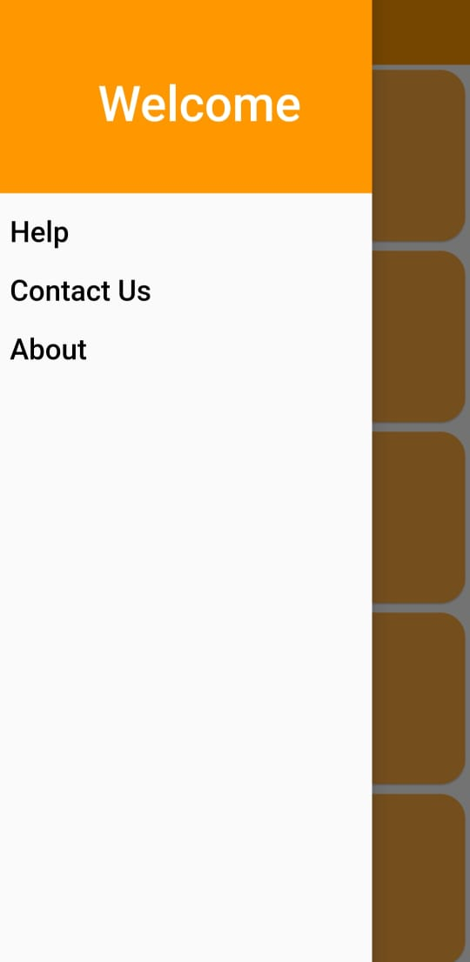
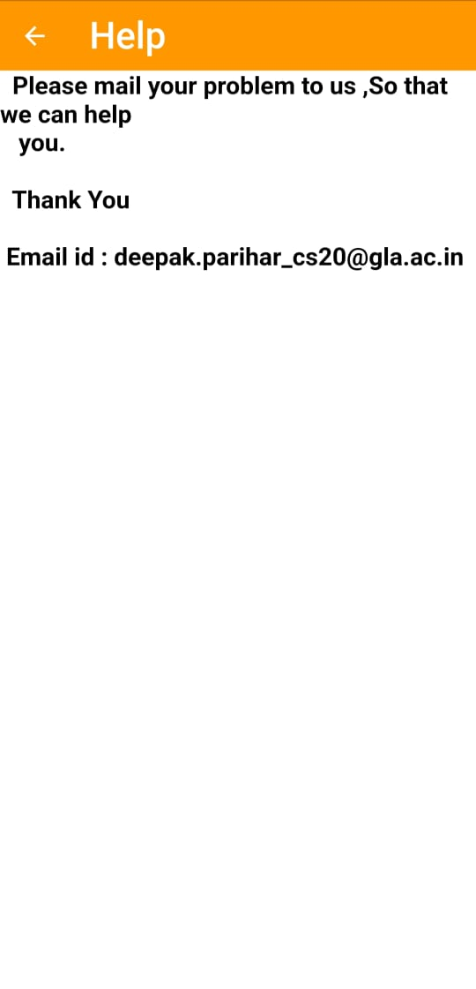
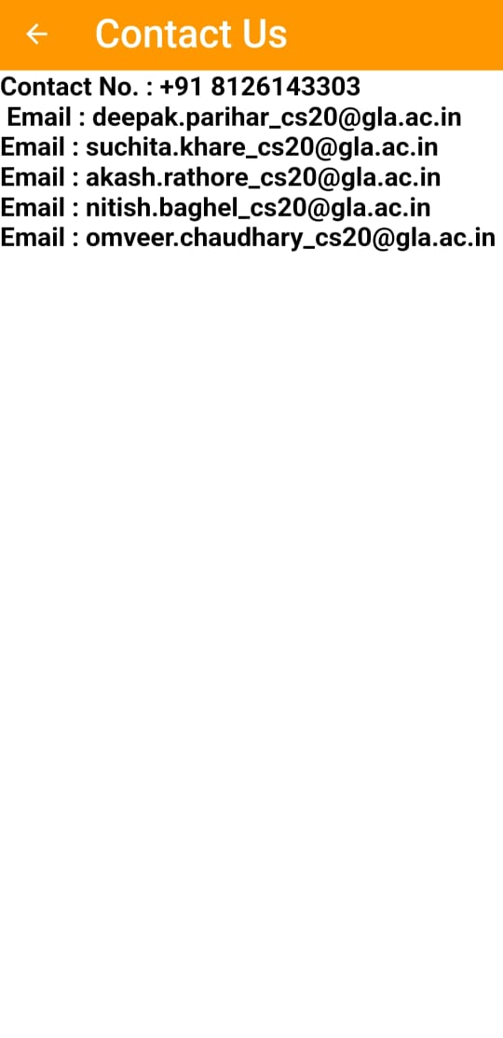
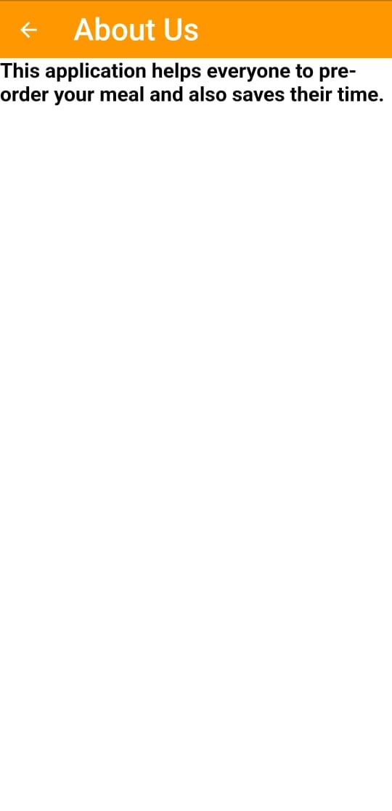
POP UP SCREENS

Slide 16
Course of action of our application-
Welcome Page
Welcome Page
Sign In/Sign up
Sign In/Sign up
Select time
Select time
Select Quantity
Select Quantity
Login Success Page
Forget Password
Forget Password
Details Entry Page
Details Entry Page
Home Page
Home Page
Order confirmed
Home
Order confirmed
Home

Slide 17
THANK YOU

