Slide 1

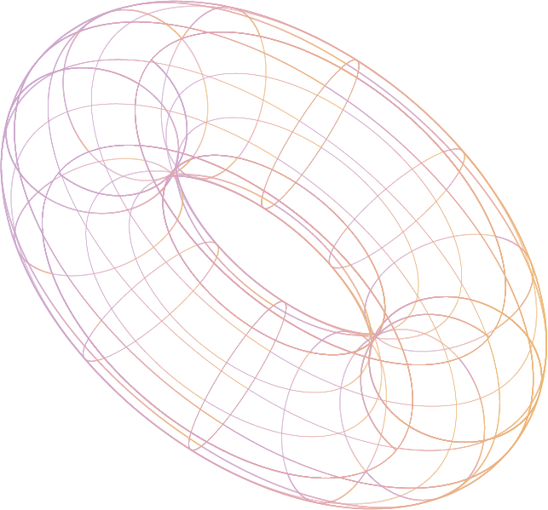

Spell Checker
Om S Vekariya
Roll No. 06
Enrollment No. 22002170110205
Department : Computer Engineering
Class : D1

Slide 2
Table of contents
01
02
03
Introduction
Data Structure
Algorithms
Basic introduction of Spell checker and need of it.
Data Structure needed to Implement Spell Checker
Algorithms used in and complexity of Spell Checker
04
05
Merit - Demerit
Future Scope
Benefits of using Spell checker and it’s limitations.
Summarize the main points of spell checker’s future empowerment.

Slide 3
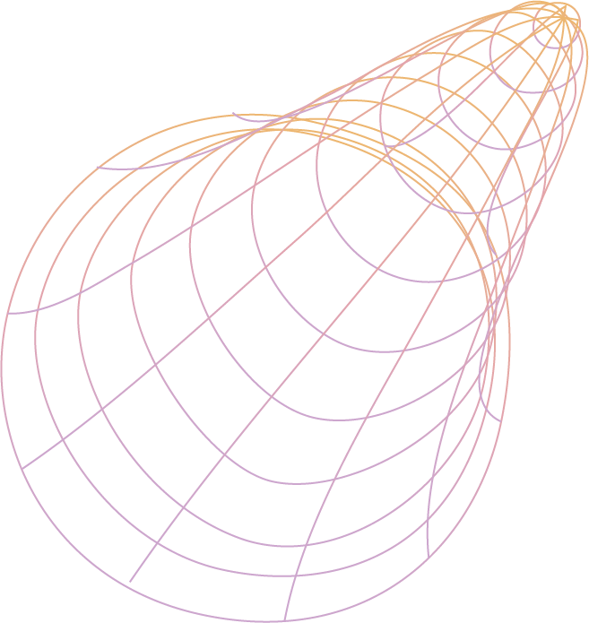
01
Introduction
Spell checking is a crucial aspect of written communication.
Accurate spelling is essential for professional documents, emails, and online content.
The presentation introduces a Java-based Spell Checker that utilizes a Trie data structure to provide precise spelling corrections.
A spell checker is a software tool designed to identify and correct misspelled words in text.
Key components of a spell checker include user input, a dictionary, a Trie data structure, and suggested corrections.
The spell checker examines input text, compares it to a dictionary, and suggests correct spellings for any misspelled words.

Slide 4
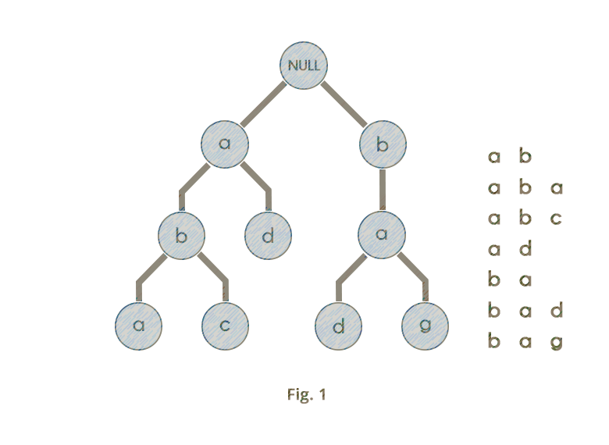
02
Data Structure
Trie Data Structure
A tree-like structure used for efficient retrieval of words and prefixes.
Trie's strengths in spell checking: fast lookup, memory efficiency, and suggestion generation.
Edit Distance (Levenshtein Distance)
A measure of similarity between two strings by counting the minimum number of operations (insertion, deletion, or substitution) required to transform one string into the other.

Slide 5
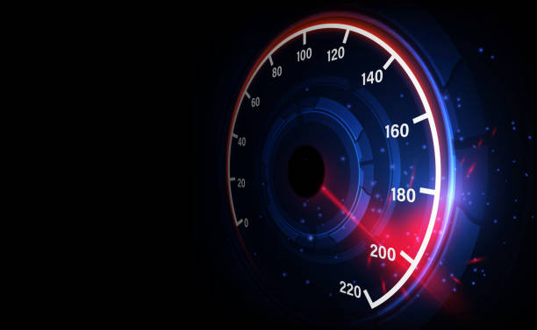
03
Algorithms
Building the Trie: Constructing a Trie data structure from a dictionary of valid words.
Input processing: Accepting user text for spell checking.
Checking words against the Trie: Identifying if input word is found in Trie words.
Suggesting corrections: Utilizing Edit Distance for correction suggestions.
Time Complexity Analysis :-
Best Case : O(K)
Worst Case : O(N * (R*C)) = O(R*C)

Slide 6
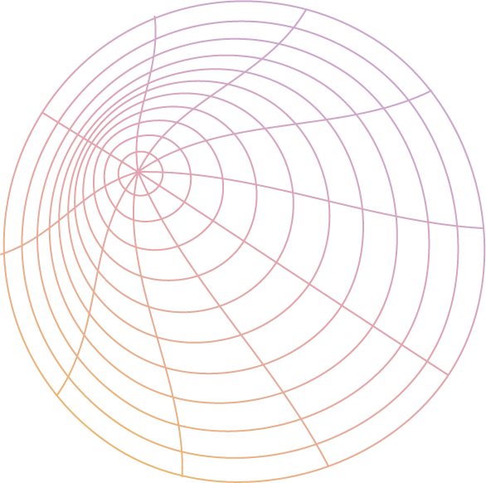
04
Merits - Demerits
Spell checker offer many benefits beyond catching spelling errors. They can help you improve your grammar and even suggest alternative words. With a spell checker, you can communicate more effectively and efficiently.
While spell checkers is powerful tool, it is not foolproof. It can miss errors, suggest incorrect corrections, and even introduce new errors. It's essential to use spell checkers wisely and always proofread your work.

Slide 7
05
Future Scope
Educational Support
Advanced Plagiarism Detection
Cross-Document Comparison
Real-Time Feedback
Multilingual Capabilities
AI and Machine Learning

Slide 8

Thanks!
Dictionary References :-
https://www.mit.edu/~ecprice/wordlist.10000
https://raw.githubusercontent.com/dwyl/english-words/master/words.txt
https://www.kaggle.com/datasets/rtatman/english-word-frequency?resource=download
Created By : Om S Vekariya

