Slide 1

USER AUTHENTICATION USING IMAGE
Project Supervisor: Dr. Judgi
Name of the Student: Mr. Kolla Om Vivek
Register Number: 39110511

Slide 2
Presentation Outline
Course Certificate
Introduction
Objectives
System Architecture
Module Implementation
Project Implementation
Results and Discussions
Conclusion
References

Slide 3
Course Certificate

Slide 4
Introduction
Username and password are the most commonly used mechanism for authentication because of simplicity and convenience. However it suffers from few drawbacks like selection of weak passwords by the users, users disclosing their passwords etc.
This weakens the security posture of the organizations. Hence we propose a new user authentication using image system. Research suggests that use of images may be more effective in terms of security

Slide 5
Introduction
User authentication is a security process that covers all of the human-to-computer interactions that require the user to sign up and log in. Simply we can say authentication asks each user, “who are you?”
When a user sign up for an account, they must create a unique ID and key that will allow them to access their account later on.
Generally, a username and password are used as the ID and key.
Now, username and image are used as the ID and Key.

Slide 6
Introduction
The user authentication process is what provides users repeat access to their own accounts while attempting to block any unauthenticated users from gaining access.
This means that User A can log in to their own account, while User B would be denied access. Conversely, User B could access their own account, while User A would be unable to.

Slide 7
Objectives
Objective of the project :
Enabling user authentication and accurately verifying an individual’s claimed identity is the first line of defence against unauthorized use of a handheld device.
The main purpose of the signup functionality is to get the data and image of the user.
The main purpose of the login functionality using image authentication is to provide advanced security to the users.

Slide 8
Objectives
Scope of the project :
Image user Authentication uses modern machine learning techniques which are quite sophisticated in terms of security.
All the registered user’s images are secured in the database.
Image consists of the user authentication information.
Thinkabout the password as a mystery picture.

Slide 9
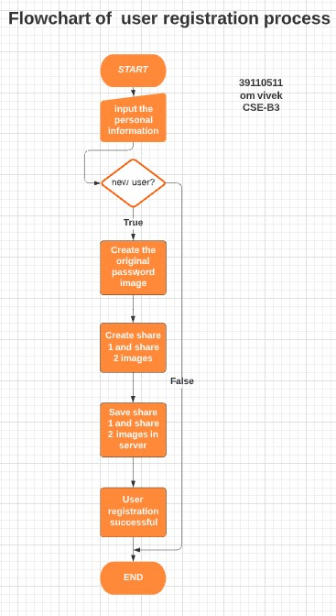
System Architecture

Slide 10
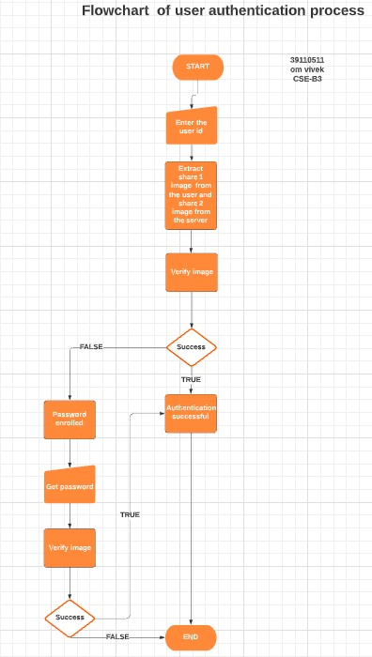
System Architecture

Slide 11
Module Implementation
THIS WEBSITE CONSIST OF 4 MAJOR PAGES / FEATURES:
HOME PAGE
LOGIN PAGE
SIGN UP PAGE
VIEW FOR LOGINED USER

Slide 12
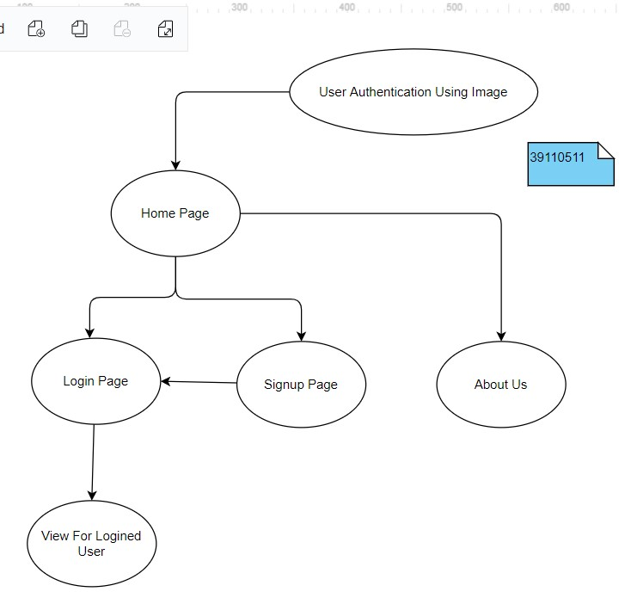
Module Implementation

Slide 13
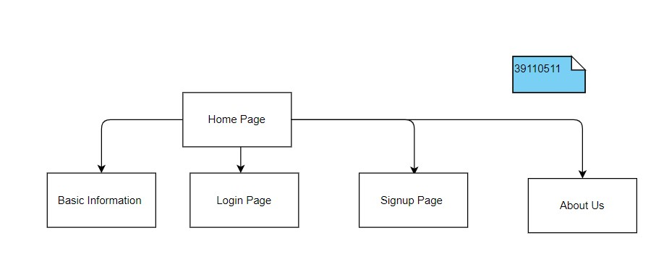
Module Implementation

Slide 14
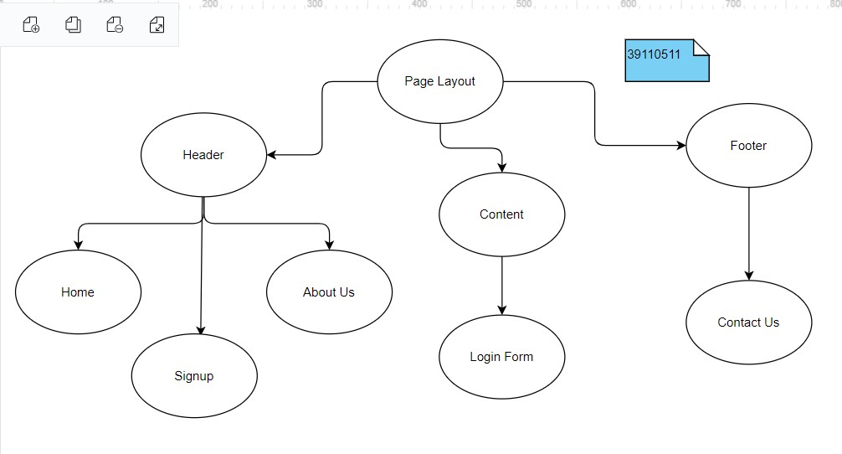
Module Implementation

Slide 15
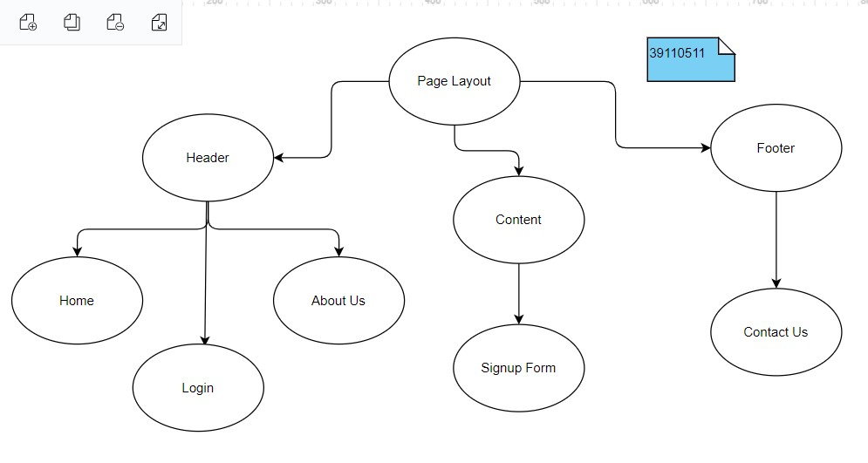
Module Implementation

Slide 16
Project Implementation
Modules.
Hardware and Software Requirements.
Construction.
Measurement and Analysis.
Methodology.

Slide 17
Modules
Flask:
Flask is a micro web framework written in Python.
It is classified as a microframework because it does not require particular tools or libraries.
It has no database abstraction layer, form validation, or any other components where pre-existing third-party libraries provide common functions.
Flask is a web framework that provides libraries to build lightweight web applications in python

Slide 18
Modules
Cv2:
OpenCV is an open-source library for the computer vision. It provides the facility to the machine to recognize the faces or objects.

Slide 19
Modules
Face_recognition:
Recognize and manipulate faces from Python or from the command line with the world’s simplest face recognition library.
Built using dlib’s state-of-the-art face recognition built with deep learning. The model has an accuracy of 99.38%
Face_recognition command line tool lets to do face recognition.

Slide 20
Modules
Flask_mysqldb:
Flask-MySQLdb provides MySQL connection for Flask.
MySQL is a very popular open-source relational database management system

Slide 21
Modules
Pandas:
pandas is a Python library for data analysis .
Pandas is built on top of two core Python libraries
matplotlib for data visualization
NumPy for mathematical operations.
Pandas acts as a wrapper over these libraries, allowing you to access many of matplotlib's and NumPy's methods with less code.

Slide 22
Modules
Deepface:
Deepface is a facial recognition and attributes analysis framework for python created by the artificial intelligence research group at Facebook in 2015. Keras and Tensorflow inspire this library’s core components.
Deepface’s face identifying accuracy goes up to 97% and has proved to be more successful in detecting faces than the average face recognition frameworks.

Slide 23
Hardware and Software Requirements
Hardware:
Desktop , Keyboard , Mouse , Screen , Hard Drive , GPU , CPU and RAM
Software:
System requirements for Python Installation:
Operating system: Linux- Ubuntu 16.04 to 17.10, or Windows 7 to 10, with 2GB RAM (4GB preferable)
You have to install Python 3.6 and related packages
Jupyter Notebook , Atom , visual studio code

Slide 24
Construction
Creating the front – end using html and css
Showing the front – end to the user by using the flask
Getting the data like name , user id , password , confirm password form the user
validating the user’s data
Storing the data in to the database with the help of MySQL
Capturing the user’s image by using the cv2
Using the haarcascade_frontalface_default we can detect the face
Capturing the user’s image until haarcascade_frontalface_default can detect the face successfully

Slide 25
Construction
Storing the image in the database with the help of MySQL
Getting the user id from the user
Validating the user id which is provided by the user , from the database
Capturing the user’s image by using the cv2
face_recognition is going to validate the images . It’s going to return either true are false
If it is true , current page is going to redirect to the emotion recognition page
Going to recognize the emotion by using the deepface
If it is false , current page is going to redirect to the thank you page

Slide 26
Measurement and Analysis
Understanding user authentication is crucial because it’s a key step in the process that keeps unauthorized users from gaining access to sensitive information. A strengthened authentication process ensures that User A only has access to the information they need and can’t see the sensitive information of User B.
The Picture Password authentication mechanism is going to strengthen the authentication than the normal password system

Slide 27
Methodology
Methodology for user authentication using image :
Step 1: Import the needed modules.
Step 2: Get the data from the user
Step 3: validate the data
Step 4: capture user image
Step 5: detect the face from the image

Slide 28
Methodology
Step 6: get user id from the image
Step 7: validate the two images
Step 8: if true , emotion recognition page
Step 9: if false, thank you page

Slide 29
Results and Discussion
This means that User A can log in to their own account, while User B would be denied access. Conversely, User B could access their own account, while User A would be unable to.

Slide 30
Conclusion
Finally, it might be time to implement a passwordless login option for websites
According to the security experts , passwords have become an unreliable form of user authentication.
Passwordless logins don’t require the user to remember anything , the login process is completed using biological characteristics (such as face recognition , fingerprint scanner , iris scanner etc., )

Slide 31
Conclusion
Implementing passwordless login, is going to substantially improve the security and user experience of login process.

Slide 32
References
[1] | Front – end : Html - https://www.w3schools.com/html/ Css - https://www.w3schools.com/css/
[2] | Back – end : Flask-mysqldb - https://flask-mysqldb.readthedocs.io/en/latest/ Mysql - https://www.w3schools.com/python/python_mysql_getstarted.asp Pandas - https://www.w3schools.com/python/pandas/default.asp
[3] | Connection : Flask - https://flask.palletsprojects.com/en/2.1.x/
[4] | Capturing image : Cv2 - https://docs.opencv.org/4.x/d6/d00/tutorial_py_root.html
[5] | Recognition : face_recognition-https://facerecognition.readthedocs.io/en/latest/readme.html Emotion recognition - https://www.geeksforgeeks.org/facial-expression-detection-using-deepface-module-in-python/

