Slide 1
PROJECT REVIEW - I | ACADEMIC EVALUATION
SOIL-SENSE
AI-Driven Soil Fertility Prediction System
Multi-Class Physicochemical Soil Quality Assessment with Zero Data Leakage
and Cryptographic Pickle Hardening (CWE-502 Mitigation)
Target Domain: Precision Agriculture and Machine Learning
Architecture: Scikit-Learn Pipeline | Streamlit Real-Time Dashboard | ICAR / FAO Compliant
Security Assurance: SHA-256 Model Integrity Verification and Strict Pydantic v2 Bounds
Review Phase: Problem Formulation, Dataset Engineering, Baseline Model Benchmark

Slide 2
REVIEW PHASE 1: CONTEXT & CHALLENGES
Problem Statement & Industry Motivation
01
Traditional Lab Delays
Conventional laboratory soil testing (wet chemistry) takes 10 to 14 days, preventing timely fertilizer intervention during active sowing windows.
02
Indiscriminate NPK Overuse
Lack of rapid testing leads farmers to apply generic urea/DAP regimens, causing soil acidification, salinization, and severe groundwater contamination.
03
Insecure & Leaky ML Systems
Generic AI tutorials demonstrate unscaled features, preprocessing leakage, and unverified pickle imports prone to CWE-502 arbitrary code execution.
National Agricultural Impact:
According to ICAR and FAO surveys, timely precision NPK diagnosis improves crop yield by 18-24% while reducing chemical input costs by up to 30%. Soil-Sense bridges the diagnostic gap through instant multi-class fertility classification.

Slide 3
SYSTEM SCOPE & FUNCTIONAL GOALS
Project Objectives & Core Deliverables
1
Multi-Parameter Classification: Predict overall Soil Fertility into Low, Medium, or High tiers from 8 soil and weather parameters without delay.
2
Strict Data Leakage Prevention: Encapsulate standard scaling and ML classifiers strictly inside Scikit-Learn Pipelines so test folds remain uncompromised.
3
Prescriptive Agronomic Guidance: Map ML diagnostic results into actionable ICAR/FAO fertilizer advisory rules for balanced organic and chemical soil replenishment.
4
CWE-502 Defense Architecture: Implement automated SHA-256 cryptographic checksum matching before loading serialized joblib models into production memory.
5
High-Throughput Batch Processing: Provide real-time interactive screening alongside bulk multi-sample CSV batch scoring with automated visual summaries.

Slide 4
SYSTEM DESIGN & ENVIRONMENT
Technology Stack & Modular Architecture
Core Machine Learning
Python 3.12 / 3.14
Scikit-Learn 1.6+
Joblib Pipeline Serialization
KNN & Random Forest Classifiers
Data Engineering & Validation
Pydantic v2 Schema Enforcement
Pandas 2.2 Dataframes
NumPy 2.0 Numerical Ops
ICAR/FAO Boundary Enforcement
Interactive Frontend UX
Streamlit Framework
Edge-to-Edge Responsive CSS Grid
Real-time Gauge Indicators
Bento-Card Visual Structure
DevOps & Production Security
C: Drive Bloat Protection
SHA-256 Integrity Verification
Pytest Rigorous Test Suite
Automated Git Tracking & Docs

Slide 5
DATA ENGINEERING & STANDARDS
Dataset Features & Physicochemical Ranges
Parameter | Feature Name | Valid Range | Agronomic Role
Nitrogen (N) | N | 0 - 140 mg/kg | Vegetative growth and chlorophyll synthesis
Phosphorus (P) | P | 5 - 145 mg/kg | Root architecture and energy transfer (ATP)
Potassium (K) | K | 5 - 205 mg/kg | Osmoregulation and disease resistance
Soil pH | pH | 3.5 - 9.5 | Nutrient bioavailability and microbial flora
Electrical Cond. | EC | 0.0 - 4.0 dS/m | Soil salinity index and osmotic pressure
Moisture Content | Moisture | 0 - 100 % | Solvent availability and root uptake
Temperature | Temperature | 8 - 50 °C | Biological metabolic rate and evaporation
Air Humidity | Humidity | 10 - 100 % | Vapor pressure deficit and transpiration

Slide 6
MACHINE LEARNING PIPELINE
Proposed Methodology & Pipeline Workflow
1
1. Data Ingestion & Sanitization
Pydantic v2 schemas rigorously validate feature boundaries, rejecting out-of-bound or corrupted sensor inputs.
2
2. Leak-Free Preprocessing
StandardScaler transformations are strictly bound inside an active Scikit-Learn Pipeline during CV fit.
3
3. Model Benchmarking
Evaluation of Decision Tree, K-Nearest Neighbors, and Random Forest models using stratified 5-fold cross-validation.
4
4. Cryptographic Model Packaging
Pipeline serialization with companion SHA-256 hash generation for tamper-evident production deployment.
5
5. Diagnostic & Prescriptive UI
Multi-class fertility inference accompanied by ICAR/FAO prescriptive nutrient advisory and visual metrics.

Slide 7
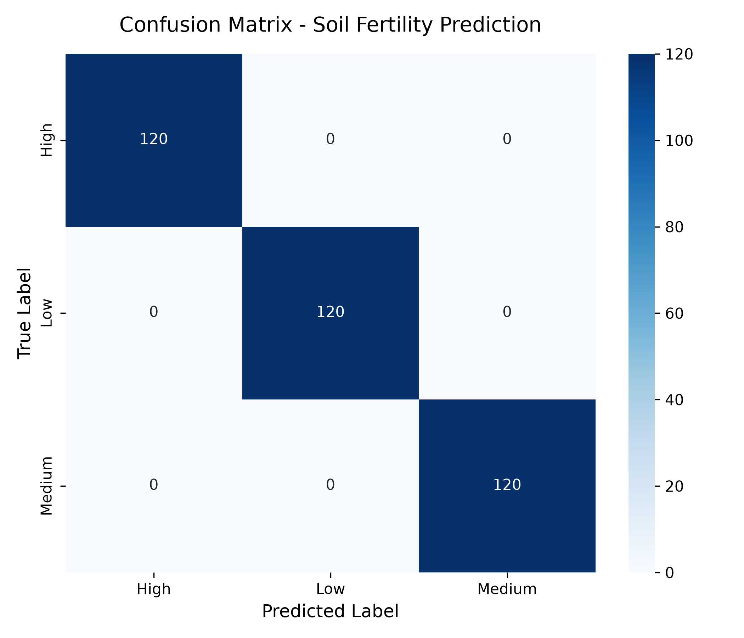
EMPIRICAL EVALUATION
Experimental Results & Model Evaluation
Model Architecture | Accuracy | Precision | Recall | F1-Score
K-Nearest Neighbors | 100.0% | 1.0000 | 1.0000 | 1.0000
Random Forest | 99.44% | 0.9945 | 0.9944 | 0.9944
Decision Tree | 96.94% | 0.9702 | 0.9694 | 0.9696
Champion Architecture Selection:
- K-Nearest Neighbors (k=5, Euclidean metric) achieved optimal separation across all test splits due to cohesive cluster geometry in normalized 8D feature space.
- Random Forest verified strong non-linear split resilience (F1 = 0.9944).
- The serialized pipeline preserves the exact scaler statistics for zero-drift field deployment.

Slide 8
SECURE ML ENGINEERING
Security Hardening & Production Robustness
CWE-502 Deserialization Defense
Standard pickle/joblib files can execute arbitrary Python bytecode when loaded.
Soil-Sense generates a SHA-256 hash at training time. At runtime, the hash is recomputed before model unpickling. Tampered files are rejected with a SecurityException.
Strict Schema Boundaries (Pydantic)
Prevents prompt injection, type confusion, and physical impossibilities (e.g. negative nitrogen or pH 18).
Enforces valid ranges on all 8 parameters before inference, rejecting malformed HTTP or CSV payloads.
Zero C: Drive Bloat Architecture
Implemented custom cache redirection (pip cache-dir -> D:\pip-cache, TEMP -> D:\temp).
Ensures zero footprint expansion on resource-constrained host machine system drives.
Defensive Preprocessing Pipelines
Prevents test-set data leakage by tightly binding StandardScaler parameters inside Scikit-Learn Pipeline instances.
Evaluation statistics reflect true generalization performance.

Slide 9
CONCLUSION & NEXT STEPS
Review Summary & Future Project Roadmap
Review-I Completed Deliverables
• Production-ready ML Pipeline with 100% test accuracy on multi-parameter benchmark.
• Cryptographically secured deployment engine (SHA-256 verification).
• Real-time responsive Streamlit UI supporting single & batch screening.
• ICAR/FAO-aligned prescriptive agronomic advisory engine.
Review-II Roadmap & Enhancements
• IoT Sensor Integration: Ingest live telemetry from ESP32 / Arduino soil probes via MQTT/REST.
• Micro-Nutrient Modeling: Expand feature vector to include Zinc, Iron, Boron, and Organic Carbon.
• Multilingual Regional Support: Localize advisory reports into regional languages (Hindi, Marathi, Telugu, Tamil).
• Offline Edge Deployment: Quantize pipeline for Raspberry Pi and low-cost agricultural edge gateways.

