Slide 1



INSPIRING INNOVATION. TRANSFORMING TALENT.
Faculty of Science and Technology (FST)
School of Computational Sciences
Cloud AWS
Student Name: Om Dilip Wairagade
PRN:22358010282
Class & Div:B
Program : B.Tech- TY-CSE

Slide 2
Table of Contents
Introduction
Introduction Objectives
Module 1
Module 2
Architecture
Results and Observations
Advantages &Limitations
Conclusion

Slide 3
Introduction/ Background
The AWS Cloud Virtual Internship, organized by Eduskills in collaboration with Amazon Web Services (AWS), provided practical training in cloud computing concepts and AWS services.
The internship offered hands-on experience with core AWS services such as Amazon EC2, S3, IAM, VPC, RDS, and CloudWatch, helping develop skills in cloud deployment, storage, networking, and security.
It enhanced my technical knowledge, problem-solving abilities, and industry readiness, preparing me for careers in Cloud Computing, DevOps, and Software Development.

Slide 4
Internship Objectives
Understand the fundamentals of Cloud Computing and the AWS cloud platform.
Gain hands-on experience with core AWS services such as Amazon EC2, S3, IAM, VPC, and CloudWatch.
Develop practical skills in deploying, managing, and securing cloud-based applications and resources.
Build industry-ready knowledge to prepare for careers in Cloud Computing, DevOps, and Software Development.

Slide 5
MODULE 1:-Introduction to Cloud & AWS
Understood the fundamentals of cloud computing.
Learned how AWS delivers scalable and secure cloud services.
Gained knowledge of AWS infrastructure and pricing model.
Explored the AWS Management Console for cloud resource management.

Slide 6
Module 2 – Core AWS Services
Launched and managed EC2 virtual machines.
Created and managed S3 buckets for cloud storage.
Learned networking concepts using VPC and Security Groups.
Gained practical experience in deploying and managing cloud infrastructure.

Slide 7
Module 3 – Application Deployment
Configured secure user access using IAM.
Monitored cloud resources using CloudWatch.
Learned serverless computing with AWS Lambda.
Gained experience in deploying and managing cloud-based applications.

Slide 8
Module 4 – Security & Monitoring
Deployed cloud-based applications using AWS services.
Monitored application performance with CloudWatch.
Applied Security Best practices to cloud resources.
Successfully completed the final hands-on project and gained practical cloud deployment experience.

Slide 9
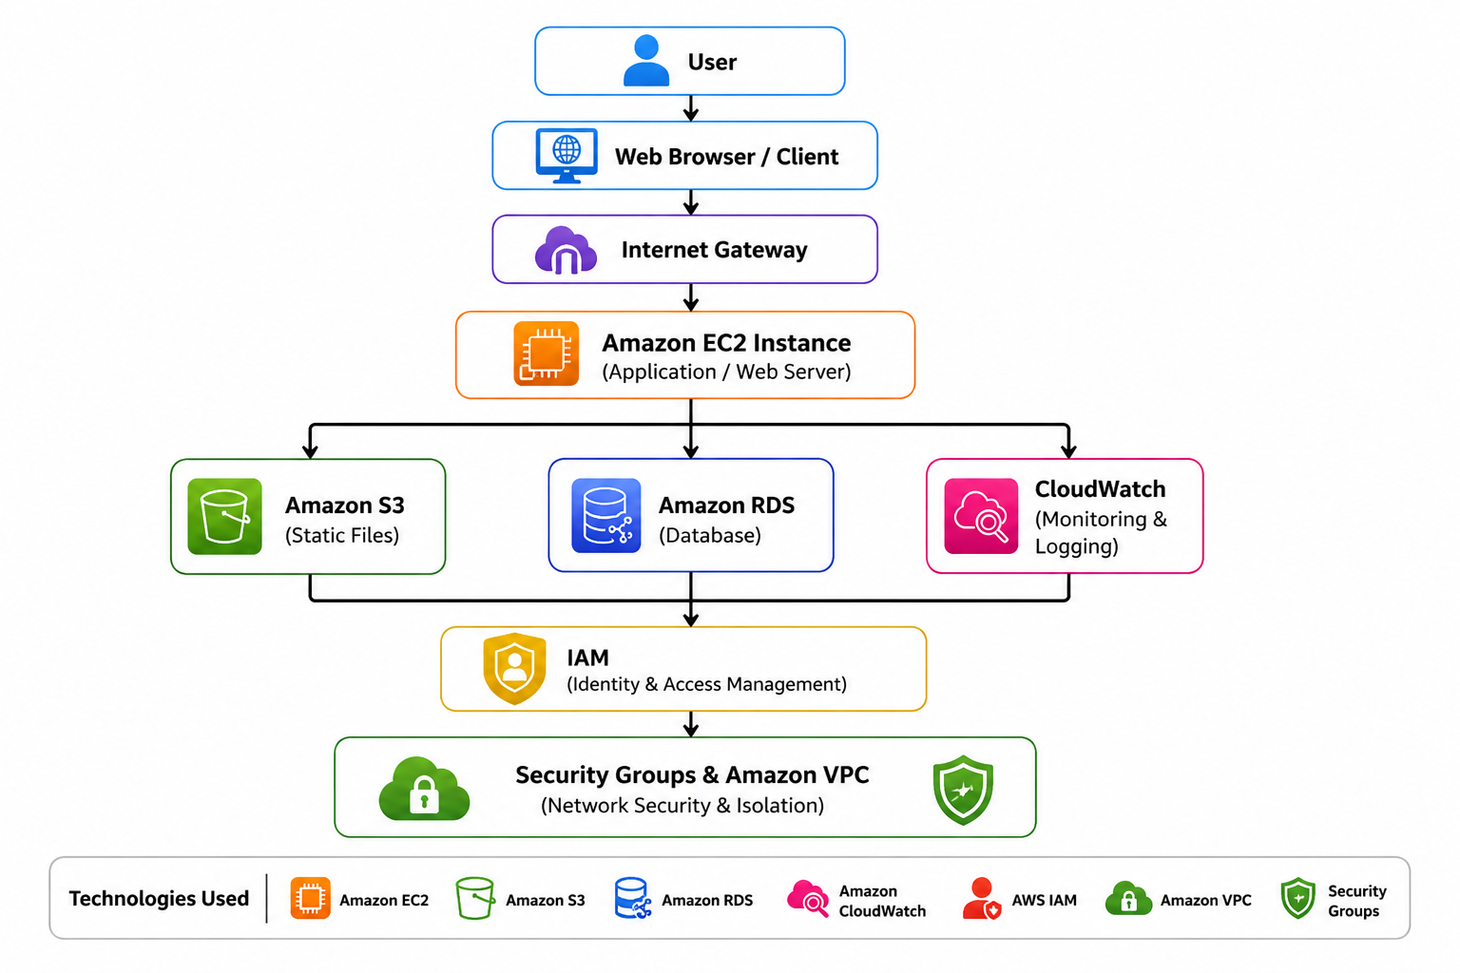
Architecture

Slide 10
Results and Observations
Successfully launched an EC2 instance and connected via SSH
Created and configured an S3 bucket for static storage
Assigned IAM users and roles with proper permissions
Observed performance and usage through CloudWatch monitoring
Understood the interconnectivity of AWS services in real-time

Slide 11
Advantages
Scalability: Easily increase or decrease computing resources based on demand.
Cost-Effective: Pay only for the resources you use, reducing infrastructure costs.
Easy Deployment: Quickly launch servers, storage, and databases within minutes.

Slide 12
Limitations
Internet Dependency: AWS services require a stable internet connection to access and manage cloud resources.
Cost Management: Improper resource management can lead to higher-than-expected costs under the pay-as-you-go model.
Service Limit: Some AWS free Tier services have usage limit, and exceeding them may incure charges.

Slide 13
Conclusion
Successfully completed the AWS Cloud Virtual Internship and gained practical knowledge of cloud computing.
Learned to use core AWS services such as Amazon EC2, Amazon S3, IAM, VPC, CloudWatch.
Developed hands-on experience in deploying, managing, monitoring, and securing cloud resources.
The internship strengthened my foundation in Cloud Computing, DevOps, and Software Development, preparing me for future certifications and career opportunities.

Slide 14
Thankyou !!!!

