Slide 1


NEXT GEN EMPLOYABILITY PROGRAM
CREATING A FUTURE-READY WORKFORCE
Student Name :
OM WAKALE
College Name :
Student ID :
AISSMS INSTITUTE OF INFORMATION TECHNOLOGY
STU63734b03506d61668500227

Slide 2
CAPSTONE PROJECT SHOWCASE
Project Title
Building Customer Segmentation Models using Python
Abstract | Problem Statement | Project Overview | Proposed Solution | Technology Used | Modelling & Results | Conclusion | Q&A

Slide 3
Abstract
1
This project aims to explore the dynamic landscape of online retail through the analysis of a transactional dataset sourced from a UK-based retailer spanning the period of 2010 to 2011. Our objective is to enhance marketing strategies and drive sales by employing customer segmentation techniques.
2
We intend to transform the transactional data into a customer-centric dataset by engineering new features, facilitating the segmentation of customers into distinct groups using the K-means clustering algorithm.
3
Through this segmentation, we seek to discern unique customer profiles and preferences, providing valuable insights for targeted marketing initiatives.
4
Additionally, we aim to develop a recommendation system to suggest top-selling products to customers within each segment who have not yet made those purchases. By doing so, we anticipate optimizing marketing efficiency and stimulating increased sales within the online retail sector.

Slide 4


Problem Statement
In this project, we delve deep into the thriving sector of online retail by analyzing a transactional dataset from a UK-based retailer, available at the UCI Machine Learning Repository. This dataset documents all transactions between 2010 and 2011. Our primary objective is to amplify the efficiency of marketing strategies and boost sales through customer segmentation. We aim to transform the transactional data into a customer-centric dataset by creating new features that will facilitate the segmentation of customers into distinct groups using the K-means clustering algorithm. This segmentation will allow us to understand the distinct profiles and preferences of different customer groups. Building upon this, we intend to develop a recommendation system that will suggest top-selling products to customers within each segment who haven't purchased those items yet, ultimately enhancing marketing efficacy and fostering increased sales.

Slide 5

Project Overview
This project delves into the realm of online retail by analyzing a transactional dataset from a UK-based retailer, sourced from the UCI Machine Learning Repository, covering transactions from 2010 to 2011. The primary objective is to enhance marketing strategies and drive sales through customer segmentation. The project entails transforming the transactional data into a customer-centric dataset, creating new features for segmentation using the K-means clustering algorithm. Following data cleaning, feature engineering, and preprocessing steps, the dataset undergoes segmentation, enabling the understanding of distinct customer profiles and preferences. Additionally, a recommendation system is developed to suggest top-selling products to customers within each segment, aiming to improve marketing efficacy and boost sales. The project progresses through various steps, including data cleaning, feature engineering, outlier detection, clustering using K-means, evaluation, cluster analysis, and the implementation of a recommendation system. Through this comprehensive approach, the project aims to provide valuable insights for targeted marketing initiatives and personalized strategies in the online retail sector.

Slide 6
Proposed Solution
The proposed solution involves a comprehensive approach to enhance marketing strategies and drive sales within the online retail sector. Beginning with data cleaning and transformation, we address missing values, duplicates, and outliers to ensure the dataset's quality. Feature engineering is then employed to create a customer-centric dataset, incorporating RFM features, product diversity, behavioral and geographic features, and cancellation insights. Following this, outlier detection and treatment, correlation analysis, feature scaling, and dimensionality reduction techniques are applied to streamline the data. Subsequently, K-means clustering is utilized to segment customers into distinct groups, with the optimal number of clusters determined through evaluation metrics such as the elbow and silhouette methods. Cluster analysis and profiling techniques, including radar and histogram chart approaches, are employed to understand the unique characteristics of each cluster. Finally, a recommendation system is developed to suggest top-selling products to customers within each segment, aiming to boost sales and marketing efficacy. Through this proposed solution, we seek to provide actionable insights for targeted marketing initiatives and foster increased sales in the online retail landscape.

Slide 7
Technology used
For this project, we utilized Jupyter Notebook as our primary development environment, along with Python programming language. Various Python libraries were employed throughout the project, including but not limited to Pandas, NumPy, Matplotlib, Seaborn, and Scikit-learn. Data cleaning and transformation tasks were performed to prepare the dataset, followed by feature engineering to create a customer-centric dataset. Data preprocessing techniques such as feature scaling and dimensionality reduction were applied to streamline the data. Customer segmentation was conducted using the K-means clustering algorithm. Evaluation of clusters was performed using visualization techniques and evaluation metrics. Additionally, we implemented a recommendation system to suggest top-selling products to customers within each segment who haven't purchased those items yet. Overall, these technologies were instrumental in achieving our objectives of enhancing marketing efficiency and boosting sales through customer segmentation and recommendation systems in the online retail sector.

Slide 8
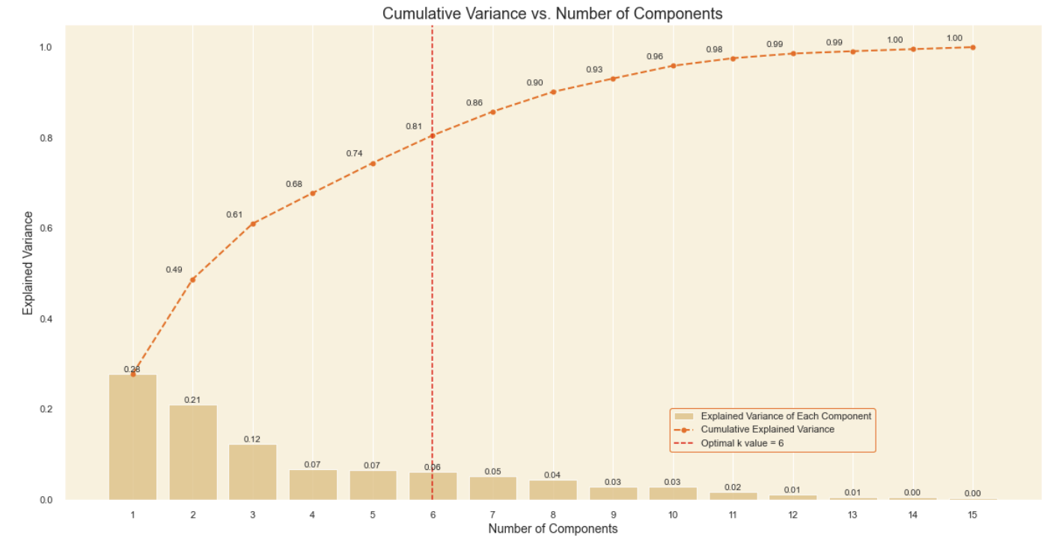
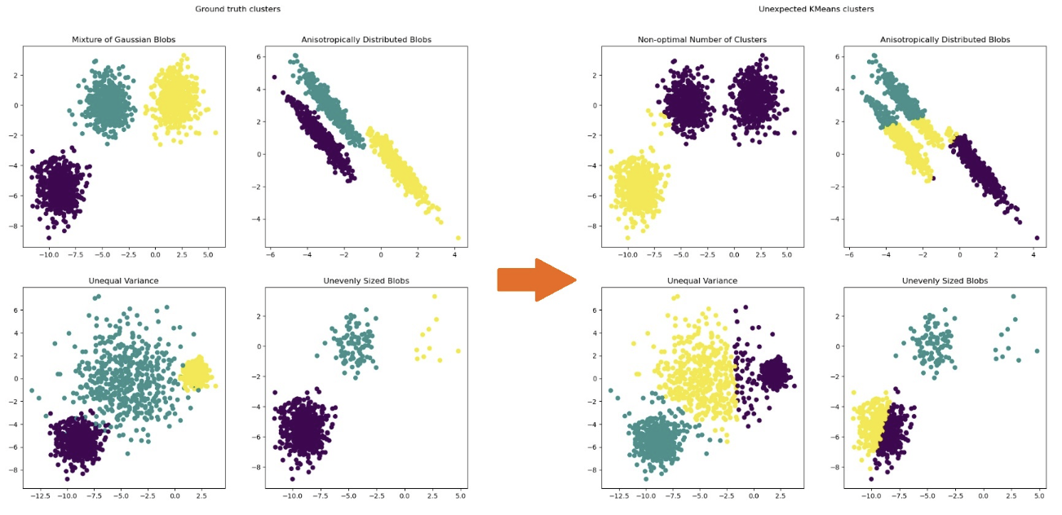
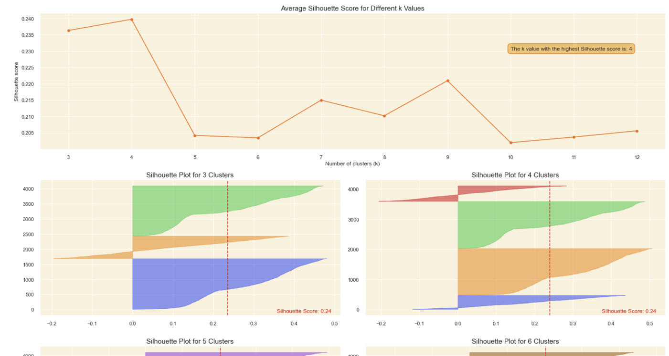
Modelling & Result
Our project embarked on a thorough exploration to refine marketing strategies and elevate sales in the online retail domain. Beginning with diligent data cleaning and transformation, we rectified missing values, duplicates, and outliers, setting the stage for insightful analysis. Through feature engineering, we crafted a customer-focused dataset essential for segmentation. Employing Principal Component Analysis (PCA), we simplified the data, preparing it for clustering.
Using the K-means algorithm, we divided customers into six distinct groups, guided by simple methods like the Elbow method and Silhouette scores. Digging deeper, cluster analysis and profiling shed light on unique customer traits and preferences, aiding in tailored marketing strategies for each cluster.

Slide 9
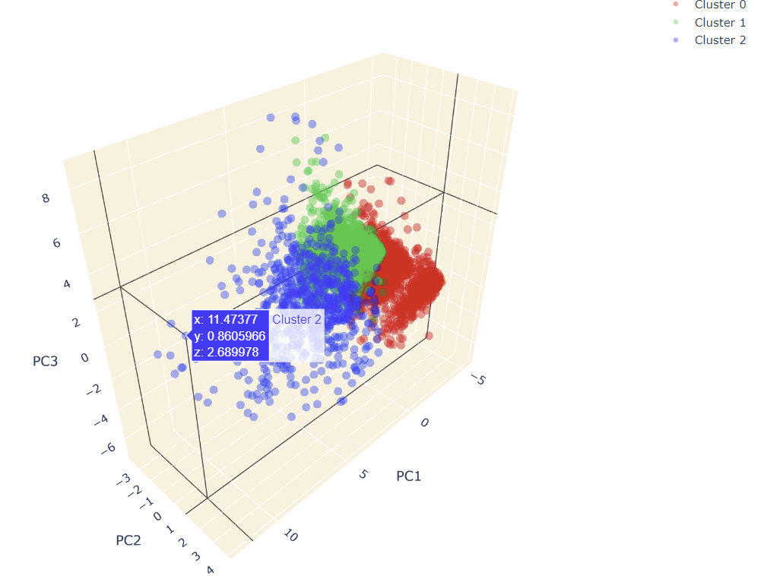
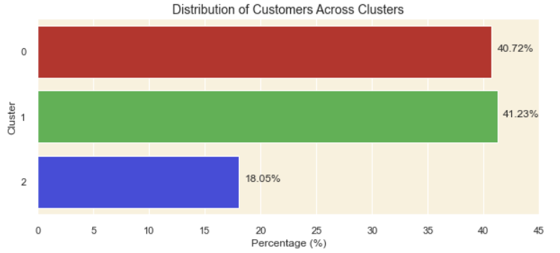
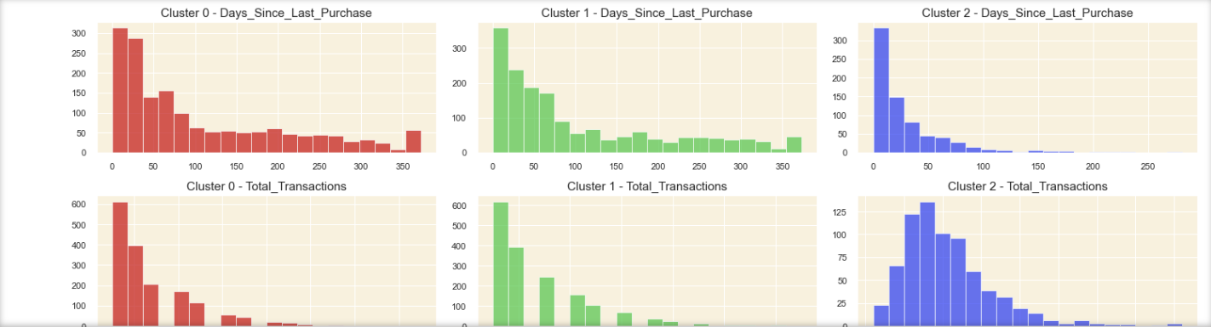
Modelling & Result
At the heart of our efforts lay the development of a user-friendly recommendation system. By pinpointing popular products within each cluster, we personalized suggestions for customers who hadn't explored these items. This approach not only enhances marketing effectiveness but also enhances the shopping experience for customers, potentially driving up sales and loyalty.

Slide 10
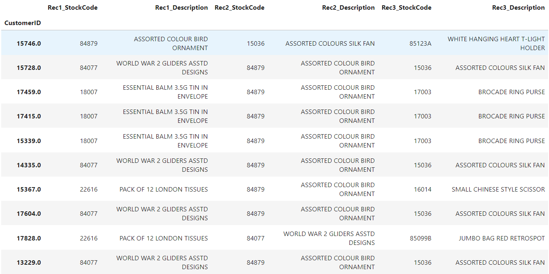
Modelling & Result
Our approach, marked by rigorous data preparation, insightful clustering, and personalized recommendation system development, underscores our commitment to driving tangible outcomes in the online retail sphere. Through these endeavors, we aim to not only improve business performance but also cultivate enduring relationships with customers, fostering sustained growth and satisfaction in the competitive e-commerce landscape.

Slide 11

Conclusion
Through comprehensive analysis and implementation of various methodologies, this project successfully addressed the objective of enhancing marketing strategies and boosting sales in the online retail sector. Beginning with data cleaning and transformation, we meticulously prepared the dataset for clustering, ensuring its suitability for customer segmentation. Feature engineering enabled the creation of a customer-centric dataset, incorporating behavioral, geographic, and seasonal features crucial for segmentation. Utilizing K-means clustering, we effectively segmented customers into distinct groups, allowing for targeted marketing strategies. Evaluation of clusters provided valuable insights into customer profiles and preferences, guiding the development of personalized marketing initiatives. The implementation of a recommendation system further augmented marketing efficacy, suggesting top-selling products to customers within each cluster. By integrating these strategies, we aimed to enhance the online shopping experience and foster increased sales. Additionally, the methodology employed, including PCA for dimensionality reduction and Silhouette analysis for determining the optimal number of clusters, ensured robust and efficient clustering results. Overall, this project showcases the potential of data-driven approaches in optimizing marketing strategies and driving sales growth in the competitive landscape of online retail.

Slide 12


Notes:
Thank You !!

